Slide 1

Cádiz Spain
Port Presentation Presented by Marc Silver

Slide 2
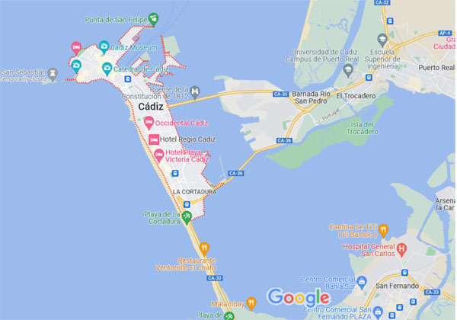
Cádiz Spain
Cádiz is an ancient port city
in the Andalucia region of
southwestern Spain. The
home of the Spanish Navy,
the port boomed in the 16th
century as a base for the
Military and trade. It has
more than100 watchtowers,
the iconic Torre Tavira,
which was traditionally
used for spotting ships. On the waterfront is the domed, 18th-century Cádiz Cathedral, featuring baroque and neoclassical elements.

Slide 3
What I Will Cover
What I Will Cover
My Port Philosophy
Don’t Miss the Ship
Money
Where is the Tourist Office?
A few interesting facts about Cadiz.
Places to see or at least consider
A few restaurant recommendations
Best way to get around Cadiz

Slide 4
My Port Philosophy
I have been cruising for over 45 years and have taken over 100 cruises. So, I consider myself an experienced cruiser.
The information I will present is based on those many years of experience.
When I am on a cruise where the city I want to visit is not the port city, I always recommend taking a ship’s tour.
But when I am in a port with multiple attractions nearby and easy to see on my own - I will do it on my own.
This presentation is for that type of port.

Slide 5
Don’t Miss the Ship
How to Avoid Missing Your Ship:
Pay attention to the time. - Ship time and local time are often different.
Put a return-to-ship reminder on your phone.
Choose excursions wisely:
If a ship-sponsored excursion is late returning to port, the ship will wait, but not for excursions taken on your own.
Be Prepared:
Have your Passport, Credit Card, and phone numbers for the ship port agent.
What to Do If You Miss the Ship: Most cruise lines have port agents stationed in the port area to assist if your ship has left without you. Sometimes, when cruisers are late returning to the vessel, the ship's crew may remove the passengers' essential items -- passports, cell phones, and medication -- from the ship to leave with the port agents.
The Port Officials can help you with contacting your ship and making necessary travel arrangements.

Slide 6

Money
The euro is the official currency of 20 European Union countries which collectively make up the euro area, also known as the eurozone.
Official Exchange is $1 to $1.079 US

Slide 7
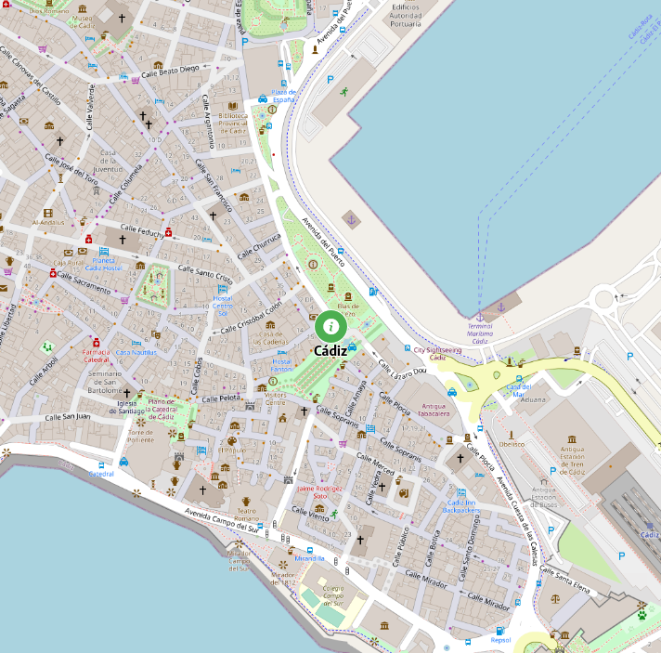
Your First Stop
Tourism Office provides a tourist information service and attention to the city's visitors.
Just walk to the end of the dock to find the Cádiz Tourist Center.
Avenida 4 de Diciembre de 1977, s/n, 11005
Phone: 956203191

Slide 8
It’s the Oldest City in Western Europe
Founded in the 12th century BC, Cadiz is the oldest city in Western Europe, and some even claim that it’s the oldest city in the entire continent of Europe.
From its founding by the Phoenicians to the Roman rule to the Moorish rule to the Reconquista, Cadiz was continuously inhabited throughout the years, so it’s more than a privilege to visit such a piece of history.

Slide 9
It’s Historic Center’s and Squares are Irresistible
Who doesn’t love historic city centers? Cadiz is where you’ll find an extremely charming one. It includes a few small neighborhoods like El Pópulo and La Viña and is the main area travelers explore when visiting the city.
Wandering through Spanish old town is always a fun thing to do. The Andalusian city’s gorgeous narrow streets and squares have something extra magical about them that I can’t put into words. They’re definitely one of the reasons to visit Cadiz, and I just know they’ll win your heart.

Slide 10
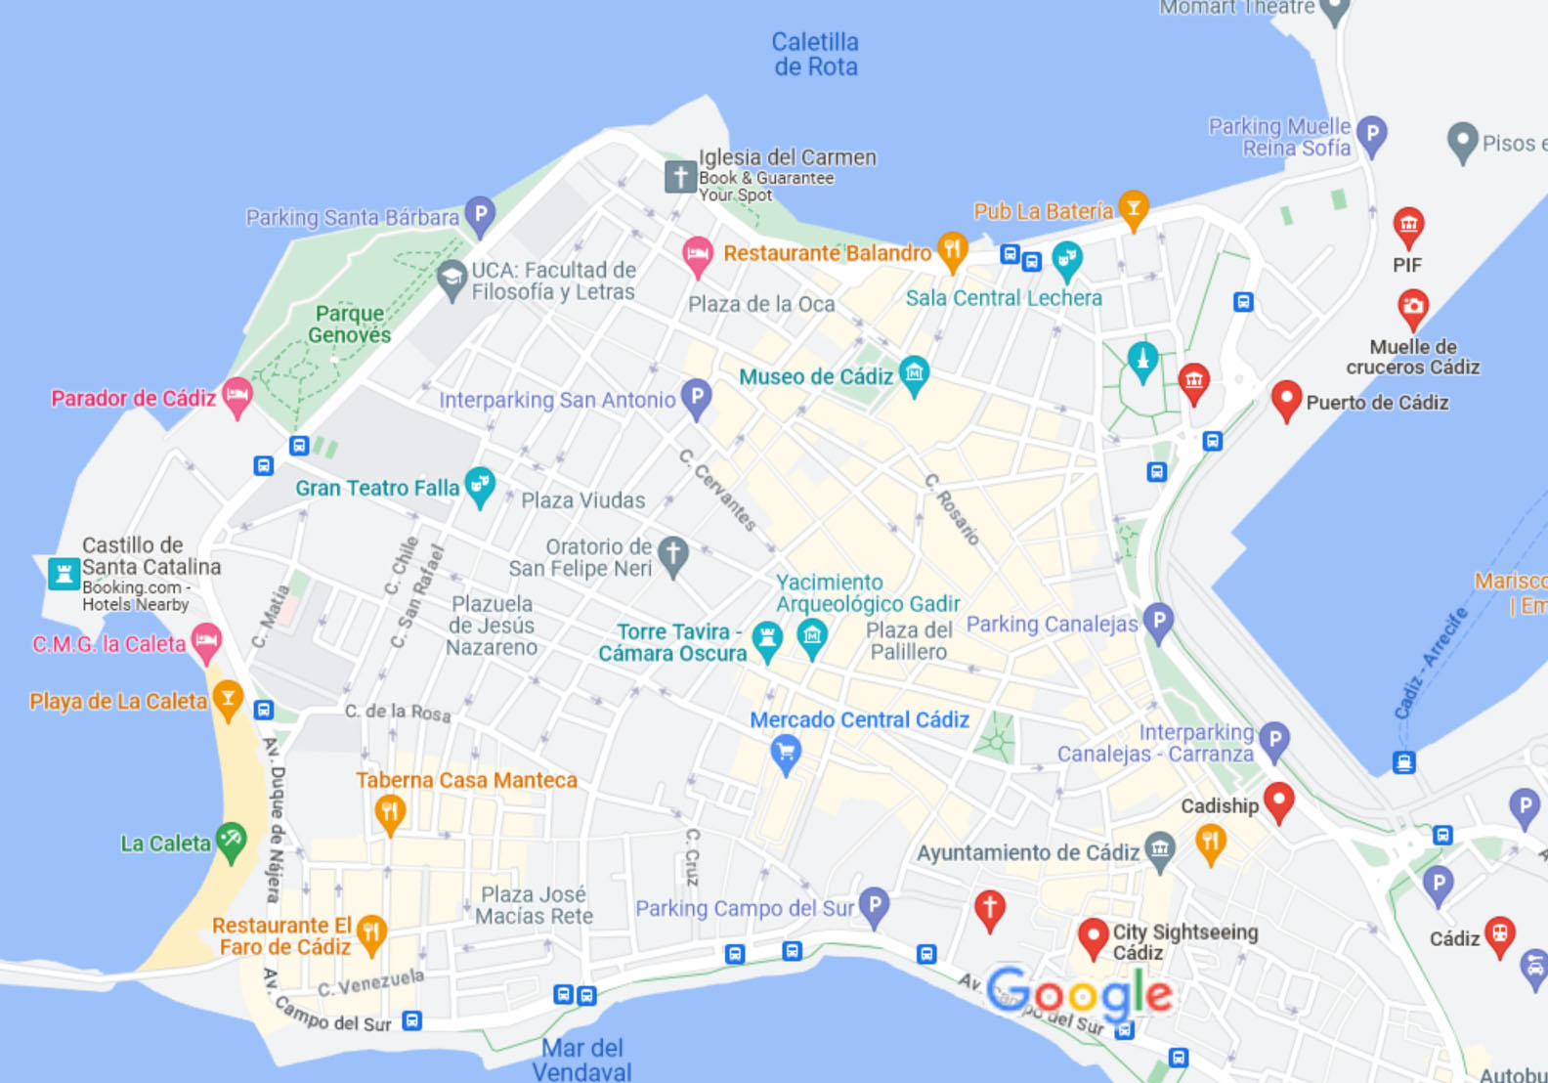
Map Of Cádiz

Slide 11
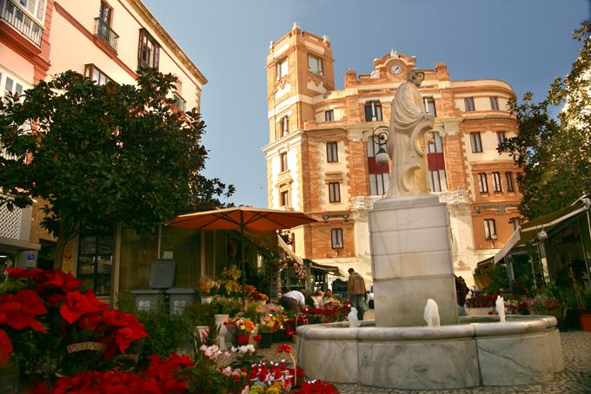
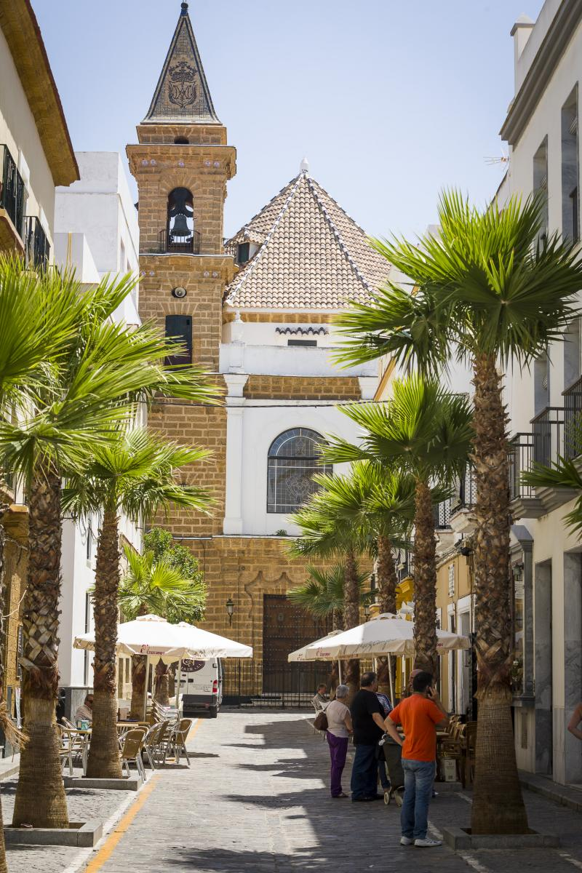
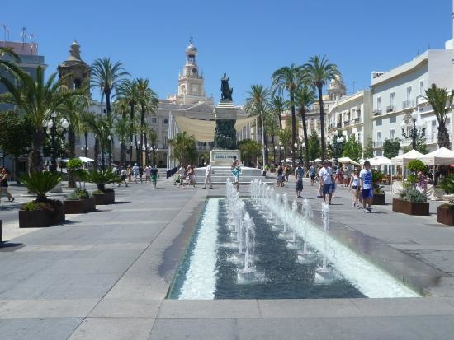
Irresistible Spots
A few spots not to miss are Plaza de las Flores, Plaza de San Juan de Dios, and Calle Virgen de la Palma, but you’ll have to discover the rest on your own.
Calle Virgen de la Palma
Calle Virgen de la Palma
Plaza de San Juan de Dios

Slide 12
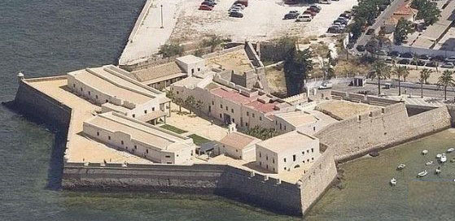
Castles and Cathedrals
From the 16th-century star-shaped Castle of Santa Catalina to the beautiful 18th-century Cadiz Cathedral to the 18th-century Torre Tavira (the best viewpoint in the city), there are more than enough historical spots in Cadiz.
Castle of Santa Catalina

Slide 13

Castles and Cathedrals
From the 16th-century star-shaped Castle of Santa Catalina to the beautiful 18th-century Cadiz Cathedral to the 18th-century Torre Tavira (the best viewpoint in the city), there are more than enough historical spots in Cadiz.
Cadiz Cathedral

Slide 14
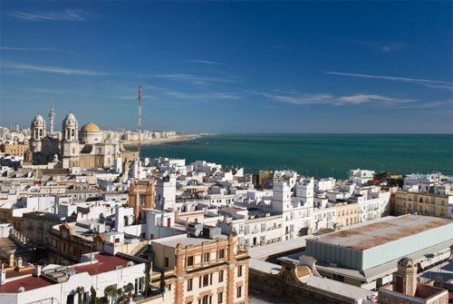
Castles and Cathedrals
From the 16th-century star-shaped Castle of Santa Catalina to the beautiful 18th-century Cadiz Cathedral to the 18th-century Torre Tavira (the best viewpoint in the city), there are more than enough historical spots in Cadiz.
Torre Tavira

Slide 15
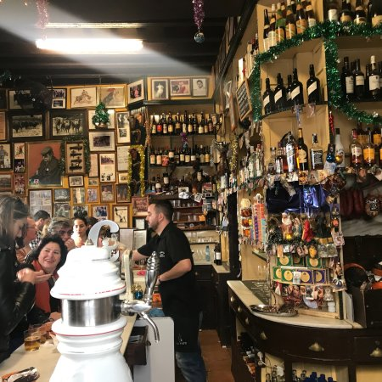
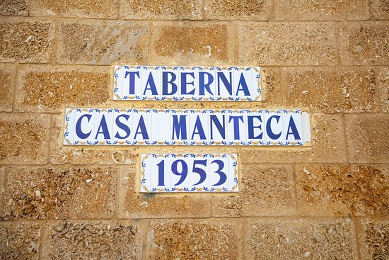
Home to Amazing Restaurants
Serving regional dishes and seafood, you’ll find plenty of traditional (and modern) restaurants in Cadiz that will make you want to stay there forever. Try Taberna Casa Manteca, Restaurante El Faro de Cádiz, and Balandro – you’ll thank me later.

Slide 16

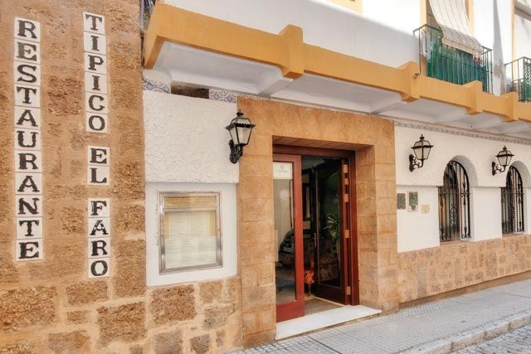
Home to Amazing Restaurants
Serving regional dishes and seafood, you’ll find plenty of traditional (and modern) restaurants in Cadiz that will make you want to stay there forever. Try Taberna Casa Manteca, Restaurante El Faro de Cádiz, and Balandro – you’ll thank me later.

Slide 17


Home to Amazing Restaurants
Serving regional dishes and seafood, you’ll find plenty of traditional (and modern) restaurants in Cadiz that will make you want to stay there forever. Try Taberna Casa Manteca, Restaurante El Faro de Cádiz, and Balandro – you’ll thank me later.

Slide 18
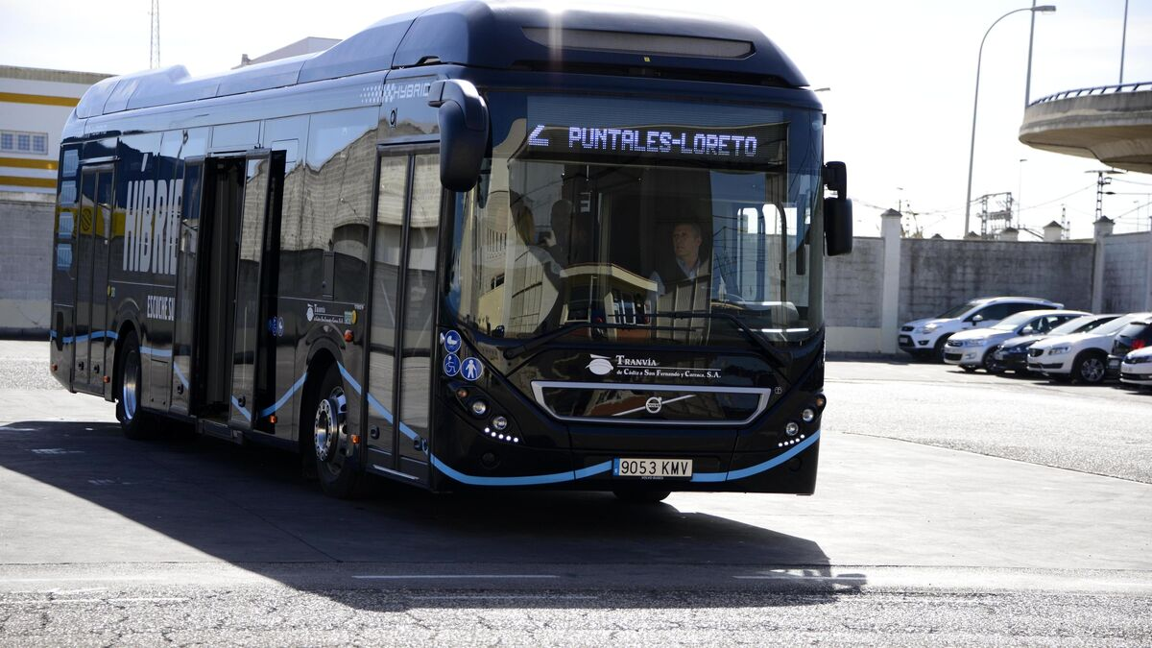
Getting Around Cadiz
For the most part Cadiz is an easy city to walk, but for those who want to avoid exercise as much as possible, There are the city buses run by Urbanos de Cádiz. There are 5 lines with fairly new buses and all have air conditioning.
City bus cost of a single journey is 1,10€. Changing bus is permitted within 45minutes.
You can also buy a 'Bonobus’ from newsagent kiosks for 7€ for ten journeys.

Slide 19
Thanks For Coming
If you have any more questions, Please ask.
I will do my best to answer them for you.
Have a great visit in Cádiz!

