Slide 1
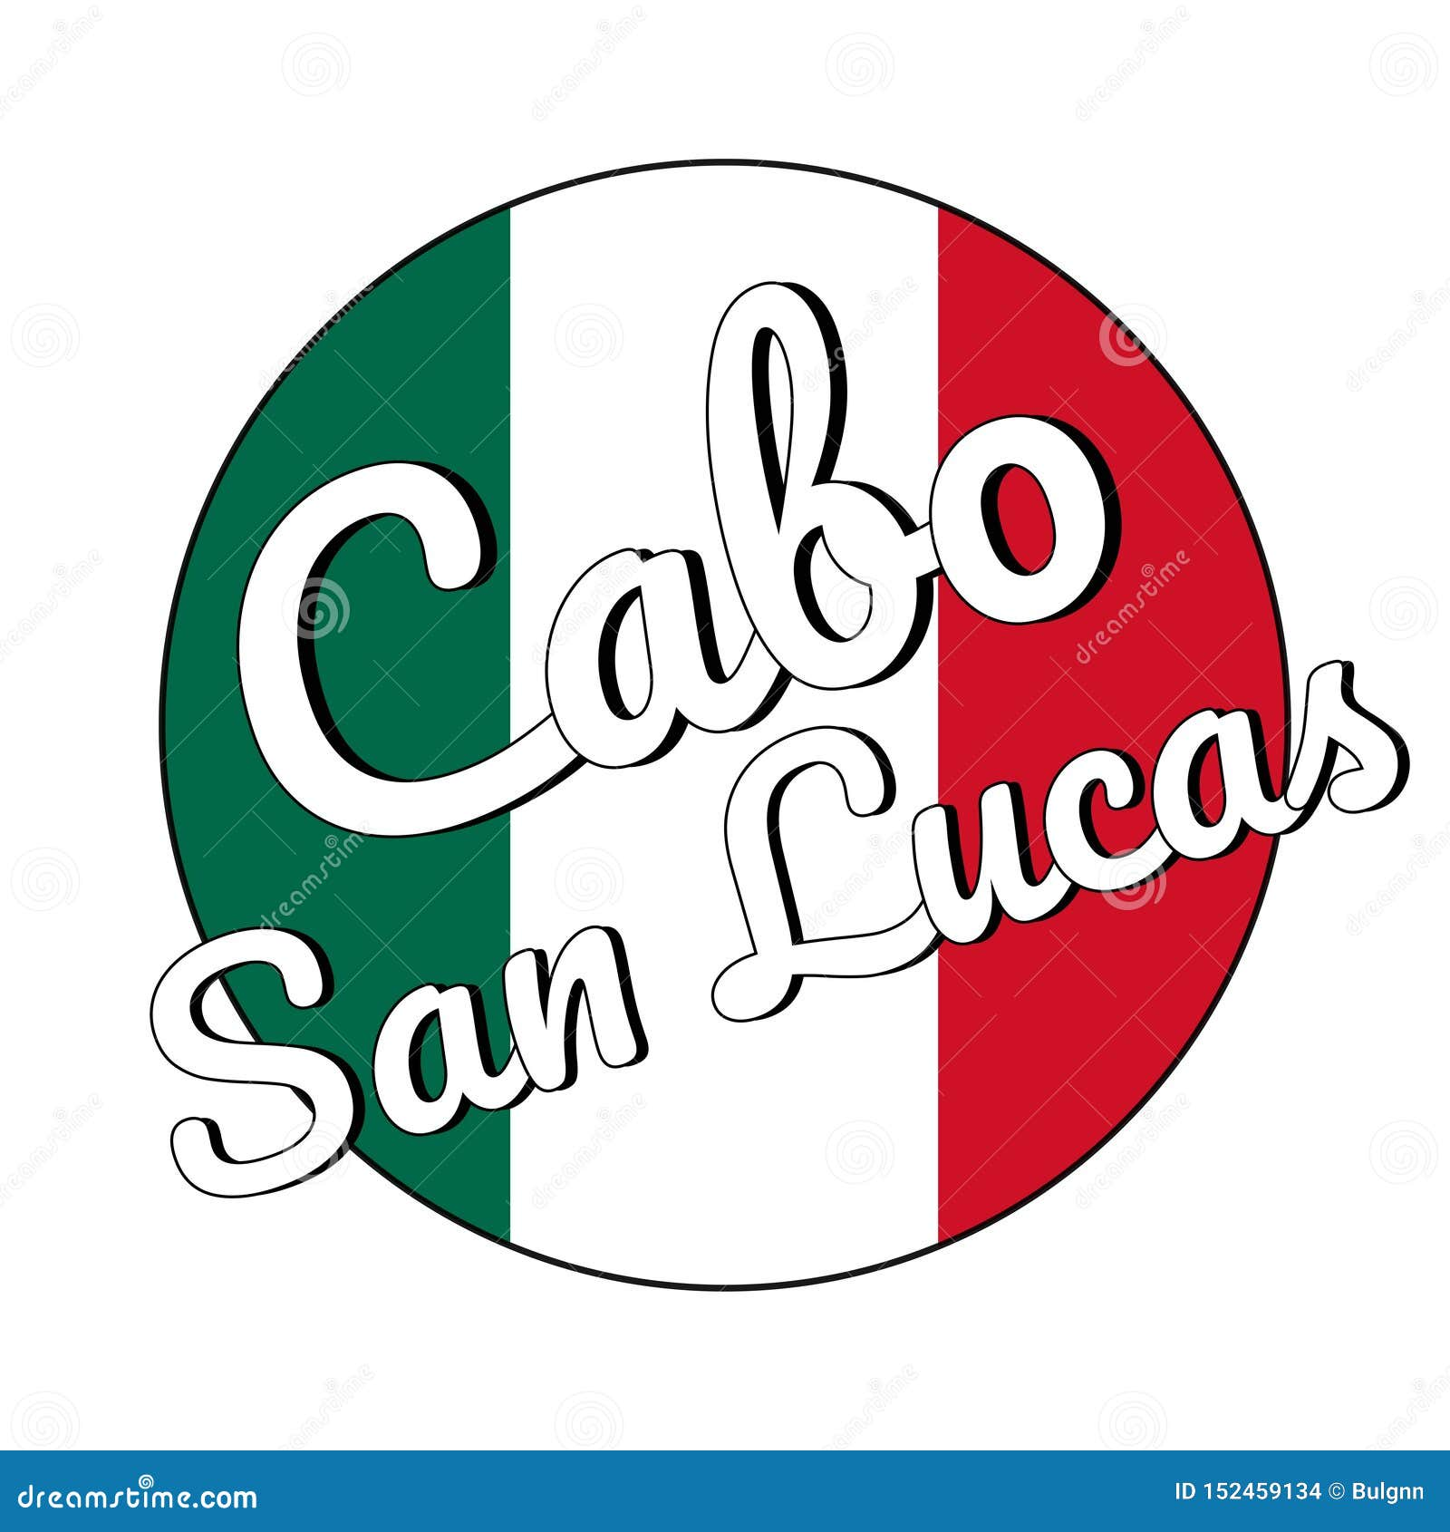
Cabo San Lucas, Mexico Presented by Marc Silver

Slide 2
What I Will Cover
My Port Philosophy
Don’t Miss the Ship
Money
About Cabo San Lucas, Mexico
History of Cabo San Lucas, Mexico
Transportation
Points of Interest
Places to see or at least consider
A few restaurant recommendations
Conclusion

Slide 3
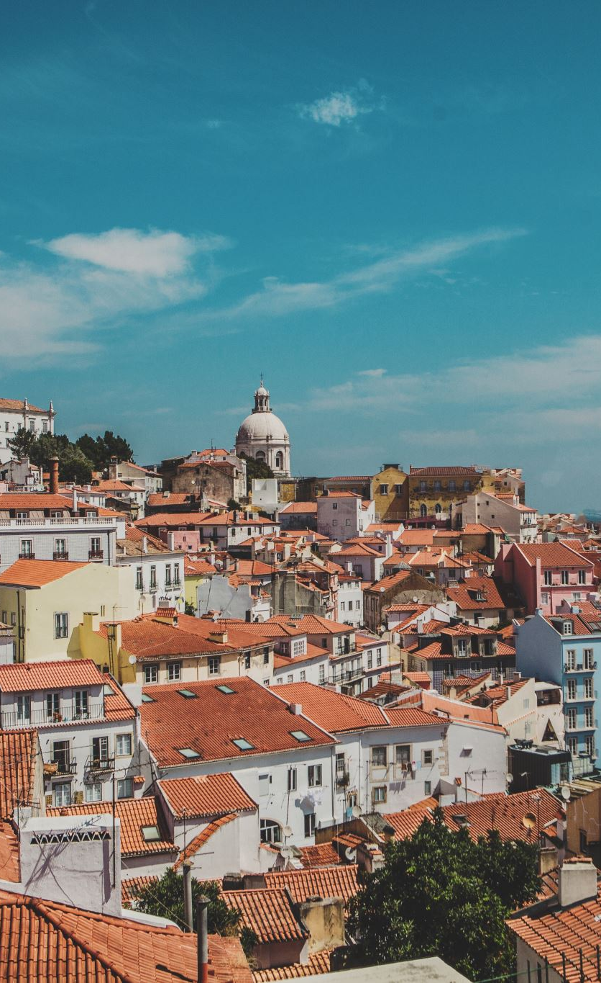
My Port Philosophy
I have been cruising for over 45 years and have taken over 100 cruises. So, I consider myself an experienced cruiser.
The information I will present is based on those many years of experience.
When I am on a cruise where the city, I want to visit is not the port city, I always recommend taking a ship’s tour.
But when I am in a port with multiple attractions nearby and easy to see on my own - I will do it on my own.
This presentation is for that type of port.

Slide 4
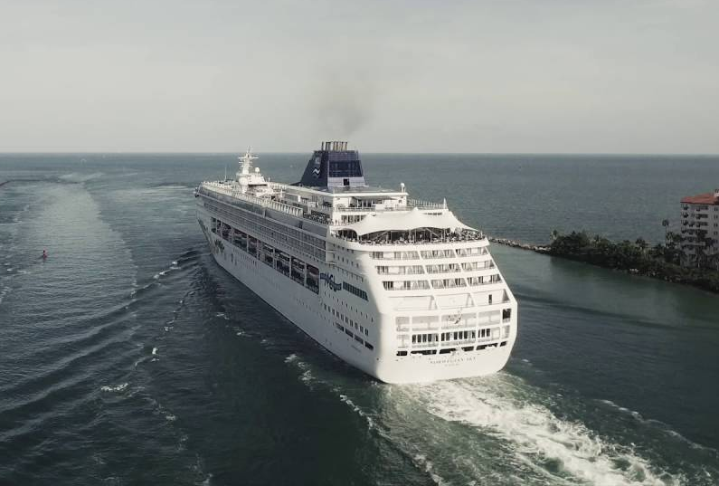
Don’t Miss the Ship
How to Avoid Missing Your Ship
Pay attention to the time. - Ship time and local time are often different.
Put a return-to-ship reminder on your phone.
Choose excursions wisely.
If a ship-sponsored excursion is late returning to port for, the ship will wait for you. If you are on your own???
Be Prepared
Have your Passport, Credit Card and phone numbers for your ship port agent.
What to Do If You Miss the Ship Most cruise lines have port agents stationed in the port area to assist if your ship has left without you. If you’re lucky, when cruisers are late returning to the vessel, the ship's crew will often remove the passengers' essential items -- passports, cell phones and medication -- from the ship to leave with the port agents.
The Port Officials can help you with contacting your ship and making necessary travel arrangements.

Slide 5

Money
The Peso is the official currency of Mexico
Official Exchange is 100 Pesos is $5.80 US
Or 17.35 Pesos to the US Dollar
Most places in Mexico use 20 pesos to the Dollar

Slide 6
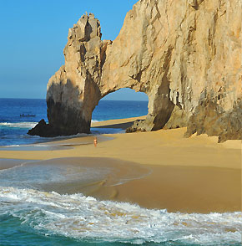
About Cabo San Lucas
Situated at the tip of Mexico’s Baja Peninsula, Cabo offers views of the photogenic rock formations of Land’s End including, the iconic “El Arco” (Cabo’s stone arch).
Cabo is famous for its hot nightlife, excellent dining, exceptionally luxurious accommodations, exciting activities, and legendary marlin fishing. While the destination previously boasted a party reputation, it now consistently attracts families, couples, and luxury-minded travelers (with a hefty dose of celebrity clientele) in search of the very finest.
Visitors who consider themselves “foodies” will appreciate the excellent variety of dining choices, from authentic local taquerias to gourmet award-winning fine dining restaurants.
The central beach in Cabo San Lucas is Médano Beach which boasts the area’s best swimming. This is also an outstanding spot to people-watch, hop on a jet ski, go parasailing, or just relax with a cold beer at a beachfront cantina.

Slide 7
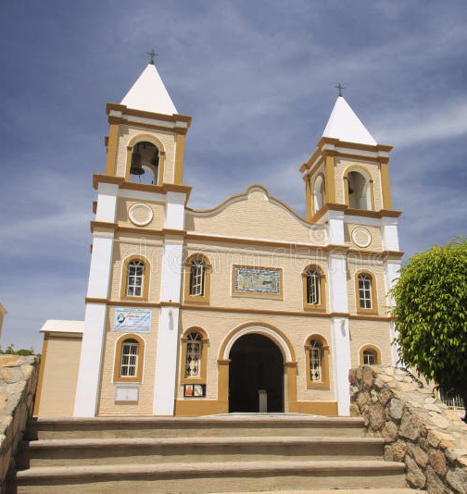
Historical Cabo San Lucas, Mexico
To protect their merchants, Spain sent Jesuit priests to establish a permanent settlement in Los Cabos in 1697.
Over the next 100 years, fights broke out between the colonizers and the indigenous people, ultimately wiping out the Pericúes people.
One of the most beautiful Cabo San Lucas historical sites to see is the Mission San Jose del Cabo Añuití. Named for Saint Joseph.
Known for its beauty the church draws visitors both to worship and to see the colonial architecture.

Slide 8
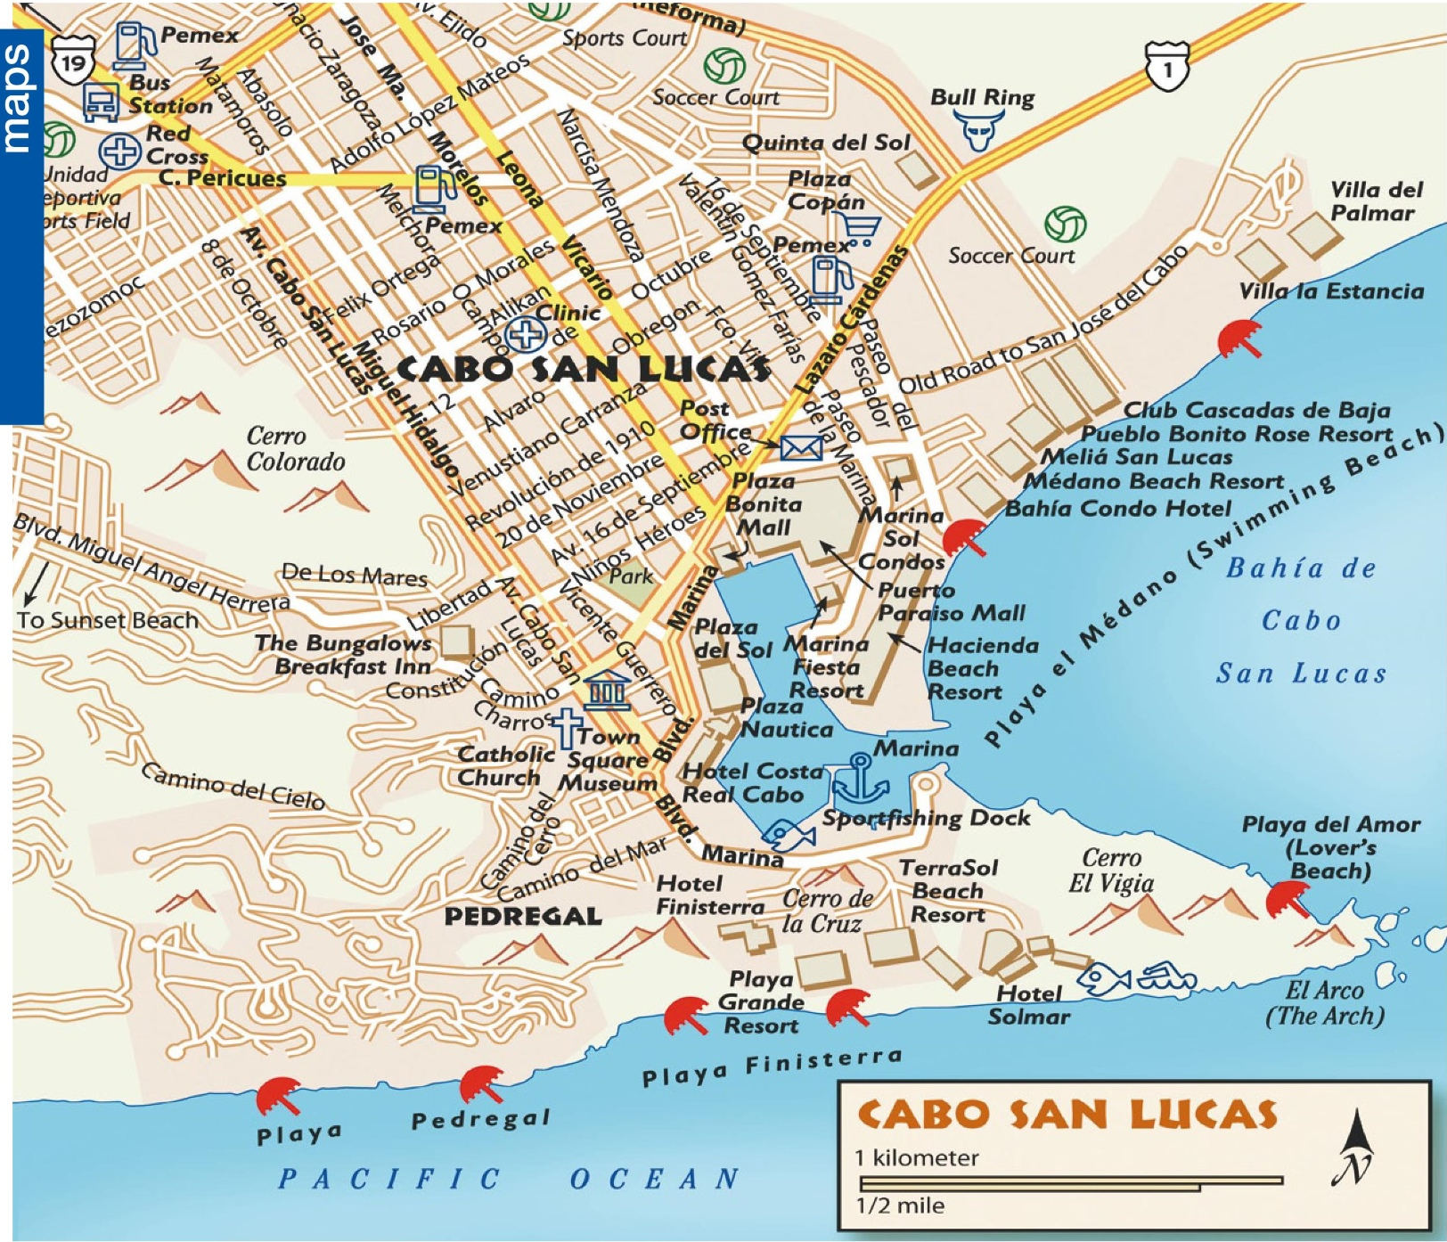
Cabo San Lucas

Slide 9
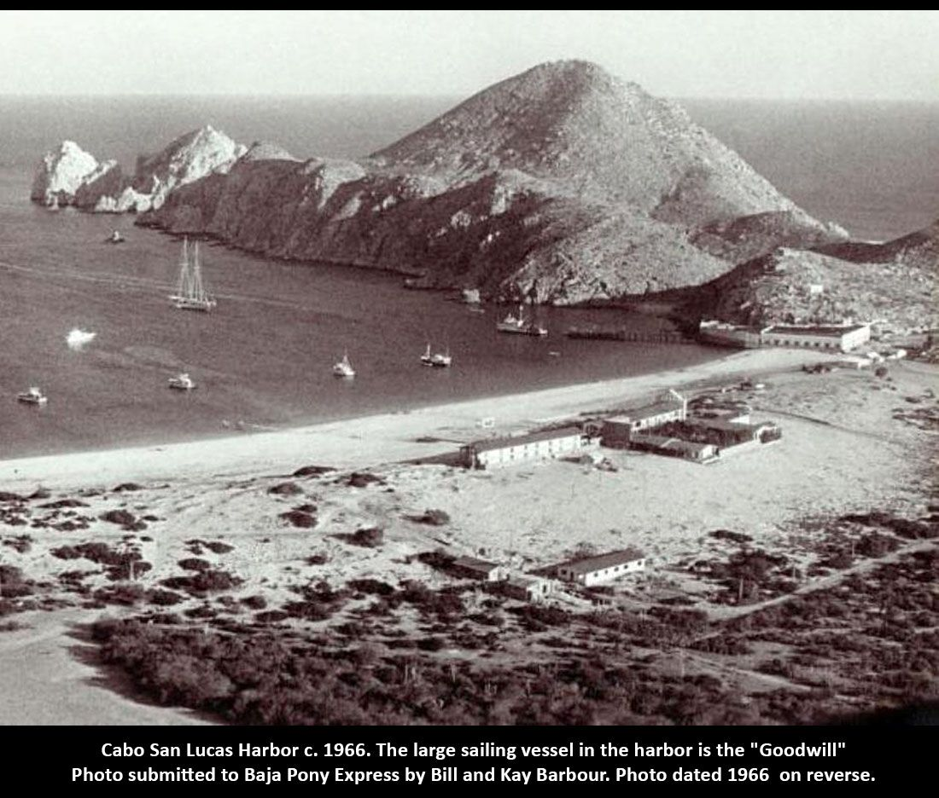
History of Cabo San Lucas
One of the interesting facts about Cabo San Lucas history is that the US conceded all of the Baja Peninsula during the Mexican-American war, telling the Mexicans that the US didn’t need more deserts and they could keep it all.
It was a group of wealthy Californians and Hollywood stars who built the city up into the world-class destination it is today.
Traveling to the tip of the Baja Peninsula in the 1900s was exclusive to those who had long-range yachts and private planes since there highway at the time.
Few resorts were built there, largely with
Hollywood money. The opening of the peninsular highway in 1974 and the call of great fishing waters put Los Cabos on the map as a premier destination in Mexico.

Slide 10
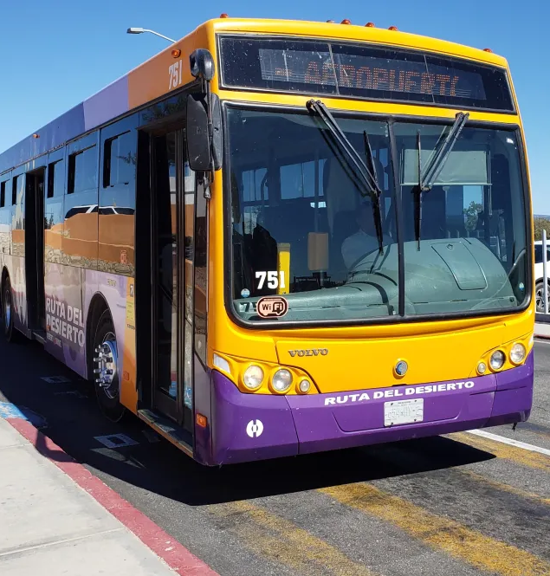
Cabo Bus Service
Downtown Cabos is close to where the tender lets off.
The waterfront walkway that winds around the marina’s edge is lined by numerous bustling bars, restaurants, and shopping hubs like the Puerto Paraiso and Luxury Avenue interconnected malls.
The bus service runs along the Tourist Corridor between Cabo San Lucas and San Jose del Cabo called the Ruta del Desierto, and the buses are purple and orange.
The Subercabos costs less than $2.50 (about 28 pesos) per ride.

Slide 11
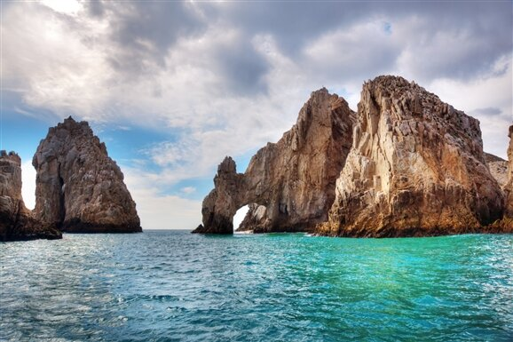
Land's End (El Arco)
Located at the southern end of Cabo San Lucas and sandwiched between Playa del Amor and Playa del Divorcio (Divorce Beach).
These rock formations were created from the rough winds and seas of the southern Baja Peninsula.
Sea lions frequent the area (especially along the Los Frailes rock formation), and Land's End remains excellent for couples looking for a romantic spot to see the sunset.

Slide 12
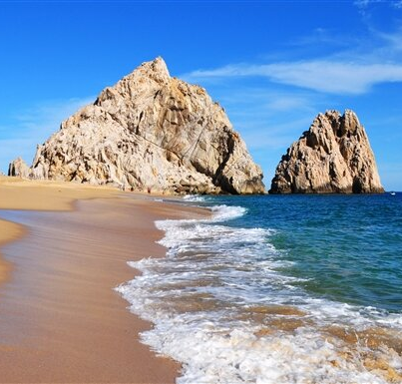
Playa del Amor (Lover's Beach)
Located right near Land's End rock formations, Playa del Amor, or Lover's Beach, is one of Cabo's most famous stretches of shoreline.
It sits south of Cabo's downtown area but remains easily accessible by water taxi from the marina. Beachgoers say this stretch of sand is relaxing, providing a nice view of the blue water and a great spot for sunbathing.
However, because of its popularity, Lover's Beach can lose its romantic appeal. For one, there are no bathrooms or beach bars, and some travelers encounter pesky flies. Be sure to bring bug spray if you decide to venture out toward the beach.

Slide 13
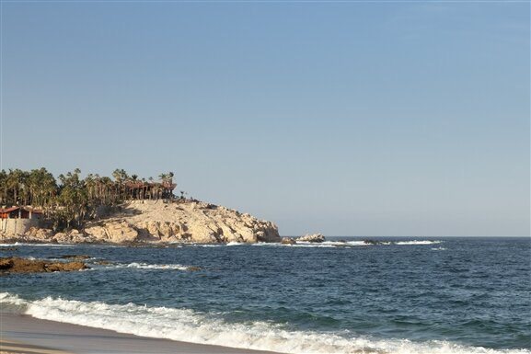
Chileno Beach's calm, shallow waters make it the go-to spot for snorkelers. But the real reason travelers love Chileno's cream-colored shore is the lack of noisy bars and restaurants that plague other Los Cabos beaches. However, this does mean that you'll have to come prepared with your own snacks and drinks and rely on public facilities.
Most people don't seem to mind these small inconveniences and say the impressive snorkeling conditions (and a variety of colorful fish) make a trip here well worth it.
Chileno Beach is easily accessible by bus from both Cabo San Lucas
Chileno Beach

Slide 14
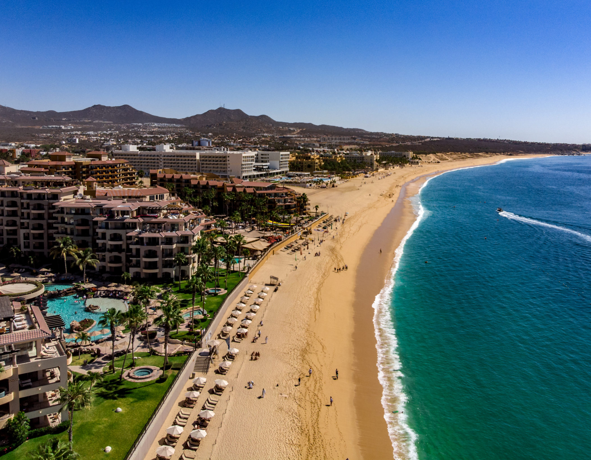
Playa El Médano (Medano Beach)
Playa El Médano is Cabo's most crowded beach, with crystal blue waters and plenty of beachside watering holes attracting hordes of sunbathers.
In addition to taking, it easy with a drink, Playa El Médano also offers some active attractions, including beach volleyball, jet skiing, kayaking, boogie boarding, and parasailing.
From the nearby boat port, you can also take a snorkeling tour or a panga (boat) out to the iconic El Arco.

Slide 15
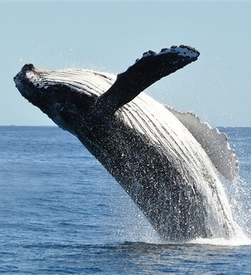
Whale Watching
With several species of whales making their way to the area every year, whale watching is extremely popular in Cabo, with many visitors saying it's an absolute must-do activity.
Generally, the best time to spot whales is between December through April, with January through March offering the chance to see baby whales, too.
Whale Watch Cabo and Cabo Trek both offer boat tours with expert marine biologists serving as guides.
When whales are spotted, they drop a marine hydrophone into the water so you can listen to the animals singing.

Slide 16
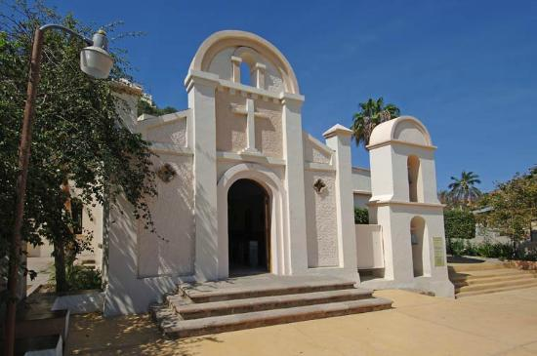
Iglesia de San Lucas and Town Square
For something more touristy, head to the Iglesia de San Lucas (Church of Saint Luke), located a short walk from the marina. The landmark is the main church in Cabo San Lucas and an excellent place to view local architecture as well as observe local traditions.
The Catholic church was constructed by a Spanish missionary in 1730 and is surrounded by a pristine plaza that contains several restaurants and small shops.
The church remains relatively unchanged since the 19th century, making it ideal for getting a glimpse into the city's architectural past.

Slide 17
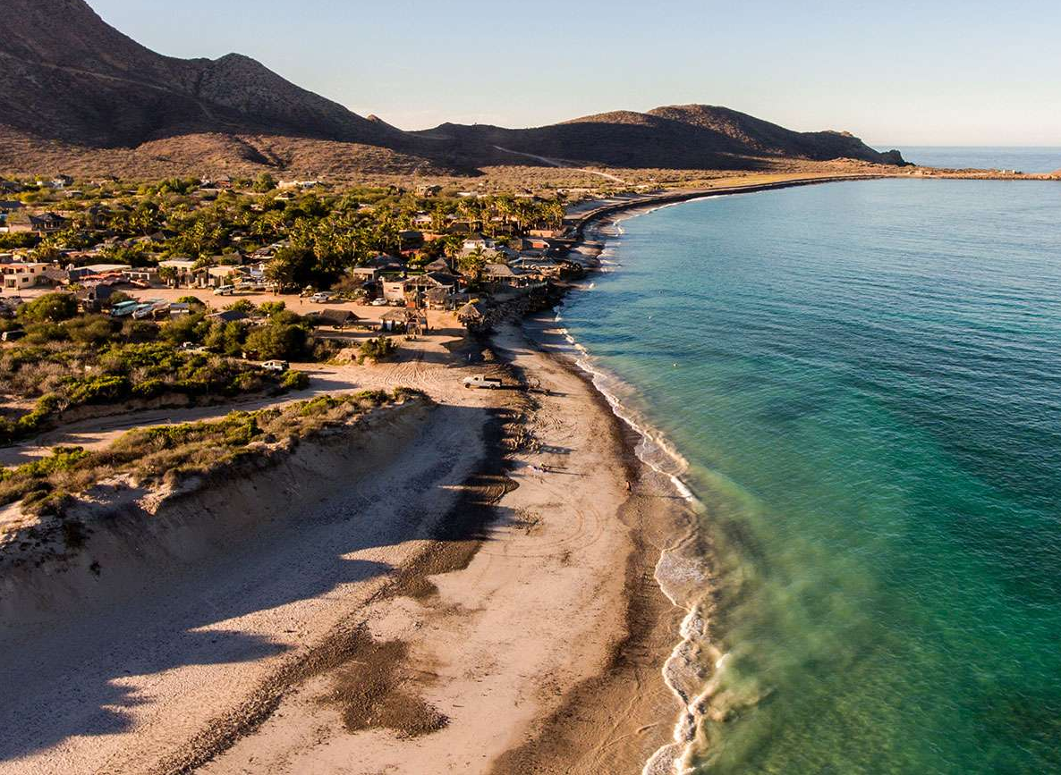
Cabo Pulmo National Marine Park
Cabo Pulmo Park is located just 60 miles north of Baja’s tourism epicenter, Los Cabos. This jewel of the East Cape region of Baja California Sur stretches five miles from the northernmost tip, Pulmo Point to the southernmost tip, Los Frailes.
Surrounded by undeveloped desert and a stunning mountain range, the pristine beaches of Cabo Pulmo Park give way to a shallow bay that cradles one of three living reefs (the only hard coral reef) in North America.

Slide 18
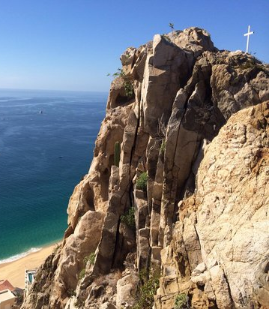
Mount Solmar
Mt. Solmar is a hiking area in Cabo where visitors can learn about the history of the region and its people.
The hike is short (2-3 miles) but challenging, with the entrance located on private property owned by a dog trainer who acts as a tour guide while walking his dogs on the mountain.
The hike offers stunning views and unique geological formations shaped by harmonic frequencies from the water on both sides.

Slide 19

Cabo San Lucas Restaurants
Cabo San Lucas has many excellent restaurants. Many of us on the ship are foodies, so naturally, we’re always on the hunt to eat at the most exclusive spots anytime we travel.
Here are a few of the best restaurants to consider in downtown Cabo.
Neptune Seafood - Seafood $$$$
La Roca Mexican - Latin $$$$
Nicksan Cabo Asian - Fusion $$$$
Lorenzillo's Restaurant Cabo San Lucas - Seafood, Healthy $$$$
Taba BBQ American - Barbecue $$$$
Tres Sirenas - Mexican $$$$
Tomatillos - Farm to Table - Contemporary, Fusion $$$$
Ruth's Chris Steak House Los Cabos - American, Steakhouse $$$$
For those of you who just like good food, you can’t go wrong just about anywhere you go in Cabo San Lucas.
GOOD EATING

Slide 20
Final Thoughts
Cabo San Lucas is a beautiful City with a rich history and numerous attractions.
Whether you're looking for stunning beaches, historic sites, or unique attractions, Cabo San Lucas has something for everyone.
I hope this presentation will help when we visit Cabo San Lucas!

Slide 21
Thanks For Coming
If you have any more questions, please ask.
I will do my best to answer them for you.
Have a great visit in Cabo San Lucas!

