Slide 1

Burnie Australia Presented by Marc Silver

Slide 2
What I Will Cover
My Port Philosophy
Don’t Miss the Ship
Money
About Burnie
Area Map of Burnie
Map of Burnie
Burnie Transportation
Places to see or at least consider
A few restaurant recommendations
Conclusion

Slide 3
My Port Philosophy
I have been cruising for over 45 years and have taken over 200 cruises. So, I consider myself an experienced cruiser.
The information I will present is based on those many years of
experience.
When I am on a cruise where the city, I want to visit is not the port city,
I always recommend taking a ship’s tour.
But when I am in a port with multiple attractions nearby and easy to see
on my own - I will do it on my own.
This presentation is for that type of port.

Slide 4

Don’t Miss the Ship
How to Avoid Missing Your Ship
Pay attention to the time. - Ship time and local time are often different.
Put a return-to-ship reminder on your phone.
Choose excursions wisely.
If a ship-sponsored excursion is late returning to port, the ship will wait for you. If you are on your own???
Be Prepared
Have your Passport, Credit Card, and phone numbers for your ship port agent.
What to Do If You Miss the Ship Most cruise lines have port agents stationed in the port area to assist if your ship has left without you. If your are lucky, when cruisers are late returning to the vessel, the ship’s crew will often remove the passengers’ essential items – passports, cell phones, and medication -- from the ship to leave with the port agents.
The Port Officials can help you with contacting your ship and making necessary travel arrangements.

Slide 5
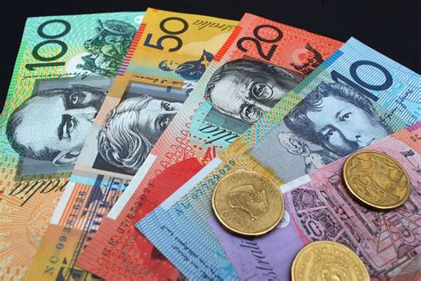
Money
The currency for Burnie is the Australian Dollar.
The conversion at the rate is $1.48 AUD to $1.00 U.S.
Or $1 AUD $.67 U.S.

Slide 6
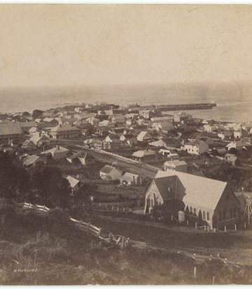
Historical Burnie
Established in the late 1820s by the Van Diemen’s Land Company as Emu Bay Settlement, the settlement was renamed to honor a company director, William Burnie, and was declared a town in 1866.
In the 1870s it served as the outport for the tin mine at Mount Bischoff. It was the center of a municipality from 1907 and was designated a city in 1988.
The township was renamed Burnie in November 1842, after William Burnie, then director of the Van Diemen's Land Company.

Slide 7
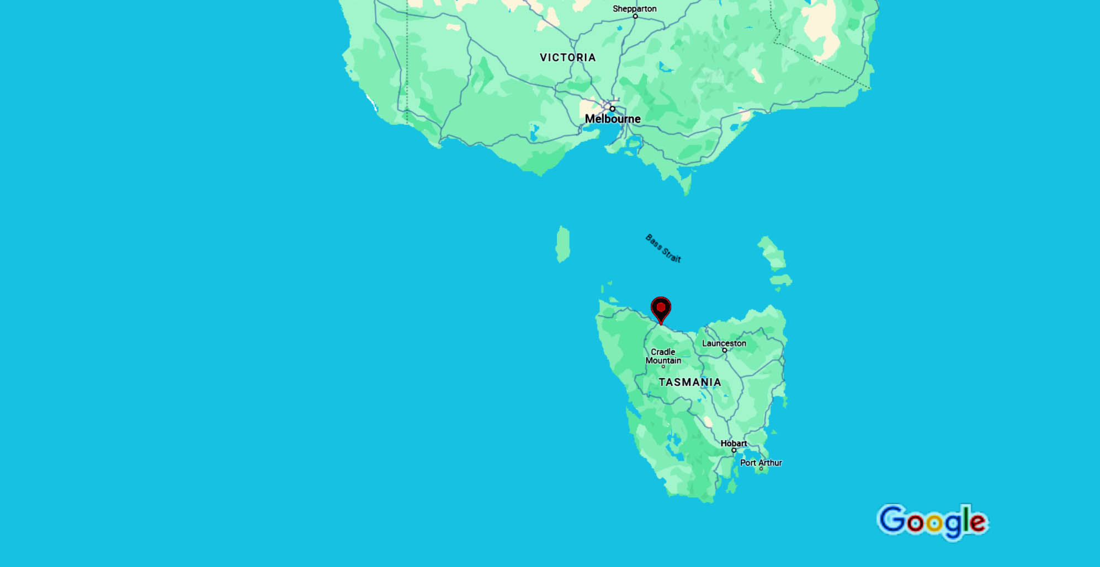
Burnie Area Map

Slide 8
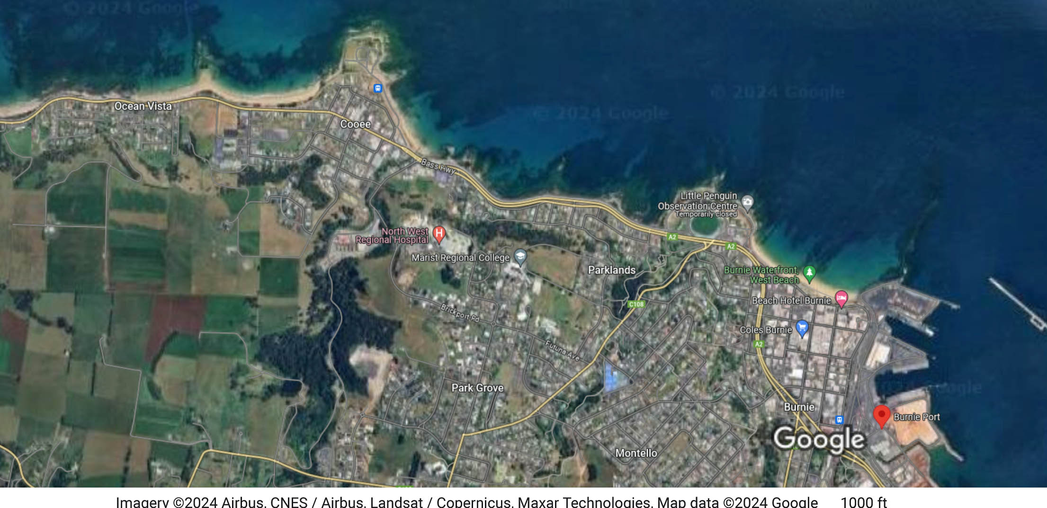
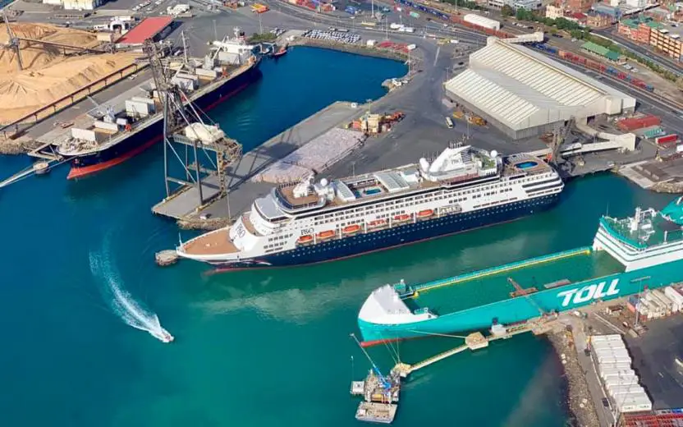
Map of Burnie

Slide 9
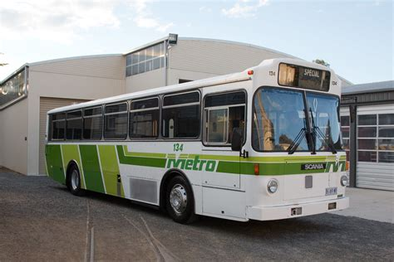
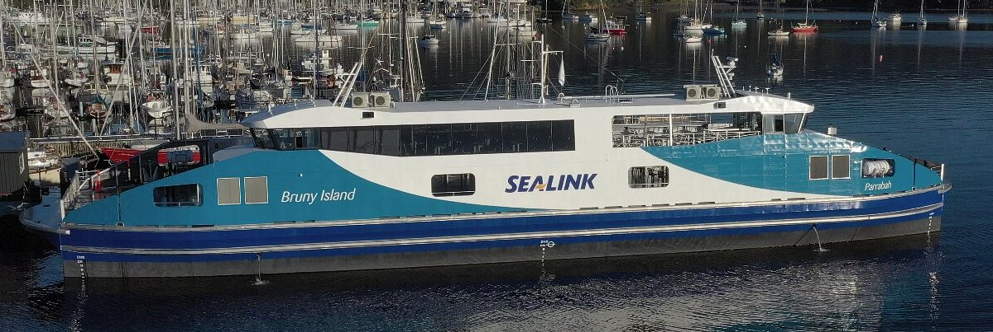
Burnie Buses
Burnie has a comprehensive and user-friendly public transport.
I recommend paying with exact change with cash.
Bus Fares: Adult $1.20 Child $1.00
10 trip Smart Card saves you 20 cents per trip.
The Bruny Island ferry service is a key link between Bruny Island and the Tasmanian mainland for island residents and visitors. Pedestrians travel free.

Slide 10
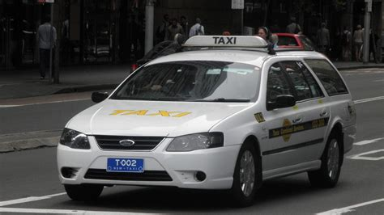
Burnie Taxis and Ride Share
Standard taxis provide a safe and reliable way to explore the city or for transport between the cruise port and various attractions.
Taxi fares are regulated by the government.
Like taxis in most locations the cost is significantly more expensive than other modes of transport.
Ride Shares in Burnie include Uber and Lyft.

Slide 11
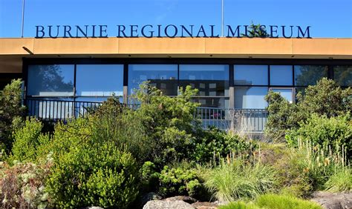
Burnie Regional Museum
Burnie’s 200 years of European history is revealed at this top-notch museum, holding the third-largest collection in the state.
The exhibition, on Federation Street, drops you into a Burnie street scene at the beginning of the 20th century. Every business that you see here was once part of Burnie, including a blacksmith, dentist, photographer, printer, saddler and boot-maker.
You can also trace the city’s roots at the Early Burnie Exhibition, finding out about the European exploration and settlement of Tasmania and the story of the Van Diemen’s Land Company. There’s ample information about forestry and papermaking, which were Burnie’s main industries for most of the 20th century.
ADULTS: $8.00 / CHILDREN 5 -12: $5.00 / CHILDREN UNDER 5 - FREE

Slide 12
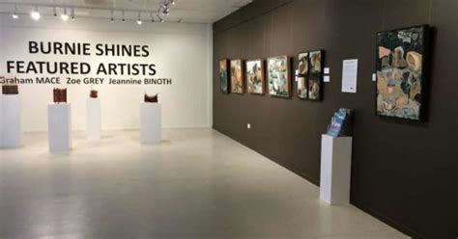
Burnie Regional Art Gallery
Another way to tap into Burnie’s dynamic arts community is at this gallery, serving the north-west and west coasts of Tasmania.
True to the city’s heritage as a papermaking hub, the regional gallery has assembled a nationally important collection of print and art on paper.
This has grown to more than 1,300 works, and you can check out selection at exhibitions.
The gallery also curates solo shows, special and touring exhibitions as well as a host of community and school programs.

Slide 13
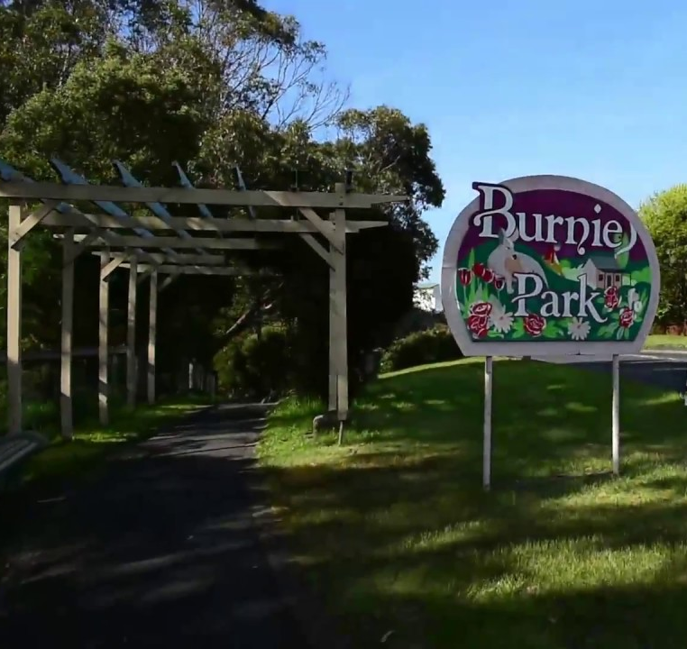
Burnie Park
Once a private garden, Burnie’s main urban park was bought by the city in the 1920s.
Once a private garden, Burnie’s main urban park was bought by the city in the 1920s.
There are neat flowerbeds planted with annuals, rambling walkways and flowing lawns under mature exotic and native trees.
The high ground also gives Burnie Park some lovely views of the Bass Strait.
There may not be a prettier urban park in Tasmania, so no wonder it’s a gathering place for seasonal events like Carols by Candlelight at Christmas and Easter Sunday’s Kids in the Park.

Slide 14
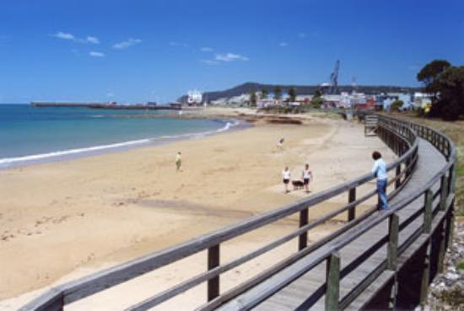
West Beach
Also known as simply “Burnie Beach”, West Beach is just a block from the CBD and is joined by the boardwalk to the Little Penguin Observation Centre.
Come on a sunny day and this is an agreeable place to linger, with a wide arc of sand and a generous foreshore equipped with picnic tables and barbecues.
There’s a children’s playground about halfway along, while Surf Club building boasts a beachfront restaurant and cafe.
People come to West Beach on December 31 to light bonfires and watch the New Year fireworks.

Slide 15
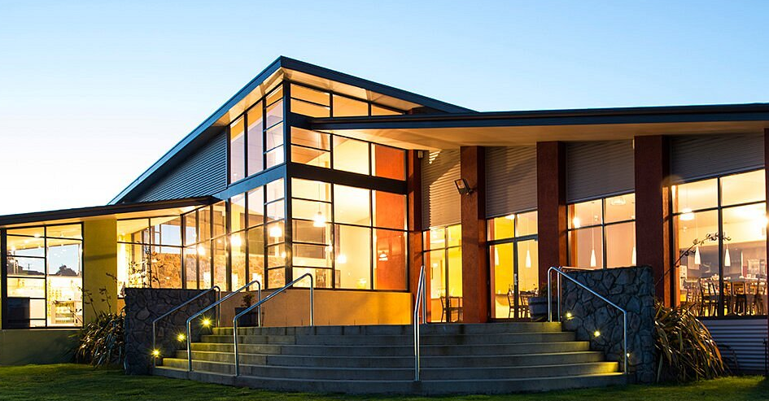
Hellyers Road Distillery
Tasmania is an island dotted with distilleries, making the most of the most of its pure mountain streams and grains nourished by a temperate climate.
Despite the stiff competition, Hellyers Road’s single malt has been acclaimed as the country’s best by the Malt Whisky Association of Australia. It’s just ten minutes from Burnie’s CBD.
You can also take a tour to watch a new batch distilling, see the American oak barrels in the bond store and pour and seal your own bottle of Hellyers Road to take home.

Slide 16
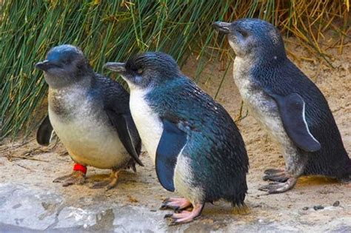
Little Penguin Observation Centre
The smallest penguin species, the little penguin, has a colony on Burnie’s foreshore, a brief walk from the CBD.
There’s an observation center on the boardwalk here, staffed by volunteer guides.
You’ll be given a rare window on the little
penguin’s seasonal life, from courtship to rearing chicks and then molting at the end of the breeding season.
At the fully accessible viewing area the guides will be on hand to give you extra insight and answer questions about the penguins, their diet and habits.
Admission: Free Penguin Guides will be at the Penguin Observation Centre 30 mins before dusk

Slide 17
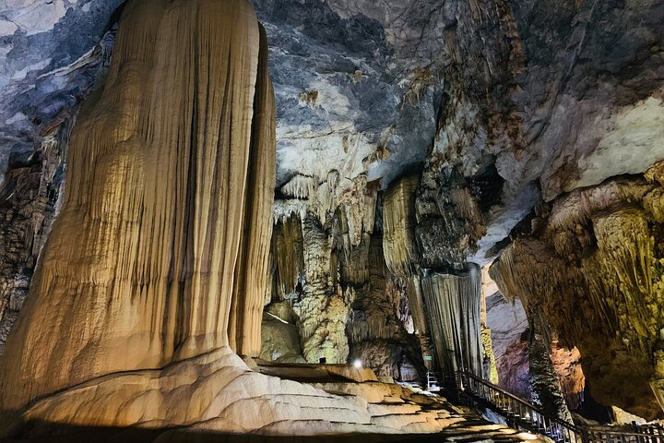
Gunns Pains Caves
Best described as a ‘hidden gem’, the Gunns Plains Cave State Reserve is home to some of the most remarkable Tasmanian caves.
On a guided cave tour, you will see impressive calcite shawls and flowstones, and an array of formations showcasing the rich colors and silver-speckled calcite crystals of the underground.
Glow worms dot areas of the cave like stars, and the underground river that formed the cave still flows underfoot as you venture along the walkway. Platypus sleep and nest in the river’s sandy banks, while freshwater crayfish, fish and eel live in its waters.
Gunns Plains Cave is one of the oldest Tasmanian cave reserves. It was proclaimed a State Reserve in 1918. It became one of Tasmania’s early tourism attractions.
The Caves are located about 45 minutes south of the port by car.

Slide 18
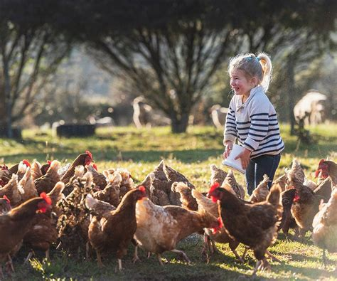
Guide Falls Farm
For families visiting Guide Falls there’s a working farm that welcomes visitors for animal encounters.
A self-guided tour around the paddocks will take around two hours, during which you’ll meet deer, alpacas, peacocks, emus, rabbits, sheep and pigs, to name just a handful.
If you like you’ll be able to hand-feed these animals.
Depending on when you come there will also be baby animals at the nursery.

Slide 19
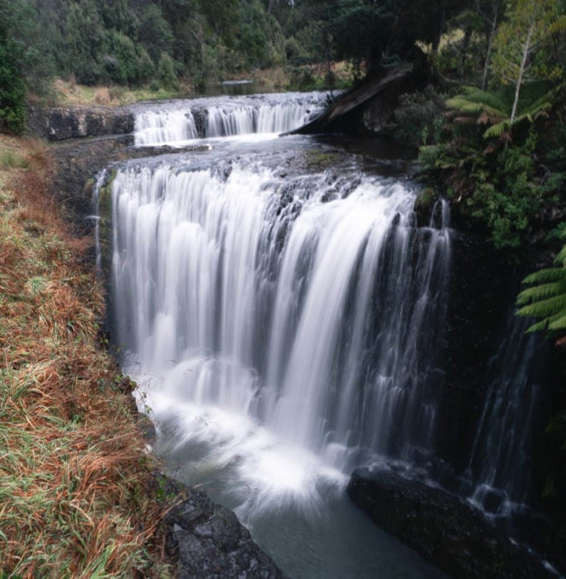
Guide Falls
Be sure to make time for a drive into Burnie’s idyllic hinterland to discover this tiered-cascade waterfall in a pristine natural reserve.
The base of Guide Falls is an easy ten-minute walk from the car park, and there’s a steep stairway up to a platform for a stunning view from above.
The setting is nothing short of sublime, with tree ferns crowding the creek and falls, and peculiar basalt formations at the main drop and along the cascades below.
The reserve offers facilities like picnic tables, two barbecues and toilets.

Slide 20
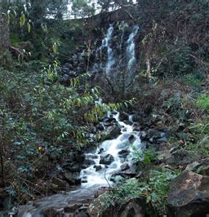
Oldaker Falls
Burnie Park even has its own waterfall, which is on Stoney Creek and can be found on the high slopes at the upper end of the park.
On paved tracks, you’ll leave the park’s neat landscaping behind for slightly wilder, overgrown scenery.
Oldaker Falls has a few signs of human intervention to manage the flow, which can be quite fierce after
prolonged rain but shrinks to a trickle in dry spells.
A stairway will lead you up beside the splash pool and intermediate falls, to the base of the main drop in a picturesque little gorge.

Slide 21
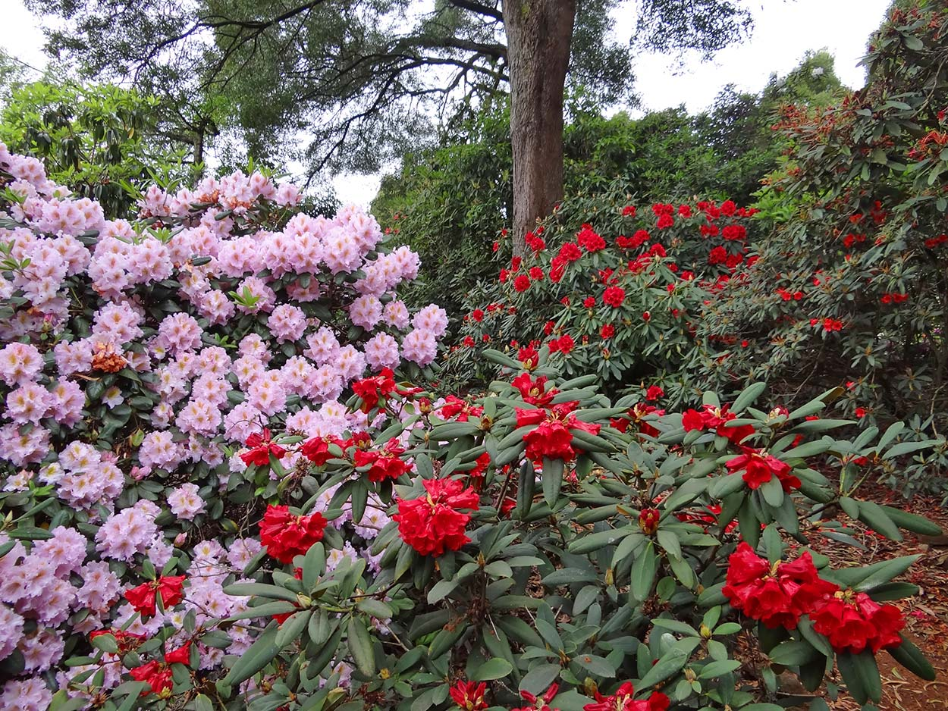
Emu Valley Rhododendron Garden
If you’re in Burnie between the end of August and January, you have to make the short trip to this garden in a natural amphitheater just outside the city.
Growing here in 11 hectares are more than 22,000 rhododendron and companion plants, which burst into flower for those few months.
The Emu Valley Rhododendron Garden has been landscaped over more than three decades by volunteers, and is embellished with features like waterfalls, bridges, four lakes, drystone walls and gazebos.
In October you can take in the garden’s cherry trees in bloom plus a Japanese-themed celebration.

Slide 22
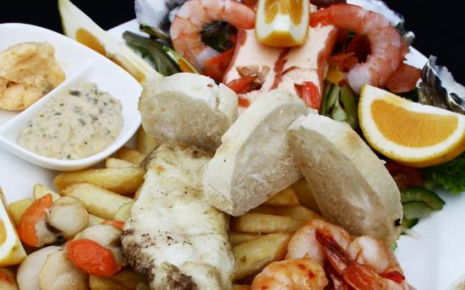
Restaurants in Burnie
There are a lot of excellent restaurants in Burnie. Especially for seafood.
Here are some recommendations: Restaurants in Burnie:
Indian Corner at Wilson $$ - $$$, Indian, Vegetarian
Fish on the Edge $$ - $$$, Seafood, Vegetarian, Vegan
Palate Food & Drink $$ - $$$, Australian, Vegetarian
Mallee Grill $$ - $$$, Steakhouse, Bar, Australian
Bayviews Restaurant & Lounge Bar $$$$, Australian, Vegetarian , Vegan
Leonardoz $$ - $$$, Australian, Vegetarian, Vegan
Regardless of your choice, it is always great to get a taste of the local area.
Good Eating!

Slide 23
Conclusion
Burnie is a beautiful City with a rich history and numerous attractions. Regardless of what you're looking for, Burnie has something for everyone.
I hope this presentation will help when we visit Burnie!

Slide 24
Thanks For Coming
If you have any more questions, please ask.
I will do my best to answer them for you.
Have a great visit to Burnie!

Slide 25
Acknowledgement
My seminars are the result of many years of travel experience combined with many hours of research over the internet.
I would like to acknowledge the many source I have accessed.
These include: Wikipedia.com, Britannica.com, and the various Museum, Park and Government websites.

