Slide 1
Buenos Aires, Argentenia
Presented by
Marc Silver

Slide 2
What I Will Cover
My Port Philosophy
Don’t Miss the Ship
Money
About Buenos Aires
Maps
Buenos Aires History
Area Map of Buenos Aires
Buenos Aires Transportation
Places to see or at least consider
A few restaurant recommendations
Conclusion

Slide 3
My Port Philosophy
I’ve been cruising for over 46 years and have taken more than
100 cruises, so I consider myself an experienced cruiser.
The information I’m sharing comes from all those years at sea.
When the city I want to visit isn’t the same as the port city,
I always recommend taking a ship’s tour.
But when a port has plenty to see nearby and it’s easy to explore,
I’ll do it on my own.
This time, it’s worth letting the ship handle the logistics.

Slide 4

Don’t Miss the Ship
How to Avoid Missing Your Ship
Pay attention to the time. - Ship time and local time
are often different. Ship time doesn’t always match
local time. Put a return-to-ship reminder on your phone.
Choose excursions wisely.
If a ship-sponsored excursion is late returning to port,
the ship will wait for you. If you are on your own.
Be Prepared
Have your Passport, Credit Card, and phone numbers for your ship port agent.
What to Do If You Miss the Ship
Most cruise lines have port agents stationed in the port area to assist if your ship has left without you. If you are lucky, when cruisers are late returning to the vessel, the ship’s crew will often remove the passengers’ essential items – passports, cell phones, and medication -- from the ship to leave with the port agents.
The Port Officials can help you with contacting your ship
and making necessary travel arrangements.

Slide 5
Money
The Argentine Peso
The official exchange rate is:
$1.00 US = 1,400 Argentine Pesos (ARS$)
100 Argentine Peso = 0.07 US Dollar
As of 2025, the rate hovers around 1,400 ARS to 1 USD,
but it changes daily.

Slide 6
About Buenos Aires
Buenos Aires lies on the western shore of the Río de la Plata, facing Uruguay across the water.
It is Argentina’s capital and largest city, a mix of European elegance and Latin passion.
Buenos Aires has a dramatic history spanning nearly five centuries. Spanish conquistador Pedro de Mendoza first founded the settlement in 1536, but indigenous resistance forced abandonment. Juan de Garay reestablished the city in 1580, naming it "Santa María del Buen Ayre.“

Slide 7
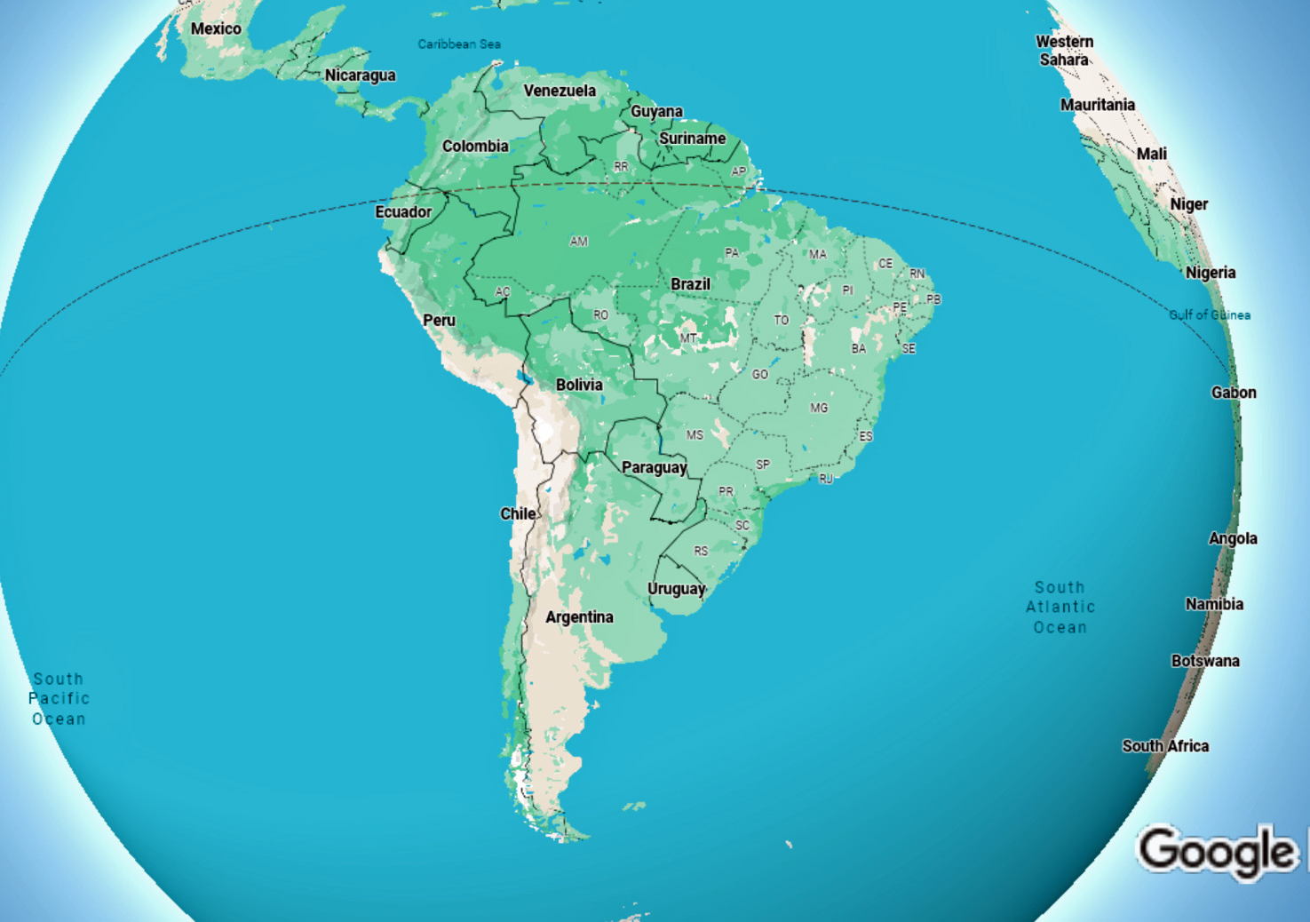
Buenos Aires

Slide 8
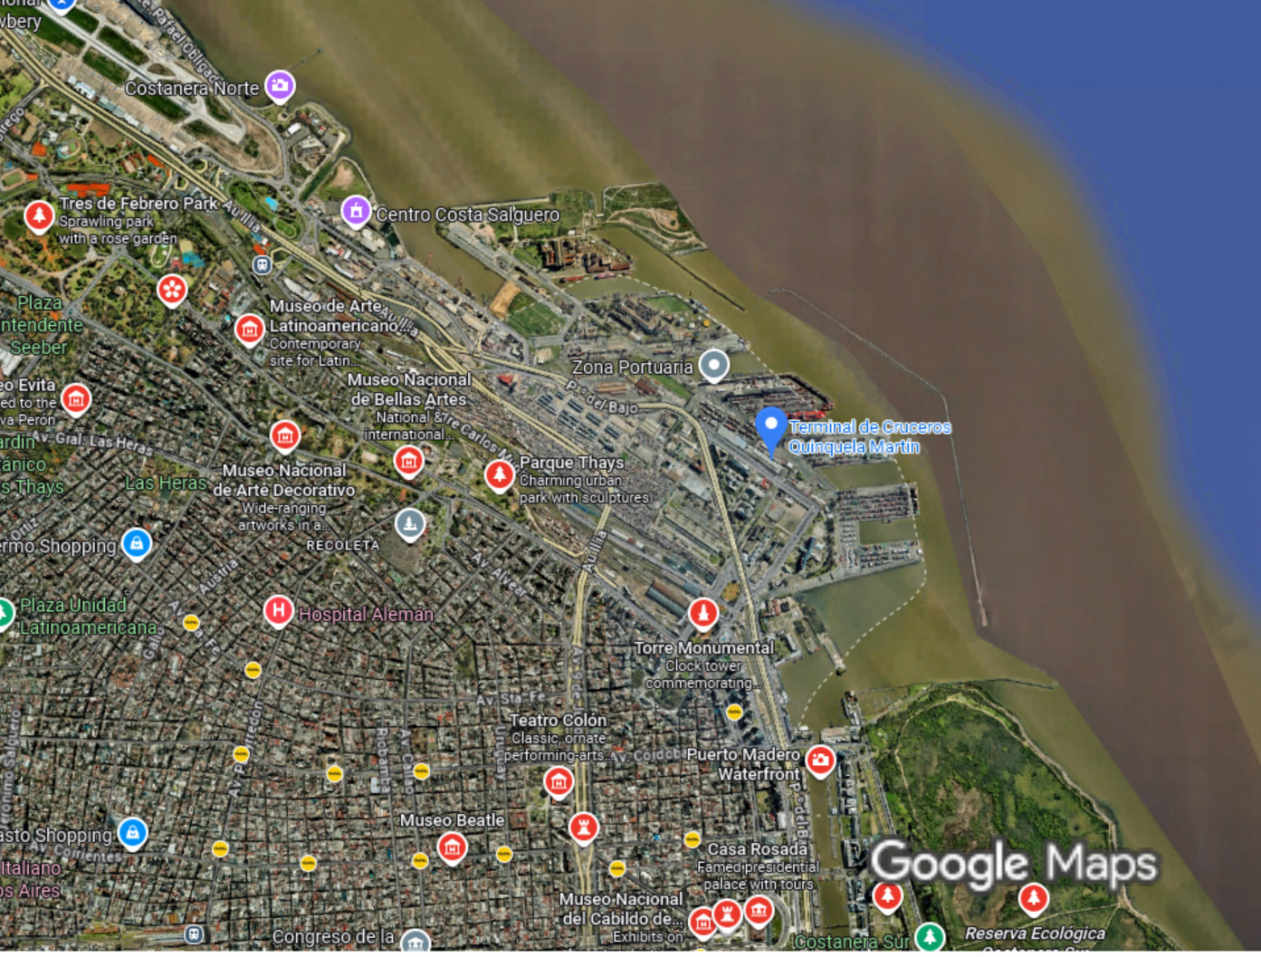
Buenos Aires
Cruise Port

Slide 9
A Brief History
Buenos Aires began as a modest colonial settlement but grew into a thriving regional port by the 18th century.
Its position along the Río de la Plata made it a key center for trade long before independence.
When it finally became Argentina’s official capital in 1880, the city exploded into
prosperity as one
of South America’s
major ports,
exporting beef and
grain to a hungry
world.

Slide 10
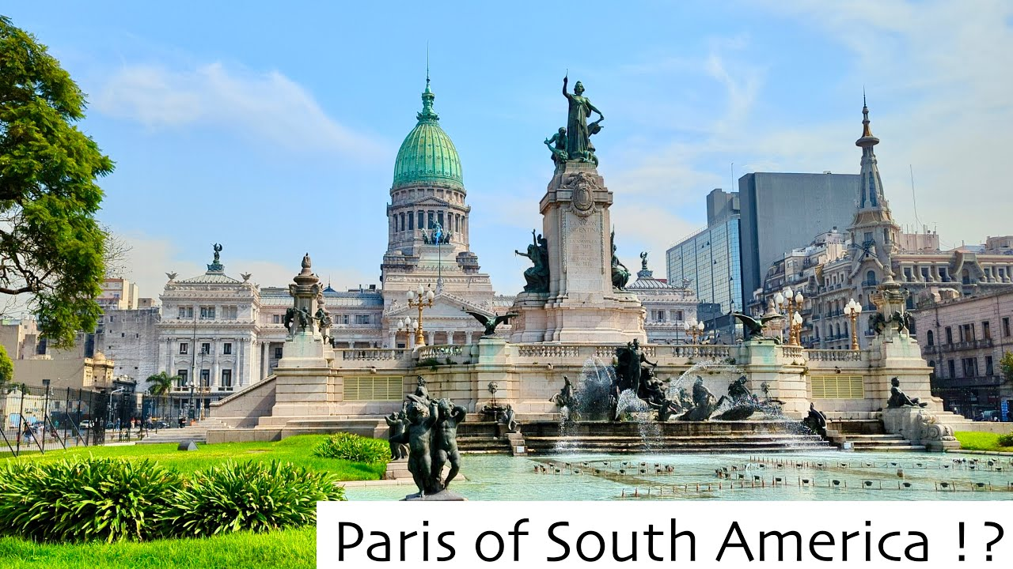
A Brief History
This golden age attracted massive European immigration, primarily from Italy and Spain, transforming both the population and the city’s character.
Nineteenth- and early twentieth-century wealth funded ambitious urban planning modeled after Paris. Grand boulevards like Avenida de Mayo were built, lined with ornate Beaux-Arts buildings, elegant cafés, and leafy plazas.
This European aesthetic earned Buenos Aires its enduring nickname: “The Paris of South America.” It became Latin America’s most cosmopolitan city, a bridge between the Old World and the New.

Slide 11
Getting Around Buenos Aires
Buenos Aires offers diverse transportation options at varying price points. The colectivo (bus) system is extensive with over 150 routes, costing around 270-400 pesos ($0.27-$0.40 USD) depending on distance, paid via SUBE card.
Taxis are metered and charge approximately 650 pesos base fare plus 80 pesos per kilometer—a typical cross-city ride costs 3,000-5,000 pesos ($3-$5 USD).
Uber operates legally with similar or slightly lower rates than taxis; short trips average 2,000-3,000 pesos. Cabify and DiDi offer comparable pricing.
The Subte (metro) is cheapest at
around 270 pesos per ride. All
options are affordable by international
standards, though traffic congestion
during rush hours affects travel times.

Slide 12
Buenos Aires, Argentina
The Paris of South America
Buenos Aires captivates visitors with its intoxicating blend of European elegance and Latin American passion. The city earned its "Paris of South America" moniker through stunning Beaux-Arts architecture, wide boulevards lined with jacaranda trees, and sidewalk cafés where porteños linger for hours over coffee.

Slide 13
The Paris of South America
Tango pulses through the city's veins, born in the working-class neighborhoods of La Boca and San Telmo, this sultry dance embodies Buenos Aires' soul. You'll find it performed in intimate milongas, grand theaters, and street corners alike.

Slide 14
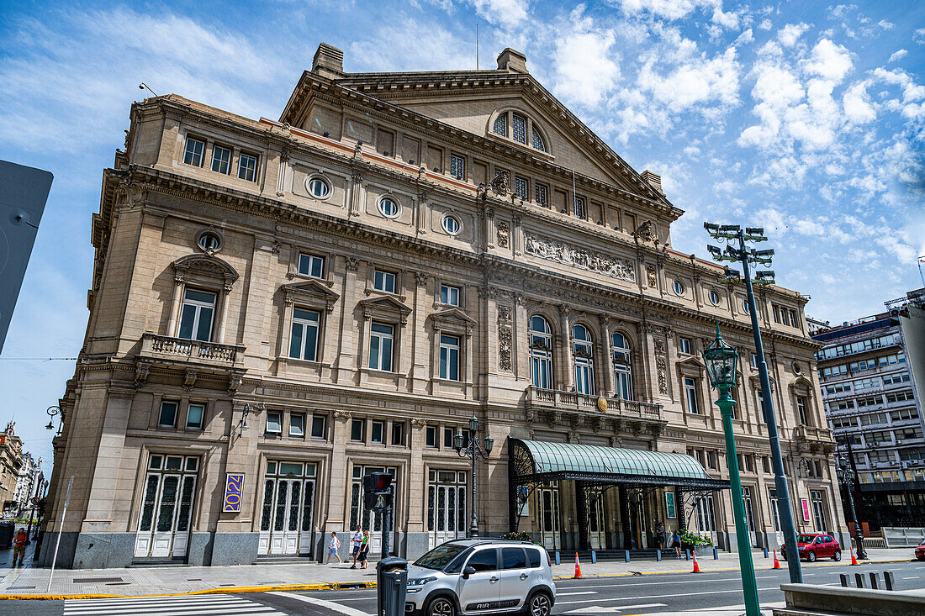
The Paris of South America
The architecture tells stories of ambitious 19th-century prosperity: the ornate Teatro Colón opera house, the Recoleta Cemetery's elaborate mausoleums, and the colorful Italian-style tenements called conventillos.
Yet beneath this European veneer beats an unmistakably Argentine spirit—fiercely independent, melancholic yet vibrant, shaped by waves of immigration, political turbulence, and an enduring love for futbol, mate, and endless conversation. Buenos Aires doesn't merely imitate
Paris; it reimagines it with distinctly
South Teatro Colón opera house
American flair.

Slide 15
The Neighborhoods
1. La Boca – Colorful streets and tango culture.
2. San Telmo – Colonial charm and antique markets.
3. Recoleta – Elegant, home to Evita’s resting place.
4. Palermo – Parks, nightlife, and restaurants.
5. Puerto Madero – Modern riverfrontdevelopment.
La Boca
San Telmo
Puerto Madero
Notes:
San Telmo

Slide 16
Iconic Landmarks
1. Plaza de Mayo – Historic square.
2. Casa Rosada – Presidential palace.
3. Teatro Colón – One of the world’s
top opera houses.
4. Recoleta Cemetery – Ornate mausoleums.
5. Obelisco – Center of city pride.
Plaza de Mayo
Teatro Colón
Obelisco
Casa Rosada
Notes:
Teatro Colón

Slide 17
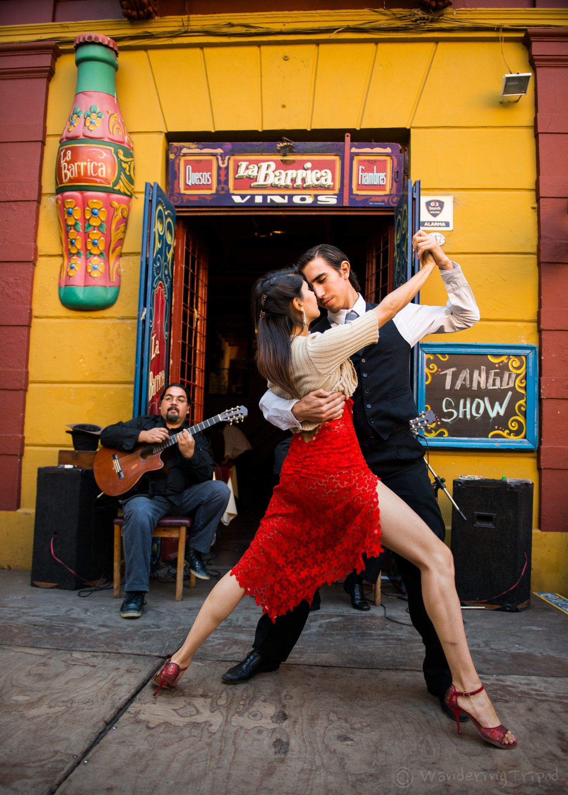
Tango: The Soul of Buenos Aires
Born in the 1880s in working-class neighborhoods.
A blend of African rhythms, Italian melodies, and Argentine passion.
Tango shows abound in San Telmo and La Boca.
Don’t miss Café Tortoni, the city’s oldest cafe and tango hub.

Slide 18
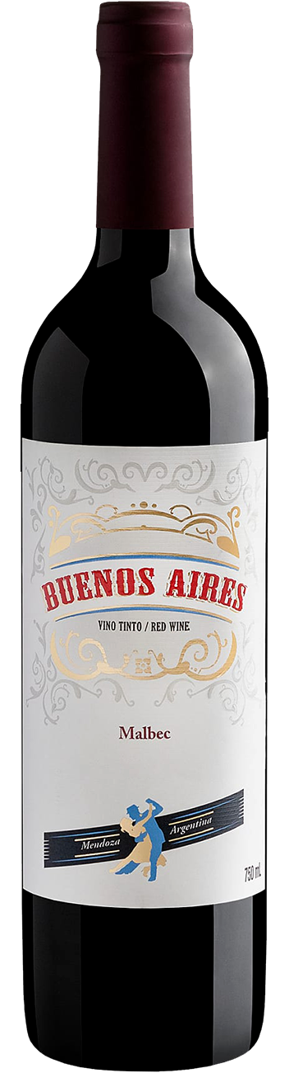
Culture and Cuisine
Buenos Aires thrives on art, literature, and food.
Museums: MALBA, Museo Nacional de Bellas Artes.
Cuisine: world-famous steaks, empanadas, and Malbec wine.
Café culture: locals linger for hours over conversation.

Slide 19
Local Life and Traditions
Portenos (locals) are proud, stylish, and expressive.
Sunday markets, football matches, and mate drinking are everyday rituals.
Soccer is a passion—Boca Juniors vs River Plate is legendary.

Slide 20
Practical Tips
Currency: Argentine Peso (ARS).
Language: Spanish.
Weather: Temperate—warm summers, mild winters.
Souvenirs: leather goods, tango art, mate cups.
Safety: watch belongings in crowded areas.

Slide 21
Day Trip Ideas
1. Tigre Delta – Boat tours through scenic waterways.
2. Colonia del Sacramento, Uruguay – Ferry across Río de la Plata.
3. San Antonio de Areco – Traditional gaucho town.
4. La Plata – Planned city with neo-gothic cathedral.

Slide 22
Reflection & Closing
“Buenos Aires is a city that dances even when the music stops.”
It’s a blend of old-world grandeur and contemporary creativity.

Slide 23
Q&A
Questions & Curiosities
Let’s dance our way through Buenos Aires together!

Slide 24
Thanks For Coming
If you have any more questions, please ask.
I will do my best to answer them for you.
Have a great visit to Buenos Aires!

