Slide 1

Brisbane Australia Presented by Marc Silver

Slide 2
What I Will Cover
My Port Philosophy
Don’t Miss the Ship
Money
About Brisbane
Area Map of Brisbane
Map of Brisbane
Brisbane Transportation
Places to see or at least consider
A few restaurant recommendations
Conclusion

Slide 3
My Port Philosophy
I have been cruising for over 45 years and have taken over 200 cruises. So, I consider myself an experienced cruiser.
The information I will present is based on those many years of
experience.
When I am on a cruise where the city, I want to visit is not the port city,
I always recommend taking a ship’s tour.
But when I am in a port with multiple attractions nearby and easy to see
on my own - I will do it on my own.
This presentation is for that type of port.

Slide 4

Don’t Miss the Ship
How to Avoid Missing Your Ship
Pay attention to the time. - Ship time and local time are often different.
Put a return-to-ship reminder on your phone.
Choose excursions wisely.
If a ship-sponsored excursion is late returning to port, the ship will wait for you. If you are on your own???
Be Prepared
Have your Passport, Credit Card, and phone numbers for your ship port agent.
What to Do If You Miss the Ship Most cruise lines have port agents stationed in the port area to assist if your ship has left without you. If your are lucky, when cruisers are late returning to the vessel, the ship’s crew will often remove the passengers’ essential items – passports, cell phones, and medication -- from the ship to leave with the port agents.
The Port Officials can help you with contacting your ship and making necessary travel arrangements.

Slide 5

Money
The currency for Brisbane is the Australian Dollar.
The conversion at the rate is $1.48 AUD to $1.00 U.S.
Or $1 AUD $.67 U.S.

Slide 6
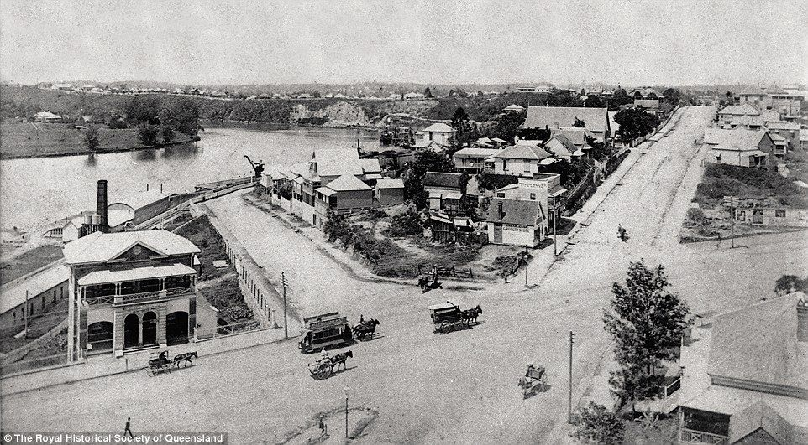
The Origin of Brisbane
The origin of Brisbane is steeped in debate and conjecture. Some historians suggest that the city was established by convicts, who first arrived in 1825 and named the location 'Edenglassie' which is derived from an Aboriginal term meaning 'windy place’.
Upon the arrival of explorers in 1823 laid the groundwork for what would eventually become Brisbane, as they noted the area might be suitable for settlement.
At the time of the explorer's visit, Southern Aboriginals were residing in the vicinity along with a small number of settlers and free convicts.

Slide 7
The Origin of Brisbane Cont.
Their presence in the region may also have shaped what Brisbane would eventually become. However, it is important to mention that it was not until later settlement began under Lieutenant Governors Patrick Logan and Thomas Henry after 1824 that Brisbane began to truly take shape.
Ultimately, there is no definitive answer to the question surrounding Brisbane's origin. But considering its rich history and diverse Indigenous Brisbane culture, one can not help but appreciate the complexity of this small Queensland city. With this in mind, let us move onto examine how the formation as a colony impacted Brisbane's course of development over time.

Slide 8
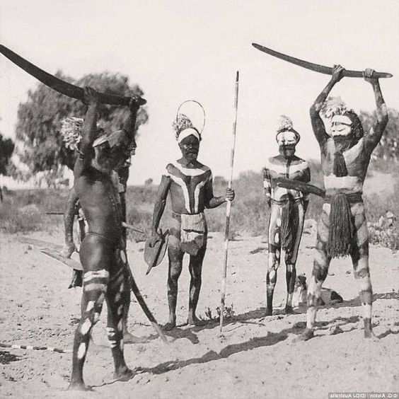
Lifestyles of the Settlers
The early settlers of Brisbane came from diverse backgrounds, many of whom embraced the lifestyle of their colonial predecessors. Even prior to arrival of Governor Gipps’ in 1839, British traders had been busy establishing trading vessels and ports in Brisbane.
While some of the earliest arrivals stayed in the area, most left as soon as possible due to food shortages and hostile Aboriginals.

Slide 9
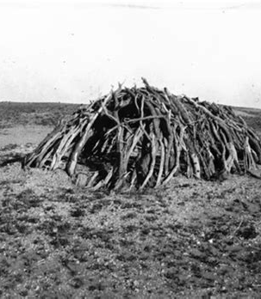
Lifestyles of the Settlers Cont.
Of those who stayed, they lived mainly in tents which grew into humpies spread along Eagle Street and Queen's Wharf.
Lacking necessary goods, the majority engaged in subsistence agricultural lifestyle with some practicing semi-nomadism and others making use of local seasonal resources.
These individuals took advantage of agricultural land around what is now known as Boggo Road, supplementing their diets by hunting kangaroo, scrub turkeys and other animals on nearby islands. Cut bush timber was also used to construct huts for shelter.

Slide 10
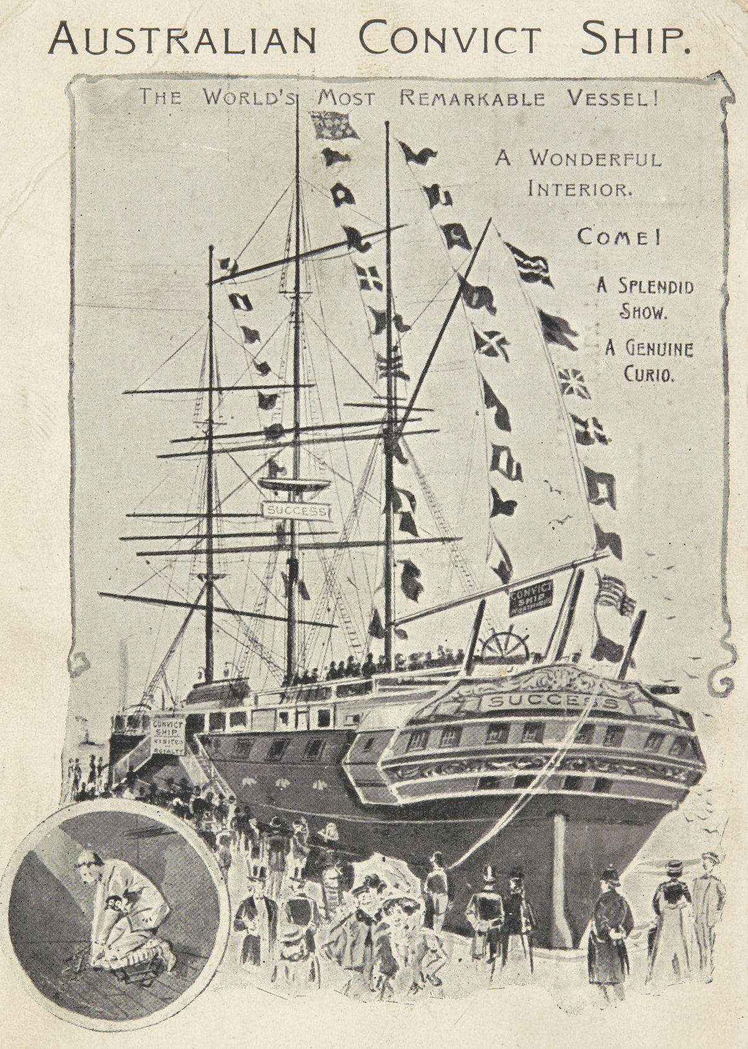
Lifestyles of the Settlers Cont.
By the 1840s, a number of convict ships had arrived bringing workers for public projects such as the creation of roads, bridges and jails.
This influx allowed for a more sedentary lifestyle amongst the settlers who established themselves on various allotments located throughout Brisbane Town and surrounding districts such as Kangaroo Point and south Brisbane.
The majority utilized the surrounding environment to make a living through farming, fishing or gathering yams or turtles' egg on nearby Moreton Island.

Slide 11
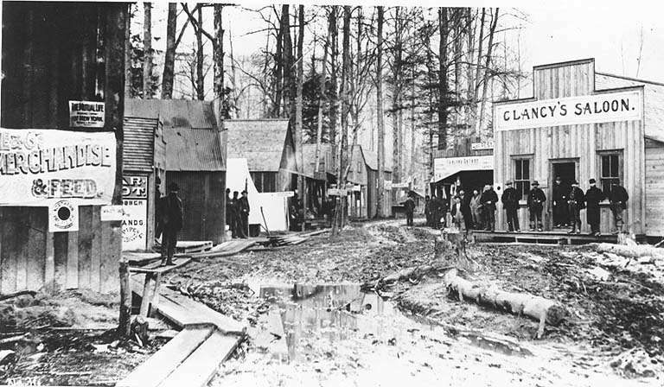
Boomtown Era
The arrival of government marked the start of the Boomtown Era of Brisbane. At first, during the colonial period, Brisbane was enshrined with Australian laws and regulations.
The settlers began to organize and formalize their way of life, creating an educational system and governance structure which allowed for greater organization and development.

Slide 12
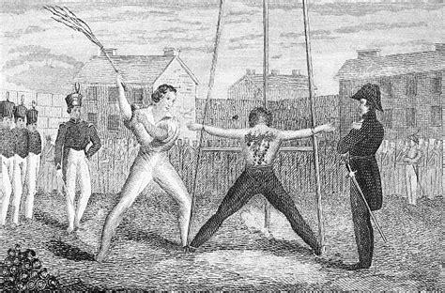
Boomtown Era Cont.
On the other hand, it could be argued that with this new governance system came oppressive measures such as heavy taxation which hindered many citizens from improving their standards of living.
Additionally, crimes committed under British law had serious punishments such as flogging, transportation and
prison sentences. This led some to question the effectiveness, fairness and progressiveness of government’s policies and reforms.

Slide 13
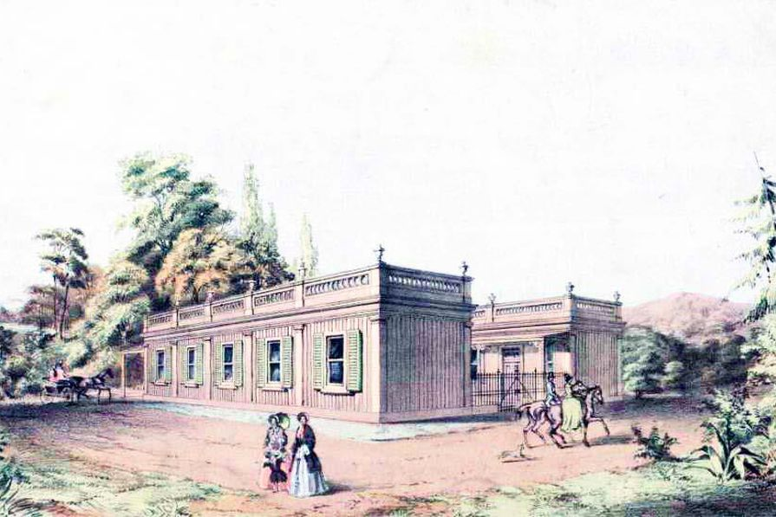
Boomtown Era Cont.
There is no denying that the arrival of government helped shape Brisbane into a prosperous city that we recognize today.
The grandiose buildings, stylish streetscapes and a growing population during this period in time, Brisbane successfully transitioned from its old agricultural roots into a bustling city full of opportunity and ambition.

Slide 14
Brisbane Area Map

Slide 15
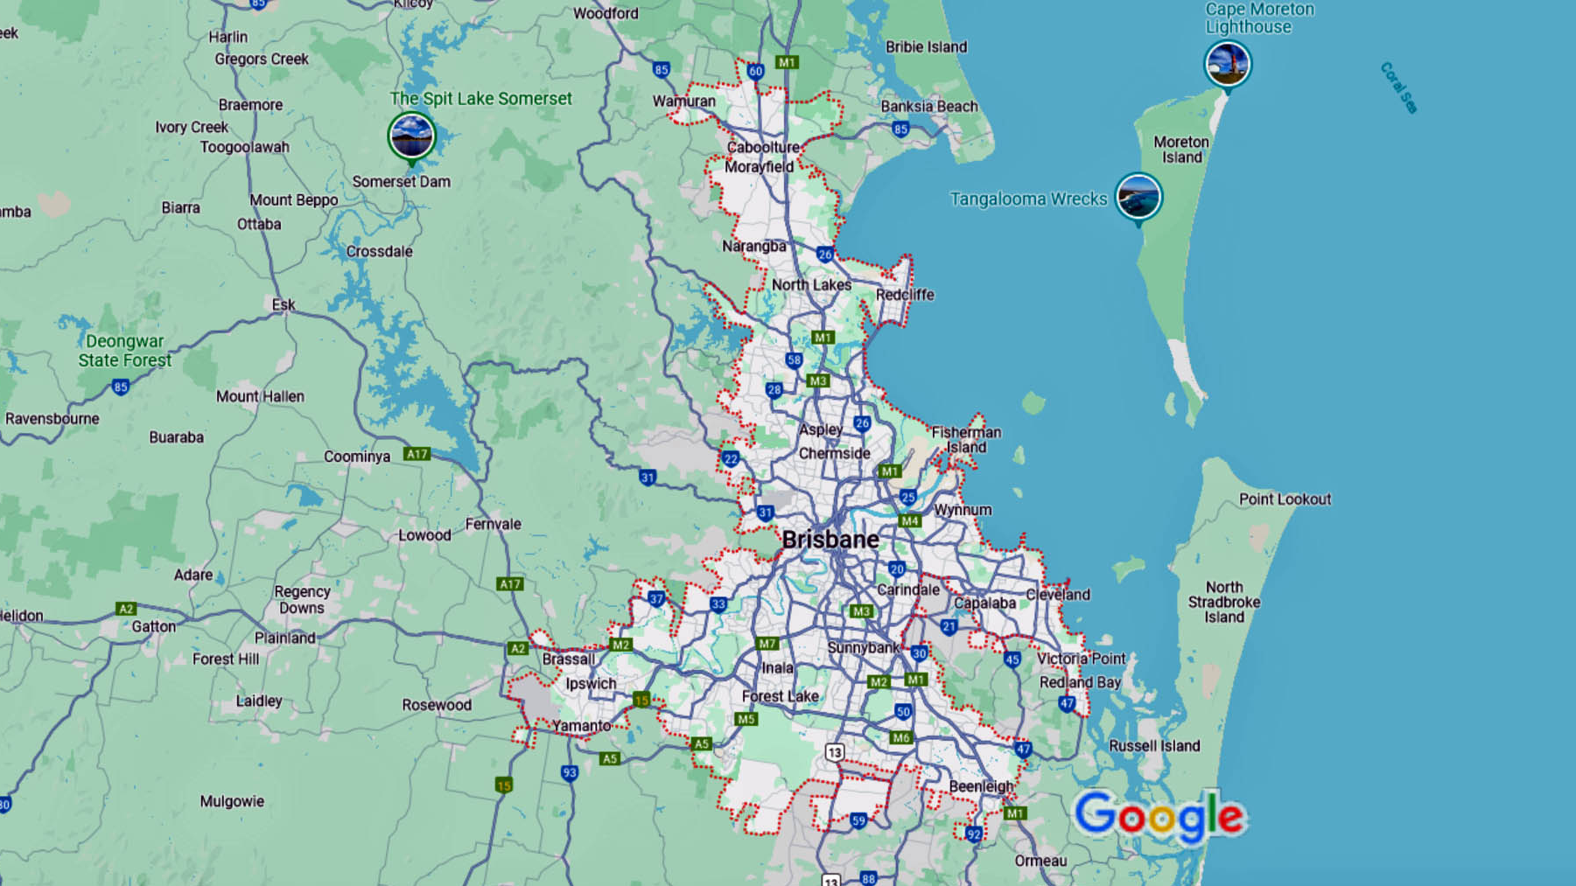
Map of Brisbane

Slide 16
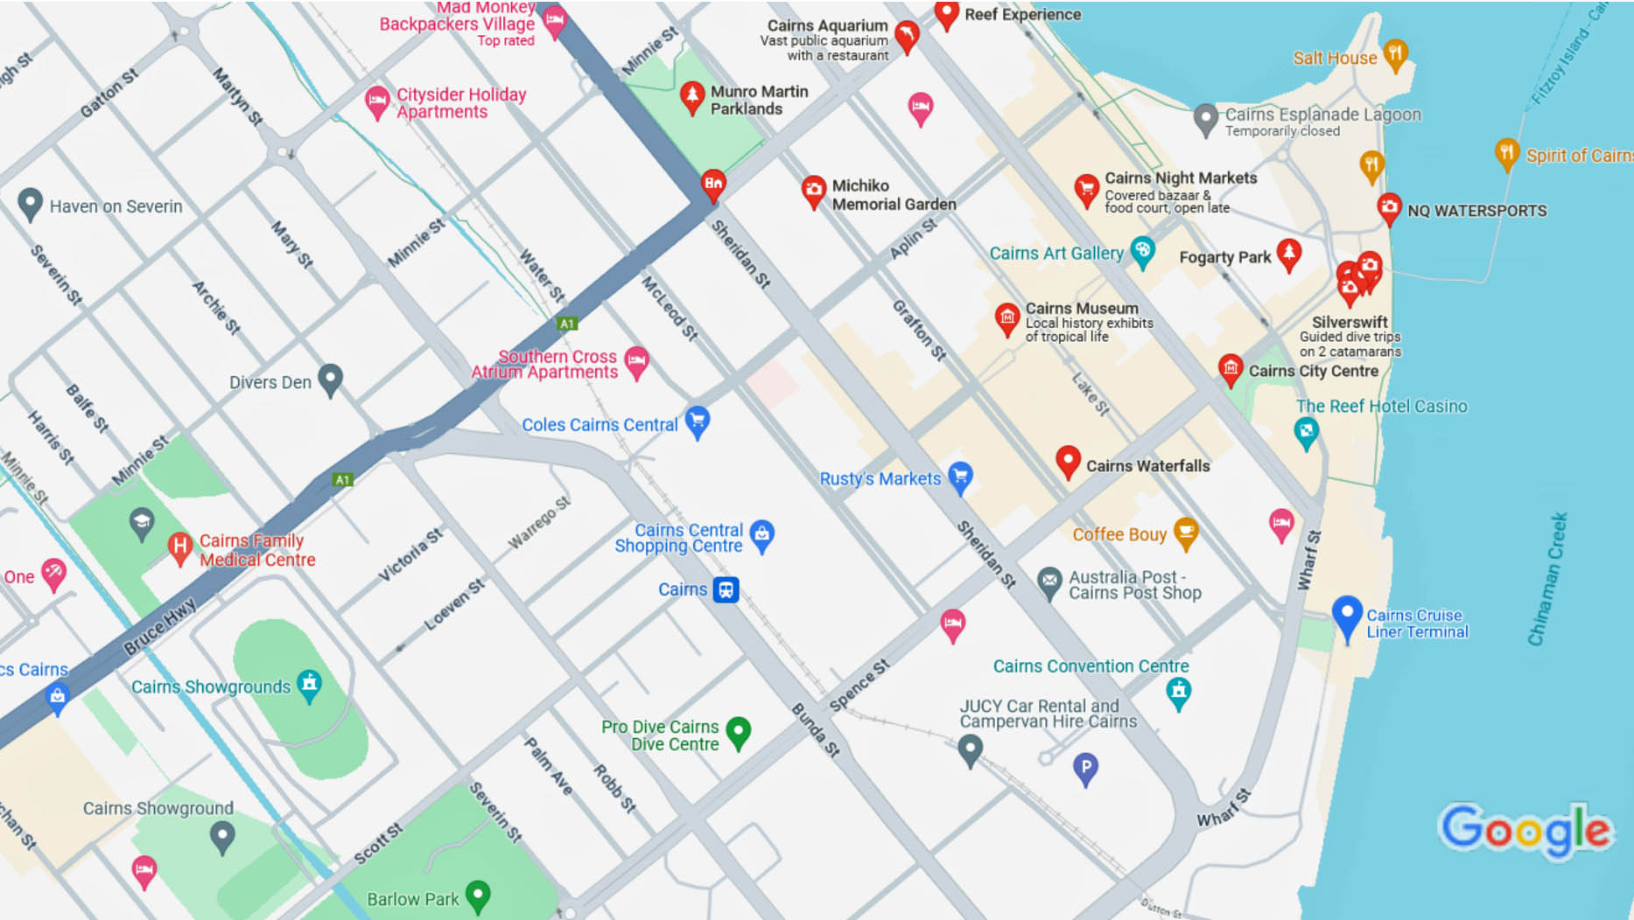
Where We Dock

Slide 17
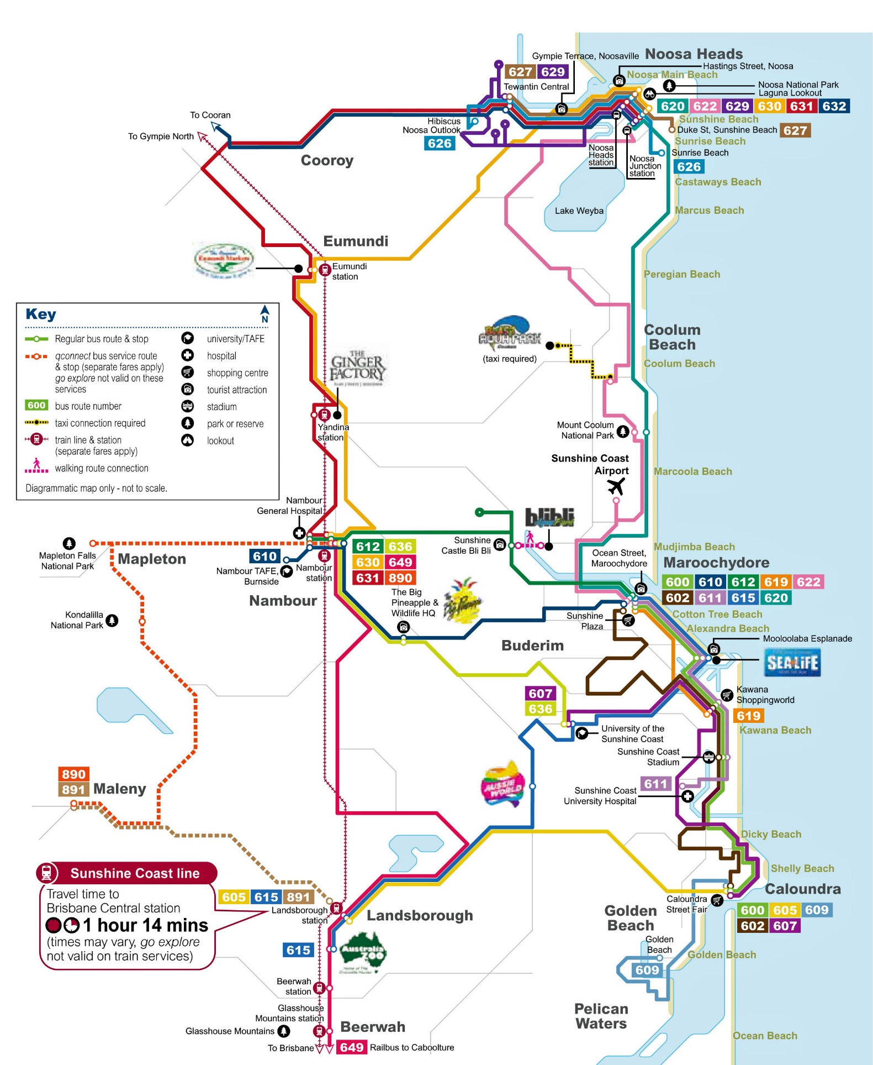

Brisbane Transit
Explore breathtaking beaches, wildlife, theme parks and award-winning dining on the Gold Coast and now, the Sunshine Coast.
The go explore card offers visitors and tourists freedom, flexibility and value for money!
You can now use your go explore card on TransLink buses on the Sunshine Coast, as well as on trams and TransLink buses across the Gold Coast.
Go Explore Card is only $10 a day for unlimited travel.

Slide 18
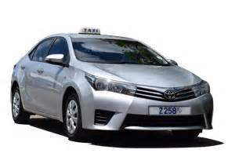
Brisbane Taxis
Standard taxis provide a safe and reliable way to explore the city or for transport between the cruise port and various attractions.
Like taxis in most locations the cost is significantly more expensive than other modes of transport.

Slide 19
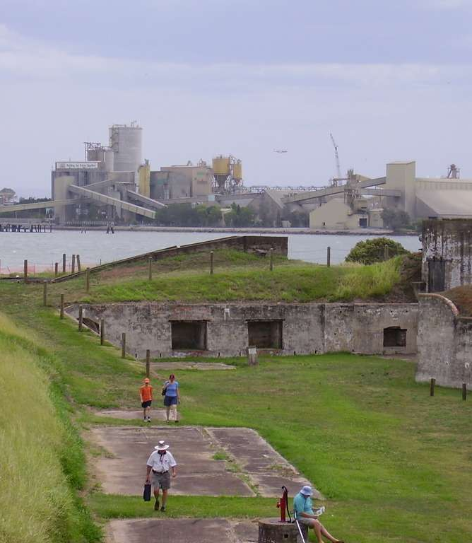
Fort Lytton National Park
Fort Lytton is an important historic site. Built in 1881 and used for the defense of Brisbane until the end of the Second World War, it is a pentagonal fortress concealed behind grassy embankments.

Slide 20
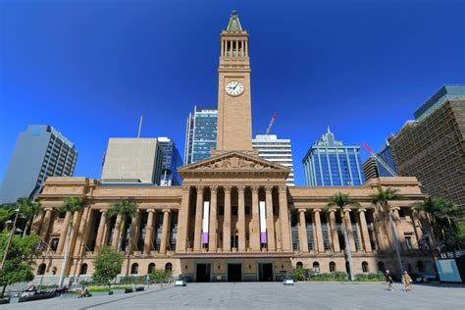
Museum of Brisbane
Museum of Brisbane (MoB) explores contemporary and historic Brisbane, Australia, and its people through a program of art and social history exhibitions, workshops, talks, tours and children's activities.
Located on Level 3, of Brisbane Hall, the Museum and its staff are highly regarded for their innovation and contemporary international practice across the museum and gallery sector.

Slide 21
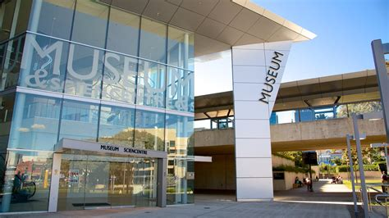
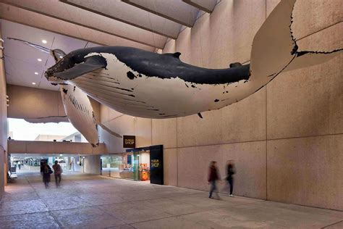
Queensland Museum
Queensland Museum is custodian of the state’s natural and cultural heritage, caring for more than a million items and specimens in collections that tell the changing story of Queensland.

Slide 22
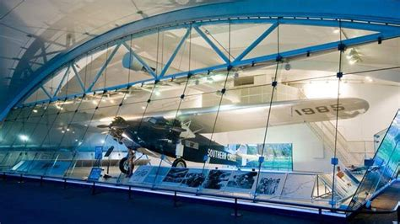
Sir Charles Kingsford Smith Memorial
This memorial is dedicated to the early Australian aviator Sir Charles, best known for making the first trans-Pacific flight from the United States to Australia, the first non-stop crossing of the Australian mainland and the first flight between Australia and New Zealand.
The preserved “Southern Cross” airplane, which Kingsford Smith used for the trans-tasman flight is on display at this memorial, and Brisbane Airport is the custodian of this important relic for the Commonwealth of Australia.
Did I mention it’s completely free?

Slide 23
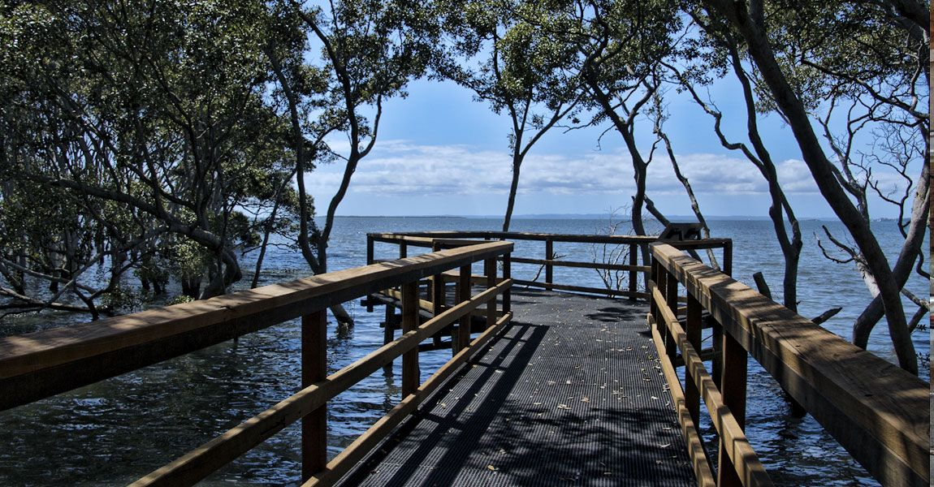
Wynnum Mangrove Boardwalk
This marvelous elevated wooden boardwalk threads its way through a tidal mangrove ecosystem on the edge of Moreton Bay. It's only an 800m stroll with informative plaques and several viewing platforms with chairs for sitting and watching nature go by.
Visiting at low or high tide presents different experiences. Low tide allows viewing of the mangrove roots and the fascinating bottom-dwelling life, while high tide is a less aromatic, more peaceful, walking-on-water vibe.

Slide 24
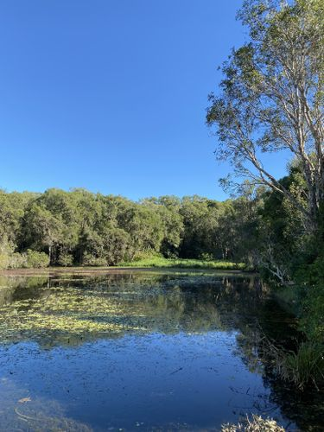
Nudgee Waterhole Reserve
This is a terrific, short, trail around the Nudgee Waterhole Reserve, next to the Australian Catholic University in northern Brisbane, Queensland.
The trail is only a 0.9-mile loop. Generally considered an easy route, it takes an average of 18 min to complete. This trail is great for hiking and walking, and it's unlikely you'll encounter many other people while exploring.
The trail is open year-round and is beautiful to visit anytime.

Slide 25
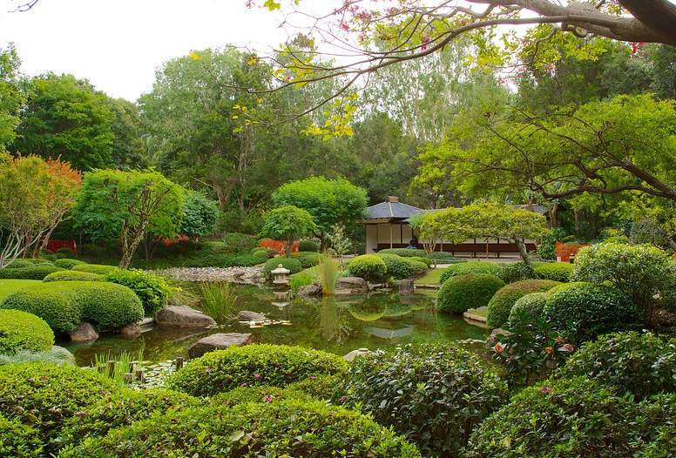
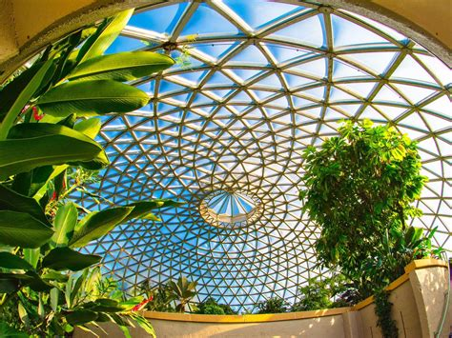
Brisbane City Botanic Gardens
Brisbane boasts not one but two botanic gardens? The 17-hectare City Botanic Gardens are located in the heart of Brisbane on Alice Street and are bounded by the Brisbane River.
The 56-hectare Brisbane Botanic Gardens Mount Coot-tha is located 6 kilometres from the Brisbane Central Business District.

Slide 26
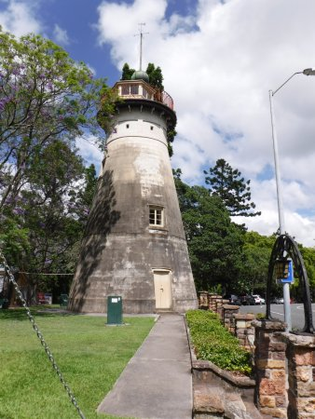
Old Windmill Tower
The Old Windmill, situated in Brisbane’s Observatory Park just north of the city center, is the city’s oldest building. It was built by convicts 200 years ago, making it both the longest surviving convict building and the oldest windmill tower left standing in Australia.
It was originally built to process the wheat and corn crops from the Moreton Bay colonial penal settlement. However, as it is located in a somewhat windless location, it quickly became a place of punishment, with convicts being put to work on a treadmill to keep the arms and heavy millstone turning.

Slide 27
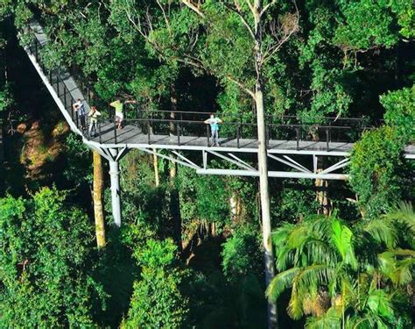
Rainforest Walk
This exciting new Eco-Adventure offers guests a unique and thrilling way to explore the beautiful rainforest canopies. Set in a magical 30 acres of privately owned rainforest beside the crystal clear rock-pools of Cedar Creek on Mt Tamborine, Queensland, Australia.
The walk departs directly from the Eco Gallery with a comprehensive array of Australian rainforest flora and fauna displays.
Pricing:
Adults (17 Age and Over) $19.5
Children $9.50

Slide 28
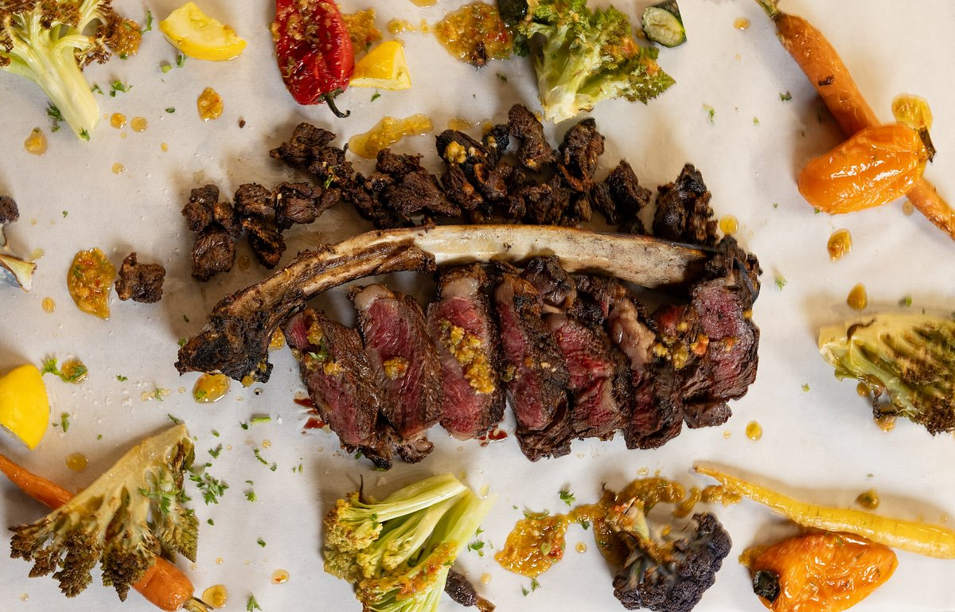
Restaurants in Brisbane
There are a lot of excellent restaurants in Hokkaido. Especially for seafood.
Here are some recommendations: Restaurants in Brisbane:
Rogue Bistro $$ - $$$, Australian, Vegetarian
Olive Thyme $$ - $$$, Turkish, Vegetarian, Vegan
1889 Enoteca $$$$, Italian, Vegetarian, Vegan
La Vue Waterfront Restaurant $$$$, French, Vegetarian, Vegan
Moda Restaurant $$$$, Mediterranean, Spanish, Contemporary
Tartufo Classic Italian $$ - $$$, Italian, Pizza, Mediterranean
Lamberts Restaurant $$ - $$$, Contemporary, Australian, Vegetarian

Slide 29
Conclusion
Brisbane is a beautiful City with a rich history and numerous attractions. Regardless of what you're looking for, Brisbane has something for everyone.
I hope this presentation will help when we visit Brisbane!

Slide 30
Thanks For Coming
If you have any more questions, please ask.
I will do my best to answer them for you.
Have a great visit to Brisbane!

Slide 31
Acknowledgement
My seminars are the result of many years of travel experience combined with many hours of research over the internet.
I would like to acknowledge the many source I have accessed.
These include: Wikipedia.com, Britannica.com, and the various Museum, Park and Government websites.

