Slide 1
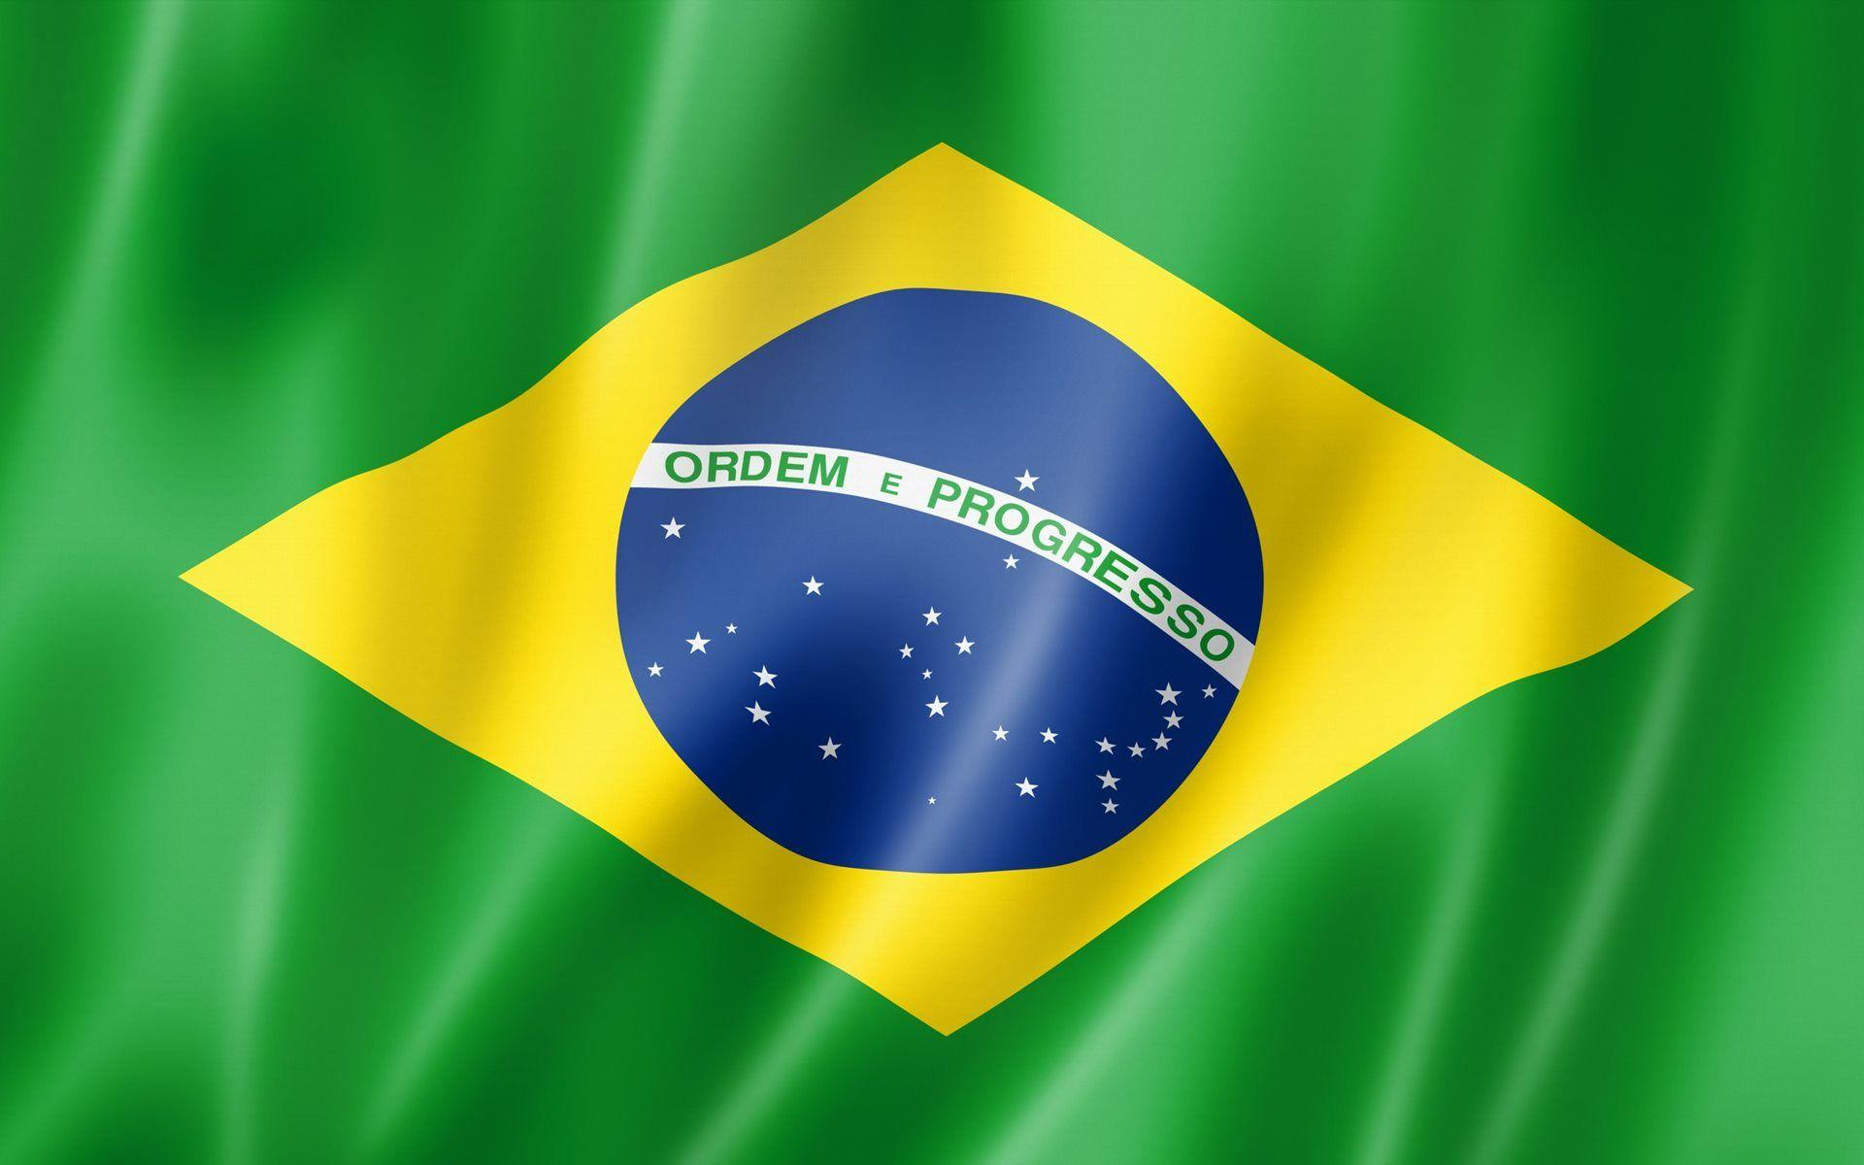
Boca da Valeria, Brazil
Presented by
Marc Silver

Slide 2
What I Will Cover
My Port Philosophy
Don’t Miss the Ship
Money
About Boca da Valeria
Area Map
Weather
Local Children
Boca da Valeria Transportation
Things to see and do
Conclusion

Slide 3
My Port Philosophy
I have been cruising for over 44 years and have taken over 200 cruises.
So, I consider myself an experienced cruiser.
The information I will present is based on those many years of
experience.
When I am on a cruise where the city, I want to visit is not the port city,
I always recommend taking a ship’s tour.
But when I am in a port with multiple attractions nearby and easy to see
on my own -
I will do it on my own.
This presentation is not like that.

Slide 4

Don’t Miss the Ship
How to Avoid Missing Your Ship
Pay attention to the time. - Ship time and local time are
often different.
Put a return-to-ship reminder on your phone.
Choose excursions wisely.
If a ship-sponsored excursion is late returning to port, the
ship will wait for you. If you are on your own.
Be Prepared
Have your Passport, Credit Card, and phone numbers for
your ship port agent.
What to Do If You Miss the Ship
Most cruise lines have port agents stationed in the port area to assist if your ship has left without you. If your are lucky, when cruisers are late returning to the vessel, the ship’s crew will often remove the passengers’ essential items – passports, cell phones, and medication -- from the ship to leave with the port agents.
The Port Officials can help you with contacting your ship
and making necessary travel arrangements.

Slide 5
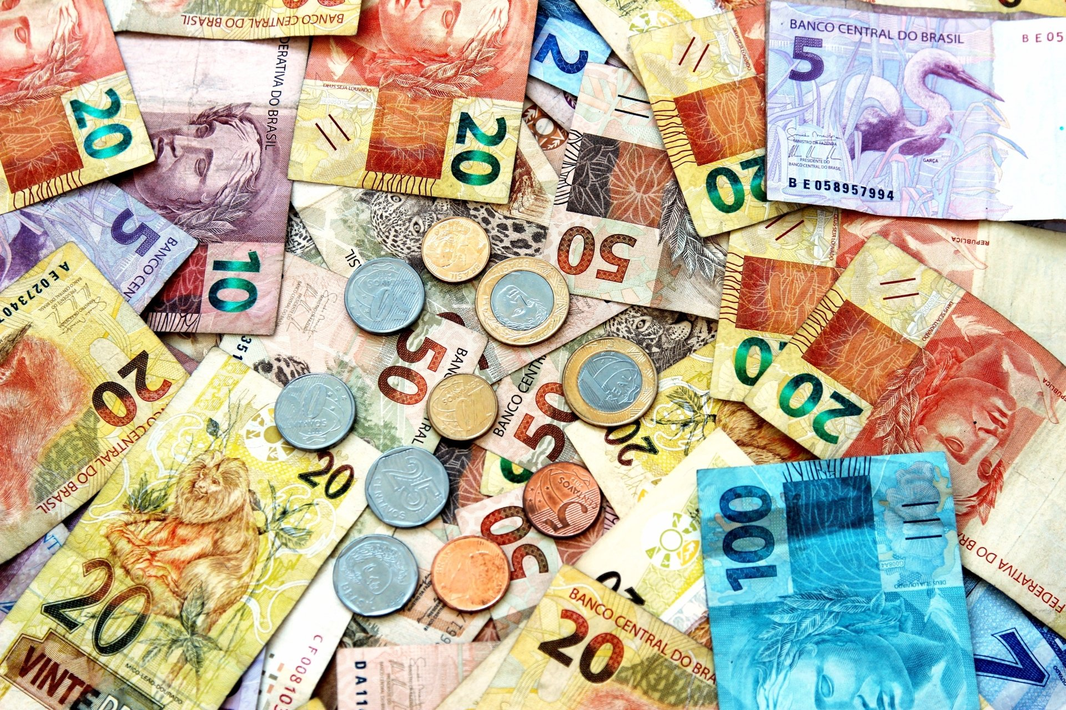
Money
The Brazilian Real
The official exchange rate is:
$1.00 US = 4.9310457 Real
1.00 Brazilian Real = 0.2028 US Dollars

Slide 6
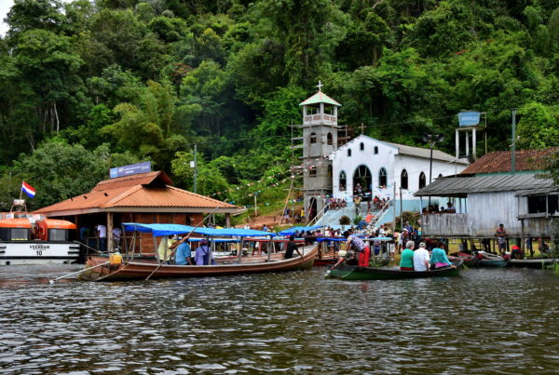
About Boca da Valeria, Brazil
A small village within the Amazon Basin, arriving at the picturesque cruise port of Boca da Valeria, Brazil tends to attract its just over 100 residents, along with their neighbors. With homes raised on stilts to avoid flooding from the Amazon during rainy season, this relatively remote area has been referred to as “the real Brazil.”

Slide 7
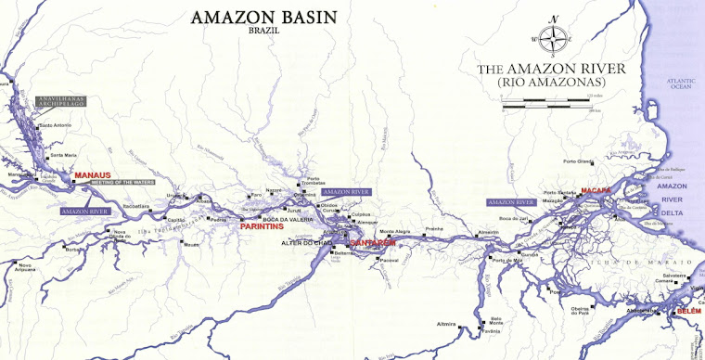
Area Map of Boca da Valeria, Brazil

Slide 8
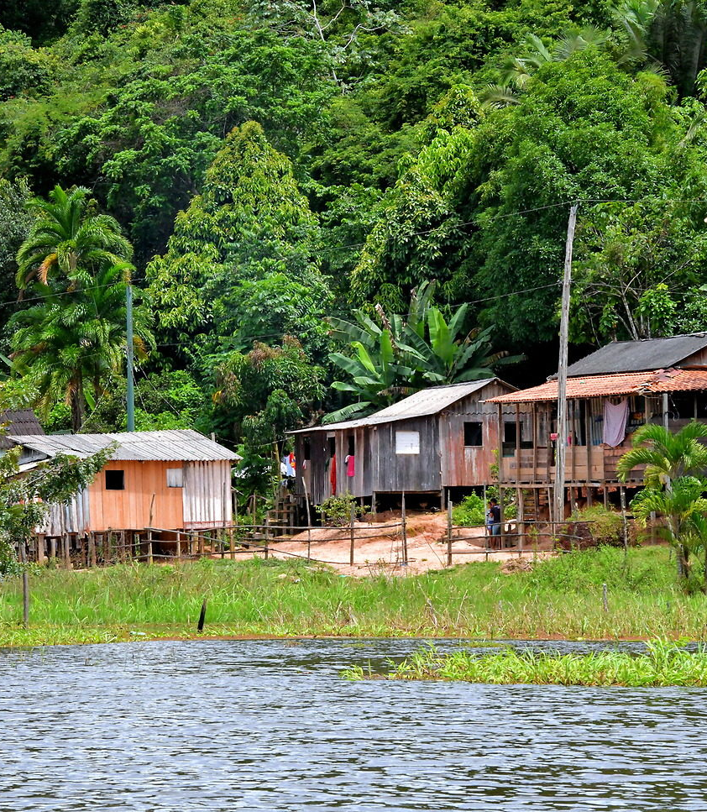
Weather in Boca da Valeria, Brazil
After spending a few hours in Boca da Valeria, you will understand why locals hope for any breeze through an open window to cool them off.
The temperature is hot all year. The lows are in the mid-70s°F. The highs are in the upper-80s. From September through December, it is common to reach the mid to upper 90s compounded by high relative humidity. In short, the heat index measures sweltering!

Slide 9
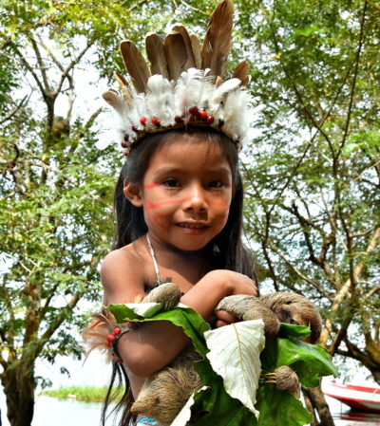
Local Children
When we arrive in Boca da Valeria, you’ll likely be flanked by colorfully dressed children who will escort you around the area for the promise of a dollar.
Don’t expect to find a five-star restaurant or even a gift shop, you will discover a charming stop and a great opportunity to take plenty of photos.
The weather can be very hot and humid – it is the jungle, after all – so dress accordingly, and perhaps keep a small umbrella on hand. Listed below are a handful of our favorite experiences while cruising to Boca da Valeria, Brazil:

Slide 10
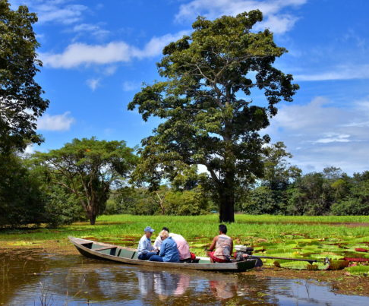
Boca da Valeria, Brazil Transportation
An absolute must-do while visiting Boca da Valeria is touring the Valeria River. This is an inexpensive pleasure. Depending upon the operator, five USD will get you a 30 to 60-minute ride.
The types of watercraft vary from a canoe to a canopied rowboat. They are all powered by a tiny motor. The six-foot driveshaft with a propeller at the end is capable of swiveling 180 degrees. This is perfect for navigating the confined, often weed-choked backwaters.

Slide 11
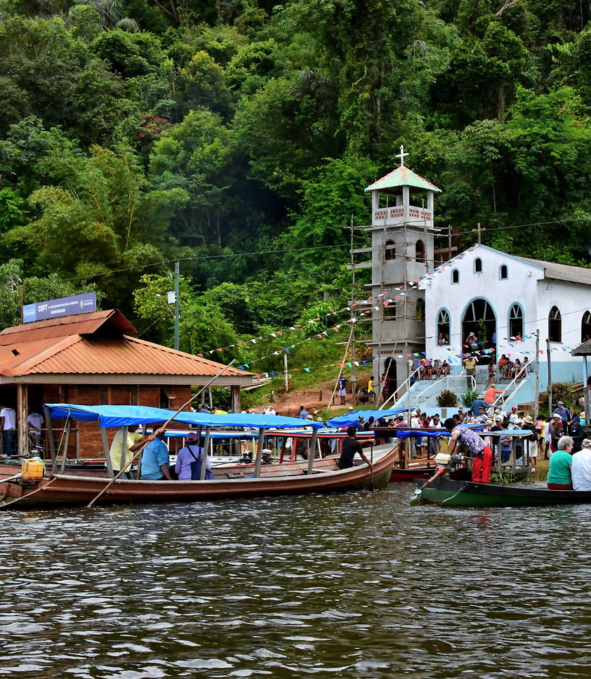
Village Church
The village church is visible from the shore. Small and white, its interior is simple: plastic chairs in place of pews, with a colorful altar in front.
The village’s lone school is next door – although instead of attending classes, the children are more likely to offer to have their pictures taken with visitors for money.

Slide 12
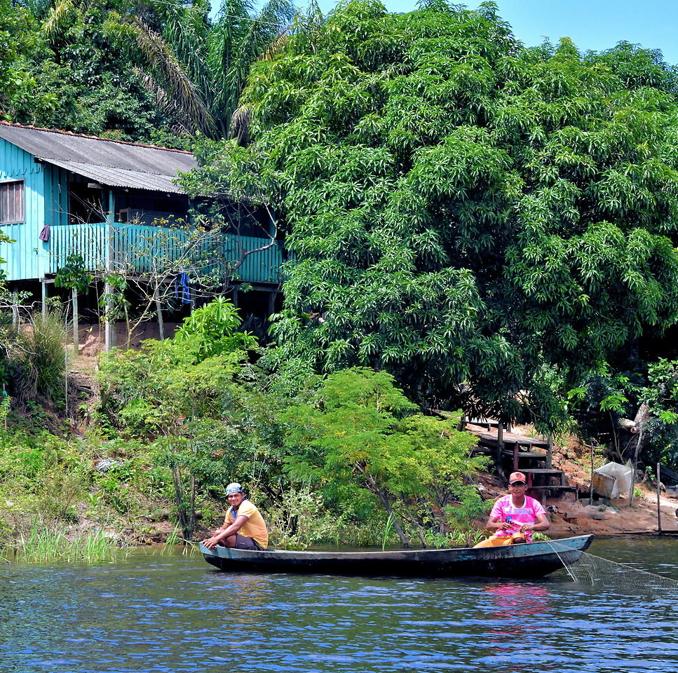
Fishing in Boca da Valeria, Brazil
There are about 3,000 species of fish endemic to the Amazon River and its tributaries.
About 40% are catfish or characidae. Others include sharks, stingrays, eels, and the piranhas.
The locals are carrying on the tradition of fishing with a net. Their ancestors were hunters, gatherers, and fishermen.
The primary food source of native Brazilians has always been farming one or two gardens.

Slide 13
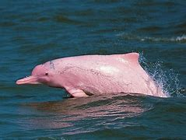
Pink River Dolphins
Keep an eye out for the Amazon River dolphins, also called Boto or pink river dolphins. They inhabit this part of the Amazon; averaging about 8 feet and several hundred pounds, they missing the typical dorsal fin that’s associated with the bottlenose dolphin, so you’ll have to be on high alert to spot one.

Slide 14
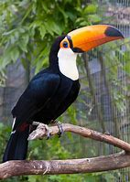
Toco Toucan
The toco toucan is the largest species of toucan and has a distinctive appearance, with a black body, a white throat, chest and upper tail coverts, and red under tail coverts. Its most conspicuous feature is its massive beak, which is yellow-orange with a black base and a large spot on the tip. It is endemic to South America.
Toco toucans mainly feed on fleshy fruits but also supplement their diets with insects, eggs, and nestlings of other birds. They will eat any available sugar-rich fruits, and show a high level of variation in their diet depending on the surrounding habitat.
There are over 40 species living in a range from southern Mexico to northern Argentina.

Slide 15
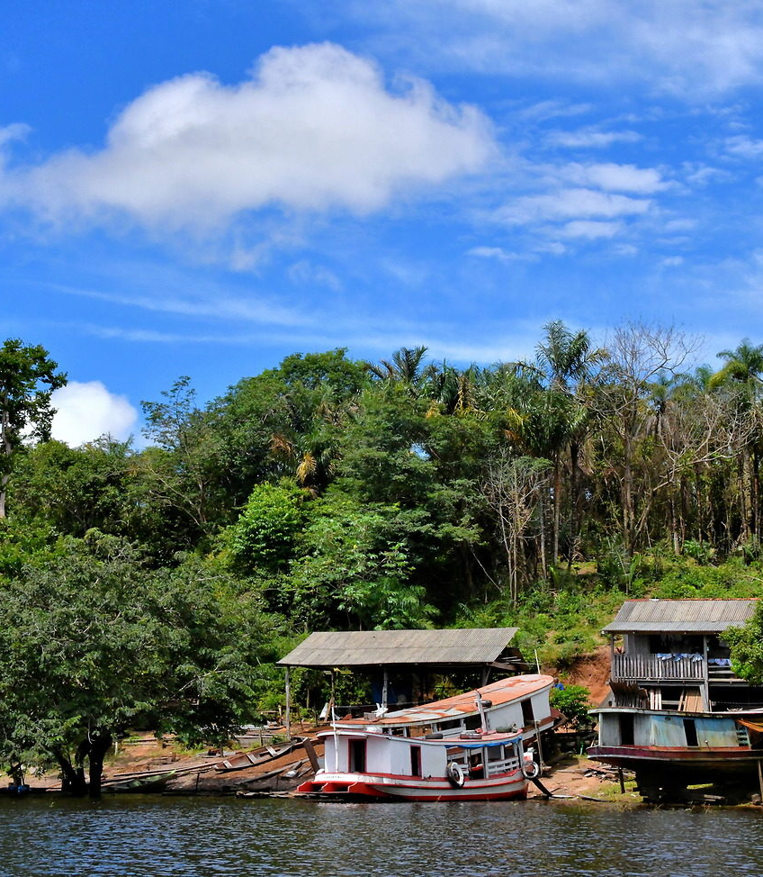
Lakeside Houses
Before the convergence of the Valeria River into the Amazon, there is a cluster of lakes. Many of the homes you will float by are huddled along these shorelines.
The homes are hidden from passing traffic along the Amazon. Yet it is a short distance to navigate to the main river. The freshwater is calm and virtually free of silt. The area is small enough to provide a sense of community yet large enough to enjoy the feeling of isolation.

Slide 16
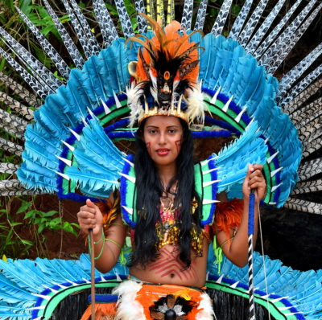
Native Costumes
The young woman proudly displays an elaborate native costume. The bright blue feathers are from hyacinth macaws.
The loin cloth and headdress are adorned by feathers from other macaw species plus parrots and toucans.
The accouterments consist of animal teeth, claws, and nails as well as chiseled stones.
The jewelry was made from forest seeds and berries. The Tupi people were best known for creating such elaborate attire.
This type of apparel was reserved for rituals and celebrations plus pre and post wars. Post-wars

Slide 17
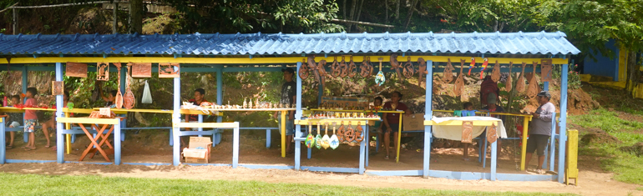
Shopping?
For those looking to spend some money on something other than photos and river tours, the locals have handcrafted items for sale.
Some of their designs are the same as those from 1,000 years ago and range from beads and jewelry to larger wood carvings and mahogany pictures.
Believe me, nothing is made in China here.

Slide 18
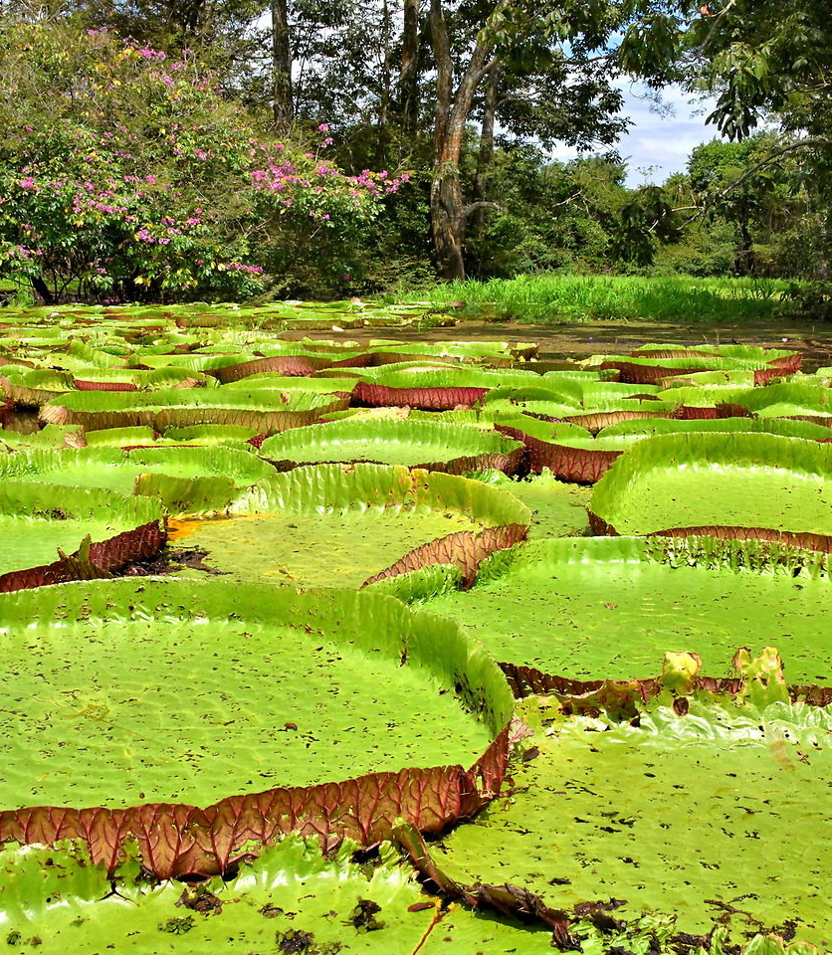
Water Lilies in Boca da Valeria, Brazil
Victoria Amazonica is a visual high point of the Amazon River. This is the world’s largest water lily.
The huge circular leaves can span ten feet. Below the waterline is a submerged stalk reaching 23 to 26 feet long. The blooming of the lily is a fleeting, 48-hour event. On the first day, the flower is white and female. Their scent attracts beetles for pollination. After closing for the evening, it reopens the next morning as a pink bloom that is male. When the fertilization is done during the day, the flower closes, wilts and sinks below the water.

Slide 19
Thanks For Coming
If you have any more questions, please ask.
I will do my best to answer them for you.
Have a great visit to Boca da Valeria!

