Slide 1

Bimini
Bahamas
Presented by
Marc Silver

Slide 2
What I Will Cover
My Port Philosophy
Don’t Miss the Ship
Money
About Bimini
Bimini’s History
Area Map of Bimini
Map of Bimini
Getting Around Bimini
Places to see or at least consider
Conclusion

Slide 3
My Port Philosophy
I have been cruising for over 45 years and have taken over 100 cruises.
So, I consider myself an experienced cruiser.
The information I will present is based on those many years of
experience.
When I am on a cruise where the city, I want to visit is not the port city,
I always recommend taking a ship’s tour.
But when I am in a port with multiple attractions nearby and easy to see
on my own - I will do it on my own.
This presentation is not like that.

Slide 4

Don’t Miss the Ship
How to Avoid Missing Your Ship
Pay attention to the time. - Ship time and local time are
often different.
Put a return-to-ship reminder on your phone.
Choose excursions wisely.
If a ship-sponsored excursion is late returning to port, the
ship will wait for you. If you are on your own.
Be Prepared
Have your Passport, Credit Card, and phone numbers for
your ship port agent.
What to Do If You Miss the Ship
Most cruise lines have port agents stationed in the port area to assist if your ship has left without you. If your are lucky, when cruisers are late returning to the vessel, the ship’s crew will often remove the passengers’ essential items – passports, cell phones, and medication -- from the ship to leave with the port agents.
The Port Officials can help you with contacting your ship
and making necessary travel arrangements.

Slide 5
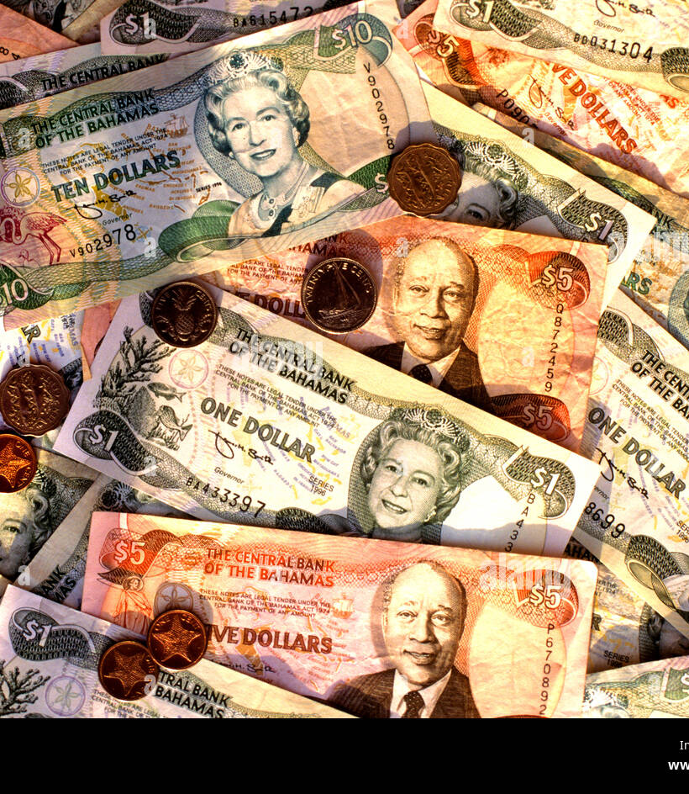
Bahamian Money
1.00 US Dollar = 1.00 Bahamian Dollar
The official currency of the Bahamas is the Bahamian dollar since the year 1966.
The currency is issued and managed by the Central Bank of The Bahamas and is divided into 100 cents.
Bank notes are available 50, 20,10,5, and $1. Coins are available in 25, 10, and 5-cent pieces.
The symbol is B$.

Slide 6
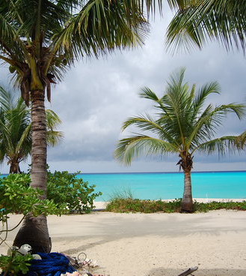
About Bimini
Bimini is the westernmost district of the Bahamas and comprises a chain of islands located about 50 mi due east of Miami.
Bimini is the closest point in the Bahamas to the mainland United States and approximately 130 mi west-northwest of Nassau. The population is 2,417 as of the 2022 census.

Slide 7
Bimini’s History
The first inhabitants on the island were the Lucayans, and the name Bimini means "two islands" in the Lucayan language.
The Bimini Road, sometimes called the Bimini Wall, is an underwater rock formation near North Bimini island in the Bahamas. The Road consists of a 0.8 km (0.50 mi)-long northeast-southwest linear feature composed of roughly rectangular limestone blocks. Various claims have been made for this feature being either a wall, road, pier, breakwater, or other man-made structure. However, credible evidence or arguments are lacking for such an origin.

Slide 8
Bimini’s History
During the period of Prohibition in the United States, Bimini was a favorite haven and supply point for the rum-running trade. Some claim that the term "the real McCoy" was applied to the rum provided by William S. McCoy, who used Bimini to transport whiskey to America during Prohibition, although the phrase pre-dates the Prohibition Era – it is first recorded in the US in 1908.
Chalk's International Airlines operated seaplane flights between Miami Harbor and the Bahamas from 1917, so the company was an island institution for generations. As goods on the island were expensive because of shipping costs, many locals used Chalk's flights to buy cheaper goods in Florida and take the goods to Bimini.

Slide 9
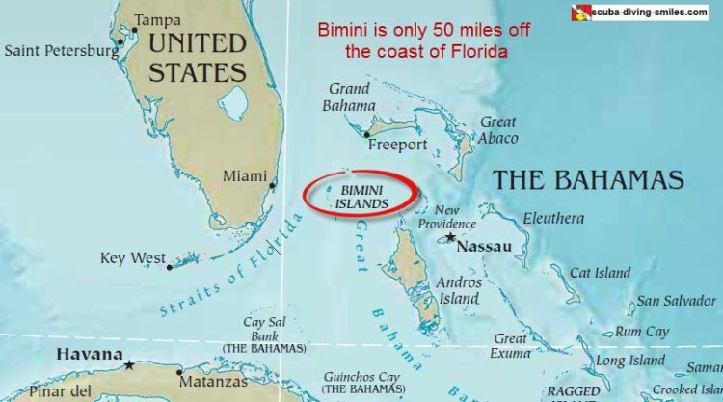

Slide 10
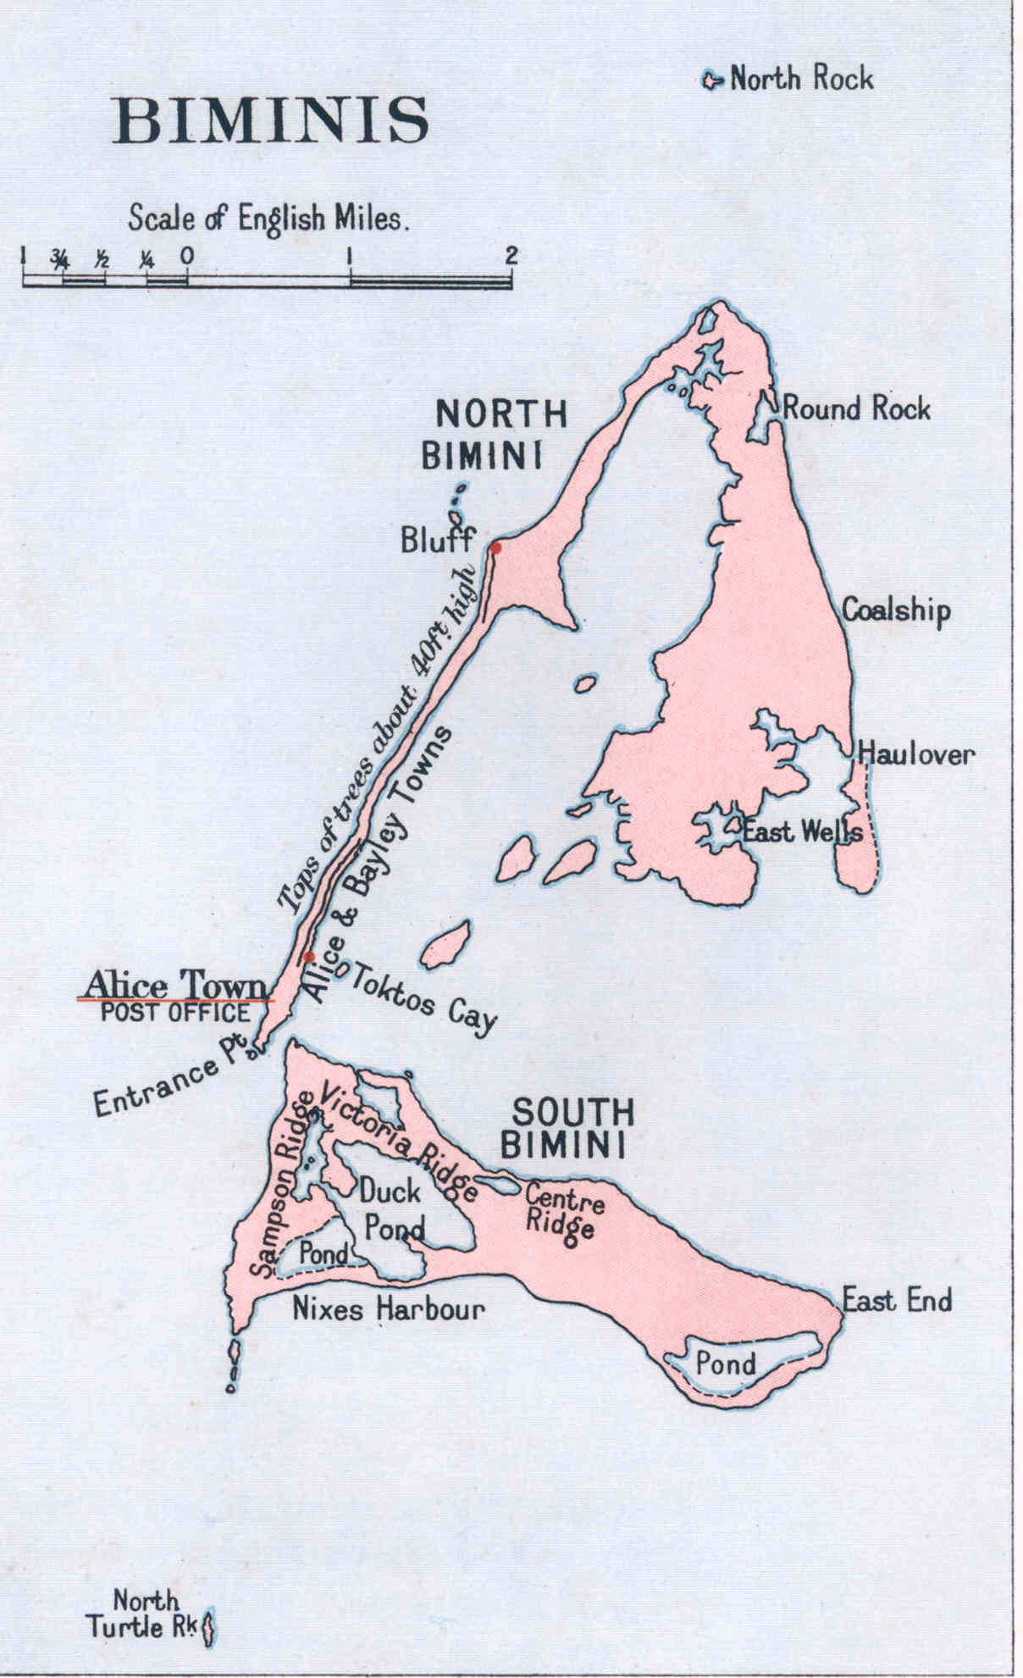
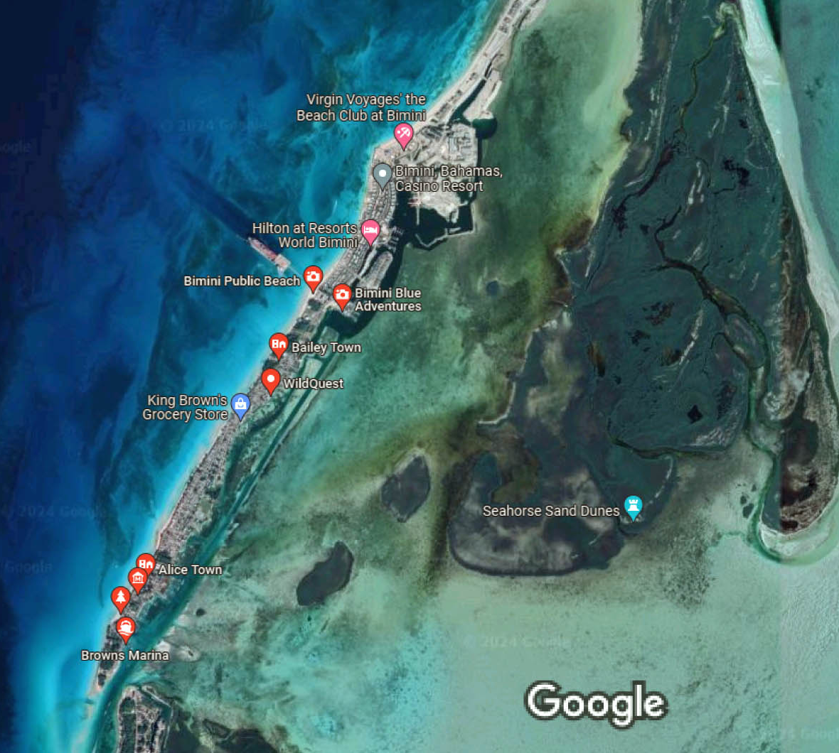

Slide 11
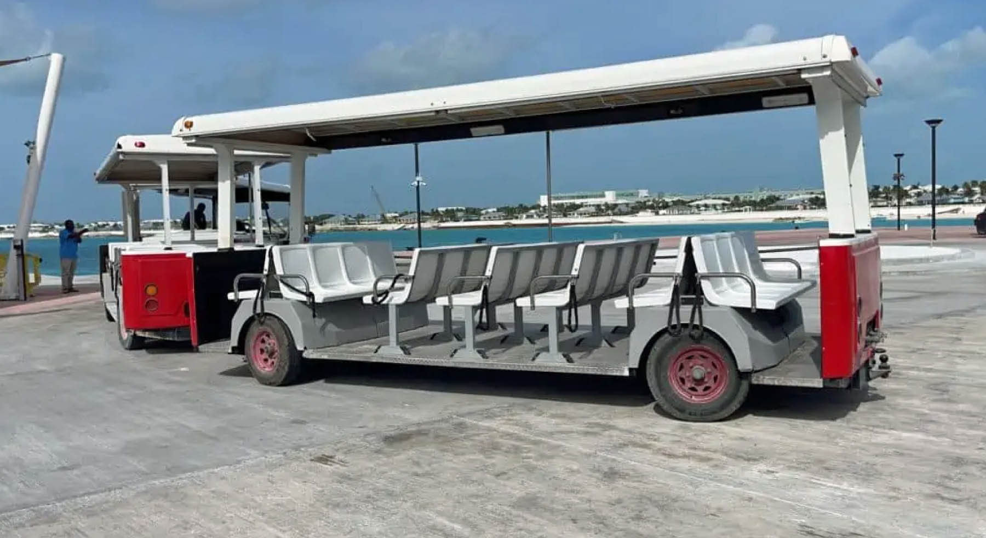
Getting Around Bimini
Our ship will dock at the pier, and you’ll be able to walk right into the port. It is a flat and wide pier, with plenty of room for all passengers.
At the end of the pier, you’ll come to a parking lot that acts as a pickup station for the island tram, which is run by Resorts World. The tram is free and will take you to most of the Resorts World properties and activities.
You could also walk across the bridge into town for direct access to Kayak Beach, Fisherman’s Village, golf cart rentals, and taxis
The Bimini Shuttle Bus is a great way to get
around the island and to get to Bimini. The bus
runs every hour on hour from 7 am to 7 pm and
costs $1 per person. The bus can take you
anywhere on the island that you want to go.

Slide 12
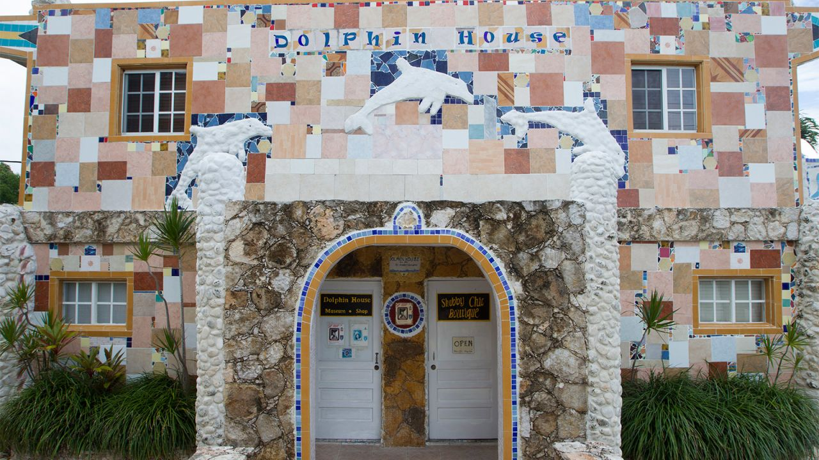
Dolphin House Museum
A Bahamian national treasure and landmark, established in 1993 and still under construction to complete the third floor, the Dolphin House Museum is a dolphin and ocean-inspired museum built over the last 27 years using recycled, salvaged, and donated materials by award-winning Bahamian author, historian and retired teacher Ashley Saunders.
A popular attraction visited daily (Mon-Sat 10 am-6 pm) also offers a novel gift shop for souvenir purchases. Visitors to Dolphin House can enjoy daily walking tours conducted by Mr. Saunders, who has written two history books on the Bimini islands in the Bahamas he was born and raised.

Slide 13
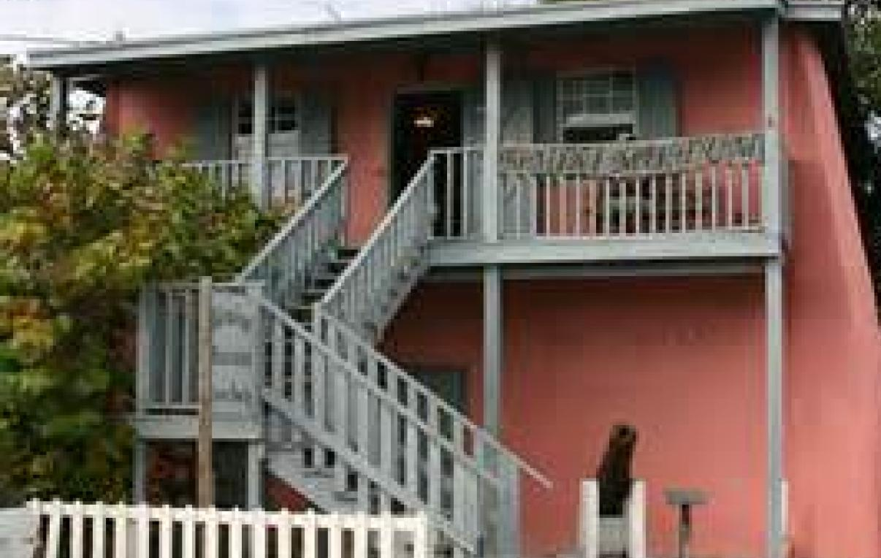
Located across from the Bimini Craft Center, the museum was started by the Bimini Historical Society to preserve the history of the island.
There are pictures, stories, artifacts, and relics that commemorate those who contributed to the development of Bimini, in addition to memorabilia of Bimini’s most famous former resident, Ernest Hemingway.
Bimini Museum
The building housing the Bimini Museum was built in 1921 as the Commissioner's Office and jail, but it was abandoned in 1974. In 1999, it was restored and now contains historical artifacts, such as old cannon balls, photographs of Ernest Hemingway, and artifacts from the old Rod & Gun Club.
Admission: Free.

Slide 14
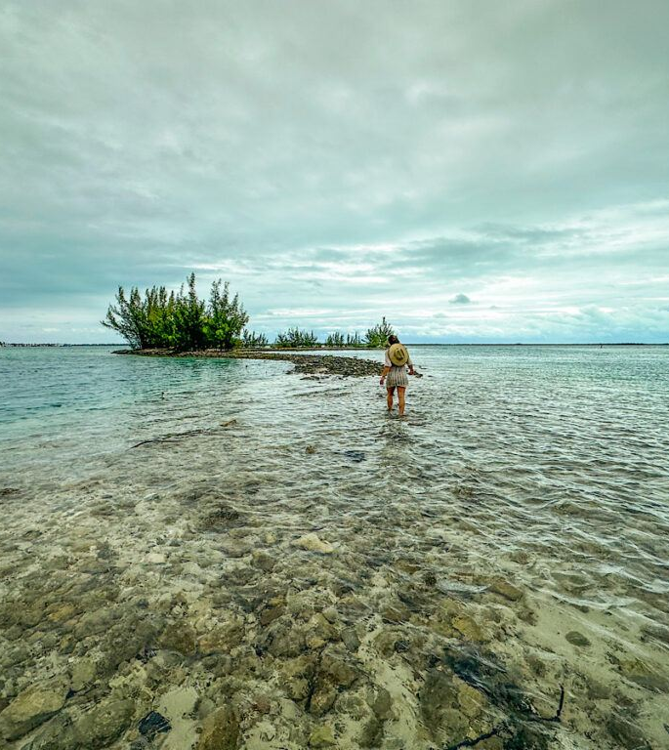
Walk the Spit at low-tide
Heading north, you’ll stumble upon a little trail on the right-hand side, just as you reach the piney part of North Bimini. That leads to a rock path that is about ankle-deep at low tide. You can take that path to a small island, where the trail zigzags to the end and pops you right in the middle of one of Bimini’s major coves.
It is a neat place to watch the seaplanes come in and look back at the rest of the island.

Slide 15
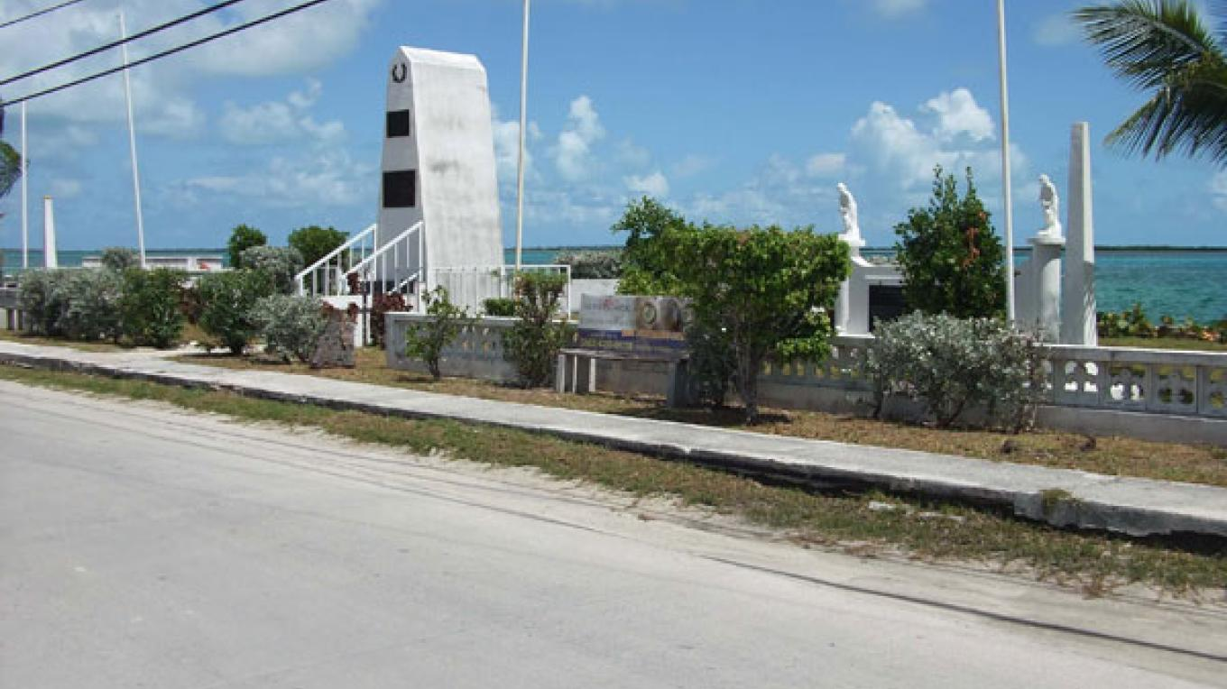
Heroes Park
The Park honors Bimini's veterans of World Wars I & II, numerous leaders of the community, and sports figures. It features plaques inscribed with the names of the deceased, including a portion dedicated to victims of the Chalk's Flight 101 crash in December 2005.
Located off King’s Highway
(Bimini’s only main road), it’s
a good place to rest and take
in the view.

Slide 16
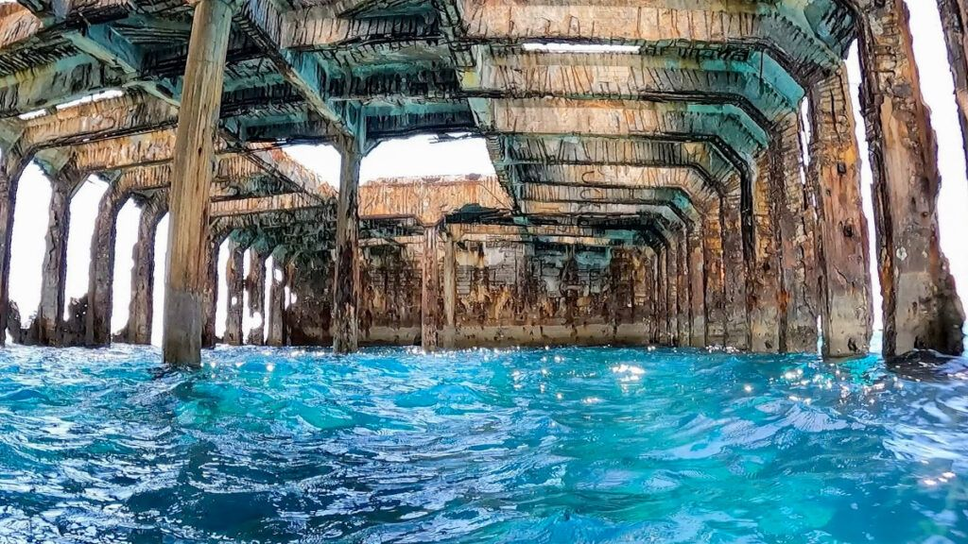
Snorkel
Snorkel the SS Sapona/ A 282-foot steamship made out of concrete, it carried cargo until it sank in 15 feet of water in a 1926 hurricane. Because the area is so shallow, it’s a popular snorkeling spot. Part of the wreck is below the water and the rest is above.
Snorkel Bimini Road
. While swimming above the “road,” it did really look like some sort of infrastructure from a past civilization. The shape of the stones and the way they were arranged, side by side, was too intentional to be a work of Mother Nature. Keep in mind that there is a lot of open water here, and it is about twenty feet deep. You can book an excursion here.
Snorkel the arch. There are three rocks off the coast of North Bimini with some pretty wildlife and unique structures. Go when the water is calm because the rocks are jagged. The biggest rock is the one that has the arch. If you don’t have your own boat, you can get here via the Bimini Road excursion.

Slide 17
Conclusion
Bimini is a beautiful island with a rich history and great snorkeling. Regardless of what you're looking for, Bimini has something for everyone.
I hope this presentation will help when we visit Bimini!

Slide 18
Thanks For Coming
If you have any more questions, please ask.
I will do my best to answer them for you.
Have a great visit in Bimini!

