Slide 1

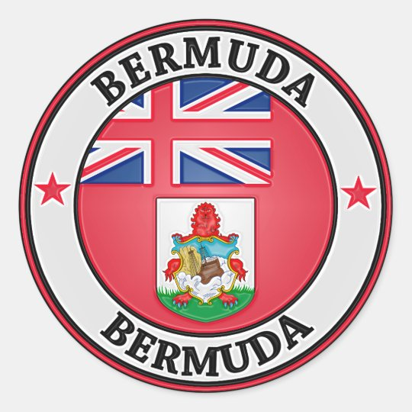
Bermuda is a Great Place to Visit Port Presentation Presented by Marc Silver.

Slide 2
What I Will Cover
My Port Philosophy
Money
Don’t Miss the Ship
Points of Interest
Places to see or at least consider
A few interesting facts about Bermuda
Best way to get around Bermuda
Fun Facts about Bermuda
Conclusion

Slide 3
My Port Philosophy
I have been cruising for over 45 years and have taken over 100 cruises. So, I consider myself an experienced cruiser.
When I am on a cruise where the city I want to visit is not the port city, I always recommend taking a ship’s tour.
When I am in a port new to me or just easy to see on my own - I will.
This presention is for this type of port.

Slide 4
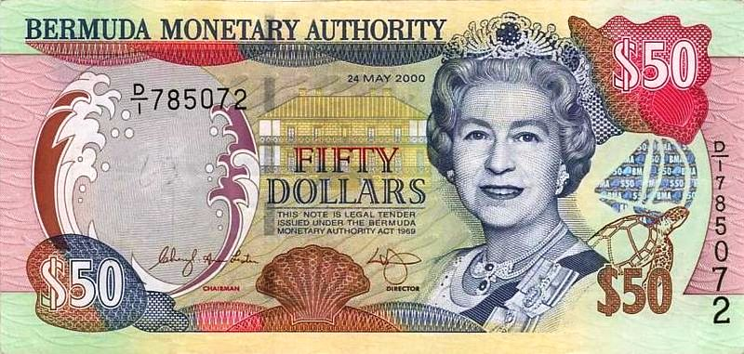
Money
There is no corporate income tax, making it a popular tax haven for the ultra wealthy.
Bermuda has its own currency but US currency is accepted everywhere on the island. Exchange is $1 to $1 US

Slide 5
Don’t Miss the Ship
How to Avoid Missing Your Ship:
Pay attention to the time. - Ship time and local time are often different.
Put a return-to-ship reminder on your phone.
Choose excursions wisely:
If a ship-sponsored excursion is late returning to port, the ship will wait, but not for excursions taken on your own.
Be Prepared:
Have your Passport, Credit Card, and phone numbers for the ship port agent.
What to Do If You Miss the Ship: Most cruise lines have port agents stationed in the port area to assist if your ship has left without you. Sometimes, when cruisers are late returning to the vessel, the ship's crew may remove the passengers' essential items -- passports, cell phones, and medication -- from the ship to leave with the port agents.
The Port Officials can help you with contacting your ship and making necessary travel arrangements.

Slide 6
Bermuda Points of Interest
Bermuda is a beautiful island nation located in the North Atlantic Ocean. It is famous for its stunning pink sand beaches, turquoise waters, and charming colonial architecture. If you're planning a trip to Bermuda, here are some of the best places to visit and why they're worth your time.

Slide 7
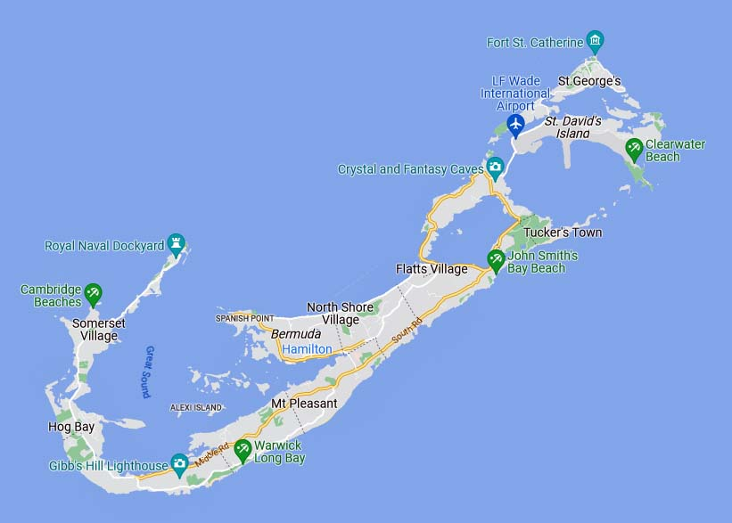
Bermuda Points of Interest

Slide 8
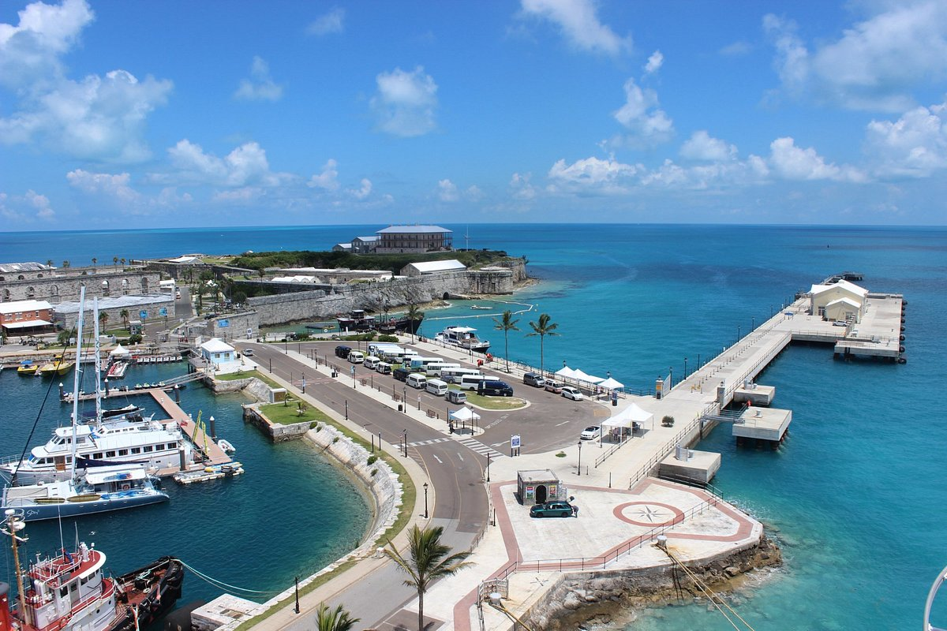
Royal Naval Dockyard
The Royal Naval Dockyard is a historic site that was once used by the British Navy. Today, it has been transformed into a tourist attraction with shops, restaurants, and museums. This is also where we dock.

Slide 9
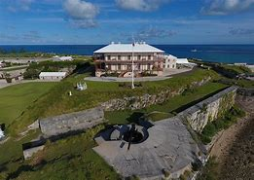
Museum of Bermuda
The Museum is housed in Bermuda’s largest fort, the Keep, at the Royal Navy Dockyard. The Keep’s massive ramparts and bastions enclose eight Grade I listed buildings, including the hilltop Commissioner’s House.
Admission Rates: Adults $18, Seniors over 65 $15, Under 16 FREE

Slide 10
Museum of Bermuda
The Museum is housed in Bermuda’s largest fort, the Keep, at the Royal Navy Dockyard. The Keep’s massive ramparts and bastions enclose eight Grade I listed buildings, including the hilltop Commissioner’s House.
The 16-acre Museum property also extends to the fortifications adjoining the Keep and includes Casemates Barracks, which dominates the Dockyard skyline.
Admission Rates: Adults $18, Seniors over 65 $15, Under 16 FREE

Slide 11
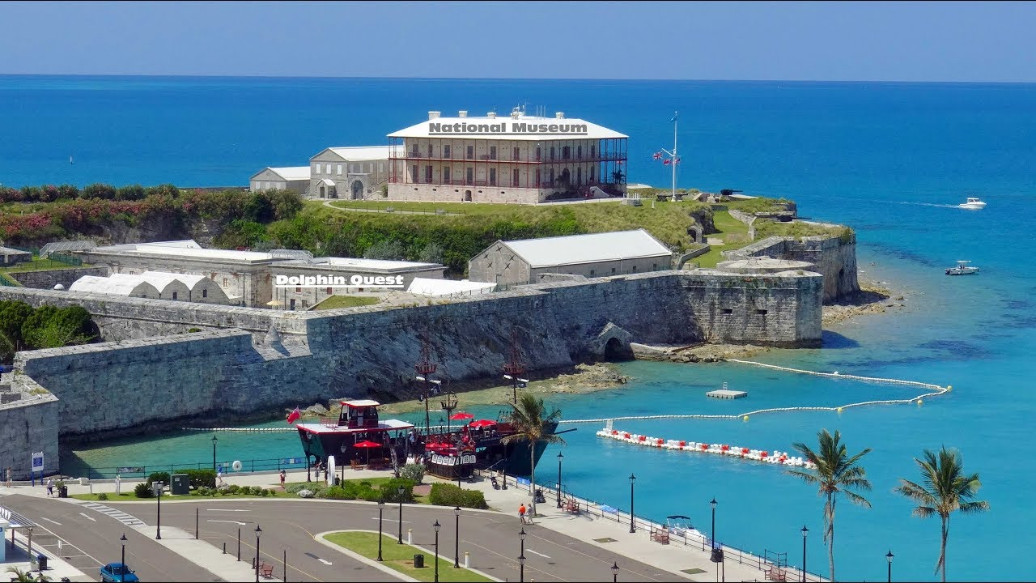
Museum of Bermuda
Admission Rates: Adults $18, Seniors over 65 $15, Under 16 FREE

Slide 12
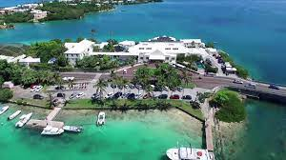
Aquarium, Museum and Zoo
The Bermuda Aquarium, Museum & Zoo is a great place to learn about Bermuda's unique wildlife and marine life. It has over 300 species of animals and is perfect for families with children.
It is located about 26 miles from our dock.
Admission is $100 per adult and $80 for a child.

Slide 13
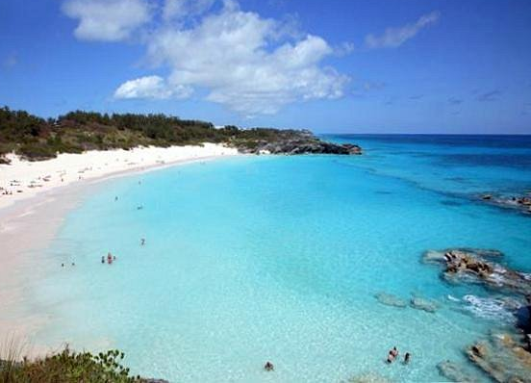
Horsehoe Bay Beach
Horseshoe Bay Beach is undoubtedly one of the most beautiful beaches in the world. Its pink sand, clear water, and rock formations make it a must-visit destination in Bermuda.
It's perfect for sunbathing, swimming, and snorkeling.

Slide 14
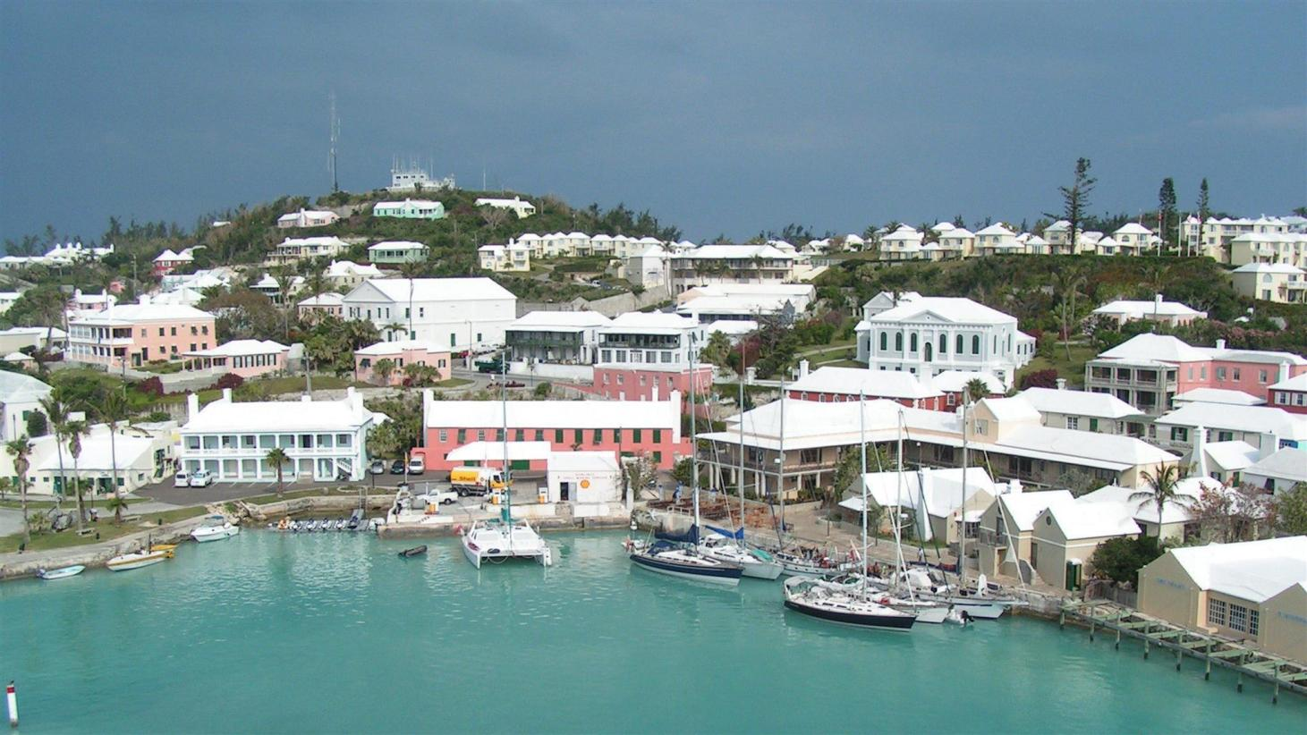
St. George’s
St. George's is a charming historic town located on the northeastern side of Bermuda. It is a UNESCO World Heritage Site and has numerous attractions, such as the Bermuda National Trust Museum, St. Peter's Church, and the Unfinished Church.
St. George holds the honor of being the oldest continuously inhabited town of English origin in the new world.

Slide 15
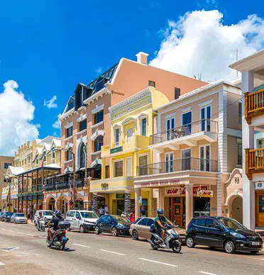
Hamilton
Hamilton is the capital city of Bermuda and is known for its stunning harbor views, shopping, and dining options.
It's a great place to spend a day exploring, taking a stroll around the harbor, and enjoying the local cuisine.

Slide 16
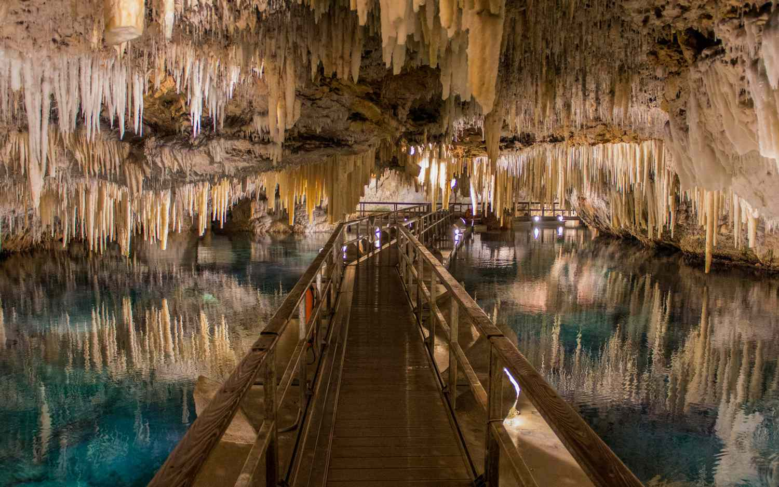
The Crystal Caves
The Crystal Caves are a natural wonder and a must-visit attraction in Bermuda. The caves were formed over millions of years and have stunning crystal formations and underground pools.
Adults: $24 Children (>12): $10

Slide 17
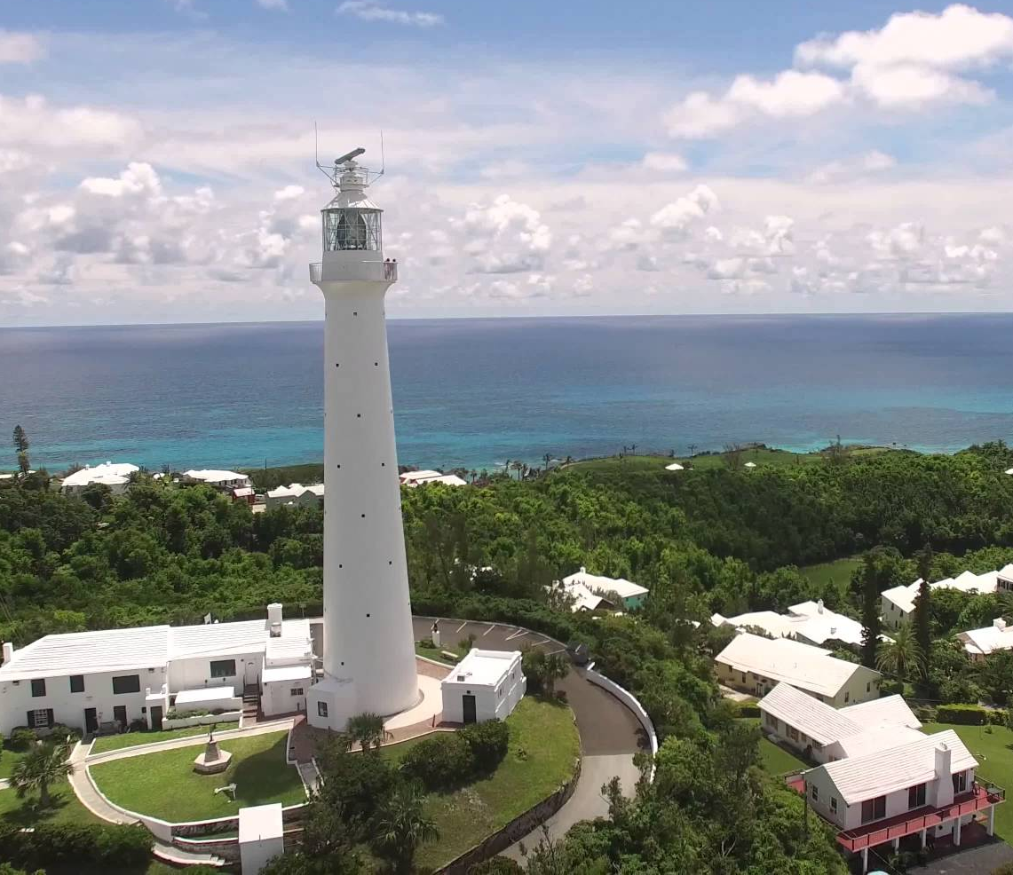
Gibb’s Hill Lighthouse
The Gibb's Hill Lighthouse is one of the oldest cast-iron lighthouses in the world and provides stunning views of Bermuda's coastline. Visitors can climb to the top of the lighthouse for a panoramic view of the island.

Slide 18
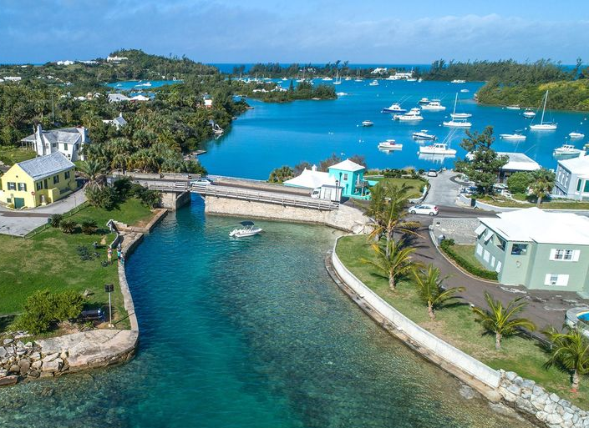
Somerset Bridge
Somerset Bridge is the world's smallest drawbridge and is a unique attraction in Bermuda. It is located in Somerset Village and is a great place to take a photo and enjoy the scenic views.

Slide 19
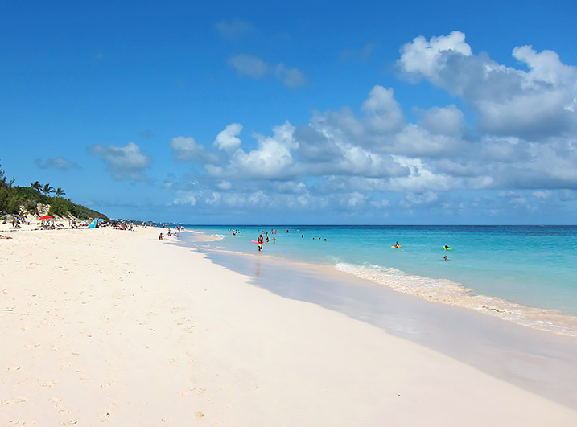
Elbow Beach
Elbow Beach is another stunning beach in Bermuda and is perfect for those who want a more secluded and quiet beach experience.
It has crystal clear waters and is surrounded by lush greenery.

Slide 20
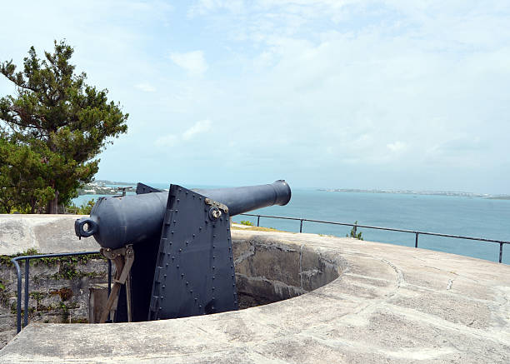
Fort Scaur
Fort Scaur is a historic fort that offers stunning views of Bermuda's coastline.
It was built in the mid-1800s and is now a popular spot for picnics and hiking.

Slide 21
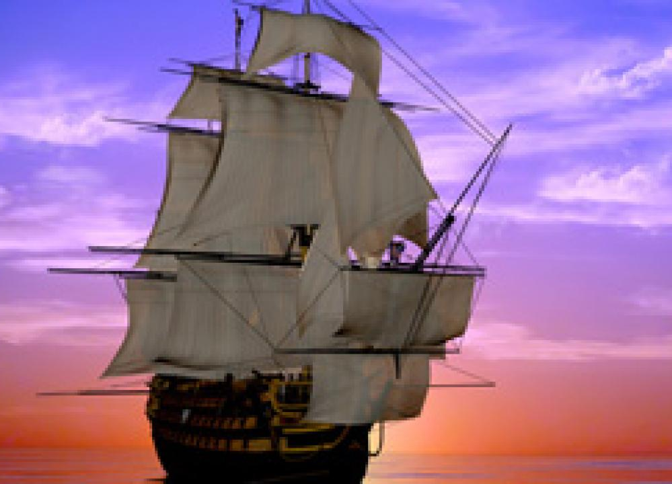
Some Facts about Bermuda
The winters can be chilly due to it's location in the mid Atlantic. It is approximately on the same latitude as Atlanta.
Bermudians are over-the-top friendly. Probably because of the beautiful place they live. It is considered good manners to great everyone you see.
It has a robust history of pirating. Bermuda was a center of privateering for most of its early history, with Bermuda governors Nathaniel Butler and Benjamin Bennett actively encouraging the practice.

Slide 22

Transportation
Public transportation is easy with buses, taxis and ferries. You can rent a electric car and scooters.
That is a Renaut Twizzy!

Slide 23
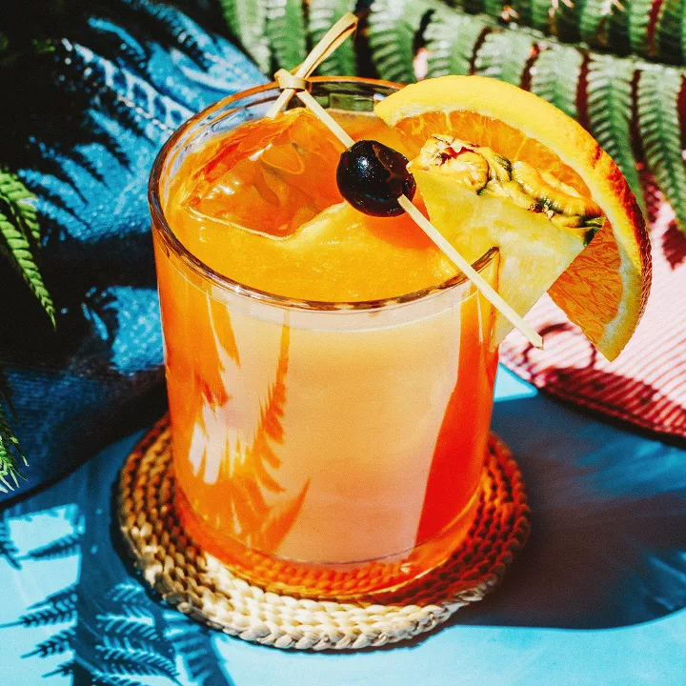
Nation Drink
The rum-based Swizzle, Bermuda’s National Drink
Ingredients:
4 ounces Gosling’s Gold Seal rum 8 ounces orange juice, freshly squeezed 8 ounces pineapple juice 3/4 ounce grenadine 6 dashes Angostura bitters Garnish: cherry Garnish: orange slice Garnish: pineapple wedge

Slide 24
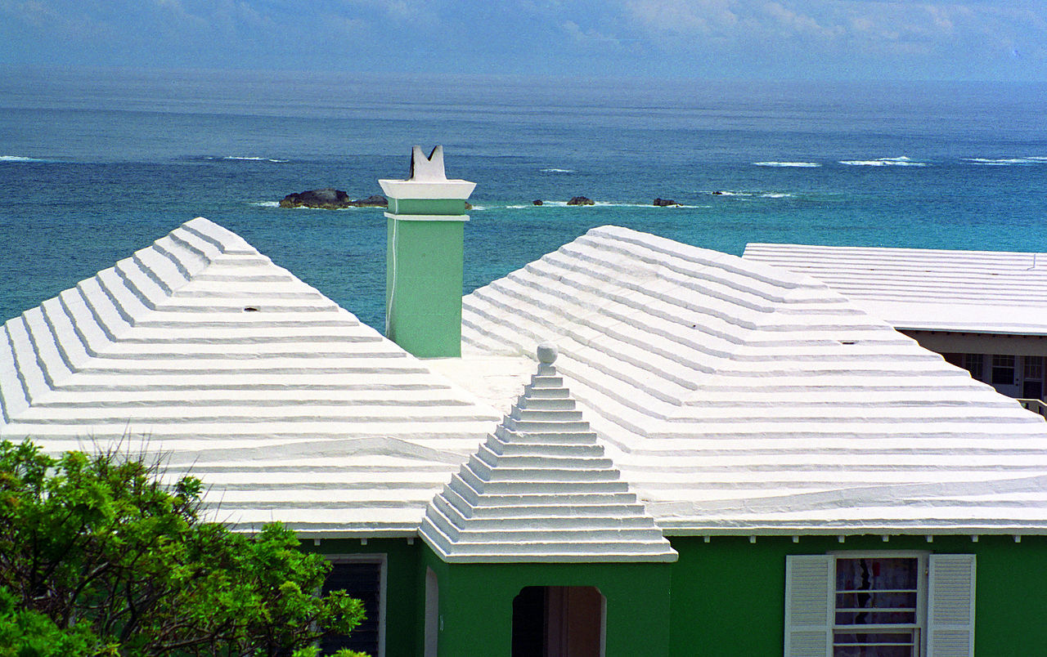
Fun Facts
Rainwater is Bermuda’s only source of fresh water, captured from the roofs of its buildings.
The economy is based on tourism and offshore insurance companies.
Conservative attire attitudes, bikinis are banned more than 25 feet from the water

Slide 25
More than One Island
Bermuda is not just one island but rather a cluster of 138 islands located in the North Atlantic ocean.

Slide 26
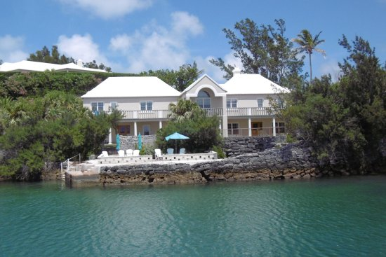
John Lennon’s Vacaton Home
John Lennon had a home
here for many years.

Slide 27
Conclusion
Bermuda is a beautiful island nation with a rich history and numerous attractions. Whether you're looking for stunning beaches, historic sites, or unique attractions, Bermuda has something for everyone.
I hope this presentation will help when we visit Bermuda!

