Slide 1
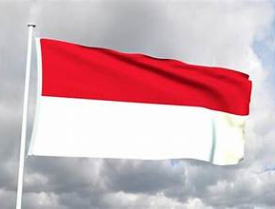
Benoa Indonesia
Presented by
Marc Silver

Slide 2
What I Will Cover
My Port Philosophy
Don’t Miss the Ship
Indonesiaese Money
About Benoa
Maps
Getting Around Benoa
Places to see or at least consider
A few restaurant recommendations
Conclusion

Slide 3
My Port Philosophy
I have been cruising for over 46 years and have taken over 100 cruises.
So, I consider myself an experienced cruiser.
The information I will present is based on those many years of
experience.
When I am on a cruise where the city, I want to visit is not the port city,
I always recommend taking a ship’s tour.
But when I am in a port with multiple attractions nearby and easy to see
on my own -
I will do it on my own.
This presentation is not like that.

Slide 4

Don’t Miss the Ship
How to Avoid Missing Your Ship
Pay attention to the time. - Ship time and local time are often
different.
Put a return-to-ship reminder on your phone.
Choose excursions wisely.
If a ship-sponsored excursion is late returning to port, the ship will
wait for you. If you are on your own???
Be Prepared
Have your Passport, Credit Card, and phone numbers for your ship
port agent.
What to Do If You Miss the Ship
Most cruise lines have port agents stationed in the port area to assist if your ship has left without you. If your are lucky, when cruisers are late returning to the vessel, the ship’s crew will often remove the passengers’ essential items, but it is not guaranteed. – passports, cell phones, and medication -- from the ship to leave with the port agents.
The Port Officials can help you with contacting your ship
and making necessary travel arrangements.

Slide 5
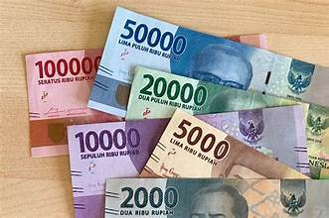
Money
As of January 2026, the exchange rate for USD to IDR is approximately
$1 US dollar = 16,000 to 17,000 IDR.
Don’t be misled, The big numbers don't mean their money is worthless - Indonesia just never 'reset' their
currency.
Think of it like this: their smallest practical bill is
like our $1, it just says 1,000
instead of 1.
Indonesia's inflation is actually
lower than the US right now at
around 3%.
Coins technically exist, but in
practice most transactions use
paper bills.

Slide 6
About Benoa
Welcome to Bali, one of the world’s most famous islands.
Your ship docks at Benoa Harbor, in the south of the island, close to some of Bali’s most popular beaches and resorts.
From here, you can step into a place known for its temples, rice terraces, dances, and traditions that have earned it the nickname the Island of the Gods.

Slide 7
A Port with a Story
Benoa was once a small fishing harbor, but today it serves as the gateway for cruise ships and ferries.
Beyond the port lies Bali’s unique culture, Hindu in a country that is mostly Muslim, and deeply spiritual in its daily rituals.
Bali has long attracted artists, travelers, and seekers, becoming a crossroads of tradition and modern tourism.

Slide 8
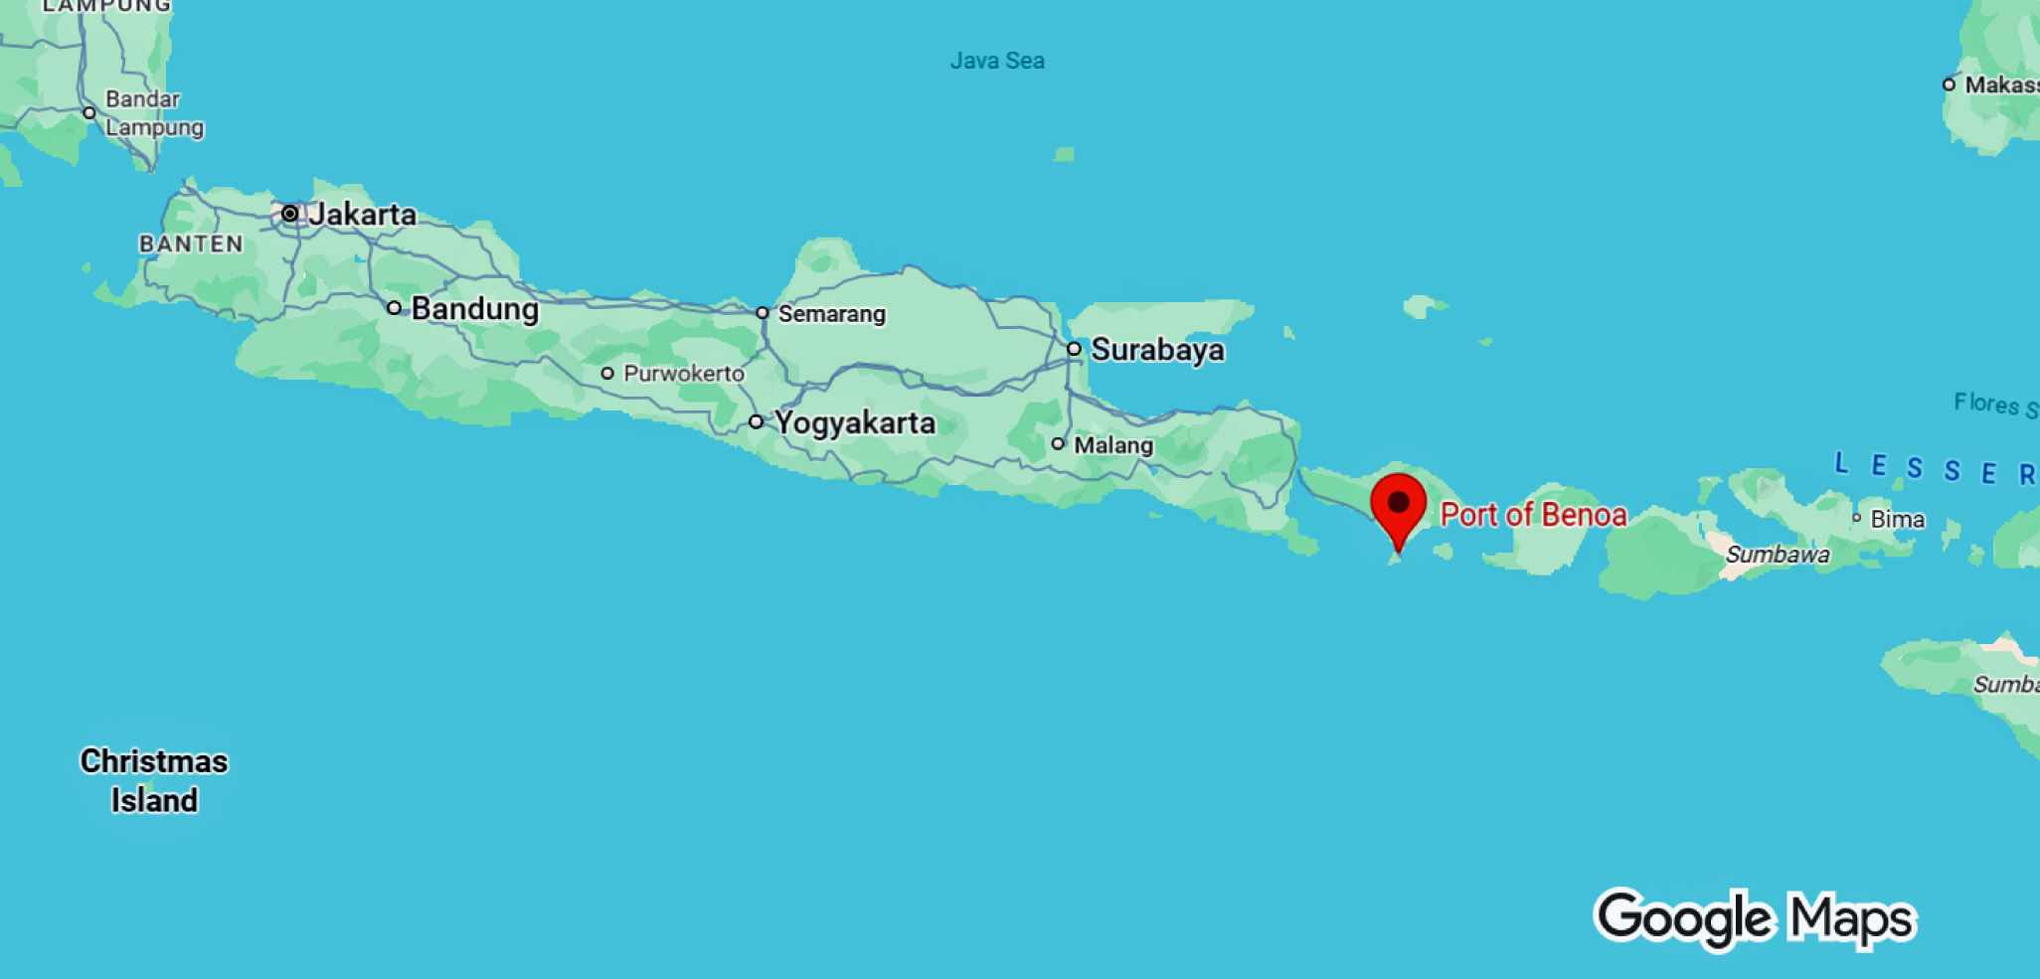
Benoa

Slide 9
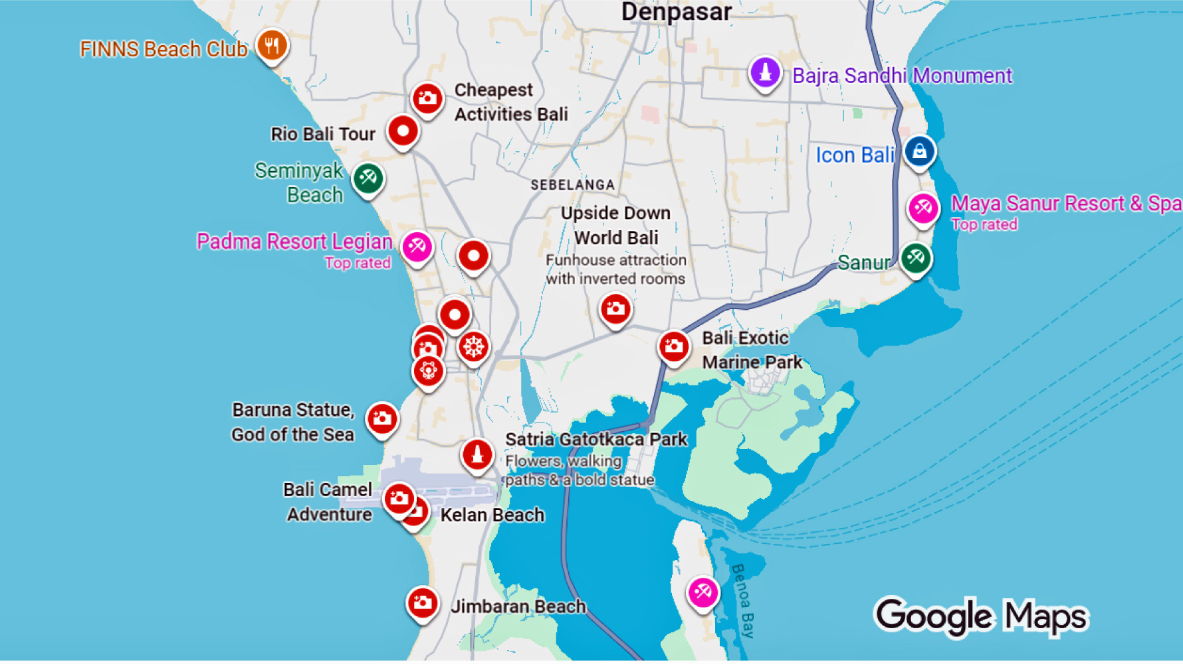
<Cruise Port

Slide 10
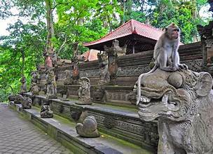
Getting Around
From Benoa, taxis and organized tours are the best way to explore, as attractions are spread across the island.
Traffic can be heavy, so allow time for travel.
Shore excursions typically cover either cultural Bali (Ubud and temples) or beach resorts in the south.

Slide 11
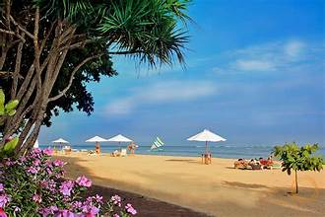
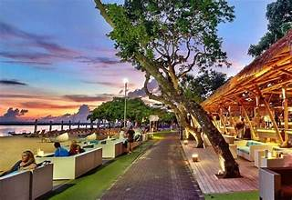
Getting Around
Walking Tour Option
If you’d like to stay nearby, Sanur Beach is a short taxi ride from the port and offers a pleasant seaside walk…”
Start along the beachfront promenade, explore small shops and cafés, and return along the same path for sea views and a relaxed pace.

Slide 12
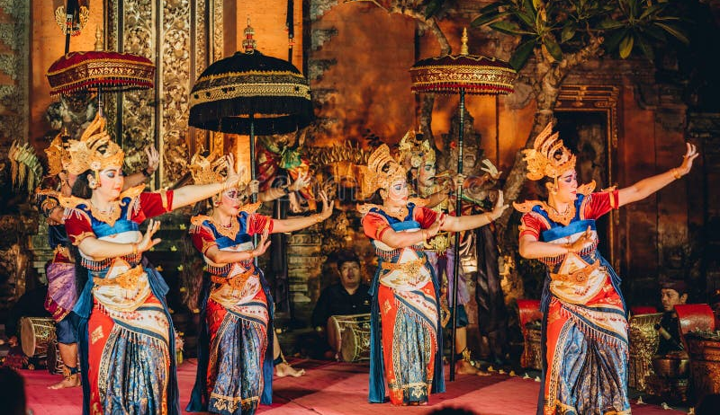
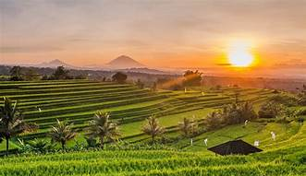
What Benoa is Famous For
Temples: Thousands of them, from coastal Tanah Lot to the towering Mother Temple at Besakih.
Beaches: From lively Kuta to laid-back Sanur and upscale Nusa Dua.
Culture & Dance: Traditional gamelan music, Barong and Legong dances, and daily offerings seen at every doorstep.
Scenery: Rice terraces, volcanoes, and tropical jungles.

Slide 13
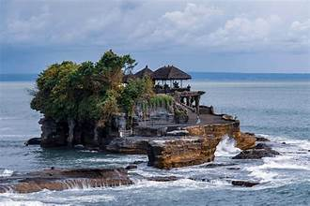
Highlights for Visitors
Tanah Lot Temple: A sea temple perched on a rocky outcrop, especially striking at sunset.

Slide 14
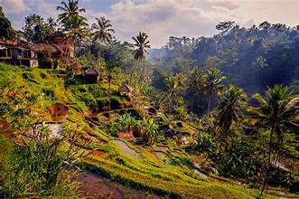
Highlights for Visitors
Ubud: The cultural heart of Bali, known for arts, crafts, and rice terraces.

Slide 15
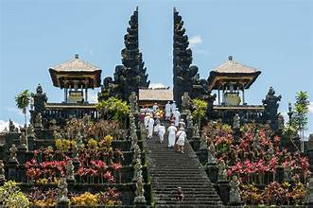
Highlights for Visitors
Besakih Temple: The island’s holiest temple, located on the slopes of Mount Agung.
Besakih is sometimes called the “Mother Temple,” but access can be restricted during ceremonies. Not an error, just a reality worth noting if you want to manage expectations.

Slide 16
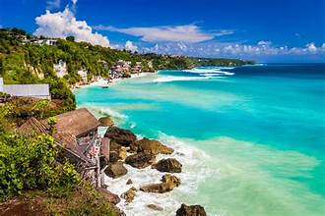
Highlights for Visitors
Kuta & Nusa Dua Beaches: Sun, surf, and shopping at the southern resorts.

Slide 17
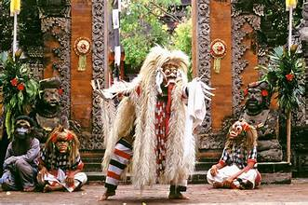
Highlights for Visitors
Barong Dance Performances: Traditional storytelling through dance and costume.

Slide 18
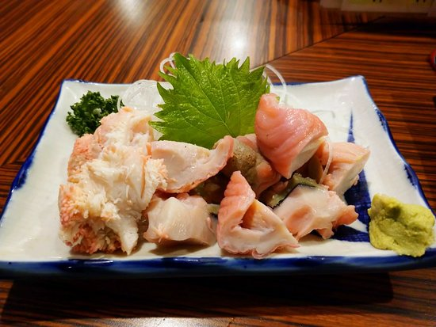
Food and Drink
Balinese cuisine is aromatic and colorful.
Try babi guling (suckling pig), nasi campur (rice with assorted dishes), and satay lilit (minced seafood satay wrapped on sticks).
For dessert, tropical fruits like snake fruit and rambutan abound.
Don’t miss a cup of kopi Bali (Balinese coffee).

Slide 19
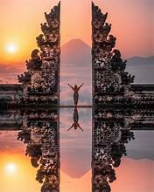
Reflection
Bali is more than just a tropical island, it’s a living culture of rituals, temples, and art layered over breathtaking landscapes.
Whether you’re watching dancers in Ubud, walking barefoot on the beach, or standing before a temple at sunset,
Bali leaves an impression of harmony between the spiritual and the natural.

Slide 20
Thanks For Coming
If you have any more questions, please ask.
I will do my best to answer them for you.
Have a great visit in Benoa!

