Slide 1
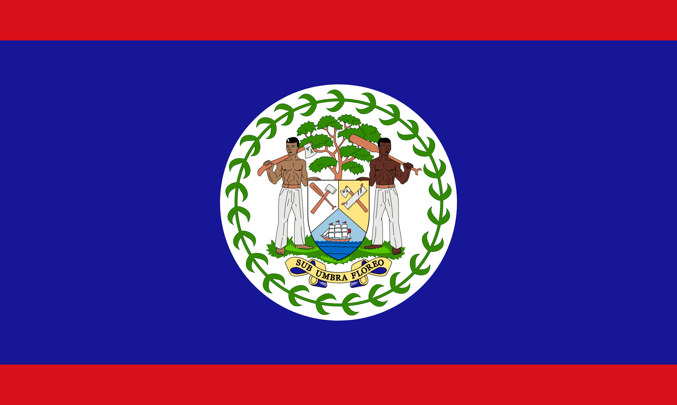
Belize City, Belize
Presented by
Marc Silver

Slide 2
What I Will Cover
My Port Philosophy
Don’t Miss the Ship
Money
About Belize City
History of Belize
Area Map of Belize
Map of Belize City
Belize City Transportation
Places to see or at least consider
A few restaurant recommendations
Conclusion

Slide 3
My Port Philosophy
I have been cruising for over 45 years and have taken over 200 cruises.
So, I consider myself an experienced cruiser.
The information I will present is based on those many years of experience.
When I am on a cruise where the city, I want to visit is not the port city,
I always recommend taking a ship’s tour.
But when I am in a port with multiple attractions nearby and easy to see on my own - I will do it on my own.
This presentation is for that type of port.

Slide 4

Don’t Miss the Ship
How to Avoid Missing Your Ship
Pay attention to the time. - Ship time and local time are often
different.
Put a return-to-ship reminder on your phone.
Choose excursions wisely.
If a ship-sponsored excursion is late returning to port, the ship
will wait for you. If you are on your own???
Be Prepared
Have your Passport, Credit Card, and phone numbers for your
ship port agent.
What to Do If You Miss the Ship
Most cruise lines have port agents stationed in the port area to assist if your ship has left without you. If your are lucky, when cruisers are late returning to the vessel, the ship’s crew will often remove the passengers’ essential items – passports, cell phones, and medication -- from the ship to leave with the port agents.
The Port Officials can help you with contacting your ship
and making necessary travel arrangements.

Slide 5

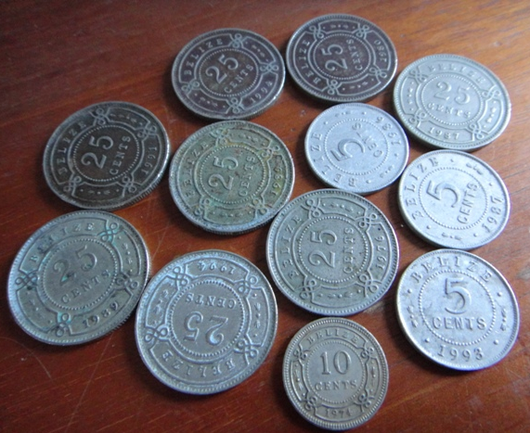
Belize Money
The Belize dollar (BZD)
fixed rate of exchange is BZ. $2.00 to US$1.00.

Slide 6
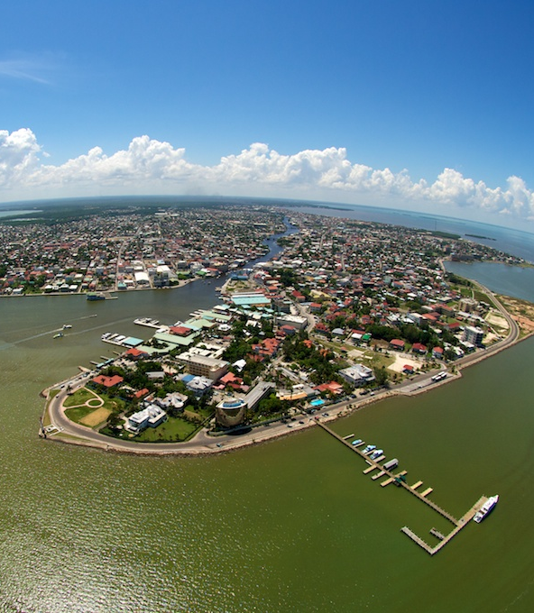
About Belize City
Belize City is the largest city in the country and hosts an eclectic variety of ethnicities from all over the world. Our urban haven is characterized by the perfect balance of industry and natural resources which makes for a beautiful developing city filled with potential and opportunity.
The City has a population of 66,083 residents and is Belize's central port as well as the financial and industrial hub of the country which garners the bulk of our tourism.
The Belize City north side is considered the safest and most prosperous area of the city, with good hotels, casinos, and the Museum of Belize.
As a seaport, the city built itself from the east inwards so most of the older colonial structures are near the coast.

Slide 7
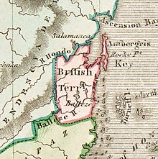
History of Belize
The history of Belize dates back thousands of years. The Maya civilization spread into the area of Belize between 1500 BC to 1200 BC and flourished until about 1000 AD.
Several Maya ruin sites, including Cahal Pech, Caracol, Lamanai, Lubaantun, Altun Ha, and Xunantunich reflect the advanced civilization and much denser population of that period.
The first recorded European incursions in the region were made by Spanish conquistadors and missionaries in the 16th century. Many Mayans remained in Belize when the Europeans arrived in the 16th and 17th centuries. The political geography of that period did not coincide with current boundaries, so several Maya provinces lay across the frontiers of modern Belize.
The earliest reference to African slaves in the British settlement appeared in a 1724 Spanish missionary's account, which stated that the British recently had been importing them from Jamaica, Bermuda, and other Central American British Colonies. Due to Britain’s influence, Belize is the only English-speaking country in Central and South America.

Slide 8
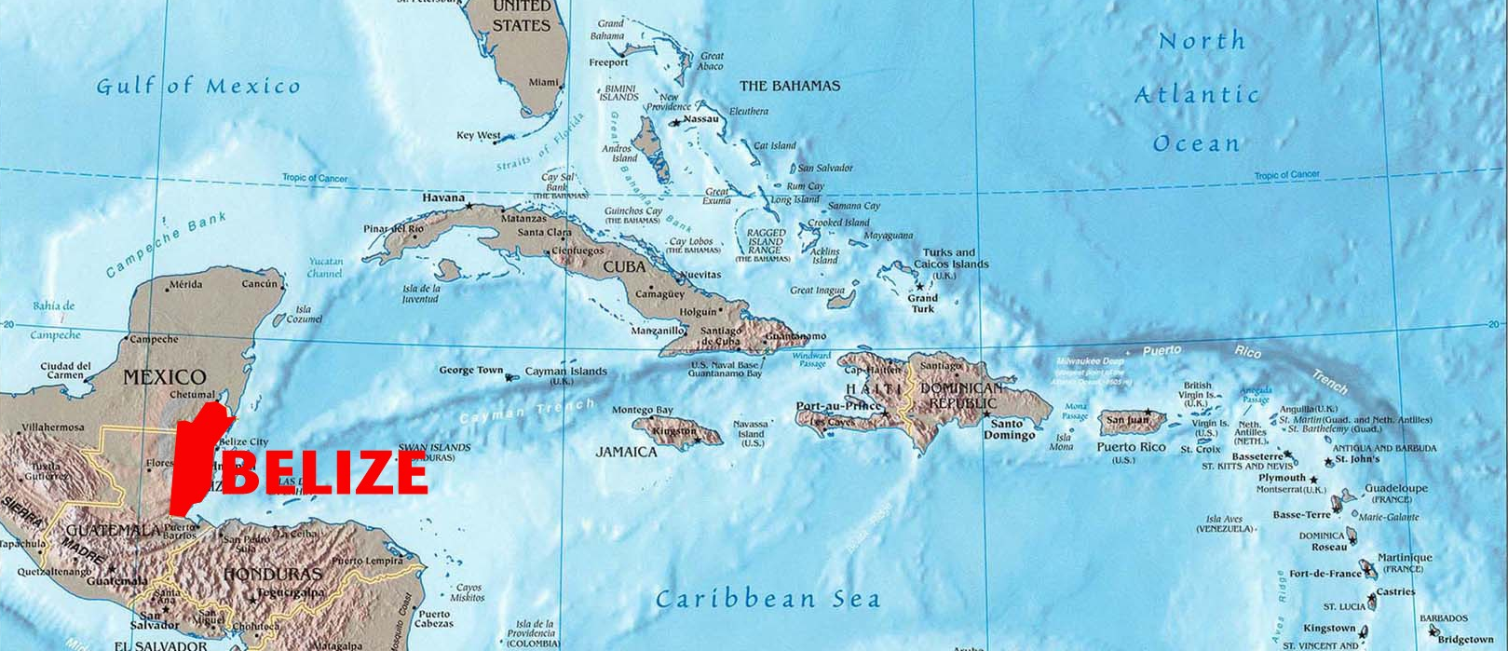
Area Map of Belize

Slide 9
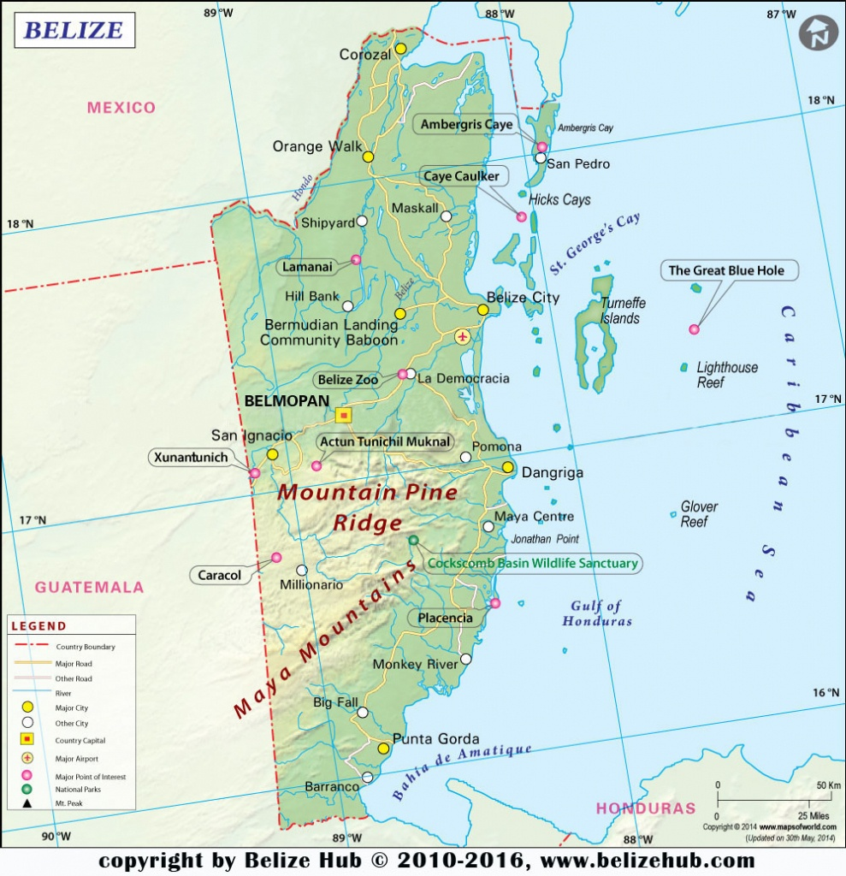
Map of Belize

Slide 10
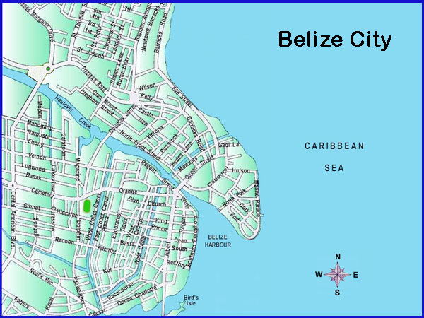
Belize City Map

Slide 11
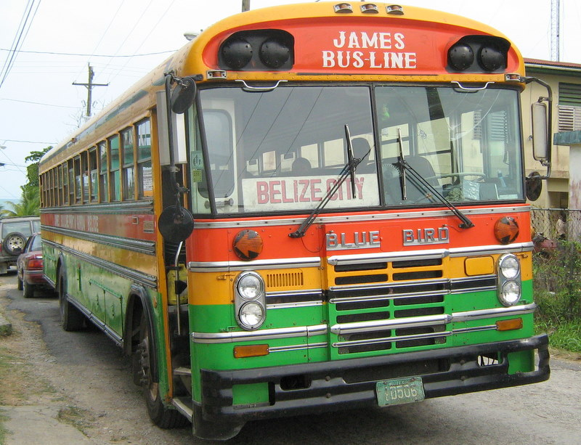
Belize City Buses
Normally I suggest using local buses for getting around, but in Belize, I understand most buses only travel on major highways.
So, for Belize City, I urge you to use your best judgment.

Slide 12
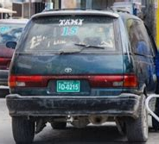
Belize City Taxis
Taxis don’t have meters in Belize, so you’ll need to discuss the fare with your driver before you set off. Regular trips have standard fares, but other journeys will be a matter of negotiation.
Discuss whether you want to pay by the hour, distance, or the number of stops, as all are options. Also, agree with the driver in advance whether you are happy to share the ride. If you do not, the driver may pick up other passengers along the way. Paying a fare does not guarantee a private car.
Tipping taxi drivers for short distances isn’t necessary, but if the driver acts as a guide or provides excellent service, he’ll always be grateful to receive something.

Slide 13
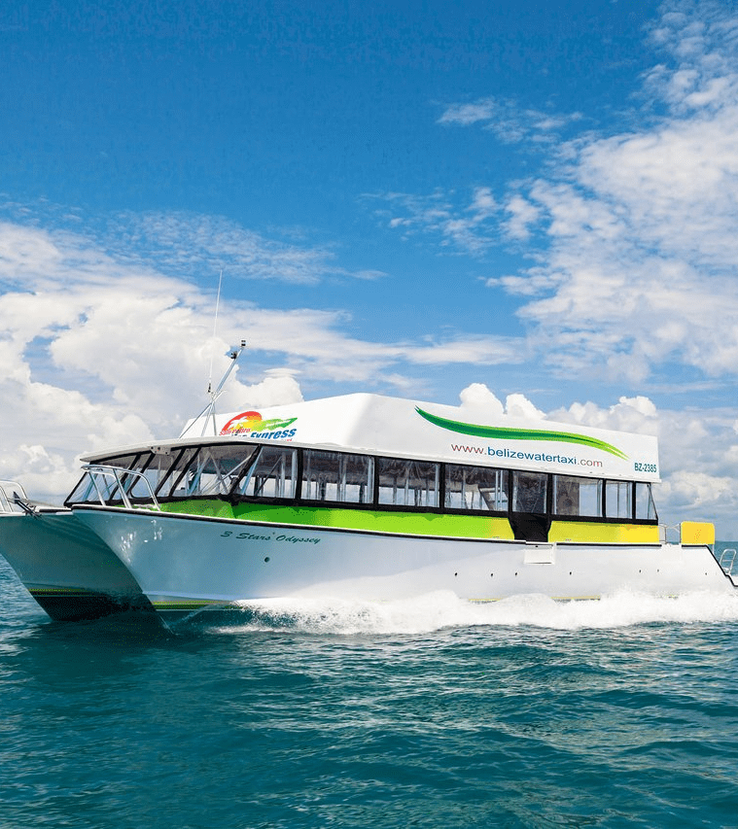
Water Taxi
Water Taxi from Belize City to San Pedro or Caye Caulker
Most travelers visit popular destinations, such as Ambergris Caye and Caye Caulker. The water taxi from Belize City to San Pedro and Caye Caulker is the most economical way to get to the northern islands.
Consider traveling with Belize Express. Their water taxi from Belize City to San Pedro runs 5-6 times a day, starting as early as 6 AM with the last one running at 5:30 PM. The trip is about 1.5 hours each way. The price is approximately $50 USD round trip.

Slide 14
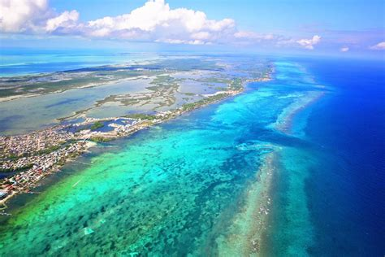
Ambergris Caye
With its plentiful outdoor activities, this 25-mile-long island off the coast of northern Belize caters to the snorkeling and diving set.
Today, Ambergris Caye welcomes thousands of visitors seeking easy access to the barrier reef that surrounds the island. Snorkelers and intrepid divers alike will want to explore Hol Chan Marine Reserve.
Most of the diving and snorkeling shops and instructors are found in San Pedro.
All offer a variety of daily excursions.
Prices vary depending on the type and length of tours, plus any certification fees for diving.

Slide 15
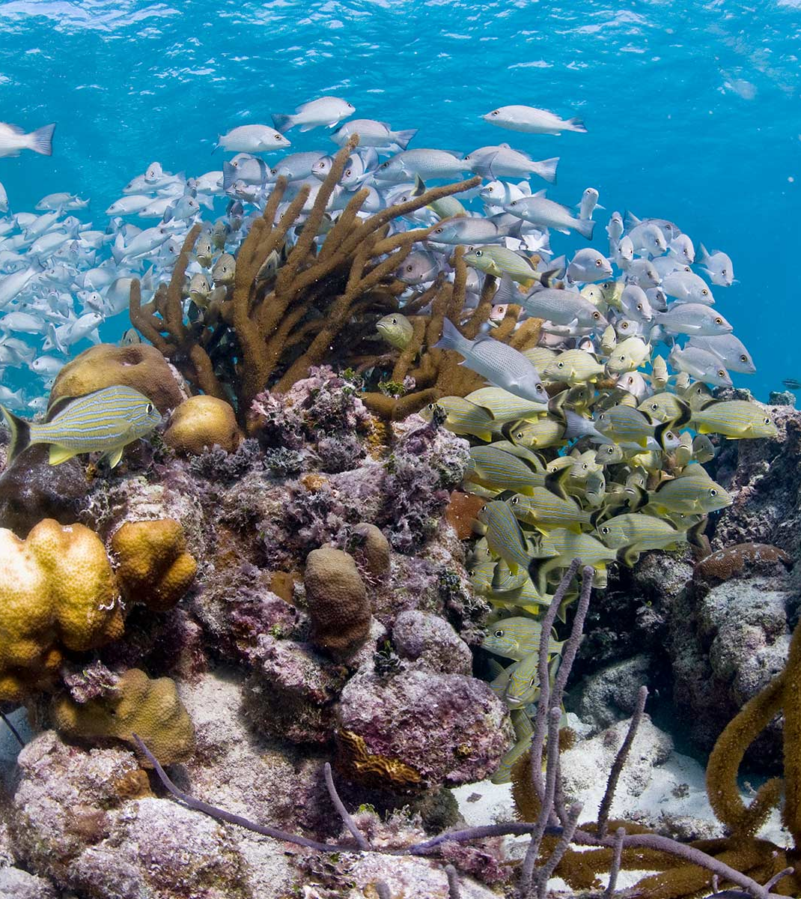
Hol Chan
Marine Reserve
The Hol Chan Marine Reserve is probably the most popular dive destination of the cuts or channels. The reserve covers about five square miles and is located four miles southeast of San Pedro in the northern section of the Belize Reef.
The channel is about 30 feet deep, and since no fishing is permitted in the reserve, it is rich with sea life of every description. Divers can expect to see abundant angelfish, blue-striped grunts, schoolmaster snapper, and hundreds of other varieties. The areas for recreation are marked with buoys.
The usual rule: take only photos! It is clearly spelled out: do not collect coral or fish whether with spear or handlines.

Slide 16
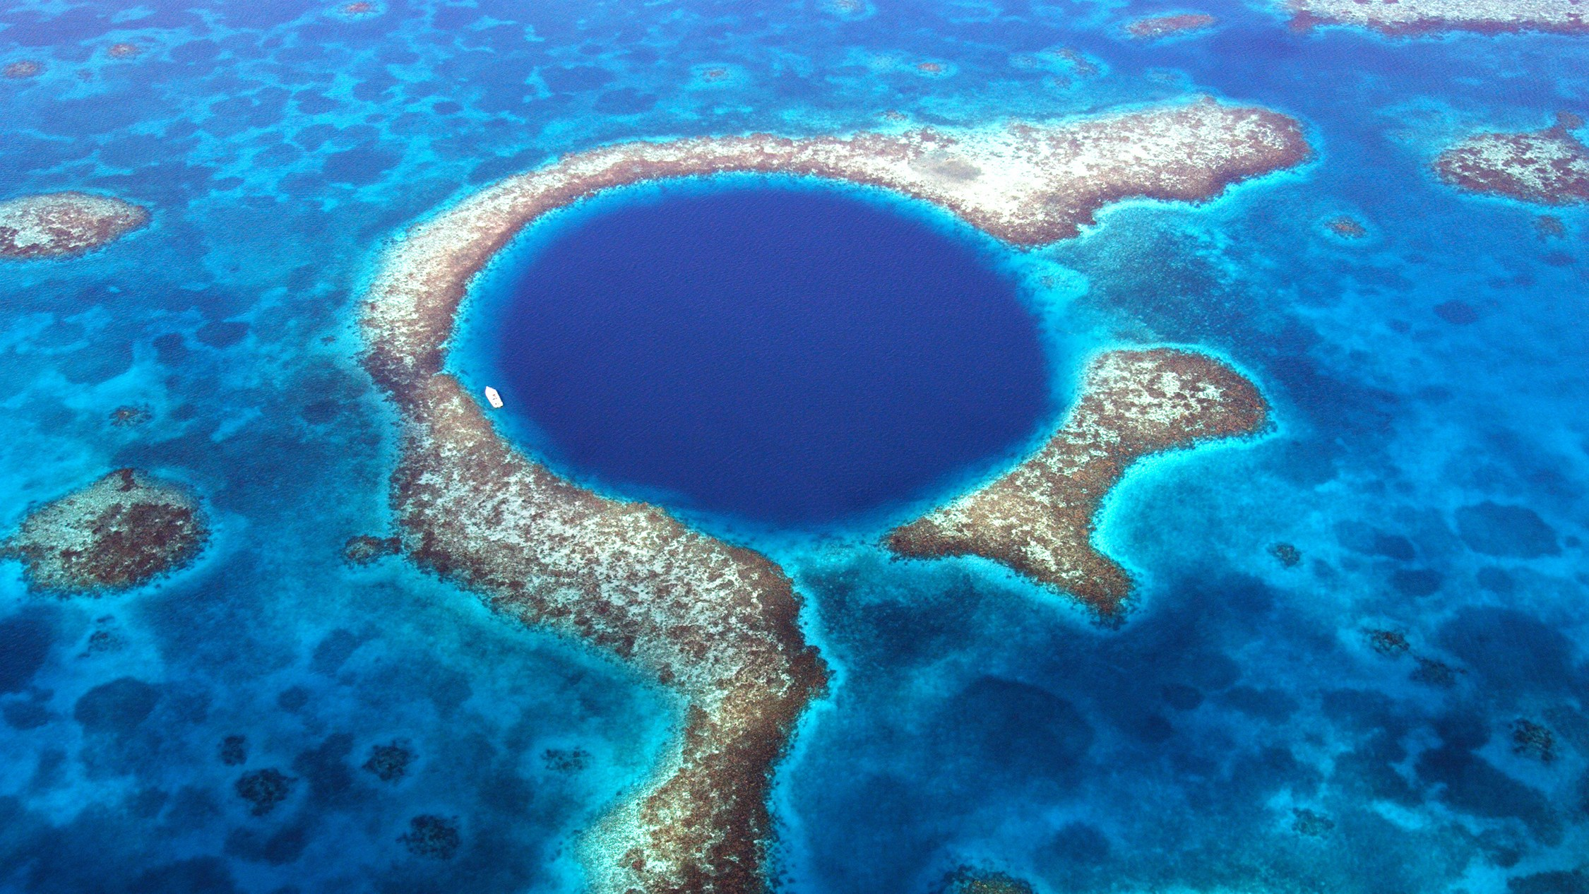
Great Blue Hole
The Great Blue Hole is located about 43 miles off the coast of Belize along the Lighthouse Reef Atoll. You can visit the Great Blue Hole with a number of dive services that operate out of Belize City, San Pedro and Caye Caulker. In addition to operator fees, be prepared to pay an extra $40 to dive and snorkel at the Great Blue Hole.
Plunge into this deep blue hole and you'll discover imposing ancient stalactites (calcium deposits resembling icicles) and coral fringe.
Declared a UNESCO World Heritage Site in 1996 — along with six other areas surrounding Belize's barrier reef.
The Great Blue Hole remains one of the world’s most distinguished scuba sites. Created approximately 10,000 years ago after a cave roof crumbled in, this blue channel contains underwater tunnels, caverns, and rock formations

Slide 17
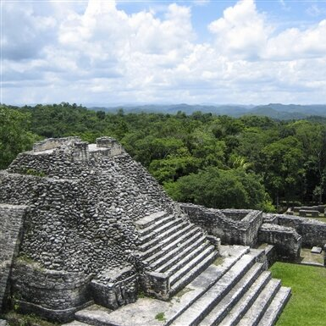
Cayo District
Travel west of Belize City and you'll discover a cluster of ancient Mayan sites, rolling hills, gorgeous sunsets, tranquil butterfly gardens, and verdant jungles. In the heart of the Cayo District sits San Ignacio, a small town that boasts traditional culinary dishes and affordable hotels.
Start your tour just 6 miles south of the town at the ancient Mayan ruin Xunantunich. Set along the Mopan River and less than a mile from the Guatemalan border, the temple at Xunantunich was once a civic ceremonial center for the Mayan people.
Your best bet is to find a local tour company for a recommendation.

Slide 18
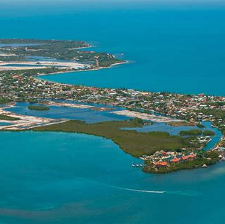
Placencia Peninsula
Imagine tranquil beaches topped with rustling palm trees and backed by pastel-colored beachfront villas and calm Caribbean waters.
This is Placencia, Belize's rapidly booming beach town. Stretching across a 16-mile-long peninsula, Placencia boasts a myriad of nature reserves and underwater sanctuaries along with postcard-perfect vistas.
The area offers the only golden sands on mainland Belize.

Slide 19
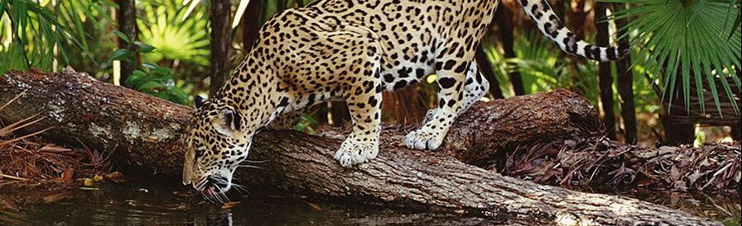
Cockscomb Basin Wildlife Sanctuary
The Cockscomb Basin Wildlife Sanctuary is a nature reserve in the Stann Creek District of south-central Belize.
It was established to protect the forests, fauna, and watersheds of an approximately 150 sq mi area on the eastern slopes of the Maya Mountains
Entrance fee $10 BZD ($5 USD)

Slide 20
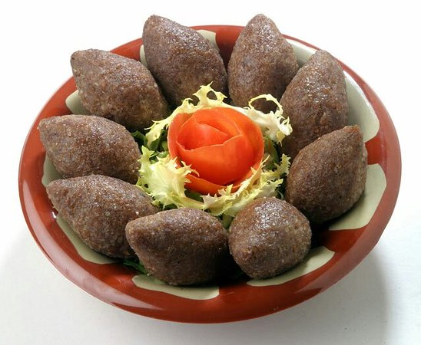
Restaurant Choices
There are a lot of excellent restaurants in Belize City. Especially for seafood.
Here are some recommendations:
Restaurants in Belize City:
Martha's Café $$ - $$$ Seafood, Healthy , Central American
10 Fort Street, Belize City
CELEBRITY RESTAURANT $$ - $$$ Caribbean , Seafood , Central American
Marine Parade Volta Building, Belize City
Bird's Isle $$ - $$$ Caribbean , Bar , Seafood
90 Albert Street Bird's Isle, Belize City
Friendship Chinese Restaurant $ Chinese , Asian
Philip Goldson Hwy, Belize City
The Sahara Grill $$ - $$$ Lebanese , Mediterranean , Middle Eastern
Mile 3 Northern Highway Opposite Biltmore Plaza Hotel, Belize City
For those of you who just like good food, you can’t go wrong just
about anywhere you go in Belize City.
GOOD EATING

Slide 21
Final Thoughts
Belize City is a beautiful City with a rich history and numerous attractions.
Regardless of what you're looking for, Belize City has something for everyone.
I hope this presentation will help when we visit Belize!

Slide 22
Thanks For Coming
If you have any more questions, please ask.
I will do my best to answer them for you.
Have a great visit in Belize City !

