Slide 1

Belfast, Northern Ireland Port Guide Presented by Marc Silver

Slide 2
What I Will Cover
My Port Philosophy
Don’t Miss the Ship
Money
Exchanging Money
A Brief History of Civitavecchia
Maps
Transportation
Top Attractions & Points of Interest
Local Cuisine & Dining Options
Important Tips & Practical Advice
Conclusion

Slide 3
My Port Philosophy
I have been cruising for over 45 years and have taken over 100 cruises. So, I consider myself an experienced cruiser.
The information I will present is based on those many years of
experience.
When I am on a cruise where the city, I want to visit is not the port city,
I always recommend taking a ship’s tour.
But when I am in a port with multiple attractions nearby and easy to see
on my own - I will do it on my own.
This presentation is not like that.

Slide 4

Don’t Miss the Ship
How to Avoid Missing Your Ship
Pay attention to the time. - Ship time and local time are often different.
Put a return-to-ship reminder on your phone.
Choose excursions wisely.
If a ship-sponsored excursion is late returning to port, the ship will wait for you. If you are on your own???
Be Prepared
Have your Passport, Credit Card, and phone numbers for your ship port agent.
What to Do If You Miss the Ship Most cruise lines have port agents stationed in the port area to assist if your ship has left without you. If your are lucky, when cruisers are late returning to the vessel, the ship’s crew will often remove the passengers’ essential items – passports, cell phones, and medication -- from the ship to leave with the port agents.
The Port Officials can help you with contacting your ship and making necessary travel arrangements.

Slide 5
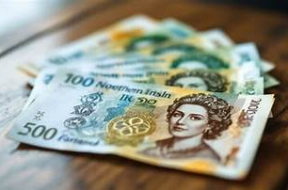
Money
Northern Ireland uses the British Pound Sterling (£).
As a rough guide, one British Pound is slightly stronger than the U.S. dollar.
Prices in Belfast tend to be reasonable compared to London or Dublin, especially for food and local transportation. 1 EUR = 1.05 USD.
Currency exchange tips: Avoid airport/port kiosks due to high fees and poor rates. Use ATMs for better rates when withdrawing cash. Credit and debit cards are widely accepted, but keep some cash for small purchases and tips.

Slide 6
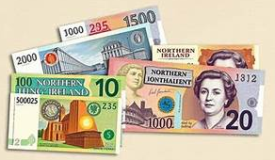
Exchanging Money
When exchanging money, it’s best to avoid doing so at the port exchange kiosks, as they tend to have higher fees and less favorable rates.
Instead, consider using ATMs to withdraw Money directly, as they often offer better rates.
Additionally, credit and debit cards are widely accepted throughout Northern Ireland though having some cash on hand is always a good idea for smaller purchases.

Slide 7
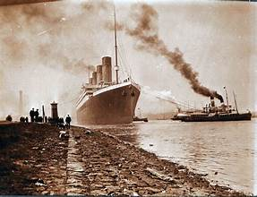
A Brief History of Belfast
Belfast grew rapidly during the Industrial Revolution, becoming a major center for shipbuilding, linen production, and engineering.
The city is best known internationally as the birthplace of the RMS Titanic, built here in the early 1900s. At the same time, Belfast has a complex political history shaped by decades of conflict known as “The Troubles.”
Today, Belfast is a transformed city. It is modern, energetic, and welcoming, while still deeply connected to its past. You will see history acknowledged openly rather than hidden, which makes visiting here especially meaningful.

Slide 8
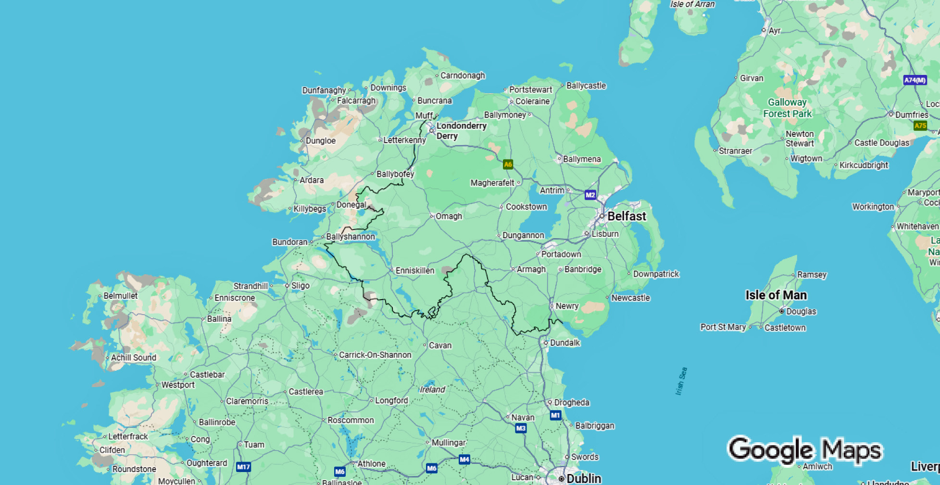
Northern Ireland

Slide 9
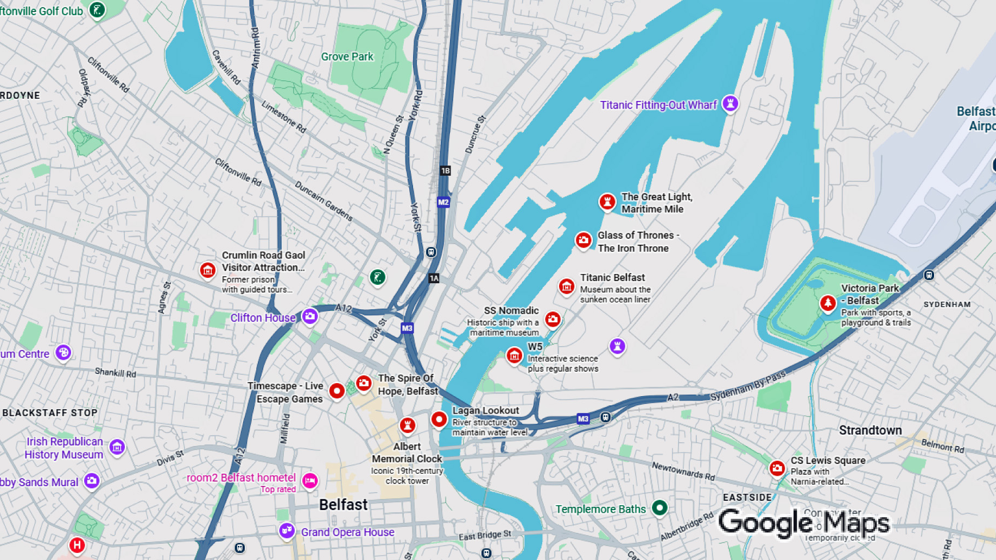
Belfast

Slide 10
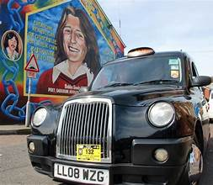
Transportation
Getting Around Belfast
Cruise ships dock near the Titanic Quarter. From the port, shuttle buses, taxis, and walking paths make it easy to reach key areas.
Taxis are plentiful and reasonably priced. Ride times into the city center are short.
Public transportation includes buses and light rail, but most visitors find taxis or walking more convenient for a short port stay.

Slide 11
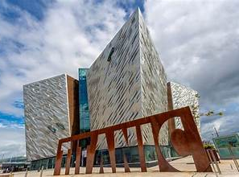
Top Attractions & Points of Interest
Titanic Belfast A world-class museum built on the exact site where Titanic was designed and constructed.
Even non-museum lovers usually find this excellent.

Slide 12
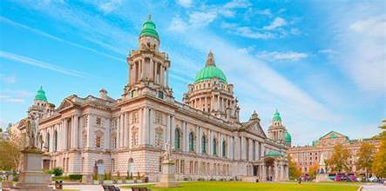
Top Attractions & Points of Interest
Belfast City Hall is a stunning Edwardian architectural masterpiece situated in the heart of Belfast's city center. This impressive building offers free admission to visitors and features beautiful interiors, ornate marble staircases, and grand ceremonial spaces.
The grounds include lovely gardens and memorials.
It's an essential stop for anyone exploring Belfast, offering both historical significance and architectural beauty in a convenient, accessible location that's well worth dedicating time to explore.

Slide 13
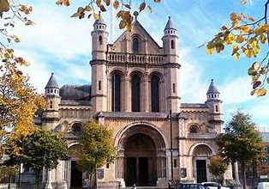
Top Attractions & Points of Interest
Cathedral Quarter
A lively historic area filled with pubs, restaurants, street art, and music venues.

Slide 14
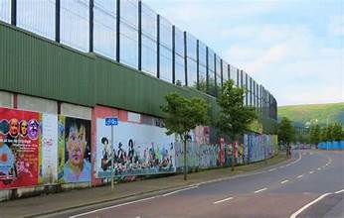
Top Attractions & Points of Interest
Peace Walls
Guided taxi tours explain the city’s political history clearly and respectfully. This is one of the most educational experiences in Belfast

Slide 15
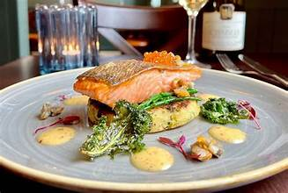
Local Cuisine & Dining Options
Belfast food is hearty and comforting.
Look for traditional dishes like Irish stew, soda bread, and seafood chowder. Fresh seafood is excellent here.
The Cathedral Quarter offers a wide range of casual pubs and sit-down restaurants. Portions are generous, and prices are generally fair.
Tipping is appreciated but not expected. Rounding up or leaving about 10 percent for good service is perfectly acceptable.

Slide 16
Important Tips & Practical Advice
Dress for changing weather. Belfast weather can shift quickly, even on sunny days.
Walking shoes are important. Many areas are best explored on foot.
Belfast is generally safe and friendly. As in any city, stay aware in crowded areas, but violent crime affecting tourists is rare.
Most attractions can be comfortably visited in a half day without rushing.

Slide 17
Final Thoughts
Belfast is one of those ports that often surprises people. It is walkable, approachable, and filled with stories that matter.
Whether you focus on Titanic history, political history, or simply enjoy the city’s energy, this is a port that leaves an impression.
Thanks for coming today. If you have questions, I’m happy to help. Enjoy your time in Belfast, and most importantly, enjoy your day ashore.
Is this conversation helpful so far?

Slide 18
Thanks For Coming
If you have any more questions, please ask.
I will do my best to answer them for you.
Have a great visit in Belfast!

