Slide 1

Barcelona
Port Presentation
Presented by
Marc Silver

Slide 2
What I Will Cover
Barcelona
My Port Philosophy
Money
Don’t Miss the Ship
Traffic In Barcelona
A few interesting facts about Barcelona
Where is the Tourist Office?
Getting around Barcelona
Places to see or at least consider
A few restaurant recommendations

Slide 3
Barcelona
Overlooking the Mediterranean Sea, and famous for
Gaudí and other Art Nouveau architecture, Barcelona
is one of Europe's trendiest cities.
It's a hub of new trends in the world of culture,
fashion and cuisine. It combines the creativity of its
artists and designers with respect and care for local
traditions.
If you didn’t know it, Spanish is the native language.

Slide 4
My Port Philosophy
I have been cruising for over 46 years and have taken over 100 cruises. So I consider myself an experienced cruiser.
Don’t The information I will present is based on those many years of experience.
When I am on a cruise where the city I want to visit is not the port city, I always recommend taking a ship’s tour.
But when I am in a port with multiple attractions nearby and easy to see on my own -
I will do it on my own.
This presentation is for that type of port.

Slide 5
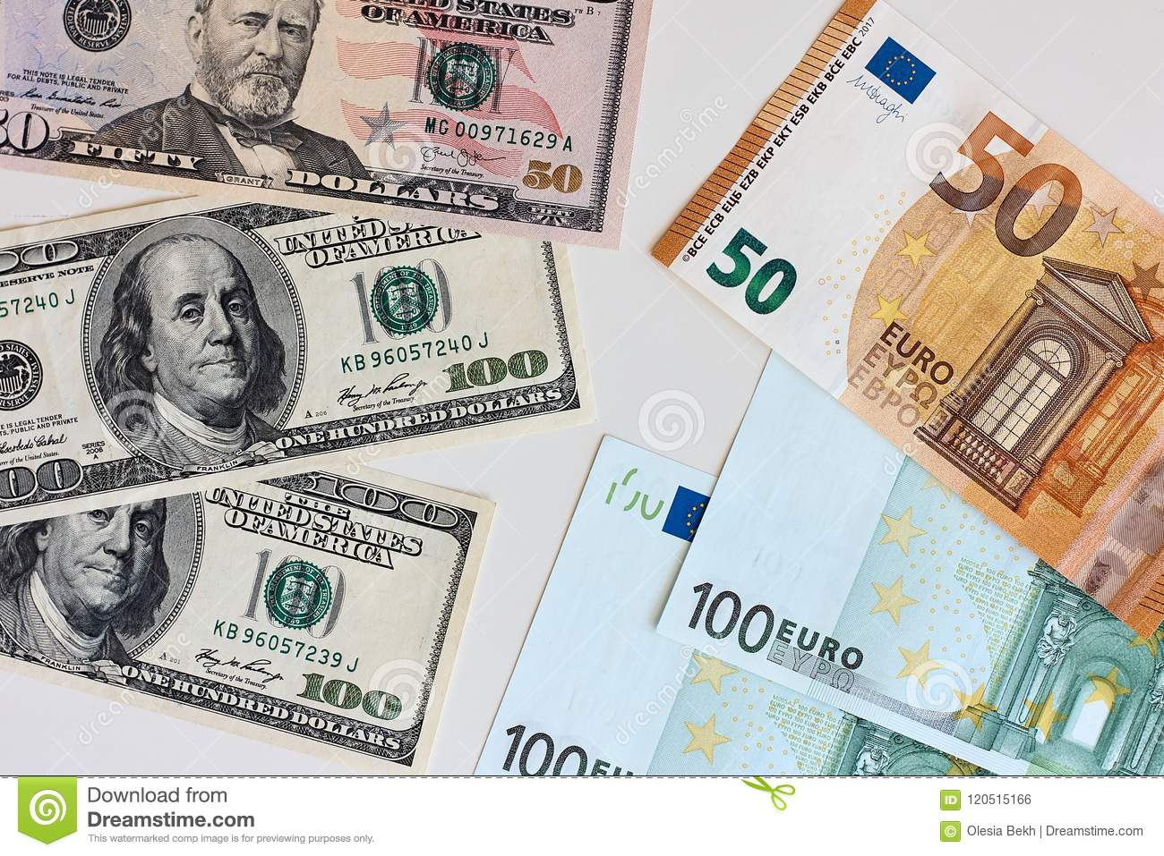
Money
The euro is the official currency of 20 European Union countries which collectively make up the euro area, also known as the euro-zone.
Official Exchange is $1.079 US to €1

Slide 6

Don’t Miss the Ship
How to Avoid Missing Your Ship:
Pay attention to the time. - Ship time and local time
are often different.
Put a return-to-ship reminder on your phone.
Choose excursions wisely:
If a ship-sponsored excursion is late returning to port, the ship will wait, but not for excursions taken on your own.
Be Prepared:
Have your Passport, Credit Card, and phone numbers for the ship port agent.
What to Do If You Miss the Ship:
Most cruise lines have port agents stationed in the port area to assist if your ship has left without you. Sometimes, when cruisers are late returning to the vessel, the ship's crew may remove the passengers' essential items -- passports, cell phones, and medication -- from the ship to leave with the port agents.
The Port Officials can help you with contacting your ship
and making necessary travel arrangements.

Slide 7
We’re Not Here Alone
There are 9 terminals in total at the Barcelona port, 7 of these are cruise terminals.
Expect to see cruise ships from several other lines in port with us.
You may want to plan accordingly!

Slide 8
Traffic in Barcelona
Drivers in Barcelona are considered among the worst in the world, with accidents occurring in the city every nineteen seconds! This can go up to ten accidents every second on weekends, which makes it safer to walk than to drive.
However, PLEASE watch out for crazy drivers!

Slide 9
The Founding of Barcelona
There is a dispute about the founding of Barcelona. There is one camp which claims that Hercules founded the city about 400 years before the building of Rome.
The other side believes that Barcelona was built by Hamilcar Barca, the father of Hannibal. The name Barcelona comes from the Barca family of Carthage who ruled the area in the 3rd century before Christ.

Slide 10
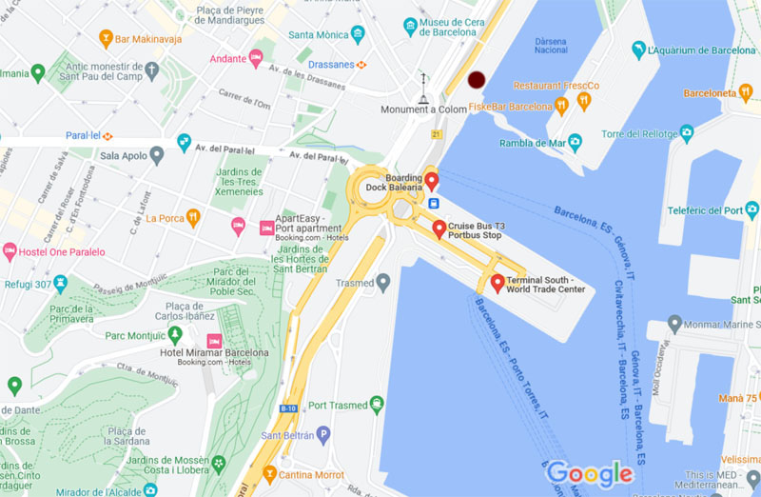
Official Barcelona Tourist Offices
The Tourist information is located near the Columbus Monument about 1000ft North East of the Cruise Port Bus Stop.
Located at the Black Dot
It’s a little out of the way but a good place to get information

Slide 11
Getting Around Barcelona
Like most large European cities, the cities mass transit system has both buses and subways. Getting around is not difficult. Barcelona has an excellent Subway for those interested in getting beyond the core of the city. You can choose from the different ticket types and travel cards.

Slide 12
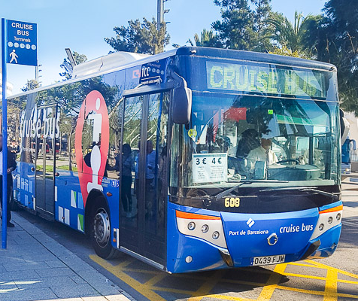
Cruise Terminal Bus
Cruise Bus Route
The Cruise Bus runs from all 7 of the cruise port terminals to the Christopher Columbus Monument and back.
The bus is wheelchair accessible.
Cruise Bus Tickets
The tickets for the Cruise Bus can only be purchased with cash on the bus itself. Alternatively you can book your tickets online in advance. Follow the link below to book in advance.
The walking time from the Christopher Columbus monument to La Ramba is about 1 minute, and the nearest Metro is Drassanes (Green Line, L3), which is only about 5 minutes walk from the monument.

Slide 13
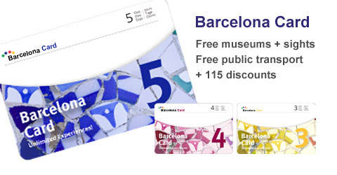
Barcelona Card
Pre-paid travel on public
transport + discount
card for sightseeing.
advantages:
Free or reduced
admission for museums,
aquarium, zoo…
Skip the line entry for
some attractions
Free or reduced admiss-
ion for events or tours (with guide) through the city
Unlimited and free travel on public transport: city bus, metro (also airport route), tram, Renfe – trains

Slide 14
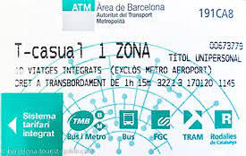
City Bus Pass
10 journey ticket “T-Casual” former “ATM T-10” for one zone € 11.35. Barcelona does not offer 1 day pass, like some other cities.
With luck you can ask the bus driver for details.

Slide 15
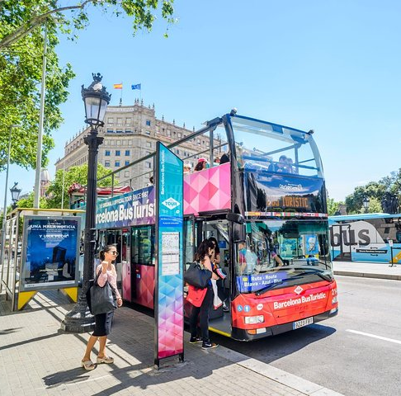
Hop-On Hop-Off Bus Tour
Highlights
See some of Barcelona’s city highlights from a convenient open-topped bus
Determine your own itinerary with a hop-on hop-off sightseeing bus ticket
Enjoy unlimited travel for one or two days, depending on your schedule
Receive a complimentary coupon book with discounts to many top attractions
Ticket Price: €30,00
Children (4-12y) €16,00

Slide 16
Gaudi
Antoni Gaudi is considered one of the great architects who vastly influenced buildings in the city. His La Sagrada Familia, a Roman Catholic Church was begun in 1882 and is still under construction many years after his death. He chose to take the donkey of a woman selling sand as a model for the main entrance to this church. You will see his influence throughout the city.

Slide 17
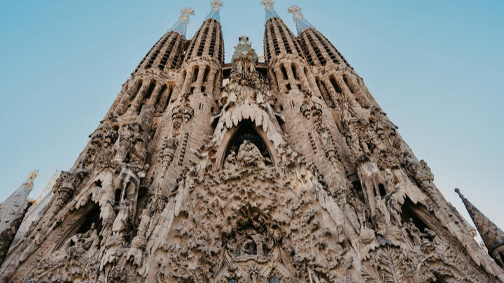
Gaudi’s Sagrada Familia
Sagrada Familia

Slide 18
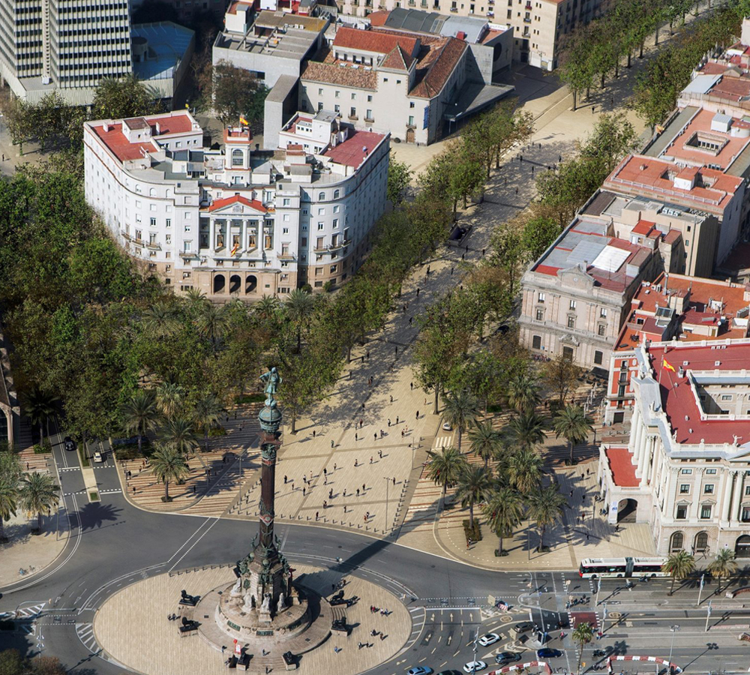
Las Ramblas
Las Ramblas is a 2 kilometer long boulevard where it is customary to walk and take in the sights of the street artists, enjoy a cup of coffee or buy flowers. This street is busy throughout the day and night and is a famous meeting point for tourists.

Slide 19
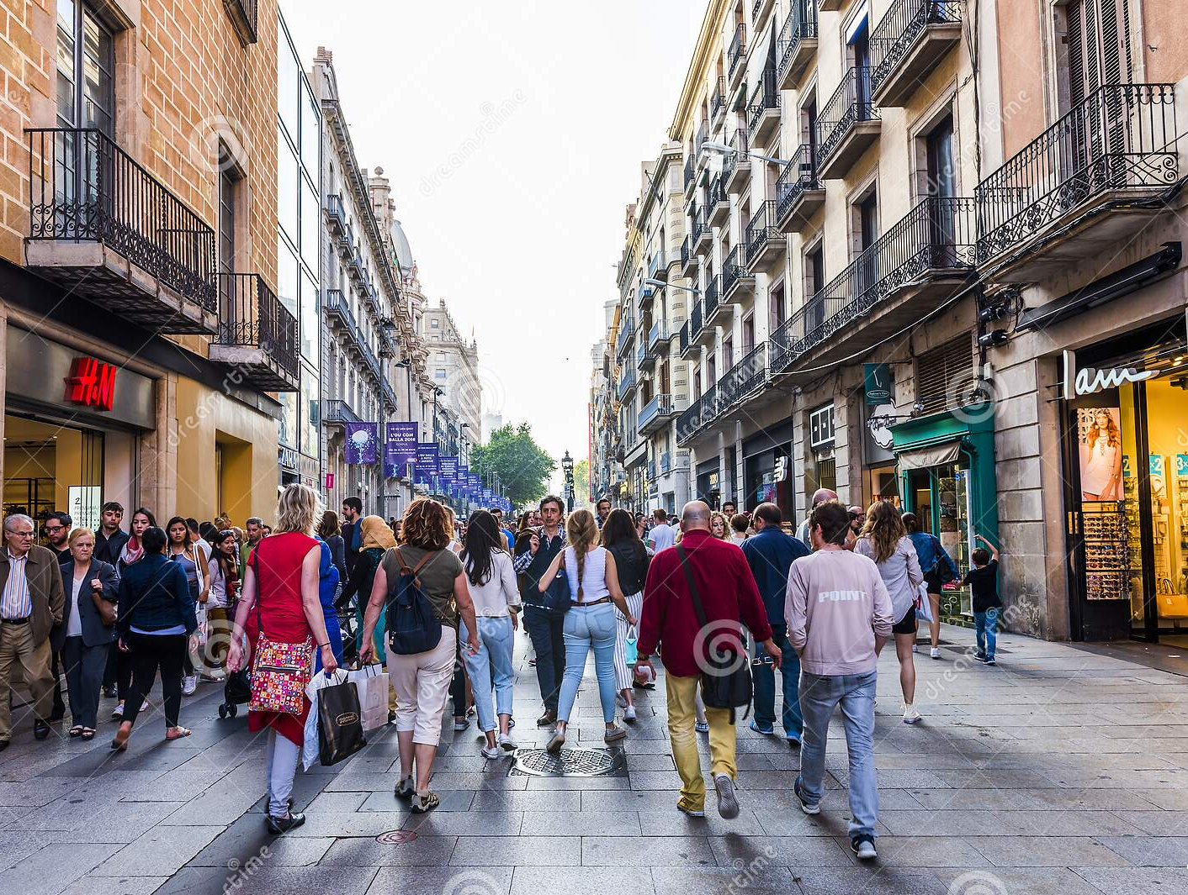
The Most Walked Street in Spain
Portal de l’Angel is one of the most popular and expensive shopping streets in Barcelona, Spain, with a wide variety of goods available and a specialty in textiles. Much sought after and exclusive clothing brands represented on Portal de l’Angel from around the world include Zara, Benetton and Massimo Dutti. Also, The street is a pedestrian zone, meaning most vehicle use is prohibited.
Portal de l’Angel

Slide 20
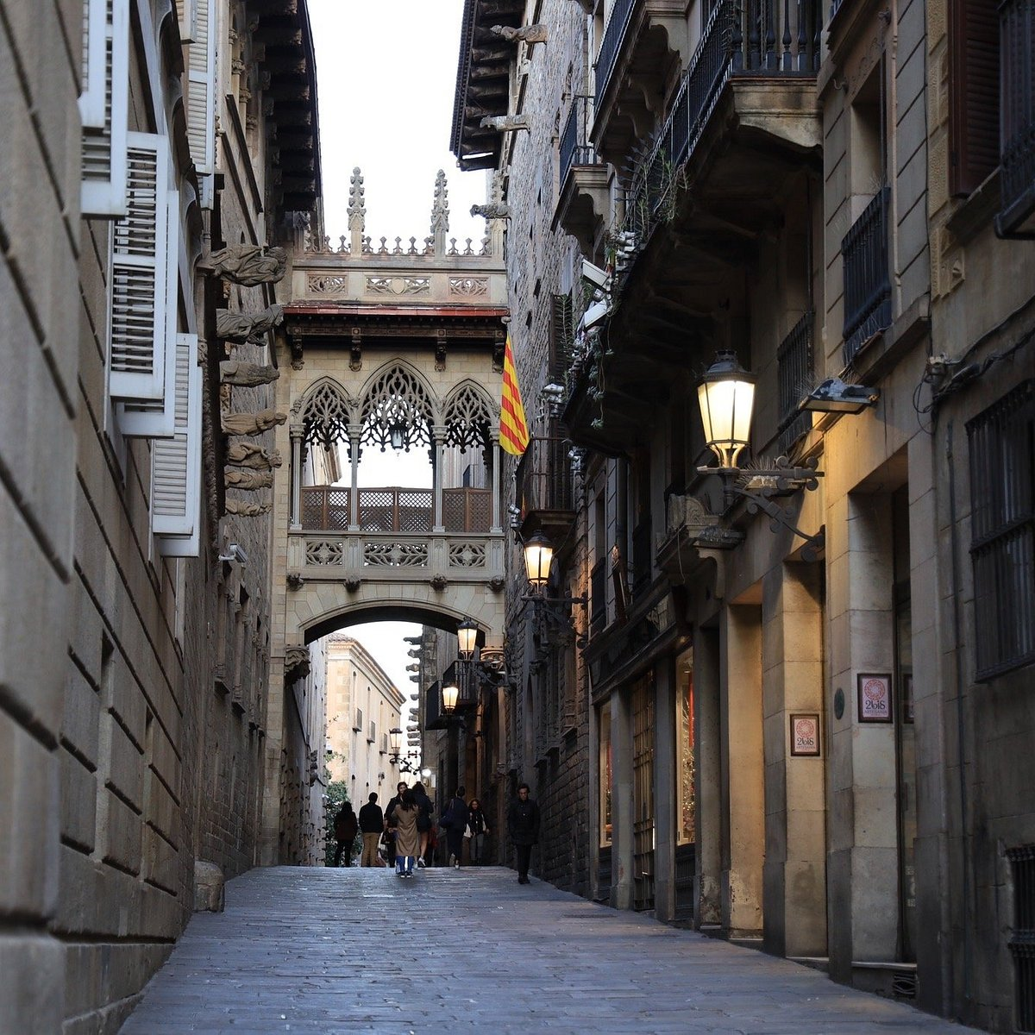
Barri Gotic
The Barri Gotic is the center of old Barcelona and some of the buildings go back even to the Roman era. Medieval architecture is quite common here and the attraction of these buildings brings in over a million tourists to Barcelona every week.

Slide 21
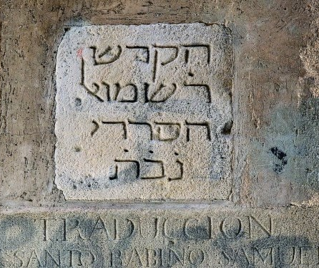
The Jewish Quarter
The Jewish Quarter (El Call) established in the Middle Ages, was one of the largest and most important of all the self-governing communities, or Aljamas, in the countries under the rule of the Crown of Aragon.
Today Jews represented 10% of the overall population of Barcelona.
Dónde está el barrio judío? Or
Dónde está El Call

Slide 22
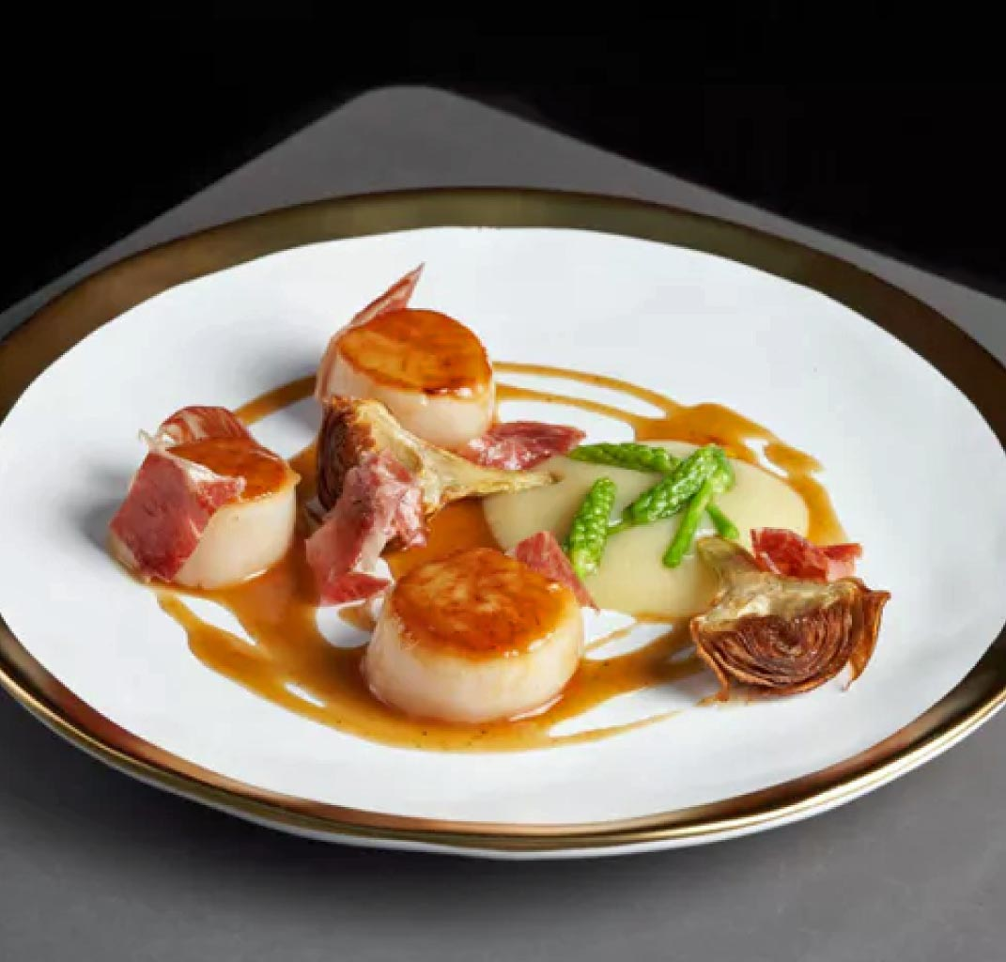
Many Amazing Restaurants
Barcelona has nearly 40 Michelin star restaurants. Many of us on the ship are foodies, so naturally we’re always on the hunt to eat at the most exclusive spots anytime we travel.
Here are just a few of the Michelin Star Restaurants in Barcelona.
Estimar - Sant Antoni dels Sombrerers 3, €€€€ · Seafood
Aürt - Paseo del Taulat 262-264, €€€€ · Modern
Tram-Tram - Major de Sarrià 121, €€€ · Contemporary
Windsor - Còrsega 286, €€€ · Modern
BaLó - Déu I Mata 141, €€ · Contemporar
Paco Meralgo - Muntaner 171, € · Traditiona
La Mundana - Vallespir 93, € · Fusion
For those of you that just like good food, you can’t go wrong just about anywhere you go in Cannes. After all this is Spain!

Slide 23
Thanks For Coming
If you have any more questions, Please ask.
I will do my best to answer them for you.
Have a great visit in Barcelona!

