Slide 1

Barbados Presented by Marc Silver

Slide 2
What I Will Cover
My Port Philosophy
Don’t Miss the Ship
Money
About Barbados
Area Map of Barbados
Map of Barbados
Barbados Transportation
Places to see or at least consider
A few restaurant recommendations
Conclusion

Slide 3
My Port Philosophy
I have been cruising for over 45 years and have taken over 200 cruises. So, I consider myself an experienced cruiser.
The information I will present is based on those many years of
experience.
When I am on a cruise where the city, I want to visit is not the port city,
I always recommend taking a ship’s tour.
But when I am in a port with multiple attractions nearby and easy to see
on my own - I will do it on my own.
This presentation is for that type of port.

Slide 4

Don’t Miss the Ship
How to Avoid Missing Your Ship
Pay attention to the time. - Ship time and local time are often different.
Put a return-to-ship reminder on your phone.
Choose excursions wisely.
If a ship-sponsored excursion is late returning to port, the ship will wait for you. If you are on your own???
Be Prepared
Have your Passport, Credit Card, and phone numbers for your ship port agent.
What to Do If You Miss the Ship Most cruise lines have port agents stationed in the port area to assist if your ship has left without you. If your are lucky, when cruisers are late returning to the vessel, the ship’s crew will often remove the passengers’ essential items – passports, cell phones, and medication -- from the ship to leave with the port agents.
The Port Officials can help you with contacting your ship and making necessary travel arrangements.

Slide 5

Money
The currency of Barbados is the Barbados Dollar (BBD).
The conversion at the rate is $1.98 BDS to $1.00 U.S.
Or $1.00 BDS to $.49 U.S.

Slide 6
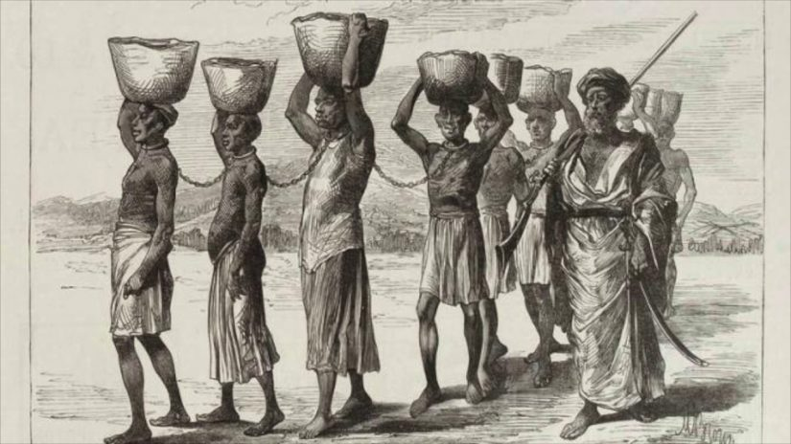
Historical Barbados
About 700 thousand years ago the island emerged from the ocean as a result of a rising body of soft rock in the mantle known as a diapir, located under Barbados, pushing it upwards. This process is still happening and makes the island rise about 30 centimeters on average every thousand years. Currently, dozens of inland sea reefs still dominate coastal features within terraces and cliffs of the island.
Archeological evidence suggests humans may have first settled or visited the island circa 1600 BC. More permanent Amerindian settlement of Barbados dates to about the 4th to 7th centuries AD, by a group known as the Saladoid-Barrancoid. Settlements of Arawaks from South America appeared by around 800 AD and again in the 12th-13th century. The Kalinago (called "Caribs" by the Spanish) visited the island regularly, although there is no evidence of permanent settlement.

Slide 7
About Barbados
Barbados is an island country and microstate in the Lesser Antilles of the West Indies, and the most easterly of the Caribbean Islands.
Inhabited by Kalinago people since the 13th century, and prior to that by other Amerindians, Spanish navigators took possession of Barbados in the late 15th century, claiming it for the Crown of Castile.
The Portuguese Empire claimed the island between 1532 and 1536 but abandoned it in 1620 with their only remnants being an introduction of wild boars for a good supply of meat whenever the island was visited.
An English ship, the Olive Blossom, arrived in Barbados on 14 May 1625; its men took possession of the island in the name of King James I.
In 1627, the first permanent settlers arrived from England, and Barbados became an English and later British colony. During this period, the colony operated on a plantation economy, relying on the labor of African slaves who worked on the island's plantations. Slavery continued until it was phased out through most of the British Empire by the Slavery Abolition Act of 1833.

Slide 8
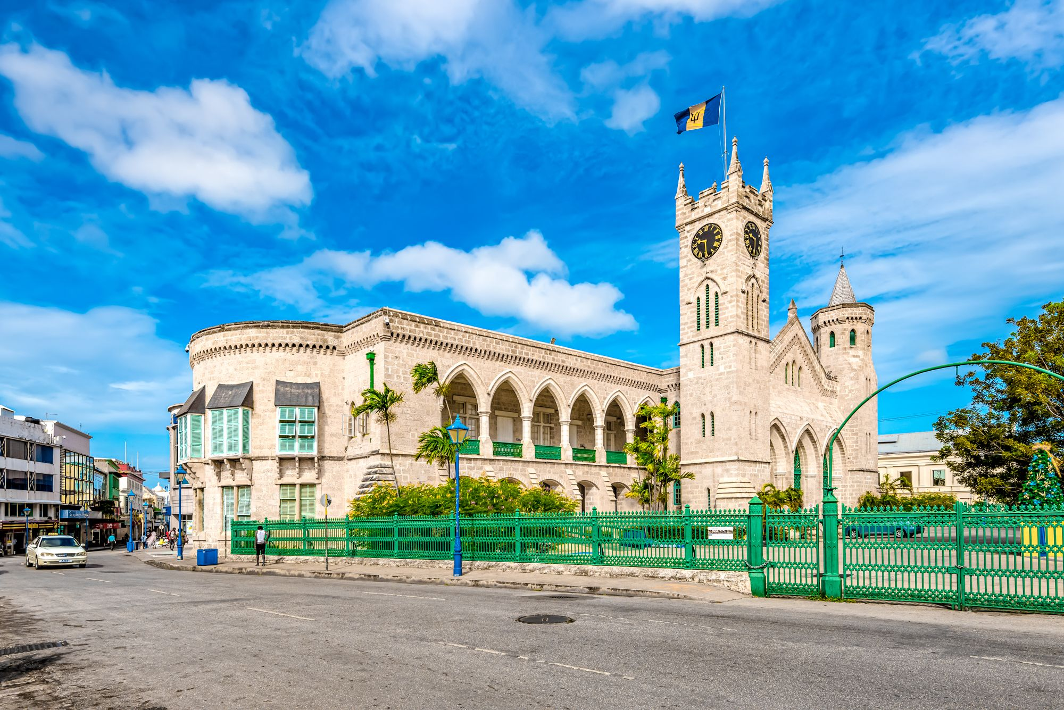
About Barbados
On 30 November 1966, Barbados gained independence and became a Commonwealth realm with Elizabeth II as Queen of Barbados. On 30 November 2021, Barbados transitioned to a republic within the Commonwealth.
Barbados's population is predominantly of African ancestry. While it is technically an Atlantic
island, Barbados is closely associated with the Caribbean and is ranked as one of its leading tourist destinations.

Slide 9
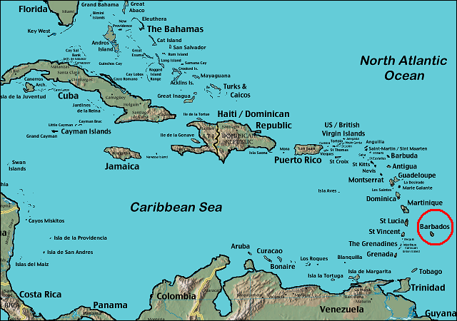
Caribbean Area Map

Slide 10
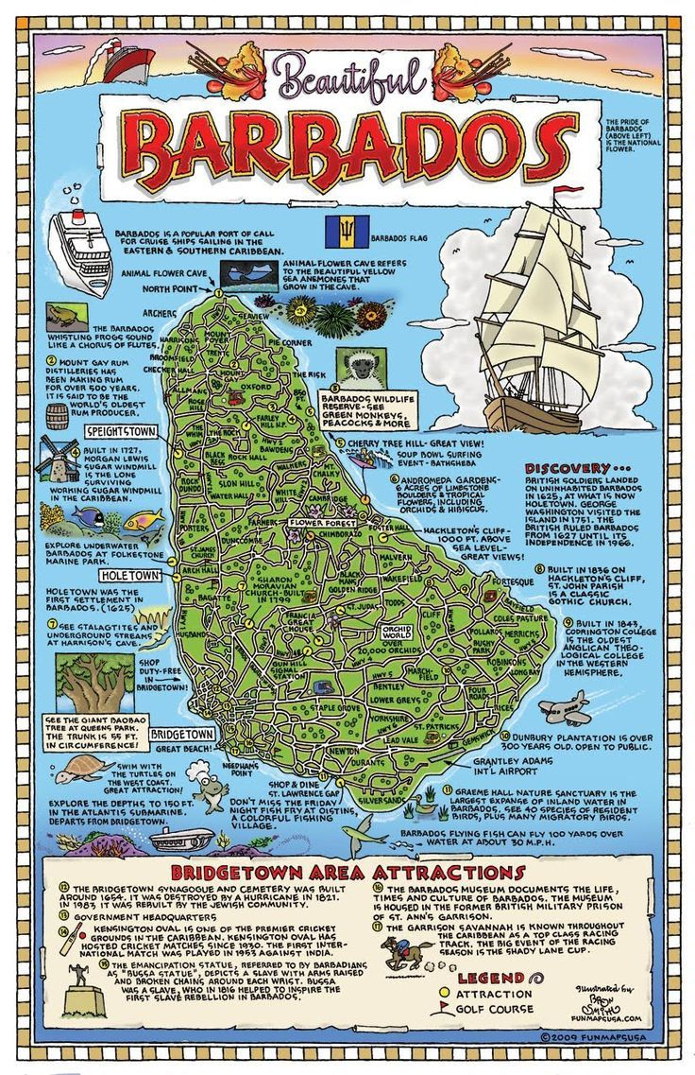
Map of Barbados

Slide 11
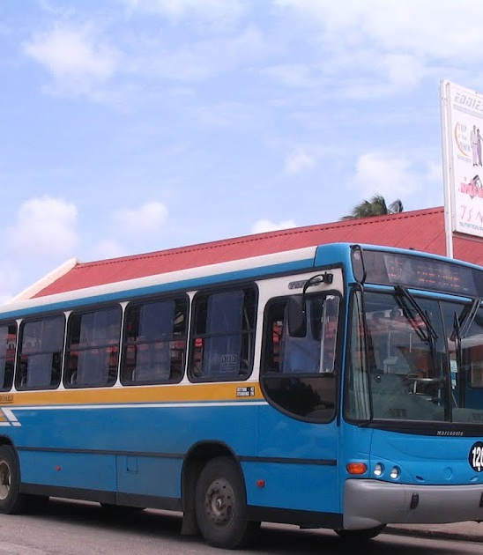
Barbados Buses
Barbados has one of the most comprehensive and user-friendly public transport networks in the Caribbean. With modern, electric government-run buses, always entertaining private buses and minivans, and only B$3.50 (US$1.75) per trip.
Outside the city terminals, these buses only stop at designated stops, helpfully marked “to city” and “out of city” to prevent tourists from heading in the wrong direction.
Pay with cash in exact change.

Slide 12
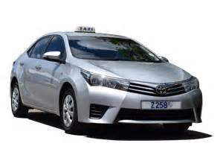
Barbados Taxis
Standard taxis provide a safe and reliable way to explore the island or for transport between the cruise port and various attractions around
Taxis are easily identified by the Z designation on their license plates.
Like taxis in most locations the cost is significantly more expensive than other modes of transport.

Slide 13
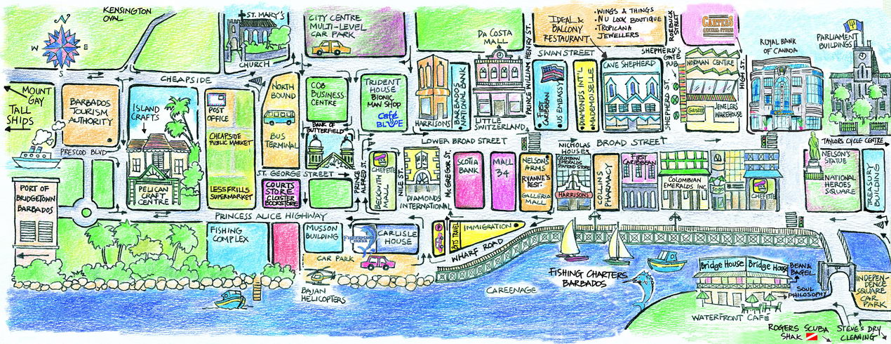
Bridgetown Walking Tour
Take a Bridgetown walking tour of the interesting points and historic buildings in the capital city of Barbados.
Places You Will See in Bridgetown:
St. Mary's Church
The Jewish Synagogue
St. Michael's Cathedral
Queen's Park
Heroes Square
Parliament Buildings

Slide 14
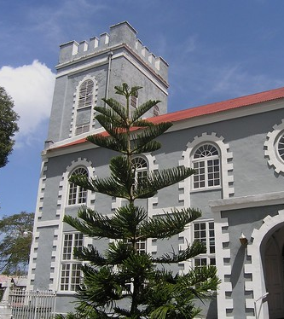
St. Mary's Church
St. Mary’s Church currently occupies the site of the first city church, now known as the Cathedral of St. Michael and All Angels or simply as, St. Michael’s Cathedral.
When the church was built in this location in 1641 it was a small wooden structure, but it was deemed inadequate by 1665 when the decision was taken to relocate the church. To facilitate this move, land was donated to the diocese but before the planned relocation could take place, the church was destroyed in 1780 by the great hurricane that struck Barbados.
This cleared the way for the rebuilding of a much grander church.

Slide 15
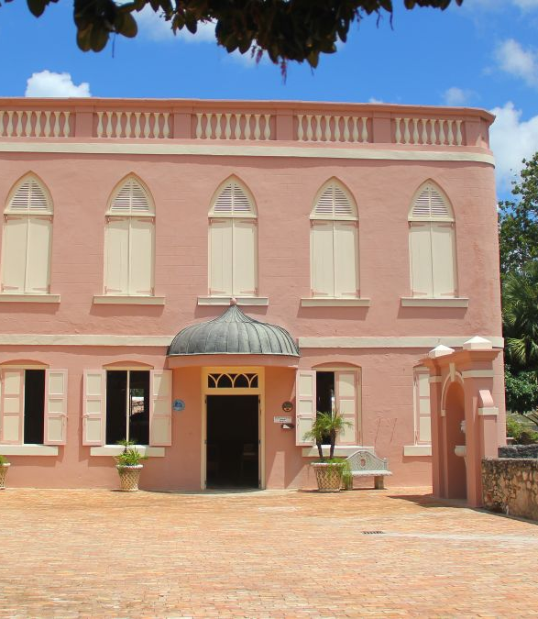
The Jewish Synagogue
Come to the Nidhe Israel Synagogue UNESCO Heritage Site and be guided through the lives and walk in the footsteps of our ancestors as they fled the Spanish Inquisition and came to Barbados to establish a thriving Sephardic community in Barbados.
The tours are guided by a volunteer Docent from the community.
ADULTS: $12.50 USD / $25.00 BBD
CHILDREN 5 -12: $6.25 USD / $12.50 BBD
CHILDREN UNDER 5 - FREE

Slide 16
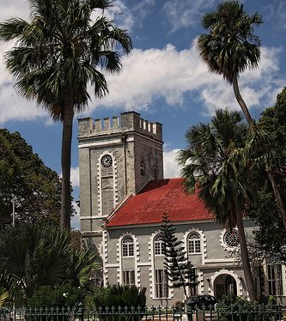
St. Michael's Cathedral
Saint Michael’s Cathedral is also the Parish Church of Saint Michael, and as such it is about the fourth structure to have been erected since the settlement of the Island.
In 1780 the Church was destroyed by Hurricane. The next Church, which followed the plan of the former edifice, was erected in 1789.
A small marble font situated at the Western end of the Cathedral is dated 1680. This font was salvaged from the ruins of the old St. Michael’s Parish Church, destroyed in 1780.

Slide 17
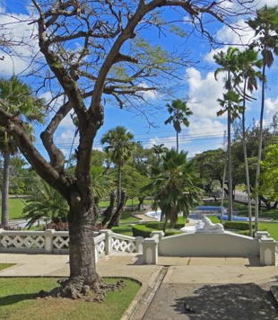
Queen's Park
Queen's Park is located in the capital city of Bridgetown. This historic site dates back to the 1780's when it was purchased by the British Government as the residence of the commanding General of the British troops in the West Indies.
Today the area is a designated park, and it is lovely to stop by if you are visiting Bridgetown. The park is run by the National Conservation Commission and includes washroom facilities and a children's play park.

Slide 18
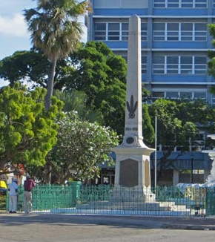
Heroes Square
Barbados, known for its stunning beaches and vibrant culture, holds a significant historical landmark known as National Heroes Square otherwise known as Barbados National Monument. This iconic monument stands as a testament to the nation’s rich heritage and pays tribute to the remarkable individuals who have shaped its history.
National Heroes Square holds immense cultural and historical significance for the people of Barbados. It serves as a reminder of the nation’s resilience and the struggles endured by its heroes.

Slide 19
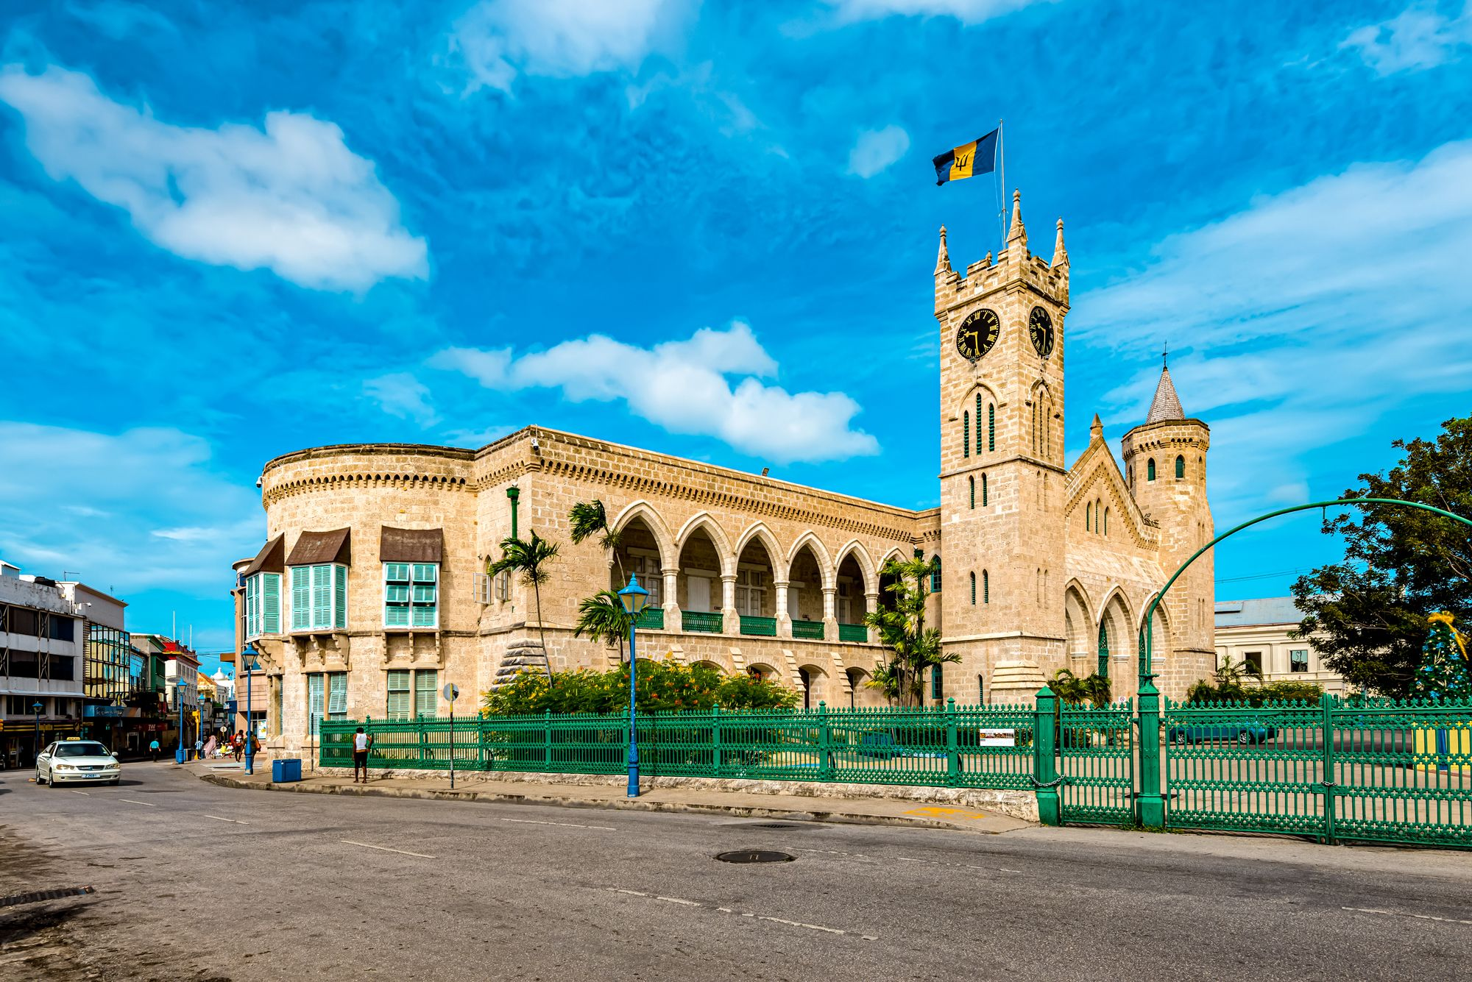
Parliament Buildings
On the north side of National Heroes Sq are two stone-block, neo-Gothic-style buildings constructed in 1871.
The western building with the clock tower contains public offices; the building on the east side houses the Senate and House of Assembly.
The museum focuses on the island’s democratic heritage and the gallery of national heroes.
When the assembly building is not in session, it's possible to take tours to check out the stained-glass windows.

Slide 20
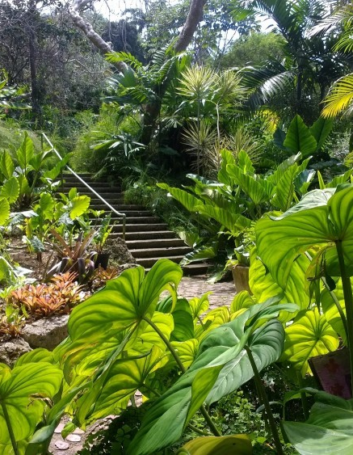
Andromeda Botanic Gardens
The Oldest and the Largest Garden in Barbados this 8 acres of cultivated gardens with over 500 plant species – the oldest Barbadian garden and the largest garden in Barbados, both in terms of acreage and number of plant species.
Amazing trees, beautiful individual but connected gardens, outstanding biodiversity including monarch butterflies – all in this organic, historic, botanical landscape. Visiting Andromeda is a truly authentic Barbados experience.
The creator of Andromeda Botanic Gardens, Iris Bannochie, created a garden with dual roles – a pleasure garden and a botanic garden

Slide 21
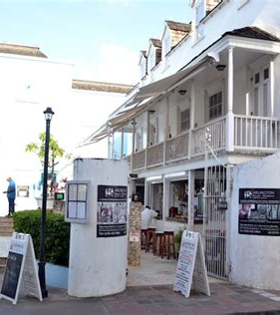
Arlington House Museum
Arlington House Museum is an eighteenth-century building located in the historic northern town of Speightstown and features three floors of exhibits.
The museum provides an abundance of interesting information while entertaining and educating all ages about the Barbados heritage.
The ground floor represents typical lifestyles in coastal Speightstown; the second floor features “Plantation Memories”; and the third floor invokes “Wharf Memories,” illustrating the prominence of Speightstown as an ocean trading “hub” to the New World.

Slide 22
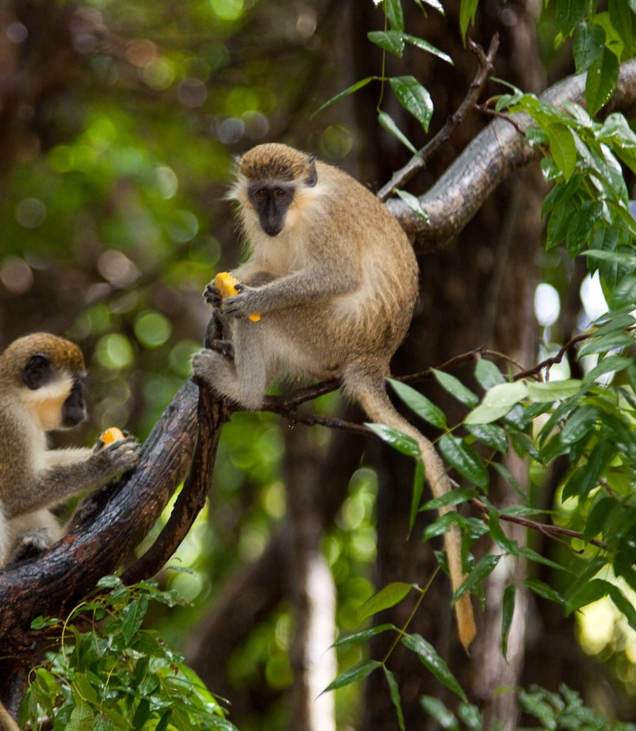
Barbados Wildlife Reserve
Barbados Wildlife Reserve is a walk-through zoo opposite Farley Hill, with short paths that meander through a mahogany forest containing green monkeys and loads of sluggish red-footed turtles. Other creatures include brocket deer, iguanas, and agoutis.
Despite presenting itself as a sanctuary, the animal welfare credentials of the place are suspect, to say the least considering one of its major businesses is the exportation of live monkeys for experiments to laboratories in Europe and the US.
Admission Fee: Adults US$15, Children US$7.50

Slide 23
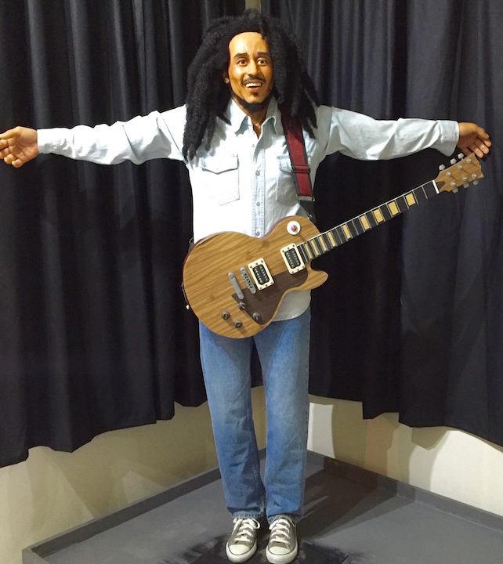
Caribbean Wax Museum
The Caribbean Wax Museum, is the first of its kind in Latin America and the Caribbean consisting of a growing collection of finely detailed lifelike depictions of the most famous regional personalities in Politics, Culture, Sport, and Literature. From Simon Bolivar to Usain Bolt, Toussaint Louverture to Rihanna. The wax figures honor those who have helped to shape the image of the region forever.
Adults : $10.00 USD Children under 12 : $5.00 USD

Slide 24
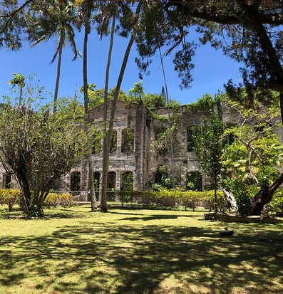
Farley Hill National Park
Farley Hill National Park is located in the parish of St. Andrew, on the east coast of Barbados. The park is a forest of Mahogany Trees, which sits high up on a hill overlooking The Atlantic Ocean.
The park is set around the ruins of an old estate home. Climb to the top and sit on one of the benches in front of the pagoda for a fresh breeze and phenomenal views down to the Atlantic.
If you arrive in a taxi, you pay admission, but if you walk up from the public bus, it's free.

Slide 25
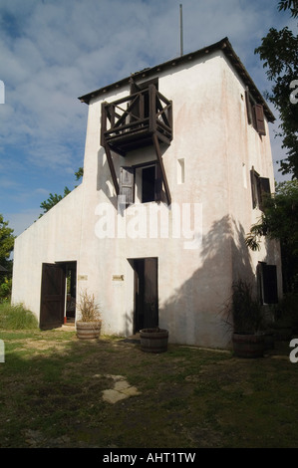
Grenade Hall Forest & Signal Station
Both history and nature lovers will appreciate a visit to Grenade Hall, an attraction that combines a restored historic signal station and a natural forest. In fact, it's really a three-in-one attraction since one entry fee gains admission to both Grenade Hall and the adjoining Barbados Wildlife Reserve.
When you're finished exploring the signal station, follow the paths through the Grenade Hall Forest and discover the healing powers of many of the plants found there.
Admission Fee: Adults US$15, Children US$7.50

Slide 26
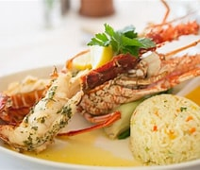
Restaurants in Barbados
There are a lot of excellent restaurants in Hokkaido. Especially for seafood.
Here are some recommendations: Restaurants in Barbados
The Tides $$$$ Caribbean, Seafood, European
The Tides Restaurant, Holetown Barbados
Nishi Restaurant $$ - $$$ Seafood, Sushi, Asian
Second Street, Holetown Barbados
Shanti’s Rum And Roti $$ - $$$ Indian, Caribbean 1 Tudor Street, Bridgetown
Coconut Bar & Grill $$ - $$$ Caribbean, Bar
Bridgetown Cruise Terminal, Bridgetown

Slide 27
Conclusion
Barbados is a beautiful City with a rich history and numerous attractions. Regardless of what you're looking for, Barbados has something for everyone.
I hope this presentation will help when we visit Barbados!

Slide 28
Thanks For Coming
If you have any more questions, please ask.
I will do my best to answer them for you.
Have a great visit to Barbados !

