Slide 1
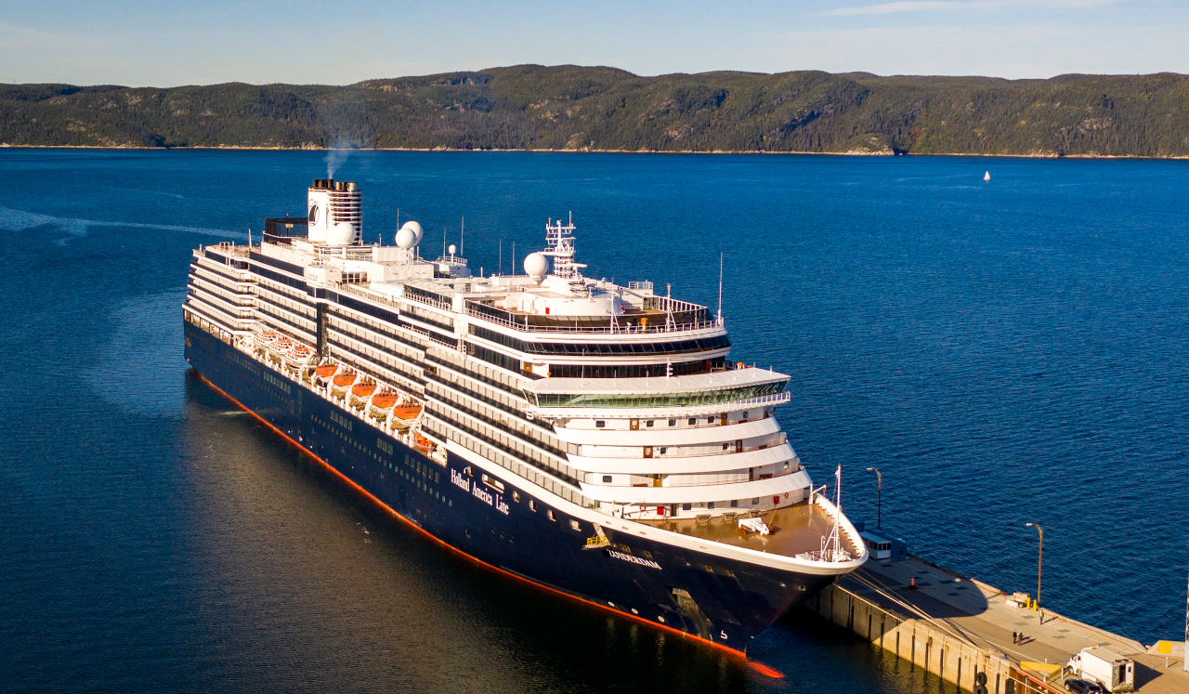
Baie-Comeau, Quebec Port Guide Presented by Marc Silver

Slide 2
What I Will Cover
My Port Philosophy
Don’t Miss the Ship
Money
Maps
A Brief History of Civitavecchia
Transportation
Top Attractions & Points of Interest
Local Cuisine & Dining Options
Important Tips & Practical Advice
Conclusion

Slide 3
My Port Philosophy
I have been cruising for over 45 years and have taken over 100 cruises. So, I consider myself an experienced cruiser.
The information I will present is based on those many years of
experience.
When I am on a cruise where the city, I want to visit is not the port city,
I always recommend taking a ship’s tour.
But when I am in a port with multiple attractions nearby and easy to see
on my own - I will do it on my own.
This presentation is not like that.

Slide 4

Don’t Miss the Ship
How to Avoid Missing Your Ship
Pay attention to the time. - Ship time and local time are often different.
Put a return-to-ship reminder on your phone.
Choose excursions wisely.
If a ship-sponsored excursion is late returning to port, the ship will wait for you. If you are on your own???
Be Prepared
Have your Passport, Credit Card, and phone numbers for your ship port agent.
What to Do If You Miss the Ship Most cruise lines have port agents stationed in the port area to assist if your ship has left without you. If your are lucky, when cruisers are late returning to the vessel, the ship’s crew will often remove the passengers’ essential items – passports, cell phones, and medication -- from the ship to leave with the port agents.
The Port Officials can help you with contacting your ship and making necessary travel arrangements.

Slide 5

Money
Canada uses the Canadian dollar as its official currency. The exchange rate between the U.S. Dollar (USD) and the Canadian Dollar is about: 1 USD = 1.3755 CAD
This means U.S. travelers should anticipate slightly lower prices in terms of conversion.
When exchanging money, it’s best to avoid doing so at the port exchange kiosks, as they tend to have higher fees and less favorable rates.
Instead, use your credit and debit cards which are widely accepted everywhere.
Having some cash on hand is always a good idea for smaller purchases or tips.

Slide 6
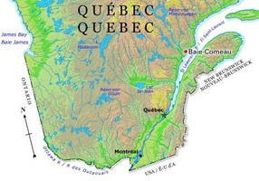

Slide 7
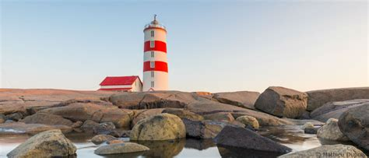
Welcome to Baie-Comeau
Welcome aboard, fellow adventurers! You know you're on a cruise when your idea of a morning commute is deciding which side of the ship has the best sunrise view.
Today, I'm excited to help you discover Baie-Comeau, a charming gem along Quebec's North Shore that perfectly balances industrial heritage with natural beauty.
Founded in the 1930s as an industrial town, Baie-Comeau has blossomed into a fascinating destination where pristine wilderness meets Quebec culture.
Whether you're a nature enthusiast, history buff, or simply looking to experience authentic Quebecois charm, this port has something special waiting for you.

Slide 8
A Brief History of Baie-Comeau
The region was originally home to the Innu people, who have lived along the North Shore for thousands of years. Their deep connection to the land and expertise in trading helped establish this area as an important meeting point long before European settlement. The Innu called this area "Manicouagan," meaning "where there is bark," referring to the white birch trees that still dot the landscape today.
Colonel Robert McCormick, publisher of the Chicago Tribune, founded Baie-Comeau in 1937 to support a paper mill operation. This industrial beginning might surprise you when you see today's picturesque town. Speaking of surprises – did you know that former Canadian Prime Minister Brian Mulroney was raised here? The town's fascinating blend of industrial heritage and natural beauty has shaped its unique character.

Slide 9
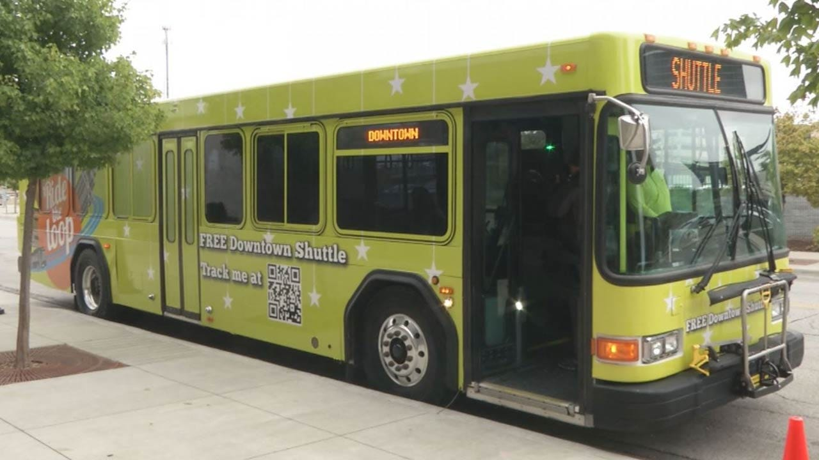
Transportation
The cruise terminal is located about 3 kilometers from downtown. You'll find:
Free shuttle buses running every 30 minutes between the port and city center.
Local taxis readily available (expect to pay around 15 CAD for downtown trips)
Walking is possible but takes about 40 minutes to reach downtown

Slide 10

Top Attractions & Points of Interest
Centre Boréal
This interpretation center showcases the region's unique ecosystem and industrial heritage. The interactive exhibits about the boreal forest are fascinating, and the panoramic views of the St. Lawrence River are breathtaking. Arrive before 11 AM to catch their excellent guided tours in English.

Slide 11
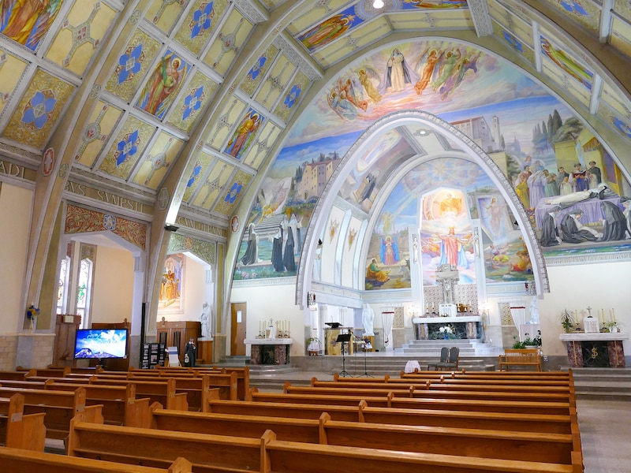
Top Attractions & Points of Interest
St. Amélie Church
A stunning example of modern religious architecture, this church features remarkable stained glass windows and a unique angular design. The morning light creates an absolutely magical atmosphere inside – photographers, take note!

Slide 12

Top Attractions & Points of Interest
Jardin des Glaciers
Experience the last ice age through state-of-the-art multimedia presentations. It's like stepping 20,000 years back in time! The guided tour takes about 90 minutes and offers fascinating insights into how glaciers shaped this entire region.

Slide 13

Local Cuisine & Dining Options
Traditional Dishes
Quebec's North Shore is famous for its seafood, and Baie-Comeau doesn't disappoint.
The local specialty is fresh snow crab (in season from April to July).
Another must-try is tourtière, a hearty meat pie that reflects the region's French-Canadian heritage.
For the adventurous, try the cloudberries (called "chicoutai" locally) they're a rare arctic delicacy with a unique honey-like taste.

Slide 14
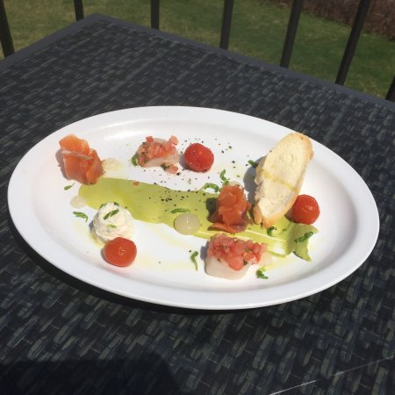
Local Cuisine & Dining Options
Dining Recomendations
Café Bistro Le Spinnaker: Perfect for lunch with excellent seafood chowder and harbor views
Restaurant Le Mora: Higher-end dining featuring local ingredients and spectacular presentations
Casse-Croûte du Pêcheur: For casual, authentic Quebec fast food including poutine

Slide 15
Important Tips & Practical Advice
Time to visit attractions: Most of the major sites can be visited in 1-2 hours, so plan for 3-4 hours if you want to see it all.
Booking excursions: Cruise lines offer packages, but you may find better value booking independently through reputable tour companies.
Remember that Baie-Comeau operates on Eastern Time (ET). Plan to be back at least an hour before departure – better to have time for one last photo than to be running for the last tender.

Slide 16
Thanks For Coming
If you have any more questions, please ask.
I will do my best to answer them for you.
Have a great visit in Baie-Comeau, Quebec !

