Slide 1
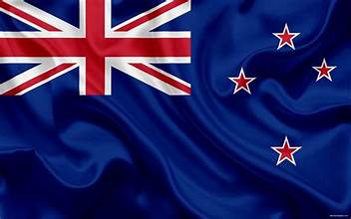
Auckland, New Zealand Presented by Marc Silver
As they say in New Zealand, “Kia ora” which is a Māori greeting for Welcome.

Slide 2
What I Will Cover
My Port Philosophy
Don’t Miss the Ship
Money
About Auckland
Area Map of Auckland
Map of Auckland
Auckland Transportation
Places to see or at least consider
A few restaurant recommendations
Conclusion

Slide 3
My Port Philosophy
I have been cruising for over 45 years and have taken over 200 cruises. So, I consider myself an experienced cruiser.
The information I will present is based on those many years of
experience.
When I am on a cruise here the city, I want to visit is not the port city,
I always recommend taking a ship’s tour.
But when I am in a port with multiple attractions nearby and easy to see
on my own - I will do it on my own.
This presentation is for that type of port.

Slide 4

Don’t Miss the Ship
How to Avoid Missing Your Ship
Pay attention to the time. - Ship time and local time are often different.
Put a return-to-ship reminder on your phone.
Choose excursions wisely.
If a ship-sponsored excursion is late returning to port, the ship will wait for you. If you are on your own???
Be Prepared
Have your Passport, Credit Card, and phone numbers for your ship port agent.
What to Do If You Miss the Ship Most cruise lines have port agents stationed in the port area to assist if your ship has left without you. If your are lucky, when cruisers are late returning to the vessel, the ship’s crew will often remove the passengers’ essential items – passports, cell phones, and medication -- from the ship to leave with the port agents.
The Port Officials can help you with contacting your ship and making necessary travel arrangements.

Slide 5
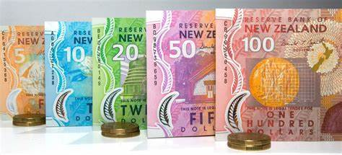
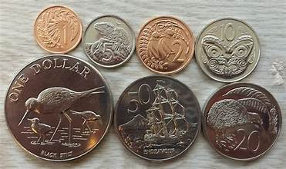
Money
The currency for Auckland is the New Zealand Dollar (NZD).
The conversion at the rate is $ 1.63 (NZD) to $1.00 U.S.
Or $1 (NZD) to $. 61 U.S.

Slide 6
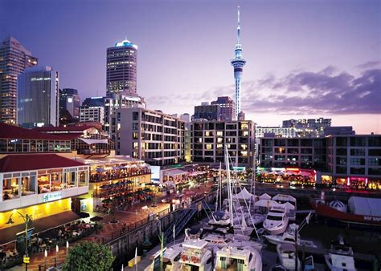
About Auckland
The main feature of human settlement in the Auckland region has been the development of a substantial urban area (the largest in New Zealand) in which approximately 90% of the regional population live.
This metropolitan area is located on and around the central isthmus and occupies around 10% of the regional land mass.
Auckland is home to over 1.4 million people, Auckland is a vibrant center for trade, commerce, culture and employment.

Slide 7
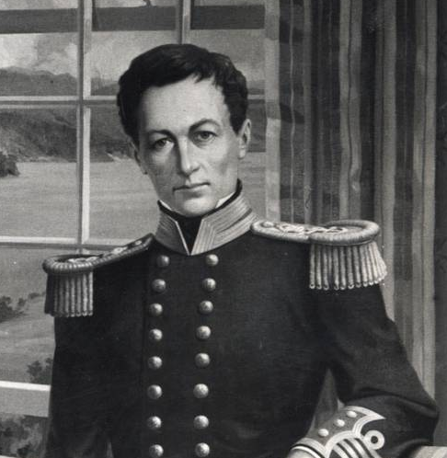
Brief History of Auckland
1840 – 1859: The inaugural years
Auckland was founded on the 18th of September 1840 by the Governor of New Zealand, William Hobson. At that time, it was New Zealand’s capital.
Hobson chose the area and purchased 3,000 acres ) from local Mäori Chiefs, for an assortment of blankets, money, trousers, tobacco, gown pieces and hatchets.
The original Deed of Purchase on October 20 1840 included the what is now the majority of the area west of Downtown.
Within a few months of the legal foundation of the city. the Surveyor-General, drew up a plan for the capital and the first land sales were held in April 1841, only six months after the first landing at Point Britomart.

Slide 8
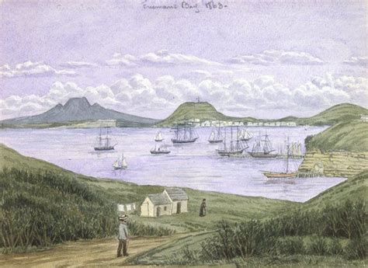
Brief History Cont.
1840 – 1859: The inaugural years
Land sales started in 1841, and people began to live in and around what was then referred to as Commercial Bay (at the base of Queen Street). This area served as the prime source of livelihood, directly or indirectly, for the majority of the people.
Commercial activities were located to the east of Queen Street along Shortland Crescent (now known as Shortland Street) to Point Britomart, the original shoreline of Commercial Bay.
Over the next two decades the areas of Freemans Bay and Mechanics Bay became established. Land reclamation began in 1859 from Shortland Street to the foot of Franklin Road in Freemans Bay.

Slide 9
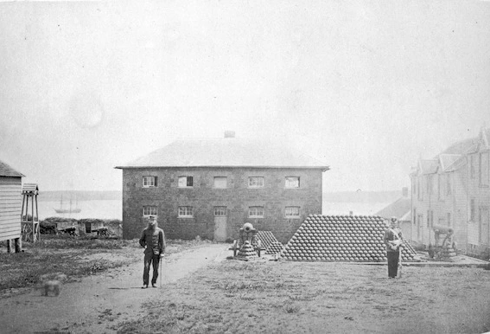
Brief History Cont.
1840 – 1859: The inaugural years
By the late 1840s, road infrastructure had been laid over most of the isthmus, but elsewhere navigable waterways, assisted by the portages at Riverhead, Otahuhu and Waiuku, remained the most important links between Auckland and its outlying settlements.
In 1841, New Zealand’s first British fort was established on Point Britomart, on and previously occupied by a Mäori pa.
The fort was established to control Auckland’s harbor entrance and bring order to the growing settlement. In the 1860s, during the New Zealand Wars, the barracks at Fort Britomart were used to house 10,000 troops.
Fort Britomart

Slide 10
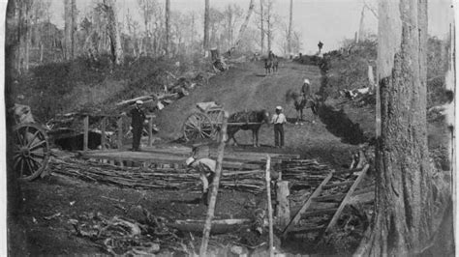
Brief History Cont.
1860 – 1879: Land wars and development of rail lines
In the early 1860s, Mäori resentment over land losses and Auckland’s growth led to Pakeha fears that Auckland was vulnerable to attack from Waikato to the south. The city’s garrison was enlarged by 12,500 British troops and military settlers.
Preparations for war began with the construction of the Great South Road and a chain of military protective barriers through Franklin.
Development of the southern part of the region continued once the hostilities settled in 1864. By that time the electric telegraph had been introduced and regular coach services were operating.
This facilitated growth in the outlying settlements of the isthmus.
Great South Road

Slide 11
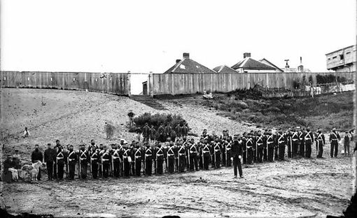
Brief History Cont.
1860 – 1879: Land wars and development of rail lines
There were major flows of settlers from the British Isles to the colony during this time, encouraged by an active recruitment drive that included free or assisted passage.
Bombay Hills area received its name in 1866 from its settlement by immigrants who arrived on the ship ‘Bombay’.
The township of Howick was established in 1874 when three companies of the Royal New Zealand Fencibles were assigned to defense posts. They were retired soldiers, mostly Irish, enlisted to serve for seven years in exchange for a cottage and an acre of land.
Howick was the largest of the four Fencible settlements, with 804 people in three companies by 1884.

Slide 12
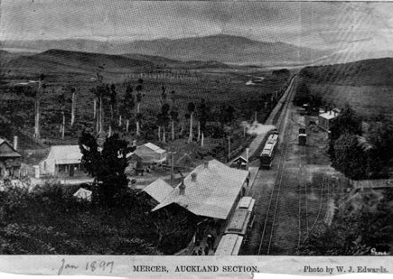
Brief History Cont.
1860 – 1879:Land wars and development of rail lines
After a period of economic decline in 1865, Auckland’s economy boomed again in 1870 primarily due to the discovery of gold at Thames and Waihi in the Coromandel Peninsula, west of Aukland, and a booming timber export industry.
The city grew as a commercial center and housing continued to be developed around the city.
Starting in 1870, railway links were laid to Onehunga, Helensville and the Waikato, and the first train ran in Auckland in 1872 on the Auckland Mercer line.
In 1869, water began being piped from the Auckland Domain springs into the town to facilitate growth, and settlement continued south towards Mt Eden, Otahuhu and Panmure.

Slide 13
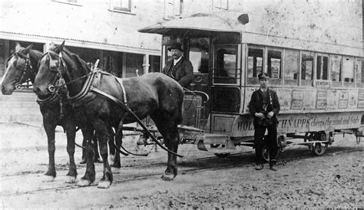
Brief History Cont.
1880 – 1899: Economic expansion
Growth in the commercial services sector as well as large-scale manufacturing broadened the region’s economy during this period.
The main forms of public transport consisted of rail, horse-drawn trams and ferries. These transport innovations permitted a closer integration of the more outlying townships.
In 1884, the first horse-drawn tram operated between Queen Street and Ponsonby. Horse-drawn trams became a common form of public transport.
To the west, rail links encouraged settlements as well. At this time, the main built area comprised of what is now the Central Business District (CBD) and the adjacent suburbs.

Slide 14
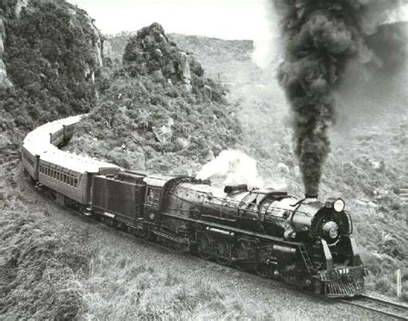
Brief History Cont.
1900 – 1929: Turning into a city
The Auckland urban form changed dramatically in the first two decades of the 20th century.
By the turn of the century, dairy farming had become the new source of wealth in New Zealand, and Auckland thrived as dairying expanded throughout the periphery.
Meat and dairy produce was processed in factories at Penrose and Otahuhu, and then exported from the ports of Onehunga and Commercial Bay.
Auckland became New Zealand’s largest industrial center by the end of the first decade.
During this period of economic growth, the Railways Department issued ‘workmen’s tickets’ at low rates to stimulate settlements in the outer suburbs served by the railway north, west and south of the town center

Slide 15
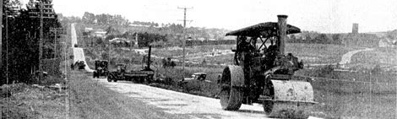
Brief History Cont.
1900 – 1929: Turning into a city
Construction of an electric tramway system began in 1901 which became the main instrument for Auckland’s metropolitan expansion into the early 1920s.
Motorcars and buses also started to emerge in the first decade of the 20th century, but were not as popular as rail, tram and ferry links, due to cost and availability.

Slide 16
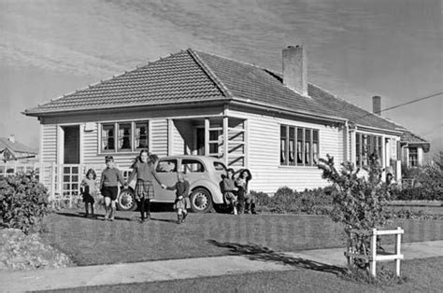
Brief History Cont.
1930 – 1949: Emergence of State housing provision
This period includes the national and international watershed events of the economic depression of the 1930s, as well as World War Two (1939 to 1945).
Auckland population growth slowed during the ‘Great Depression’ as large scale urban - rural drift took place but the growth rate sharply increased again, as the direct effects of the economic depression started to wear off.
The population shift became more established during the 1930s throughout Auckland, as a result of new roads, tramlines and infrastructure, and increased state intervention in the provision of housing.

Slide 17
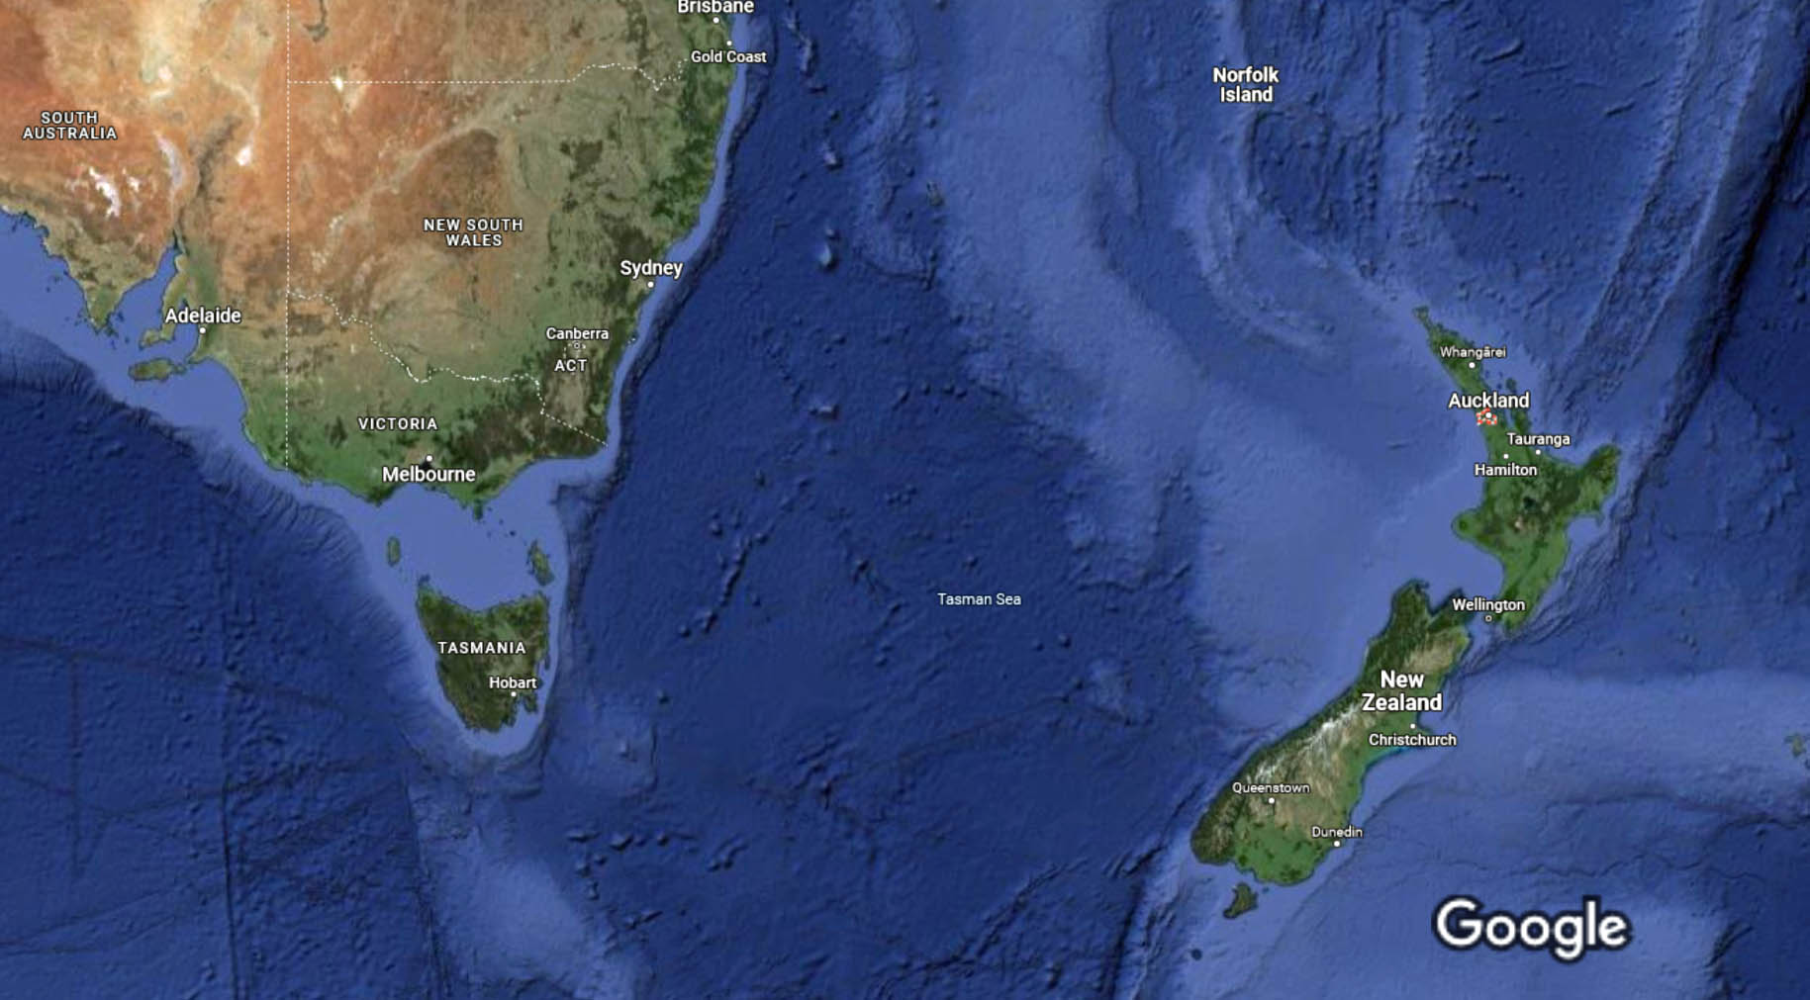
New Zealand Area Map
Auckland

Slide 18
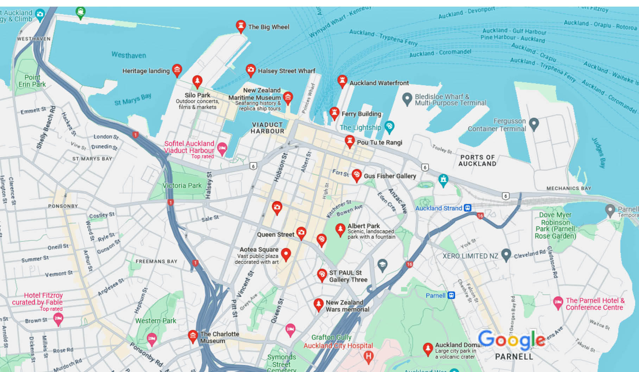
Map of Auckland

Slide 19

Auckland Transit System
Auckland has one of the most comprehensive and user-friendly public transport.
You can buy HOP cards from vending machines at the Downtown ferry terminal for $25 ($5 for the card plus $20 credit).
Eligible seniors with a SuperGold card need to buy a gold AT HOP card to travel on public transport at discounted rates. Senior citizens can travel for free on AT trains and selected bus and ferry services.
Offer applies after 9am on weekdays and all day on weekends and public holidays. You must have an AT HOP card loaded with a SuperGold concession.
The $5 card charge is not refundable.
Cash fares for public bus services start at NZ$2.50 to travel a short distance if paying in cash or are a little cheaper with HOP cards.

Slide 20
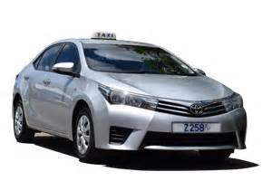
Auckland Taxis
Standard taxis provide a safe and reliable way to explore the city or for transport between the cruise port and various attractions.
Like taxis in most locations the cost is significantly more expensive than other modes of transport.
Uber, Lyft, Didi, and Ola rideshares are also available in Auckland.

Slide 21
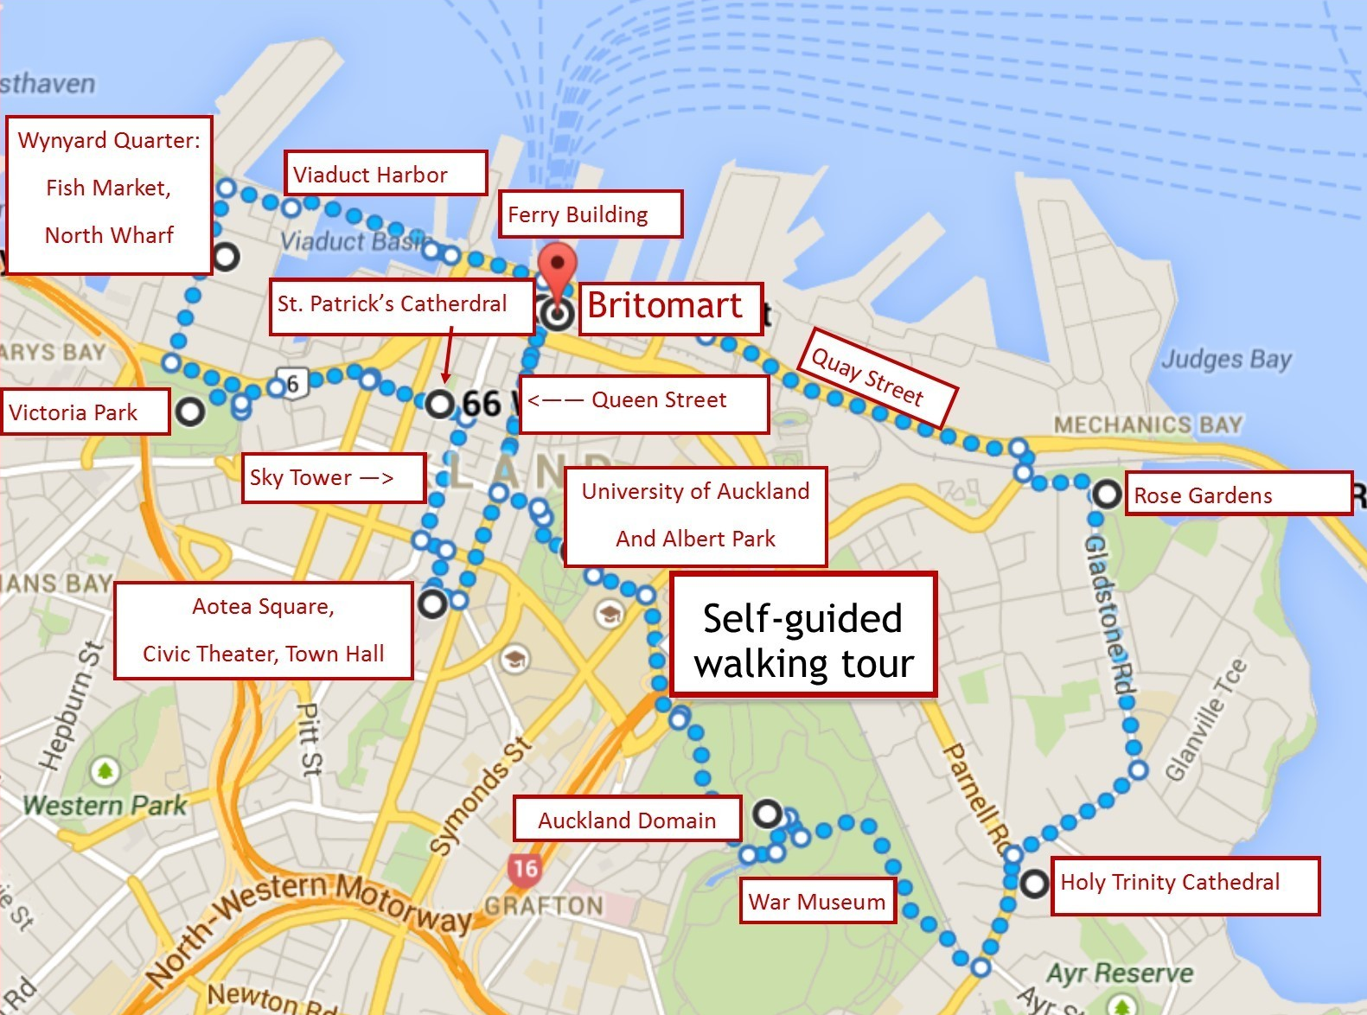
Auckland Walking Tour
Take a Auckland walking tour of the interesting points and historic buildings in the capital city of Auckland.
Places You Will See on your walk: Quay Street, Britomart, Ferry Building, Viaduct Harbor, Fish Market, Victoria Park,St. Patrick’s Cathedral, Sky Tower, Aotea Square, Albert park, Auckland Domain, War Museum, War Museum, Holy Trinity Cathedral, Rose Garden

Slide 22
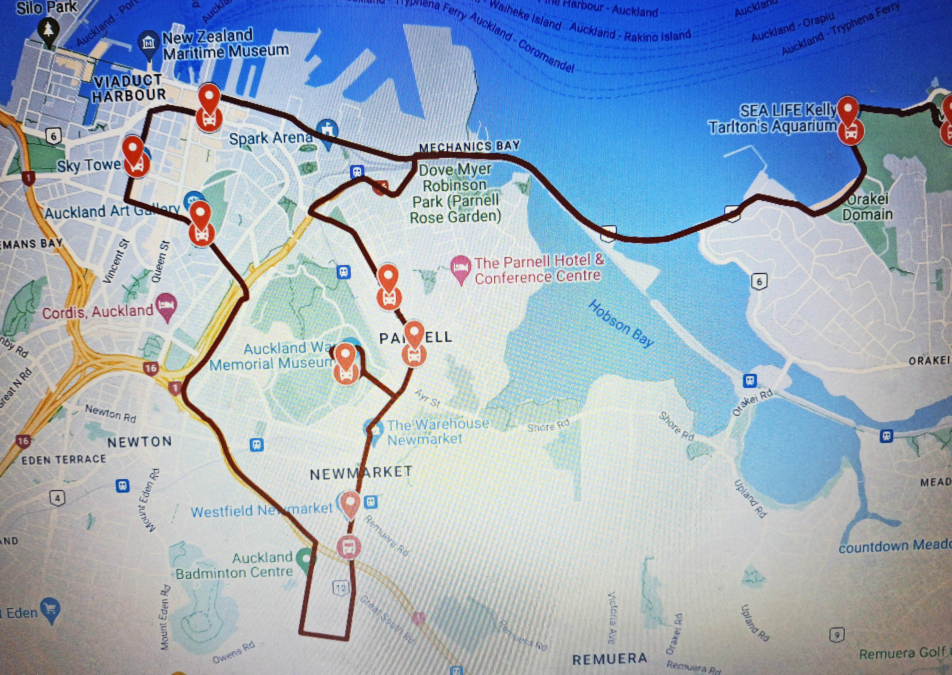
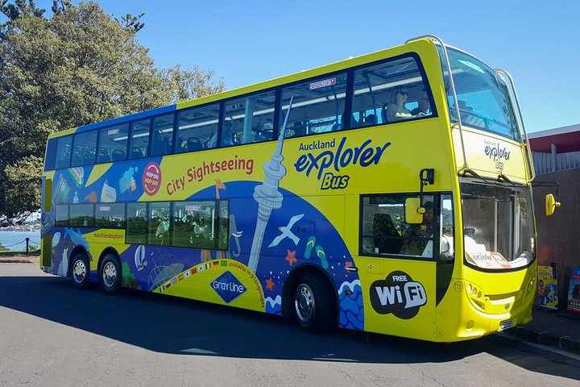
Hop-on Hop-off Tour
The Auckland hop-on hop-off bus tour provides all the benefits of a guided tour—including hassle-free transport and on-board audio commentary—with the flexibility of independent travel.
Adult $55, Child $27 Family $150*

Slide 23
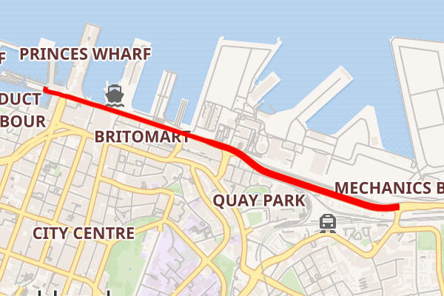
Quay Street
Quay Street is the northernmost street in the Auckland CBD, New Zealand.
The Auckland Ferry Terminal, which has ferries running to Devonport, Waiheke Island, and other places in Waitematā Harbor; the Hilton Auckland hotel; and Ports of Auckland are on the north side of the street.
The Britomart Transport Centre, Queen Elizabeth Square and Grand Mercure Auckland hotel are on the south side.

Slide 24
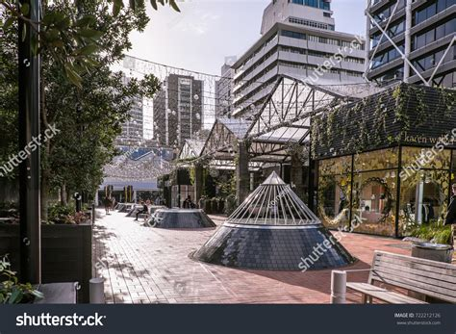
Britomart
Britomart transport and entertainment precinct, is named for the HMS Britomart, a British brig that raised the Union Jack over Auckland for the first time in 1840.
Britomart is the central train station and bus transport hub, but the area is also full of renovated historic buildings housing everything from clothing boutiques, bars and nightclubs, yoga studios, and fantastic international cuisine.

Slide 25
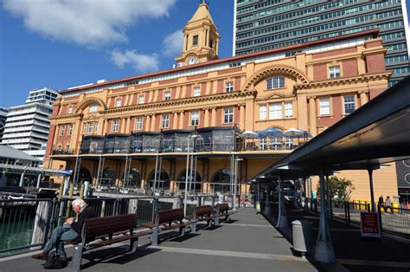
Ferry Building
Explore the crown jewel of the harbor front, the Auckland Ferry Terminal. The site of this magnificent terminal was once just salt and sea breeze, the land reclaimed by building a base of native granite.
When the terminal was completed in 1912, people catching a ferry thought the building was so beautiful that they didn’t want to leave!
The Ferry Terminal building is composed of two main structures, a yellow Edwardian Baroque building facing Queen Street and the CBD, and a newer waiting area building (which became the actual ferry terminal of today) facing the Waitematā Harbor.

Slide 26
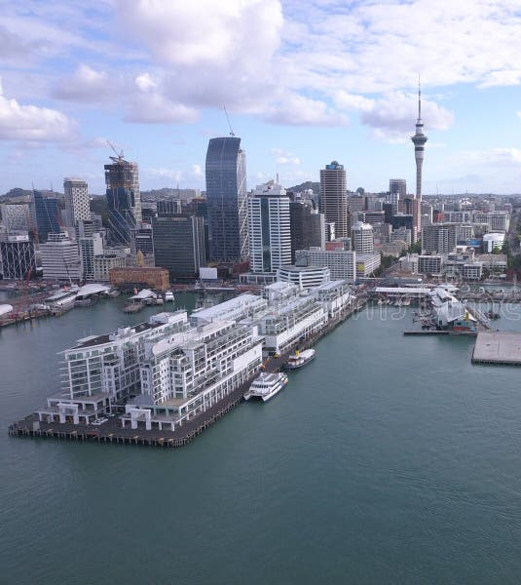
Viaduct Harbor
Viaduct Harbor is home to some of Auckland’s best restaurants and bars. From cocktails to cafes, there is something to inspire everyone’s palette.
It is also a world-class marina, luxury hotels, apartment living and business quarters.
Viaduct Harbour is a vibrant waterfront community welcoming residents, workers and visitors to the heart of Auckland.

Slide 27

Auckland Fish Market
Auckland Fish Market is not just a place to be fresh fish, it also has dozens of places to eat fish as well.
It is widely considered one of the best Fish Markets in New Zealand and well worth the visit.

Slide 28
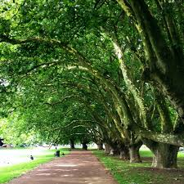
Victoria Park
Victoria Park is a park and sports ground in the Auckland city center, New Zealand. It was opened in 1905 and named after the queen who had died four years earlier.
It lies on reclaimed bay land in Freemans Bay, a suburb directly west of the Auckland CBD.
The bay started to be filled in as early as the 1870s although the bulk of the reclamation appears to have happened after 1901.
The Park was 'finished' around 1912, the area to the north (called the Western Reclamation) dates from after that.

Slide 29
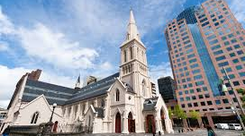
St. Patrick’s Cathedral
The Cathedral of Saint Patrick and Saint Joseph (usually known as St Patrick's Cathedral) is an heritage-listed Catholic cathedral church in Auckland CBD, situated on the corner of Federal Street and Wyndham St. It is the mother church of the Roman Catholic Diocese of Auckland and the seat of the Bishop of Auckland.
In 1841, the land was acquired by Bishop Jean-Baptiste Pompallier, the first Catholic bishop in New Zealand.
A wooden chapel was constructed in 1843, replaced by a stone church in 1848, which was expanded in 1884, and finally replaced with the current cathedral in 1907.
The church was designated as a cathedral in 1848, and consecrated in 1963.

Slide 30
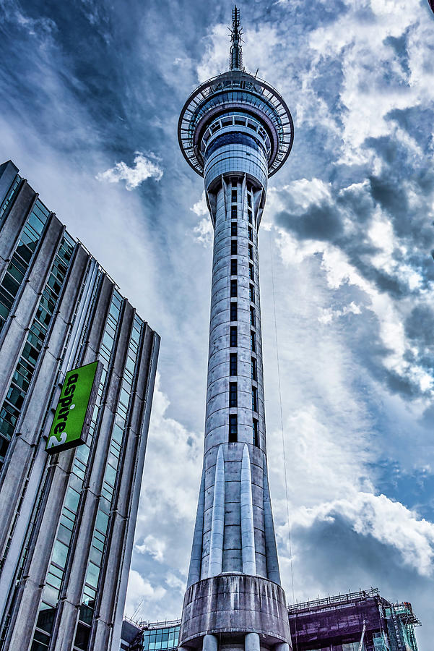
Sky Tower
The iconic 1076-foot-tall Sky Tower has stood for over 25 years.
Take the elevator to above the clouds and experience an incredible 360° view of Tāmaki Makaurau, taking in ancient volcanoes, sparkling sunlit harbors and beyond.
ADULT 15 years and above |  | $42
CHILD 3-14 years |  | $20
CHILD 2 years and under |  | FREE
FAMILY PACK (2 Adults and up to 2 Children) |  | $109

Slide 31
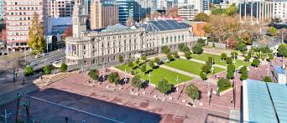
Aotea Square
Aotea Square is a large paved public area in the CBD of Auckland.
Officially opened in 1979 by Sir Dove-Myer Robinson next to Queen Street, it is used for open-air concerts and gatherings, markets, and political rallies.
In November 2010, a major redevelopment of Aotea Square was completed.

Slide 32
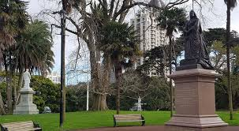
Albert Park
Albert Park is one of Auckland’s best parks.
Its central location in the heart of the city, together with its long history and distinctive character, have earned it a special place in the hearts of Aucklanders and made it an important destination for visitors.
At one corner of the park is the Auckland City Art Gallery and gardens, and on the other side is the original park-keepers cottage which is now a museum of memorabilia.
It's the perfect place for a lunchtime stroll and somewhere to eat your lunch on a lovely sunny day.

Slide 33
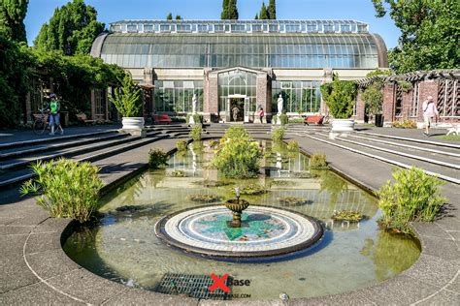
Auckland Domain
The Domain was set aside in 1880 as a 200-acre public reserve.
In the 1880s, a pond and the area immediately surrounding it were used by the Auckland Acclimatization Society as a testing ground for exotic fish and plant species.
These early plantings developed into the initial site of Auckland's botanic gardens, leaving a legacy of magnificent mature trees for visitors to enjoy today. The pond, fed by an underground spring, went on to become Auckland's first water supply.
Today it is populated by ducks and the outflow stream runs alongside the picturesque 'Lovers Walk' track through a hillside section of native forest.

Slide 34
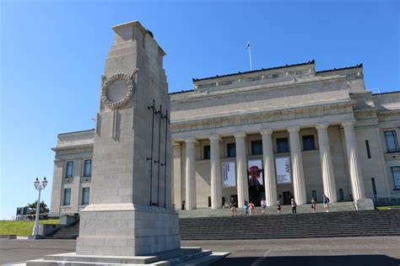
War Museum
Auckland Museum's collections and exhibits began in 1852.
In 1867 Aucklanders formed a learned society—the Auckland Philosophical Society, soon renamed Auckland Institute.
Within a few years Auckland Museum was transferred to Auckland Institute, thereafter known as Auckland Institute and Museum until 1996.
Auckland War Memorial Museum was the name of the new building opened in 1929, but since 1996 it has been more commonly used for the institution as well. \
Admission Fee:
Adults $19.25
Children $12.00

Slide 35
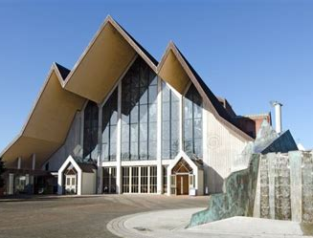
Holy Trinity Cathedral
Holy Trinity Cathedral is an Anglican cathedral situated in Parnell, a residential suburb of Auckland, New Zealand.
It is the 'mother church' of the Anglican Diocese of Auckland and the seat of the Bishop of Auckland.
The current main church building was consecrated in 1973.

Slide 36
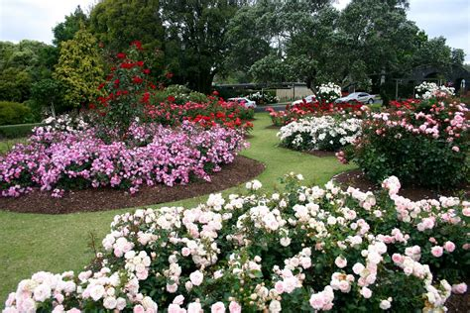
Rose Garden
Visit the Rose Gardens at Auckland Botanic Gardens and admire these plants that have inspired so many poets and lovers over history with their plush flowers and delicious .
Roses have a reputation for being high maintenance and susceptible to pest and disease. The rose gardens here prove otherwise! Before roses become successful members of the collection they go through 3 years of trials.
Only those that thrive, without chemical applications, succeed. You too can grow beautiful roses in Auckland without as much energy as you may have thought.

Slide 37
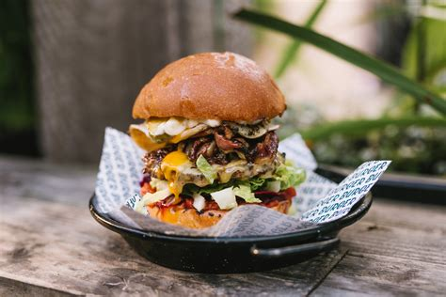
Restaurants in Auckland
There are a lot of excellent restaurants in Aukland. But there are many choices close to the ship at VIADUCT HARBOUR.
This list may be of help:
Bivacco - A bold, Italian.
Boracay Garden - is a Filipino restaurant.
COOPS Corner Pub known for their grazing plates.
Cellar Bar is a late-night party hub.
Danny Doolan’s offers hearty pub fare.
Dr Rudi's Rooftop Brewing Co. is a rooftop bar and brewery serves lunch.
Esther brings a taste of the Mediterranean.
Frida Cocina Mexicana & Tequila Bar serves up authentic Mexican flavours.
Giraffe’s spacious cafē and bistro is a great spot to enjoy all-day dining.
Grand Harbour offers an authentic Chinese dining.
HQ for great food, drinks and music.
Hello Beasty offers contemporary Asian food.
Homeland is both an eatery and a cooking school.
La Marée offers both French and Italian dinning.

Slide 38
Conclusion
Auckland is a beautiful City with a rich history and numerous attractions. Regardless of what you're looking for, Auckland has something for everyone.
I hope this presentation will help when we visit Auckland!

Slide 39
Thanks For Coming
If you have any more questions, please ask.
I will do my best to answer them for you.
Have a great visit to Auckland!

Slide 40
Acknowledgement
My seminars are the result of many years of travel experience combined with many hours of research over the internet.
I would like to acknowledge the many source I have accessed.
These include: Wikipedia.com, Britannica.com, and the various Museum, Park and Government websites.

