Slide 1

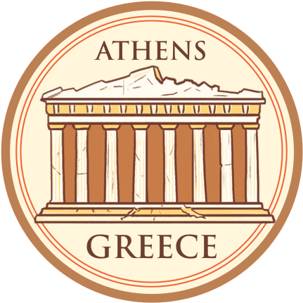
Athens Presented by Marc Silver

Slide 2
What I Will Cover
My Port Philosophy
Don’t Miss the Ship
Money
About Athens
Map of Greece
24 Hour Tourist Card
Hop On – Hop Off
Places to see or at least consider
A few restaurant recommendations
Conclusion

Slide 3
My Port Philosophy
I have been cruising for over 46 years and have taken over 100 cruises. So, I consider myself an experienced cruiser.
The information I will present is based on those many years of
experience.
When I am on a cruise where the city I want to visit is not the port city,
I always recommend taking a ship’s tour.
But when I am in a port with multiple attractions nearby and easy to see
on my own - I will do it on my own.
This presentation is not like that.

Slide 4
Don’t Miss the Ship
How to Avoid Missing Your Ship
Pay attention to the time. - Ship time and local time are often different.
Put a return to ship reminder on your phone.
Choose excursions wisely.
If a ship-sponsored excursion is late returning to port for, the ship will wait for you. If you are on your own???
Be Prepared
Have your Passport, Credit Card and phone numbers for your ship port agent.
What to Do If You Miss the Ship Most cruise lines have port agents stationed in the port area to assist if your ship has left without you. If your lucky, when cruisers are late returning to the vessel, the ship's crew will often remove the passengers' essential items -- passports, cell phones and medication -- from the ship to leave with the port agents.
The Port Officials can help you with contacting your ship and making necessary travel arrangements.

Slide 5
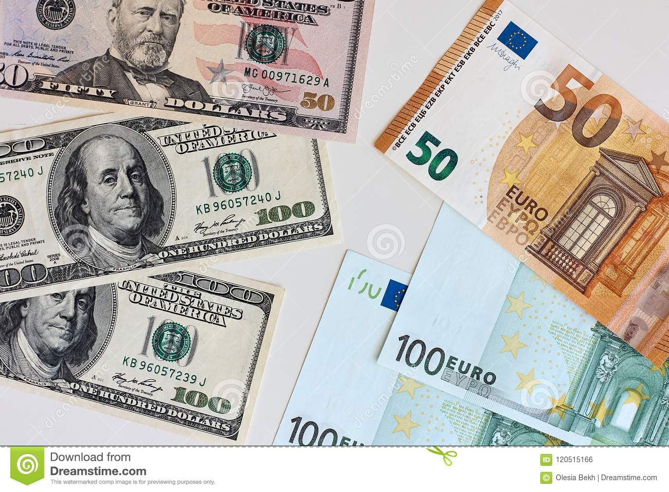
Money
The euro is the official currency of 20 European Union countries which collectively make up the euro area, also known as the euro-zone
Official Exchange is $1.079 US to €1

Slide 6
About Athens
Athens is Europe’s oldest capital city that dates back to 3,000 B.C.
The ancient Olympic games were never actually held there but is was the birthplace of the modern Olympic games in 1896. However, the ancient Olympics were never actually held in Ancient Greek Athēnai the original Greek capital.
Athens was the birthplace of democracy.
In 500 B.C., a system was enacted in Athens where eligible citizens could directly vote on laws – giving rise to democracy.
The marathon was named after a long run to Athens in 490 B.C.
The first-ever plays were performed in Athens.
Athens set the precedent for performing arts, with a history of theater that dates back thousands of years. Today, there are nearly 150 theaters in the city.

Slide 7
About Athens
Athens is one of the only cities to have experienced all types of government. Monarchy, democracy, socialism, capitalism and communism. Athens has experienced them all.
The highest temperature ever recorded in Europe was recorded in Athens.
On July 10, 1977, the temperature in Athens reached a record-breaking high of 118.4 °F which was the hottest temperature ever recorded in Europe.
About 18 million tourists visit Athens each year.
That’s about six times Athens’ total population! The Acropolis, the Parthenon, and the Temple of Olympian Zeus are three of the many must-see attractions that draw millions of visitors to Athens each year.

Slide 8
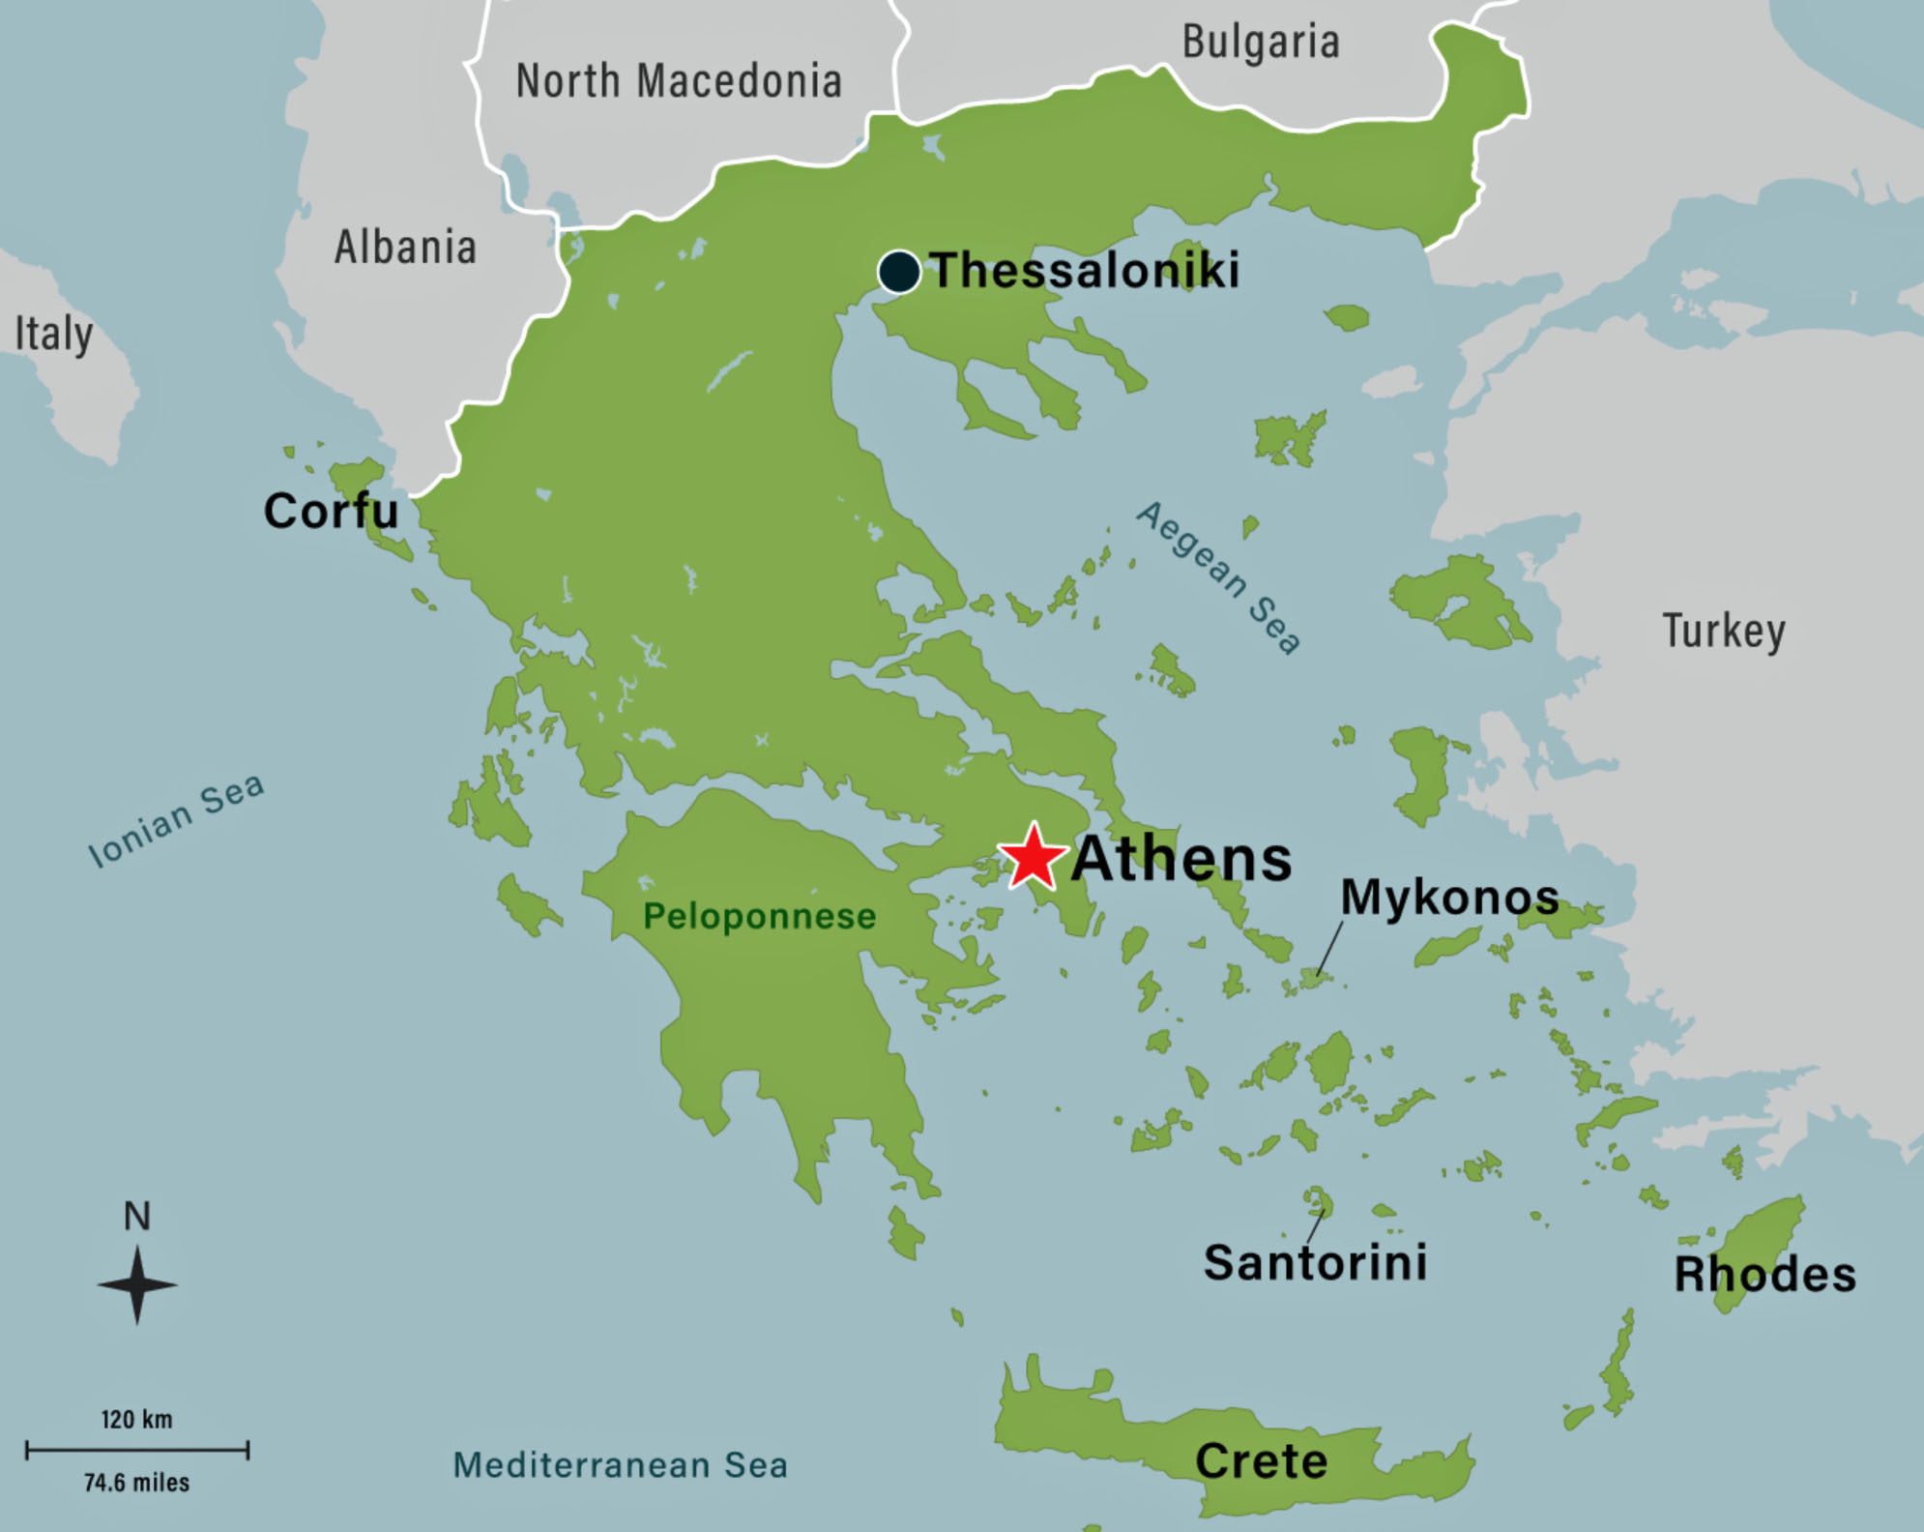
Map of Greece

Slide 9
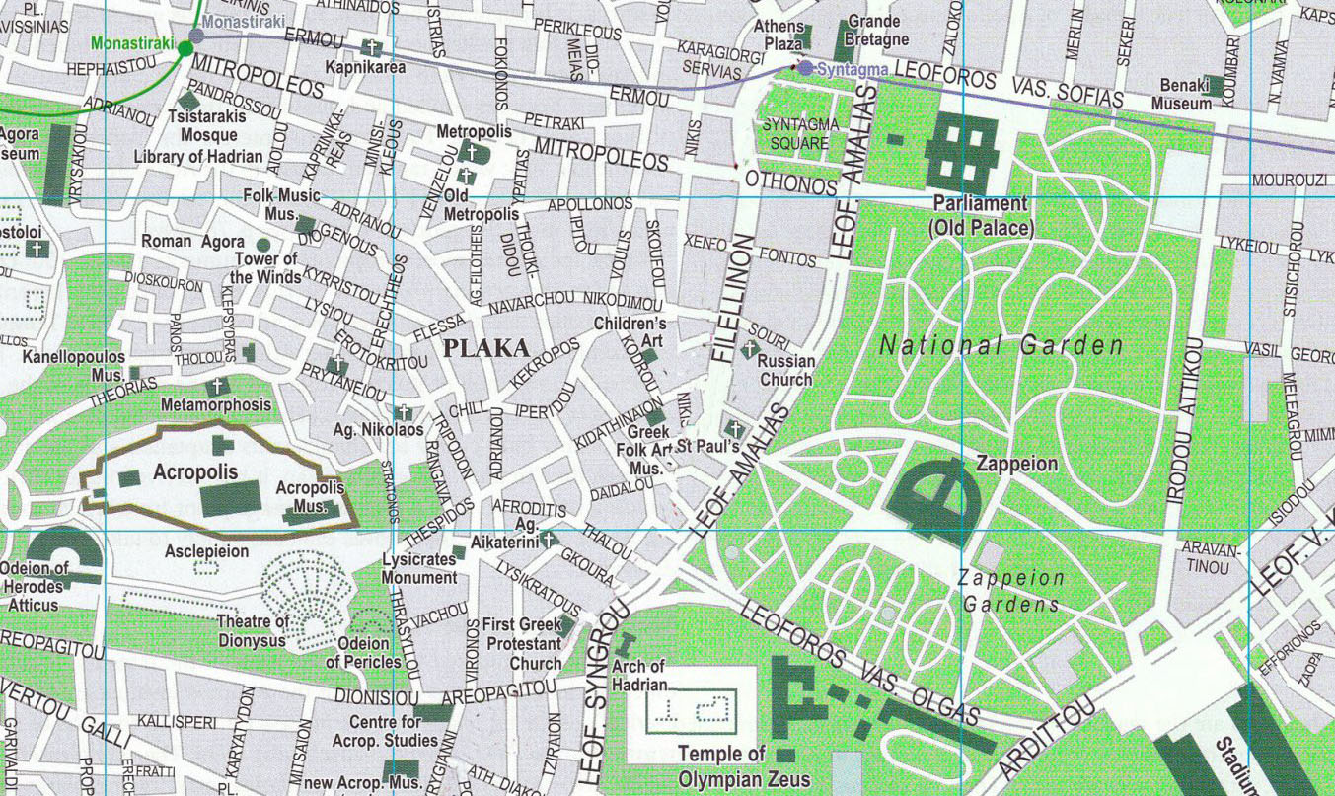
Map of Athens

Slide 10
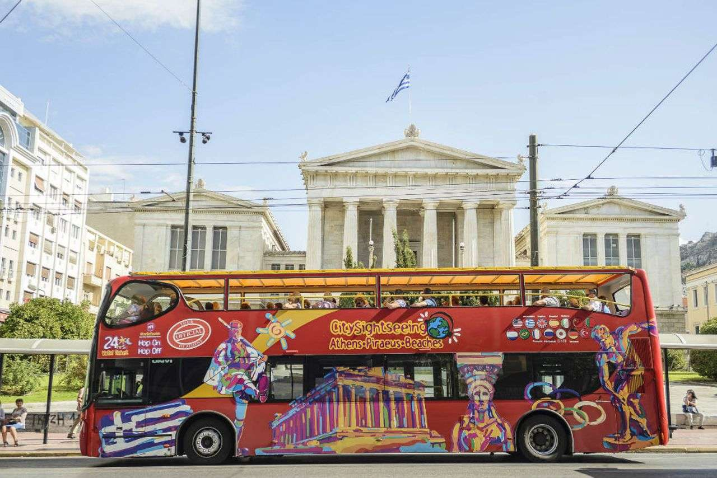
24 Hour Hop-on Hop-off Bus
I have to admit I rarely use or recommend the Hop-on Hop-off Bus, but in Athens, it's one of the easiest way to see a lot. Tickets available to see the sights at your leisure.
Stops include:
Syntagma Square
Plaka
The Acropolis & Parthenon
Temple of Zeus
From
€16 per person

Slide 11
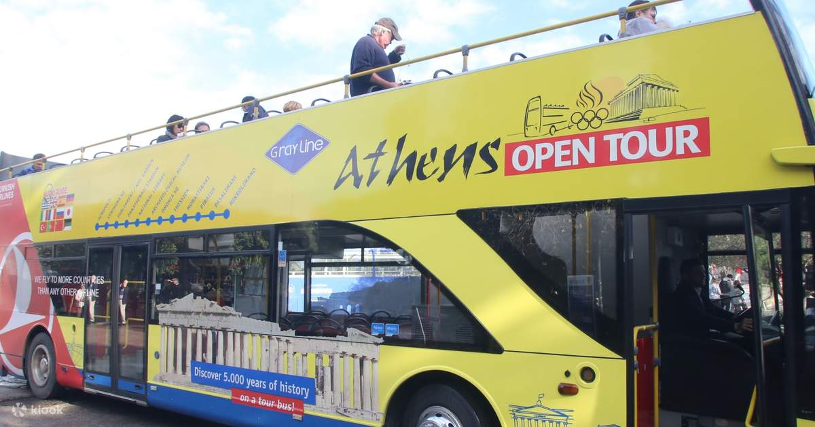
Hop-on Hop-off Bus Stops
Could there possibly be a city with a richer history than Athens? With over 3000 years of civilization under its belt, Athens is heralded as the birthplace of democracy. You’ll be a Greek history buff in no time listening to our informative audio guide as you zoom along to your chosen destination. Hop off right in the heart of the city, at the iconic Syntagma Square. The Athenians rose up against King Otto of Greece here in 1843 and it remains a a hotbed of political activity today. Explore the lovely nearby neighborhood of Plaka, where you’ll find pavement cafes spilling onto
cobbled lanes lined by cheery bougainvillea.

Slide 12
Athens Transport Tickets
The public transport system in Athens offers various kinds of electronic tickets, monthly and yearly travel cards that are easily rechargeable. The price of transport tickets in Athens are cheaper than most other European cities.
The following tickets are valid for the city’s public buses, trolleybuses,
metro, tram and commuter trains.
90-minute ticket: € 1.20 (US$ 1.30)
24-hour ticket: € 4.10 (US$ 4.50)

Slide 13
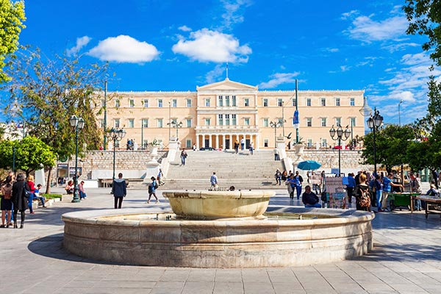
Syntagma Square
Syntagma Square or "Constitution Square" is the central square of Athens.
It is located in front of the 19th-century Old Royal Palace, housing the Greek Parliament since 1934. Syntagma Square is the most important square of modern Athens from both a historical and social point of view, at the heart of commercial activity and Greek politics. The metro station is located underneath the square, where lines 2 and 3 connect, along with the tram terminal and the numerous bus stops, and constitutes one of the busiest transport hubs in the country.

Slide 14
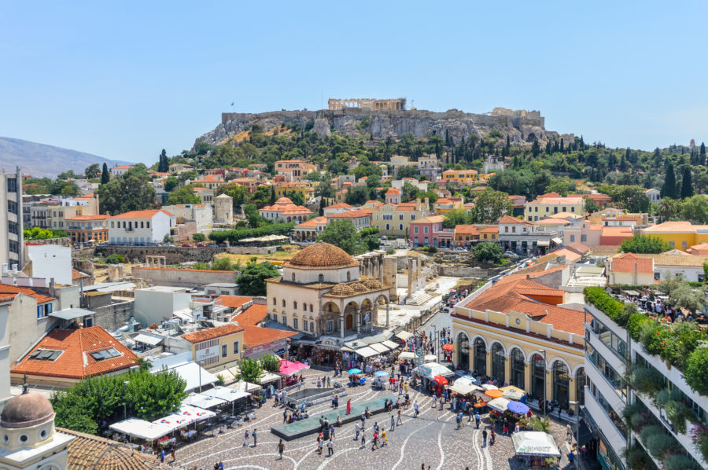
Plaka
Plaka Athens: Famous as a shopping Athens hub. The area is found between Syntagma and Monastriraki and it is easily accessed on foot from the center of Athens. Due to the numerous ancient Greek monuments that are scattered all around the area, Plaka is also known as the "neighborhood of the gods".

Slide 15
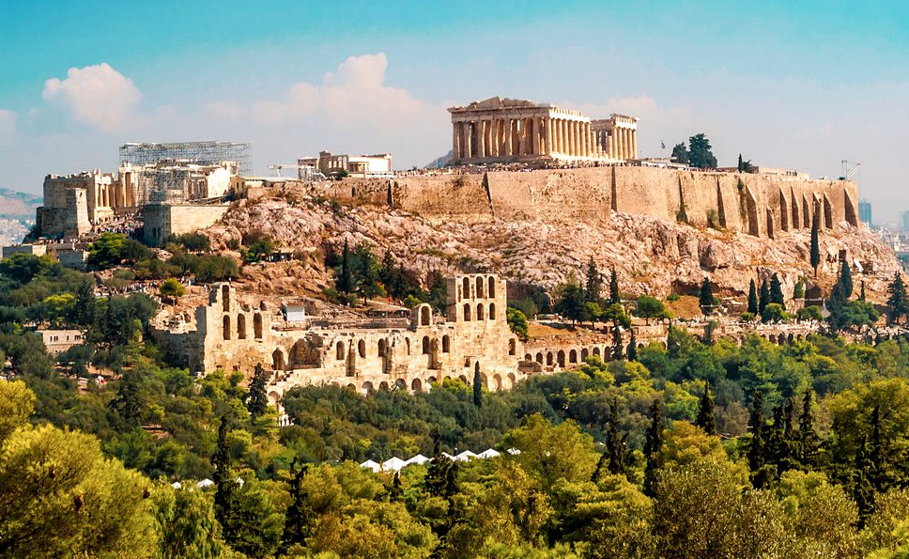
The Acropolis
The Acropolis of Athens is located on a rocky outcrop above the city of Athens and contains the remains of the most famous buildings.
There is evidence that the hill was inhabited as early as the fourth millennium BC, and the buildings whose present remains are the site’s most important ones, including the Parthenon, the Propylaea, the Erechtheion, and the Temple of Athena Nike. The Parthenon and the other buildings were seriously damaged during the 1687 siege by the Venetians during the Morean War when gunpowder being stored by the then-Turkish rulers in the Parthenon was hit by a Venetian bombardment and exploded.
Site Admission: €24.50
Acropolis Museum Tickets €17

Slide 16
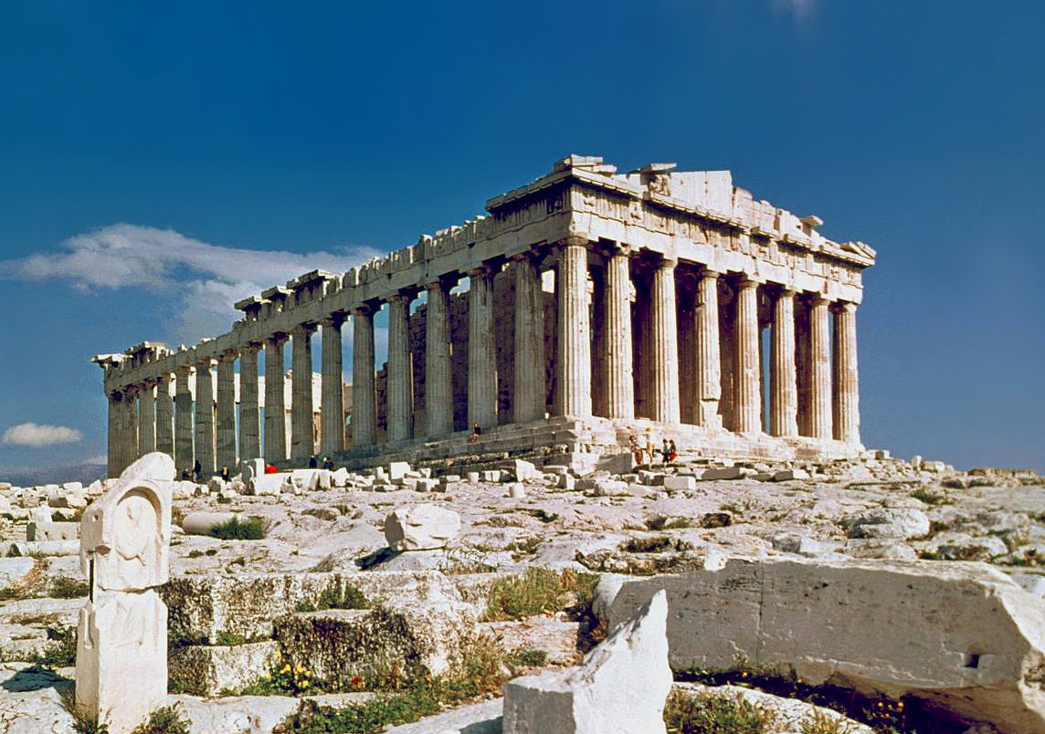
The Parthenon
Dedicated to the city’s patron, the goddess Athena, the temple was completed in 438 BC, just in time for the Panathenaia—a festival held every four years on the Acropolis.
The Parthenon was built to replace two earlier temples dedicated to Athena, including an unfinished one in the same spot.
Constructed entirely of Pendeli marble, the Parthenon represents architectural perfection—a pinnacle of human achievement.
A ticket to the Acropolis includes the Parthenon

Slide 17
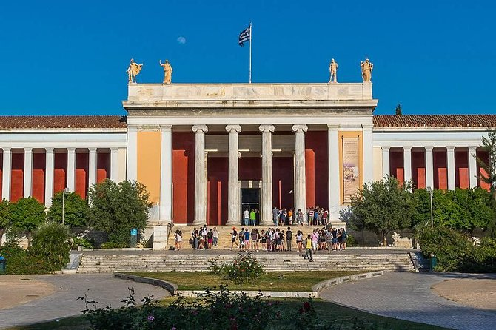
National Archaeological Museum
The National Archaeological Museum was founded at the end of the 19th century is, not only the largest archaeological museum in Greece, but its collection of Ancient Greek art is considered one of the finest in the world.
The National Archaeological Museum of Athens, built between 1866 and 1889, was initially named the Central Museum. It was first established to display the numerous findings dating from the beginning of Prehistory to Late Antiquity excavated in Athens and its surroundings. During World War II, the imposing neoclassical building was closed, and its pieces were placed in wooden boxes and buried to avoid the German troops from looting them. Once the war was over, the museum reopened in 1945.
Admission: € 12 Children under 18: Free.

Slide 18
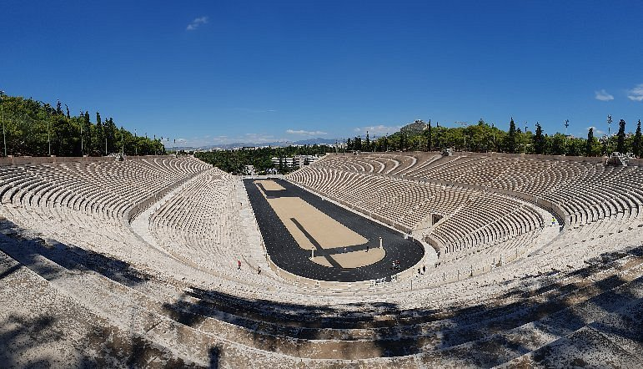
The Panathenaic Stadium
The Panathenaic Stadium was made entirely of white marble in 144 AD. In the nineteenth century, it was dug up and rebuilt. It hosted the first contemporary Olympics in 1896.
The Panathenaic Stadium is one of the most visited attractions in Athens. It is currently a multi-function stadium that was initially built as a race track in 330 BC for the Panathenaic Games.
Dedicated to Athena, goddess of wisdom and war, the Panathenaic Games was a popular event that took place once every four years, in which the inhabitants of Athens organized a religious festival with a sports competition and other cultural events.
Admission: Adults: 3 € Senior visitors 1.50 €

Slide 19

Michelin Star Restaurants
Athens is home to some excellent gourmet restaurants. Many of us on the ship are foodies, so naturally we’re always on the hunt to eat at the most exclusive spots anytime we travel.
Here are a few of the Michelin Star Restaurants in Athens:
Pelagos 40 Apollonos Street, Athens, €€€€ · Contemporary, Mediterranean Cuisine
Soil 5 Ferekidou Street, Athens, €€€€ · Greek, Contemporary
Varoulko Seaside 54-56 Koumoundourou Coast, Athens, €€€ · Seafood
GB Roof Garden 1A Vasileos Georgiou, Athens, €€€ · Mediterranean Cuisine
Athénée 9 Voukourestiou Street, Athens, €€ · Modern Cuisine
Aneton 3 Navarchou Nikodimou Street, Athens, €€ · Mediterranean Cuisine
Nolan 31-33 Voulis Street, Athens, € · Fusion
Oikeîo 15 Ploutarchou Street, Athens, € · Greek

Slide 20
Final Thoughts
Athens is a beautiful City with a rich history and numerous attractions. Regardless of what you're looking for, Athens has something for everyone.
I hope this presentation will help when we visit Athens!

Slide 21
Thanks For Coming
If you have any more questions, please ask.
I will do my best to answer them for you.
Have a great visit in Athens !

