Slide 1

Aruba
Presented by
Fellow Cruiser
Marc Silver

Slide 2
What I Will Cover
My Port Philosophy
Don’t Miss the Ship
Money
VAT Refunds
About Aruba,
History of Aruba,
Transportation
Points of Interest
Places to see or at least consider
A few restaurant recommendations
Conclusion

Slide 3
My Port Philosophy
I have been cruising for over 45 years and have taken over 200 cruises.
So, I consider myself an experienced cruiser.
The information I will present is based on those many years of experience.
When I am on a cruise where the city, I want to visit is not the port city,
I always recommend taking a ship’s tour.
But when I am in a port with multiple attractions nearby and easy to see on my own - I will do it on my own.
This presentation is for that type of port.

Slide 4
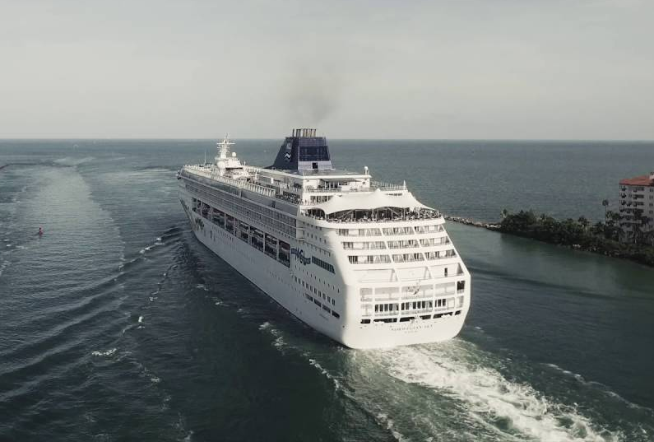
Don’t Miss the Ship
How to Avoid Missing Your Ship
Pay attention to the time. - Ship time and local time are often
different.
Put a return-to-ship reminder on your phone.
Choose excursions wisely.
If a ship-sponsored excursion is late returning to port for, the ship will
wait for you. If you are on your own???
Be Prepared
Have your Passport, Credit Card and phone numbers for your ship port agent.
What to Do If You Miss the Ship
Most cruise lines have port agents stationed in the port area to assist if your ship has left without you. If you’re lucky, when cruisers are late returning to the vessel, the ship's crew will often remove the passengers' essential items -- passports, cell phones and medication -- from the ship to leave with the port agents.
The Port Officials can help you with contacting your ship
and making necessary travel arrangements.

Slide 5
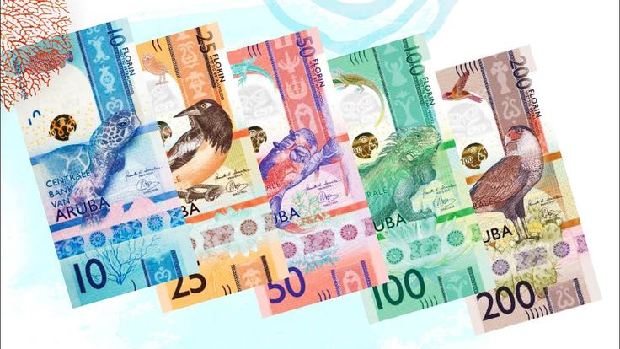
Money
The currency on the island is the Aruba Florin. You can exchange U.S. dollars, but it isn’t necessary.
The Aruba currency exchange rate for U.S. dollars is Afl 1.77 for cash and Afl 1.78 for traveler’s checks. Most supermarkets and gas stations use the exchange rate of Afl 1.75, while many restaurants and shops use the exchange rate of Afl 1.80.

Slide 6
VAT Refunds
Aruba's main VAT rate is 2%, with other rates including NA that can apply to certain transactions. The Health tax (HT) is administered by the Departamento di Impuesto in Oranjestad and applies to most purchases of goods within Aruba. A VAT refund may be available to visitors who qualify for VAT-free purchases in Aruba.
Who qualifies for an Aruba VAT Refund?
The VAT tax is meant to tax the consumption of goods within Aruba, not goods exported to a foreign country. Therefore, Aruba allows tourists and others who purchase goods within Aruba for export to receive a refund of any VAT taxes paid.
In order to qualify to request a VAT refund in Aruba, you must make at least 100€ Euros worth of qualifying purchases. $100US spent (incl. 2% VAT) = $98.00 base price + $2.00 VAT paid.
Your Tax-Free Forms must be export-validated in order to be accepted for a tax refund. Validation confirms that the products have been exported from Aruba and will often be done in the airport as you leave the country.
The big question is it really worth the effort. You decide.

Slide 7
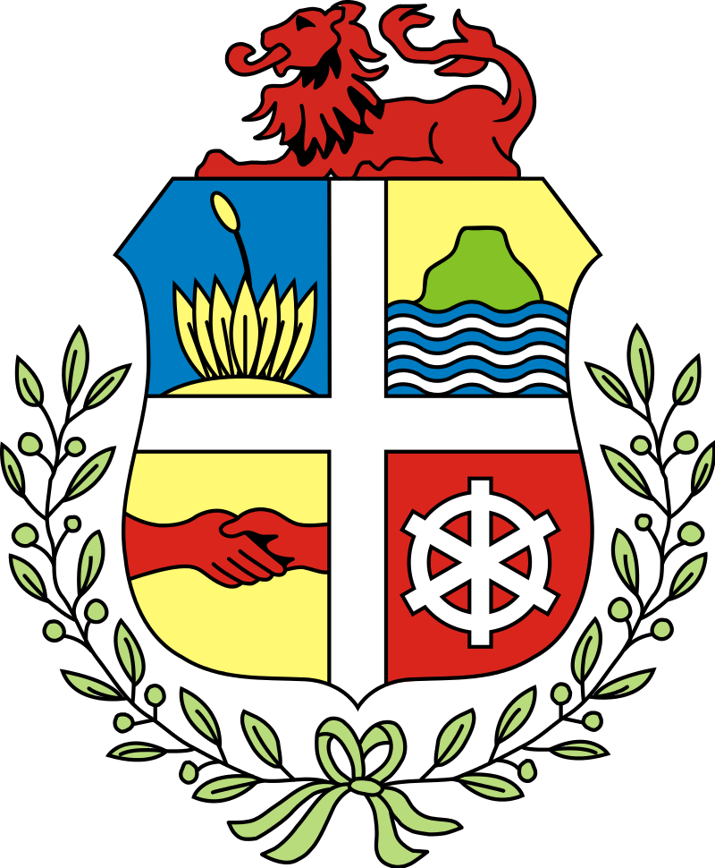
Aruba
The Country of Aruba is a constituent country of the Kingdom of the Netherlands physically located in the mid-south of the Caribbean Sea, about 18 miles north of the Venezuela peninsula of Paraguaná and 50 miles northwest of Curaçao. It measures 20 mi long from its northwestern to its southeastern end and 6 miles across at its widest point. Together with Bonaire and Curaçao, Aruba forms a group referred to as the ABC islands. Collectively, these and the other three Dutch substantial islands in the Caribbean are often called the Dutch Caribbean, of which Aruba has about one-third of the population.

Slide 8
Historical Aruba
The first known inhabitants of the island of Aruba were the Caiquetio Indians of the Arawak tribe from Venezuela. During the Pre-Ceramic period, 2500 BC - 1000 AD, this seminomadic tribe fished, hunted, and gathered food, depending mostly on the sea for survival. They created tools out of roughly flaked stones and shells and lived in small family groups in the coastal areas known today as Malmok and Palm Beach.
In 1499, Spanish explorer Alonso de Ojeda discovered Aruba, kicking off the colonization of the island by the Spanish. Due to the relatively low rainfall on the island, the colonizers did not believe that Aruba was a good place for plantations or crop growing. In 1513, the Spaniards enslaved many of the Caquetio Indians and sent them to Hispaniola to work on plantations and in mines. Some Indians returned to Aruba in 1515 and were recruited as laborers for cattle and horse breeding operations. Approximately nine years after Alonso de Ojeda landed on Aruba, the Spanish Crown appointed him as the first governor of the island. Aruba stayed under Spanish control for 137 years.

Slide 9
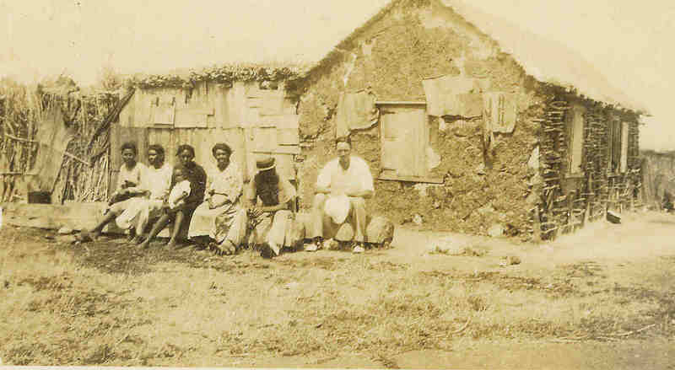
History of Aruba
Because of Aruba’s strategic location, the Dutch occupied the island in 1636 to protect their salt supply from the South American mainland while also ensuring a naval base in the Caribbean during their Eighty Years’ War with Spain. The Dutch recruited the Caquetio people to build farms and raise cattle for meat that would be sold and shipped to other islands. During the Napoleonic Wars, the British invaded and took control of Aruba, but the Netherlands took it back in 1816. Aruba officially became part of the Netherlands Antilles in 1845.
Aruba seceded from the Netherlands Antilles in 1986, a victory much fought for by political activist and local hero Betico Croes.
Today, Aruba remains a constituent country of the Kingdom of the Netherlands which controls Foreign affairs and national defense. Everything else is controlled by the Aruban government.

Slide 10
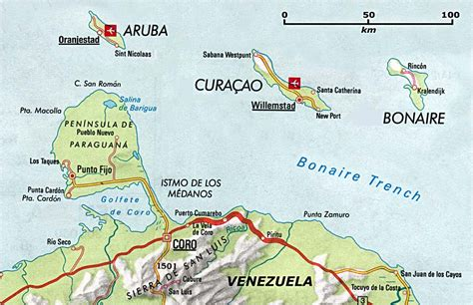

Slide 11
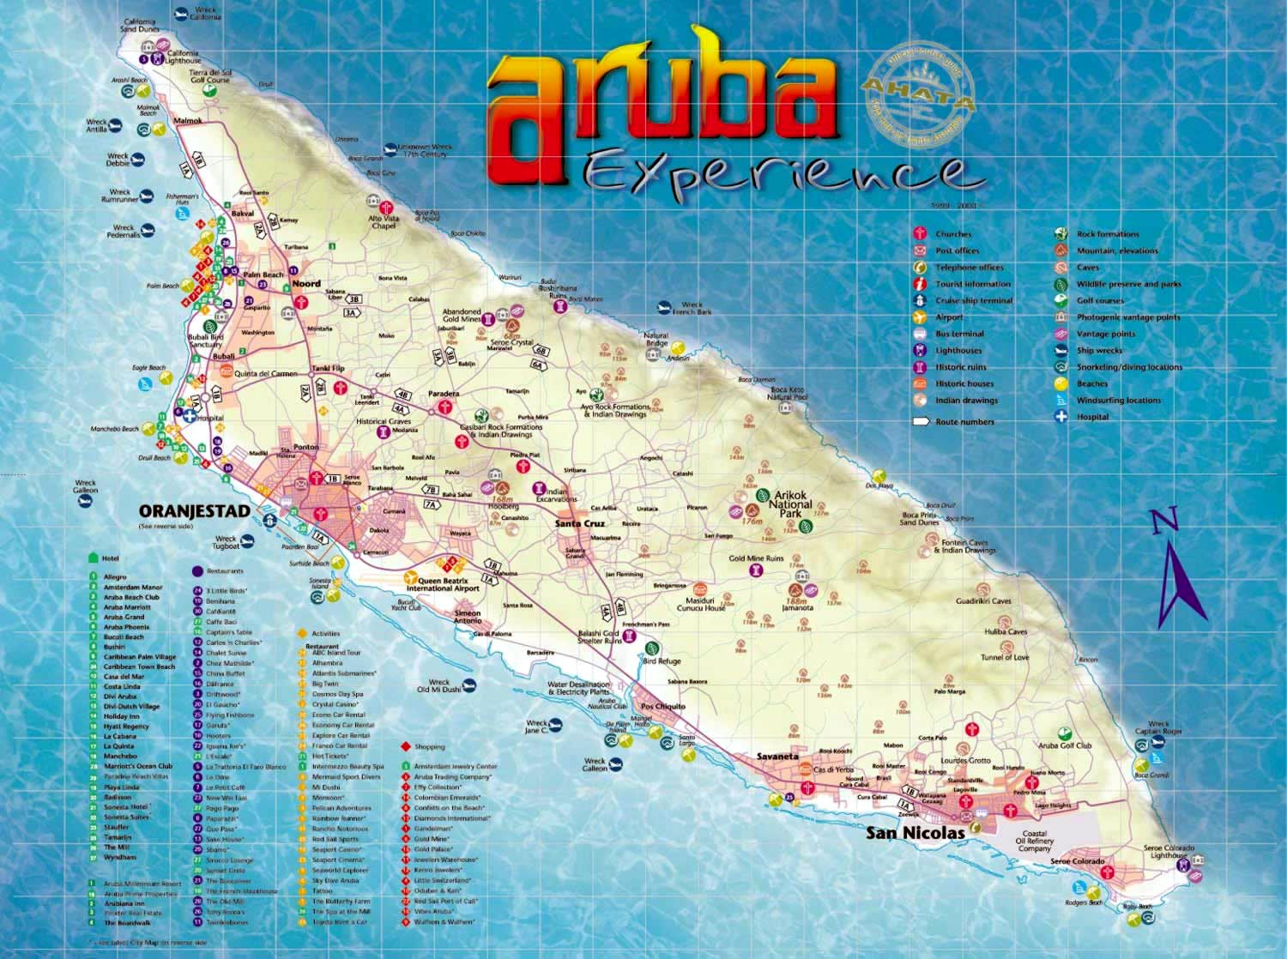
Map of Aruba

Slide 12
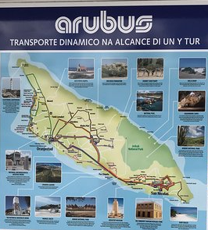
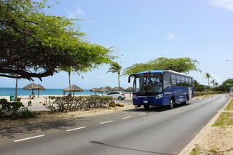
Aruba Bus
The busses on the island belong to Arubus, the major public transportation company owned by the Government of Aruba.
Aruba bus routes cover almost the entire island. If you want to see the exact routes or the full Aruba bus map, check out the website of Arubus.
There is bus service every 15 minutes from 5:45 a.m. until 6 p.m.; buses then run every 40 minutes until 11:30 p.m. The central bus station in downtown Oranjestad is located adjacent to the cruise terminal and next to the Royal Plaza. Getting around the island using public transportation is inexpensive.
Retour cards, cards for specific beaches, and all-day, unlimited passes are all readily available.
2 Trip Retour Card $5.00US
Day Pass $10.00US.

Slide 13
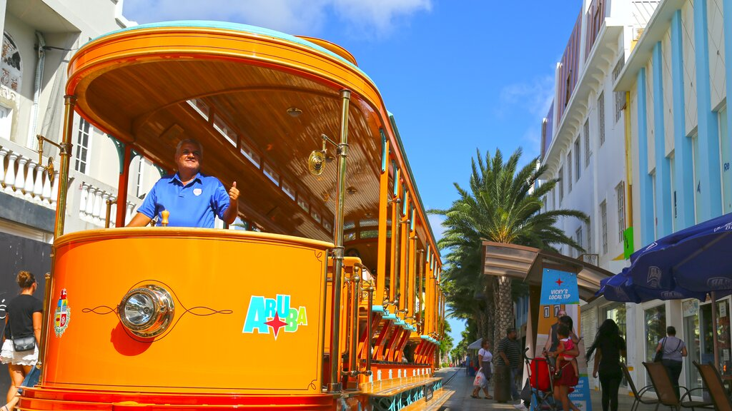
Aruba's Free Trolley
The free open-air trolley is an addition to downtown Oranjestad and a great way to navigate the main street’s shopping and dining areas without having to walk too much. Hop on to get to your specific destination or just to take a ride,
free of charge.
Some trolleys are even double-deckers, allowing a 360 view of the downtown area. Cruise passengers frequently make use of the trolley service, because it loops from the shopping areas to the cruise ship terminal.
If you’re ready to hop on, the trolley starts running at 10 a.m. with 25-minute intervals and a break from 12 p.m. to 1 p.m. The last trolley of the day departs from the cruise port at 5 p.m.

Slide 14
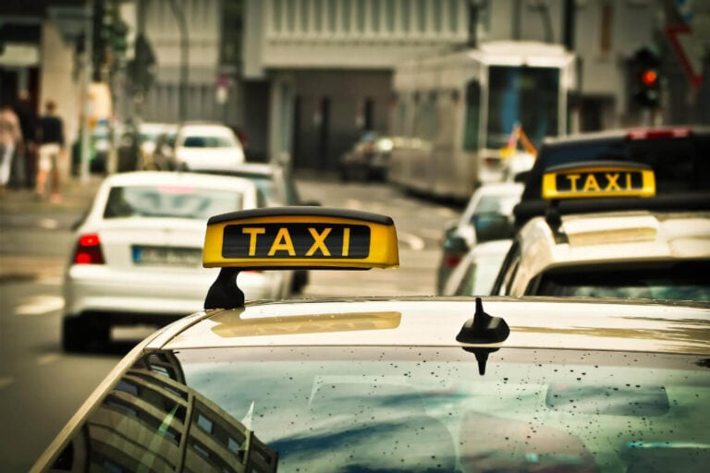
Taxis in Aruba
Traveling by taxi in Aruba is a breeze, there’s no need to worry about complicated charges, as they have fixed rates, set by the government. Just ask what the fare for your trip is going to be before you get in for complete transparency.
Getting a taxi is easy too! If you have cell service, you can easily call a taxi yourself. If you’re out and about, feel free to just flag one down, as they’re readily available throughout most of the areas that people visit. If they don’t have any passengers on board yet, they’ll pick you up and drive you to your destination.
Some taxis even offer private island tours, so that’s also a way of getting around Aruba!
Please note that the taxi fee covers a ride for a maximum of five passengers, so if you have a larger group, you’ll need to arrange it accordingly.

Slide 15
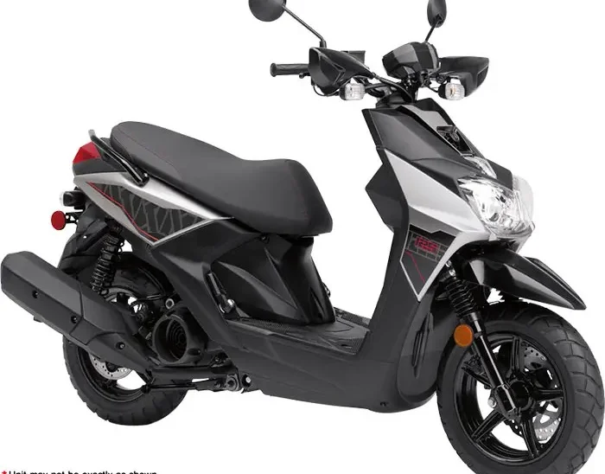
Scooter Rentals
For a fun, liberating way to navigate the island, jump on a scooter and hit the open road!
Rent yourself a scooter or motorcycle. Helmets are supplied. All you need is a regular driver's license and the desire to ride in one of the most beautiful Caribbean islands!
A terrific way to get around this compact island is to rent a scooter or motorcycle—yes, even Harleys are available! You really get a good feel for the island’s distinctive topography while enjoying some "easy riding." Plus, our well-paved roads ensure a smooth ride.
George Cycle Scooter Rental
The perfect vehicle to just take a stroll downtown and further.
Seats: 2 Adults
Engine Type: 125cc, Automatic
$55 Daily (9am to 5pm)

Slide 16
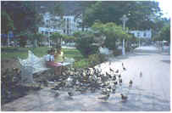
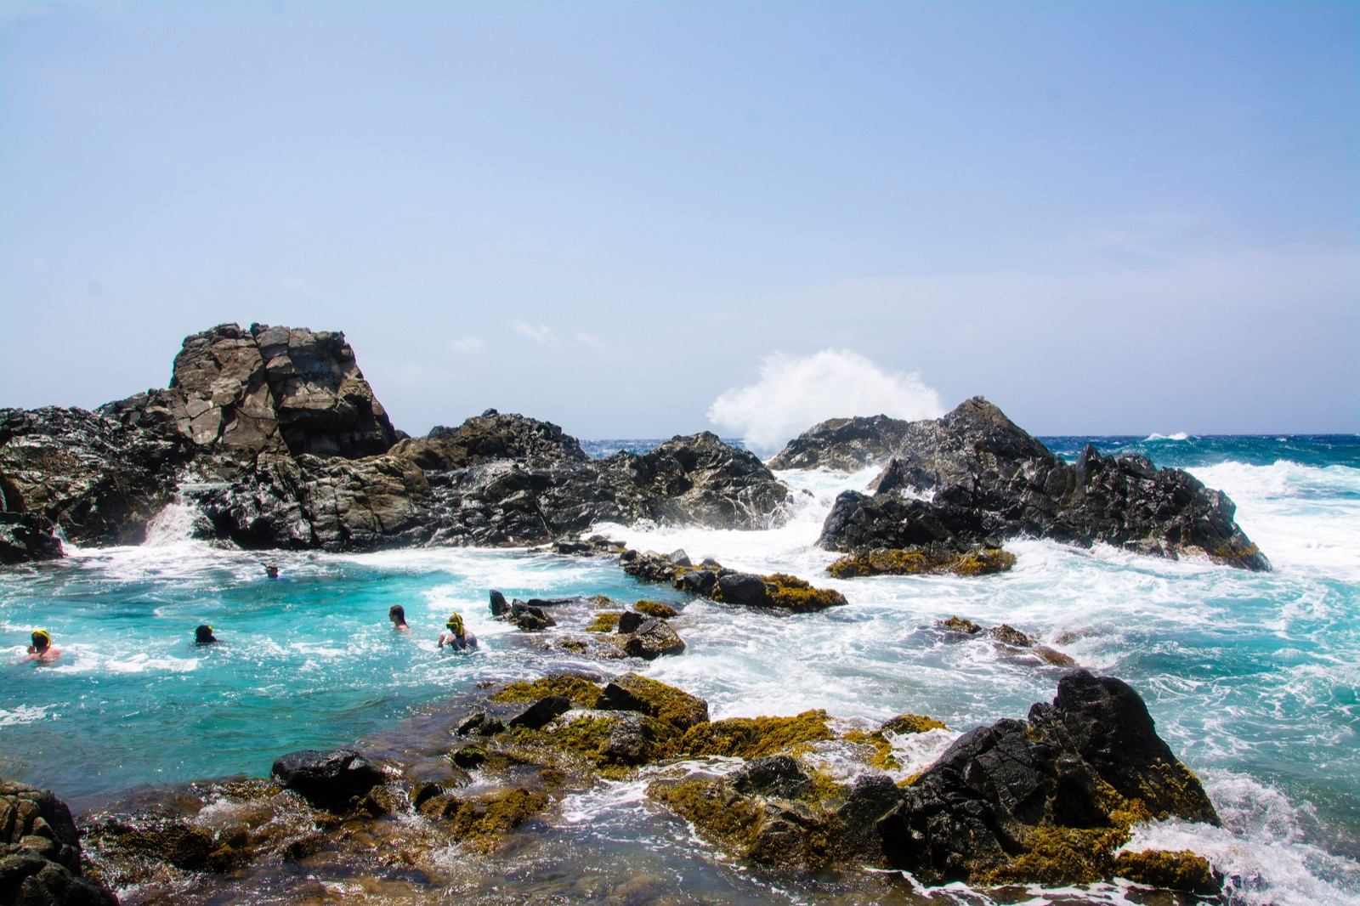
Arikok National Park
Aruban rattlesnakes, parakeets, and whiptail lizards make their home in the Arikok National Park, as do numerous iguanas, goats, donkeys, and migratory birds. So, if you don't like animals, stay clear of Aruba's southeastern quadrant, which is dominated by this ecological preserve and extremely popular tourist stop.
Admission to Arikok National Park costs $11. Children ages 17 and younger can enter for free. The park is open daily from 8 a.m. to 4 p.m. Stop by the visitor center to speak with a ranger and pick up a map.
Visit the park's official website for more information on hours, park rules, and fees.

Slide 17


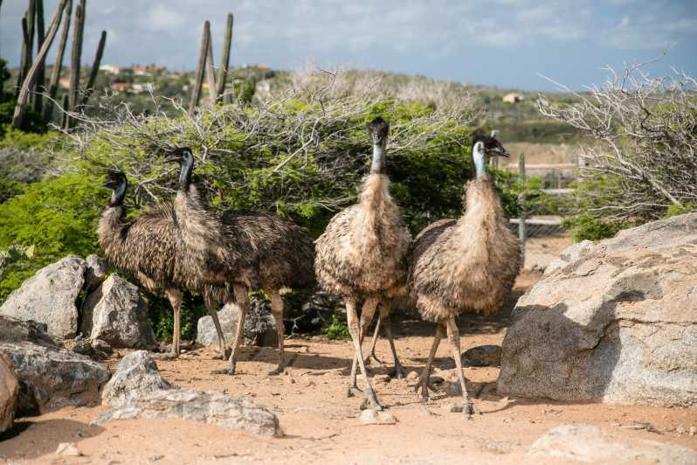
Aruba Ostrich Farm
Did you know that ostriches lay the largest eggs of any bird species? Or that they only have two toes per foot? You can learn all kinds of fascinating – and trivial – facts of this sort during a day at the Aruba Ostrich Farm on the island's eastern coast.
In addition to trivia, the farm's tour guides will educate you on the survival instincts and mannerisms of the ostriches and emus that live at the farm, plus you'll get a chance to interact with them up close.
Recent vacationers especially enjoyed feeding the large birds but said it's a quick stop. Those traveling with kids said this was an especially memorable experience for youngsters.
Be aware the professional photos taken by the farm's photographer are not free.
Price & Hours
Tours are $14 for adults
$7 for kids
9 a.m.-4 p.m. daily

Slide 18
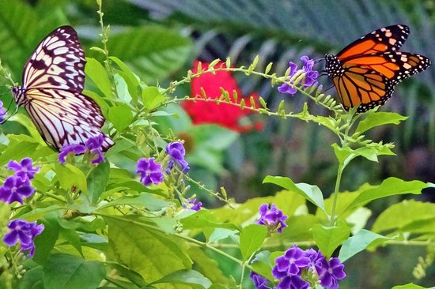
The Butterfly Farm
This colorful attraction in Oranjestad boasts hundreds of exotic butterflies from around the world, from blue morphos from South America to longwings and monarchs from the Caribbean. Visitors are encouraged to take a 20-minute guided tour, which are offered all day, to learn about the evolutionary cycle of butterflies.
The farm is open daily from 8:30 a.m. to 4:30 p.m. (last guided tour starts at 4 p.m.). Tickets cost $15 for adults and $8 for kids between the ages of 4 and 16. Children 3 and younger are admitted for free.

Slide 19
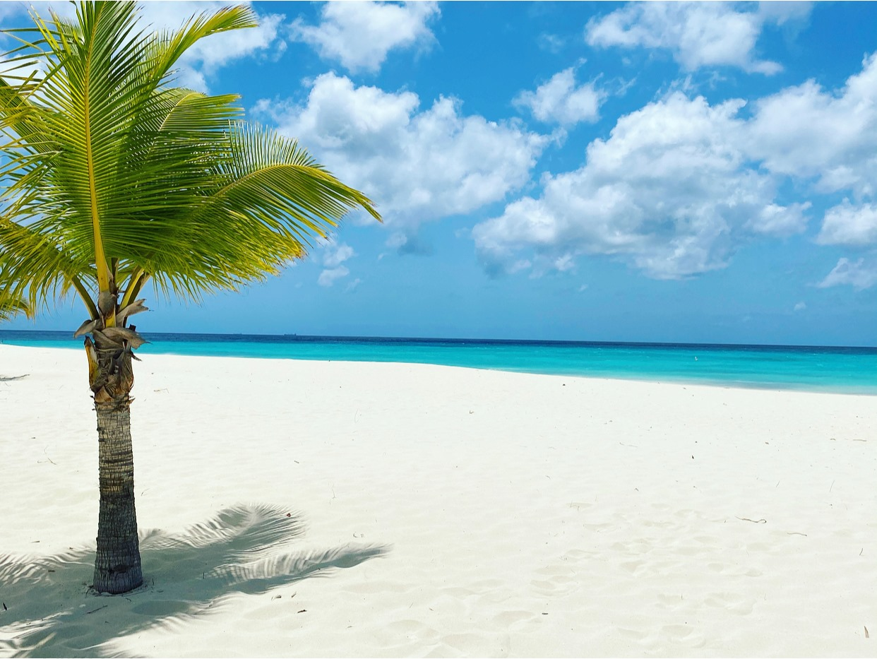
Eagle Beach
Known as the "Low-Rise area" for its low-to-the-ground hotels and timeshares, northwestern Eagle Beach is one of the island's top shores by default – you're probably staying nearby. Convenience aside, Eagle Beach truly is one of the best places to spend a day in Aruba.
Recent visitors called the beach magnificent with gorgeous white sand and the bluest water. They do warn of high winds, however, so plan to wear a hat to protect from any flying sand.

Slide 20
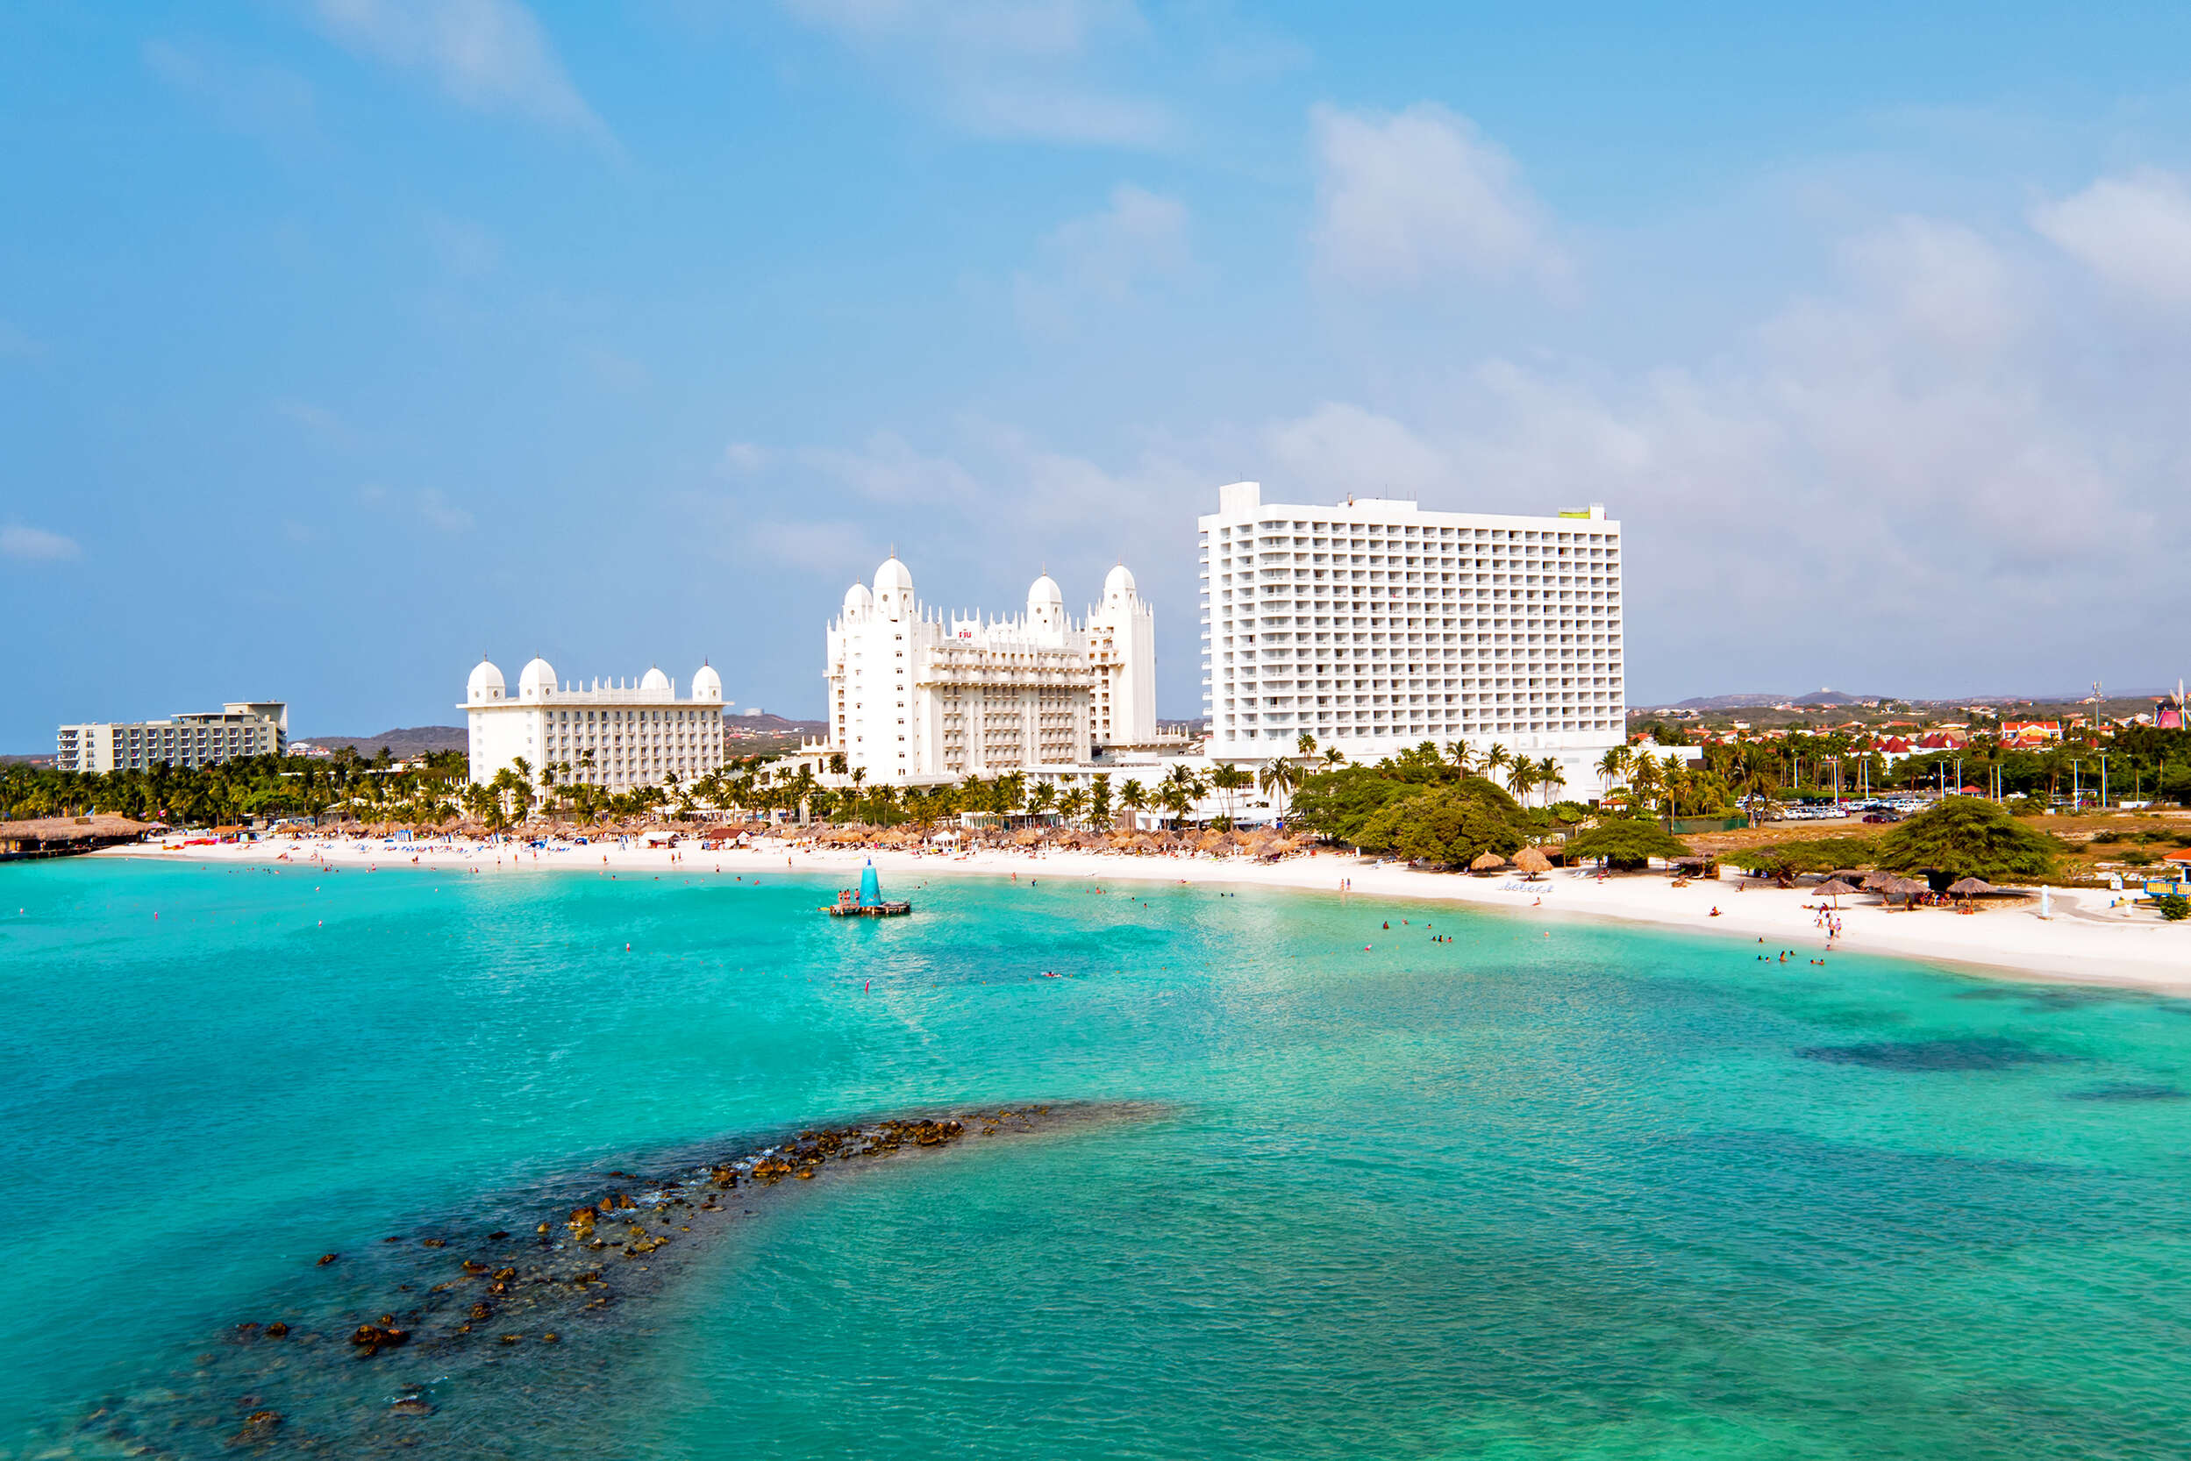
Palm Beach
Palm Beach is ideal for swimming, but not so much for sports. If this is you, ditch the "Low-Rise area" at Eagle Beach and try the more tranquil turquoise waters along Palm Beach, located just above Eagle Beach on Aruba's western coast. You'll have fewer Jet Skis and wakeboarders to avoid as you wade in the Caribbean Sea. There is beautiful blue water and a soft, white sand beach.
Known as the "High-Rise area," because of the Aruba Marriott Resort & Stellaris Casino, the Hilton Aruba Caribbean Resort & Casino, and the Hyatt Regency Aruba Resort Spa & Casino, among others. Even so, Palm Beach is open to the public at any time of day, and many of the hotels will allow you to change in their lobby bathrooms or purchase refreshments at their concession stands or beach bars.

Slide 21
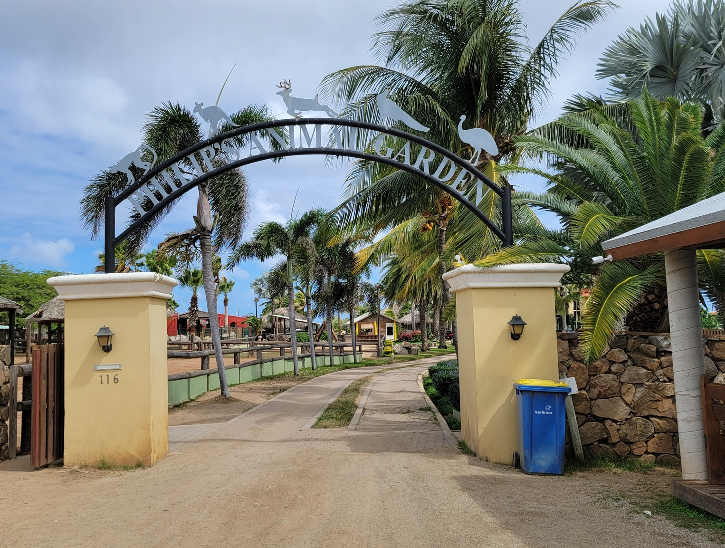
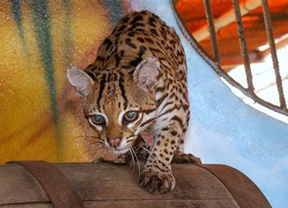
Philip's Animal Garden
Philip’s Animal Garden / Philip’s Pet Collection Foundation, is a non-profit organization that focuses on rescuing exotic animals in Aruba and the region. Founded in 2009 it is the only organization rescuing and rehabilitating exotic animals in Aruba, which has resulted in an amazing collection of these animals. Up until recently the owner, Philip, has built this shelter with his own efforts; building all the cages from scratch, designing all structures, and welding them with his own hands. His goal is to upgrade
the facilities to a world-class animal shelter with veterinary
care and round-the-clock staff. With the input from the
Aruban community and visitors, they provide the best care
for these animals.
Ticket: Adults: $10
Children: 2-13 years $5
Children 0 – 2 years Free.

Slide 22
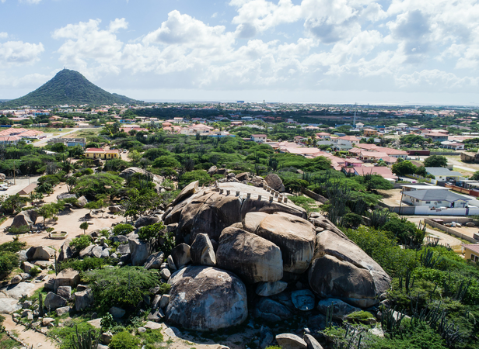
Ayo and Casibari Rock Formations
About 1 mile west of Ayo Rock, these mysterious rock formations rise out of the desert landscape in the shape of creatures such as birds and dragons. It's worth the climb to the top for amazing views across the island.
Ayo and Casibari are free to visit at any time of day, however, you should stop by early in the morning to beat the Caribbean heat and the cruise ship crowds.

Slide 23
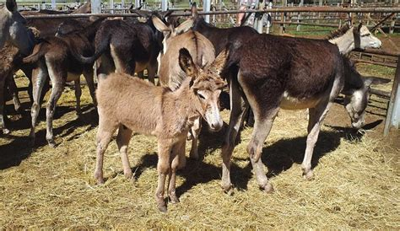
Donkey Sanctuary Aruba
The Donkey Sanctuary Aruba is a nonprofit organization devoted to saving the island's donkeys and educating locals and tourists on their care. Donkeys used to be the main form of transportation on the island; now many of them are sick and injured. The lucky ones receive proper care and shelter in this donkey sanctuary in the Santa Cruz neighborhood in Aruba's northeast side about 8 miles from Eagle Beach.
Admission Free; donations accepted

Slide 24
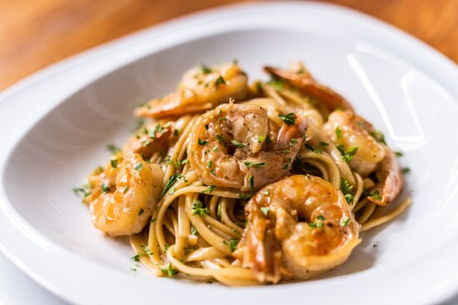
Aruba Restaurants
Aruba has many excellent restaurants. Many of us on the ship are
foodies, so naturally, we’re always on the hunt to eat at the most
exclusive spots anytime we travel.
Here are a few of the best restaurants to consider in downtown Aruba.
CAYA House Aruba $$$$ Latin, International, Contemporary
J.E. Irausquin Boulevard 372 In Front Of Hostaria Da Vittorio, Noord
Fred Royal Aruba $$$$ Gluten Free Options
Wilhelminastraat 18 Que Pasa, Oranjestad
Aquarius $$ - $$$ Seafood, International, Vegetarian Friendly
Renaissance Aruba Resort & Casino L. G. Smith Boulevard 82, Oranjestad
Ocean Z Restaurant $$$$ Caribbean, Bar, Seafood
L.G. Smith Boulevard 526, Noord
Azia Restaurant & Lounge $$ - $$$ Chinese, Japanese, Sushi
J.E. Irausquin Boulevard 348, Palm - Eagle Beach Aruba
For those of you who just like good food, you can’t go wrong just about anywhere you go in Aruba.
GOOD EATING

Slide 25
Conclusion
Aruba is a beautiful Island with a rich history and numerous attractions. Whether you're looking for stunning beaches, historic sites, or unique attractions, Aruba has something for everyone.
I hope this presentation will help when we visit Aruba!

Slide 26
Thanks For Coming
If you have any more questions, please ask.
I will do my best to answer them for you.
Have a great visit in Aruba!

