Slide 1
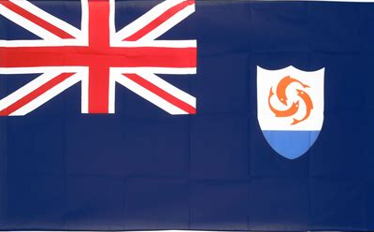
Anguilla Presented by Fellow Passenger Marc Silver

Slide 2
What I Will Cover
My Port Philosophy
Don’t Miss the Ship
Money
Why Come To Anguilla
About Anguilla
Area Map of Anguilla
Map of Anguilla
Anguilla Transportation
Places to see or at least consider
A few restaurant recommendations
Conclusion

Slide 3
My Port Philosophy
I have been cruising for over 45 years and have taken over 200 cruises. So, I consider myself an experienced cruiser.
The information I will present is based on those many years of
experience.
When I am on a cruise where the city, I want to visit is not the port city,
I always recommend taking a ship’s tour.
But when I am in a port with multiple attractions nearby and easy to see
on my own - I will do it on my own.
This presentation is for that type of port.

Slide 4

Don’t Miss the Ship
How to Avoid Missing Your Ship
Pay attention to the time. - Ship time and local time are often different.
Put a return-to-ship reminder on your phone.
Choose excursions wisely.
If a ship-sponsored excursion is late returning to port, the ship will wait for you. If you are on your own???
Be Prepared
Have your Passport, Credit Card, and phone numbers for your ship port agent.
What to Do If You Miss the Ship Most cruise lines have port agents stationed in the port area to assist if your ship has left without you. If your are lucky, when cruisers are late returning to the vessel, the ship’s crew will often remove the passengers’ essential items – passports, cell phones, and medication -- from the ship to leave with the port agents.
The Port Officials can help you with contacting your ship and making necessary travel arrangements.

Slide 5
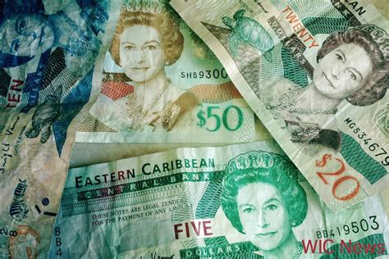
Anguilla Money
The official currency of Anguilla is the East Caribbean dollar, with the symbol EC$ and currency code XCD.
The official Exchange is 1EC$ = $0.36 USD
2.7 XCD to $1 USD

Slide 6
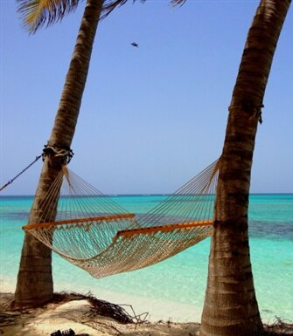
Why Come To Anguilla
Compared to some Caribbean islands masquerading as tourist traps, you'll find something a little more authentic in Anguilla. There's an embargo on large cruise ships, casinos, and high-rise hotels, but a surplus of clear, coral-filled waters, unmarked and unpaved roads, and low-key beachfront villas. Pampering is also at a premium, from the grandiose resorts to the sophisticated alfresco dining. With little to do but relax, the days here are long. But after the sun does go down, you'll be treated to one of the best live music scenes in the Western Hemisphere. Everyone from Quincy Jones to Bankie Banx to Jimmy Buffett has stopped by Anguilla's shores to perform.

Slide 7
About Anguilla
On 27 February 1967, Britain granted the territory of Saint Christopher-Nevis-Anguilla the status of "associated state", with its own constitution and a considerable degree of self-government. Many Anguillans strenuously objected to the continuing political subservience to Saint Kitts, and on 30 May 1967 (known as "Anguilla Day"), the Kittian police were evicted from the island. On 11 July 1967, a referendum on Anguilla's secession from the fledgling state was held. The results were 1,813 votes for secession and 5 against. A separate legislative council was immediately declared.
After eight days of negotiation in Barbados, on July 31, it was agreed to return Anguilla to the Anguilla–St Kitts–Nevis federation, in exchange for granting Anguilla limited self-rule similar to that enjoyed by Nevis.
In December, two members of Britain's Parliament worked out an interim agreement by which for one year a British official would exercise basic administrative authority along with the Anguilla Council.
Effectively Anguilla was allowed to secede from Saint Kitts and Nevis, receiving its first constitution on 12 February 1976. It was not until 19 December 1980 that Anguilla was formally disassociated from Saint Kitts to become a separate British dependency. While Saint Kitts and Nevis went on to gain full independence from Britain in 1983. Today, Anguilla remains a British overseas territory.

Slide 8
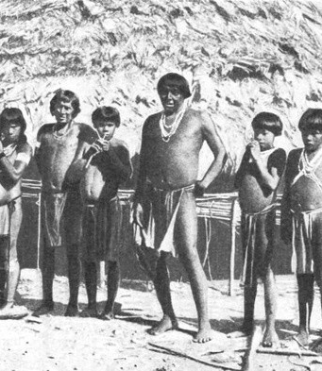
History of Anguilla
The earliest inhabitants of Anguilla were Amerindian people from South America, commonly referred to as Arawaks. These people traveled to the island on rafts and in dugout canoes, settling in fishing, hunting, and farming groups. Forty Arawak villages have been excavated, the largest being those at Island Harbor, Sandy Ground, Sandy Hill, Rendezvous Bay, and Shoal Bay East. The Amerindian name for the island was Malliouhana. The earliest Amerindian artifacts found on Anguilla have been dated to around 1300 BC, and remains of settlements dating from AD 600 have been uncovered. Religious artifacts and remnants of ceremonies found at locations, such as Big Springs and Fountain Cavern, suggest that the pre-European inhabitants were extremely religious in nature. The Arawaks are popularly said to have been later displaced by the fiercer Carib, but this version of events and characterization is disputed by some.

Slide 9
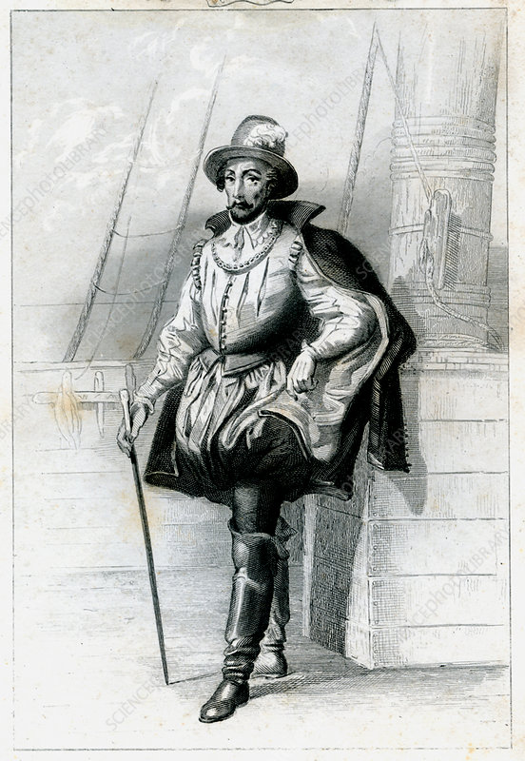
History of Anguilla
Some historians credit Anguilla’s discovery to the French explorer René Goulaine de Laudonnière during his voyages in 1564 and 1565. The Dutch West India Company established a fort on the island in 1631. The Dutch withdrew after the destruction of the fort by Spanish forces in 1633. In 1871, Anguilla was forced into a federation with St Kitts; the next year, the islands petitioned the British colonial office to permit separate and direct rule. Around this time, the population had risen to 3000. In 1882, Nevis was added.
The population had risen to 3890 by the time of the First World War. By that time, charcoal production had essentially deforested the entire island, but the expanded pastureland permitted the export of cattle to Saint Thomas.
It was not until 1951 that Anguilla had a say in its administration, the British colony of Saint Christopher-Nevis-Anguilla, itself part of the Federal Colony of the Leeward Islands. Between 1958 and 1962, the tri-state was part of the West Indies Federation.

Slide 10
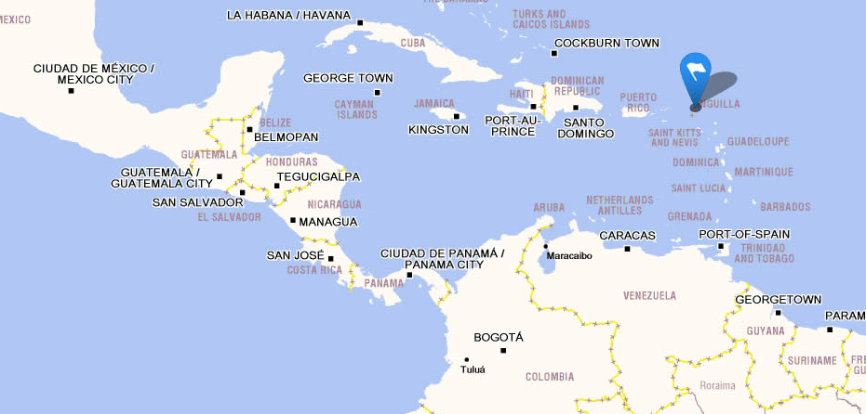
Area Map for Anguilla

Slide 11
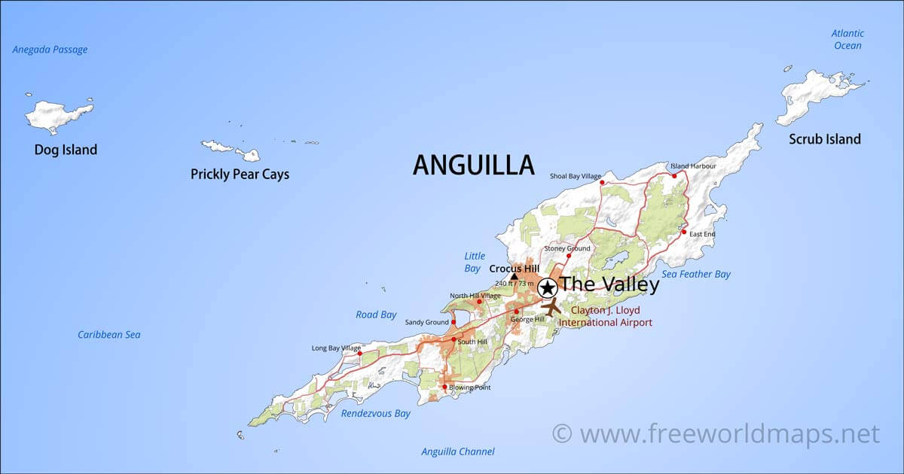
Map of Anguilla

Slide 12
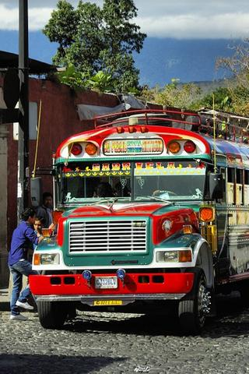
Anguilla Buses
The public transportation system in Anguilla is made up of privately owned buses. These buses range from 15-seater buses to larger vehicles. Although the majority of the island is covered, not all bus routes have consistent service, and only a few service the major hotels on the island. Bus fares range from US $1 - 2 one way. There are no buses as such on Barbuda
If you use the bus system, bear in mind that it's designed for the needs of residents, so many tourist destinations will not be covered.
One of the most useful, and popular routes, though, is the #22, which travels from the West Bus Station (at Marketplace) down along the west coast via Jolly Harbor to the village of Old Road and takes in the lovely West Coast chain of beaches - a great cheap alternative for getting down to these, especially for those staying in the resorts from Jolly Beach and south.

Slide 13
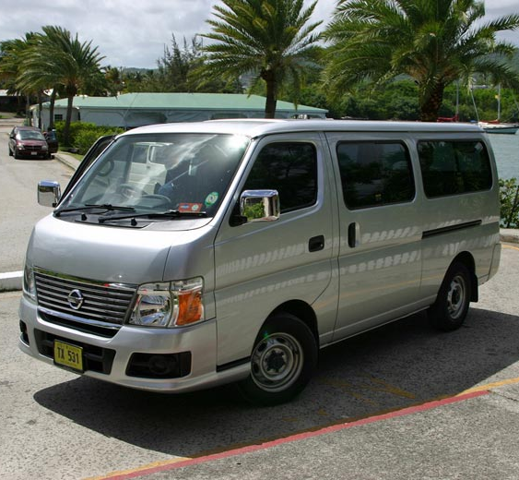
Anguilla Taxis
From stunning beaches and marinas to fascinating museums and trails that lead to breathtaking panoramic views, there’s so much to do in Anguilla. Whether you’re looking for a relaxing vacation in the sun or an adventure-filled trip, taking an Anguilla taxi is the best way to get around the island.
You can hail a taxi in the street, call and have a local taxi pick you up, or you can book your transfers in advance.
Taxi prices are regulated by the Anguilla & Barbuda Transport Board.

Slide 14
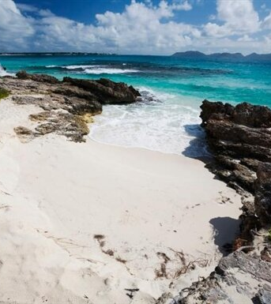
Beaches, Beaches, Beaches
Shoal Bay East - Anguilla has approximately 35 beaches, but the most popular one is Shoal Bay East. This northern shore has long entertained day trippers, so there are plenty of bars and restaurants, plus rental equipment for snorkeling, parasailing, and scuba diving.
Meads Bay - Located on the western end of Anguilla, Meads Bay is beloved for its silky-smooth sand, aquamarine waters, and gorgeous views. Plus, there are many places to eat
Rendezvous Bay - This 2-mile slice of paradise may be reason enough to visit Anguilla. With calm waters for even the least confident swimmers and the mellow sounds of Dune Preserve in the background, Rendezvous is an idyllic retreat for vacationers looking to escape Shoal Bay East's hustle and tourist bustle.

Slide 15
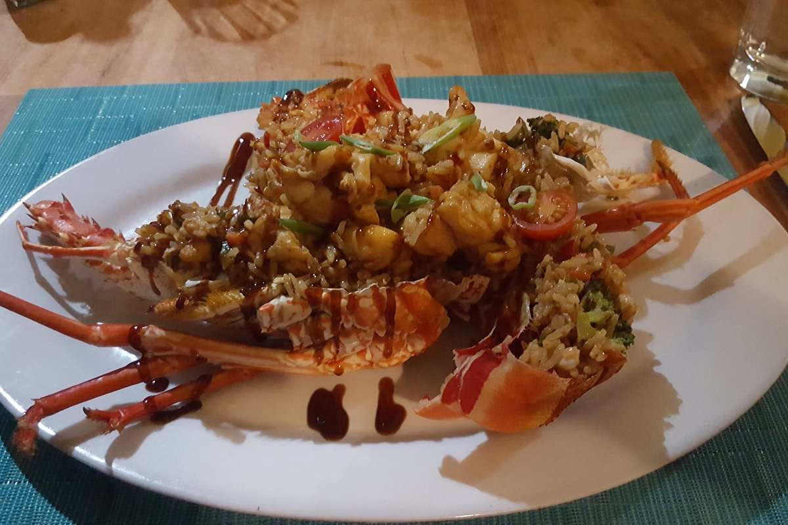
Restaurants
There are a lot of excellent restaurants in Anguilla. Especially for seafood.
Here are some Anguilla Restaurants recommendations:
Sharky's Restaurant $$ - $$$ Caribbean Seafood Vegetarian friendly, West End Village, Anguilla Tropical Sunset Restaurant & Bar $$ - $$$ Caribbean Bar Seafood Shoal Bay, Shoal Bay Village
Veya Restaurant $$$$ Caribbean Seafood Contemporary Sandy Ground Anguilla
Tasty's Restaurant $$ - $$$ Caribbean Seafood South Hill Road, South Hill Anguilla
Veya Restaurant $$$$ Caribbean Seafood Contemporary Sandy Ground Anguilla
Good Eating

Slide 16
Conclusion
Anguilla is a beautiful Island with a rich history and numerous attractions. Regardless of what you're looking for, Anguilla has something for everyone.
I hope this presentation will help when we visit Anguilla!

Slide 17
Thanks For Coming
If you have any more questions, please ask.
I will do my best to answer them for you.
Have a great visit in Anguilla!

