Slide 1
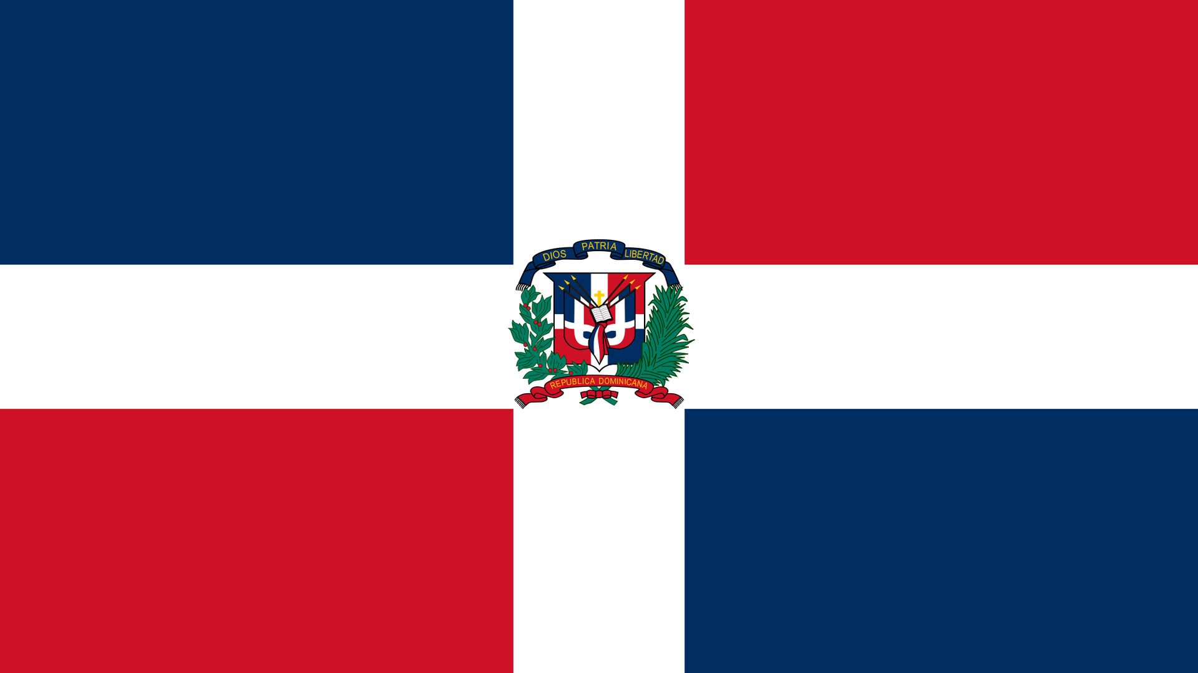
Amber Cove Dominican Republic Presented by Marc Silver

Slide 2
What I Will Cover
My Port Philosophy
Don’t Miss the Ship
Money
About Dominican Republic
About Puerto Plata
Area Map of Dominican Republic
Map of Amber Cove
Amber Cove Transportation
Places to see or at least consider
Conclusion

Slide 3
My Port Philosophy
I have been cruising for over 44 years and have taken over 200 cruises. So, I consider myself an experienced cruiser.
The information I will present is based on those many years of
experience.
When I am on a cruise where the city, I want to visit is not the port city,
I always recommend taking a ship’s tour.
But when I am in a port with multiple attractions nearby and easy to see
on my own - I will do it on my own.
This presentation is not like that.

Slide 4

Don’t Miss the Ship
How to Avoid Missing Your Ship
Pay attention to the time. - Ship time and local time are often different.
Put a return-to-ship reminder on your phone.
Choose excursions wisely.
If a ship-sponsored excursion is late returning to port, the ship will wait for you. If you are on your own.
Be Prepared
Have your Passport, Credit Card, and phone numbers for your ship port agent.
What to Do If You Miss the Ship Most cruise lines have port agents stationed in the port area to assist if your ship has left without you. If you are lucky, when cruisers are late returning to the vessel, the ship’s crew will often remove the passengers’ essential items – passports, cell phones, and medication -- from the ship to leave with the port agents.
The Port Officials can help you with contacting your ship and making necessary travel arrangements.

Slide 5
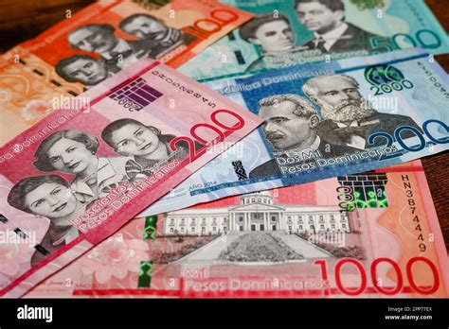
Dominican Republic Money
The Yen is the official currency of Dominicana Pesos
Official Exchange is 1.00 US Dollar = 58.64 Dominicana Pesos
Or
1.00 Dominican Peso = 0.017 US Dollars

Slide 6
Dominican Republic History Cont.
The Dominican Republic is a country on the island of Hispaniola in the Greater Antilles archipelago. It occupies the eastern five-eighths of the island, which it shares with Haiti, making Hispaniola one of only two Caribbean islands, along with Saint Martin, which is shared by two sovereign states.
It is the second-largest nation in the Antilles by area (after Cuba), and second-largest by population, with approximately 11.4 million people in 2024, most living in Santo Domingo, the capital city.
The native Taíno people had inhabited Hispaniola before the arrival of Europeans, dividing it into five chiefdoms. Christopher Columbus explored and claimed the island of Castile, landing there on his first voyage in 1492. The colony of Santo Domingo became the site of the first permanent European settlement in the Americas and the first seat of Spanish colonial rule in the New World. In 1697, Spain recognized French dominion over the western third of the island, which became the independent state of Haiti in 1804.

Slide 7
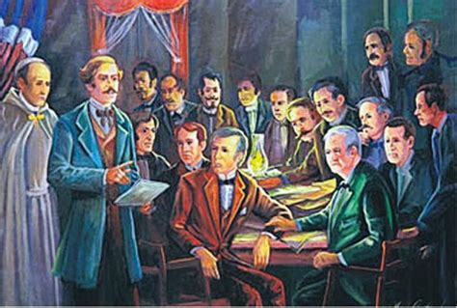
Dominican Republic History
The Dominican people declared independence from Spain in November 1821. The colony Santo Domingo was regionally divided with many rival and competing provincial leaders during the 1800s.
Dominicans were often at war fighting against the French, Haitians, Spanish, or amongst themselves, resulting in a society heavily influenced by military strongmen. Santo Domingo attained independence as the Dominican Republic in 1844 when Dominican nationalists led an insurrection against the Haitians.
Over the next decades, the Dominican Republic experienced several civil wars, battles against Haiti, and a brief return to Spanish colonial status, before permanently ousting the Spanish during the Dominican War of Restoration of 1863–1865.

Slide 8
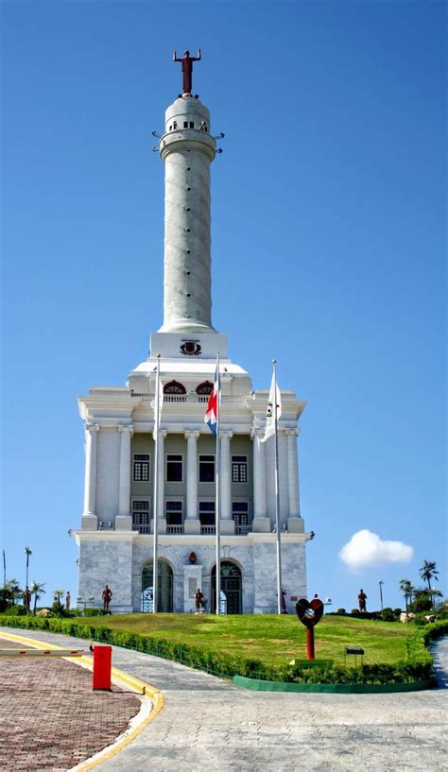
About Dominican Republic
Since 2012, the province of Puerto Plata, located on the north coast of the Dominican Republic, has experienced an impressive tourism resurgence. With significant investment in tourism infrastructure and services, the province has attracted millions of visitors and has become one of the country’s most popular tourist destinations.
In recent years, Puerto Plata has seen the construction of 911 hotels and more than 13,800 rooms, which has allowed the province to significantly increase its capacity to receive tourists. In addition, since 2012, Puerto Plata has received more than 3 million tourists, demonstrating the success of investments in the tourism sector.

Slide 9
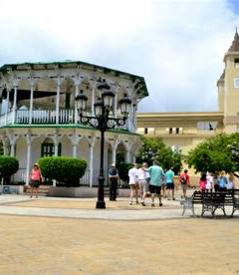
About Puerta Plata
Puerto Plata, officially known as San Felipe de Puerto Plata, is a major coastal city in the Dominican Republic, and the capital of the province of Puerto Plata.
The first aerial tramway of the Caribbean is located in Puerto Plata, in which visitors can ride up to the Pico Isabel de Torres, a 2600-foot-high mountain within the city.
The small bay around which the city was built provides a natural harbor. Puerto Plata is the largest city on the northern seaboard. Its subdivisions include El Cupey, Maimón, Los Mameyes, Sabana Grande, El Toro, Tubagua, and Yásica. The mountain Isabel de Torres is situated some 5 km to the southwest of the city of San Felipe.

Slide 10
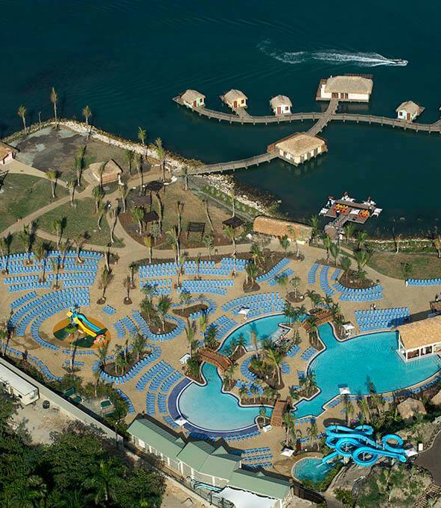
About Amber Cove
Amber Cove Cruise Center is the newest cruise port in the Dominican Republic.
Our port of call is located on the Bay of Maimon along the Dominican Republic’s northern “Amber Coast” just northwest of Puerto Plata.
The two-berth cruise terminal is named after the amber stone that is mined in the area. It represents one of the largest cruise industry investments ever made in the Dominican Republic.
Established in 2015, this 25-acre cruise port was an $85 million investment by Carnival Corporation.

Slide 11
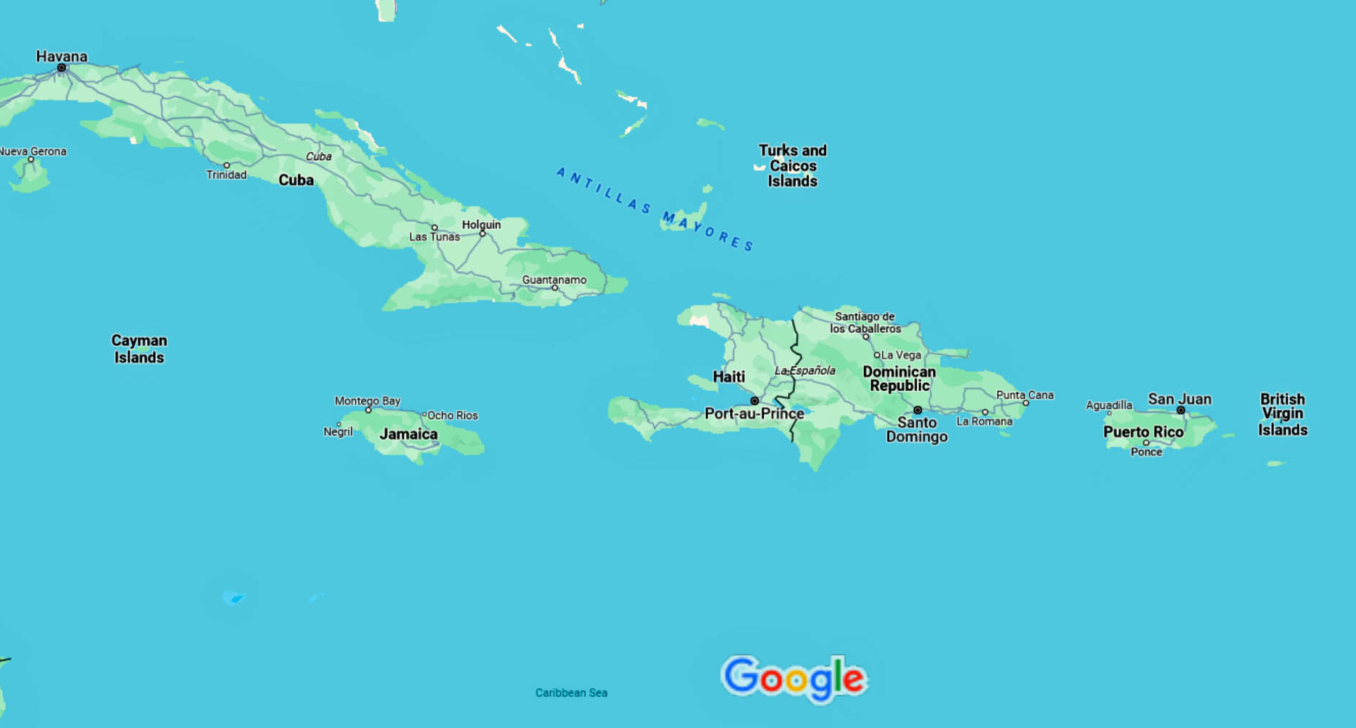
Area Map of Dominican Republic

Slide 12
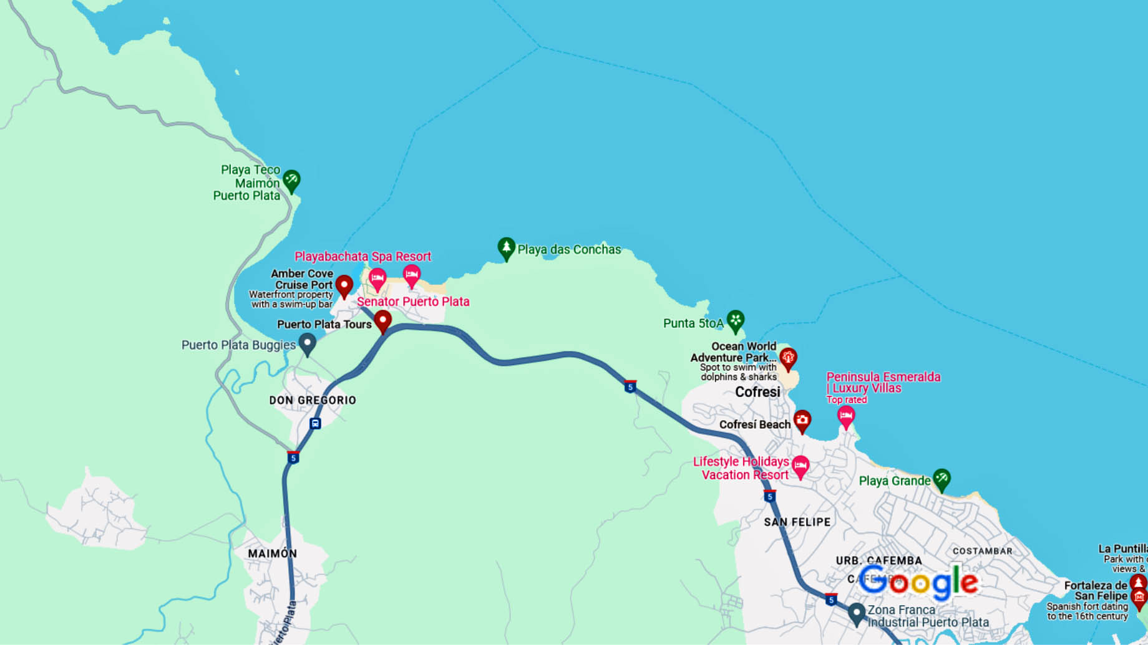
Amber Cove Area

Slide 13
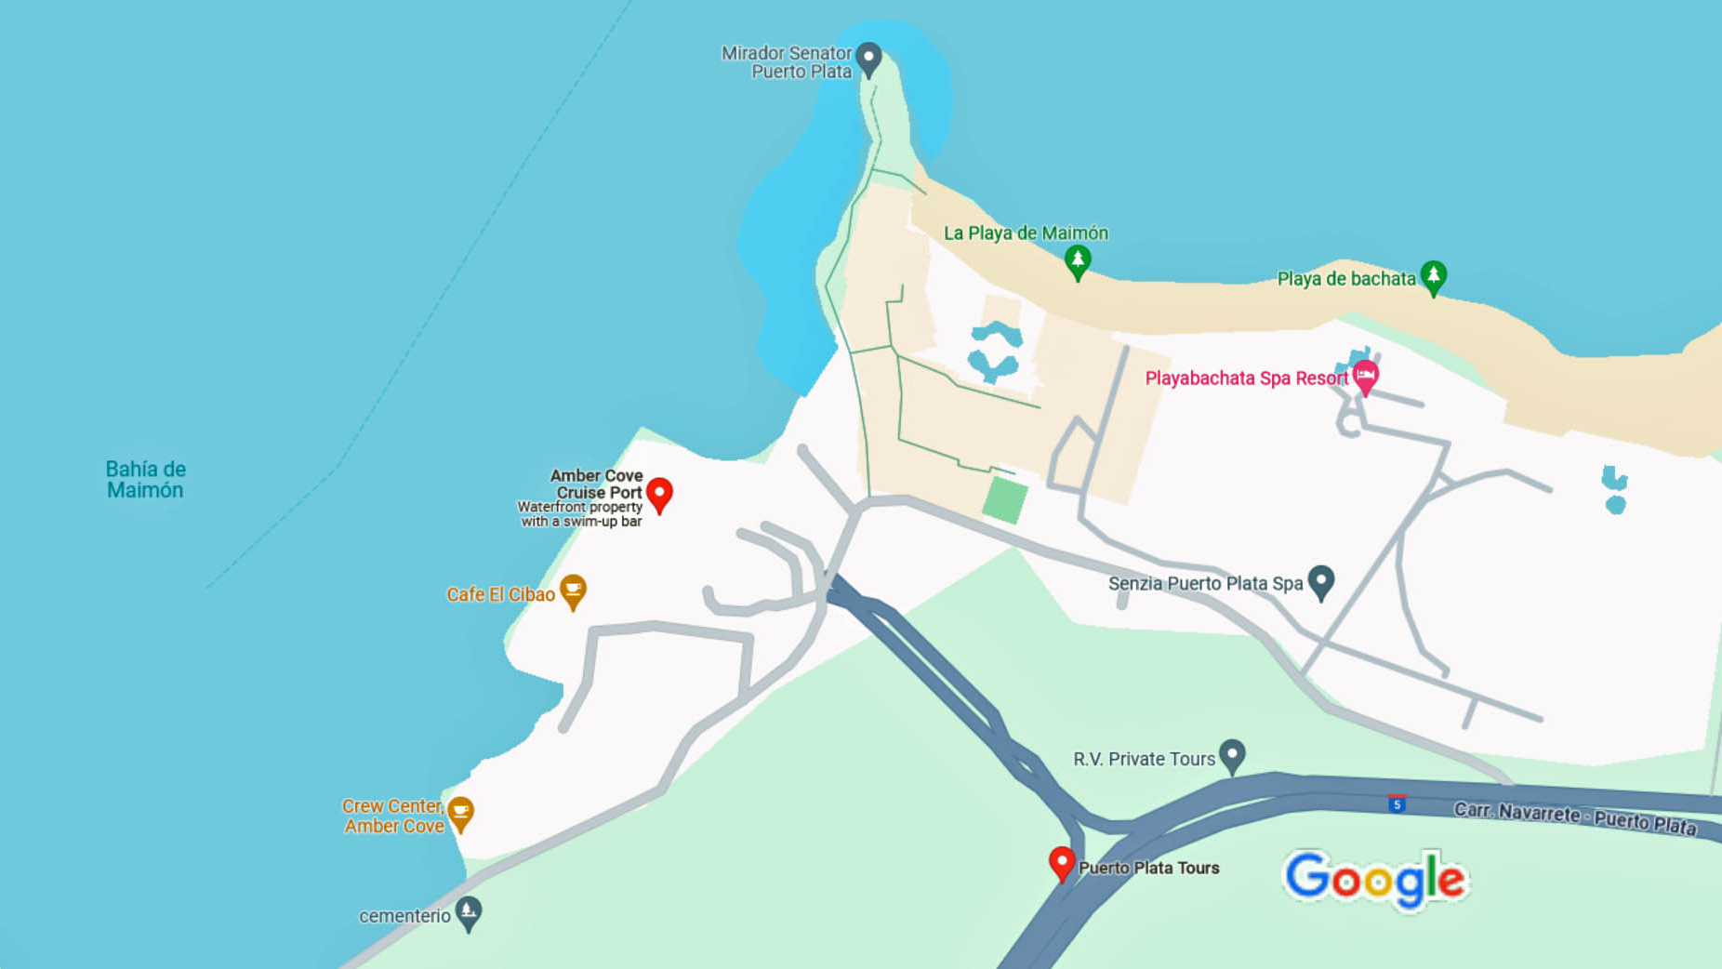
Amber Cove

Slide 14
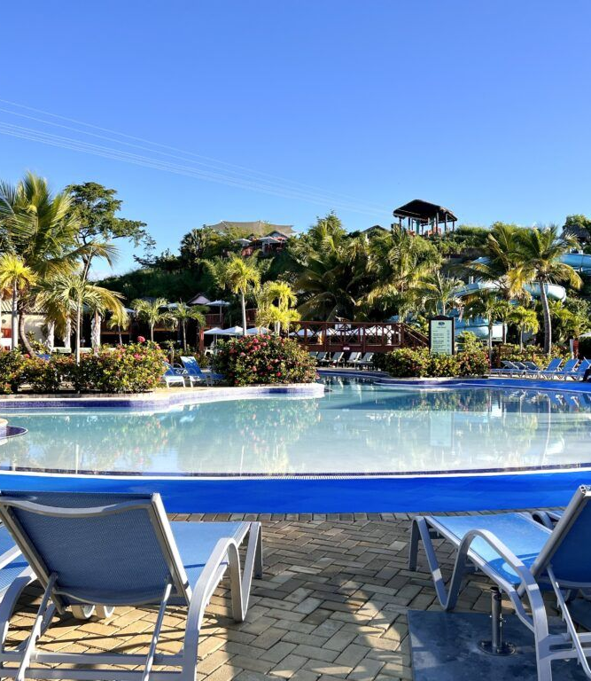
In Port
When visiting Amber Cove Dominican Republic on a cruise, guests have the option to spend the day in the port or book an excursion to explore more of this historic area.
While Amber Cove does not have a beach, there is plenty to do within the port without spending any money. The biggest draw of Amber Cove Dominican Republic is the large resort-style pool.
This pool has a swim-up bar and plenty of lounge chairs to relax and soak up the sun. The beach loungers are complimentary, but you will need to bring towels from the ship. With only one ship in port, this area was quiet. Still, I recommend getting off the ship early to get the best spots.
Located near the pool, there are also two waterslides and a splash pad for the kids. Again, these areas are free for the little ones to enjoy at no added cost. There is also a basketball and volleyball court, as well as a giant chess game.
If you want to escape the crowds near the pool, there is a small secluded section of hammocks near the bay.
An all-day Amber Cove WiFi package is just $8.

Slide 15
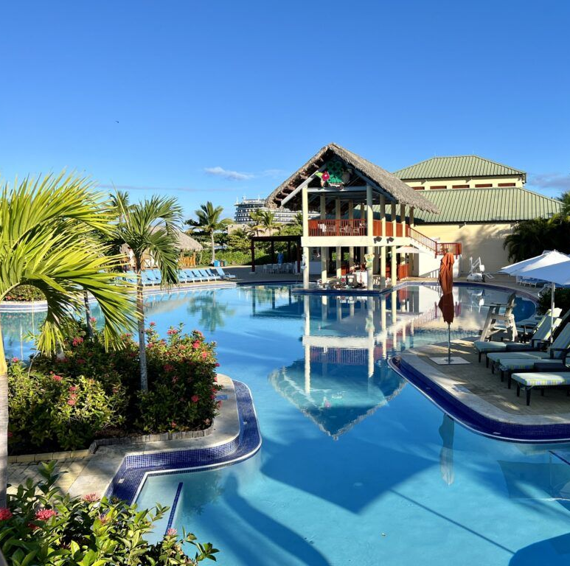
Aqua Zone
While in Amber Cove, the most popular activity is probably the Aqua Zone. You can lounge by this complimentary pool area, while the kids enjoy the waterslides and splash pad which are also free to use.
If you are looking for a bit of adventure, the Aqua Zone has a zipline that soars over the pool area. Guests can purchase an all-day pass for just $20. There is also a water sports rental area.
Here, guests can rent items like paddleboards, hydro bikes, kayaks, pedal boats, or solar catamarans for either a half hour or an hour at varying prices from $20 to $60, umbrellas for $20, lockers for $6, or book a VIP package.

Slide 16
Shore Excursions
If you’d prefer to venture beyond this port area, there are plenty of shore excursions that depart from Amber Cove. They can vary from beach breaks, historical tours, and adventure activities.
Puerto Plata’s Atlantic coastline has more than 60 miles of beaches. Thus, a beach break is a popular way to spend your day at Amber Cove.
The cruise lines offer the All-Inclusive Coconut Cove and Playa Bachata beach breaks as well as other beach stops included in Puerto Plata sightseeing tours.
Puerto Plata’s Malecon is known for its shopping, restaurants, and bars where you can enjoy a bit of Dominican culture. At the very end of the seafront, you will see the massive stone walls of the Fortress of San Felipe, a historic military fortress converted into a museum.
You can also partake in chocolate factory tours, visit the Amber Museum, tour the Brugal Rum Factory or a cigar factory, and interact with local coffee farmers.

Slide 17
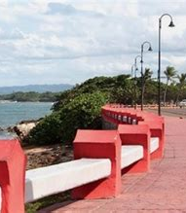
Puerto Plata’s Malecon
The completely paved Malecón (also known as Av General Luperón and Av Circunvalación Norte) runs along the shore.
There are a handful of restaurants, as well as a half-dozen beachside shacks selling food and drinks on Long Beach, the main city beach around 2km east of downtown.
You can also experience kitesurfers who launch themselves into the waves here on windy days.

Slide 18
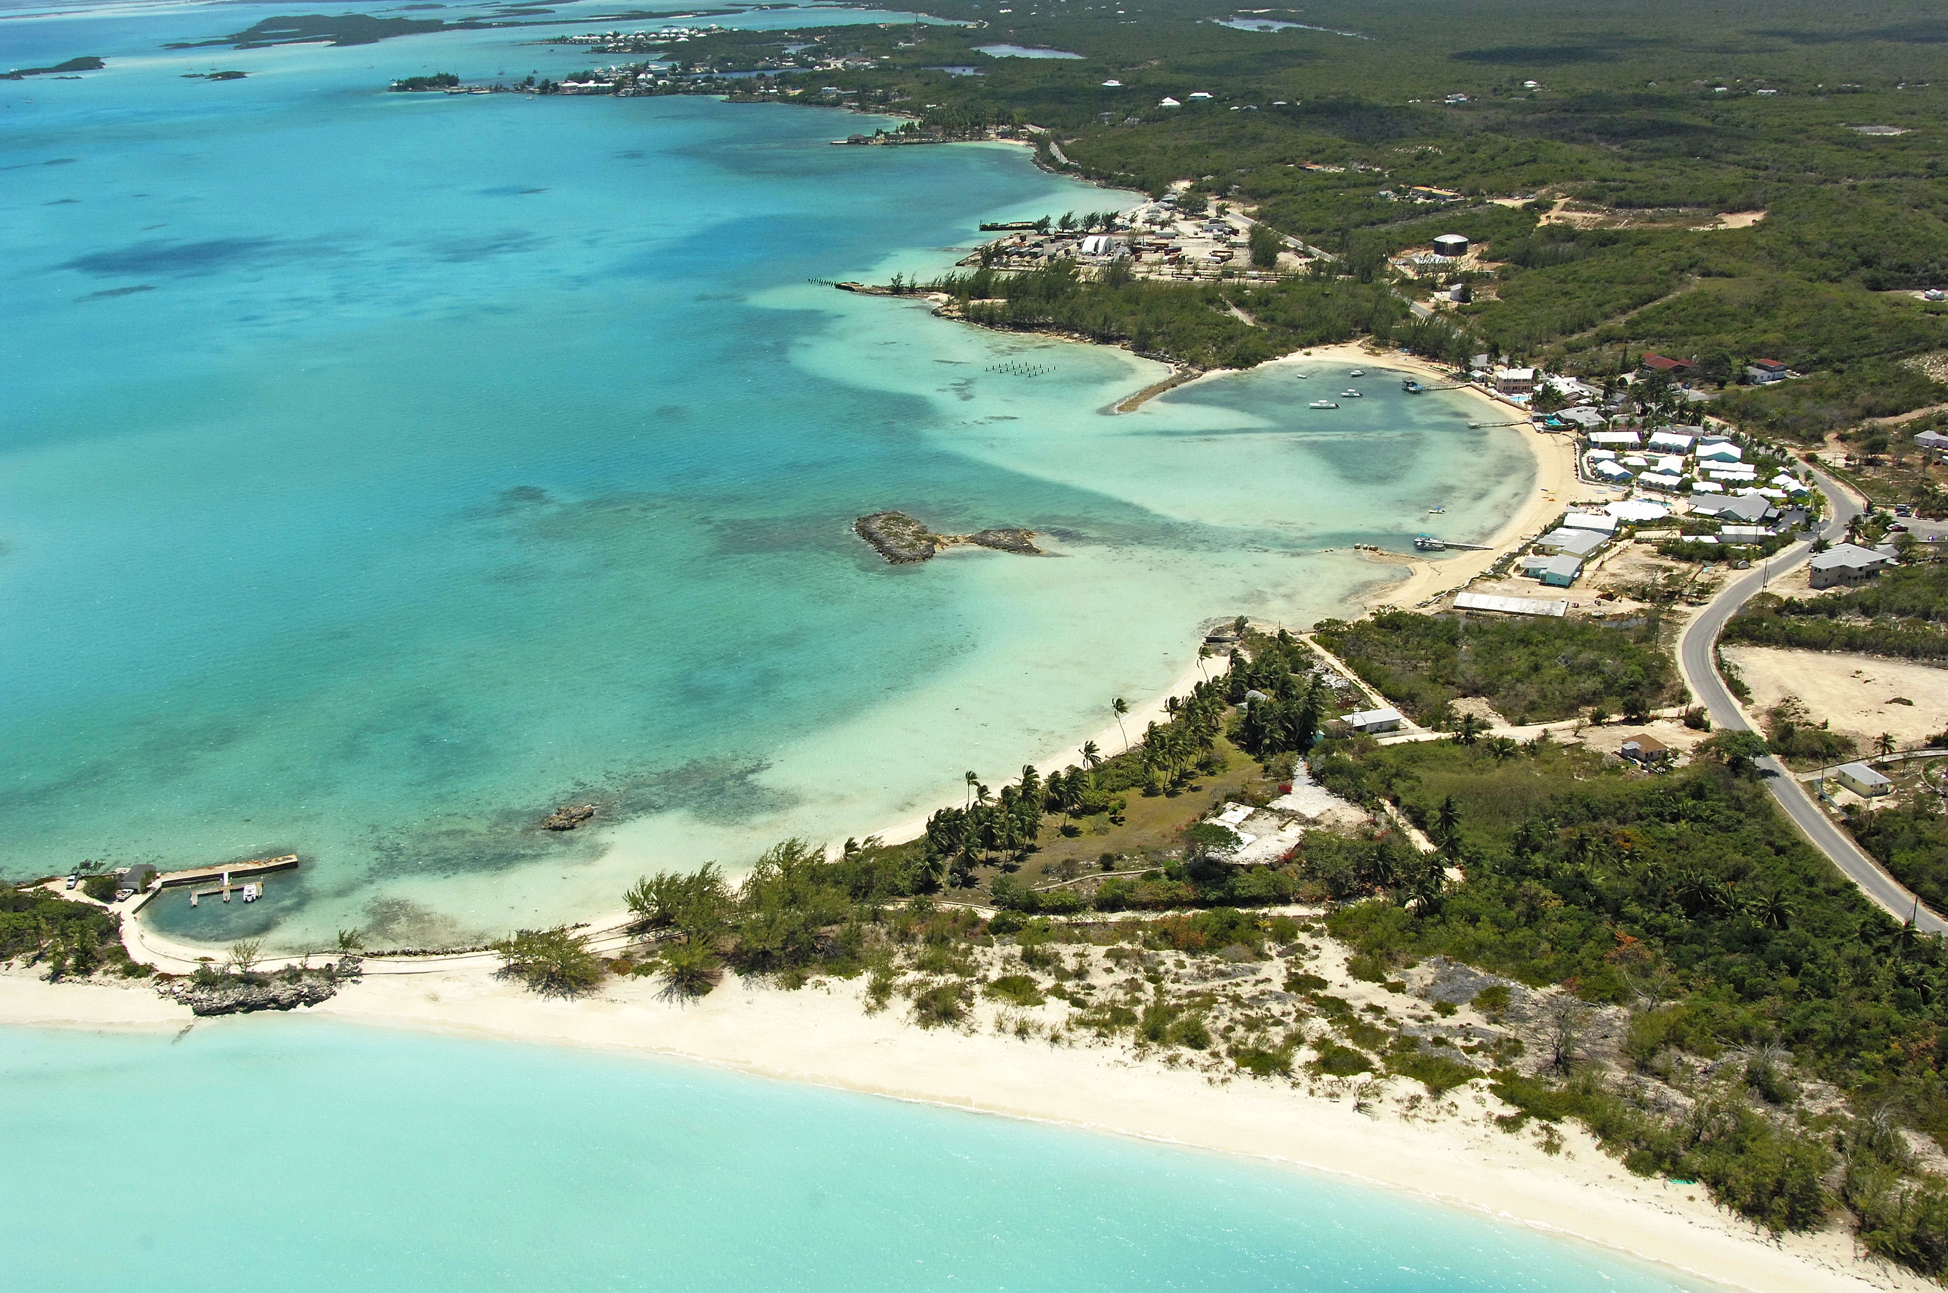
Coconut Cove
Have it all when you visit our private Coconut Cove Beach tucked away in a hidden part of the island’s coastline with stunning vistas and a sprawling white sand beach.
Coconut Cove is just 35 minutes south of the pier. This beach oasis is ready for you to lounge on the beach with an island.
Take a relaxing swim in the ocean, or try a kayak, paddleboard, or snorkel the shallow reef.
Prices $79.00 (ages 10 and up) $59.00 (ages 3 to 9) $0.00 (ages 0 to 2)
It’s all yours to enjoy in this full all-inclusive experience. Your package includes a welcome drink, beach chairs, umbrellas, hammocks, Local beers, local rum, rum punch, fruit punch, sodas, and a Dominican cuisine buffet lunch.
Kayaks, paddle boards, and snorkel equipment are also included.

Slide 19
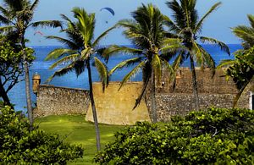
Fortress of San Felipe
During your visit to Puerto Plata, Fortaleza de San Felipe Fortress is a must-see, not only because of its history but also for the incredible sight of the coast.
Located in Puerto Plata’s Bay, near the seawall, the building was constructed in the 16th century to defend the city from pirates. Today, it is proof of the colonial past of Puerto Plata.
In the fortress, you can discover its walls and the moat that surrounds it. Inside, there is a little museum that possesses some historical relics..
Entrance fee: $10 for adults, children under 15 are free

Slide 20
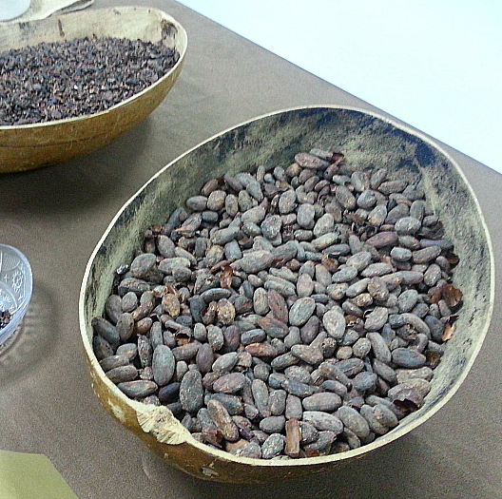
Del Oro Chocolate Factory
The Dominican Republic is well known for its chocolate production, so of course I had to take a Del Oro Chocolate Factory tour.
The cultivation, processing, and exporting of raw cacao and other cocoa products is a large portion of their economy and they do it well!
The factory tour is free, but you’ll probably end up spending money while you are there.
Who can resist good chocolate?

Slide 21
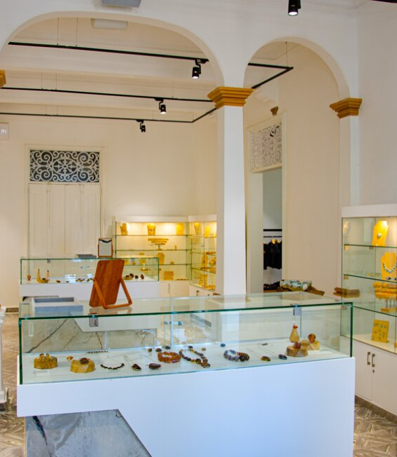
Museo Del Ambar
The Dominican Republic has a special relationship with amber, producing an extraordinary range of colors.
Considered a semi-precious gem, amber is formed when tree sap fossilizes, sometimes catching plants, and animals in it. Amber mining has, over the centuries, become a big business in the Dominican Republic.
Get an up-close look at the Dominican Republic's beloved amber in this Victorian mansion situated in downtown Puerto Plata. There are two floors worth of amber specimens, some fossilized. One of the highlights is a fossilized lizard dating back millions of years.

Slide 22
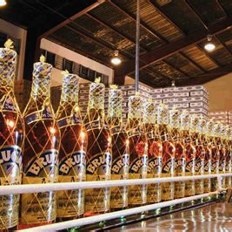
Brugal Rum Factory
If you have never been to a distillery this is your opportunity.
Founded in 1888, the Brugal family has run the distillery for five generations and is the country's most famous rum distillery.
They offer 30-minute tours from a 2nd-floor gangway, during which visitors tour to learn what makes Brugal a distinctive and worldwide-awarded Rum.
You will learn their history, and process and enjoy a tasting of some of their best rums.

Slide 23
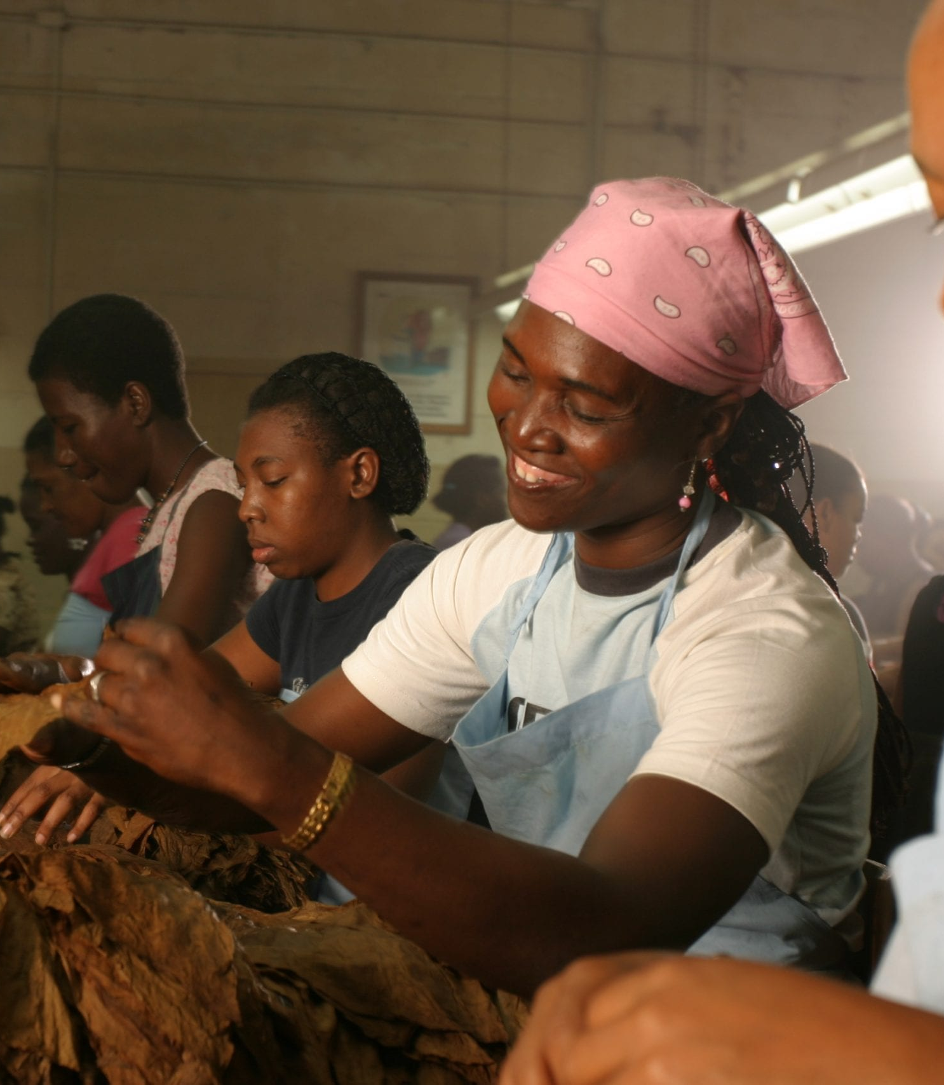
Espigón Cigar Factory
Located in the historic center of Puerto Plata on the north coast of the Dominican Republic, the Epigon Cigars pride themselves on the quality and consistency of their cigars.
You can watch their experienced cigar rollers at work crafting premium cigars and visit their well-stocked walk-in humidor, the only one in Puerto Plata.
They also carry a large range of local Rum and organic honey, chocolate, and coffee. .
They are located just steps from the city’s main square, Espigon Cigars is only a 20-minute cab ride away from the dock.

Slide 24
Conclusion
Amber Cover is a beautiful Area Regardless of what you're looking for, our port has something for everyone.
I hope this presentation will help when we visit the Dominican Republic!

Slide 25
Thanks For Coming
If you have any more questions, please ask.
I will do my best to answer them for you.
Have a great visit in the Dominican Republic!

