Slide 1

Alter Do Chao, Brazil
Presented by
Marc Silver

Slide 2
What I Will Cover
My Port Philosophy
Don’t Miss the Ship
Money
About Alter Do Chao
Alter Do Chao History
Area Map of Alter Do Chao
Map of Alter Do Chao
Alter Do Chao Transportation
Places to see or at least consider
A few restaurant recommendations
Conclusion

Slide 3
My Port Philosophy
I have been cruising for over 44 years and have taken over 200 cruises.
So, I consider myself an experienced cruiser.
The information I will present is based on those many years of
experience.
When I am on a cruise where the city, I want to visit is not the port city,
I always recommend taking a ship’s tour.
But when I am in a port with multiple attractions nearby and easy to see
on my own -
I will do it on my own.
This presentation is not like that.

Slide 4

Don’t Miss the Ship
How to Avoid Missing Your Ship
Pay attention to the time. - Ship time and local time are
often different.
Put a return-to-ship reminder on your phone.
Choose excursions wisely.
If a ship-sponsored excursion is late returning to port, the
ship will wait for you. If you are on your own.
Be Prepared
Have your Passport, Credit Card, and phone numbers for
your ship port agent.
What to Do If You Miss the Ship
Most cruise lines have port agents stationed in the port area to assist if your ship has left without you. If your are lucky, when cruisers are late returning to the vessel, the ship’s crew will often remove the passengers’ essential items – passports, cell phones, and medication -- from the ship to leave with the port agents.
The Port Officials can help you with contacting your ship
and making necessary travel arrangements.

Slide 5

Money
The Brazilian Real
The official exchange rate is:
$1.00 US = 4.9310457 Real
1.00 Brazilian Real = 0.2028 US Dollars

Slide 6
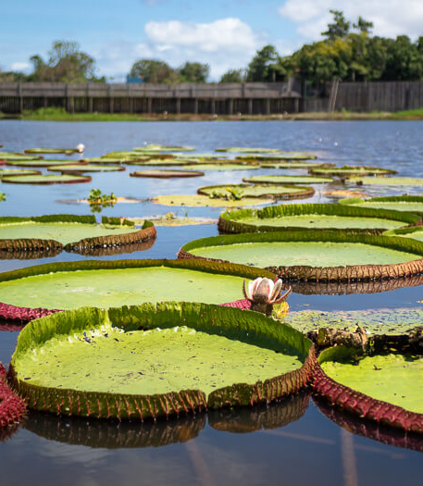
About Alter Do Chao, Brazil
In the heart of the Amazon rainforest, in the state of Pará in Brazil, lies Alter do Chão.
Although largely undiscovered by foreign tourists, it’s quite a popular holiday destination among Brazilians. Not only is this little town surrounded by wonderful tropical nature, but it also boasts the most beautiful freshwater beaches in Brazil.
Alter do Chão is known as the ‘Caribbean of the Amazon’ thanks to its countless white sand beaches along the shores of Rio Tapajós, one of the largest tributaries of the Amazon River. The beaches in Alter do Chão have clear blue water perfect for swimming.

Slide 7
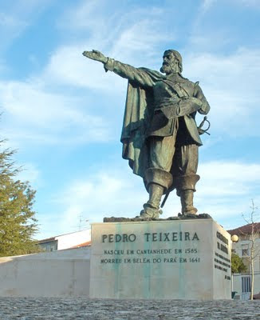
Alter Do Chao, Brazil History
Founded on March 6, 1626, by Portuguese Pedro Teixeira, and was elevated to a town by Francisco Xavier de Mendonça Furtado, governor of the State of Grão-Pará and Maranhão, during Colonial Brazil, on March 6, 1758.
Alter do Chão, during the 17th century and 18th century, received several religious missions, led by the Jesuits of the Franciscan order. The cult of Our Lady of Remedies was established. This became the patron saint of this holy place.
In the 20th century, during the rubber cycle, it became one of the routes of latex extracted in Belterra and Fordlândia until 1950, Alter do Chao was one of the transportation routes of latex extracted from rubber trees Belterra and Fordlandia. It was a short period of development for the town. In the 1950s the decay of Amazonian extraction began, and the village was hit by the economic deficit. From the 1990s to the present day, the district has focused on tourism to evolve economically, which has achieved good results.

Slide 8
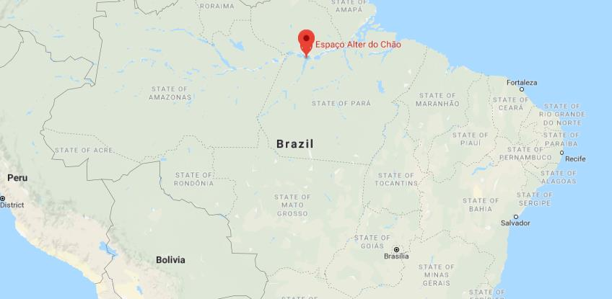
Area Map of Alter Do Chao, Brazil

Slide 9
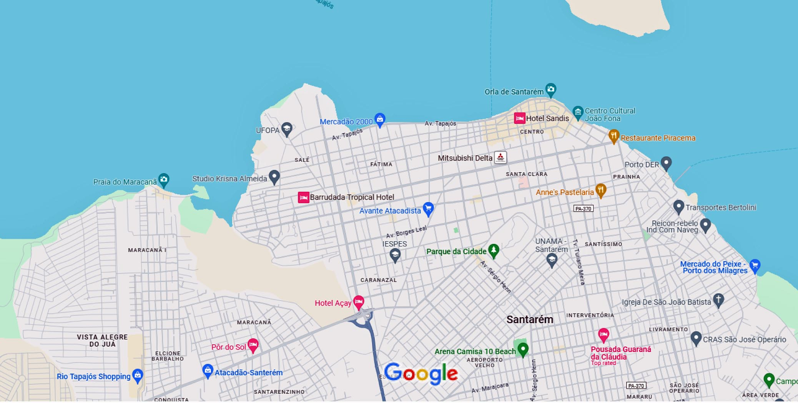
Map of Alter Do Chao

Slide 10
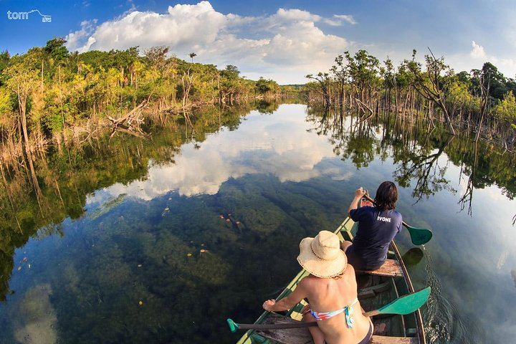
Alter Do Chao, Brazil Transportation
Alter do Chão is small enough to walk around.
For very little money you can hire a canoe or fishing boat to show you around the area from the water.

Slide 11
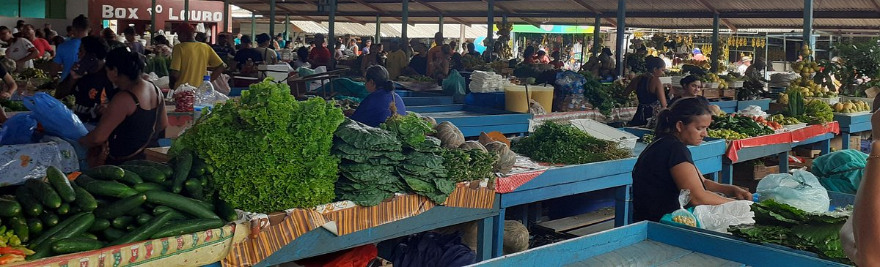
Mercadão 2000
The Mercadão 2000 is the largest street market in Latin America and one of the most visited tourist attractions in the area.
Located less than a ½ mile form the cruise port, Mercado 2000 has regional fruits, handicrafts, and also medicinal plants, and other natural drugs produced from native species with empirically proven healing power are found. The market doesn’t leave anything to be desired when it comes to finding fresh items from the Amazon.

Slide 12
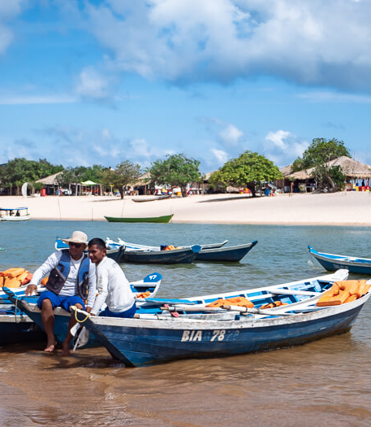
Ilho do Amor, Alter do Chão
It’s possible to charter a fishing boat to take you around to other islands in the area while you search for wildlife such as playful river dolphins.
A half-day trip costs around 150 BRL (US$30) for up to four people.
To get to Ilha do Amor you can either swim or hire a canoe for R$ 3 for up to four people.
During the dry season, there are several places where you can wade across in water that is no more than 2 feet deep.
Be especially careful of stingrays when visiting some of the more remote beaches in the area. They will only sting when stepped on, so shuffle your feet when you walk in the water.

Slide 13
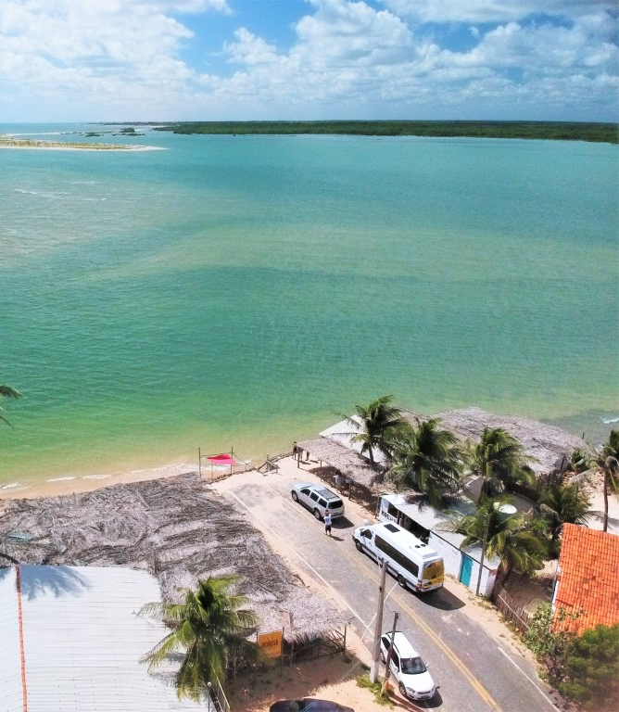
Praia do Cajueiro
A few blocks west of the town center along the waterfront promenade is this pleasant beach, wrapping around to the Tapajós River.

Slide 14
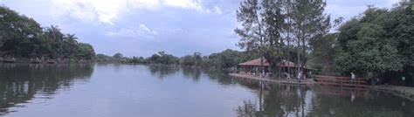
Lago Verde
This huge three-fingered lake is surrounded by forest and has places to swim, snorkel with fish and spot wildlife (including a resident family of monkeys).
Tour agencies do good boat tours (per person R$50 to R$75, two to three hours, two to six people) or you can hire one of the yellow-shirted freelance boatmen on the waterfront; the latter are cheaper but may not have the same service or equipment that agencies do.

Slide 15
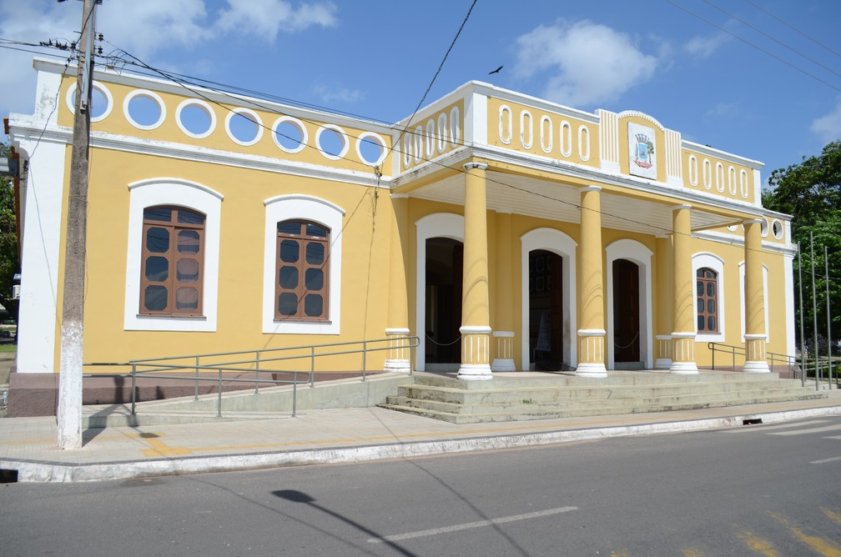
Museu de Santarém
Housed in a large yellow waterfront mansion, this museum is also known as the Centro Cultural João Fona, after the Pará artist who painted the frescoes on its interior walls.
It features, among other things, an excellent collection of stone and clay artifacts from the Tapajoara culture that flourished in this area more than 6000 years ago.

Slide 16
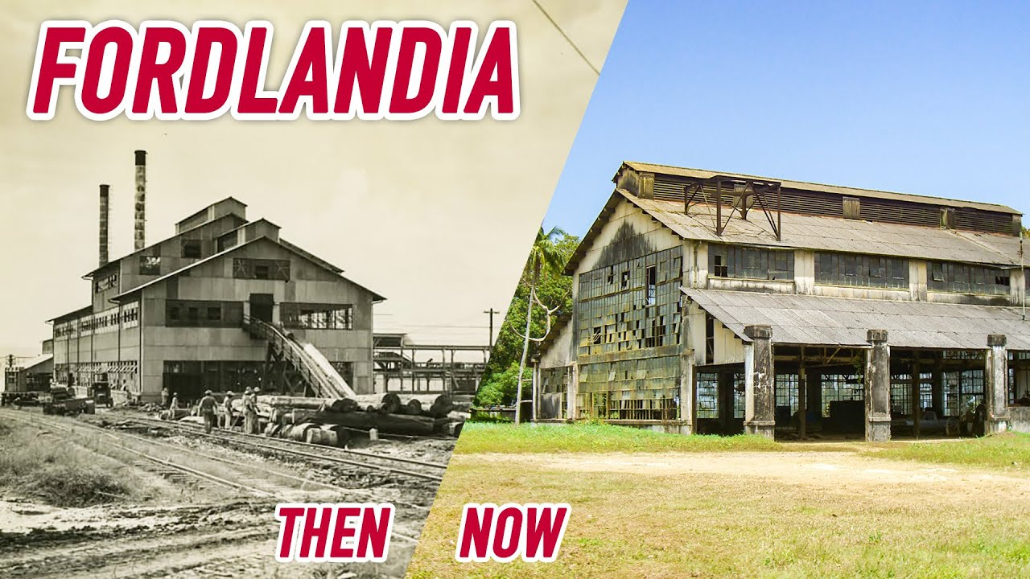
Belterra
Located about 30 minutes south of Alter Do Chao is Belterra.
Henry Ford briefly moved his Fordlândia operations to this tidy little town in the 1940s and this site located just 40km from Santarém, makes for an easy day trip. There's a small museum of Ford-era photos and artifacts, a small grove of rubber trees, and several green-and-white buildings, built for Ford managers; behind one (the Secretária de Educação) is a cement platform with river views.
There's a water tower, with a still-working industrial whistle that is used to summon the workers.
Buses run $3.50 every 30 to 60 minutes, until 9 pm. Some guides, may include tours here.

Slide 17
Thanks For Coming
If you have any more questions, please ask.
I will do my best to answer them for you.
Have a great visit to Alter Do Chao!

