Slide 1

Alicante Spain Cruise Travel Guide
Port Presentation Presented by Marc Silver

Slide 2
What I Will Cover
My Port Philosophy
Don’t Miss the Ship
Money
Introduction to Alicante Spain
A Cruise Traveler’s Guide
History of Alicante
Maps
Getting Around
Tourist Office?
Attractions & Points of Interest.
A few restaurant recommendations
Important Tips & Practical Advice
Final Thoughts

Slide 3
My Port Philosophy
I have been cruising for over 45 years and have taken over 100 cruises. I consider myself an experienced cruiser.
The information I will present is based on those many years of experience.
When I am on a cruise where the city I want to visit is not the port city, I always recommend taking a ship’s tour.
But when I am in a port with multiple attractions nearby and easy to see on my own - I will do it on my own.
This presentation is for that type of port.

Slide 4
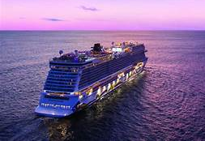
Don’t Miss the Ship
How to Avoid Missing Your Ship:
Pay attention to the time. - Ship time and local time are often different.
Put a return-to-ship reminder on your phone.
Choose excursions wisely:
If a ship-sponsored excursion is late returning to port, the ship will wait, but not for excursions taken on your own.
Be Prepared:
Have your Passport, Credit Card, and phone numbers for the ship port agent.
What to Do If You Miss the Ship: Most cruise lines have port agents stationed in the port area to assist if your ship has left without you. Sometimes, when cruisers are late returning to the vessel, the ship's crew may remove the passengers' essential items -- passports, cell phones, and medication -- from the ship to leave with the port agents.
The Port Officials can help you with contacting your ship and making necessary travel arrangements.

Slide 5

Money
Spain uses the Euro (€) as its official currency. As of October 2024, the exchange rate between the Euro and the U.S. Dollar (USD) is about 1 EUR = 1.05 USD.
This means U.S. travelers should anticipate slightly higher prices in terms of conversion, but Spain remains a relatively affordable destination compared to many other Western European countries.
When exchanging money, it’s best to avoid doing so at the port exchange kiosks, as they tend to have higher fees and less favorable rates.
Instead, consider using ATMs to withdraw Euros directly, as they often offer better rates. Additionally, credit and debit cards are widely accepted throughout Alicante, though having some cash on hand is always a good idea for smaller purchases or tips.

Slide 6
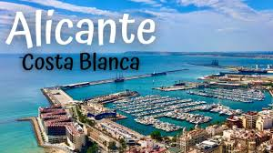
Introduction to Alicante Spain
Nestled on the picturesque Costa Blanca, Alicante is a delightful blend of history, culture, and sun-kissed beaches, making it a must-visit destination for cruise travelers.
For first-time visitors, start your journey with a stroll along the Explanada de España, a stunning promenade lined with palm trees and mosaic tiles. Dive into history at the Castillo de Santa Bárbara, towering above the city and offering panoramic views.
Don't miss the vibrant Mercado Central for a taste of local life and cuisine. For beach lovers, Playa del Postiguet, conveniently located near the city center, offers a perfect retreat

Slide 7
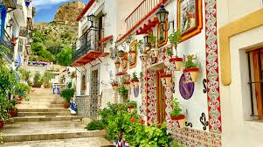
A Cruise Traveler’s Guide
This sun-kissed paradise along Spain's southeastern coast has burgeoned as a favorite port of call for cruise passengers
Renting a bike is a great way to explore Alicante's flat and scenic paths, providing both flexibility and adventure.
When dining out, try traditional dishes like 'paella' at local eateries.
Lastly, learning a few basic Spanish phrases can enhance your interactions with the locals, adding a personal touch to your visit.
This guide will help you get the most out of your visit, whether you're making a pilgrimage or returning to this bewitching Mediterranean city for more.

Slide 8
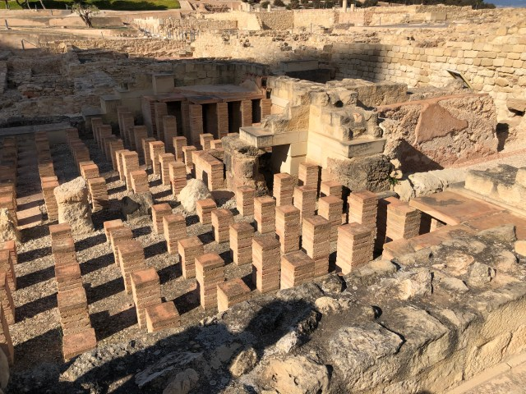
The History of Alicante
A Time Traveling experience
The history of Alicante dates back over 7,000 years ago, to the early settlements of Iberians tribes.
Its location on the eastern coast of Spain and its access to the Mediterranean Sea has made it a strategic point in several occasions throughout history.
The Greeks and Phoenicians realized its potential earlier but the Romans are associated with making a trading post out of it.

Slide 9
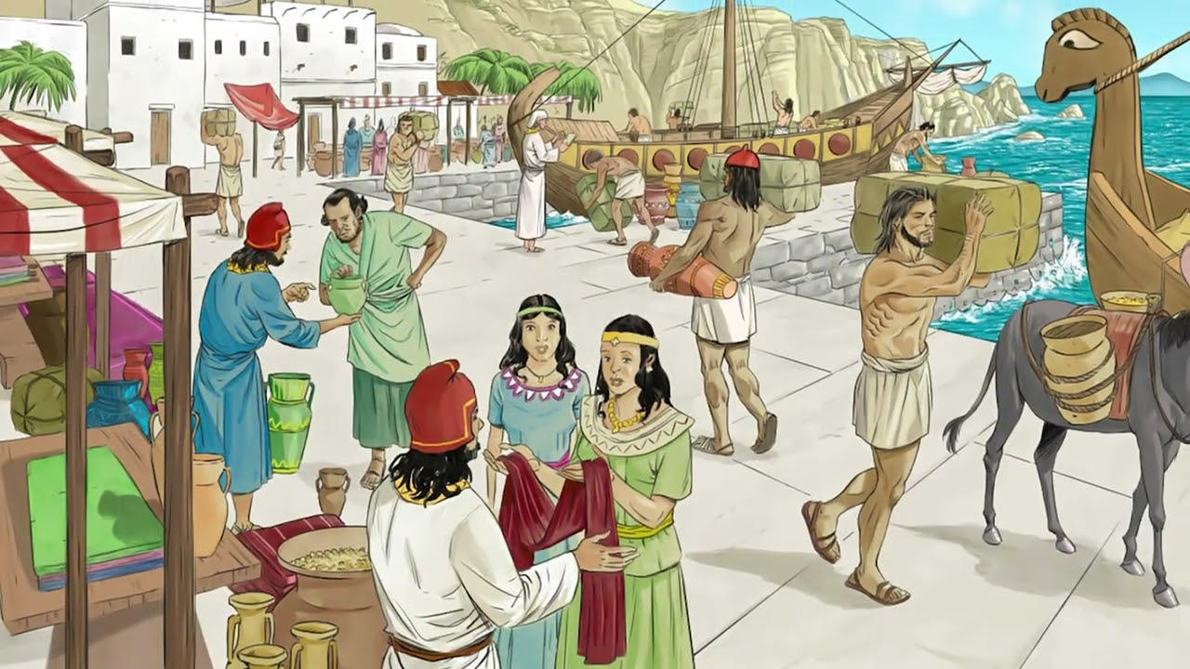
Alicante's History A Journey Through Time
Alicante's history stretches back over 7,000 years, starting with early settlements by Iberian tribes.
The city’s location, on the eastern coast of Spain with easy access to the Mediterranean Sea, made it a strategic point for various civilizations.
The Greeks and Phoenicians were the first to recognize its potential, but it was the Romans who truly established the town as a trading post known as “Lucentum,” which you can still visit today in the form of impressive ancient ruins.

Slide 10

Alicante's History A Journey Through Time
During the 8th century, Alicante came under Moorish rule, a period that left a lasting imprint on its culture and architecture.
The Moors built the Castillo de Santa Bárbara, a hilltop fortress that dominates the city's skyline.
This majestic castle, offering panoramic views over the sea and the town, is a must-see for any visitor.

Slide 11
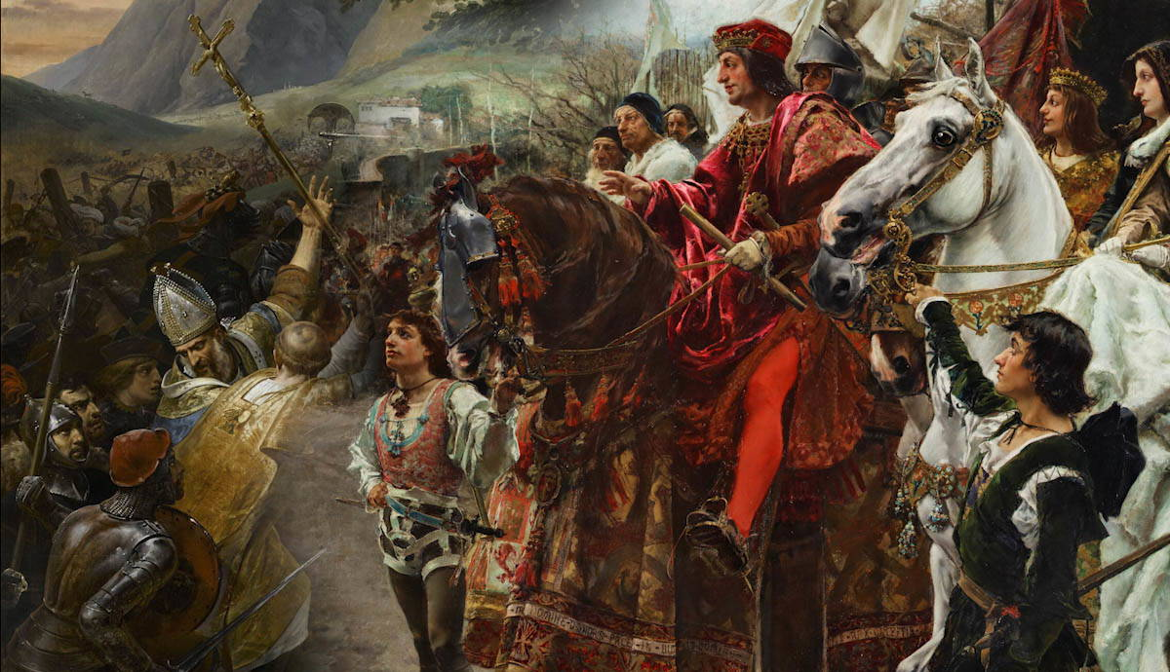
Alicante's History A Journey Through Time
Alicante was reconquered by Christian forces in the 13th century and quickly became a vital port for the Kingdom of Castile.
Over the centuries, it developed into a bustling maritime city and an important hub for trade, particularly during the Spanish Empire.
Today, Alicante is not only a commercial center but also a major tourist destination, known for its lively festivals, historic landmarks, and beautiful beaches.

Slide 12
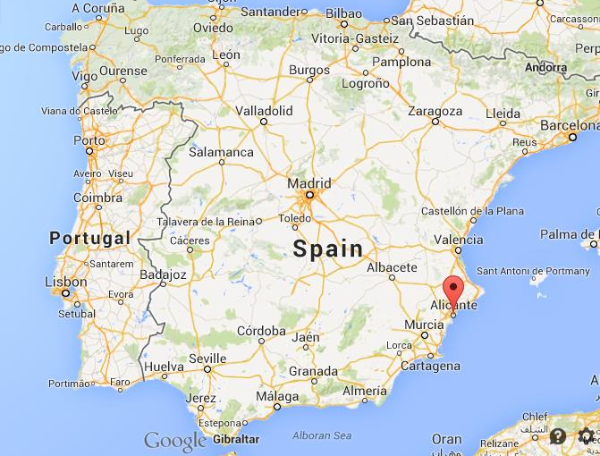

Slide 13
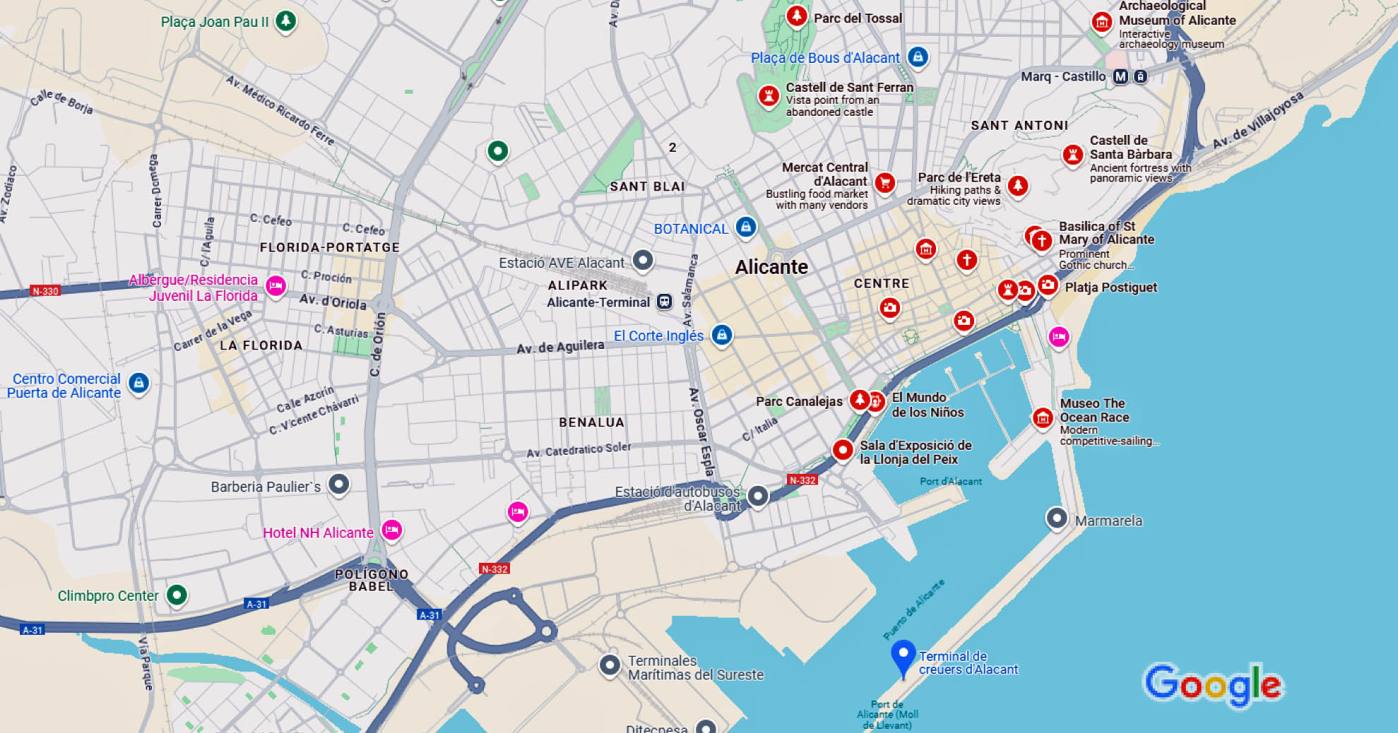
Map Of Alicante

Slide 14
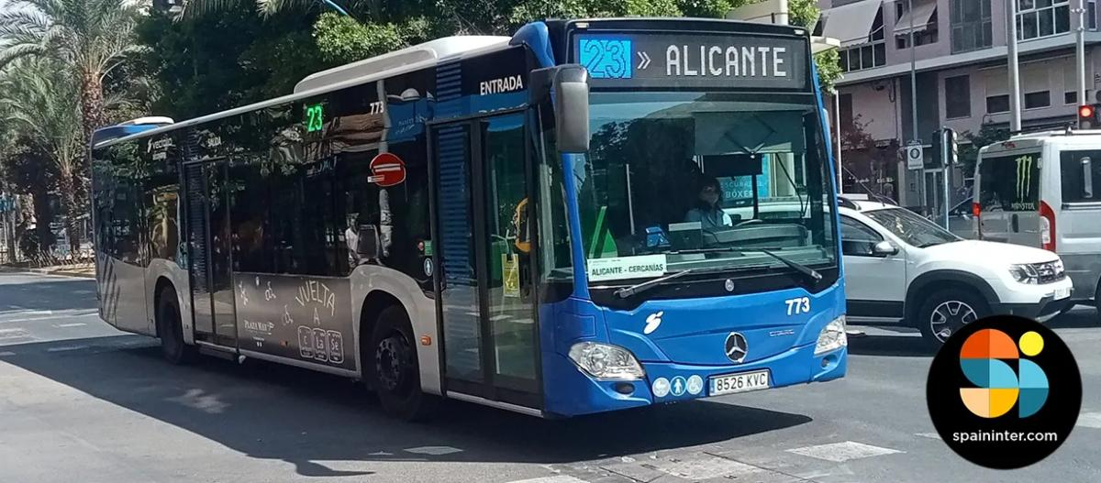
Getting Around Alicante
Public Buses
For the most part Alicante is an easy city to walk, but for those who want to avoid exercise as much as possible, there are the city buses.
The system offers routes that connect the key parts of the city along with the cruise port, city center and top tourist attractions such as the Castle of Santa Bárbara and Postiguet Beach.
A one-way ticket fare is around €1.45, and buses are available throughout the day at short intervals. They are not only very affordable, but they are also known for their punctuality which is perfect both for tourists and city dwellers.

Slide 15
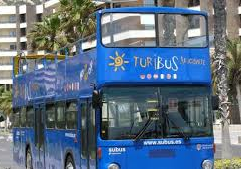
Getting Around Alicante
Alicante Turibus Bus
A hop-on hop-off bus service in Alicante is a perfect break for travelers who want to explore the city at a slower pace.
The double-decker bus guarantees you easy access to your favorite attraction since you are free from the strict schedule and the contrasting multiple languages are provided by the audio narrator.
Tickets cost about €20 for a 24-hour trip, and buses are stopping at the best places such as the Archaeological Museum (MARQ) and Old Quarter.
It is the perfect choice for those who are in a hurry and who still want to experience the most of the city. That is therefore it’s an absolute and hassle-free way for those tourists, which are so short on time but though they want to visit as many places as they can.

Slide 16

Getting Around Alicante
Taxis and Ride-Sharing
Taxis are readily available throughout Alicante, and the fare from the port to the city center typically ranges from €5 to €10.
Taxis in Alicante are safe, metered, and regulated, but confirming the fare before getting in is always a good idea.
Ride-sharing services like Uber are not widely available in Alicante, so taxis remain the primary private transportation option.

Slide 17

Getting Around Alicante by Bike
When out cruise stops in Alicante, consider a bike rental for a budget-friendly, eco-friendly way to explore the city.
Blue Bike Rental & Tours is 400 yards from the pier. With rentals near the port costing between €10 and €26 per day, it's an easy, affordable option.
They also offer Scooter rentals for €125
Alicante’s flat terrain and well-marked bike paths make cycling accessible for all skill levels.
You can explore the city’s charming streets, visit landmarks like Santa Bárbara Castle, or enjoy a peaceful ride through Canalejas Park or along the waterfront at Explanada de España.

Slide 18
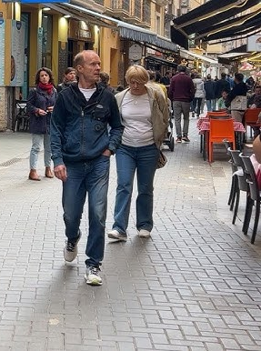
Getting Around Alicante
Walking
In Alicante, walking is an easy and pleasant activity, especially in the old town, the Explanada de España, and the port area.
Many of the main attractions are located at very small distances in between which enables tourists to walk from one to another very conveniently.
As you stroll through the streets, you'll have the chance to discover hidden treasures like charming cafes and unique shops tucked away in the narrow alleyways.

Slide 19
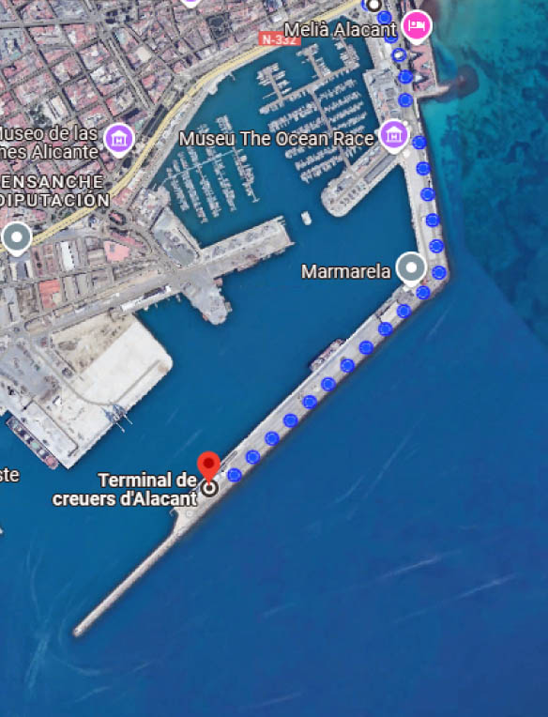
Your First Stop
The Tourism Office provides a tourist information service and attention to the city's visitors.
Just walk to the end of the dock to find the Alicante Tourist Center.
You can pick up pamphlets on places to see throughout Alicante as well as getting advice from the associates there.

Slide 20
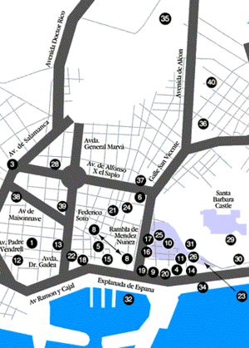
Attractions & Points of Interest
Walking Tour
Sights/shopping 28. Museo Arqueologico 29. Castillo Santa Barbara 30. Elevator to Castillo 31. Museo de Arte Siglo XX 32. Boats to Tabarca Island Beaches: 33. Playa San Juan 34. Playa Postiguet Shopping: 37. Mercado Central 38. El Corte Ingles 39. Galerias Preciados 40. Mercadillo Campoamor
Spanish Food: 8. Resaurant Row (inexpensive) 9. La Goleta 10. Quo Venit 11. El Corregidor 12. Museo de Jamon Seafood: 18. Currican Snacks: 19. McDonald's 20. Burger King Worship: 25. Catedral de San Nicolas 26. Iglesia de Santa Maria 27. Evangelical Baptist Church

Slide 21
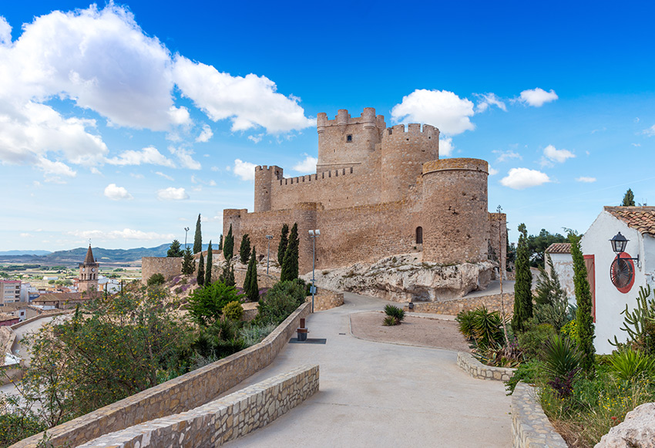
Attractions & Points of Interest
Alicante offers a wide range of attractions, from historical landmarks to stunning natural sites. Here are some must-see spots:
Castillo de Santa Bárbara
Castillo de Santa Barbara is an old fortress on Mount Benacantil that has remained the largest fortress in the Mediterranean. It is only a ½ hour walk to the Castle. It was built in the ninth century during the Muslim occupation era.
It is such a joy to walk through its towers, dungeons stimulatory, and fortified walls. In addition, the views of the city and coastline are so dazzling
Admission: Free
Tips: Wear comfortable shoes for the climb or take the elevator from Postiguet Beach.

Slide 22
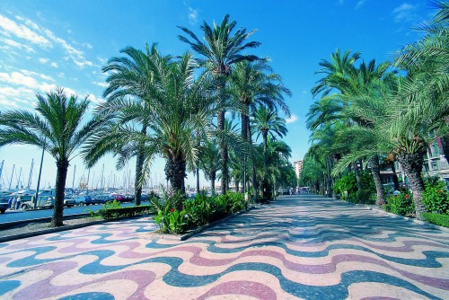
Explanada de España
The Explanada de España in Alicante, which is certainly the most famous pedestrian walkway in Alicante.
It´s nearly 600 m long and parallel to the harbor, connecting Plaza Puerta del Mar with the Parque de Canalejas.
It’s unique dry-stone mosaic floor mimicking waves from the Mediterranean, offers a delightful stroll and perfect views out to sea.
A symbol of the Alicante itself, with palm lined track covered in 6.5 million marble pieces set to create a mosaic Seafront.
This pleasant walkway beside the marina affords the option of a contemplative stroll or people-watching at a café.

Slide 23
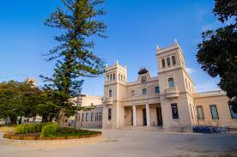
Archaeological Museum of Alicante
MARQ is an archaeology museum which is dedicated to displaying its collection of classified and catalogued finds.
The museum won the European Museum of the Year Award in 2004, a few years after significant expansion and reallocation to renovated buildings of the antique hospital of San Juan de Dios.
The museum houses eight galleries that use multimedia to allow visitors to interact with the lives of past residents of the region
There are also many educational and interactive displays such as demonstrations, workshops, etc., through to the most recent period for history.
Admission: €5 for adults, free for children under 12
Joint Ticket (MARQ + Lucentum + La Illetta + Torre Almudaina) € 8,00

Slide 24
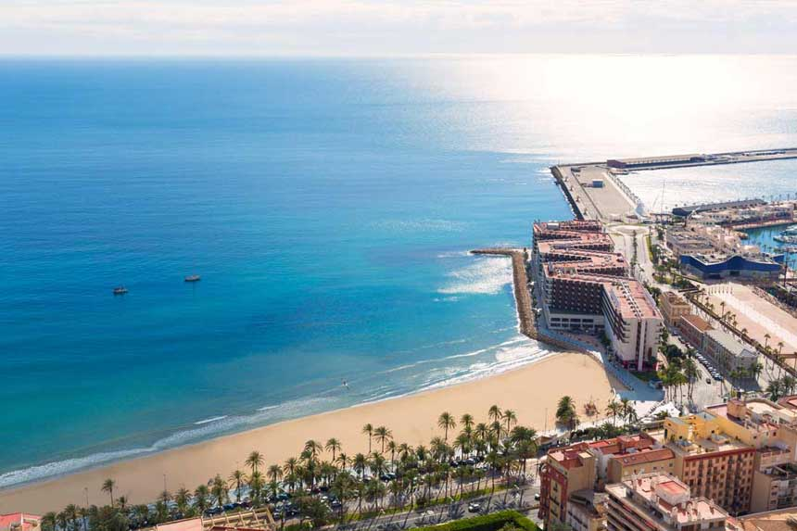
Postiguet Beach
A popular urban beach located right next to the city center, Postiguet Beach offers golden sands and clear blue waters. It’s perfect for a quick dip or a relaxing afternoon soaking up the sun.
Postiguet beach stands out for the quality of its fine golden sand and calm waters.
Together with its easy access to the old city centre, the beach has become an emblem of Alicante city.
This is the closest beach to the cruise port.

Slide 25
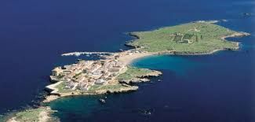
Tabarca Island
Description: Just a stone's throw from Alicante, Tabarca island, which is Spain's smallest inhabited island, is literally a desert-island getaway. At the same time, the sea here is incredible for snorkeling and the village is quite picturesque.
Ferry ride costs around €20 back and forth.
Tips: Bring your own food or pop out to a seafood spot on the island.

Slide 26
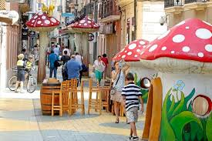
Alicante’s Calle de Las Setas (The Mushroom Street)
In 2013 part of San Francisco Street was transformed into a whimsical, fantasy wonderland of yellow brick roads, toadstool houses, and towering mushrooms.
The purpose of this initiative was to rejuvenate the street and help the businesses in the area during a state of economic decline. The mushroom statues are the work of artist Sergio Martinez, and cost the City of Alicante around €66,000.
Shop owners in the street are grateful that the mushroom statues and the rest of the decorations were added, since it has meant a dramatic increase in the number of visitors to their shops.
Many locals seem to have forgotten the original name of the street “San Francisco” and refer to it as “Mushroom Street.”

Slide 27
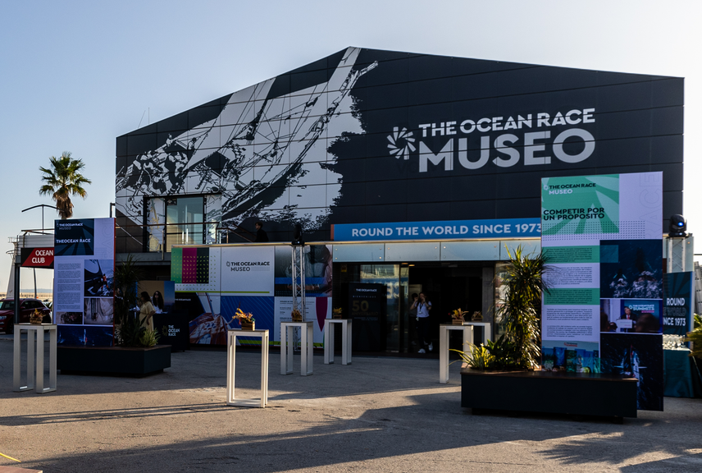
Museo The Ocean Race
The Ocean Race Museum is the only museum in the world dedicated to the toughest sailing competition in existence: The Ocean Race.
An interactive space that covers the more than 50 years of history of the regatta and its advances in nautical technology, showing the human effort that this sporting challenge entails, through audiovisual installations, games, models and much more.
uman effort that this sporting challenge entails, through audiovisu The Ocean Race Museum is on right on the Pier where we dock. Dock.

Slide 28
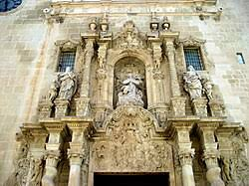
Basilica of St Mary of Alicante
The Basilica of St. Mary of Alicante is the city’s oldest church, dating back to the 14th century, built on a former mosque after the Reconquista.
It showcases a blend of Gothic and Baroque architecture, with a Gothic interior and a striking Baroque facade added in the 18th century.
Inside, you'll find an ornate Baroque altar and a historic pipe organ. The basilica is also home to the statue of the Virgen del Remedio, Alicante’s patron saint. This historic site is both a religious and cultural icon in Alicante.

Slide 29
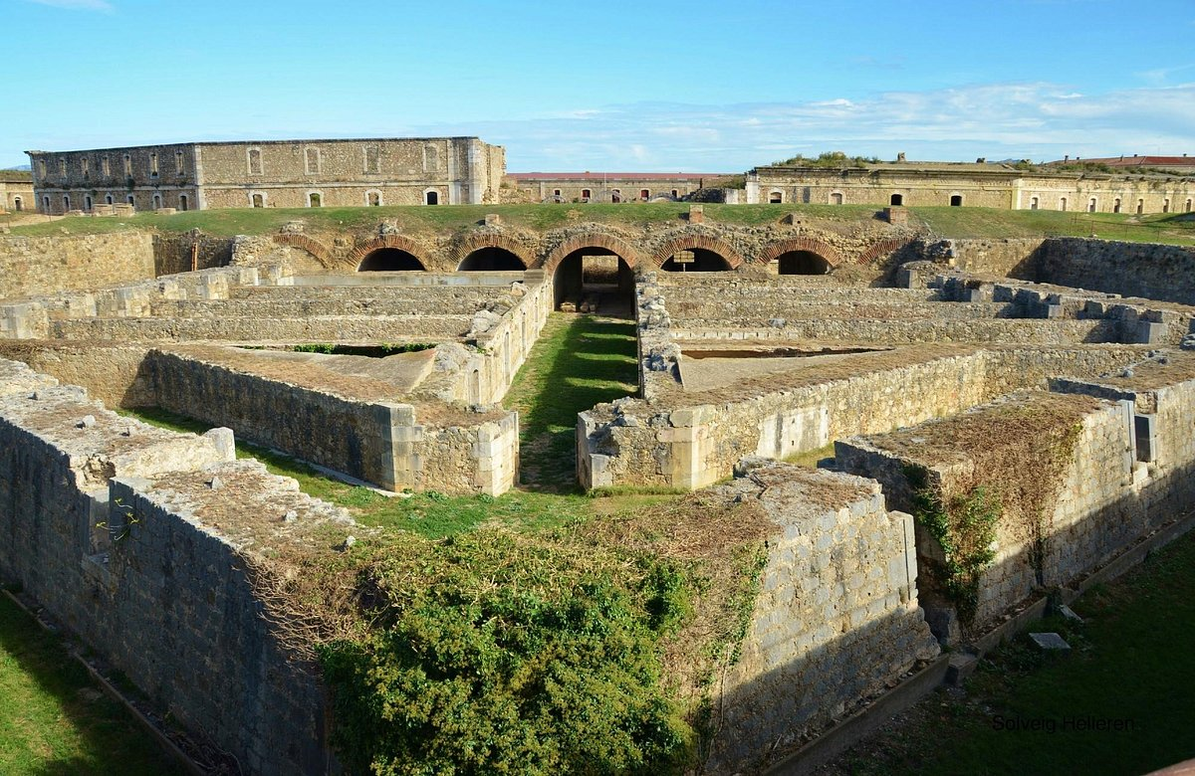
Castell de Sant Ferran
Perched atop a hill at the end of Pujada del Castell, Sant Ferran Castle is an impressive 18th-century fortress designed by Juan Martín Zermeño, a commander of the Corps of Engineers.
Covering 32 hectares with a perimeter of 3,120 meters, this vast stronghold includes underground tanks capable of storing 9 million liters of water. Built to accommodate 4,000 soldiers, it stands as one of Catalonia's most significant historical landmarks and the largest modern-era fortress.
The castle’s sheer size, advanced construction techniques for its time, and well-preserved state make it a remarkable example of military engineering.
Entry fee is €6

Slide 30
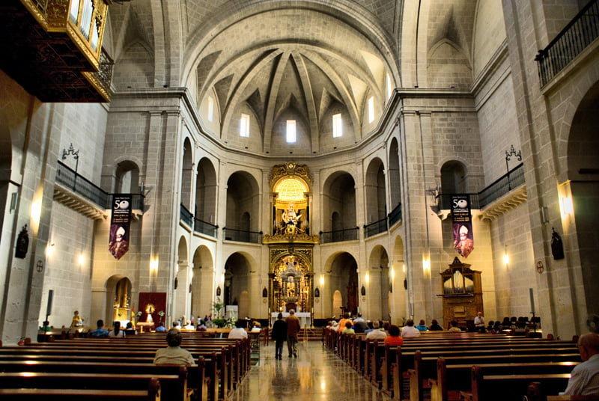
Cocatedral de Sant Nicolau de Bari d'Alacant
The Co-Cathedral of St. Nicholas of Bari in Alicante, Spain, is a beautiful example of Spanish Renaissance architecture.
Built between the 15th and 17th centuries, it features a simple yet elegant exterior contrasted by an ornate Baroque interior.
The church is named after St. Nicholas of Bari, the patron saint of Alicante, and is one of the city’s main religious landmarks.
Notable features include its large dome, the richly decorated chapel of the Holy Communion, and its serene cloister. Located in the heart of Alicante, it serves as a co-cathedral of the Diocese of Orihuela-Alicante.
There is no admission fee.

Slide 31
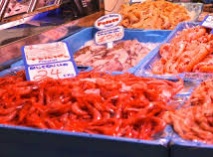
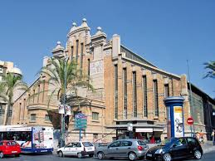
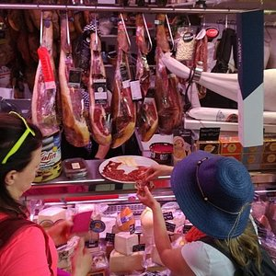
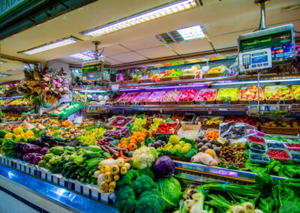
Mercat Central d'Alacant
The Mercat Central d'Alacant (Central Market of Alicante) is a bustling, vibrant marketplace located in the heart of the city.
Housed in an impressive early 20th-century building with a mix of Modernist and Baroque Revival styles, it serves as a hub for local culture and commerce.
Inside, you'll find a wide variety of fresh produce, seafood, meats, cheeses, and local delicacies, making it a favorite spot for both residents and tourists.
The market offers an authentic taste of Alicante's culinary traditions and is an essential stop for food lovers.

Slide 32
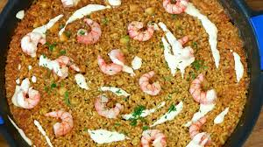
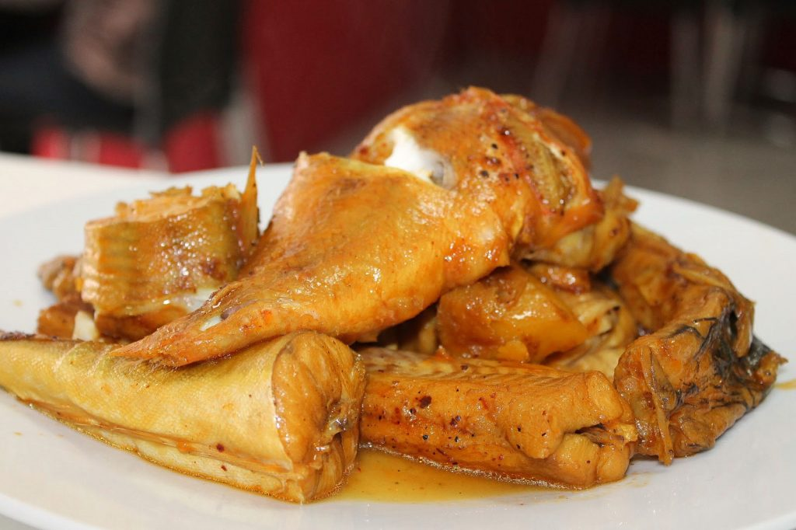
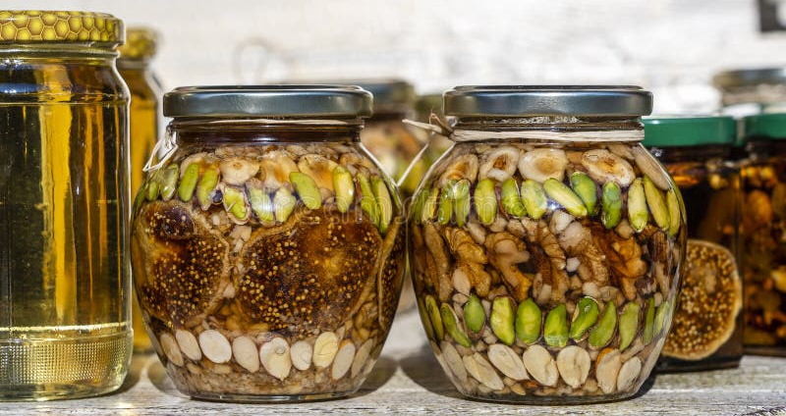
Home to Amazing Restaurants
Alicante’s culinary scene is rich and diverse, with influences from its Moorish past and Mediterranean location. Here’s what to look for:
Traditional Dishes
Arroz a la banda: Baked pae with clams, garlic and eggs is a local variation of paella, made with fish stock.
Montenegro Honey is honey named after its town of origin and made from almonds and salmon. It is a nougat-like dessert.
Caldero de pescado: A rice dish made with fish stock is called Caldero especially when it is equally made from fish. A dish terribly hit on Tabarca Island shows that it is popular.

Slide 33
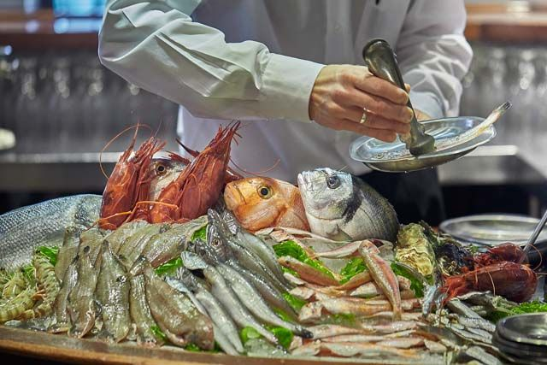
Home to Amazing Restaurants
Best Spots to Eat
Nou Manolin: The city centers of Spain are very crowded therefore Vodka Bar is a high-end restaurant worth trying for its tapas and seafood. City center is the name of the restaurant and it keeps the flavor of the tradition of making food from Spainality by coining it as food Lovers will do this. So you must go to this place.
La Taberna del Gourmet: A Michelin-recognized offering is this spot where you can find gourmet tapas.
Mercado Central: The central market would be the optimum destination to pick up some fresh produce. It is also a great place for you to try out local cheeses and cured meats, or to find places where you can taste street food.
Serving regional dishes and seafood, you’ll find plenty of restaurants in Alicante that will make you want to stay there forever.

Slide 34
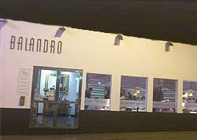
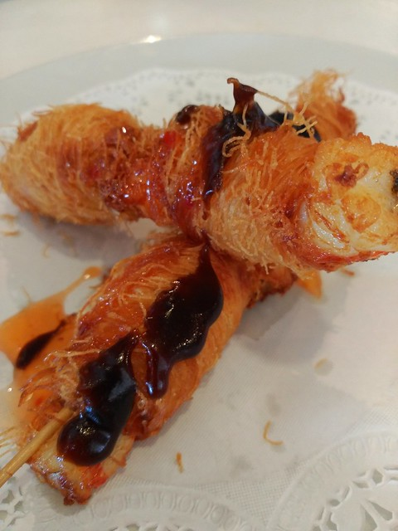
Home to Amazing Restaurants
Serving regional dishes and seafood, you’ll find plenty of traditional (and modern) restaurants in Alicante that will make you want to stay there forever. Try, Restaurante El Faro de Alicante, and Balandro – you’ll thank me later.

Slide 35
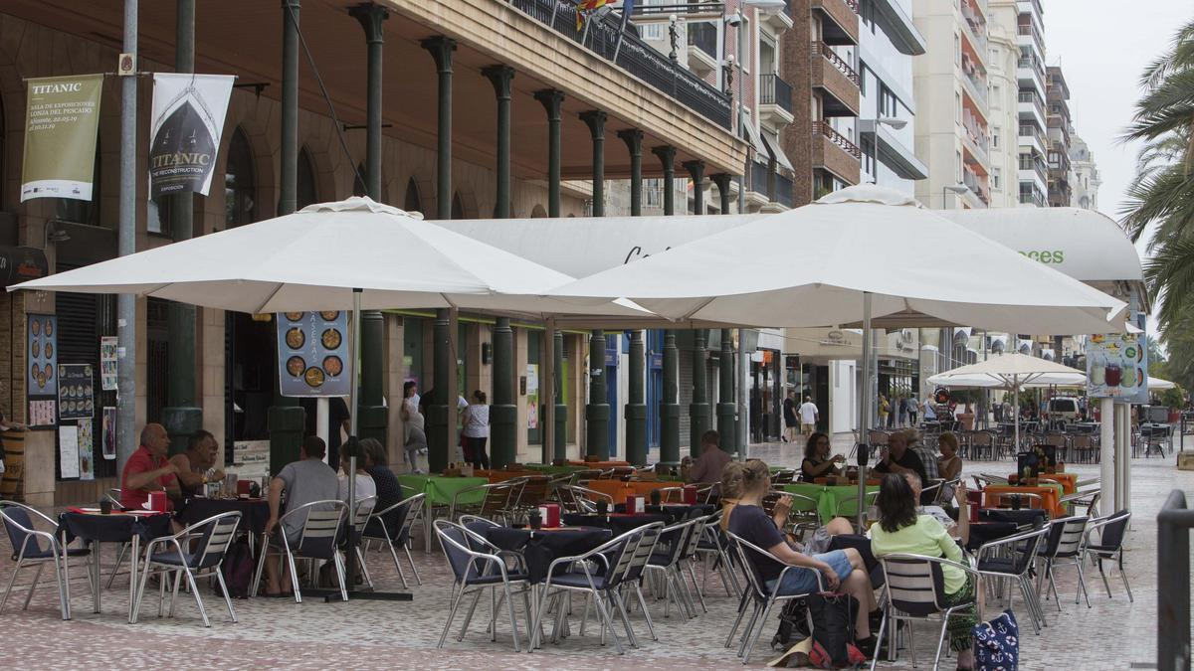
Important Tips & Practical Advice
Tips for Authentic Dining: Do not pick restaurants that are close to places that are popular with tourists like the Explanada de España. These restaurants are mostly targeting tourists and that’s why they are more likely to overcharge.
Instead, the best would be to look out for some of the smaller eateries in the old town or inquire from the locals for recommendations.
Safety: Alicante is generally a very safe destination for tourists, but it's important to remain cautious. Busy tourist areas near the waterfront can occasionally attract petty crime, such as pickpocketing.
While restaurants and bars are safe to enjoy, crowded spots may present opportunities for scams or theft, so it’s wise to stay alert in those areas.

Slide 36
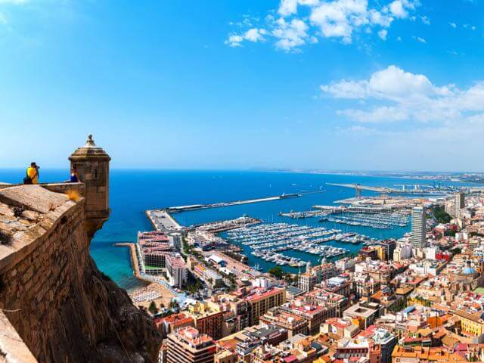
Final Thoughts
With its combination of historical charm, beautiful beaches, and vibrant culture, Alicante is a gem waiting to be explored.
Whether you're drawn by the rich history or the alluring beaches, Alicante promises a memorable adventure filled with captivating experiences.
Even with only a one day, this city will leave a lasting impression on your Mediterranean cruise adventure.
Enjoy your voyage!

Slide 37
Thanks For Coming
If you have any more questions, Please ask.
I will do my best to answer them for you.
Have a great visit in Alicante!

Slide 38
References
Reviews on popular food review sites
Websites of mentioned restaurants like Nou Manolin and La Taberna del Gourmet
Alicante food guides from travel bloggers
General Travel Advice:
Government or travel advisory websites (e.g., U.S. State Department travel tips)
Health advice from sources like the Centers for Disease Control and Prevention (CDC)
Alicante-specific travel blogs for practical tips

