Slide 1
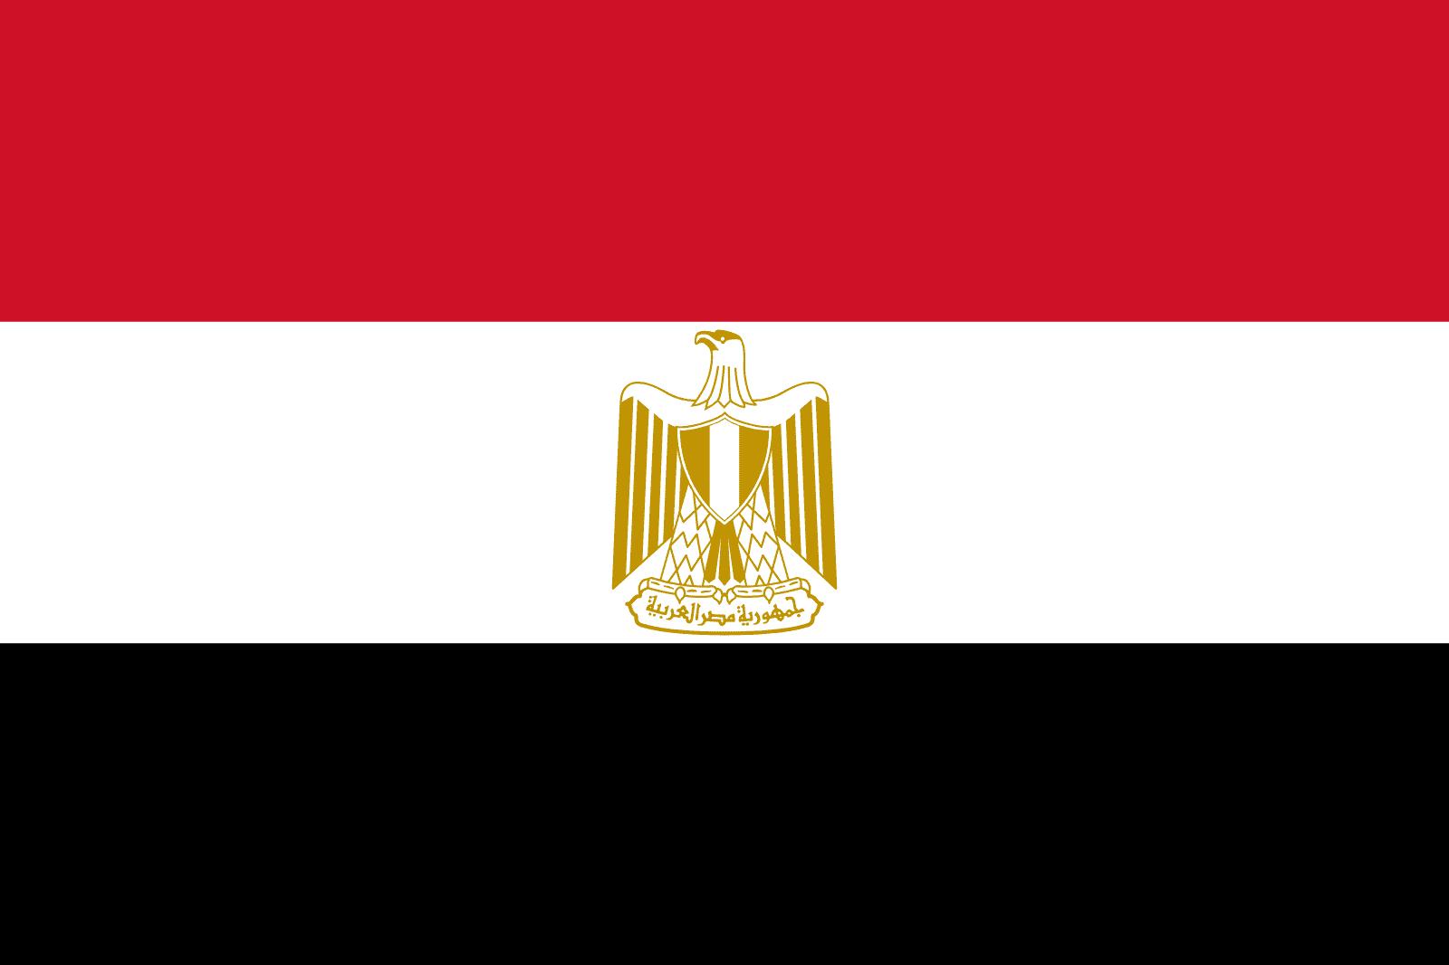
Alexandria, Egypt Presented by Marc Silver

Slide 2
What I Will Cover
My Port Philosophy
Don’t Miss the Ship
Money
About Alexandria
A Brief History
Maps
Transportation
Top Attractions & Points of Interest
Local Cuisine & Dining Options
Important Tips & Practical Advice
Final Thoughts

Slide 3
My Port Philosophy
I have been cruising for over 46 years and have taken over 100 cruises. So, I consider myself an experienced cruiser.
The information I will present is based on those many years of experience.
When I am on a cruise where the city, I want to visit is not the port city,
I always recommend taking a ship’s tour.
But when I am in a port with multiple attractions nearby and easy to see on my own - I will do it on my own.
This presentation is not like that.

Slide 4

Don’t Miss the Ship
How to Avoid Missing Your Ship
Pay attention to the time. - Ship time and local time are often different.
Put a return-to-ship reminder on your phone.
Choose excursions wisely.
If a ship-sponsored excursion is late returning to port, the ship will wait for you. If you are on your own???
Be Prepared
Have your Passport, Credit Card, and phone numbers for your ship port agent.
What to Do If You Miss the Ship Most cruise lines have port agents stationed in the port area to assist if your ship has left without you. If your are lucky, when cruisers are late returning to the vessel, the ship’s crew will often remove the passengers’ essential items – passports, cell phones, and medication -- from the ship to leave with the port agents.
The Port Officials can help you with contacting your ship and making necessary travel arrangements.

Slide 5
Money
Egypt uses the Egyptian pound (EGP) as its official currency.
The exchange rate changes but is roughly:
1 USD = 50 EGP
EGP 500 = $10 USD
EGP 100 = EUR 2

Slide 6
Exchanging Money
When exchanging money, it's best to avoid doing so in the tourist areas, since they often charge high fees and offer poor exchange rates.
You'll usually get better value by withdrawing pounds directly from bank ATMs, which are widely available in the city.
Major credit and debit cards are accepted at most restaurants and shops in tourist areas, but smaller businesses and markets still prefer cash, so keeping some local currency on hand is a smart idea.

Slide 7
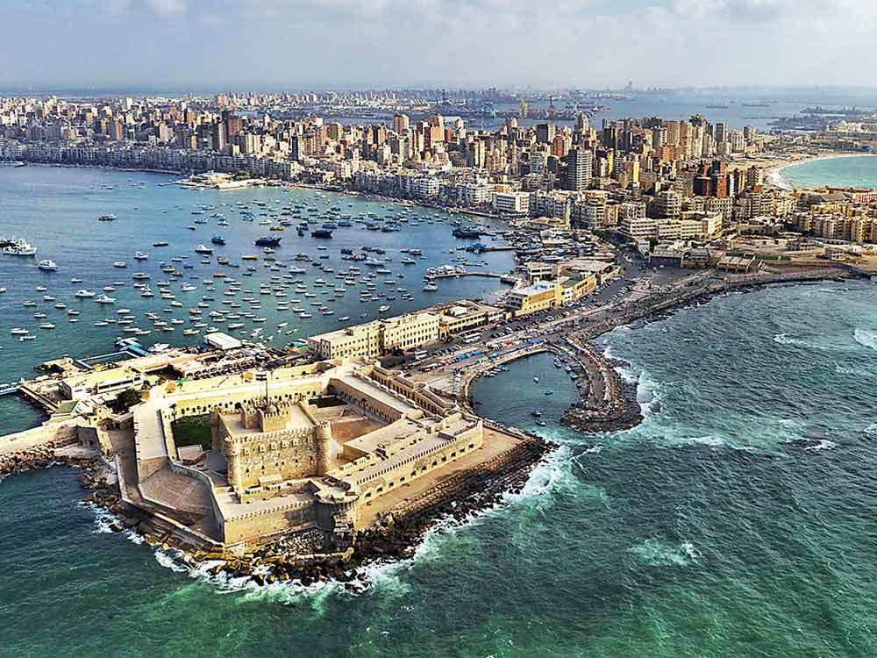
Welcome to Egypt’s Northern Port
Welcome to Egypt, a country where every stone, temple, and street corner seems to whisper history.
Alexandria and Port Said, Egypt’s two great Mediterranean ports, the northern gateways to Cairo, the Nile, and the world’s most famous monuments.

Slide 8
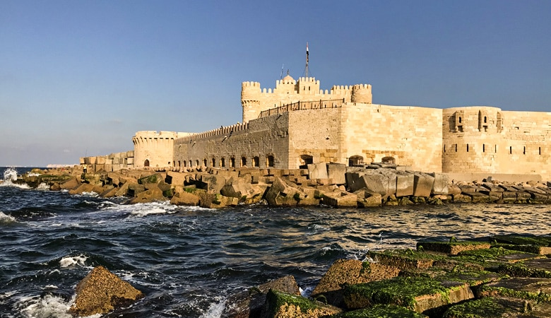
Brief History of Alexandria
Founded by Alexander the Great in 331 BC, Alexandria became the cultural and intellectual capital of the ancient world.
It was home to the legendary Library of Alexandria, the Pharos Lighthouse (one of the Seven Wonders of the Ancient World), and scholars who shaped Western science and philosophy.
Modern Alexandria still carries that spirit, a lively mix of old and new, where Mediterranean charm meets Egyptian warmth.

Slide 9
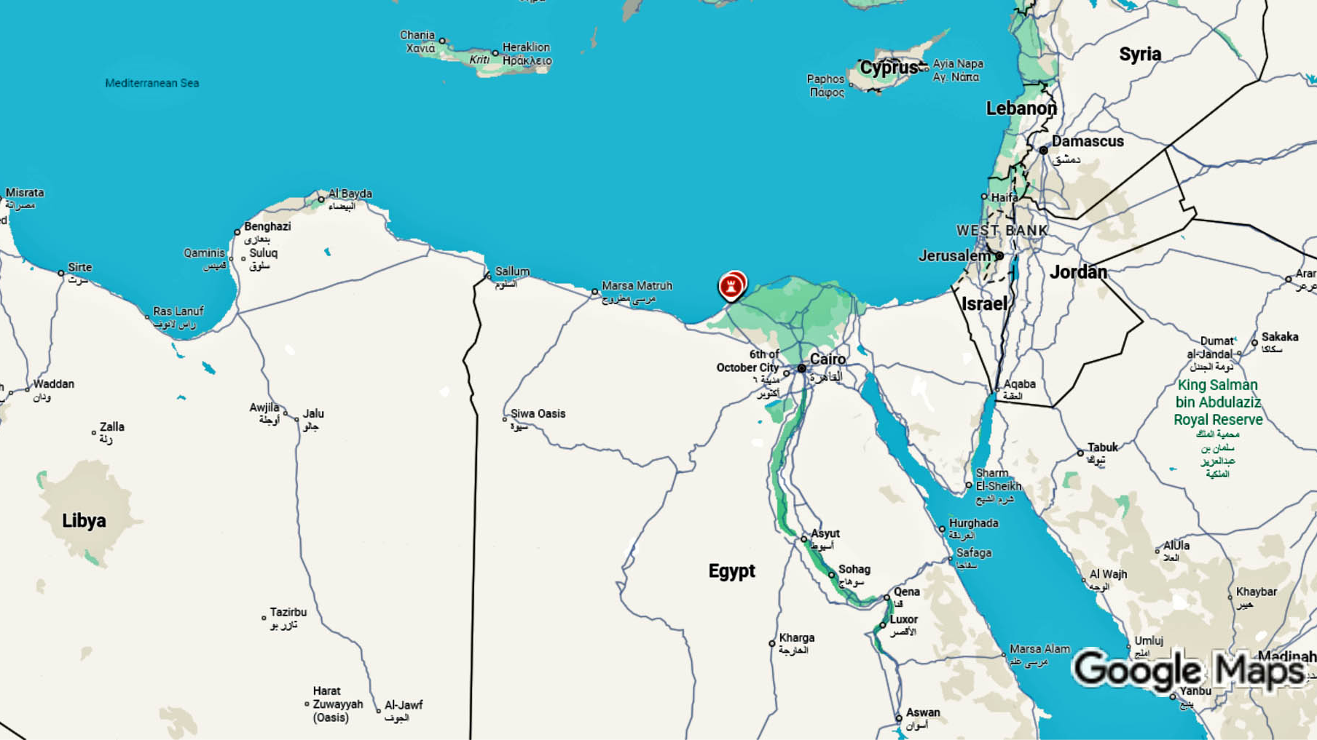
Alexandria

Slide 10
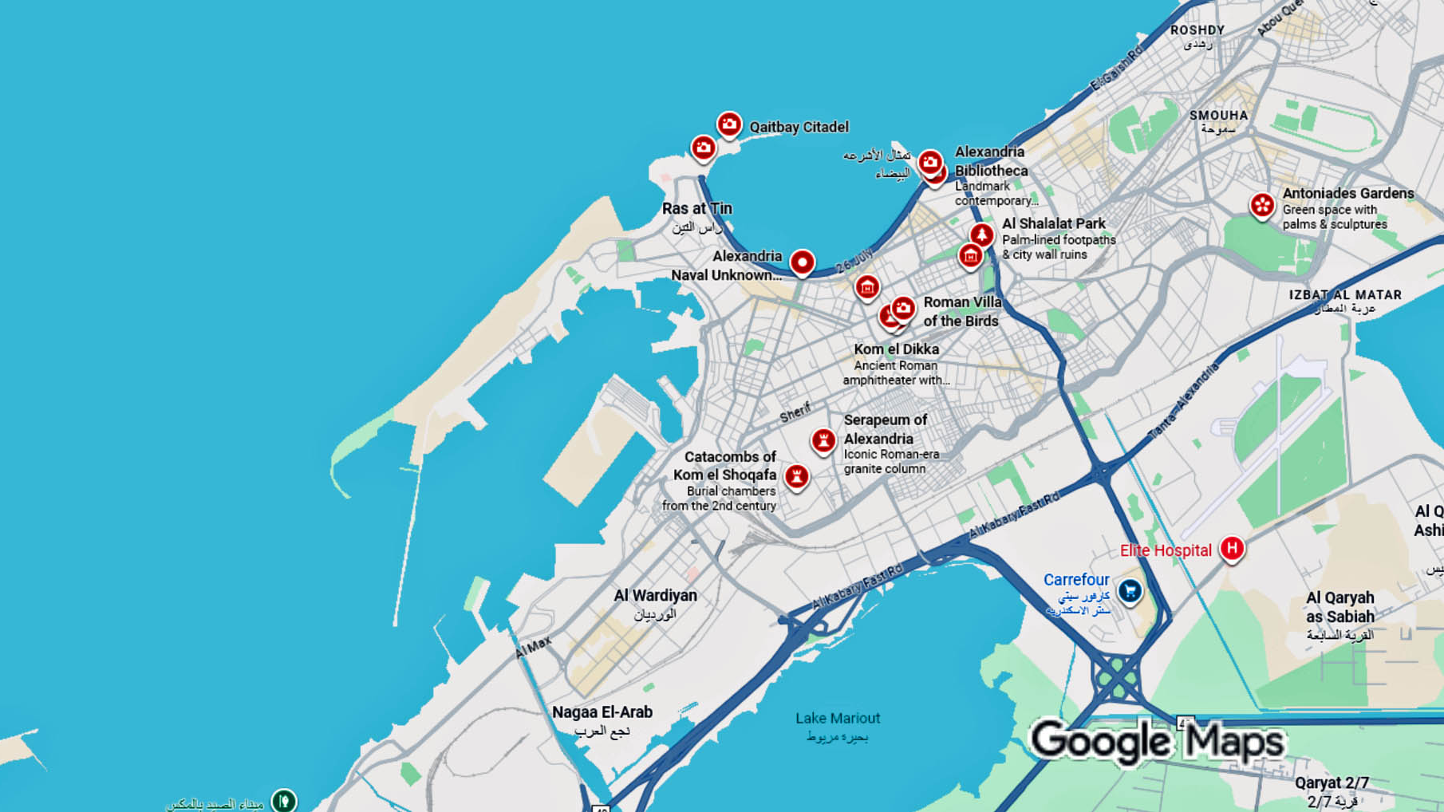
Cruise Port

Slide 11
Transportation
Getting Around
Alexandria stretches along the Mediterranean coast, with a scenic waterfront Corniche connecting different areas.
Taxis and ride-hailing apps like Uber and Careem are plentiful, and local microbuses offer affordable rides along major routes.
Visitors can easily explore major sights with guided tours or local drivers, many of whom speak some basic English. Taxis are affordable, typically charging around 50-100 EGP for shorter trips within the city.

Slide 12
Transportation Options
You can also hire a taxi or pre-book a car service.
Prices range from about 250–500 EGP (≈ US $5–10), depending on your destination in Alexandria.
For waterfront areas along the Corniche, you can take the tram, which offers an affordable and scenic way to travel through the city at around 5–10 EGP (~US $0.10–0.20) per ride.

Slide 13
Port Said, Gateway to the Suez Canal
Founded in 1859 during the construction of the Suez Canal, Port Said is a symbol of Egypt’s modern ambitions.
The city straddles history and progress, with grand colonial buildings, wide boulevards, and constant maritime activity.
From your ship, you can often see massive container vessels navigating the narrow canal, a remarkable sight, considering this man-made waterway handles about 12% of global trade.

Slide 14
Exploring Port Said
Take a walk along the waterfront promenade, where locals gather for evening strolls.
Visit the Port Said National Museum, which tells Egypt’s story from pharaonic to modern times, or the Military Museum, dedicated to the Suez Canal conflicts.
A short ferry ride takes you across the canal to Port Fuad, giving you a close-up view of ships transiting one of the most strategic waterways in the world.

Slide 15
Highlights of Alexandria
Start along the Corniche, the city’s seaside boulevard lined with cafés and colonial-era architecture.
Visit the Bibliotheca Alexandrina, a stunning modern interpretation of the ancient library, housing millions of books and exhibitions.
Explore the Catacombs of Kom El Shoqafa, a fascinating blend of Greek, Roman, and Egyptian burial art. Don’t miss Montaza Palace and Gardens, once home to Egypt’s royal family, now a peaceful seaside retreat.
For a glimpse into daily life, stroll through Souq El-Attarine, the city’s historic market filled with spices, perfumes, and antiques.

Slide 16
Highlights of Alexandria
Citadel of Qaitbay
Citadel of Qaitbay - A 15th-century fortress built on the site of the ancient Lighthouse of Alexandria (one of the Seven Wonders of the Ancient World)
Catacombs of Kom el Shoqafa - An impressive underground Roman burial site combining Egyptian, Greek, and Roman architectural styles
Pompey's Pillar - An ancient Roman triumphal column dating back to around 300 AD
Roman Amphitheatre - Well-preserved Roman ruins in the Kom el Dikka archaeological site
Roman Amphitheatre

Slide 17
Top Attractions & Points of Interest
Religious Sites
Mosque of Abu al-Abbas al-Mursi - A beautiful mosque with distinctive architecture near the Citadel
St. Mark's Coptic Orthodox Cathedral - One of the oldest Christian churches in Africa.

Slide 18
Top Attractions & Points of Interest
Waterfront & Leisure
The Corniche - Alexandria's famous waterfront promenade stretching along the Mediterranean, perfect for strolling
Montaza Palace and Gardens - Former royal palace with extensive gardens overlooking the sea
Stanley Bridge - A modern landmark bridge popular for photos

Slide 19
Top Attractions & Points of Interest
Museums
Alexandria National Museum - Showcases artifacts from Alexandria's Pharaonic, Roman, Coptic, and Islamic periods
Royal Jewelry Museum - Displays the jewelry collection of Egypt's royal family
Markets & Neighborhoods
Souk District - Traditional markets for shopping and experiencing local life
The city's blend of ancient history and Mediterranean coastal charm makes it a unique destination in Egypt.

Slide 20
Cairo and the Pyramids
Both Alexandria and Port Said are popular jumping-off points for excursions to Cairo, roughly 3 hours away.
In a single day, you can stand before the Great Pyramids of Giza, gaze up at the Sphinx, and explore the treasures of the Egyptian Museum, including the golden mask of Tutankhamun.
Some cruise excursions also include a visit to Old Cairo, with its ancient mosques, Coptic churches, and bustling bazaars, giving travelers a glimpse of Egypt’s living history.

Slide 21
Modern Egypt and the Suez Canal Expansion
Egypt continues to evolve. The 2015 Suez Canal expansion created a second channel, doubling capacity and reducing wait times, a massive engineering project that reflects the country’s push toward modernization and global relevance.
Both Alexandria and Port Said are central to this future, connecting the Mediterranean with the Red Sea and acting as gateways between Europe, Asia, and Africa.

Slide 22
Local Cuisine & Must-try Dishes
Egyptian cuisine is hearty, flavorful, and deeply regional. In Alexandria, seafood is the star, grilled fish, calamari, and shrimp fresh from the Mediterranean.
Inland, try koshari, a mix of rice, lentils, pasta, and tomato sauce topped with crispy onions, Egypt’s national comfort food.
You’ll also find falafel (called ta’meya here) made with fava beans instead of chickpeas.
Stop at a local café for strong Egyptian coffee or mint tea, and you’ll quickly see how social and welcoming Egyptian culture is.
koshari
falafel
Notes:
-

Slide 23
Important Tips & Practical Advice
Currency: Egyptian Pound (EGP). U.S. dollars are widely accepted in tourist areas, but small local bills are useful.
Language: Arabic is official; English is commonly spoken in tourist zones.
Dress Code: Modest clothing is appreciated, especially when visiting mosques or rural areas.
Tipping: Small tips (5–10%) are customary and appreciated.
Safety: Stay with trusted guides or ship excursions if venturing inland. Both ports are secure and visitor-friendly.

Slide 24
Final Thoughts
From ancient wonders to modern marvels, Egypt’s northern ports offer an unforgettable blend of history, culture, and human achievement.
Whether you’re tracing the footsteps of Alexander or watching freighters glide through the canal, you’re standing at one of the great crossroads of civilization.
Keep exploring, and who knows, your next unforgettable journey might begin right here on the Egyptian coast.

Slide 25
Thanks For Coming
If you have any more questions, please ask.
I will do my best to answer them for you.
Have a great visit in Alexandria!

