Slide 1
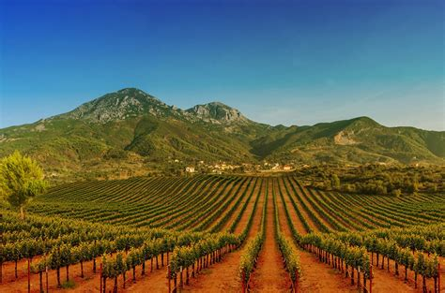
Wine Regions of the World The Wines of Albania Presented by Marc Silver

Slide 2
An Introduction to Wine in Albania
Table of Contents
Introduction
History of Wine in Albania
Albania's Wine Classification System
Introduction to Albania's Wine Regions
Regional Climate Patterns
The Cultural Significance of Wine in Albania
Albania's Unique Terroir
Major Varietals of Albania
Notable Wineries in Albania
Albania's Wine Culture and Traditions
Sustainable Winemaking Practices in Albania
Final Thoughts
References

Slide 3
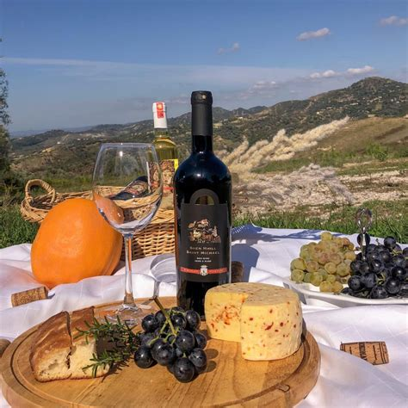
Wines of Albania
Introduction
Welcome to an exploration of Albania’s fascinating wine landscape!
While perhaps not as internationally renowned as its Mediterranean neighbors, Albania's wine industry is experiencing a remarkable renaissance, blending ancient traditions with modern innovation.
Today, we'll journey through this Balkan nation's diverse wine regions and discover what makes Albanian wines uniquely compelling in the global wine scene.

Slide 4

Ancient Beginnings
The story of Albanian wine stretches back over three millennia, intertwining deeply with the culture of the ancient Illyrians, the direct ancestors of modern Albanians.
Archaeological finds in regions like Apollonia and Durrës reveal a sophisticated winemaking society, with ancient amphoras, wine presses, and elaborate drinking vessels dating back as early as the 8th century BCE.
The Illyrians didn’t just enjoy wine—they created a structured viticultural system, cultivating terraced hillsides, building innovative irrigation channels, and establishing trade routes that connected them to the broader Mediterranean.

Slide 5
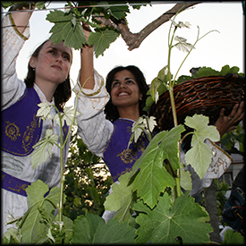
Ancient Beginnings
This ancient viticultural tradition likely included early versions of indigenous grapes still grown today, such as Kallmet and Shesh.
Particularly intriguing are the ancient wine presses carved into the rocky slopes of the Skrapar region, where Illyrian winemakers used gravity-flow techniques and natural cooling caves to refine their wines.
These age-old practices underscore Albania’s winemaking roots and set the foundation for today’s varietal diversity.

Slide 6
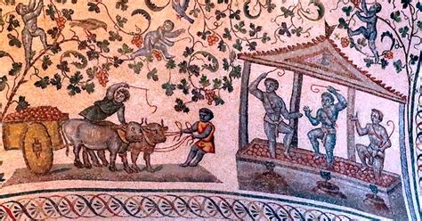
Influence of the Romans and Middle Ages
When the Romans arrived around the 2nd century BCE, they brought advanced viticulture practices that transformed Albanian winemaking.
Roman settlers introduced systematic vineyard layouts, new grape varieties, and sophisticated technology, establishing formal vineyards along the Adriatic coast.
Remnants of Roman wine estates, or "villae rusticae," can still be found in areas like Butrint and Durrës, illustrating the extent of their influence on the region’s winemaking practices.

Slide 7
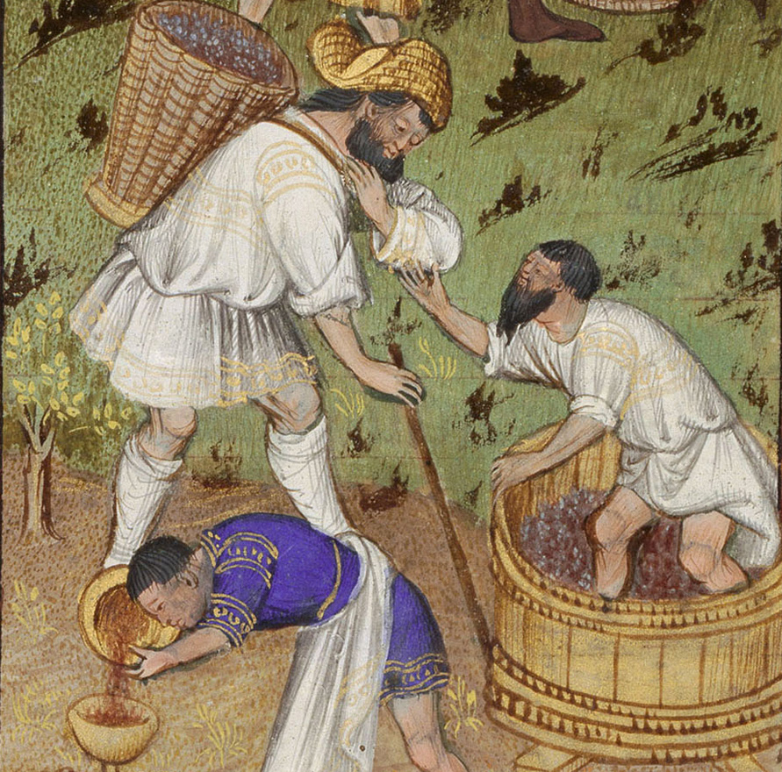
Influence of the Romans and Middle Ages
During the Middle Ages, wine production in Albania faced challenges due to the Ottoman Empire’s restrictions on alcohol.
Wine culture persisted, especially in the northern regions, where Christian monasteries preserved winemaking techniques and grape varieties.
These monasteries cultivated "secret vineyards" in remote mountain valleys, safeguarding traditional knowledge through concealed viticulture.
This period fostered distinct regional styles, as isolated communities developed unique techniques that are echoed in Albanian wines today.

Slide 8

Modern Revitalization and Global Recognition
The post-World War II communist era brought sweeping changes to Albanian viticulture, with vineyards collectivized under state control.
Production emphasized quantity over quality, and many traditional techniques were sidelined. Yet, these state-owned enterprises inadvertently preserved some indigenous grape varieties, such as Vlosh and Debinë, which may have otherwise faded into obscurity.
With the fall of communism in the early 1990s, Albania’s wine industry experienced a transformative shift.

Slide 9
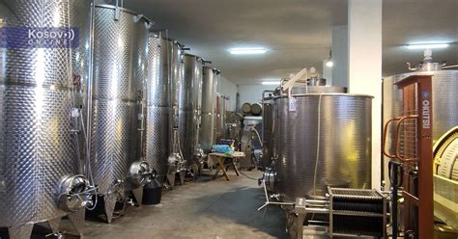
Modern Revitalization and Global Recognition
Families reclaimed ancestral vineyards, merging centuries-old practices with modern techniques.
Many winemakers, educated abroad, returned to Albania to revive traditional grapes and adopt organic and biodynamic practices.
Notable estates began to emerge, with wineries now producing award-winning wines that have earned international acclaim.
Today, Albanian winemakers are celebrated for their commitment to indigenous grapes and sustainable practices, helping to distinguish Albania on the global wine stage.
Wine tourism is flourishing as well, with wineries opening their doors to visitors eager to experience the rich heritage and unique flavors of Albanian wines.

Slide 10
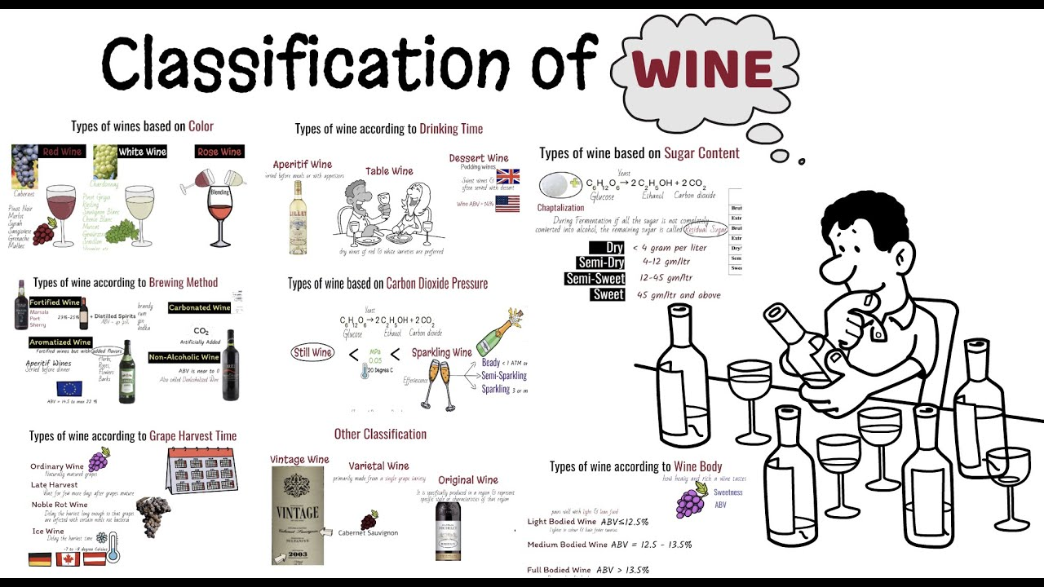
Wine Classification System
Albania's Wine Classification System
Albania’s wine classification might not have the layers of France’s AOC or Italy’s DOC, but it still captures the country’s unique wine character.
From top-tier quality wines to everyday table varieties, this system honors Albania’s winemaking heritage and its growing place in Europe’s wine scene.

Slide 11
Wine Classification System
Let’s take a quick tour.
Each level offers something unique, from the careful curation of Verë Cilësore (Quality Wine) down to Verë Tryeze (Table Wine) for laid-back sipping.
Classification | Key Features | Why It Matters
Verë Cilësore ⭐ | Strict region-specific grapes, aging, and quality controls | Top-tier Albanian wines, great for special occasions
Verë Vendi 🍇 | Flexible with 85% regional grapes; variety in techniques | Regional flavors with a bit of flair
Verë Tryeze 🍷 | Minimal restrictions; open on grape origin and production methods | Simple, everyday table wine
These categories keep Albania’s wines rooted in tradition but with room to adapt to modern tastes.

Slide 12

Wine Classification System
System Oversight: Albania’s National Food Authority (AKU) keeps quality in check across all classifications through inspections, making sure each bottle reflects the country’s commitment to standards.
Where It’s Headed: The classification system continues to evolve with new ideas in the pipeline: think sub-regional labels, premium designations, and more recognition for Albania’s indigenous grapes. The goal? To bring Albanian wine even closer to European standards while celebrating its own unique story.
In Short: Whether you’re exploring the sophisticated flavors of Verë Cilësore or reaching for a relaxed glass of Verë Tryeze, Albanian wine has something for every taste. And with its classification system still growing, there’s even more to look forward to!

Slide 13
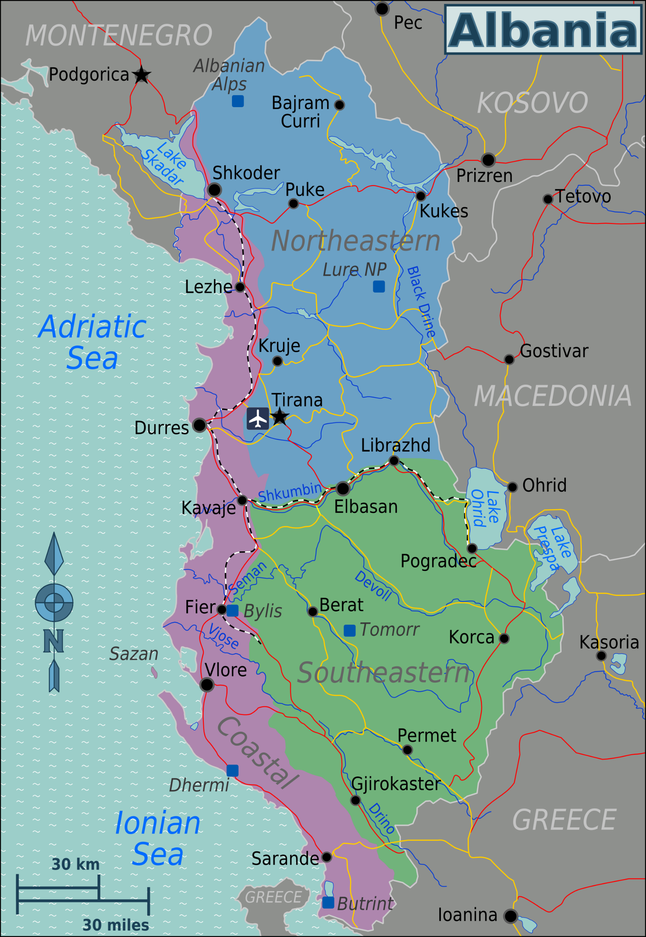
Albania's Wine Regions
Picture a country where ancient vineyards cascade down sun-drenched hillsides to meet the sparkling Adriatic Sea, while others climb the rugged Albanian Alps or nestle in sheltered inland valleys.
This is Albania's viticultural landscape – a mesmerizing patchwork of 4 primary wine regions and 12 distinct sub-regions, each contributing its own character to the nation's wine story.

Slide 14
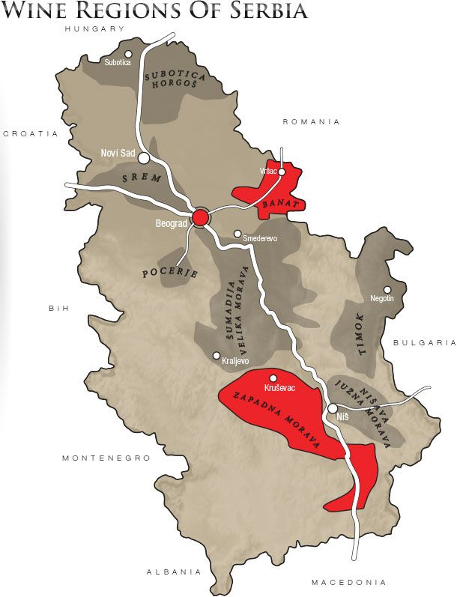
Primary Wine Regions
Coastal Region (Rajoni Bregdetar)
The Coastal Region is a vibrant hub of Albanian winemaking, contributing about 45% of the nation’s total wine production.
Within this zone, the Durrës-Kavajë Zone stands out as the largest wine-producing area.
It sits in the central coastal region, enjoying a classic Mediterranean climate with moderate rainfall of around 800 mm annually.

Slide 15
Primary Wine Regions
Coastal Region (Rajoni Bregdetar)
The elevation ranges from sea level to about 300 meters, creating the perfect conditions for grapes like Shesh i Zi, Shesh i Bardhë, and Merlot.
Known for its full-bodied reds and crisp whites, this region boasts limestone-rich clay soil that offers excellent drainage, making it a prime spot for viticulture.
Not far away, the Lezhë-Shkodër Zone adds to the diversity of the Coastal Region. Nestled in the northern coastal area, it enjoys a Mediterranean climate with continental influences.
Here, you’ll find ancient terraced vineyards that date back to Illyrian times, cultivating key varieties such as Kallmet and Vranac.

Slide 16

Wine Regions
Central Mountain Region (Rajoni Qendror Malor)
Shifting inland, the Central Mountain Region accounts for about 30% of Albania's wine production. This area includes the Berat Zone, which is not only centrally located but also a UNESCO-protected historic wine region.
The climate here is a mix of continental with Mediterranean influences, and the vineyards flourish at elevations between 400 to 800 meters.
You can expect to find unique varieties such as Pulës, Vlosh, and Debinë thriving in this beautiful setting.

Slide 17
Wine Regions
The Tirana Zone, which encompasses the capital, features a Mediterranean-continental mix climate that nurtures wines like Shesh i Zi and Cabernet Sauvignon.
This area is particularly exciting as it hosts some of Albania's most modern wineries, blending contemporary techniques with traditional practices.
Another noteworthy area is the Elbasan Zone, located in the central valley.
Known for its warm continental climate, this zone is home to traditional winemaking methods and grapes like Ceruja and Vlosh.

Slide 18
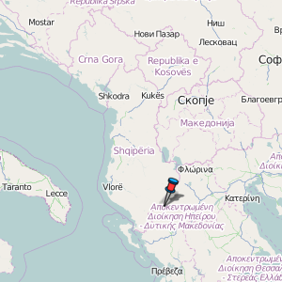
Wine Regions
Southern Region (Rajoni Jugor) In the Southern Region, which contributes around 15% to the national production, you’ll discover the Përmet Zone.
This area is celebrated for its Mediterranean-continental climate and elevation between 200 to 600 meters, where indigenous grape varieties like Debinë e Bardhë and Debinë e Zezë are preserved. The region is a haven for those interested in traditional winemaking techniques.
The Leskovik Zone lies on the southeast border and is characterized by a cool continental climate. Here, high-altitude viticulture shines, with key varieties such as Piccolit and Debinë.
Moving a bit further south, the Tepelenë Zone showcases a warm Mediterranean climate, known for its ancient wine caves and varieties like Vlosh and Mersita.

Slide 19
Wine Regions
Eastern Mountain Region (Rajoni Lindor Malor) Finally, the Eastern Mountain Region accounts for about 10% of Albania’s wine production. The Korçë Zone is located in southeast Albania and features some of the highest vineyards in the country, where cool continental conditions allow for the cultivation of elegant varieties like Riesling and Pinot Noir at elevations ranging from 800 to 1200 meters.
The Pogradec Zone, situated near Lake Ohrid, benefits from a unique lakeside microclimate that influences the flavor profiles of wines like Vranac and Riesling. Meanwhile, the Kolonjë Zone in the southeast mountains, known for its extreme viticulture conditions, produces grapes like Mavrud and Sangiovese under alpine climatic.

Slide 20
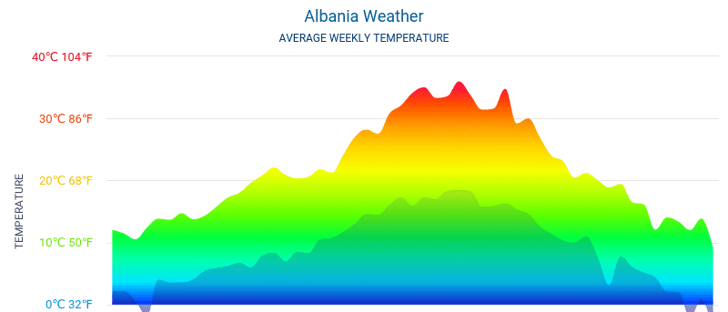
Regional Climate Patterns
What’s truly fascinating about Albania's wine regions is the climatic diversity within such a compact geographical area.
The country’s unique positioning between the Adriatic Sea and the mountainous inland creates dramatic variations in growing conditions.
Coastal regions experience a classic Mediterranean climate with hot, dry summers and mild, wet winters, while the central regions reflect more continental influences, leading to greater temperature variations and unique microclimates.
In the mountainous regions, cool nights in summer and significant diurnal temperature variations contribute to a longer growing season, making these areas particularly suited for high-quality wine production.

Slide 21
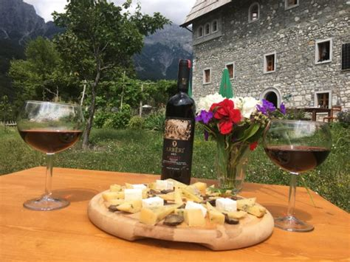
The Cultural Significance of Wine in Albania
Wine holds a special place in Albanian culture, intricately woven into social customs and celebrations.
Traditional Albanian hospitality often begins with the warm gesture of offering guests a glass of locally produced wine, a symbol of welcome and respect that underscores the importance of wine in the country’s rich cultural tapestry.

Slide 22
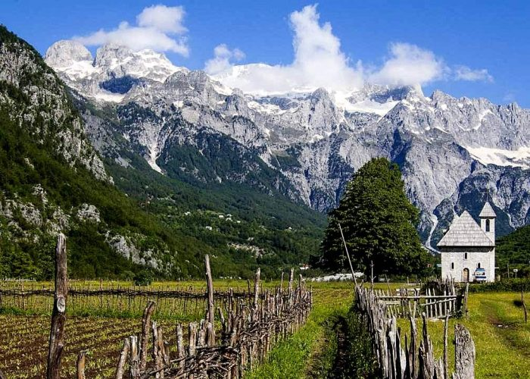
Albania's Unique Terroir
Picture the ancient limestone beds of the coastal regions and the mineral-rich schist found in the mountainous interior; this variety provides winemakers with an extraordinary palette to express their craft.
In the western coastal plains, alluvial soils tell a story of centuries of sediment deposited by Albania's rivers, enriching the land and providing the perfect foundation for viticulture.
Picture the ancient limestone beds of the coastal regions and the mineral-rich schist found in the mountainous interior; this variety provides winemakers with an extraordinary palette to express their craft.
In the western coastal plains, alluvial soils tell a story of centuries of sediment deposited by Albania's rivers, enriching the land and providing the perfect foundation for viticulture.

Slide 23
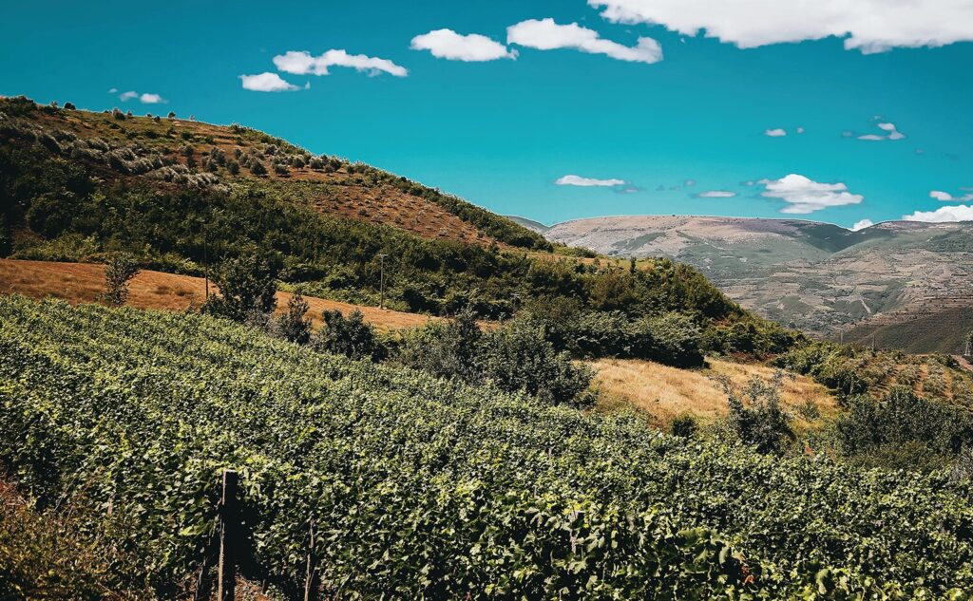
Albania's Unique Terroir
The central regions feature well-draining clay-limestone soils, ideal for producing structured red wines that stand out for their depth and character. As you move eastward, the vineyards climb into the mountains, where rocky, mineral-rich soils impart distinctive notes to the wines.
This geological complexity is further enhanced by variations in elevation, ranging from sea level to high-altitude vineyards reaching 1,200 meters. Within such a compact geographical area, Albania boasts one of Europe's most diverse viticultural landscapes.
The specific compositions of soil across these regions are as varied as the wines themselves.
In the coastal areas, you’ll find limestone-rich soils with high calcium content, clay-limestone mixtures that retain moisture, and sandy-clay soils providing excellent drainage.

Slide 24
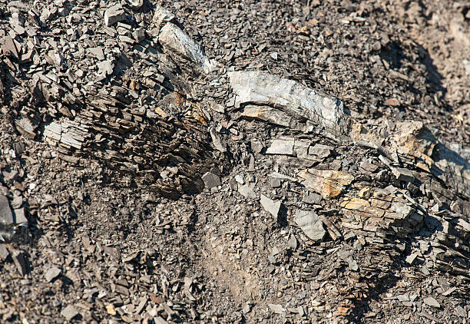
Albania's Unique Terroir
Marine sediment deposits add further mineral complexity, contributing to the expressive nature of the wines.
Moving inland, the central valleys feature deep clay and alluvial deposits rich in organic matter, alongside mixed gravel and clay compositions that introduce iron-rich red soils into the mix.
In the mountainous regions, rocky soils dominate, complemented by schist and slate formations, as well as pockets of volcanic soil that bring high mineral content from ancient seabeds uplifted through geological forces.

Slide 25
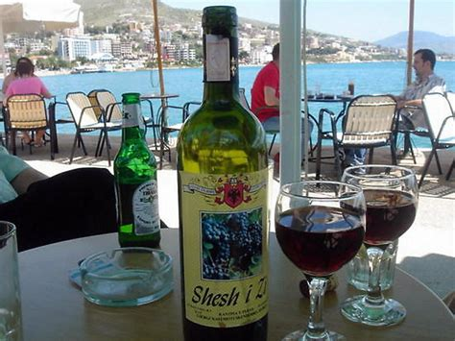
Albania's Unique Terroir
Albania's geographical position—nestled between the Adriatic Sea and several mountain ranges—creates an impressive array of microclimates that significantly influence wine production.
Within just a few kilometers, these distinct climate zones provide winemakers with diverse opportunities for grape cultivation and wine styling.
The coastal areas enjoy classic Mediterranean influences, with long, sun-drenched summers and mild winters. Sea breezes play a crucial role here, moderating temperatures and reducing disease pressure in the vineyards.
In the Durrës-Kavajë region, morning fog banks help maintain vital acidity in the grapes during the hot summer months, resulting in both full-bodied reds and fresh, aromatic whites.

Slide 26

Albania's Unique Terroir
As you venture into the inland valleys, you'll find a fascinating transition zone where Mediterranean and continental conditions merge.
Here, the temperature variations exceed those of the coast, with warm days giving way to cool nights during the growing season.
In regions like Berat and Elbasan, this diurnal temperature swing can reach up to 20°C, enriching the grapes with complex flavors and excellent natural acidity.
Protected valleys create warm mesoclimates ideal for late-ripening varieties, while hillside exposures offer varied sun aspects that benefit different grape types.

Slide 27
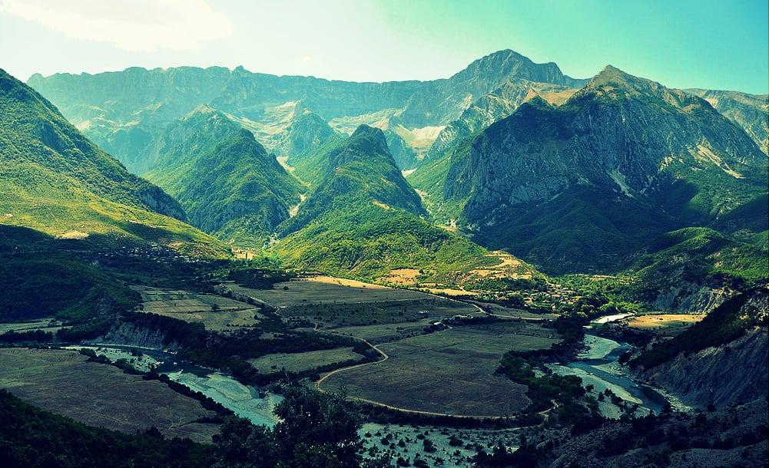
Albania's Unique Terroir
Finally, the mountain regions in eastern Albania exhibit true Alpine influences, characterized by their own unique conditions.
High-altitude vineyards, some soaring above 1,000 meters, experience a shorter growing season but are blessed with intense sun exposure and significant day-night temperature variations.
These conditions are particularly favorable for aromatic white varieties and cool-climate reds. The mountains also create rain shadow effects, leading to pockets of relative dryness despite the altitude.
While late spring frosts can pose challenges, careful site selection and modern viticultural techniques help mitigate this risk, allowing winemakers to thrive in this diverse and beautiful landscape.

Slide 28
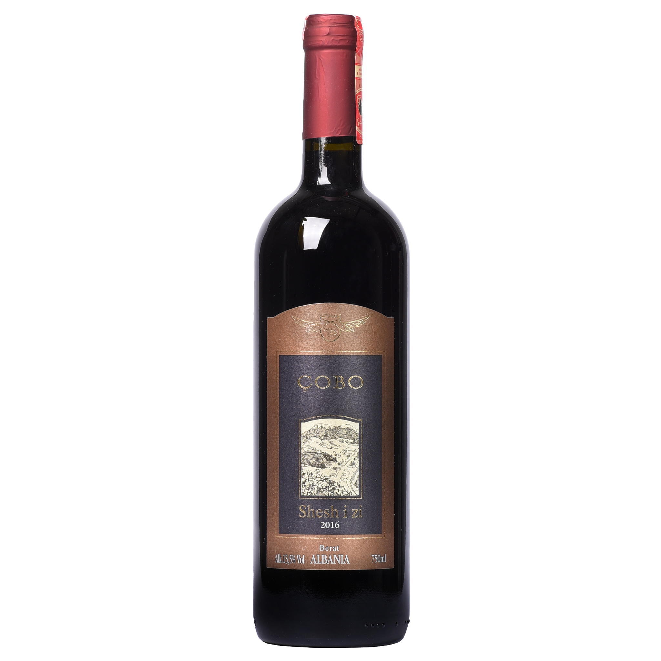
Major Varietals of Albania
Indigenous Grapes: Albania's Viticultural Treasures
Shesh i Zi: The Dark Prince of Albanian Reds Think of Shesh i Zi as Albania's answer to Cabernet Sauvignon—bold, confident, and distinctly local. This flagship red variety has been turning heads in international wine circles for good reason. Imagine diving into a bowl of sun-ripened blackberries and dark plums, with an intriguing dance of Mediterranean herbs and a whisper of black pepper. The tannins? Think silk velvet rather than rough wool.
As a perfect companion to Albania's famous grilled lamb dishes, Shesh i Zi also performs beautifully alongside aged mountain cheeses and rich meat stews. It shines particularly well in the sun-drenched vineyards of Durrës-Kavajë. Fun fact: the name "Shesh i Zi" literally means "black Shesh," named after the village where it was first cultivated.

Slide 29
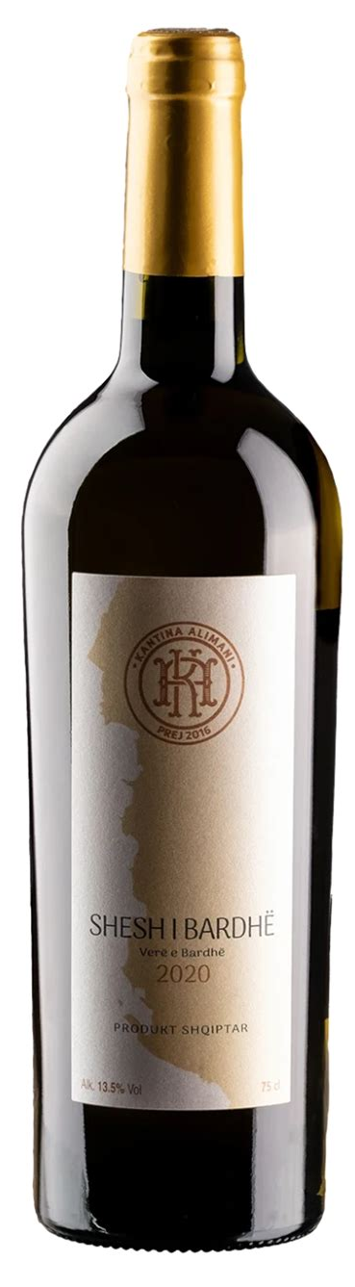
Major Varietals of Albania
Shesh i Bardhë: The Elegant White Queen If Shesh i Zi is the prince, then Shesh i Bardhë is definitely the queen of Albanian whites.
This grape has charmed locals and visitors alike for centuries with its ethereal elegance. Picture biting into a crisp green apple, followed by a burst of citrus and white peach, all wrapped in delicate white flowers. There’s often a fascinating mineral undertone that wine enthusiasts attribute to Albania's limestone-rich soils.
This variety is a match made in heaven with the Adriatic’s bounty of seafood, particularly grilled fish and shellfish. It also pairs nicely with light pasta dishes and fresh summer salads, thriving beautifully in coastal areas where sea breezes keep the grapes fresh and lively. Ancient texts suggest this variety was once used to make wines for Illyrian nobility.

Slide 30
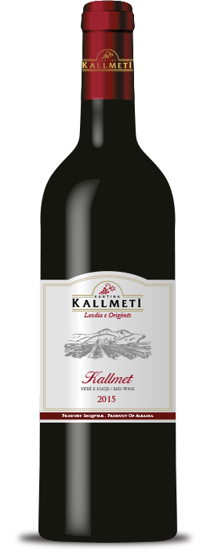
Major Varietals of Albania
Kallmet: The Ancient Warrior Kallmet is like that fascinating elder who has a thousand stories to tell. This ancient variety has survived empires, wars, and regime changes, emerging stronger with each passing century. Expect an explosion of red cherries and wild strawberries, accompanied by intriguing notes of dried herbs, earth, and an essence that can only be described as "Albanian mountain air." The tannins are firm but friendly, reminiscent of a strong handshake from a mountain villager.
This is your go-to wine for traditional Albanian meat dishes, especially slow-roasted pork or the famous ferges (a rich pepper and meat dish). It also pairs surprisingly well with aged cheeses, thriving in the northern regions, particularly around Lezhë and Shkodër. Local legend has it that Kallmet vines were planted by Roman legionaries who found the local climate reminiscent of home.

Slide 31
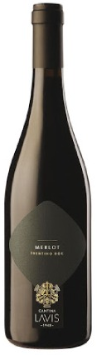
International Varieties in Albania
Global Citizens with Albanian Passports While Albania proudly champions its indigenous varieties, it also welcomes international grapes that have settled comfortably in Albanian soil.
Merlot: This adaptable charmer has taken to the Albanian terroir like a fish to water, producing wines with a Mediterranean flair—think classic Merlot plushness but with a sunny Albanian twist.
It thrives particularly in the central valleys, where it develops intense fruit character.

Slide 32
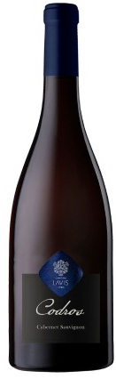
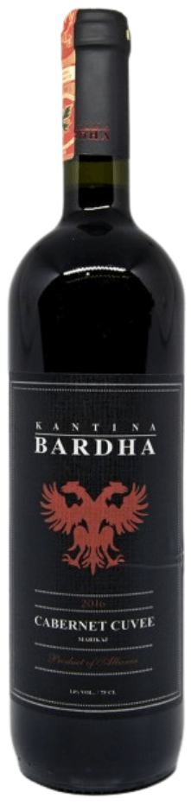
International Varieties in Albania
Cabernet Sauvignon: This noble immigrant produces wines with more Mediterranean herbs and spice than its French counterparts. It shows exceptional character in the higher elevation vineyards of Korçë.
Riesling: This alpine adventurer has found its sweet spot in Albania's cooler mountain regions, producing wines with remarkable aromatic intensity and mineral character.
Chardonnay: The cosmopolitan of the group, Chardonnay adapts beautifully to various Albanian terroirs, showcasing different personalities from region to region—crisp and mineral-driven on the coast, rich and full-bodied in warmer inland areas

Slide 33
Experimental Varieties in Albania
The New Wave of Experimental Varieties Forward-thinking Albanian winemakers are increasingly experimenting with varieties like Primitivo, Sangiovese, and even Tempranillo. This creates exciting new chapters in Albania's wine story. These "immigrant" varieties are finding their unique voices in Albanian soil, enriching the country’s increasingly diverse wine landscape.
Final Thoughts
Overall, this section effectively captures the essence of each grape while providing practical information and intriguing facts. Just remember to keep the conversational tone consistent throughout, which you've done well. If you have any more sections to review or need further adjustments, let me know!

Slide 34
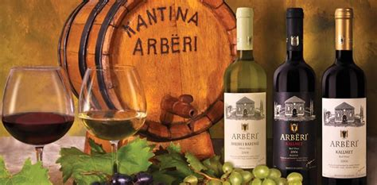
Notable Wineries in Albania
Durrës-Kavajë Region
Kantina Arbëri: Nestled on a sun-kissed hillside with a stunning view of the Adriatic, Kantina Arbëri invites you into a world where traditional Albanian charm meets modern winemaking.
Imagine walking into your grandmother’s garden—if she happened to have state-of-the-art winemaking equipment! The winery’s cellar, ingeniously carved into the limestone cliff, offers natural temperature control for their acclaimed Shesh i Zi Reserve.
Make sure to catch a sunset tasting on their terrace, pairing exquisite wines with local sheep’s cheese and fresh-baked bread while fishing boats return to the harbor. Their young winemaker, Elena Mora, trained in Tuscany but returned home to create wines that her ancestors would be proud to enjoy.

Slide 35
Notable Wineries in Albania
Durrës-Kavajë Region
Kokomani Estate: The Rebel's Paradise Tucked away in a hidden valley, Kokomani Estate radiates personality from the moment you walk through its century-old stone gates. The owner, a former rock musician turned winemaker, pours his creativity into what he affectionately calls "wines with attitude."
The tasting room, transformed from an old barn, showcases local art and often hosts spontaneous acoustic performances during the harvest season.
Their Kallmet-Merlot blend, cheekily dubbed "Mixed Marriage," consistently garners international accolades.

Slide 36
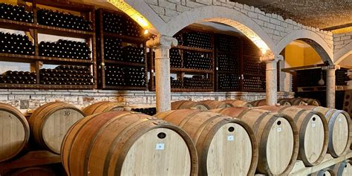
Notable Wineries in Albania
Berat Region
Çobo Winery: The Time Capsule Picture this: sipping wine in a 300-year-old stone cellar while the owner's grandmother shares tales of how they concealed their vines during communist times.
Çobo Winery is a living piece of history, blending tradition with modern comforts. Their organic vineyard tours take you past ancient olive trees, some of which are older than Albania itself.
The family's pride, the Pulës Selection, comes from vines growing on terraces built by their ancestors.
Stay for dinner, and you’ll enjoy recipes passed down through five generations, all served in their charming farm-to-table restaurant.

Slide 37
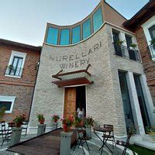
Notable Wineries in Albania
Berat Region
Nurellari Winery: The Mountain Maven Perched at 600 meters above sea level, Nurellari’s gravity-flow winery looks like a modern art installation set against the rugged mountain backdrop.
With a minimalist tasting room made of glass and local stone, you’ll be treated to breathtaking views of their organic vineyards.
They’re famous for their "Snow Wine," crafted from grapes harvested after the first frost.
For a unique experience, join one of their hiking tours through the vineyards, followed by a traditional picnic among the vines.
The young team here blends ancient local wisdom with techniques picked up in France and Italy, resulting in some truly exceptional wines.

Slide 38
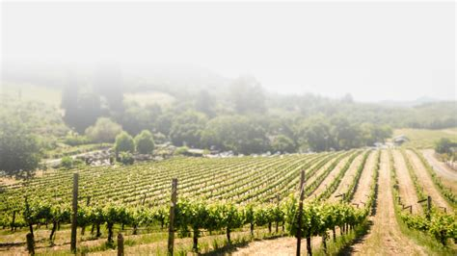
Notable Wineries in Albania
Korçë Region
Kantina Luani: The Alpine Jewel At Albania’s highest vineyard elevation, Kantina Luani feels more like the Alps than the Adriatic.
Their underground cellar network, built into the mountainside, creates perfect aging conditions for their wines.
The Korçë Riesling, lovingly dubbed "liquid sunshine" by wine critics, captures the intense mountain light in every sip. Winter visitors can enjoy wine tastings alongside skiing at nearby slopes, while summer guests can partake in moonlit tastings in the vineyard.
Don’t miss their traditional mountain breakfast, featuring fresh cheese, local herbs, and their delightful sparkling wine.

Slide 39
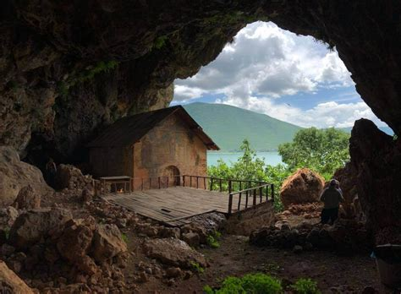
Notable Wineries in Albania
Korçë Region
Divine Wines: The Newcomer's Dream What happens when a former software engineer falls head over heels for winemaking? Welcome to Divine Wines!
This boutique winery artfully combines ancient techniques with modern technology—each fermentation tank has a QR code that reveals the story behind the wine.
The cellar boasts a professional tasting room with stunning views of Lake Ohrid. Known for their cult red blend "Binary" (because "good wine is like good code—elegant and complex"), Divine Wines also offers coding-themed wine experiences, perfect for tech industry tours.

Slide 40

Albania's Wine Culture and Traditions
Ancient Rituals Still Alive
In remote mountain villages, families gather for "Rakia Day," a centuries-old tradition where the entire community comes together to distill grape spirits in copper stills passed down through generations.
While the primary focus is on crafting rakia (brandy), these gatherings also celebrate ancient wine customs. Elders teach the younger generation to recognize the signs of perfect fermentation through the subtle cues of smell and sound.
The first glass is always poured on the ground – a tribute to Mother Earth that predates both Christianity and Islam, symbolizing gratitude and respect for the land.

Slide 41

Albania's Wine Culture and Traditions
Harvest Festivals Reimagined
Albania's wine harvest festivals blend ancient Illyrian traditions with modern flair. During "Festa e Rrushit" (Grape Festival), entire villages partake in grape-stomping competitions, but with a unique twist: teams must stomp to the rhythms of traditional folk dances.
Winners are judged not just on juice quantity but also on their ability to maintain perfect dance steps. These lively festivals often feature "wine wrestling," where contestants engage in good-natured competition, trying to pour wine into each other's glasses while performing traditional dance moves, all contributing to a joyous communal spirit.

Slide 42
Albania's Wine Culture and Traditions
The Mountain Wine Caves
High in Albania's mountains, communities still use ancient wine caves – natural limestone caverns that provide the perfect aging temperatures for wine.
Each cave has its "guardian," typically the oldest family member, who knows the ideal spot for each wine type. Many caves feature medieval niches carved by monks, which are still in use today.
Modern winemakers are reviving these caves, blending traditional storage methods with modern technology, while also maintaining the ancient "cave blessing" ceremonies each spring, honoring the spirits of the land and their ancestors.

Slide 43
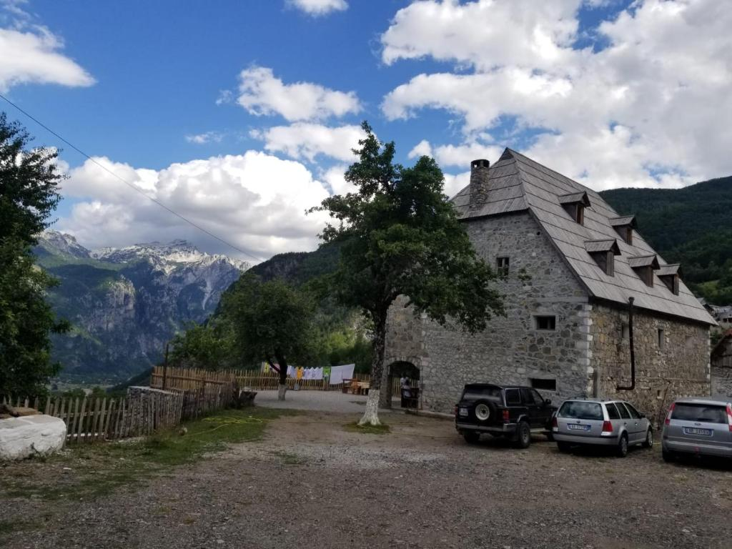
Urban Wine Renaissance
Albania's cities are experiencing a vibrant wine revival. Traditional wine bars, known as "Bujtina," are being transformed into hip natural wine spots that fuse ancient architecture with contemporary design, often featuring original Ottoman-era wine cellars.
Young sommeliers are crafting "history flights," tastings that pair traditional Albanian varieties with specific historical eras, complete with period music and storytelling.
Some bars even maintain "family tables," reserved spots for regular customers, where their personal wine collections are stored on-site, fostering a sense of belonging and community.

Slide 44

The Coffee-Wine Connection
Uniquely Albanian is the tradition of "Kafja pas verës" (coffee after wine).
This custom involves special coffee houses near wineries that serve strong Albanian mountain coffee to "reset" the palate between tastings.
Dating back to Ottoman times, this tradition has evolved into an art form, with professional coffee masters collaborating with sommeliers to create perfect coffee-wine pairing experiences.
Many modern tastings now conclude with coffee ceremonies that rival the elegance of the wine service itself, inviting guests to savor each sip and appreciate the nuances of both beverages.

Slide 45
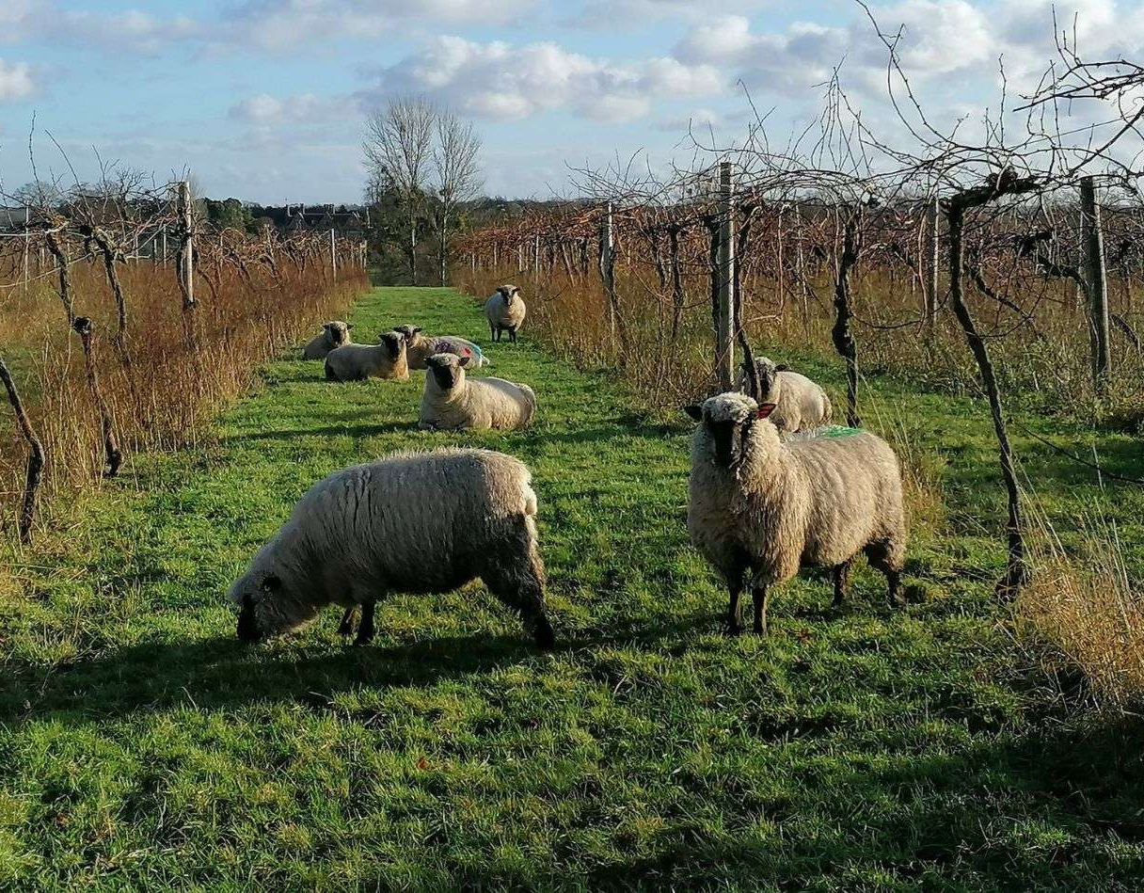
Sustainable Winemaking Practices in Albania
In a country where many vineyards have been tended by the same families for generations, sustainability isn't just a trendy buzzword; it’s deeply woven into Albanian wine culture. Today’s winemakers are seamlessly blending age-old wisdom with modern eco-friendly innovations.
Ancient terraced vineyards naturally prevent soil erosion, while solar-powered wineries are nestled in restored medieval buildings, showcasing how Albania's wine industry is proving that the future of wine is rooted in its rich past.
Current initiatives include organic certification programs that help wineries gain recognition for their sustainable practices.
Water conservation is a priority as vineyards adapt to changing climates, ensuring that precious resources are used wisely.

Slide 46
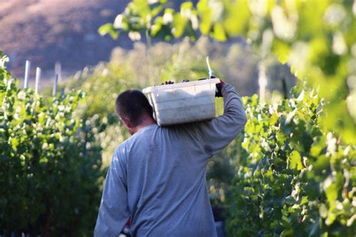
Sustainable Winemaking Practices in Albania
The implementation of solar power not only reduces energy costs but also lowers the carbon footprint of wine production. Additionally, there is a strong commitment to preserving biodiversity, with many vineyards maintaining natural habitats that support local wildlife.
Looking ahead, there will be an increased focus on indigenous varieties, as winemakers recognize the importance of cultivating grapes that thrive in Albania’s unique terroir. Sustainable packaging initiatives are also on the rise, aimed at reducing waste and environmental impact. Carbon footprint reduction programs will further solidify Albania's commitment to responsible winemaking practices, ensuring that the industry continues to flourish for generations to come.
Albania's wine industry represents an exciting frontier in European wine, combining ancient traditions with modern innovation.

Slide 47
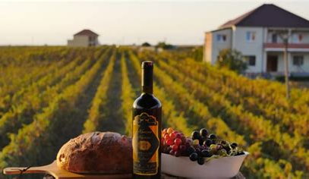
Final Thoughts
Albania's wine industry represents an exciting frontier in European wine, combining ancient traditions with modern innovation.
The country's unique terroir, indigenous varieties, and growing focus on quality position it well for increased recognition in the global wine market.

Slide 48
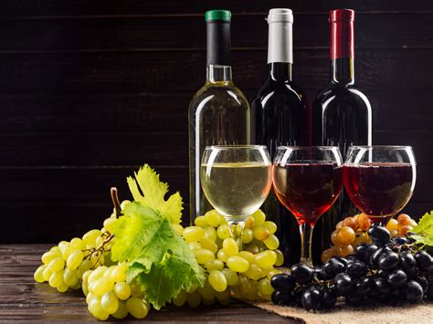
Conclusion
Albania's wine journey is a captivating blend of ancient heritage and contemporary innovation. From the sun-kissed vineyards nurtured by generations to the vibrant wine culture that thrives in both rural and urban settings, the country's wines tell a rich story of resilience and transformation. The commitment to sustainability showcases an awareness of the importance of preserving the land and traditions for future generations, ensuring that Albania remains a significant player in the European wine scene.
As Albanian winemakers continue to explore and celebrate their unique terroir and indigenous varieties, they are not just reviving a national treasure but also inviting the world to discover the depth and character of their wines. With each glass poured, Albania offers a taste of its history, culture, and the promise of what lies ahead. The future looks bright for Albanian wine, and the world is starting to take notice.

Slide 49
Acknowledgement
My seminars are the result of many years of experience combined with many hours of research over the internet.
I would like to acknowledge the many source I have accessed.
These include Wine Spectator, Wine Enthusiast, BKWine Magazine, Wine & Spirits Magazine, American Vineyard Magazine, The Grapevine Magazine, Wikipedia.com, Britannica.com, and the various Government websites.

Slide 50
Citations and References
"Albanian Wine: A Hidden Gem of the Balkans" - Wine & Spirits Magazine, 2023
"The Oxford Companion to Wine" - Jancis Robinson, 2015
Albanian Ministry of Agriculture Database
"Indigenous Wine Grapes of Albania" - Journal of Wine Research, 2022
European Union Wine Classification Guidelines
Albanian Vintners Association Reports

