Slide 1
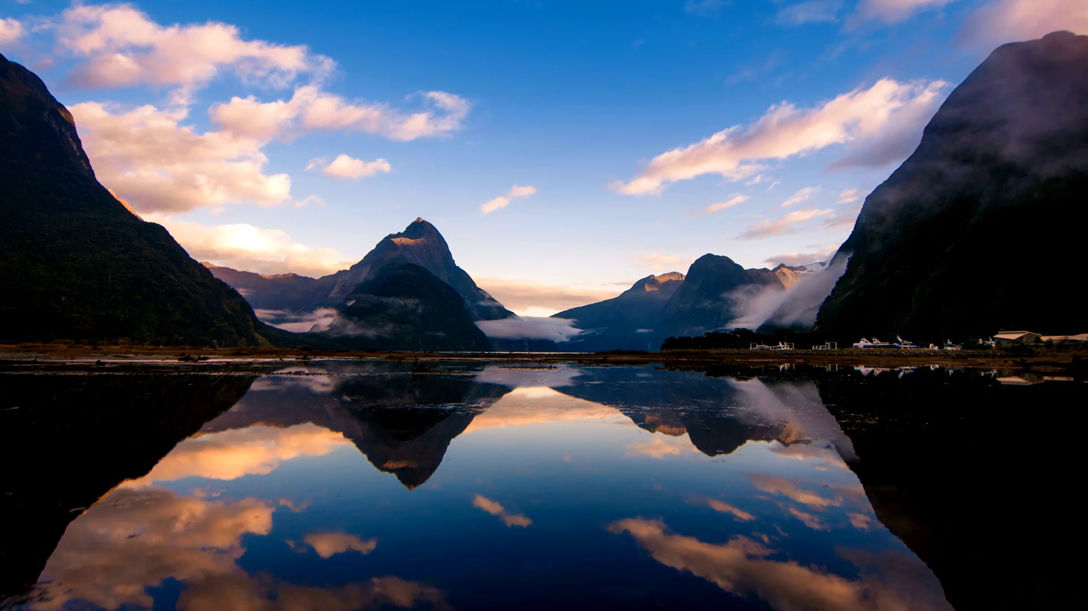
Alaska Native Peoples
Presented by
Marc Silver

Slide 2
Topics
The four common misconceptions concerning native Americans living in Alaska.
The native people of Alaska
Alaska Native Peoples
Conclusion

Slide 3
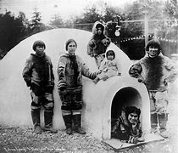
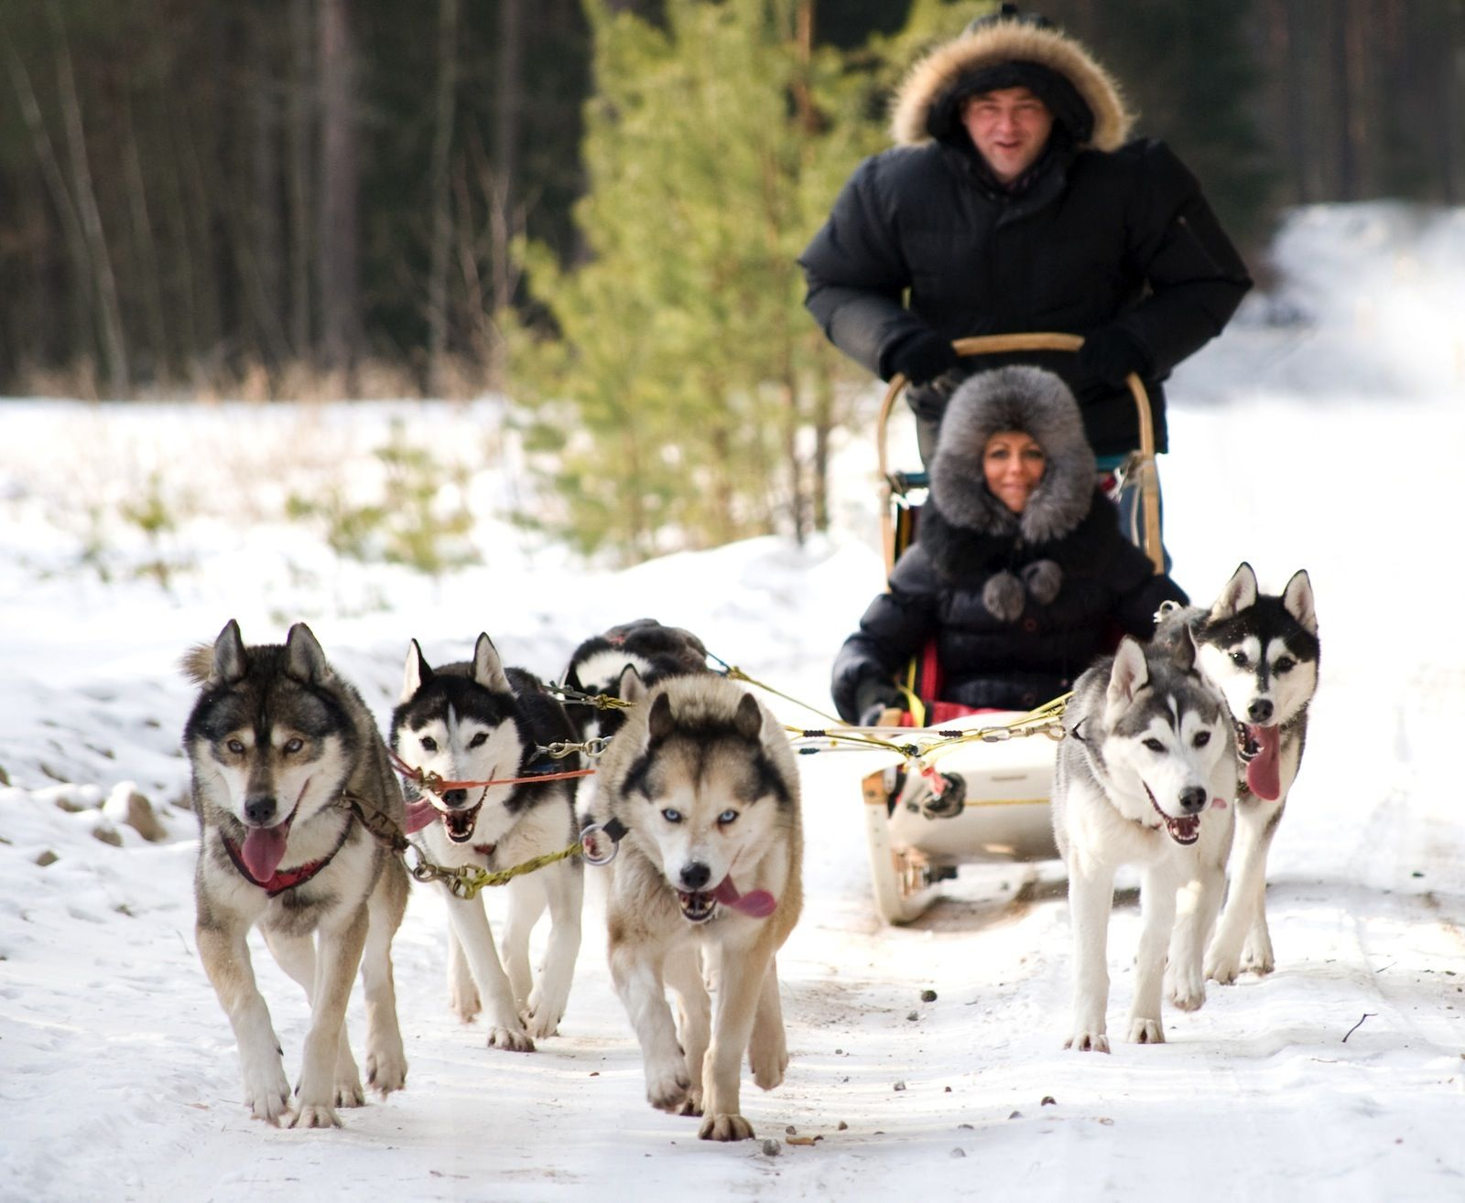
Common Misconceptions
All native people in Alaska are "Eskimos"
These Eskimos live in Igloos.
There main means of transportation is Dog Sled.
They have hundreds of words for Snow.
There are many more, but theses are the most common.

Slide 4
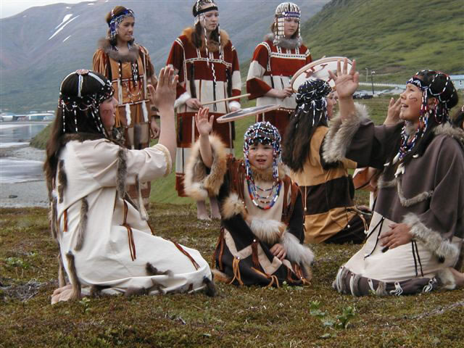
Common Misconceptions
The name "Eskimo" has been applied to the native peoples of the Arctic since the sixteenth century; ironically, it is not an Eskimo word.
For close to a century both anthropological and popular sources, including the Oxford English
and Webster's New World dictionaries, maintained that the name "Eskimo" was derived from a proto-Algonkian root translating as "eaters of the raw flesh."

Slide 5
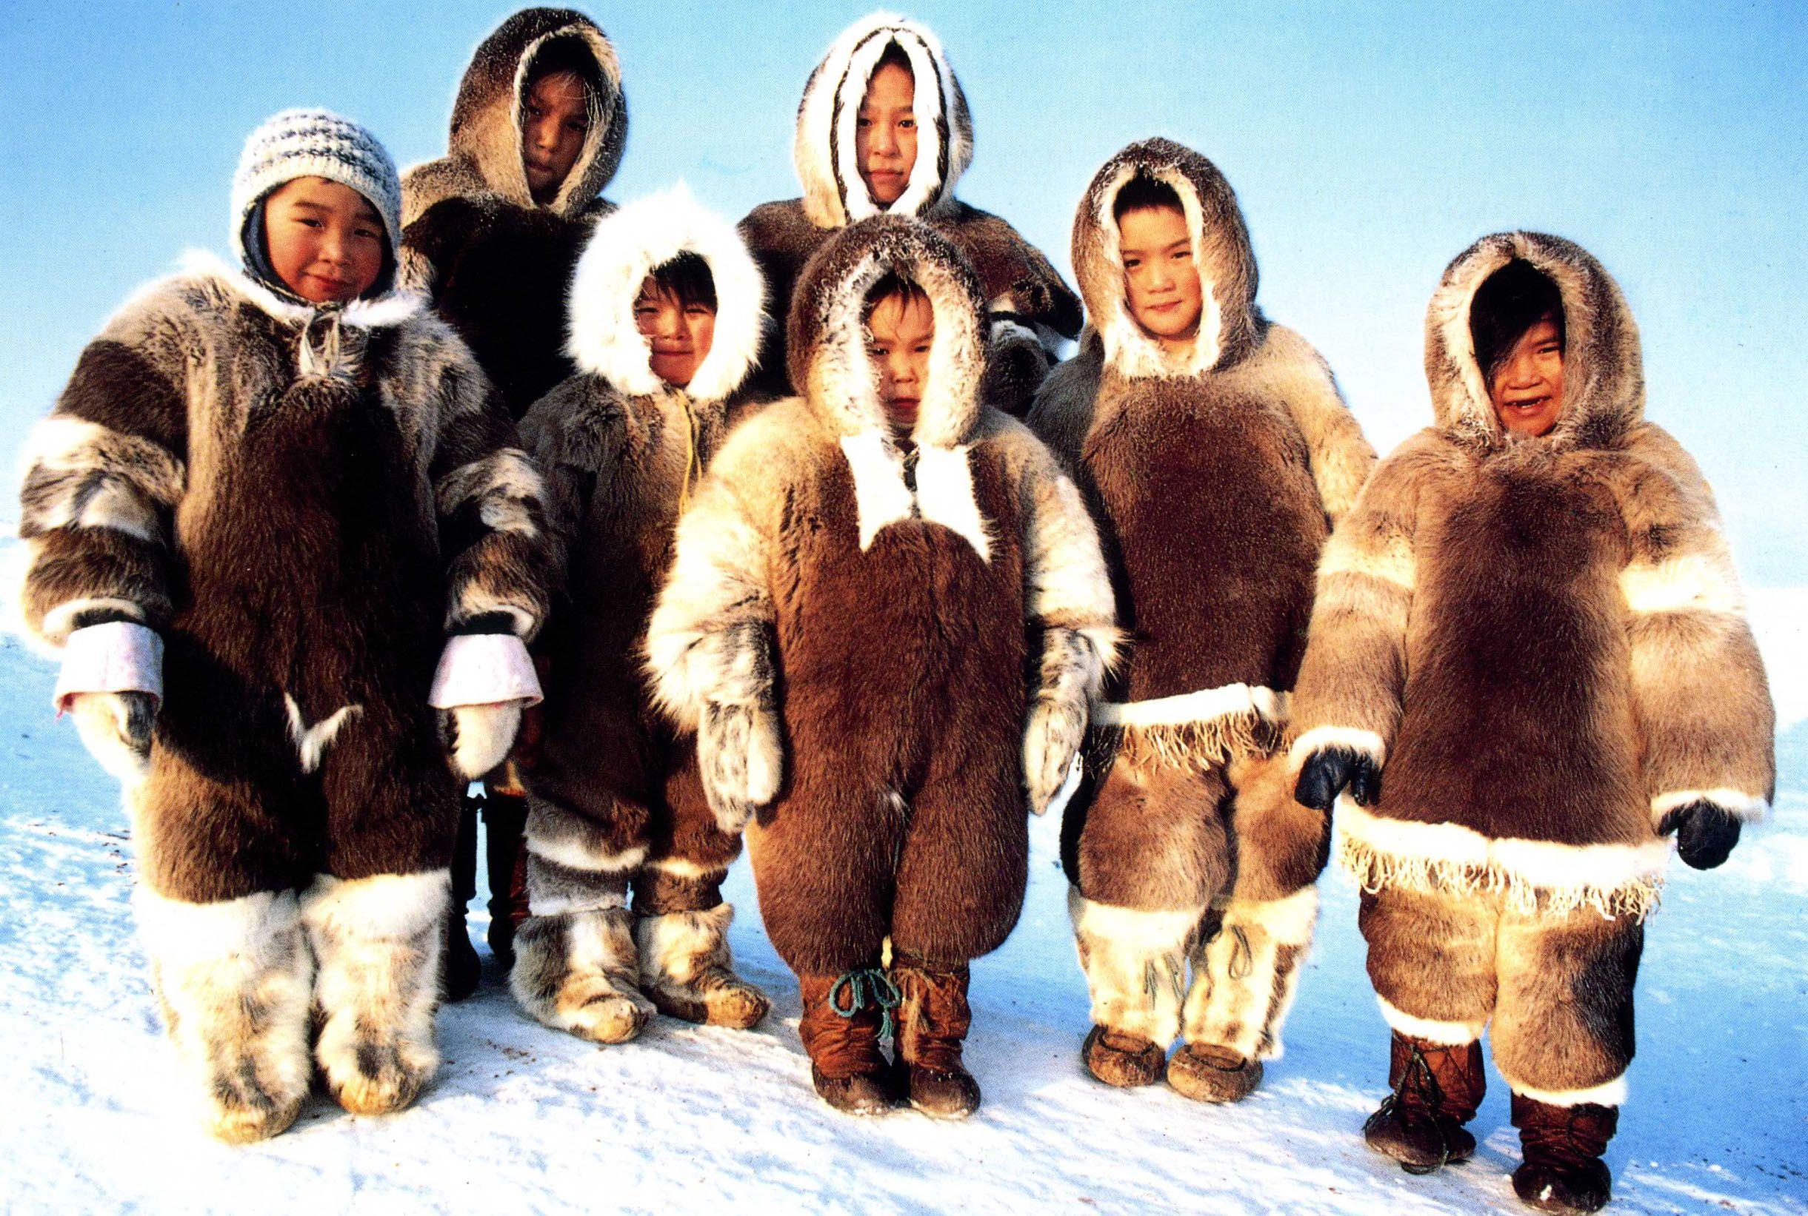
Common Misconceptions
In fact, Native Alaskans refer to themselves with terms that translate as "real people" or "authentic human beings."
These self-names vary and include the names "Inuit," "Inummaariit," "Inuvialat," "Inupiat," "Yup'ik," "Suxpiat," and "Unangan."
The term Eskimo is considered derogatory.
Canada and Greenland in 1970s adopted the designation "Inuit," an ethnonym used by eastern Arctic Eskimos and Canadian Arctic Eskimos.

Slide 6
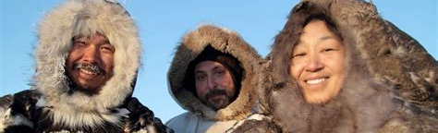
Common Misconceptions
In Alaska and Siberia, however, the term “Inuit” has never taken root. Although the matives of the western Arctic are indeed members of the larger family of Eskimo cultures, they refer to themselves in their own language as "Yup'ik," "Inupiat," or "Unangan."
To call them "Inuit" is inaccurate, and there is no all-encompassing native name for the entire native population of the Arctic.

Slide 7
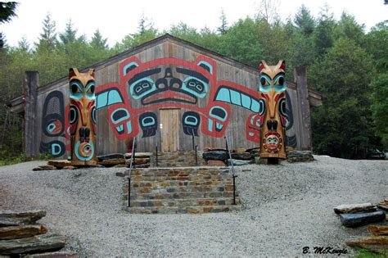
Common Misconceptions
The misconception that Alaska Native People
live in Igloos is a bit skewed. During the winter
they will make igloos typically during a hunt.
The Sitka Indian Village, first built in the 1820s,
is a cherished cultural landmark situated in
the heart of Sitka, Alaska. It was typical of
early native homes in Alaska.
Once home to over forty Lingít clan houses, only eight still stand today, and even fewer serve as active clan houses.
The village serves as a testament to the resilience and enduring legacy of Alaska Native people, as well as the urgent need to converse and rebuild what is not just a physical structure but a cornerstone of the community’s heritage and identity.

Slide 8
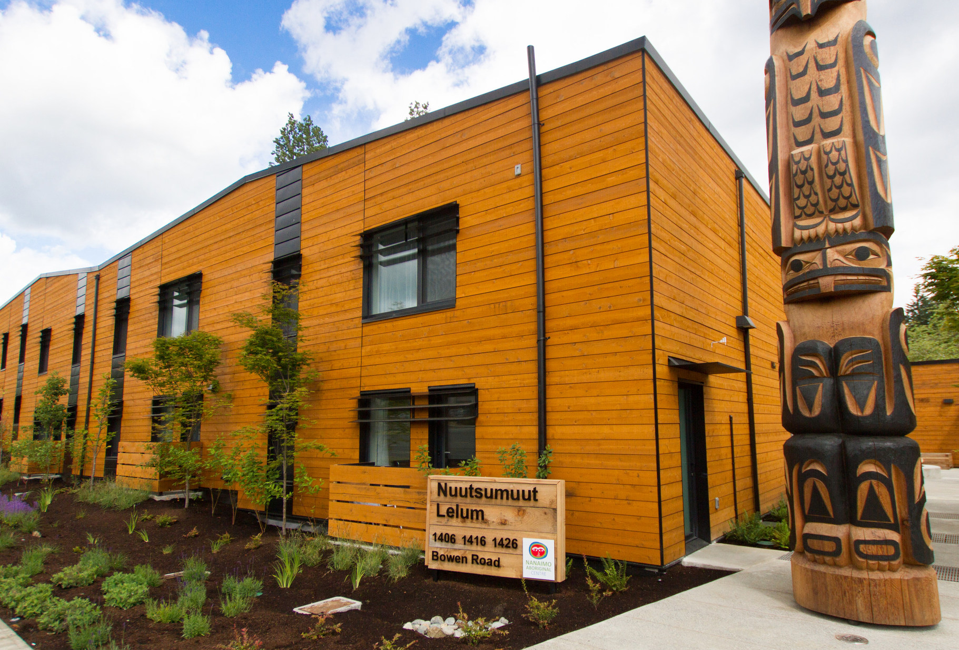
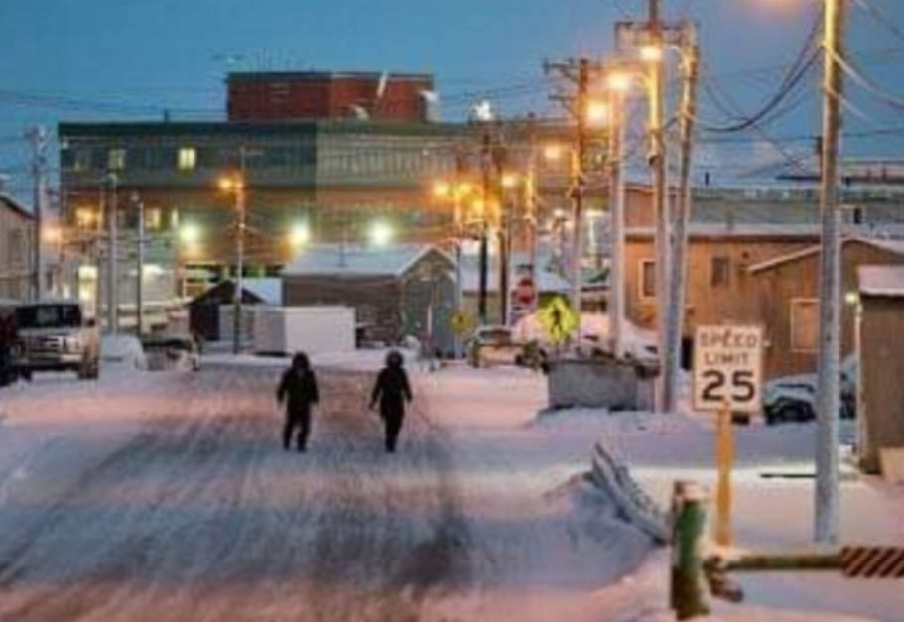
Common Misconceptions
Today Alaska Native People live in modern homes, with electricity, indoor plumbing, and many of the modern convenances we all enjoy.
The image on the right is Utqiagvik, formerly known as Barrow, is the borough seat and largest city on the North Slope of Alaska.

Slide 9
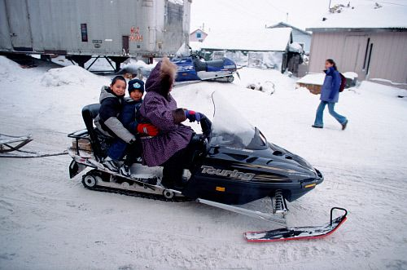
Common Misconceptions
How do Native Alaskans get around?
Although dog sleds are sill in use, they have been largely replaced by snow mobiles on land and motorized skiffs on the water.

Slide 10
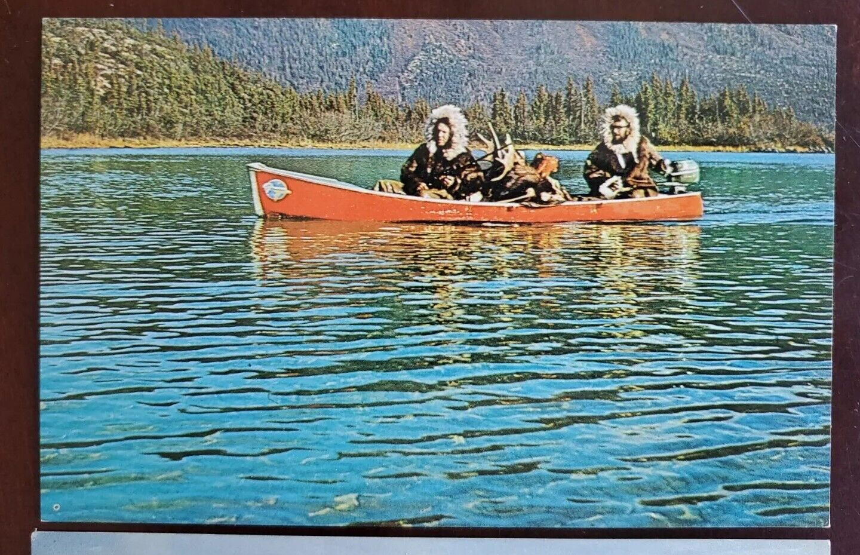
Common Misconceptions
How do Native Alaskans get around?
Canoes are not uncommon, but today power boats are the primary form of transportation on the water.

Slide 11
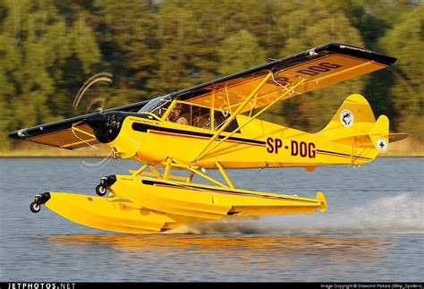
Common Misconceptions
How do Native Alaskans get around?
Today, airplanes are very common amongst Natives of Alaska.
Probably the most famous Bush Pilot was Captain Holger “Jorgy” Jorgensen was an Eskimo boy, born in an isolated mining community, having only an eight-grade education, who becomes one of the finest Alaskan pilots of his generation.
His early life in a small mining camp with a subsistence lifestyle, to his tales of experiences that range from early Alaskan aviation to flying around the world. With over 34,000 hours he, was a legendary aviator in his own time.

Slide 12
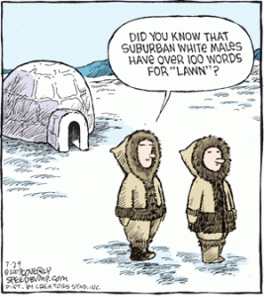
Common Misconceptions
The claim that Eskimo words for snow are unusually numerous, particularly in contrast to English, is a cliché commonly used to support the controversial linguistic relativity hypothesis. In linguistic terminology, the relevant languages are the Eskaleut languages, specifically the Yupik and Inuit varieties.
Scholars have debunked that false implication in part by debunking the snow words trope. Martin's paper and Geoffrey Pullum's well-known essay "The Great Eskimo Vocabulary Hoax" point out that the linguistic facts did not support the idea that “Eskimos” had some wildly exotic giant snow vocabulary.
In English there are equally numerous words for water.

Slide 13
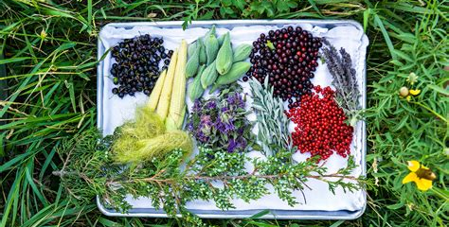
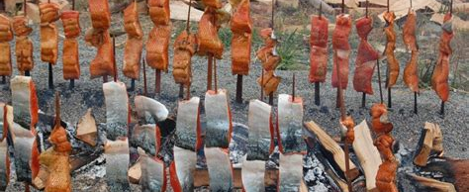
Alaska Native Peoples
For thousands of years Alaska Natives have lived throughout the vast land that became the 49th state.
A traditional subsistence lifestyle of hunting, fishing, and gathering food has enabled Alaska Natives to thrive in some of the world’s harshest and most challenging environments.

Slide 14
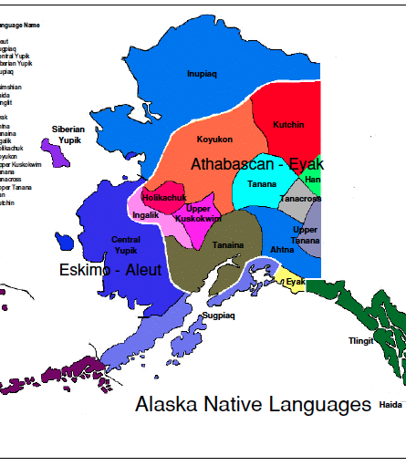
Alaska Native Peoples
There are 229 federally recognized tribes in Alaska, each with its own unique history and ancient traditions that continue to be practiced today and adapted for the modern world.
The indigenous people are comprised of widely diverse cultures, languages, life ways, art forms and histories, but they share many core values that have guided them for millennia. Eleven distinct cultures can be described geographically.
There are five groups of Alaska Native people identified by region – Iñupiat & St. Lawrence Island, Yup'ik in the Arctic, Athabascan in Southcentral and Interior Alaska, Yup’ik, Cup’ik, Unangax̂ and Sugpiaq (Alutiiq) in Southwest Alaska, Eyak, Haida, Tsimshian, and Tlingit in the Inside Passage.

Slide 15
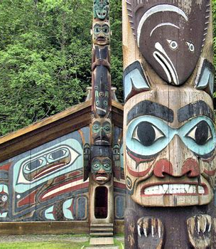
Alaska Native Peoples
Experiencing Alaska Native cultures is high on the list for many Alaska visitors — and with more than 10,000 years of human history — Alaska offers endless options for learning about our traditional lands, languages, and ways of being.
Stories are passed down from Elders.
The heartbeat of the people comes from the drums used in traditional dancing.
The sole can be found in totem carving techniques passed down from generation to generation.
The style comes from the regional and local Alaska Native functional and creative arts, ranging from carving and basket weaving to sewing and silversmithing.

Slide 16
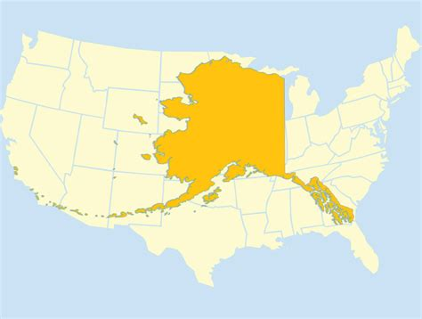
Alaska Native Peoples
Alaska Native Peoples
Alaska comprises 571,641 Square Miles of mostly pristine wilderness.

Slide 17
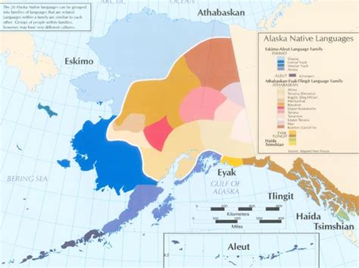
Alaska Native Peoples
ALASKA HAS THE HIGHEST STATE AND CITY NATIVE POPULATIONS
According to the 2014 Census update, 18% of Alaska’s general population is American Indian or Alaska Native – the highest rate for this racial group of any state.
Alaska’s largest city, Anchorage, has the greatest proportion of Native peoples among places with over 100,000 residents, at 12%.

Slide 18
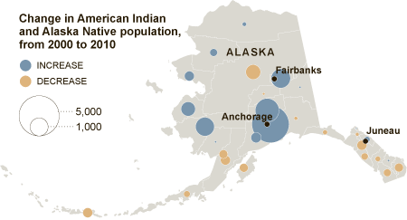
Alaska Native Peoples
NATIVE PEOPLE IN STEADY SHIFT FROM RURAL TO URBAN AREAS
The 2010 Census reports a slight majority of American Indians or Alaska Natives residing in the state’s urban cities as compared to its rural villages.
This was up from about 4 in 10 in 2000 and 3 in 10 in 1990.

Slide 19
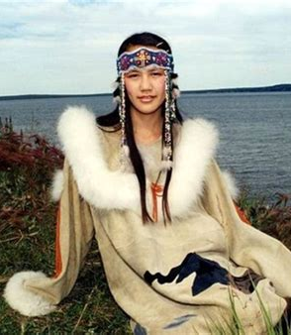
Alaska Native Peoples
YOUNG NATIVE POPULATION
Alaska Natives are a young population, with a median age of about 27. In addition, the young adult Native population is expected to dominate growth over the next decade.
Native Alaskan youth aged 16-24 have many difficult issues to face, but they are anxious to become responsible adults and role models in their communities.
With over 15 TV shows like Life Below Zero, and Life Below Zero First Alaskans, life in Alaska is fascinating people in the lower 48.

Slide 20
Thankyou for Coming!
I hope you enjoyed my talk!
If you have any more questions, please ask.
I will do my best to answer them for you.
I can be reached by e-mail at
marcs@sonic.net

Slide 21
Acknowledgement
My seminars are the result of many years of travel experience combined with many hours of research over the internet.
I would like to acknowledge the many source I have accessed.
These include: Wikipedia.com, Britannica.com, Trip Advisor and the
various Museum, Park and Government websites.

