Slide 1

Akaroa New Zealand Presented by Marc Silver
As they say in New Zealand, “Kia ora” which is a Māori greeting for Welcome.

Slide 2
What I Will Cover
My Port Philosophy
Don’t Miss the Ship
Money
About Akaroa
Area Map of Akaroa
Map of Akaroa
Akaroa Transportation
Places to see or at least consider
A few restaurant recommendations
Conclusion

Slide 3
My Port Philosophy
I have been cruising for over 45 years and have taken over 200 cruises. So, I consider myself an experienced cruiser.
The information I will present is based on those many years of
experience.
When I am on a cruise where the city, I want to visit is not the port city,
I always recommend taking a ship’s tour.
But when I am in a port with multiple attractions nearby and easy to see
on my own - I will do it on my own.
This presentation is for that type of port.

Slide 4

Don’t Miss the Ship
How to Avoid Missing Your Ship
Pay attention to the time. - Ship time and local time are often different.
Put a return-to-ship reminder on your phone.
Choose excursions wisely.
If a ship-sponsored excursion is late returning to port, the ship will wait for you. If you are on your own???
Be Prepared
Have your Passport, Credit Card, and phone numbers for your ship port agent.
What to Do If You Miss the Ship Most cruise lines have port agents stationed in the port area to assist if your ship has left without you. If your are lucky, when cruisers are late returning to the vessel, the ship’s crew will often remove the passengers’ essential items – passports, cell phones, and medication -- from the ship to leave with the port agents.
The Port Officials can help you with contacting your ship and making necessary travel arrangements.

Slide 5
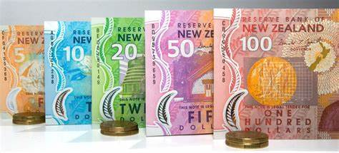
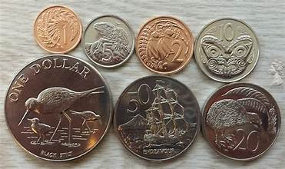
Money
The currency for Akaroa is the New Zealand Dollar (NZD).
The conversion at the rate is $ 1.63 (NZD) to $1.00 U.S.
Or $1 (NZD) to $. 61 U.S.

Slide 6
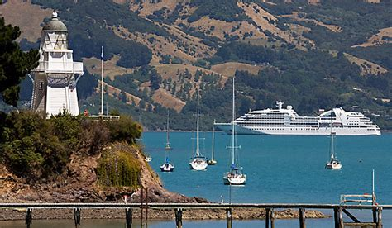
About Akaroa
Akaroa is a tender port, and the ships tenders will dope you at the long shallow water pier close to downtown.
Akaroa is the oldest town in the Canterbury region and has an intriguing history as a French settlement. The town still wears with pride that heritage with its French street and shop names and fine cuisine.
But the charming heritage buildings and French flair are only part of the story of Akaroa. Those of us that get to visit will find the contrasting colors of the turquoise harbor waters next to the rolling green hills and reserves absolutely beautiful.
Within its waters, dolphins, seals and little blue penguins put on a show for those who embark on sailing tours, kayaking excursions and catamaran cruises.

Slide 7
About Akaroa
Small in scale, Akaroa is nestled at the edge of the harbour, protected by steep hills, the remnants of a volcanic crater. The distinctive character of Akaroa village is enhanced by the large number of well-preserved colonial buildings, in the town centre, the historic French cemetery
But the charming heritage buildings and French flair are only part of the story of Akaroa. Those of us that get to visit will find the contrasting colors of the turquoise harbor waters next to the rolling green hills and reserves absolutely beautiful.
Within its waters, dolphins, seals and little blue penguins put on a show for those who embark on sailing tours, kayaking excursions and catamaran cruises.

Slide 8
Brief History of Akaroa
Akaroa and the Banks Peninsula have formed through volcanic activity some 6 to 11 million years ago. The Akaroa Harbor is a crater of a volcano that flooded when the sea level rose around 6,000 years ago.
Mäori settled in the area around 800 years ago, The first Europeans to settle in Akaroa were the French in 1838, involved in the whaling industry.
It was a French whaler, Jean Langlois, whose stories of the potential of Banks Peninsula for settlement inspired the Nanto-Bordelais Company to bring French settlers to Akaroa.
They were joined by six German families and left from France in March 1840 on the Comte de Paris, arriving in Akaroa in August.
It has been suggested that it was the settlement here that speedup Britain’s decision to annex New Zealand with the signing of the Treaty of Waitangi on February 6 1840.

Slide 9
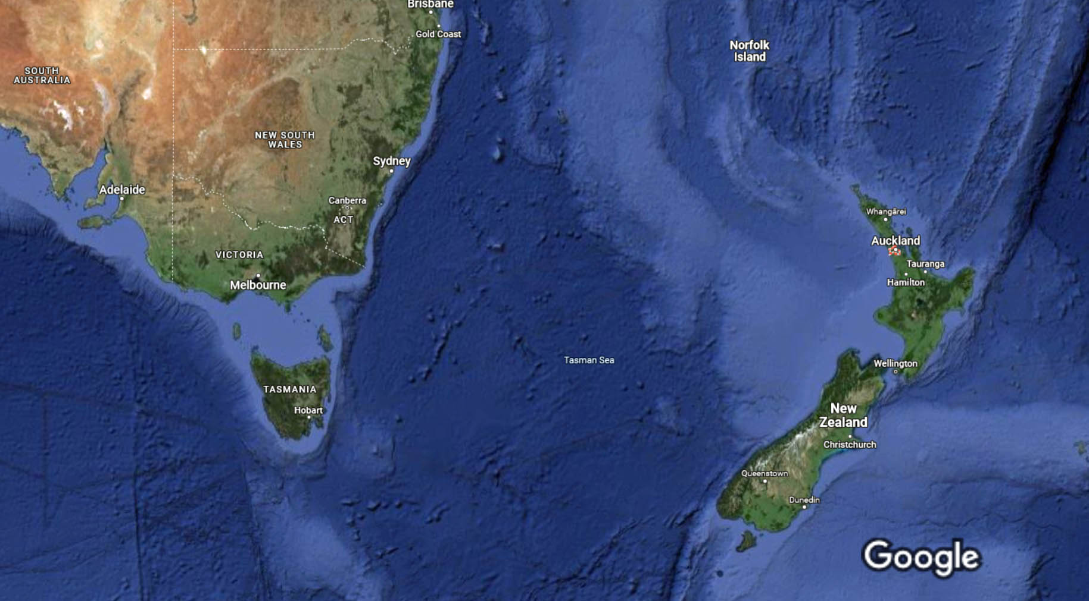
New Zealand Area Map

Slide 10
Map of Akaroa

Slide 11
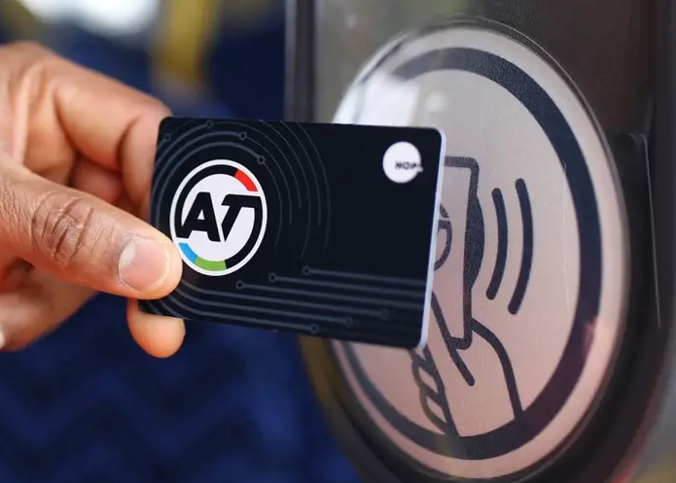
Akaroa Transit System
Akaroa has one of the most comprehensive and user-friendly public transport.
You can buy HOP cards from vending machines at the Downtown ferry terminal for $25 ($5 for the card plus $20 credit). Eligible seniors with a SuperGold card need to buy a gold AT HOP card to travel on public transport at discounted rates. Senior citizens can travel for free on AT trains and selected bus and ferry services. Offer applies after 9am on weekdays and all day on weekends and public holidays. You must have an AT HOP card loaded with a SuperGold concession.
The $5 card charge is not refundable.
Cash fares for public bus services start at NZ$2.50 to travel a short distance if paying in cash or are a little cheaper with HOP cards.

Slide 12
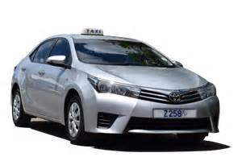
Akaroa Taxis
Taxiyo is the taxis for Akaroa. They provide a safe and reliable way to explore the city or for transport between the cruise port and various attractions.
Taxis are easily identified by the XXX designation on their license plates.
Like taxis in most locations the cost is significantly more expensive than other modes of transport.

Slide 13
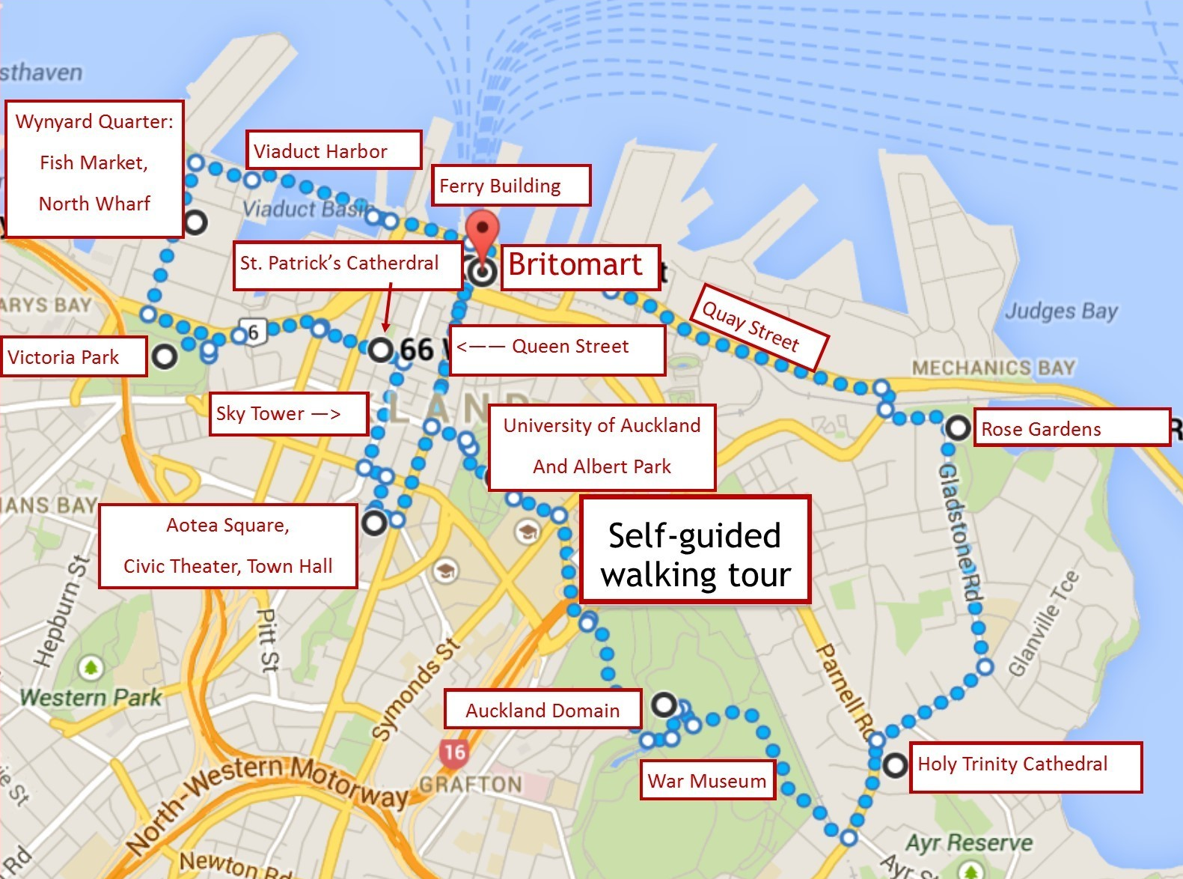
Akaroa Walking Tour
Take a Akaroa walking tour of the interesting points and historic buildings in the capital city of Akaroa.
Places You Will See in Akaroa: Quay Street, Britomart, Ferry Building, Viaduct Harbor, Fish Market, Victoria Park,St. Patrick’s Cathedral, Sky Tower, Aotea Square, Albert park, Akaroa Domain, War Museum, War Museum, Holy Trinity Cathedral, Rose Garden

Slide 14
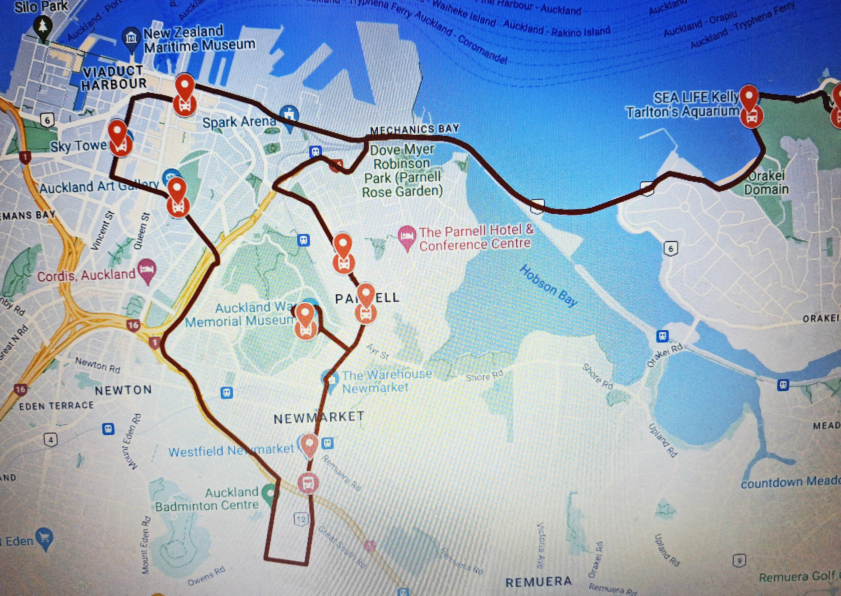
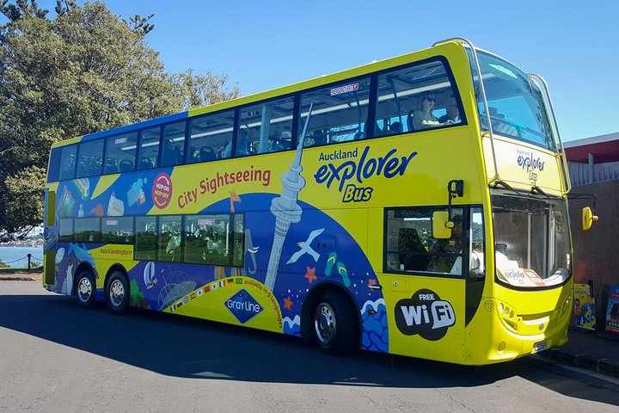
Hop-on Hop-off Tour
An Akaroa hop-on hop-off bus tour provides all the benefits of a guided tour—including hassle-free transport and on-board audio commentary—with the flexibility of independent travel.
Adult $55, Child $27 Family $150*

Slide 15
Penguin Safari

Slide 16
Akaroa Art Gallery
Although mainly open during the warmer months, the Akaroa Art Gallery is still a good go-to on those wetter summer days. Formerly the Orion Powerhouse Gallery, this art gallery has ever-changing exhibitions showcasing the works of artists of the Banks Peninsula and beyond. See artists’ impressions of Akaroa’s landscapes, wildlife and more. The gallery is typically open between October and April.

Slide 17
Akaroa Museum
While it might seem like an unimaginative suggestion, going to the museum on a rainy day is actually an interesting thing to do in Akaroa. The Akaroa Museum is set across the historic Langlois-Eteveneaux cottage, Akaroa Court House and the Custom House, featuring well-presented exhibitions about the early Maori, the transformation of the natural environment made by pioneers and explains why the town is a “French” town. What’s more, the museum is free to visit.

Slide 18
Okains Bay Museum
the Akaroa Museum wasn’t enough, there’s also another option in Okains Bay! You’ll find the Okains Bay Museum just a short and scenic drive from Akaroa. Check out historically significant Maori and early European artefacts. See waka (canoes) in the waka shed, meander from the blacksmiths to the gun room, and learn about the Banks Peninsula’s wildlife of the past and present. There’s a small admission fee for adults. Kids get in free!

Slide 19
Picturesque Churches
Akaroa is also a good opportunity for a road trip around the Banks Peninsula to see all its picturesque churches! Start with St Patrick’s Catholic Church set amongst the backdrop of bush-clad hills, then the historical St Peter’s Anglican Church is also worth a quick look – both of which are located in Akaroa town. Then hit the road to Little Akaloa to admire the Maori carvings imprinted into the stone walls of St Luke’s Anglican Church. Plus, don’t miss the wooden Maori carvings and the cutest church with a sea view at the Onuku Church.
Location: St Patrick’s Catholic Church – 29 Rue Lavaud. St Peter’s Anglican Church – 10 Rue Balguerie. St Luke’s Anglican Church – 8 Lukes Road, Little Akaloa, approximately 25km (16 miles) from Akaroa town centre. Onuku Church – Onuku Road, approximately 4km (2 miles) from Akaroa town centre.

Slide 20
Barrys Bay Cheese
If you’re a bit of a foodie, make sure you stop by Barrys Bay Cheese on the way to or from Akaroa. Sample handcrafted award-winning New Zealand cheeses, with some favourites being Havarti, Maasdam, Aged Gouda, Rinded Cheddar and Peninsula Blue. Watch the cheesemakers in action (on weekdays) through the viewing window of their factory shop, where you can also pick up local wines, craft beer, preserves and more.

Slide 21
Meniscus Wines
In the true French spirit of Akaroa, the surrounding area is home to several boutique wineries, including Meniscus Wines, The Akaroa Winery at Takamatua Valley Organic Vineyards and French Peak Wines. Either visit the wineries independently (cellar doors typically open between Labour Day and April or will open by appointment for groups) or let someone else worry about being the designated driver on a guided wine tour with The Bonjour Wine Tour.

Slide 22
French Peak Wines

Slide 23
Orion Powerhouse Gallery

Slide 24
The Giants House
Step into this garden that looks like something out of a fairy tale. The Giants House is a creation of a local artist where the garden is decorated with mosaic art, water features and more. There’s a cafe on-site and an art gallery. At NZ$20 per person, it’s definitely one of the more affordable things to do in Akaroa.

Slide 25
Hinewai Reserve
For those of you who love the great outdoors, look no further than the Hinewai Reserve! The reserve holds around 12km of walking tracks, with the main feature being Stony Bay Peak. Sitting 800m high above the Banks Peninsula, it’s a great place to soak in the scenery. Check out the details of this walk and others in Akaroa with our Akaroa – Guide for Backpackers.

Slide 26
Akaroa Lighthouse
A great vantage point of Akaroa (that’s also easy to get to) is from the Akaroa Lighthouse. This lighthouse is unusually situated inside the harbour after lighthouse enthusiasts saved the structure from being demolished when it was no longer in use. The Akaroa Lighthouse is a fantastic picture opportunity itself while being situated at a great viewpoint. The lighthouse is easy to spot from the town centre so simply walk toward it!

Slide 27
Swim with the World’s Smallest Dolphins
As long as the sea conditions aren’t too rough, which they tend not to be in the sheltered waters of the Akaroa Harbour, then there’s no reason not to enjoy a dolphin swimming cruise in the rain. Swim with the world’s smallest species of dolphin, Hector’s dolphins, on one of the fantastic dolphin swimming tours in Akaroa. You have several options to choose from, including Black Cat Cruises (check them out of Viator, Tripadvisor or Klook), EcoSEAker and Onuku Farm Hostel. All provide wetsuits and snorkel gear, as well as instructions on how to interact with the dolphins in a safe and ethical way.
Location: Black Cat Cruises – Departs from the Main Wharf, Beach Road. EcoSEAker – Departs from Daly’s Wharf, end of Rue Balguerie. Onuku Farm Hostel – 89 Hamiltons Road, Onuku, approximately 6km (4 miles) from Akaroa town centre.

Slide 28
Onuku
For a dose of Maori culture, visit the small settlement of Onuku, just 6km south of Akaroa. Either walk, bike or drive through the forested road to Onuku where the settlement boats a large carved marae “meeting house” and small Maori church. The church is accessible to the public and well worth checking out.

Slide 29
Restaurants in Akaroa
Where to Eat in Akaroa:
The Little Bistro (33 Rue Lavaud)
Sweet As Bakery (63 Rue Lavaud)
La Boucherie & Deli (67 Rue Lavaud)
Ma Maison (6 Rue Balguerie)
The Trading Rooms Restaurant (71 Beach Road)
The Wharf (75 Beach Road)
Peninsula General Store (40E Rue Lavaud)
HarBar Beachfront Cafe (83 Rue Jolie)

Slide 30
Conclusion
Akaroa is a beautiful City with a rich history and numerous attractions. Regardless of what you're looking for, Akaroa has something for everyone.
I hope this presentation will help when we visit Akaroa!

Slide 31
Thanks For Coming
If you have any more questions, please ask.
I will do my best to answer them for you.
Have a great visit to Akaroa!

Slide 32
Acknowledgement
My seminars are the result of many years of travel experience combined with many hours of research over the internet.
I would like to acknowledge the many source I have accessed.
These include: Wikipedia.com, Britannica.com, and the various Museum, Park and Government websites.

