Slide 1
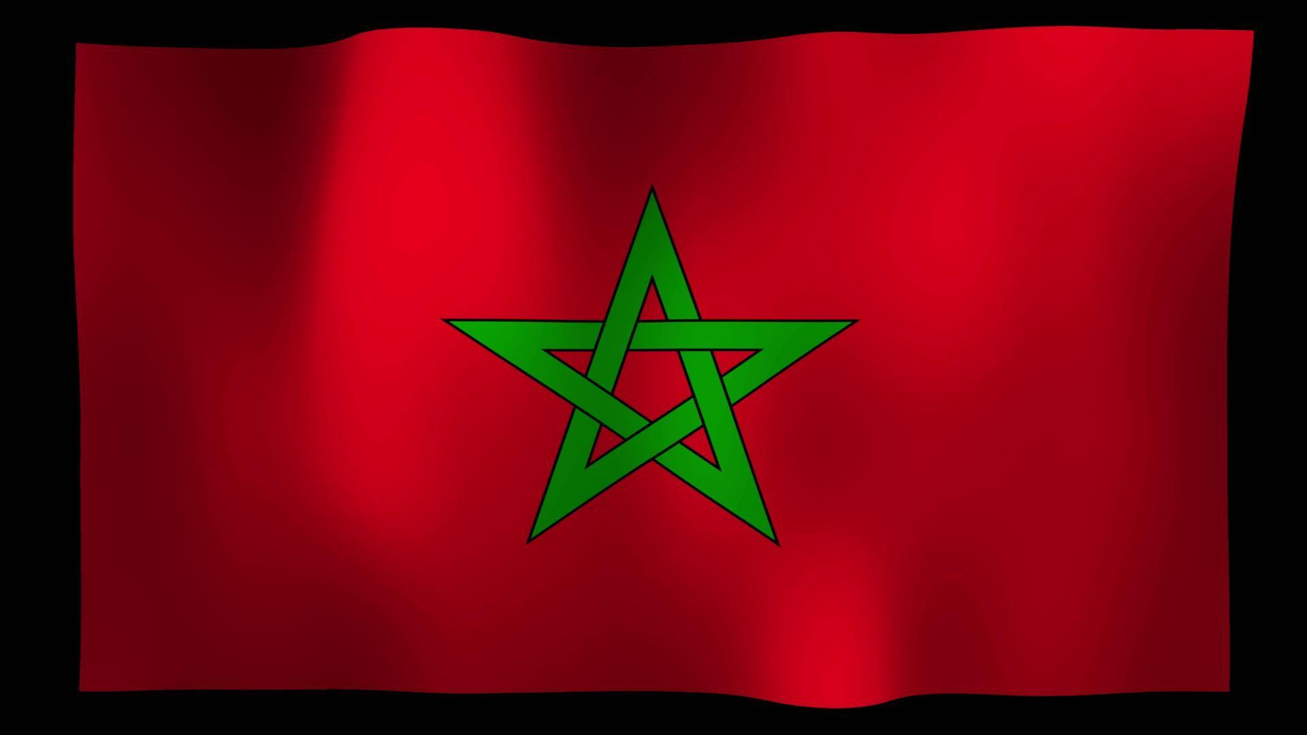
Agadir, Morocco Presented by Marc Silver

Slide 2
What I Will Cover
My Port Philosophy
Don’t Miss the Ship
Money
About Agadir, Morocco
A Brief History
Maps
Transportation
Culture and Traditions
Top Attractions & Points of Interest
Local Cuisine & Dining Options
Self-Guided Walking Tour
Important Tips & Practical Advice
Final Reflection

Slide 3
My Port Philosophy
I have been cruising for over 46 years and have taken over 100 cruises. So, I consider myself an experienced cruiser.
The information I will present is based on those many years of experience.
When I am on a cruise where the city, I want to visit is not the port city,
I always recommend taking a ship’s tour.
But when I am in a port with multiple attractions nearby and easy to see on my own - I will do it on my own.
This presentation is not like that.

Slide 4

Don’t Miss the Ship
How to Avoid Missing Your Ship
Pay attention to the time. - Ship time and local time are often different.
Put a return-to-ship reminder on your phone.
Choose excursions wisely.
If a ship-sponsored excursion is late returning to port, the ship will wait for you. If you are on your own???
Be Prepared
Have your Passport, Credit Card, and phone numbers for your ship port agent.
What to Do If You Miss the Ship Most cruise lines have port agents stationed in the port area to assist if your ship has left without you. If your are lucky, when cruisers are late returning to the vessel, the ship’s crew will often remove the passengers’ essential items – passports, cell phones, and medication -- from the ship to leave with the port agents.
The Port Officials can help you with contacting your ship and making necessary travel arrangements.

Slide 5
Money
Morocco uses the Moroccan Dirham (MAD) as its official currency. Exchange rates fluctuate, but as of late 2024: 1 USD ≈ 10.1 MAD 10 MAD ≈ 1 USD 1 MAD ≈ 0.09 EUR

Slide 6
Exchanging Money
When exchanging money in Agadir, avoid the kiosks near the port, as they often charge high fees and offer poor exchange rates.
You’ll usually get a better rate by withdrawing dirhams (MAD) directly from bank ATMs, which are easy to find throughout the city.
Major credit and debit cards are accepted at most hotels, restaurants, and shops in tourist areas, but smaller cafés, taxis, and souks often prefer cash—so keeping some local currency on hand is a good idea.

Slide 7
Welcome to Agadir, Morocco
Agadir, is Morocco’s premier Atlantic resort city, that blends modern charm with coastal beauty.
Rebuilt after the 1960 earthquake, it features wide boulevards, beachfront cafés, and a sweeping promenade along its golden bay.
The Kasbah of Agadir Oufella overlooks the city, offering views of the harbor and surrounding hills.
Known for its mild climate and relaxed atmosphere, Agadir is a favorite stop for cruise visitors and a gateway to Morocco’s south, including Taroudant and the Sahara.
With fresh seafood, friendly locals, and year-round sunshine, it’s an easygoing introduction to Moroccan culture and coastal life.

Slide 8
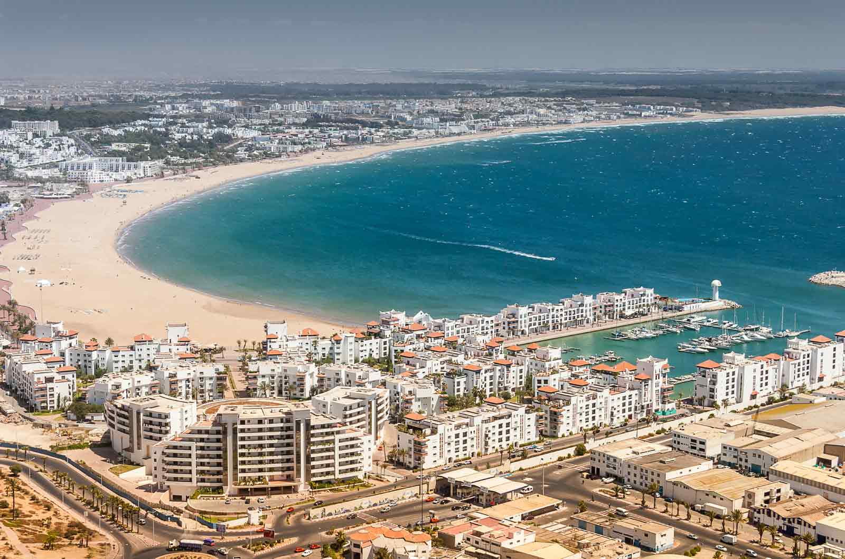
Modern Agadir and Tourism Growth
Agadir has become Morocco’s most important seaside resort, drawing visitors from Europe and beyond.
The city’s modern infrastructure, wide boulevards, and beachfront hotels make it an attractive stop for cruise lines exploring North Africa and the Canary Islands.
New investments in tourism and renewable energy are turning Agadir into a model of Morocco’s forward-looking development.

Slide 9
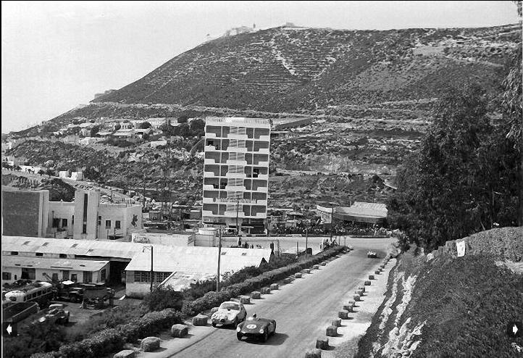
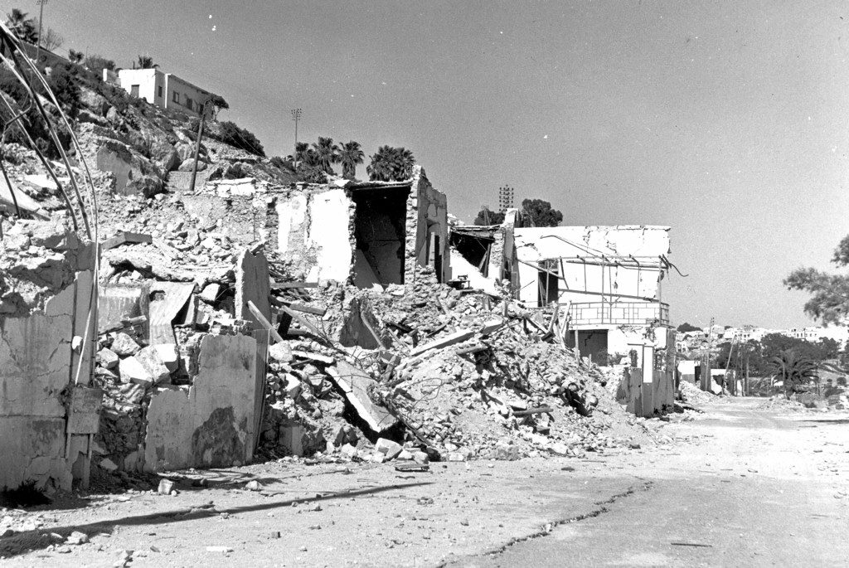
A City Reborn
Agadir’s story is one of resilience. In 1960, a massive earthquake leveled most of the city. Rather than rebuild the past, Morocco built a new Agadir, modern, clean, and spacious. Today it’s a thriving resort city known for hospitality, safety, and vibrant coastal life.
The ruins of the old Kasbah, perched high above the city, remain a reminder of Agadir’s origins and a symbol of its strength.
Before After

Slide 10
A Brief History
Agadir’s history stretches back to the early 16th century, when Portuguese traders established a small fortress and trading post on its Atlantic shore. By the mid-1500s, it came under Moroccan rule and grew into a key port for exporting sugar, spices, and gold from sub-Saharan caravans.
In 1911, the city drew international attention during the Agadir Crisis, when Germany sent a gunboat to challenge French influence in Morocco—a confrontation that hastened France’s formal colonization of the country.
On February 29, 1960, a powerful earthquake destroyed nearly all of Agadir, killing thousands. The city was completely rebuilt a few miles south, with modern architecture and a European-style layout, transforming it into today’s clean, contemporary resort hub.

Slide 11
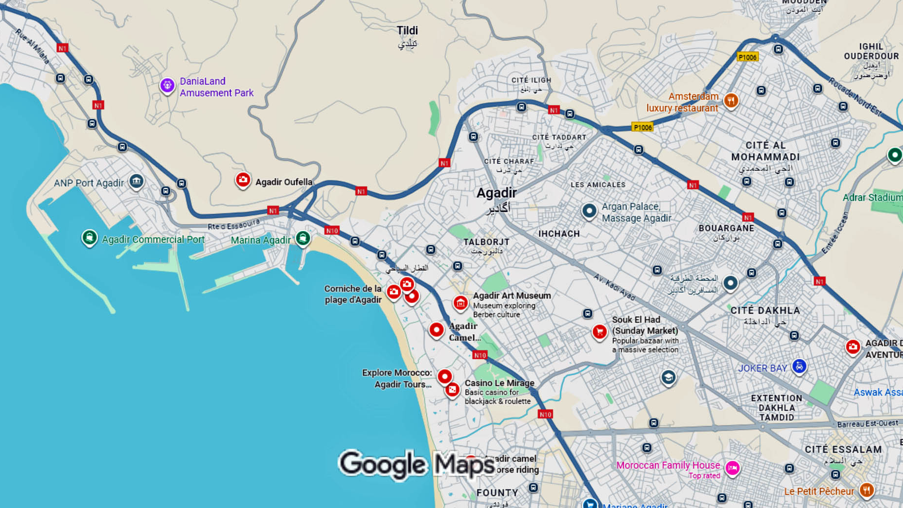
Cruise ship port
Agadir, Morocco

Slide 12
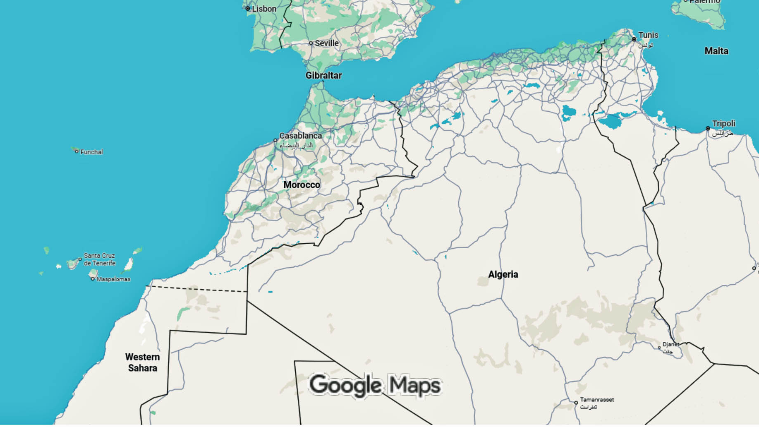
Agadir, Morocco

Slide 13
Transportation
Getting Around
The cruise terminal is conveniently located about 10 minutes from downtown.
Taxis are affordable and easy to find, just confirm the fare before departure.
The Marina, Corniche promenade, and Souk El Had are all within easy reach, making Agadir one of Morocco’s most walkable port stops

Slide 14
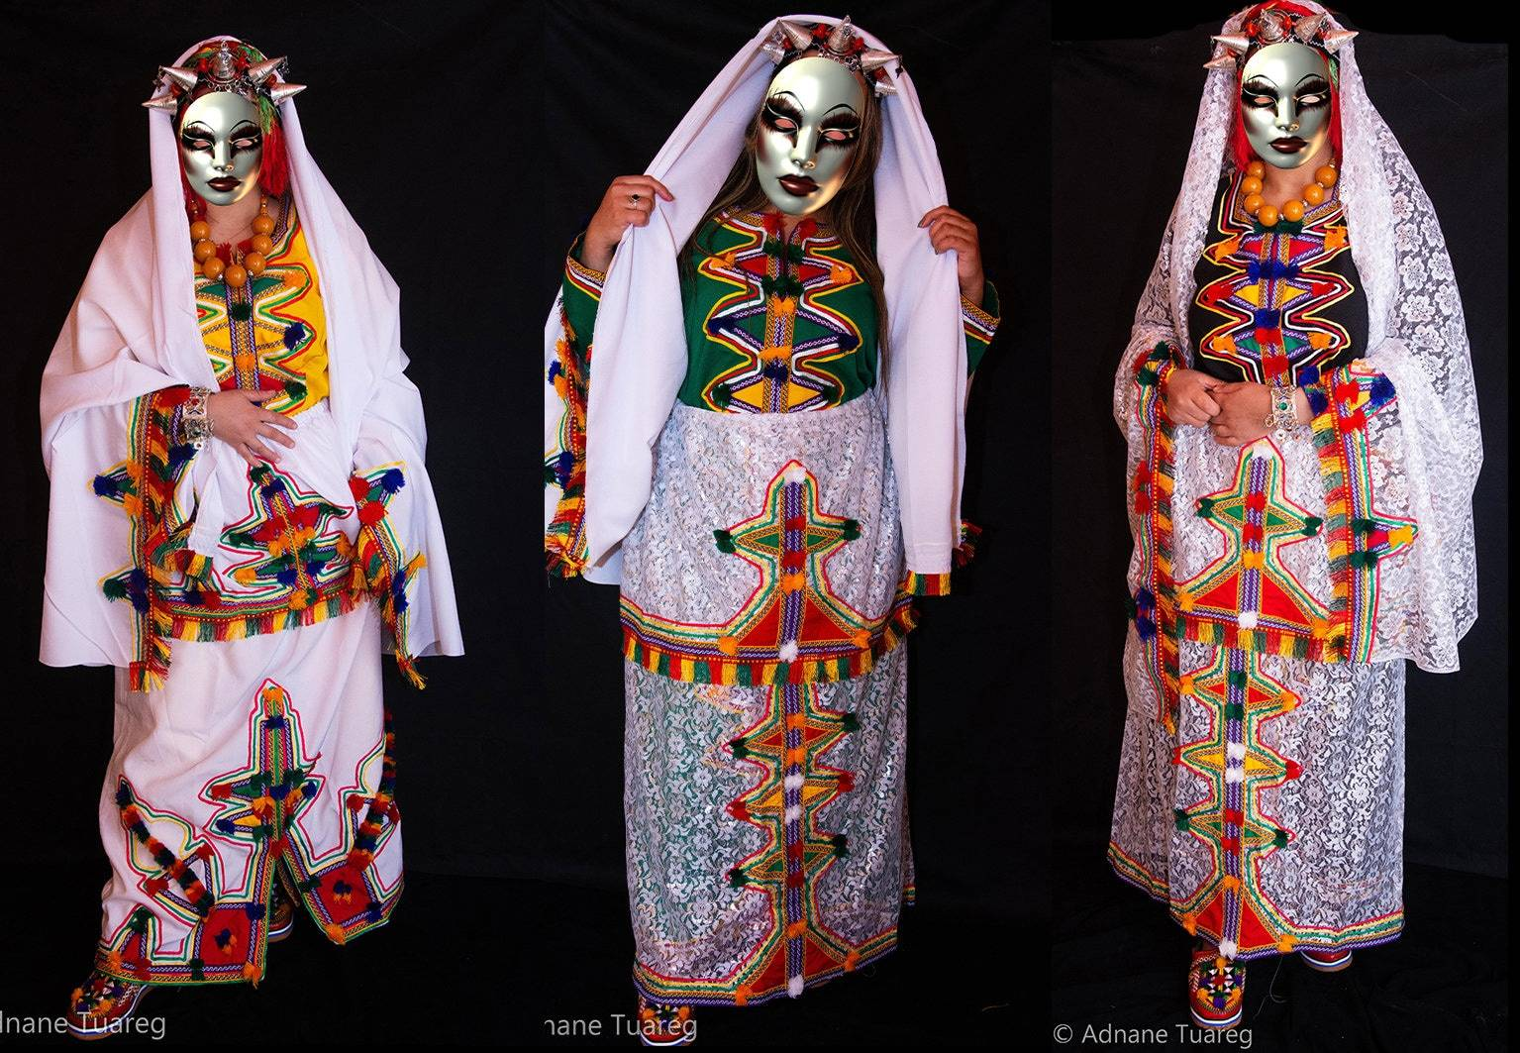
Culture and Traditions
Agadir wears its Berber (Amazigh) heritage with pride. You’ll notice it in the street signs | written in the Tifinagh script, in the geometric designs on local rugs, and in the silver jewelry crafted by hand.
Many of the argan oil products sold here come straight from women’s cooperatives in nearby villages, a tradition that blends skill with community spirit.
If you’re lucky, you might stumble upon a Berber music or dance performance, where the steady beat of drums and the twang of the lute fill the air, capturing the rhythm and soul of southern Morocco.

Slide 15
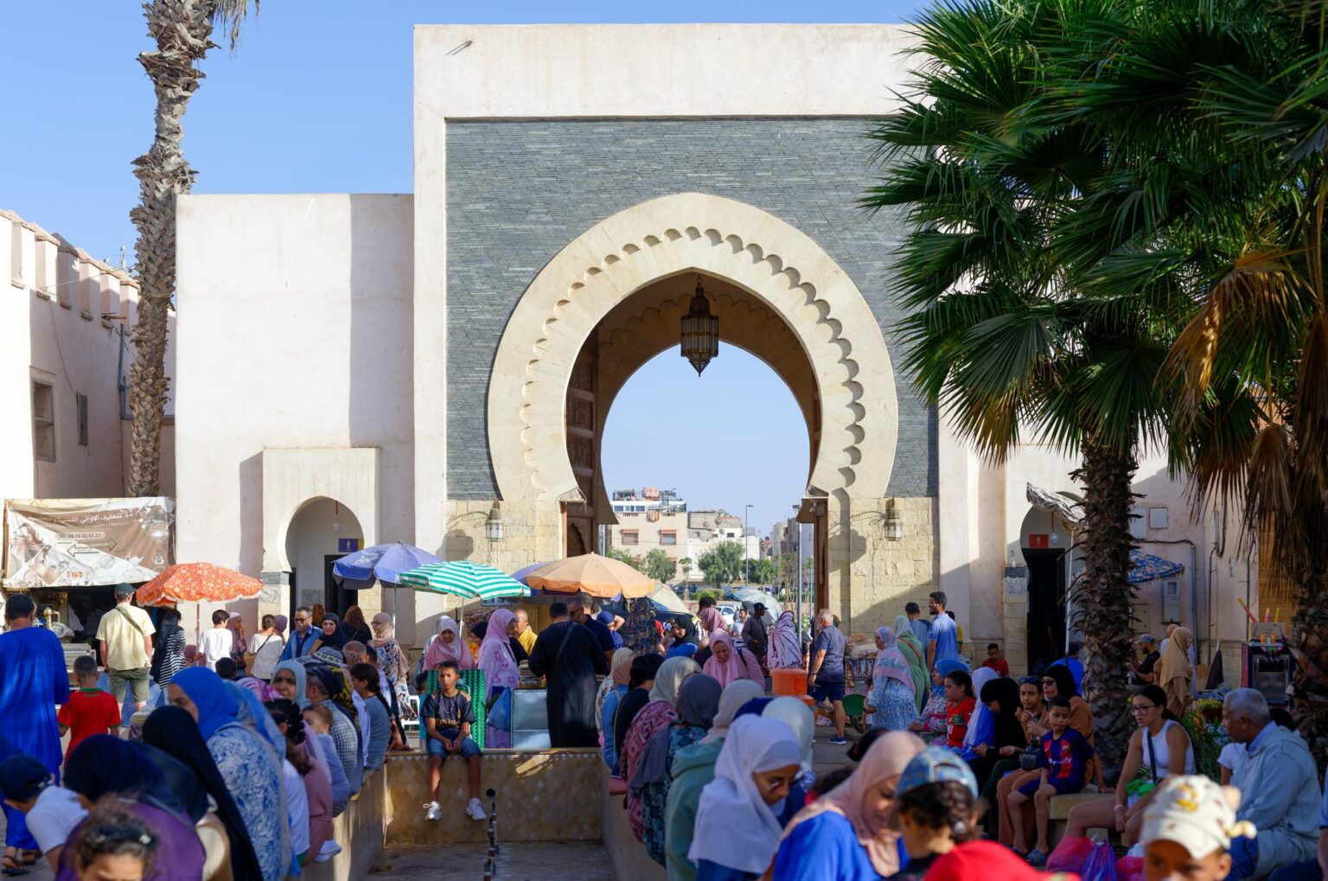
What to See and Do
Start with a visit to the Kasbah Hill, where the old fortress once stood. From the top, you’ll enjoy panoramic views of the entire bay, especially stunning in the morning light. Back in the city, explore the Souk El Had, one of Morocco’s largest covered markets with over 3,000 stalls selling everything from spices and carpets to argan oil.
Stroll along the Corniche promenade, lined with palm trees, cafés, and seaside restaurants. Stop at the Marina d’Agadir for lunch or a coffee overlooking the yachts.

Slide 16
Top Attractions & Points of Interest
Agadir Beach & Promenade – A long stretch of golden sand lined with cafés, restaurants, and hotels, perfect for swimming, sunbathing, or a seaside stroll.
Kasbah of Agadir Oufella – The remains of the old 16th-century fortress overlooking the city, offering panoramic views of the coastline and port.
Souk El Had d’Agadir – A bustling marketplace with hundreds of stalls selling spices, handicrafts, argan oil, and local produce.
Marina d’Agadir – A modern harbor area with stylish shops, restaurants, and yacht moorings.
Crocoparc – A family-friendly park home to Nile crocodiles and lush tropical gardens.
Bird Valley (Vallée des Oiseaux) – A small zoo and garden in the city center featuring exotic birds and animals.
Agadir Memorial Museum – A quiet spot that documents the 1960 earthquake and the city’s remarkable rebuilding.

Slide 17
Day Trips from Agadir
If you have time, there are great day trips from Agadir:
Taroudant: Often called “Little Marrakech,” this walled town offers traditional souks and quiet charm without the crowds.
Paradise Valley: A scenic canyon lined with palm trees, waterfalls, and natural pools, perfect for nature lovers.
Essaouira: A coastal UNESCO city known for its blue fishing boats, ramparts, and artistic vibe (about 3 hours away).

Slide 18
Local Cuisine & Must-try Dishes
Food in Morocco is an experience.
Try a tagine, a slow-cooked stew of chicken, lamb, or fish with vegetables and spices, or couscous topped with tender meat and vegetables.
Sample pastilla, a savory-sweet pie filled with chicken and almonds.
And no visit is complete without Moroccan mint tea, poured high from the pot into delicate glasses.
Along the promenade, many restaurants serve fresh Atlantic seafood, grilled sardines, calamari, and sea bass, paired with stunning ocean views.
Tagine
Pastilla
Notes:
-

Slide 19
Tips for Dining & Local Experience
Dining in Agadir is all about fresh seafood, relaxed beachfront meals, and Morocco’s southern flavors.
Head to the Marina or the seafront promenade for grilled fish, tagines, and couscous, with ocean views.
Don’t miss the local specialty, chermoula-marinated sea bream, or a steaming bowl of harira, a hearty Moroccan soup.
For a more authentic experience, venture into the Souk El Had or smaller cafés away from the tourist zones, where locals gather over mint tea and msemen (flaky flatbread).
Tipping is appreciated—about 10% is standard—and remember, alcohol is served mainly in hotel restaurants and licensed bars.
Notes:
-

Slide 20
Self-Guided Walking Tour: Agadir, Morocco
Approx. Time: 2 hours | Total Distance: 1.4 miles (2.2 km) | Start & End: Agadir Cruise Terminal
1. Agadir Cruise Terminal and Marina (Start)
Time: 10 minutes from the ship Highlight: Begin your walk at the Agadir Marina, a modern hub lined with cafés, boutiques, and luxury yachts. It’s the best place to start soaking in the relaxed seaside atmosphere before heading into town.
Tip: Stop at Café Jour et Nuit or La Terrasse for Moroccan mint tea and views of the harbor.

Slide 21
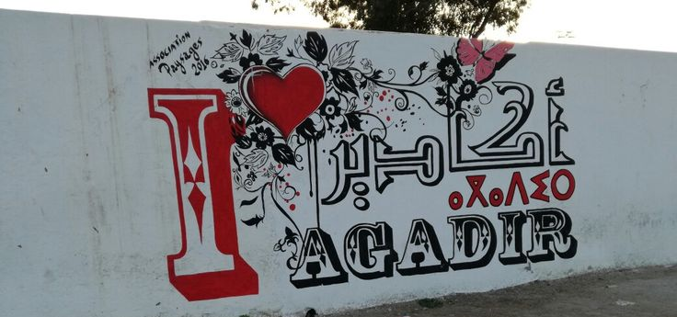
Self-Guided Walking Tour: Agadir, Morocco
2. Agadir Beach Promenade (Corniche)
Time: 5-minute stroll south from the marina What to See: The Corniche stretches for miles along the Atlantic. Palm-lined and lively, it’s perfect for people-watching, photography, and enjoying Agadir’s sunny climate. Locals jog, families gather, and vendors sell roasted nuts and fresh orange juice.
Photo Stop: The “I ♥ Agadir” sign near the main promenade is an ideal place for pictures.

Slide 22
Self-Guided Walking Tour: Agadir, Morocco
3. Agadir Birds Valley (Vallée des Oiseaux)
Time: 10-minute walk inland along Boulevard du 20 Août Highlight: A small but lovely zoological garden running through the city center, free to enter and shaded with palm trees. Parrots, flamingos, and peacocks share space with landscaped gardens and local art.
Tip: It’s a quiet break from the sun and a favorite stop for nature lovers.

Slide 23
Self-Guided Walking Tour: Agadir, Morocco
4. Souk El Had (The Grand Market)
Time: 15-minute taxi ride or 30-minute walk inland What to See: The Souk El Had is one of Morocco’s largest enclosed markets, with over 3,000 stalls selling spices, textiles, leather, ceramics, and argan oil. The name means “Sunday Market,” but it’s open daily except Monday.
Tip: Practice friendly bargaining, start around half the asking price.
Keep small bills ready for easy purchases.

Slide 24
Self-Guided Walking Tour: Agadir, Morocco
5. Mohamed V Mosque
Time: 10-minute walk east of the Souk Highlight: Built after the 1960 earthquake, this mosque showcases beautiful Moroccan craftsmanship — geometric tilework, carved plaster, and a distinctive square minaret.
Note: Non-Muslims cannot enter but can admire the exterior and take photographs respectfully.

Slide 25
Self-Guided Walking Tour: Agadir, Morocco
6. Jardin de Olhão (Olhao Garden)
Time: 10 minutes south toward Avenue Hassan II What to See: A tranquil garden honoring Agadir’s partnership with the Portuguese city of Olhão. Pathways, fountains, and shaded seating areas offer a peaceful retreat.
The Olhão Museum inside the park displays photos and stories of the 1960 earthquake that reshaped the city.

Slide 26
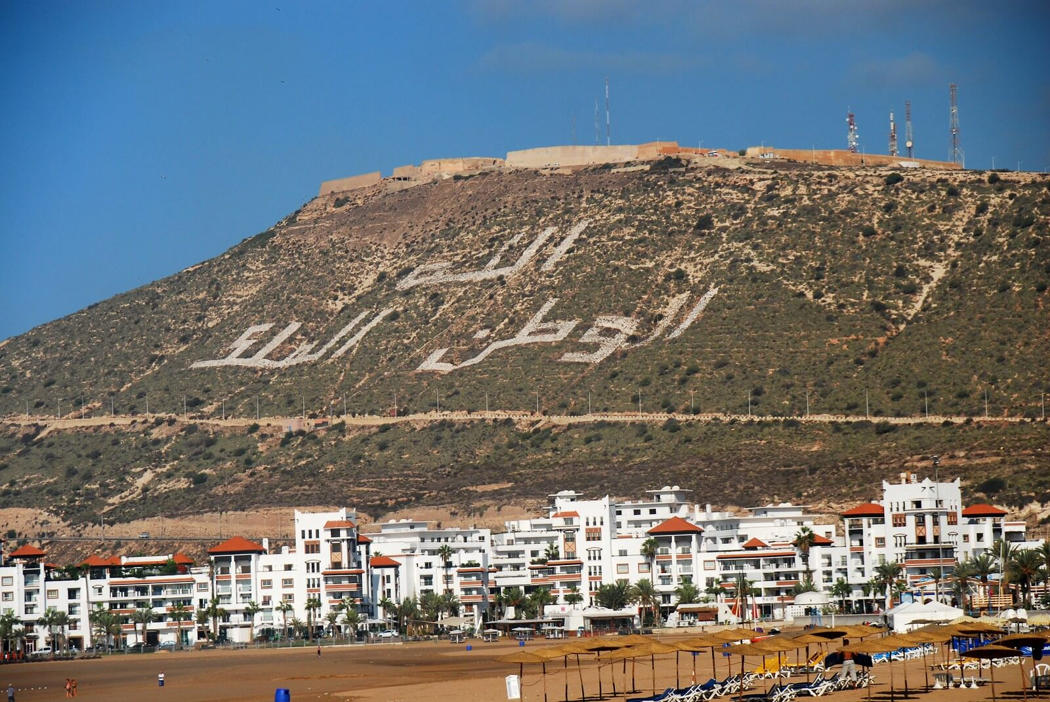
Self-Guided Walking Tour: Agadir, Morocco
7. Return Walk via Avenue Mohammed V
Time: 20-minute walk or short taxi ride back to the cruise terminal Highlight: Avenue Mohammed V connects downtown with the beachfront. The route is filled with shops, cafés, and small art galleries.
You’ll rejoin the promenade near the marina where you began.
Optional: Take the short taxi or the funicular up to Agadir Oufella (Kasbah Hill) for panoramic views over the city and bay — best at sunset.

Slide 27
Important Tips & Practical Advice
Currency: Moroccan Dirham (MAD). Credit cards are accepted in most shops, but small cash is useful for taxis and markets.
Language: Arabic and French are widely spoken; English is common in tourist areas.
Dress Code: Casual and modest. Shorts and t-shirts are fine at the beach; cover shoulders and knees when visiting markets or mosques.
Tipping: 10% is standard for good service.
Safety: Agadir is one of Morocco’s safest cities. Use the same street sense you would anywhere, avoid isolated areas at night.

Slide 28
Final Reflection
Agadir isn’t about ancient ruins or grand monuments, it’s about energy, warmth, and the simple joy of life by the sea.
Whether you’re browsing the souk, sipping mint tea on the Corniche, or watching the sun dip into the Atlantic, this is Morocco at its most relaxed and welcoming.
Keep exploring, and who knows, your next favorite port might be waiting along Morocco’s golden coast.

Slide 29
Thanks For Coming
If you have any more questions, please ask.
I will do my best to answer them for you.
Have a great visit in Agadir!

