Slide 1

Adelaide Australia Presented by Marc Silver

Slide 2
What I Will Cover
My Port Philosophy
Don’t Miss the Ship
Money
About Adelaide
Area Map of Adelaide
Map of Adelaide
Adelaide Transportation
Places to see or at least consider
A few restaurant recommendations
Conclusion

Slide 3
My Port Philosophy
I have been cruising for over 45 years and have taken over 200 cruises. So, I consider myself an experienced cruiser.
The information I will present is based on those many years of
experience.
When I am on a cruise where the city, I want to visit is not the port city,
I always recommend taking a ship’s tour.
But when I am in a port with multiple attractions nearby and easy to see
on my own - I will do it on my own.
This presentation is for that type of port.

Slide 4

Don’t Miss the Ship
How to Avoid Missing Your Ship
Pay attention to the time. - Ship time and local time are often different.
Put a return-to-ship reminder on your phone.
Choose excursions wisely.
If a ship-sponsored excursion is late returning to port, the ship will wait for you. If you are on your own???
Be Prepared
Have your Passport, Credit Card, and phone numbers for your ship port agent.
What to Do If You Miss the Ship Most cruise lines have port agents stationed in the port area to assist if your ship has left without you. If your are lucky, when cruisers are late returning to the vessel, the ship’s crew will often remove the passengers’ essential items – passports, cell phones, and medication -- from the ship to leave with the port agents.
The Port Officials can help you with contacting your ship and making necessary travel arrangements.

Slide 5
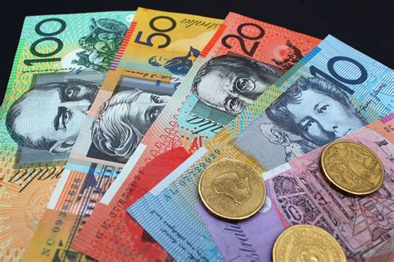
Money
The currency for Adelaide is the Australian Dollar.
The conversion at the rate is $1.48 AUD to $1.00 U.S.
Or $1 AUD $.67 U.S.

Slide 6
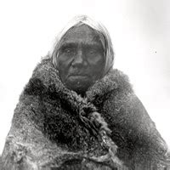
Aboriginal Adelaide
The history of Adelaide dates from the first human activity about 20,000 BC. The Adelaide plains were initially inhabited by the Kaurna people before the colonization of South Australia.
The Kaurna lived in family groups called yerta, a word which also referred to the area of land which supported the family group.
The Kaurna led a nomadic existence within the Yerta confines in large family groups of around 30.
When European settlers arrived in 1836, estimates of the Kaurna population ranged from 300 to 500 people.

Slide 7
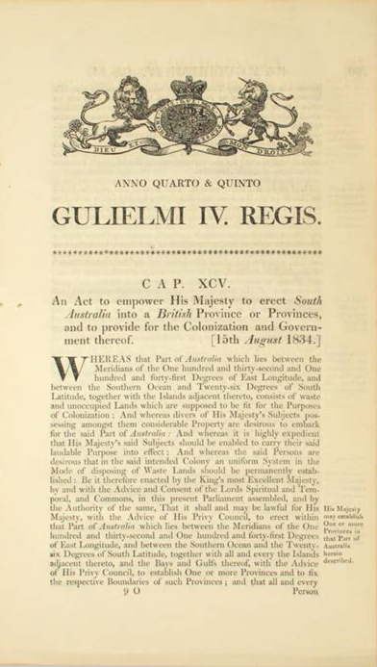
Adelaide Cont.
The area where the Adelaide city center now stands was called "Tarndanya", which translates as "male red kangaroo rock“.
In 1834 the South Australian Association, with the aid of the Duke of Wellington persuaded British Parliament to pass the South Australian Colonization act.
The Act gave free passage to suitable laborers, generally men and women under 30 years of age who were healthy and of good character. They were expected to carry out a promise of working for wages until they had saved enough to buy land of their own and employ others, a process taking at least 3 or 4 years.

Slide 8
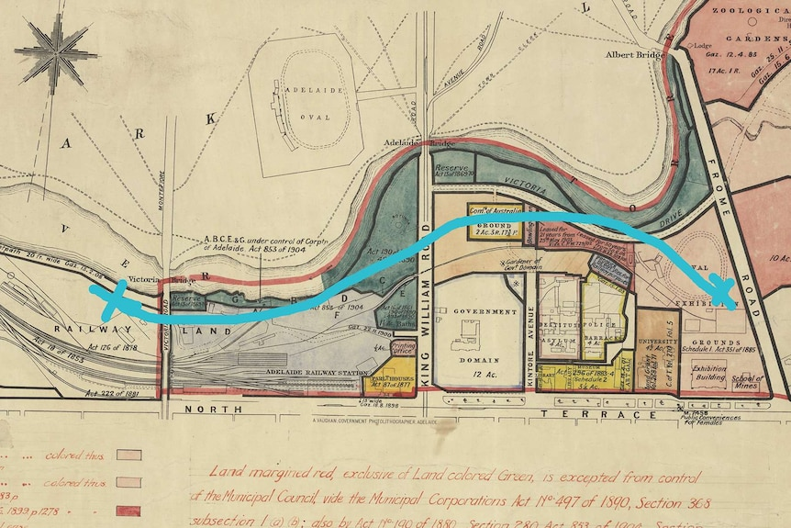
Adelaide Cont.
Founded in 1836, Adelaide was one of the first planned cities and the capital of South Australia.
Colonists who had already purchased land before departing England were given first choice on 23 March 1837, and the remaining areas were auctioned for between 2 and 14 guineas. Within a few weeks many of the same areas were selling for between 80 and 100 pounds which was seen as a healthy sign.
In 1838 the first sheep and other livestock in South Australia were brought in from Tasmania. The wool industry formed the basis of South Australia's economy for the first few years.

Slide 9
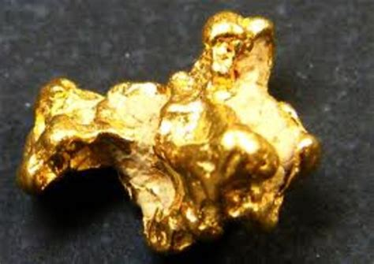
Adelaide Cont.
Copper was discovered near Kapunda in 1842. In 1845 even larger deposits of copper were discovered at Burra which brought wealth to the Adelaide shopkeepers who invested in the mines. With a series of good harvests and expanding agriculture, Adelaide exported meat, wool, wine, fruit and wheat back to England.
Gold discoveries in Victoria in 1851 brought a severe labor shortage due to the exodus of workers leaving to seek their fortunes on the goldfields. This also led to a high demand for South Australian wheat. The situation improved when prospectors returned to Adelaide with their gold finds.

Slide 10
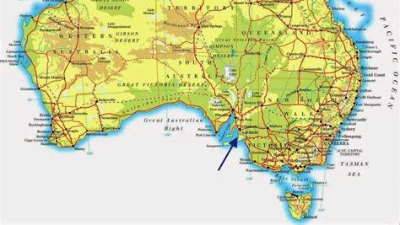
Adelaide Area Map

Slide 11
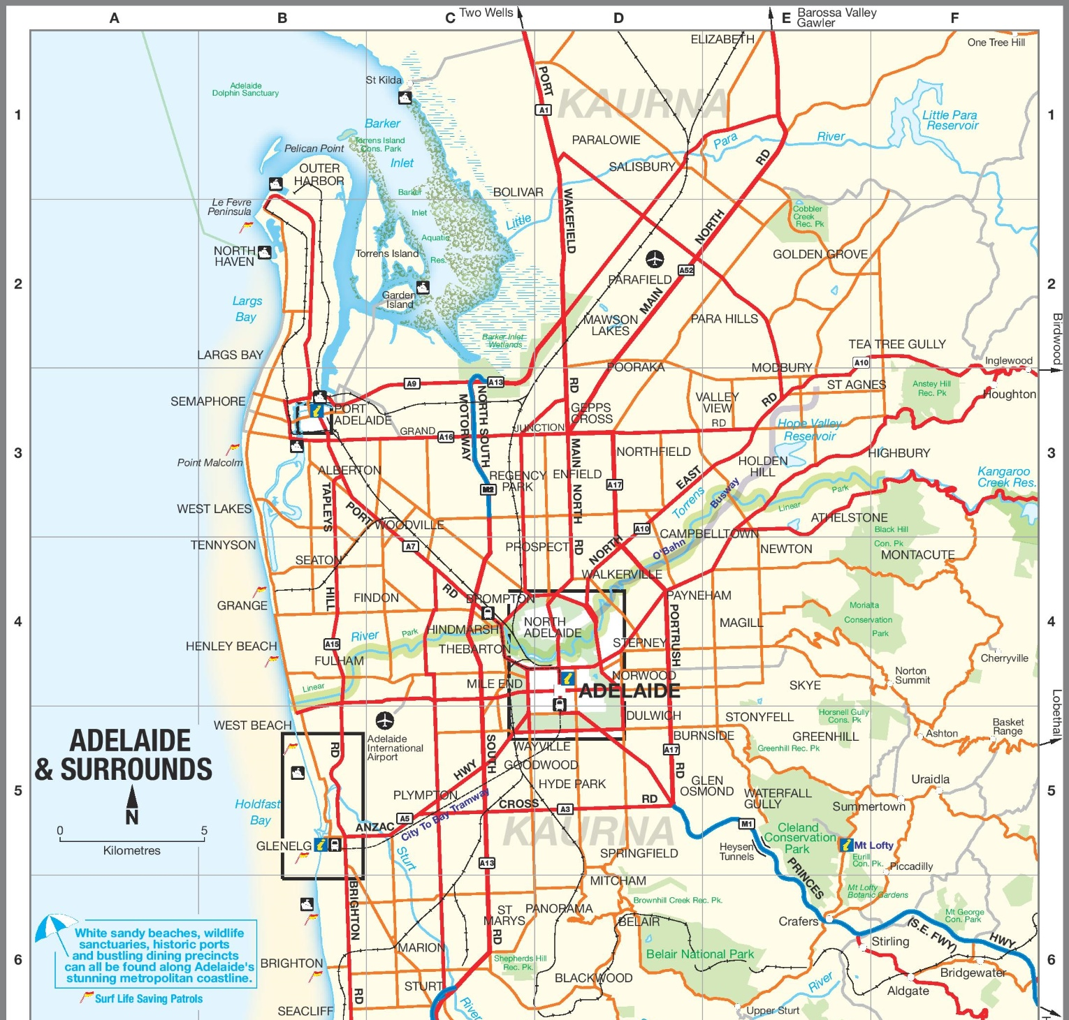
Map of Adelaide

Slide 12
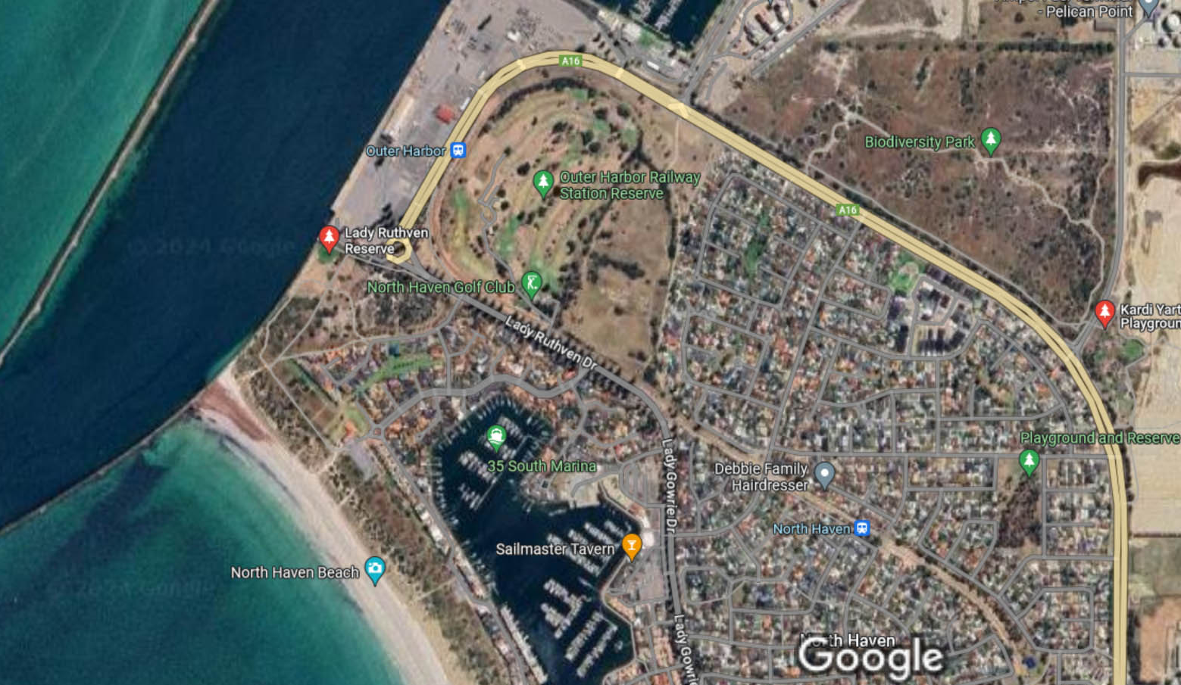
Outer Harbor Dock

Slide 13

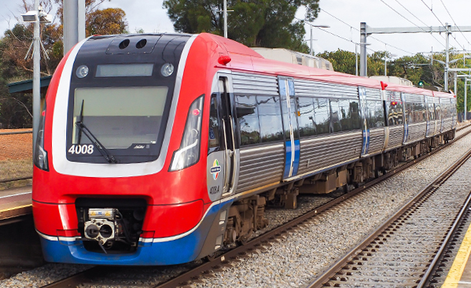
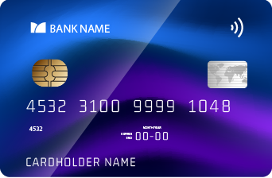
Get around Adelaide by bus, train and tram
Adelaide has one of the most comprehensive and user-friendly public transport system.
You can get downtown using the Outer Harbor line. The station is located across the street from the Outer Harbor Dock.
The Metro Card can get you everywhere.
Tap and Pay Cruise Ship Metro Card | $4.40 $10.00

Slide 14
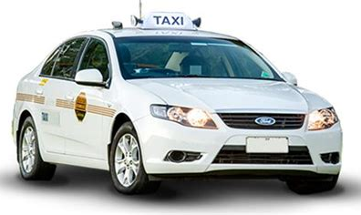
Adelaide Taxis
Standard taxis provide a safe and reliable way to explore the city or for transport between the cruise port and various attractions.
Like taxis in most locations the cost is significantly more expensive than other modes of transport.

Slide 15
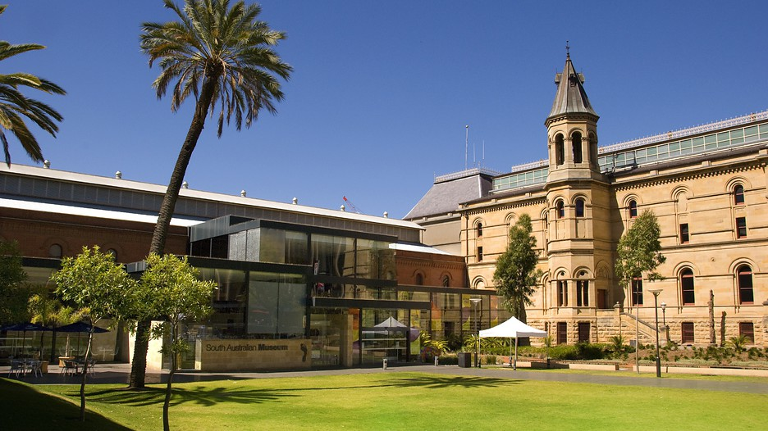
South Australian Museum
The South Australian Museum has five floors and endless wonders to discover. From the first signs of early complex life to the most comprehensive collection of Australian Aboriginal cultural material in the world, there is something for everyone at the Museum.
The Museum is open Monday to Sunday 10am-5pm.
General admission is free, although costs apply for some exhibitions and events.
A $5 donation helps to deliver world-class exhibitions.

Slide 16
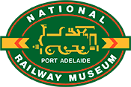
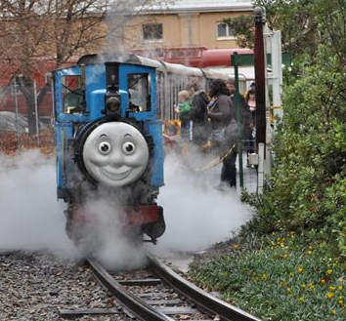
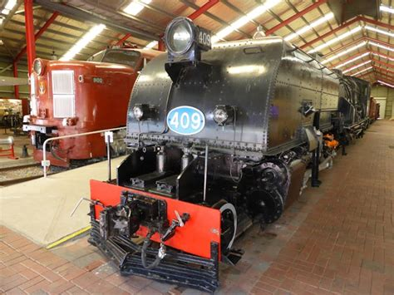
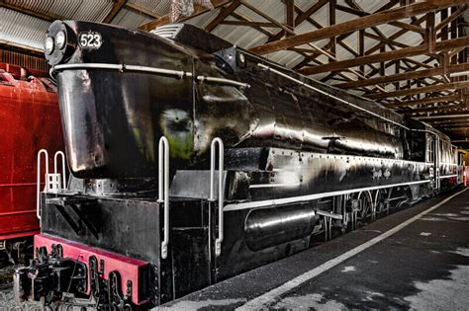
National Railway Museum
The objectives of the National Railway Museum is to operate a railway museum located at the former site of the Port Dock Station at Port Adelaide. The National Railway Museum is located within the heritage precinct of Lipson Street in Port Adelaide.
The Museum features locomotives, railway carriages, a train ride, exhibits and displays housed within two large fully enclosed pavilions and around the extensive Museum grounds.
Adult | $17
Concession | $10
Child 5-15 yrs & with an adult | $7
Family 2 adults & up to 3 children | $40

Slide 17
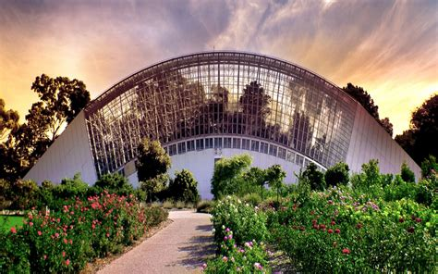
Adelaide Botanic Garden
Take time out to explore the beauty and diversity of plants from across Australia and around the world. Spend an hour or spend the day among the 123 acres of magnificently maintained gardens and stunning architecture.
Relax in the shade or enjoy a coffee among some of Australia’s finest plant collections.
The Botanic Gardens and State Herbarium of South Australia comprises three beautiful public gardens: Adelaide Botanic Garden The Botanic Park downtown and Mount Lofty Botanic Garden

Slide 18
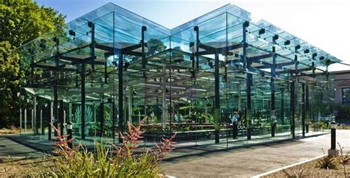
Amazon Waterlily Pavilion
The pavilion is part of the Adelaide Botanic Garden and was built in 2007 to replace the Amazon Waterlily's original purpose-built residence, the Victoria House.
The design of the energy-efficient glasshouse was inspired by the lily's giant leaves, and the original pond from the Victoria House remains as the centerpiece of the new pavilion.
Admission: Free entry

Slide 19
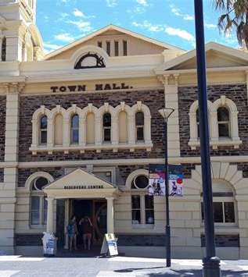
Bay Discovery Centre
The Bay Discovery Centre is a social history museum in the heart of Glenelg, celebrating the cultural heritage of South Australia.
Wander through the many galleries to discover the stories of the Kaurna People of the Adelaide Plains, South Australia's Proclamation and settlement, the evolution of beach culture, and some of our State's most loved identities.
Admission is by Donation - $1.00 minimum
Bay Discovery Centre

Slide 20
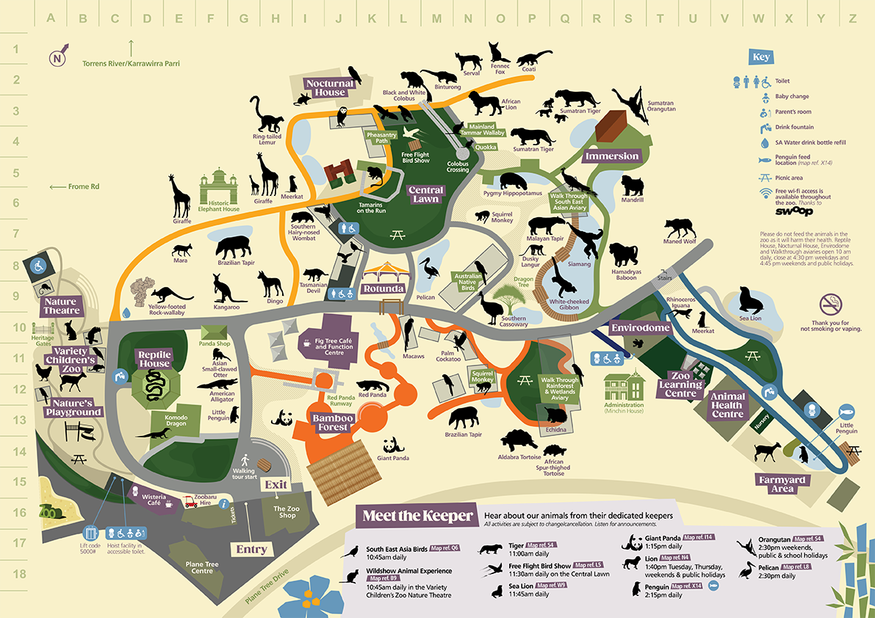
Adelaide Zoo
Adelaide Zoo, one of Adelaide’s most iconic attractions, is home to more than 2,500 animals and 250 species of exotic and native mammals, birds, reptiles and fish exhibited over 19 Acres of magnificent botanic surroundings
It is the second oldest zoo in the nation and represents a significant part of South Australia’s heritage and social history. The Adelaide Zoo opened in 1883.
Admission Prices
Adults: $46 / Seniors: $33.50
Children: 4 -14 $24.50
Children; Under 4 - FREE

Slide 21
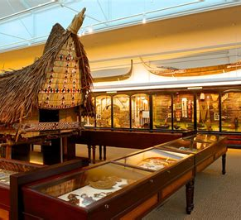
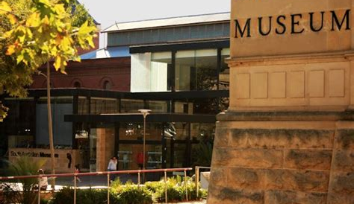
South Australian Museum
The South Australian Museum has been committed to making Australia’s natural and cultural heritage accessible, engaging and fun for over 165 years.
It is a place where families can learn and grow together. Today the Museum is one of the most visited museums in Australia and holds collections of national and international significance.

Slide 22
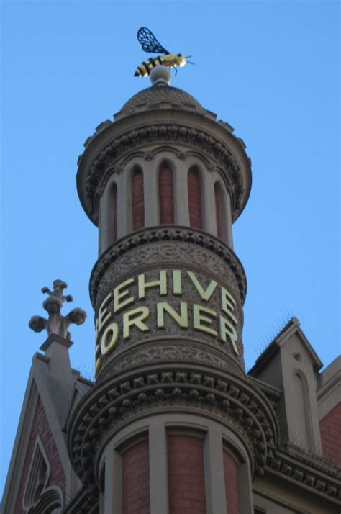
Beehive Corner
Where Rundle Mall, King William Street and Hindley Street meet sits Beehive Corner — one of the most well-recognized buildings in Adelaide and a popular meeting spot for many.
The building was designed by Adelaide architect George Soward, who drew from the Gothic revival style with an incredible amount of intricacy for a building of its time. Construction commenced in 1895, featuring a distinctive corner turret in the shape of a beehive, with a lone gilded bee sitting on top.

Slide 23
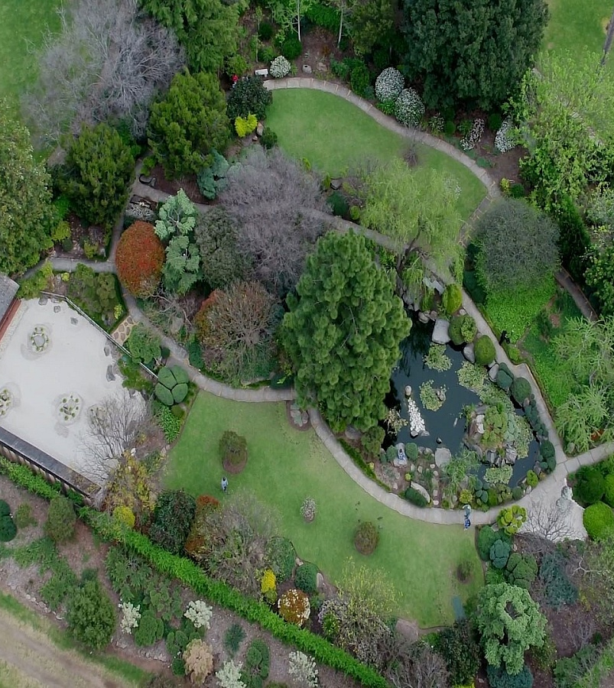
Adelaide Himeji Garden
Himeji Garden celebrates the Sister City relationship between Adelaide and the ancient Japanese city of Himeji.
Opened in 1985, the Garden is designed on Japanese Garden principles, but with adaptation to the Adelaide climate and plant availability.
Two classic Japanese garden styles are combined here - the ‘senzui’ and the ‘kare senzui’
Entry to the garden is free.

Slide 24
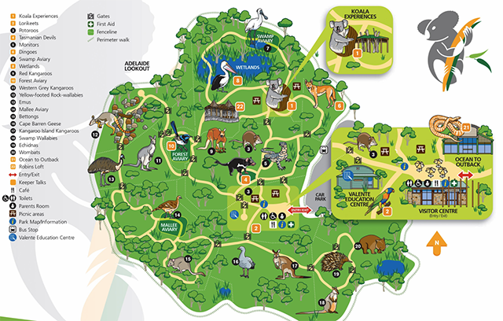
Cleland Wildlife Park
Visit Cleland Wildlife Park and feed kangaroos as they laze, wander wetlands, and surround yourself with over 130 species of Australian wildlife, all just 20 minutes from Adelaide.
Cleland Wildlife Park is one of only a few places in the world where visitors can hold a koala.
Cleland Wildlife Park is a 86 acre natural bush setting that provides a unique open space environment with very few enclosures.
Adult Admission: $33.50
Child (aged 4 - 15): $17.50

Slide 25
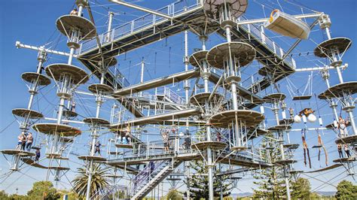
West Beach Adventure
West Beach Adventure is an absolute must do when visiting South Australia.
Featuring a combination of adrenaline oriented outdoor activities to challenge the whole family.
Get a workout on the Mega Climb, the largest aerial adventure course in Australia, experience a leap of faith on a 20m vertical drop. Scare yourself senseless on the Giant Swing.
For the less adventurous, enjoy the view from the Sky Walk.
Mega Climb Admission $54
Mega Climb + Giant Swing $74

Slide 26
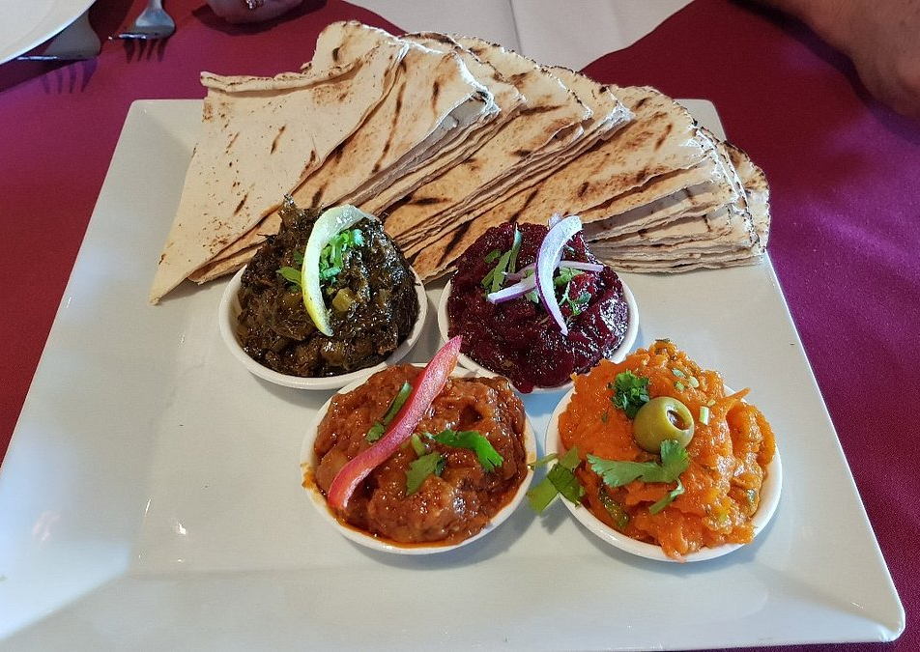
Restaurants in Adelaide
There are a lot of excellent restaurants in Hokkaido. Especially for seafood.
Here are some recommendations: Restaurants in Adelaide:
Cafe Michael 2 $$ - $$$, Thai, Vegetarian Friendly, Vegan
The Pantry On Egmont $$ - $$$, Cafe, Australian, Vegetarian
Mai Kitchen $$ - $$$, Asian, Vietnamese, Vegetarian
Soi 38 $$ - $$$, Asian, Thai, Vegetarian
Georges $$$$, Mediterranean, European, Healthy
B'Churrasco Adelaide $$ - $$$, Brazilian, Barbecue, Gluten Free
Peel Street $$ - $$$, Vegetarian Friendly, Vegan Options, Gluten Free
Marrakech Restaurant $$ - $$$, Moroccan, Vegetarian Friendly, Vegan
For those of you that just like good food, you can’t go wrong just about anywhere you go.
GOOD EATING

Slide 27
Conclusion
Adelaide is a beautiful City with a rich history and numerous attractions. Regardless of what you're looking for, Adelaide has something for everyone.
I hope this presentation will help when we visit Adelaide!

Slide 28
Thanks For Coming
If you have any more questions, please ask.
I will do my best to answer them for you.
Have a great visit to Adelaide!

Slide 29
Acknowledgement
My seminars are the result of many years of travel experience combined with many hours of research over the internet.
I would like to acknowledge the many source I have accessed.
These include: Wikipedia.com, Britannica.com, and the various Museum, Park and Government websites.

