Slide 1
Accidents That Changed the World
Presented by Marc Silver

Slide 2
Introduction
Sometimes the greatest innovations aren’t planned.
A wrong turn, a mix-up, or an unexpected reaction can change how we eat, clean, heal, and live.
These are stories of mistakes that changed the world.
Today, we’ll explore everyday products and world-changing discoveries that started with a mistake—and ended up transforming our lives.

Slide 3
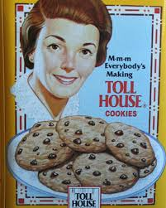
FOOD & DRINK
Chocolate Chip Cookies
In the 1930s, Ruth Graves Wakefield, co-owner of the Toll
House Inn, wanted to bake chocolate cookies but discovered she was out of baker’s chocolate. Improvising, she chopped up a Nestlé semi-sweet bar, assuming it would melt into the dough.
Instead, the chocolate pieces stayed intact, creating a new kind of cookie—soft, sweet, and filled with pockets of rich chocolate.

Slide 4
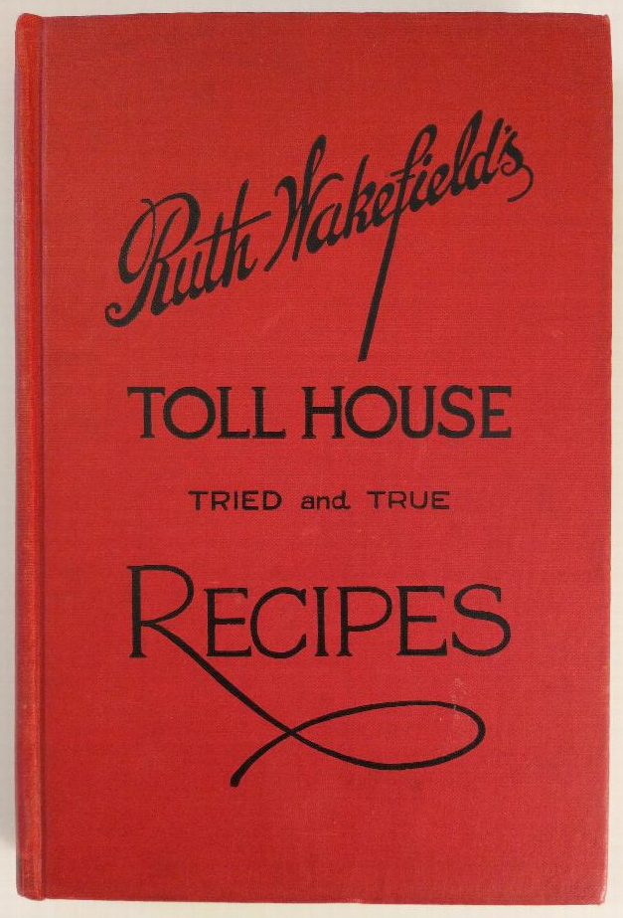
FOOD & DRINK
Chocolate Chip Cookies
The accidental recipe became wildly popular, and Nestlé later partnered with Wakefield, printing her recipe on chocolate bar wrappers and eventually launching chocolate chips as a product.
This single kitchen mishap helped shape the identity of American home baking and launched one of the most beloved cookies in the world.

Slide 5
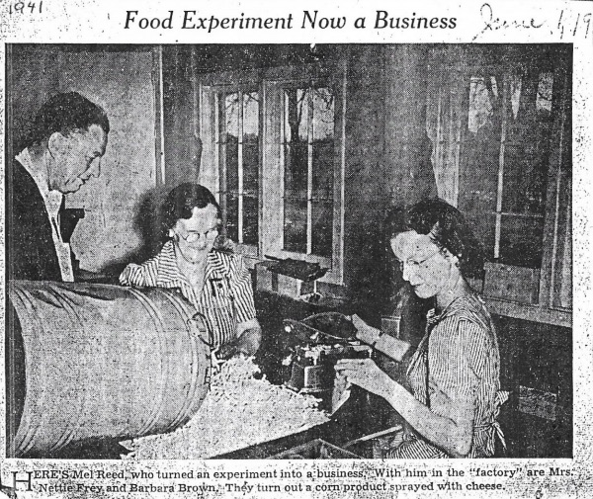
FOOD & DRINK
Cheese Puffs: From Animal Feed to Snack Aisle Staple
In the 1930s, Wisconsin’s Flakall Corporation was producing animal feed.
To prevent clogging, operators fed moistened corn into a grinder.
The heated process puffed the corn.
Employee Edward Wilson tasted the result, seasoned it with powdered cheese, and gave us the modern cheese puff.

Slide 6
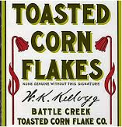
FOOD & DRINK
Corn Flakes: Born from a Burned Batch
John Harvey Kellogg and his brother Will were experimenting with cereal-based foods at their sanitarium in Michigan when they accidentally left a batch of cooked wheat sitting out overnight.
By morning, it had gone stale, but rather than waste it, they ran it through rollers.
The result wasn’t a paste, but flat flakes.

Slide 7
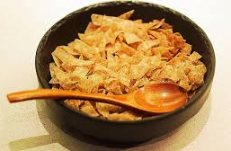
FOOD & DRINK
Corn Flakes: Born from a Burned Batch
When they baked these flakes, they turned into a crisp, crunchy food that was surprisingly tasty.
Recognizing the potential, they refined the process and later used corn instead of wheat, giving rise to Corn Flakes.
This unintentional discovery not only launched the Kellogg brand but also helped revolutionize how Americans viewed breakfast.
Quick, easy-to-prepare cereal replaced time-consuming hot meals and reshaped morning routines across the country.

Slide 8
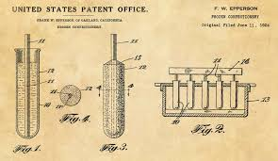
FOOD & DRINK
Popsicle: An 11-Year-Old’s Icy Mistake
In 1905, Frank Epperson left a mix of soda water and powder on his porch overnight.
It froze with the stirring stick inside.
He called it the "Epsicle," later renamed Popsicle—and it became a summertime classic.

Slide 9
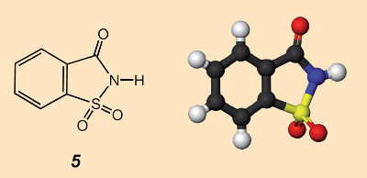
FOOD & DRINK
Saccharin: The Sweet Side of Chemistry
In 1878, chemist Constantin Fahlberg noticed a sweet taste on his fingers during dinner.
Curious, he retraced his steps and identified the source: a compound he had been working with earlier in the lab.
That compound became saccharin—the world’s first artificial sweetener.

Slide 10
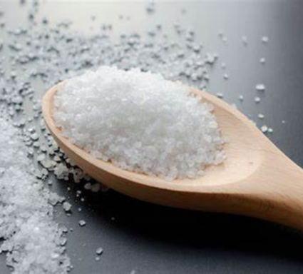
FOOD & DRINK
Saccharin: The Sweet Side of Chemistry
Its discovery opened the door to a whole new market for sugar substitutes, especially for diabetics and those looking to reduce caloric intake.
Saccharin paved the way for other artificial sweeteners like aspartame and sucralose, and helped launch a global diet food industry.

Slide 11
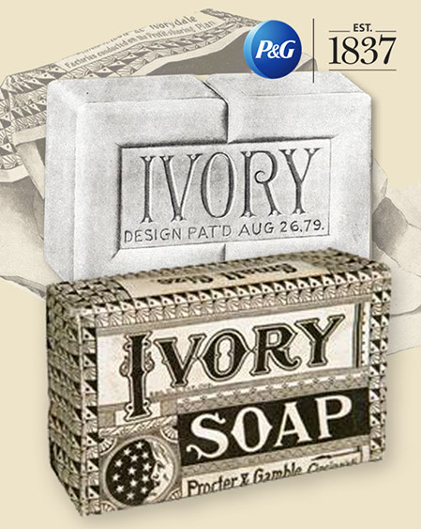
HOUSEHOLD STAPLES
Ivory Soap: The Bar That Floats
In the late 1800s, Procter & Gamble discovered that soap with air whipped into it would float.
This wasn’t an accident, but it played like one.
Floating soap was easier to use in murky rivers and caught on as a hallmark of cleanliness.

Slide 12
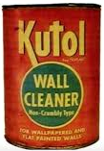
HOUSEHOLD STAPLES
Play-Doh: From Cleaner to Classroom
Originally made to clean soot from wallpaper, Play-Doh lost its market with the rise of gas heating.
Teachers began using it in classrooms. Its soft texture, non-toxic formula, and moldability made it perfect for kids.
The company pivoted—and built a toy empire.

Slide 13
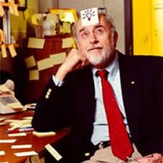
HOUSEHOLD STAPLES
Post-it Notes: Sticking Around by Accident
In 1968, Dr. Spencer Silver, a chemist at 3M, set out to develop a super-strong adhesive.
Instead, he ended up with the opposite—a weak, pressure-sensitive adhesive that stuck lightly and could be peeled off without damage.
Fry sang in his church choir and often lost his place in the hymnal. Remembering Silver’s invention, he used the adhesive to anchor small slips of paper in his book.

Slide 14

HOUSEHOLD STAPLES
Post-it Notes: Sticking Around by Accident
The notes stayed in place and could be repositioned as needed. This simple use case led to the development of Post-it Notes.
Their impact was profound. Post-its revolutionized office communication, organization, and collaboration.
From corporate brainstorming sessions to students’ study methods, these little sticky squares have become a universal tool for quick notes, reminders, and creative thinking.

Slide 15
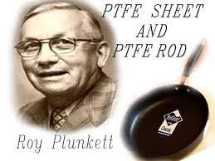
HOUSEHOLD STAPLES
Teflon: A Slick Surprise
In 1938, chemist Roy Plunkett was experimenting with gases for refrigeration when one of his samples, tetrafluoroethylene, was stored in a pressurized cylinder.
The gas mysteriously stopped flowing, so he opened the cylinder and found a white, waxy solid coating the inside. This substance was polytetrafluoroethylene, or PTFE—remarkably slippery and chemically resistant.
This accident led to the creation of Teflon, a material with incredibly low friction and high resistance to heat and corrosion.

Slide 16
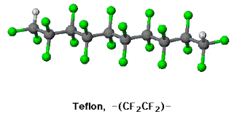
HOUSEHOLD STAPLES
Teflon: A Slick Surprise
It soon found a home in cookware, making pans easier to clean and reducing the need for cooking oils.
Beyond the kitchen, Teflon has been used in wiring insulation, aerospace applications, medical devices, and even the protective coating on space suits.
An overlooked mishap in a lab became one of the most versatile materials of the modern age.

Slide 17
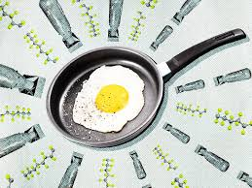
HOUSEHOLD STAPLES
Teflon: A Slick Surprise
It soon found a home in cookware, making pans easier to clean and reducing the need for cooking oils.
Beyond the kitchen, Teflon has been used in wiring insulation, aerospace applications, medical devices, and even the protective coating on space suits.
An overlooked mishap in a lab became one of the most versatile materials of the modern age.

Slide 18
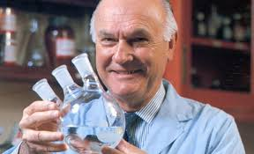
HOUSEHOLD STAPLES
Super Glue: Too Sticky to Ignore
During World War II, Dr. Harry Coover was part of a team at Eastman Kodak developing precision plastic lenses for gun sights.
One of the chemical formulations he tested—a compound called cyanoacrylate—was rejected because it stuck to everything it touched. At the time, it was considered a nuisance.

Slide 19
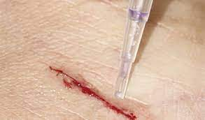
HOUSEHOLD STAPLES
Super Glue: Too Sticky to Ignore
Years later, in 1951, Coover revisited the compound during another project and realized its potential as a powerful adhesive.
This "mistake" became Super Glue—an instant-bonding glue that didn’t require heat or pressure.
It was commercialized in 1958 and found immediate use in households, workshops, and even emergency medicine.
In fact, during the Vietnam War, Super Glue was used in the field to temporarily seal wounds before surgery.

Slide 20
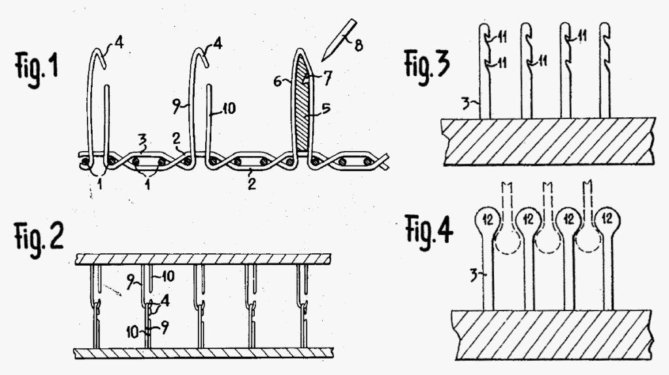
HOUSEHOLD STAPLES
Velcro: Inspired by Nature
In 1941, Swiss engineer George de Mestral noticed burrs clinging to his dog’s fur.
Under a microscope, he saw tiny hooks.
He mimicked the design and created Velcro, a fastening system now used in clothing, medical gear, and aerospace.

Slide 21
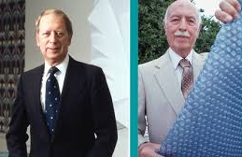
HOUSEHOLD STAPLES
Bubble Wrap: From Wall Décor to Packaging Hero
Alfred Fielding and Marc Chavannes set out to make textured wallpaper in 1957.
They sealed plastic sheets together, trapping air bubbles. It flopped as wallpaper but shined as packing material— Bubble Wrap was born.

Slide 22
SCIENCE & MEDICINE
Penicillin: Mold That Saved Millions
In 1928, Alexander Fleming returned from vacation to find one of his Petri dishes had been contaminated by a mold.
Surprisingly, the bacteria surrounding the mold had died, while the rest of the dish was still overrun.
The mold was later identified as Penicillium notatum. Fleming’s observation led to the development of penicillin—the world’s first true antibiotic.

Slide 23
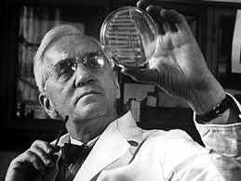
SCIENCE & MEDICINE
Penicillin: Mold That Saved Millions
Its impact was revolutionary.
Penicillin transformed the treatment of bacterial infections, saving millions of lives during World War II and beyond.
It laid the groundwork for the modern pharmaceutical industry and opened the door for the development of a wide range of life-saving antibiotics used today.

Slide 24
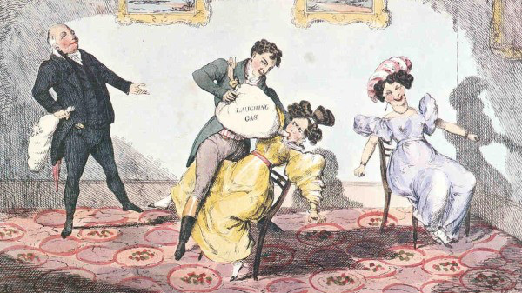
SCIENCE & MEDICINE
Anesthesia: Discovered at a Party
In the 1840s, people experimented with nitrous oxide and ether at “laughing gas” parties.
Doctors noticed that people felt no pain during injuries sustained at these events.
Soon after, anesthesia became a surgical game-changer.

Slide 25
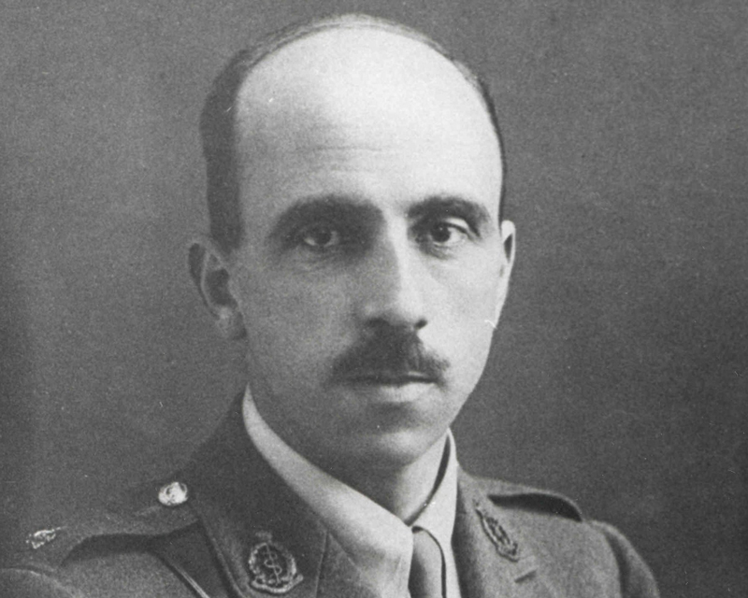
SCIENCE & MEDICINE
Plastic Surgery: A War-Time Necessity
World War I brought gruesome injuries to soldiers’ faces.
In response, surgeons pioneered reconstructive techniques that laid the groundwork for modern plastic surgery.
Surgeon Harold Gillies 1917

Slide 26
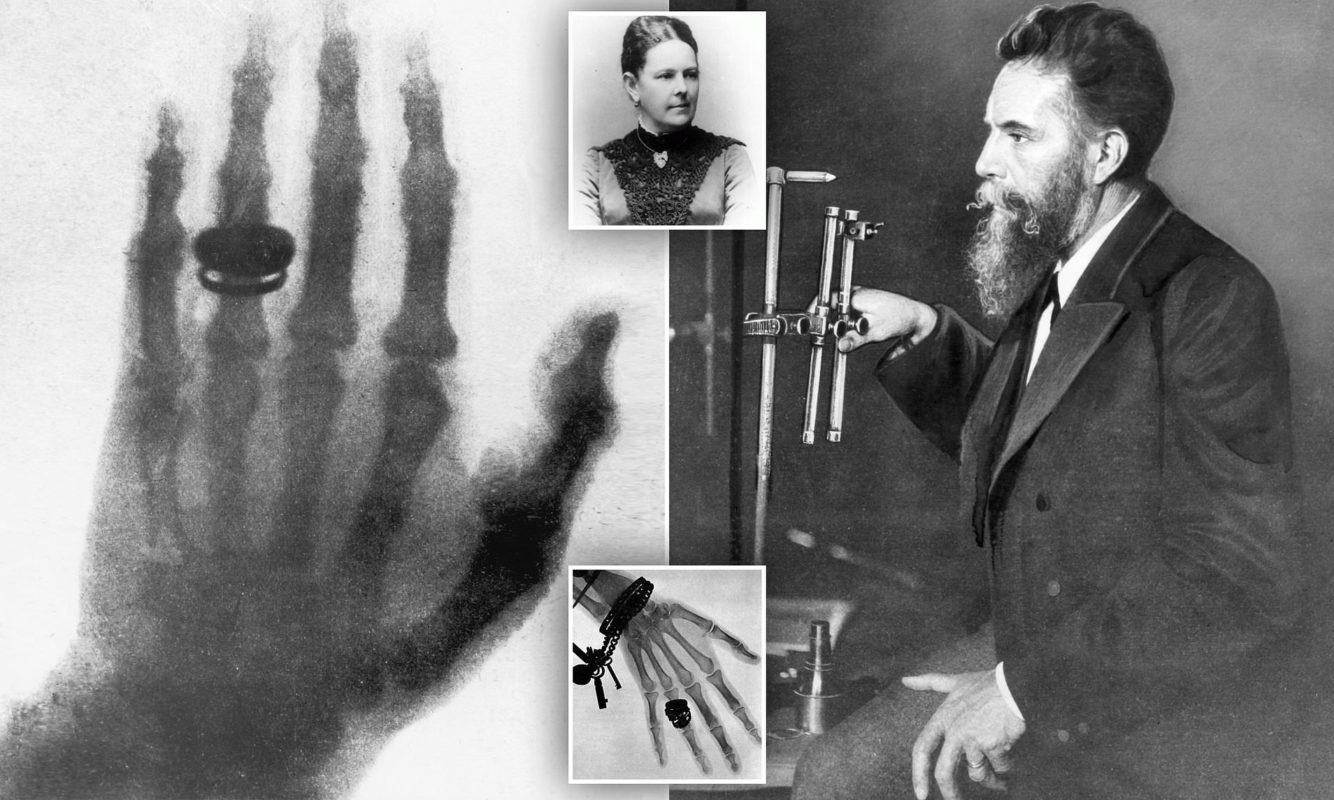
SCIENCE & MEDICINE
X-Rays: Seeing the Invisible
In 1895, German physicist Wilhelm Röntgen was experimenting with cathode rays when he noticed that a screen coated with barium platinocyanide began to glow—even though it wasn’t in the direct path of the rays.
He realized he had discovered a new form of radiation that could pass through solid objects.
Röntgen soon found that these rays could illuminate the bones inside his hand, capturing the first medical X-ray.

Slide 27
SCIENCE & MEDICINE
X-Rays: Seeing the Invisible
The discovery of X-rays transformed modern medicine almost overnight. For the first time, doctors could examine the inside of the human body without surgery.
Today, X-rays are not only essential in diagnosing fractures, infections, and tumors but are also used in fields like airport security, materials testing, and even art conservation.
This accidental discovery opened up an entirely new way to see and understand the world around us.

Slide 28
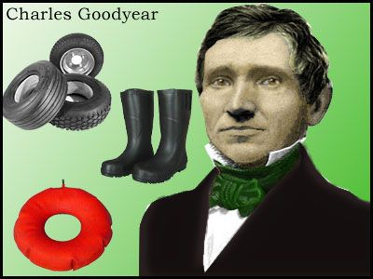
MATERIALS & MACHINERY
Vulcanized Rubber: A Hot Mistake
In 1839, Charles Goodyear, a persistent but struggling inventor, was experimenting with ways to make rubber more durable and less sticky.
At the time, natural rubber would become brittle in the cold and melt in the heat—making it unreliable for most practical uses. One day, Goodyear accidentally dropped a mixture of rubber and sulfur onto a hot stove.
Instead of melting into a gooey mess, the rubber charred slightly and became firm, elastic, and weather- resistant.

Slide 29
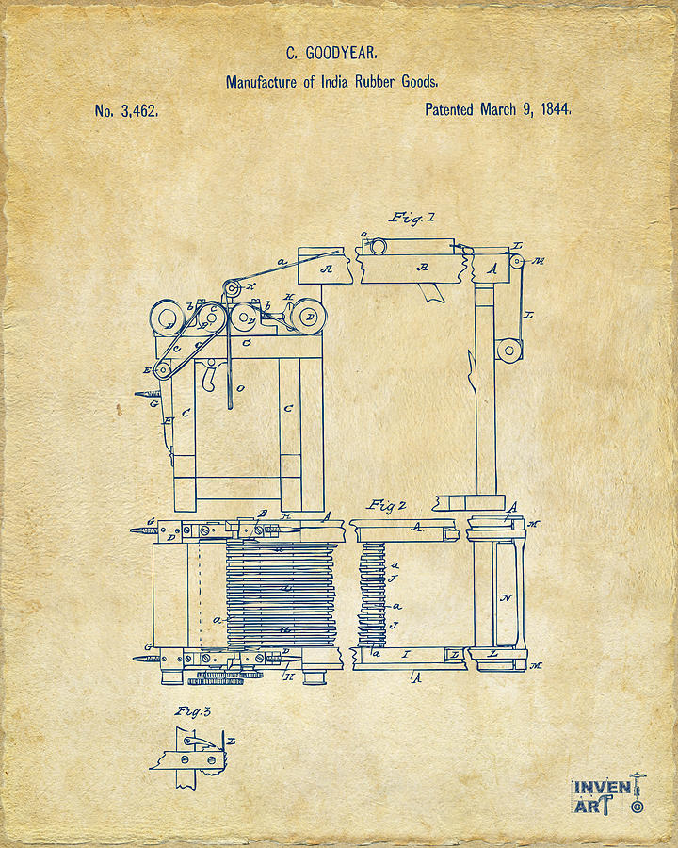
MATERIALS & MACHINERY
Vulcanized Rubber: A Hot Mistake
This process, which he called "vulcanization" (named after the Roman god of fire), revolutionized the rubber industry.
Vulcanized rubber became the foundation for an explosion of industrial products—most notably tires, but also hoses, seals, shoe soles, and countless mechanical components.
Goodyear never profited much from his discovery during his lifetime, but his accidental breakthrough paved the way for the modern automotive and manufacturing world.
Original Patent

Slide 30
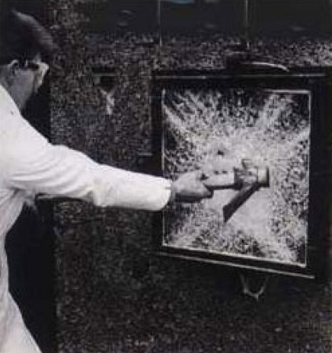
MATERIALS & MACHINERY
Safety Glass: Cracked but Not Broken
In 1903, French chemist Édouard Bénédictus accidentally dropped a glass flask that had been coated with cellulose nitrate, a type of plastic film.
Instead of shattering into dangerous shards, the glass cracked but held together.
Intrigued by the outcome, he realized that the film had kept the fragments in place—a potentially life-saving feature.

Slide 31
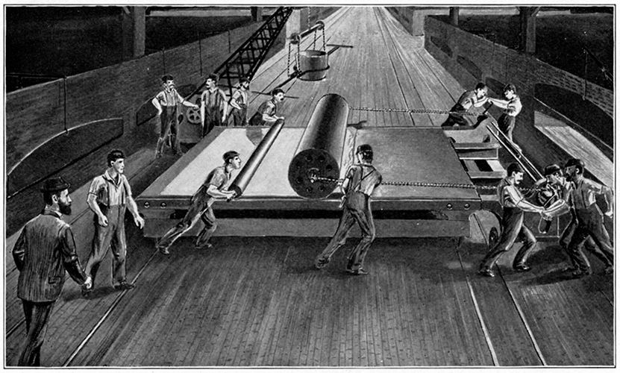
MATERIALS & MACHINERY
Safety Glass: Cracked but Not Broken
This observation led to the invention of laminated safety glass, a sandwich-like structure where a plastic layer is fused between two sheets of glass.
Today, safety glass is a standard feature in car windshields, building windows, and even protective eyewear.
It dramatically reduces the risk of injury in accidents and has become an essential part of modern safety engineering in both transportation and architecture.

Slide 32
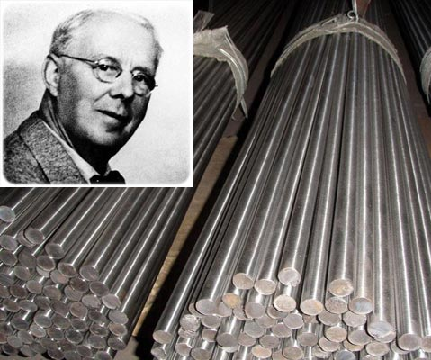
MATERIALS & MACHINERY
Stainless Steel: Rust-Free by Design
In 1913, English metallurgist Harry Brearley was tasked with developing a more erosion-resistant gun barrel for use in firearms.
While experimenting with different alloys, he created a steel mixture containing around 12% chromium.
When he set the sample aside and returned to it weeks later, he noticed something unusual: it hadn’t rusted.

Slide 33
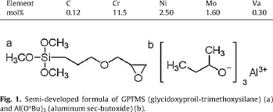
MATERIALS & MACHINERY
Stainless Steel: Rust-Free by Design
This corrosion-resistant material became known as stainless steel. Its durability, shine, and resistance to staining made it ideal not just for firearms, but for a wide range of uses.
Stainless steel quickly found a home in kitchenware, surgical tools, building materials, and modern architecture.
From skyscrapers and car parts to cutlery and surgical implants, Brearley’s overlooked discovery has become one of the most essential materials in the modern industrial and consumer world.

Slide 34
FINAL THOUGHTS
Behind every invention is a spark—but not always the kind we expect.
These stories remind us that accidents aren’t failures. They’re sometimes just detours on the way to discovery.
In the end, it’s our curiosity, persistence, and ability to recognize opportunity that shape the world.

Slide 35
Thank You for Coming!
I hope I’ve educated and entertained you today.
I can be contacted by e-mail at marcs@souic.net

Slide 36
REFERENCES
History.com Editors. (2021). 8 Accidental Inventions That Changed the World. https://www.history.com/news/8-accidental-inventions-that-changed-the-world
Concordia University. 9 Successful Inventions Made by Accident. https://www.concordia.edu/blog/9-successful-inventions-made-by-accident.html
Smithsonian Magazine. (2020). The True Story of the Popsicle. https://www.smithsonianmag.com/innovation/popsicle-invented-by-11-year-old-boy-180960291/
Wired. (2009). Top Ten Accidental Inventions. https://www.wired.com/2009/10/accidental-inventions/
Mental Floss. (2022). 12 Everyday Products That Were Invented by Accident. https://www.mentalfloss.com/article/58317/12-everyday-products-were-invented-accident
Tedium. (2016). The Origin of Cheese Puffs. https://tedium.co/2016/11/10/cheese-curls-creation-story/

