Slide 1
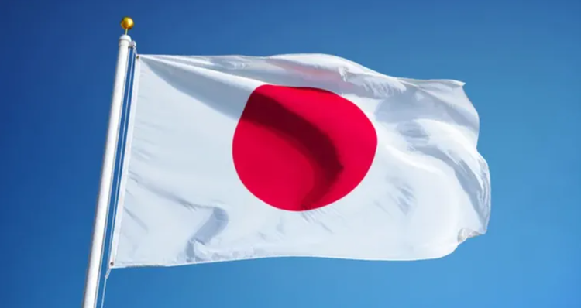
Aburatsu, Japan Presented by Marc Silver

Slide 2
What I Will Cover
My Port Philosophy
Don’t Miss the Ship
Money
About Aburatsu
Points of Interest
Places to see or at least consider
A few restaurant recommendations
Conclusion

Slide 3
My Port Philosophy
I have been cruising for over 44 years and have taken over 200 cruises. So, I consider myself an experienced cruiser.
The information I will present is based on those many years of
experience.
When I am on a cruise where the city, I want to visit is not the port city,
I always recommend taking a ship’s tour.
But when I am in a port with multiple attractions nearby and easy to see
on my own - I will do it on my own.
This presentation is for that type of port.

Slide 4

Don’t Miss the Ship
How to Avoid Missing Your Ship
Pay attention to the time. - Ship time and local time are often different.
Put a return-to-ship reminder on your phone.
Choose excursions wisely.
If a ship-sponsored excursion is late returning to port, the ship will wait for you. If you are on your own???
Be Prepared
Have your Passport, Credit Card, and phone numbers for your ship port agent.
What to Do If You Miss the Ship Most cruise lines have port agents stationed in the port area to assist if your ship has left without you. If your are lucky, when cruisers are late returning to the vessel, the ship’s crew will often remove the passengers’ essential items – passports, cell phones, and medication -- from the ship to leave with the port agents.
The Port Officials can help you with contacting your ship and making necessary travel arrangements.

Slide 5
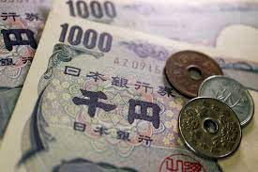
Money
The Yen is the official currency of Japan
Official Exchange is 100 Yen is 72 cents US
Or 142.15 Yen to the US Dollar

Slide 6
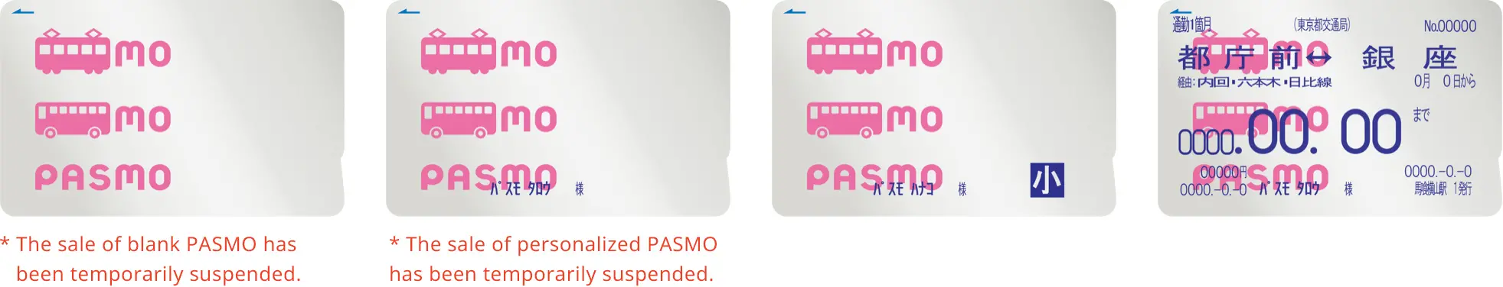
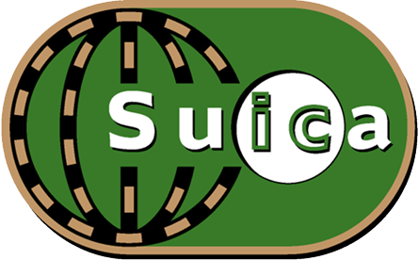
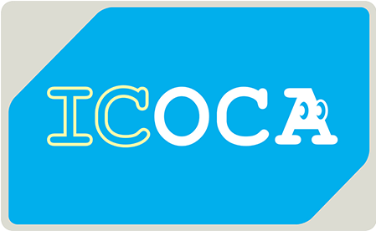
PASMO, Suica, & ICOCA Cards
The PASMO, Suica, and ICOCA Cards are e-money IC cards that can be used for travel and shopping across Japan.
Cashless fare payment
Use it for shopping
No waiting for change
Get special privileges
Apple phone users can also link with all three cards.
PASMO refunds - If you no longer need your PASMO, it can be refunded. Suica and ICOA cards do not offer refunds.

Slide 7
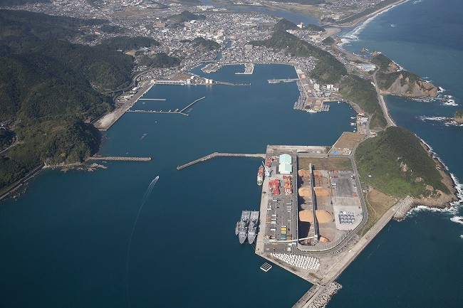
About Port
Aburatsu Port is a natural port located on the Nichinan Coast in scenic Miyazaki Prefecture. It was designated as a Special Major Port in 1952. In 1955, after port and harbor plans were drawn up, construction projects for breakwaters and mooring facilities were carried out. In 1998, the Higashi Wharf was opened. As a result, the port is able to handle a greater amount of cargo. In addition to cargo ships, many large passenger ships, including the Japanese passenger ships "Asuka II," "Pacific Venus" and "Nipponmaru," and the foreign passenger ships, “Norwegian Jewel” and "Legend of the Seas" have called at the port. This is an indication that many people have enjoyed trips to the southern areas of Miyazaki Prefecture. Aburatsu Port serves as an important marine gateway that connects the southern areas of Miyazaki Prefecture with major metropolitan areas around Asia.

Slide 8
Points of Interest
Aburatsu Shopping Arcade
Obi Castletown
Udo Shrine
Aoshima Island
Horikawa Canal
Cape Toi
Obi Castletown Walking Tour
Pier Tourist Information Booths

Slide 9
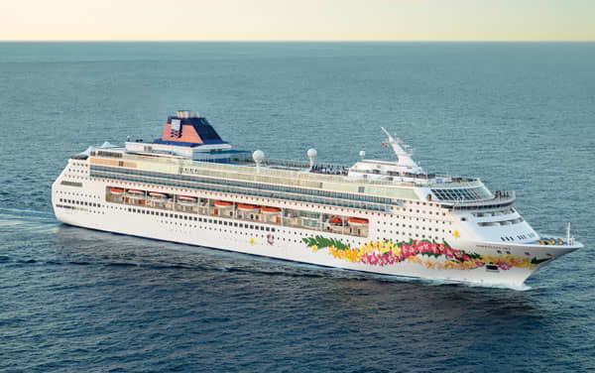
Pier Tourist Information
When passenger ships arrive and depart from the port, attractions and Tourist Information booths are set up to welcome the tourists at the piers where the ships land. In addition, passengers are
warmly welcomed with the local
taste through such activities as
product fairs stocked with regional
produce.

Slide 10
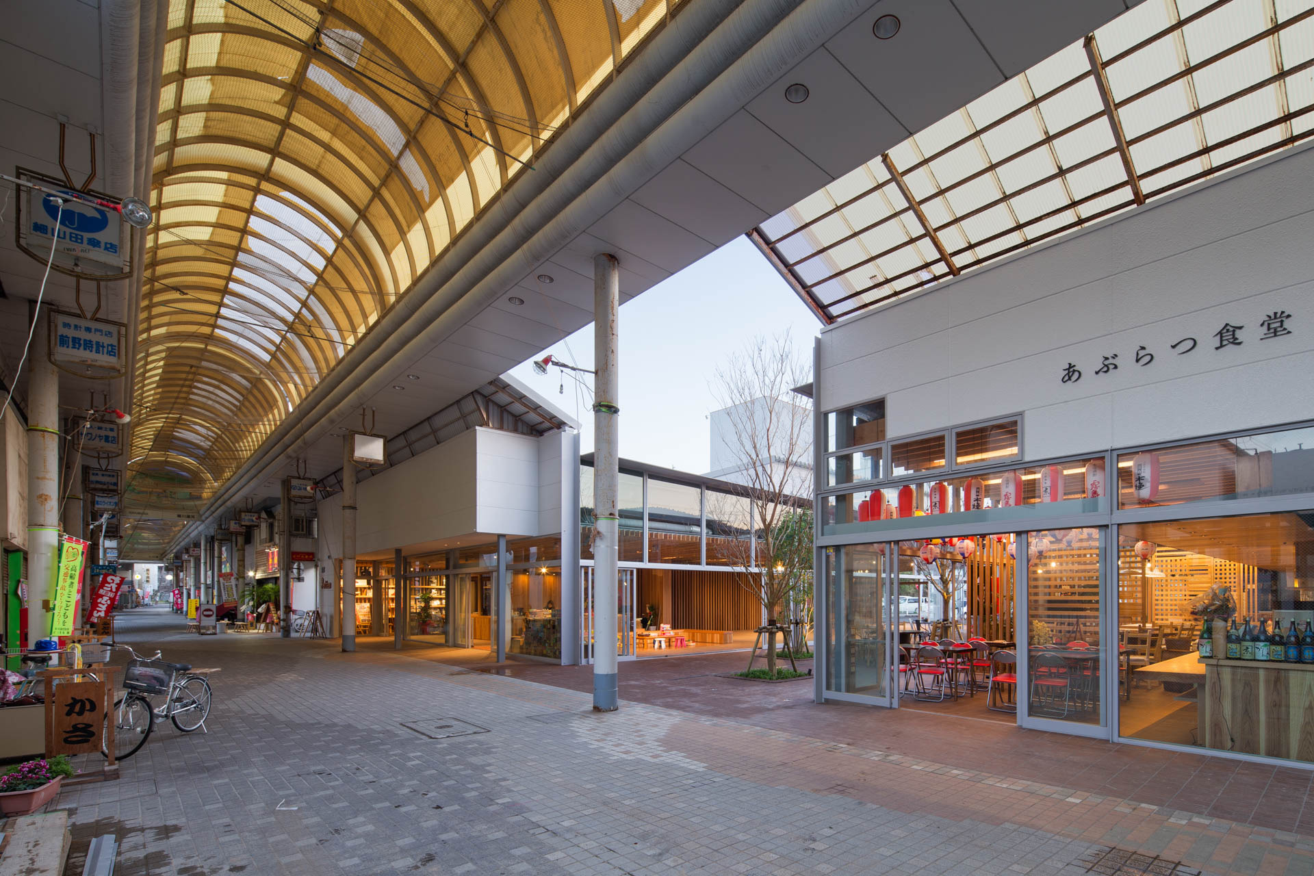
Aburatsu Shopping Arcade
The Aburatsu Shopping Arcade, located in downtown Aburatsu, is a commercial area which includes Sapia Nichinan
Shopping Center, Nichinan Yamakataya department store, and Iwasaki Shopping Street. In the shopping area are many
stores that sell clothing, general merchandise, souvenirs, and food.

Slide 11
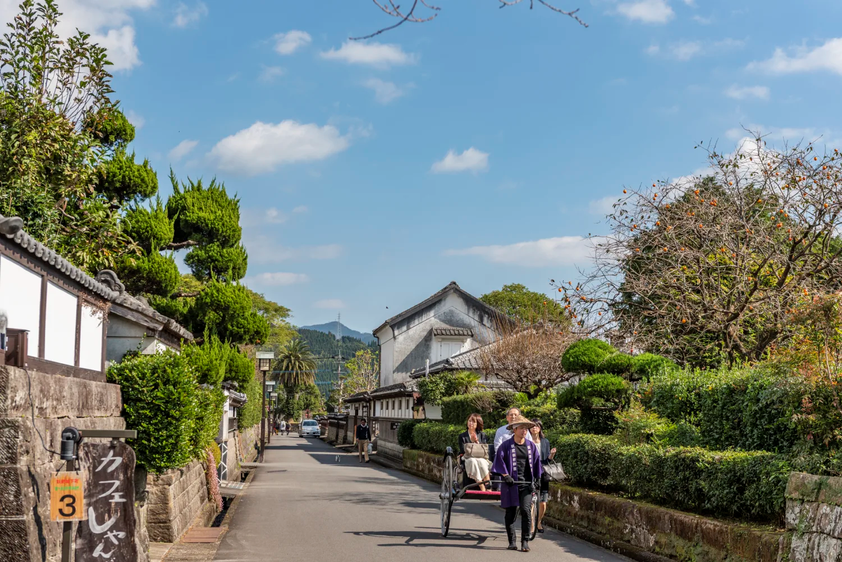
Obi Castletown
This area flourished as the 51,000 "koku" (rice yield) castle town of Lord Ito of the Obi domain. In 1977, the townscape,
where gates that represent old samurai residences and quaint stone and plaster walls still remain, was selected as
Preservation Districts for Groups of Traditional Buildings by the Japanese government. There are many other historic places
you can visit such as Japanese gardens and museum

Slide 12
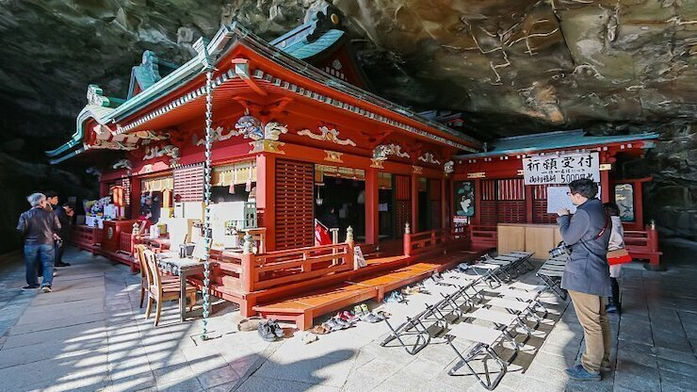
Udo Shrin
Udo Shrine (Udo-jingu in Japanese), which is described in the folktale "Umisachihiko and Yamasachihiko," is an unusual shrine even by Japanese standards. The bright vermilion-lacquered main hall of the shrine is located inside a cave which is on the tip of
a cape that overlooks the Pacific.
Near the main hall, you can throw
un-dama (fortune balls) that are said to make the thrower's wish come true. Men throw this un-dama with their
left hand and women with their
right hand, aiming for a square hole
in the kameishi (turtle rock).

Slide 13
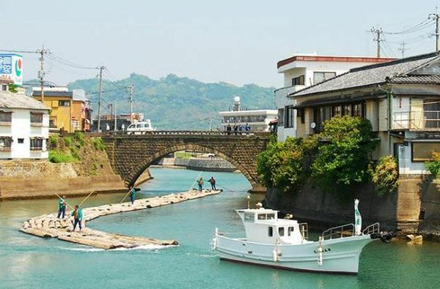
Horikawa Canal
Horikawa Canal (Horikawa Unga in Japanese) was built over a span of two years and four months under the order of Ito Sukezane from the fifth generation of local lords, who ruled Obi Province. The canal was built in 1683 to transport Obi cedar.
Along the canal are Akarengakan Soko (the red brick warehouse) which was built in 1922, the Horikawa Bridge, and the
Horikawa Historical Museum, which provides a glimpse at the old towns

Slide 14
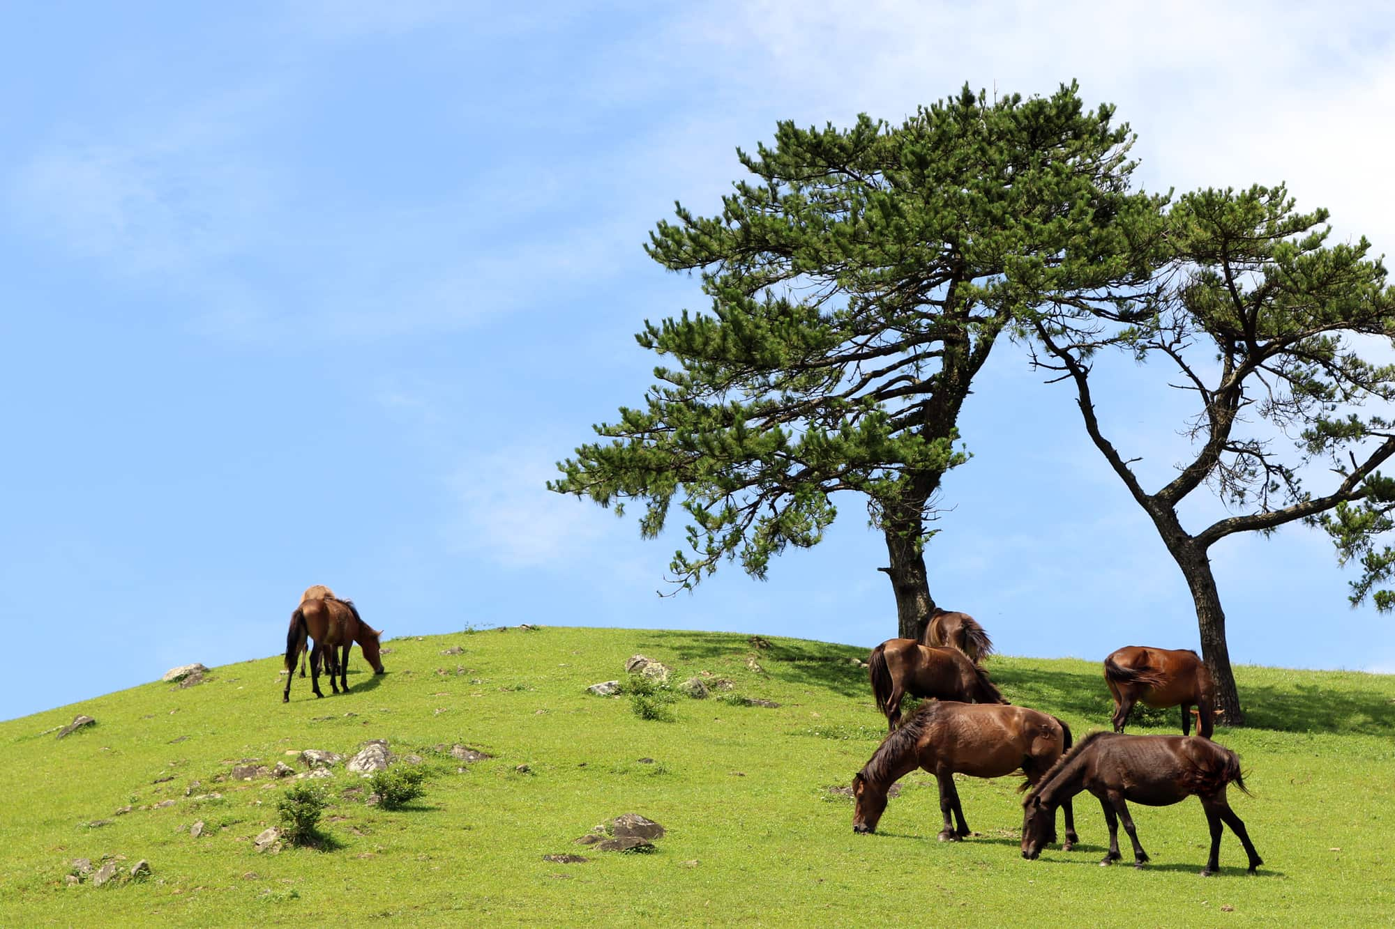
Cape Toi
Cape Toi (Toi Misaki in Japanese) is a tourist attraction where you can watch wild horses. It is a pasture which was set up in 1697 and kept by the han (domain). The horses have been raised through year-round grazing, for the last 300 years or so. Therefore, their reproduction has been completely left up to nature.
At the Cape Toi Lighthouse at the tip of the cape, you can climb up to the observatory for a beautiful view of the Pacific Ocean.

Slide 15
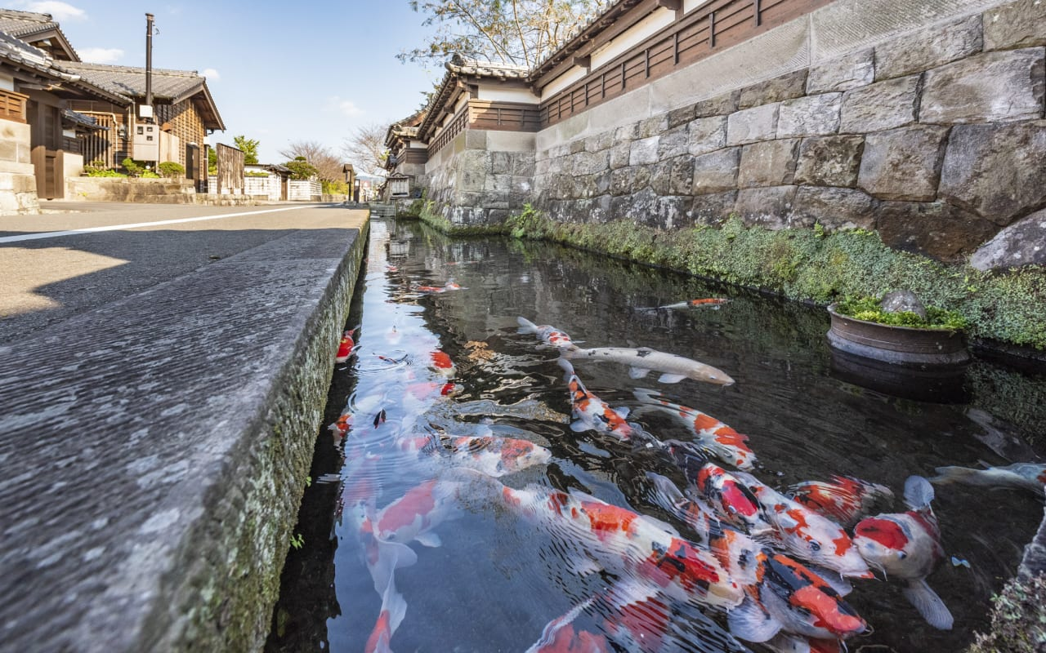
Obi Castletown Walking Tour
The Obi Castletown is located at the far north end of the city some distance from the port. Obi is a town of well-preserved samurai houses in Miyazaki’s Nichinan City. Obi Castle dates back to the 15th century, when it was built by the Shimazu family of Kagoshima to protect them from their long-standing enemies, the Itoh family. The Itohs captured the castle during a war in 1484. Almost 100 years later, the Shimazus recaptured it, but quickly lost it again to Hideyoshi Toyotomi, a famous warlord and ally of the Itoh family, who then ruled from the castle for
the next fourteen generations. Among the homes you can visit are Yoshokan, the home of the head of the Itoh family, which features a meticulously landscaped Japanese garden and Matsuo no Maru, a large, modern replica of a nobleman’s residence from the Edo period (1603-1867), and the Obi Clan Historical Museum, where samurai armor and weapons are displayed.

Slide 16
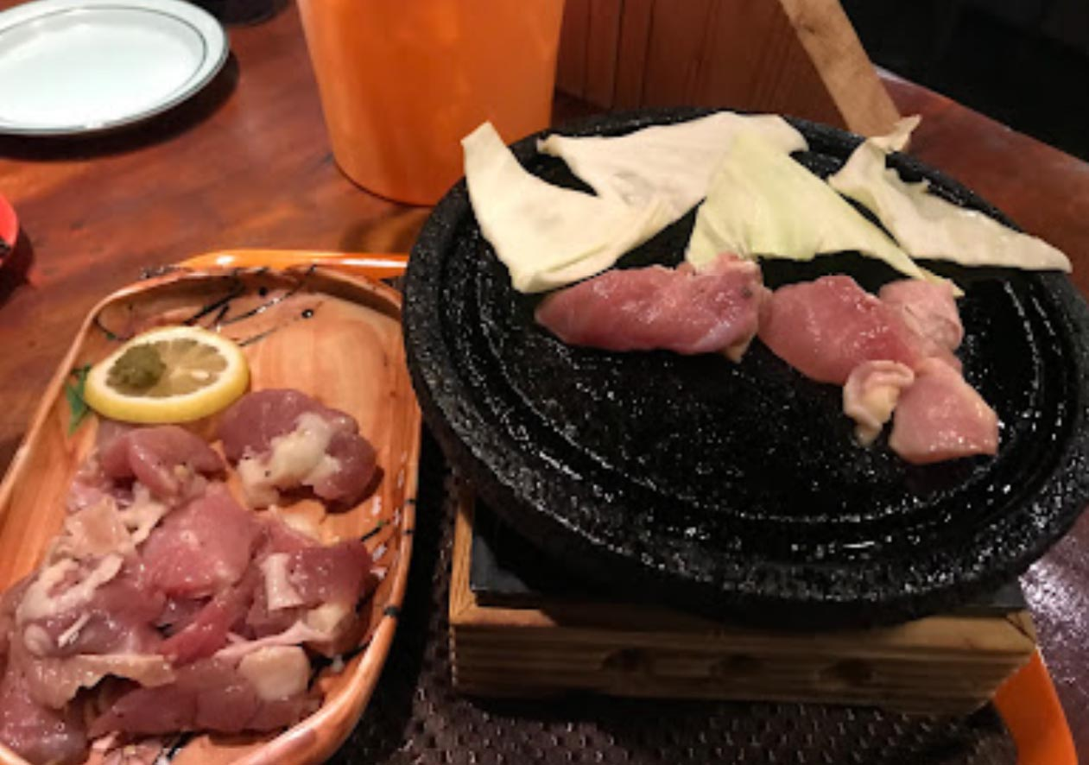
Aburatsu Restaurants
Many of us on the ship are foodies, so naturally, we’re always on the hunt to eat at the most exclusive spots anytime we travel.
Here are a few Restaurants to consider.
Bibin-ya – Sea Food Restaurant ·$$
Midoriya – Tzakaya - $$
Suzuki - Ramen - $
Tombo – Noodles - $
Suyama – Japanese - $$
Naochan – Ramen - $
Restaurant Suehiro - Japanese Western - $$$
Seaside Restaurant ITa Tov – Western - $$
Restaurant Ru-Na – Japanese Fast Food - $
For those of you that just like good food, you can’t go wrong just about anywhere you go in Aburatsu
GOOD EATING

Slide 17
Conclusion
Aburatsu is a beautiful City with a rich history and numerous attractions. Whether you're looking for stunning beaches, historic sites, or unique attractions, Aburatsu has something for everyone.
I hope this presentation will help when we visit Aburatsu!

Slide 18
Thanks For Coming
If you have any more questions, please ask.
I will do my best to answer them for you.
Have a great visit in Aburatsu!

