Slide 1

Abidjan, Ivory Coast
Presented by
Marc Silver

Slide 2
What I Will Cover
My Port Philosophy
Don’t Miss the Ship
Money
About Abidjan
A Brief History
Maps
Transportation
Top Attractions & Points of Interest
Local Cuisine & Dining Options
Self Guided Walking Tour
Important Tips & Practical Advice
Conclusion

Slide 3
My Port Philosophy
I have been cruising for over 46 years and have taken over 100 cruises.
So, I consider myself an experienced cruiser.
The information I will present is based on those many years of
experience.
When I am on a cruise where the city, I want to visit is not the port city,
I always recommend taking a ship’s tour.
But when I am in a port with multiple attractions nearby and easy to see
on my own - I will do it on my own.
This presentation is not like that.

Slide 4

Don’t Miss the Ship
How to Avoid Missing Your Ship
Pay attention to the time. - Ship time and local time are often
different.
Put a return-to-ship reminder on your phone.
Choose excursions wisely.
If a ship-sponsored excursion is late returning to port, the ship will
wait for you. If you are on your own???
Be Prepared
Have your Passport, Credit Card, and phone numbers for your ship
port agent.
What to Do If You Miss the Ship
Most cruise lines have port agents stationed in the port area to assist if your ship has left without you. If your are lucky, when cruisers are late returning to the vessel, the ship’s crew will often remove the passengers’ essential items – passports, cell phones, and medication -- from the ship to leave with the port agents.
The Port Officials can help you with contacting your ship
and making necessary travel arrangements.

Slide 5
Money
Ivory Coast uses the
West African CFA franc (XOF) as its official currency.
The exchange rate change but are roughly
1 USD = 610 XOF.
XOF 500 = $1 USD
XOF 100 = EUR 0.15
The West African franc is the currency of eight independent states including: Benin, Burkina Faso, Côte d'Ivoire, Guinea-Bissau, Mali, Niger, Sénégal and Togo.

Slide 6
Exchanging Money
When exchanging money, it’s best to avoid doing so at the port kiosks, since they often charge high fees and offer poor exchange rates.
You’ll usually get better value by withdrawing francs directly from bank ATMs, which are widely available in the city.
Major credit and debit cards are accepted at most restaurants, and shops in tourist areas, but smaller businesses and markets still prefer cash, so keeping some local currency on hand is a smart idea.
          Côte d'Ivoire 10 Franc Coin

Slide 7
Welcome to Abidjan
Abidjan is a city that surprises almost everyone
who visits.
Known as the “Paris of West Africa,” it’s a modern, bustling metropolis of skyscrapers, art, and music, set against the lush backdrop of the Ébrié Lagoon.
This is Ivory Coast’s economic heart and one of the fastest-growing cruise destinations in West Africa.

Slide 8
A City with Many Faces
Abidjan is a city of contrasts.
The Plateau district shines with modern glass towers and international hotels, while Treichville pulses with local life, markets, and the aroma of grilled fish and attiéké, a local cassava dish.
The city has French flair with African rhythm, a mix that defines the Ivorian spirit.

Slide 9
A Brief History
Originally a small fishing village, Abidjan rose to prominence in the 1950s when the French colonial administration moved the capital here.
The construction of the Vridi Canal connected the Ébrié Lagoon to the Atlantic Ocean, transforming Abidjan into a major deep-water port, and the gateway to French West Africa.
19th Century French Colonial Abidjan
Though the political capital later moved to Yamoussoukro, Abidjan remains the beating heart of the country, culturally and economically.

Slide 10
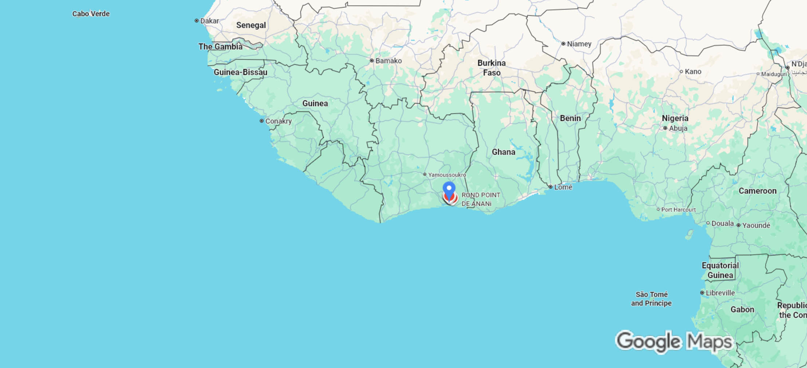
Côte d'Ivoire
Abidjan

Slide 11
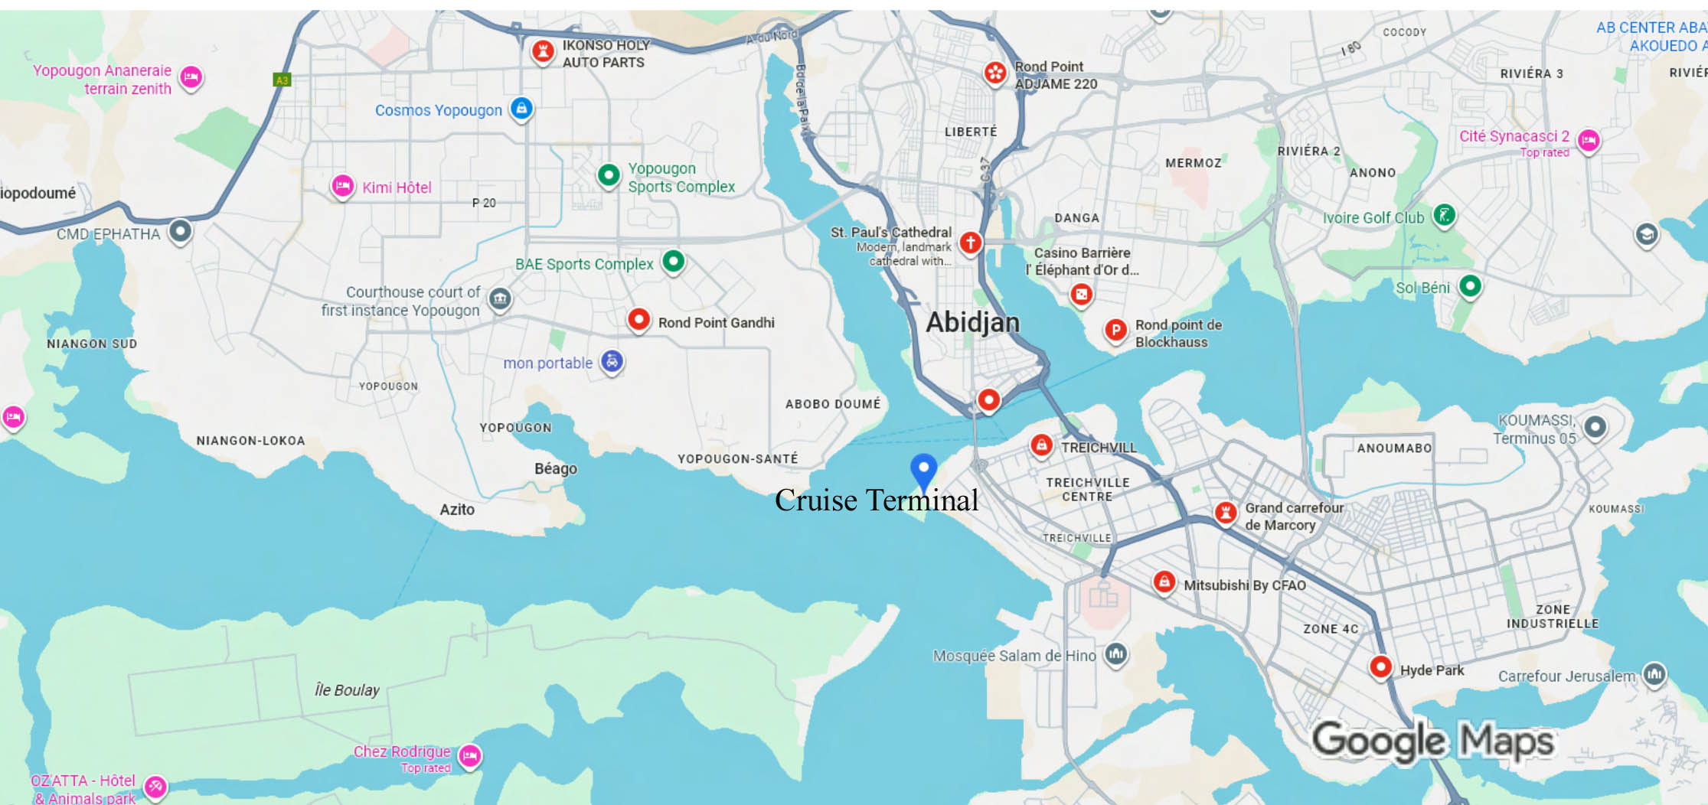
Area Map

Slide 12
Transportation
Getting Around
Abidjan is spread across islands and lagoons, connected by bridges and causeways.
Taxis are plentiful, and local ferries offer scenic rides across the water.
Cruise passengers can easily explore major sights with guided tours or local drivers, many of whom speak French and some basic English. Taxis are about $.63 / mile.

Slide 13
Transportation
Transportation Options for Tourists
You can also hire a taxi or pre-book a car
service.
Prices range from about XOF 5,000
–10,000 (≈ US $8–17), depending on your
destination in Abidjan.
For the Ébrié Lagoon The official transport company SOTRA lists a short “pleasure ride” on the lagoon (water bus/ferry) at 200 XOF (~US $0.30) per person.

Slide 14
Top Attractions & Points of Interest
National Museum of Côte d’Ivoire
Located in the Plateau district, the National Museum houses a fascinating collection of traditional masks, sculptures, and ceremonial objects from across the country’s many ethnic groups.
It’s a great place to start if you want to understand Ivory Coast’s deep cultural roots and artistry.
Admission to the Musée des Civilisations de Côte d’Ivoire is free.
The museum is open from Monday to Sunday, from 9 AM to 5 PM

Slide 15
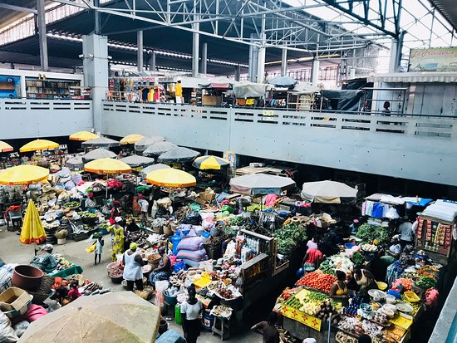
Top Attractions & Points of Interest
Treichville Arts and Crafts Market
For a taste of everyday Abidjan, cross the lagoon to Treichville.
The market is alive with color—vendors selling handmade jewelry, wood carvings, woven baskets, and bright textiles.
It’s also one of the best spots to sample local dishes like attiéké (a cassava couscous) and grilled fish right off the street.

Slide 16
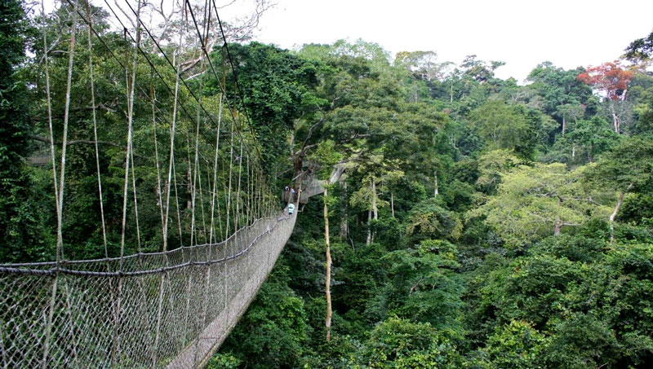
Top Attractions & Points of Interest
Parc National du Banco
A surprising pocket of rainforest just a few miles from downtown, Banco National Park 3471 hectares of tropical forests. Nice for hiking in the urban zone of Abidjan.
It’s a peaceful break from the city’s bustle, perfect for anyone craving a bit of nature without leaving Abidjan.
You might spot monkeys or colorful birds as you wander the trails.
Open 9:00 AM-5:00 PM
Admission is about $9

Slide 17
Top Attractions & Points of Interest
St. Paul’s Cathedral
This striking modern cathedral dominates the skyline of Plateau.
Designed by Italian architect Aldo Spirito, its sweeping concrete arches and vibrant stained-glass windows make it one of the most iconic landmarks in the city.
The interior is just as impressive, filled with light and color that tell stories of faith and national identity.

Slide 18
Local Cuisine & Must-try Dishes
Attiéké - A staple made from fermented, grated
cassava—prepared like tiny couscous-grains.
Alloco - Ripe plantains deep-fried until golden,
often served with a spicy tomato-onion sauce.
Kédjénou - This is a slow-cooked stew (often
chicken) cooked in its own juices, sometimes in
a sealed pot called a canari.
Sauce Graine (Palm Nut Stew) - Made with
juice from palm nuts, often including fish,
snails or meat, paired with sides like foutou or
placali.
Attiéké
Kédjénou
Notes:
-

Slide 19
Tips for Dining & Local Experience
Many “maquis” (open-air local restaurants) serve
grilled fish & chicken with sides like attiéké or
kédjénou. Also try palm wine or ginger drinks.
Spice level: be ready. Some sauces are noticeably
hot. If you’re unsure, ask for the mild version or
ease into it.
Street food is a great option. Alloco or attiéké with fish from street vendors are common and usually reliable, but use your judgment (cleanliness, crowd, etc.).
Go for variety: don’t just stick to what you know. Try something with cassava or palm nut sauce.
Notes:
-

Slide 20
Self-Guided Walking Tour
If you’d like to explore on your own, the Treichville district near the port offers an easy and rewarding walk. Here’s a suggested route — about 2 miles round trip — that starts and ends at the cruise terminal.
1. Cruise Port to Avenue de Marseille (10 minutes)
Leave the terminal and walk toward Avenue de Marseille, the main commercial street. You’ll pass colorful stalls selling fabrics, fresh fruit, and handmade crafts. It’s a lively introduction to Abidjan street life.
2. Treichville Market (Marché de Treichville)
One of the city’s largest traditional markets. Wander through aisles of spices, textiles, and wooden carvings. Bargain gently and keep an eye on your belongings — the market is busy but friendly.

Slide 21
Self-Guided Walking Tour
4. Local Café Stop
Just a few blocks away, grab a seat at a local café for coffee or a refreshing Bock beer. Try a light snack of attiéké and grilled fish if you’re hungry.
5. Ébrié Lagoon Promenade
Head north toward the waterfront to enjoy lagoon views and watch ferries cross to the Plateau district. It’s a great spot for photos, especially with the skyline in the distance.
6. Return to the Port
Loop back to the cruise terminal along Boulevard de Marseille. You’ll pass small shops and murals celebrating Ivorian music and art — a fitting end to your walk.

Slide 22
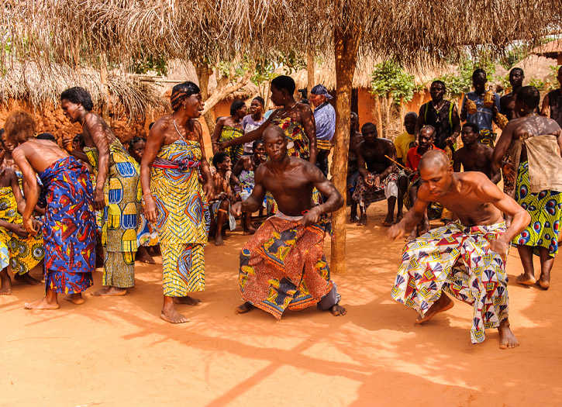
The Rhythm of Abidjan
Music is the heartbeat of Abidjan. From the energetic Coupé-Décalé clubs to soulful Afro-jazz lounges, the city moves to its own rhythm.
Ivorian musicians have influenced African pop for decades, and live music can be heard almost every night.

Slide 23
Modern Growth and Future Promise
Abidjan is reinventing itself as one of Africa’s great modern cities.
Major investments in infrastructure, tourism, and the cruise terminal have positioned it as a rising hub for West African exploration.
More cruise lines are now adding Abidjan to itineraries along the Gulf of Guinea, recognizing its blend of culture, commerce, and coastal charm.

Slide 24
Important Tips & Practical Advice
Currency: The local money is the West African CFA franc. U.S. dollars aren’t widely accepted, so small local notes are useful.
Language: French is the official language, but English is increasingly spoken in tourist areas.
Safety: Abidjan is generally safe in the main districts, but like any major city, keep an eye on valuables and avoid wandering off alone at night.
Etiquette: A warm greeting goes a long way — Ivorians appreciate friendliness and courtesy.
Connectivity: Most hotels, cafes, and tour buses offer Wi-Fi, and mobile data is widely available.

Slide 25
Important Tips & Practical Advice
Abidjan is where Africa’s modern pulse meets timeless tradition.
It’s a city of music, color, and resilience, reinventing itself after decades of change.
For travelers, it offers something rare — a look at Africa in motion, vibrant and full of promise.
Keep exploring, and who knows, your next favorite port might be waiting right here on the Ivory Coast.

Slide 26
Thanks For Coming
If you have any more questions, please ask.
I will do my best to answer them for you.
Have a great visit in Abidjan!

