Slide 1
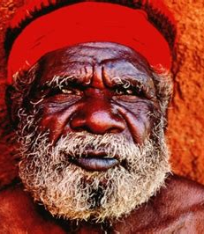
42,000 Years of Australia’s History
Presented by
Marc Silver

Slide 2
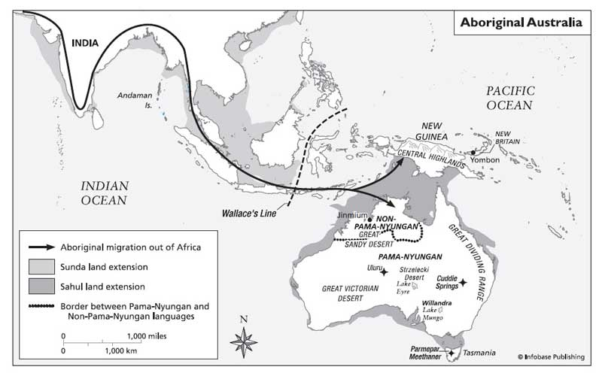
First Arrival
The first Aborigines arrived on the Australian continent from south-east Asia around 40,000 BC.
By 20,000 BC they had spread throughout the mainland and south into Tasmania. Australia remained isolated from the rest of the world for the next 42,000 years.

Slide 3
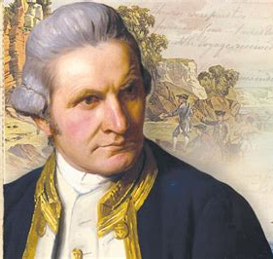
Western Discovery
It wasn’t until 1770 when Captain James Cook arrived to chart the east coast of Australia in his ship HMS Endeavour. Cook claimed it as a British possession and names eastern Australia "New South Wales".
8 years later in 1788 the British Navy captain Arthur Phillip founded a penal settlement at Sydney. He had arrived with a fleet of 11 vessels, carrying nearly 800 convicts. At the time it was believed the Aboriginal population was thought to number several hundred thousand.

Slide 4
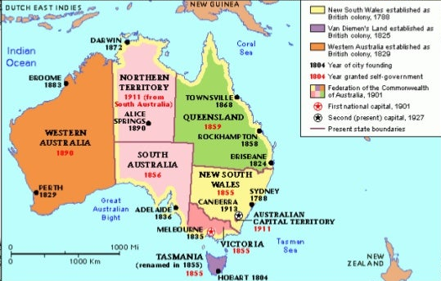
Early Colonization
Actual colonization didn’t occur until 1829 when a colony in Western Australia was established at Perth by Captain James Stirling.
The region of South Australia was established in 1836 and Adelaide was established as its capital.

Slide 5
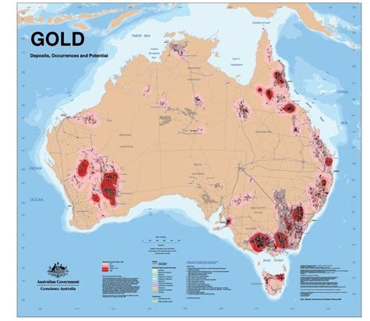
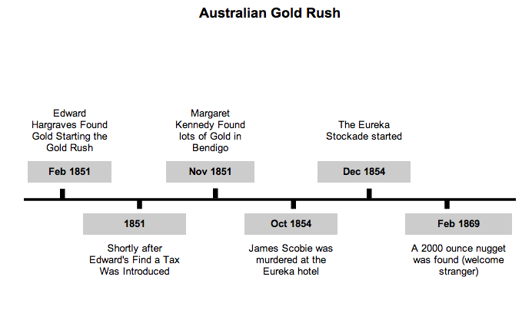
Australia’s Gold Rush
The gold rush wasn’t just a US thing. In 1850 gold was found at several locations in Australia, leading to gold rushes throughout the decade.

Slide 6
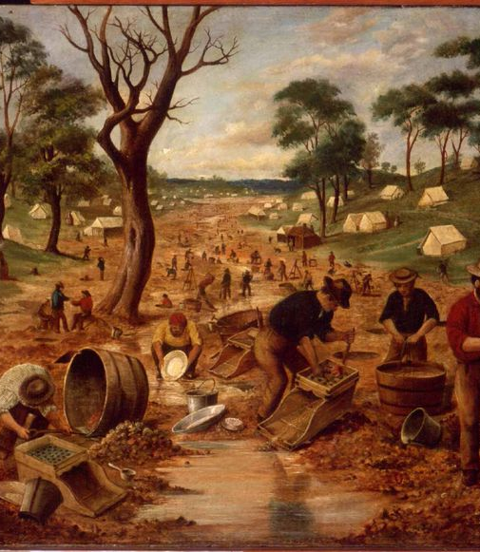
Australia’s Gold Rush Cont.
The arrival of thousands of Chinese in Australia during the 1850s gold rushes, followed by the recruitment of South Sea Islanders to work on Queensland plantations in the late 1800s, sparked fears of labor competition among Australians of European descent.
Because of gold fever and demand for labor, the population tripled in just 10 years, increasing the population to over a million people.

Slide 7
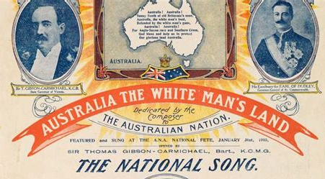
Immigration Restriction Act
In the 1890s the desire for a coordinated immigration ban against nonwhites was one factor that encouraged the Australian colonies to form a federation. The Immigration Restriction Act 1901, also known as the White Australia policy, affected migrants who came to Australia between 1901 and 1958.
Shortly after the Commonwealth of Australia was created in 1901, the new federal Parliament introduced the Immigration Restriction Act. To pass the test, they needed to write 50 words in any European language, as dictated by an immigration officer.
After 1905, the officer could choose any language at all. A Chinese immigrant, for example, could be asked to write out 50 words in French, Italian or another language. This law, effectively stopped all non-European immigration entering the country. The law was the cornerstone of what became known as the White Australia Policy.

Slide 8

The End of the Act
The Immigration Restriction Act and dictation test eventually ended in 1958. Other parts of the White Australia policy, such as the registration of non-British migrants as ‘aliens’, continued into the early 1970s.
The Racial Discrimination Act 1975 made it illegal to discriminate against migrants based on their race. It removed the last traces of the White Australia policy.
Despite the White Australia policy, people from all the world settled in Australia, creating the multicultural society we see today.

Slide 9
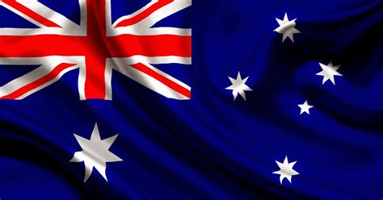
The Commonwealth of Australia
At the turn of the century the country becomes a unified nation. The Commonwealth of Australia comes into being on 1st January 1901.
Canberra is founded in 1911 and was designated as the new nation’s capital.

Slide 10
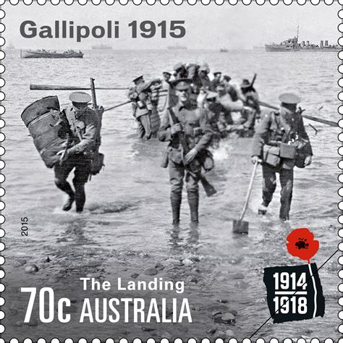
World War I
1914 marked the Outbreak of World War I. Australia commits hundreds of thousands of troops to the British war effort.
Their participation - alongside New Zealanders - in the Gallipoli campaign in Turkey in 1915 leads to heavy casualties. The Gallipoli landings helped cement a sense of identity in the young nation.

Slide 11
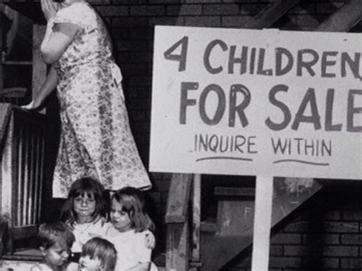
Economic Woes and War
The Great Depression spread worldwide following the Wall Street Crash of 1929 and was devastating to Australia.
Recovery was slow, and the Labor government in power, was blamed for the economy, and defeated in the election of 1931.
Between World War I and World War II Australia suffered greatly from the Great Depression. This limited Australian defense expenditure and led to a decline in the size and effectiveness of their armed forces during the 1930s.

Slide 12
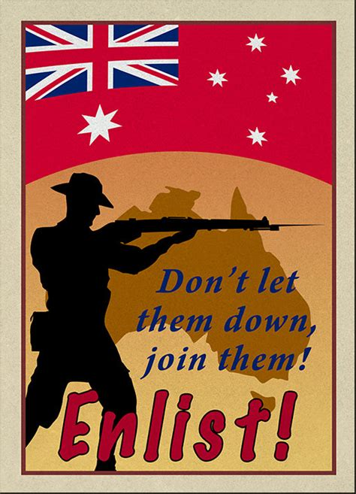
Australia and WWII
Australia joined WWII in 1939 following Britain's lead and declares war on Nazi Germany.
Following the outbreak of war on the 3rd of September 1939, 11 days later, on 14 September 1939 Prime Minister Robert Menzies announced that 40,000 members of the Militia would be called up for training and a 20,000-strong expeditionary force, designated the Second Australian Imperial Force would be formed for overseas service.

Slide 13
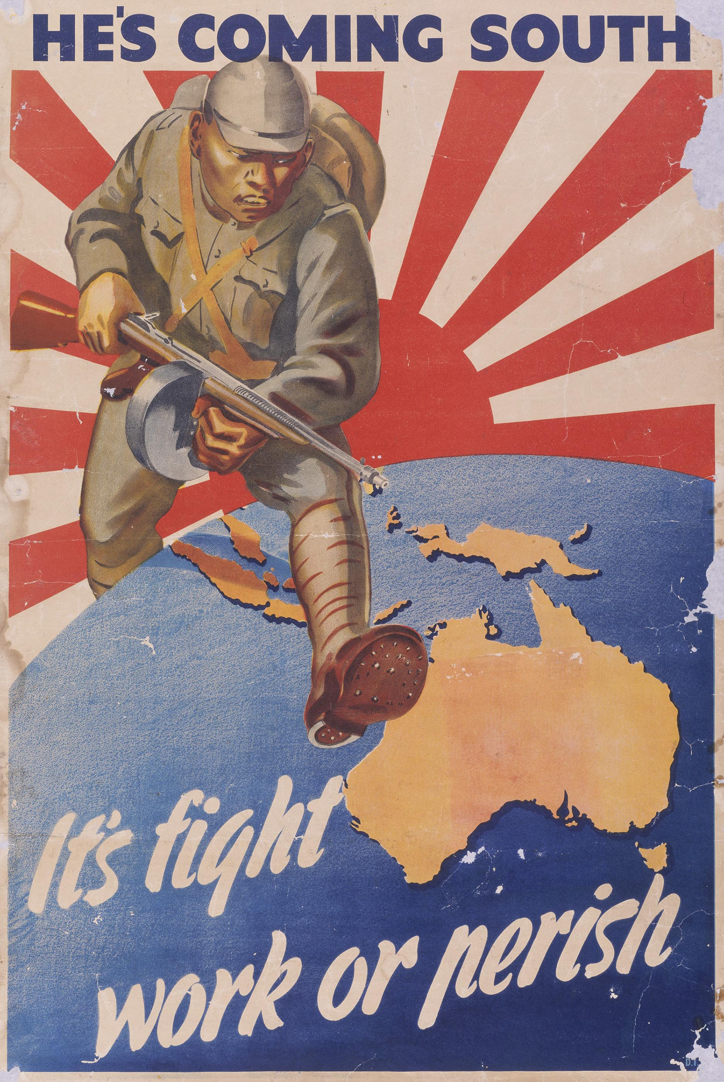
War on Japan
In 1941 the US declares war on Japan and Australia turns to the US for help in its defenses after the Japanese take Singapore.
Australia allows the US to base its supreme command for the Pacific war on its territory.
On September 2, 1945, formal surrender documents were signed aboard the USS Missouri, designating the day as the official Victory over Japan Day (V-J Day).

Slide 14
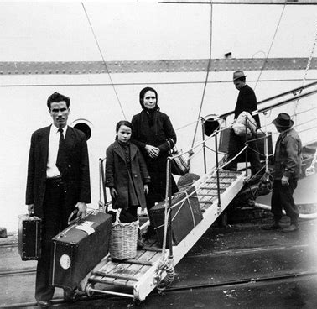
World War II Ends
The end of World War II brought significant changes to Australia’s immigration policy. Between 1945 and 1965, two million immigrants arrived in Australia. The decision by the Australian Government to open up the nation in this way was based on the notion of ‘populate or perish’ that emerged in the wake of the Second World War.
Among the new immigrants were the first government-sanctioned non-British migrants.
This massive influx of people transformed Australian society.

Slide 15
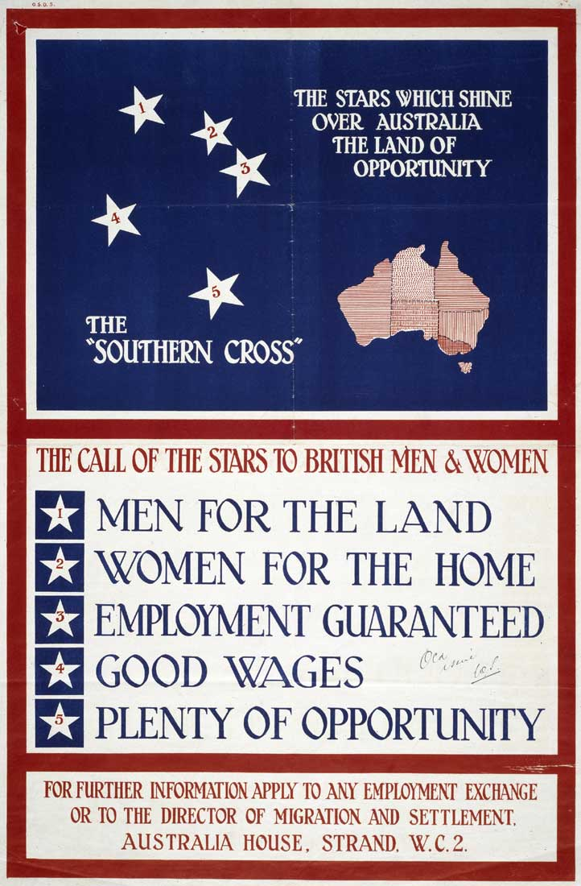
World War II Ends Cont.
The country also had a severe labor shortage that hindered its efforts to expand the economy. These circumstances led the federal government to introduce a large-scale immigration program to boost the population.
In 1945 the government established the Department of Immigration, and the first minister for immigration, Arthur Calwell, urged Australia to “populate or perish.” 1948 - Australia begins a scheme for immigration from Europe. The government set a goal of 2 percent population growth each year, with half of the growth coming from immigration. Over the next 30 years, more than two million people arrive, about one-third of them from Britain, and hundreds of thousands from Italy, Greece and Germany.
Australia commits troops to the UN forces for the Korean war in 1950.

Slide 16
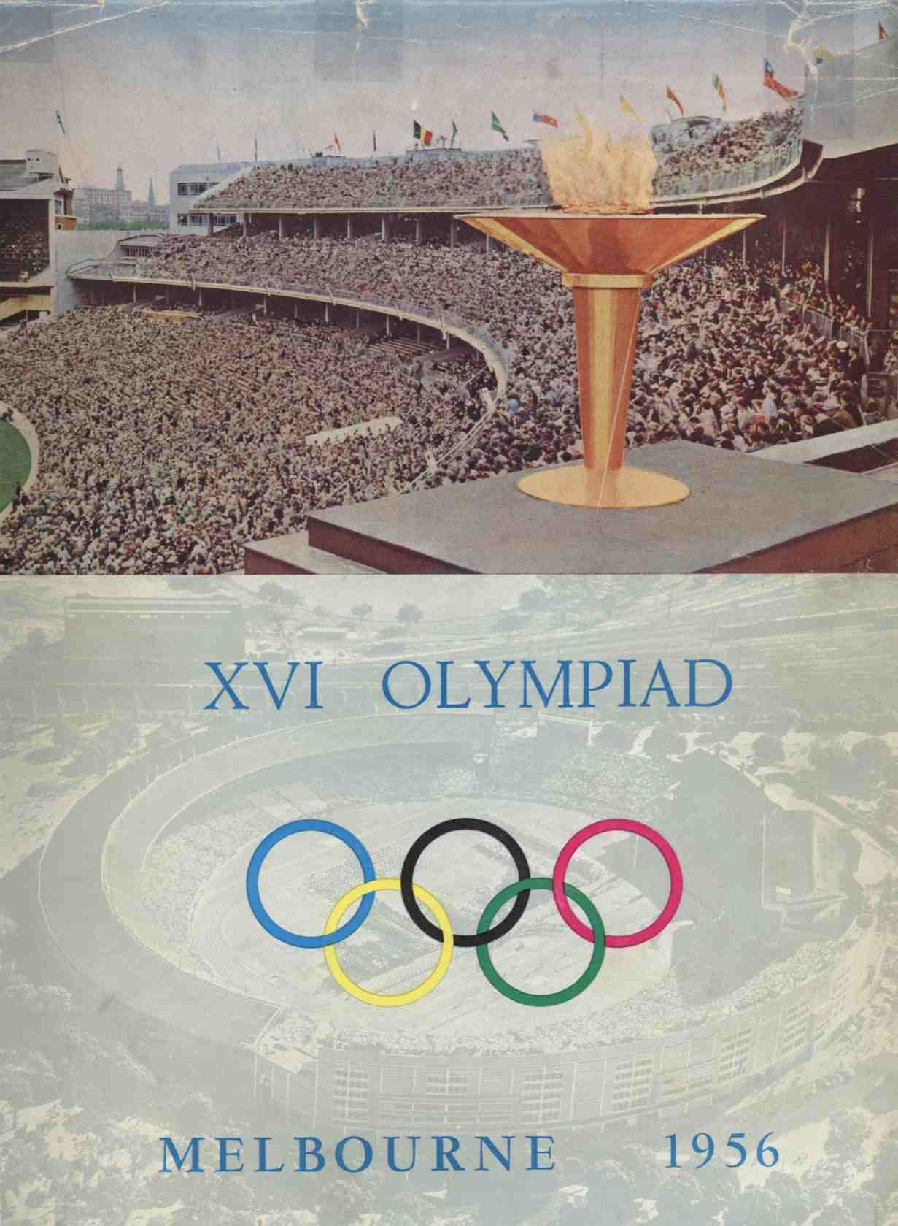
XVI Olympics
Olympic Games, an athletic festival held in Melbourne that took place November 22–December 8, 1956. The Melbourne Games were the 13th occurrence of the modern Olympic Games.
The 1956 Olympics were the first held in the Southern Hemisphere. Because of the reversal of seasons, the Games were celebrated in November and December. 1956 - Olympic Games held in Melbourne.
Australia commits troops to the US war effort in Vietnam 1965.

Slide 17
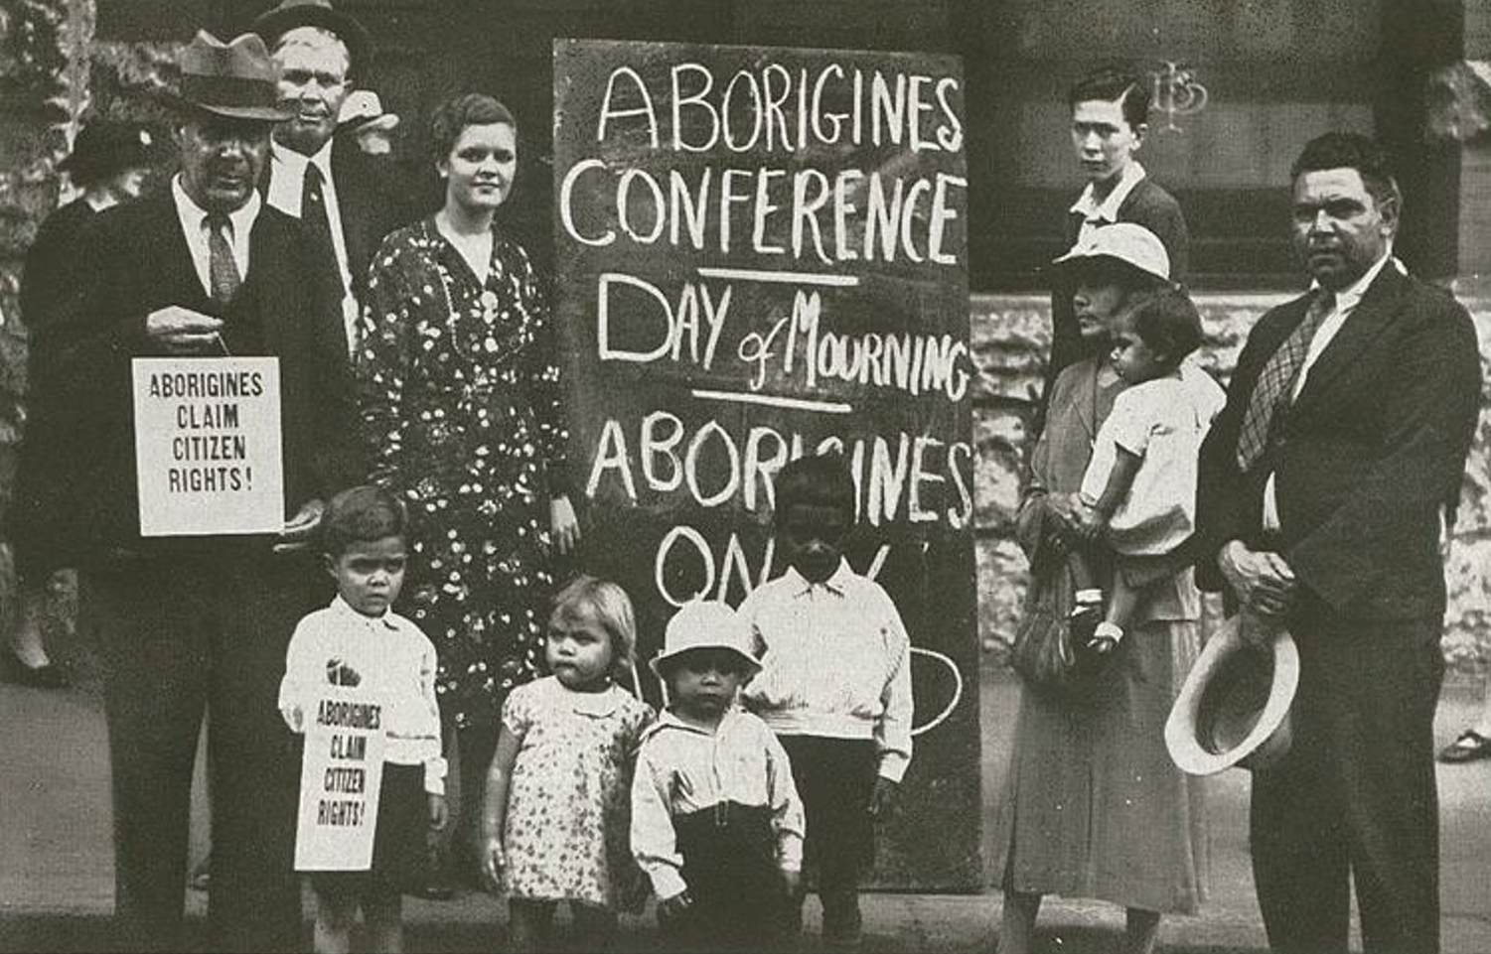
Aboriginal Issues
A National referendum on changes to constitution is passed in 1967. The section which excluded Aboriginal people from the official census was removed. Another change enabled federal government to pass laws in support of Aboriginal issues.
Australia introduces new immigration laws, restricting the number of unskilled workers allowed into the country in 1975.

Slide 18
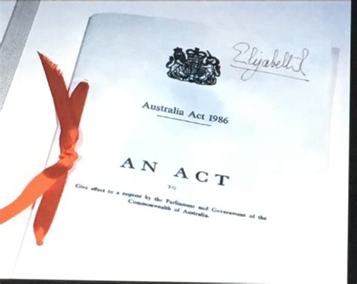
The Australia Act
In 1986 with the adoption of the Australia Act that made Australian law fully independent of the British parliament and its legal system.
The Australia Act 1986 is the short title of each of a pair of separate but related pieces of legislation: one an act of the Parliament of Australia, the other an act of the Parliament of the United Kingdom.
With the enacting of The Australia Act Australia became an independent Sovern nation, independent of the United Kingdom.
However, Australia still recognizes the King of England as their Royal Sovereign.

Slide 19
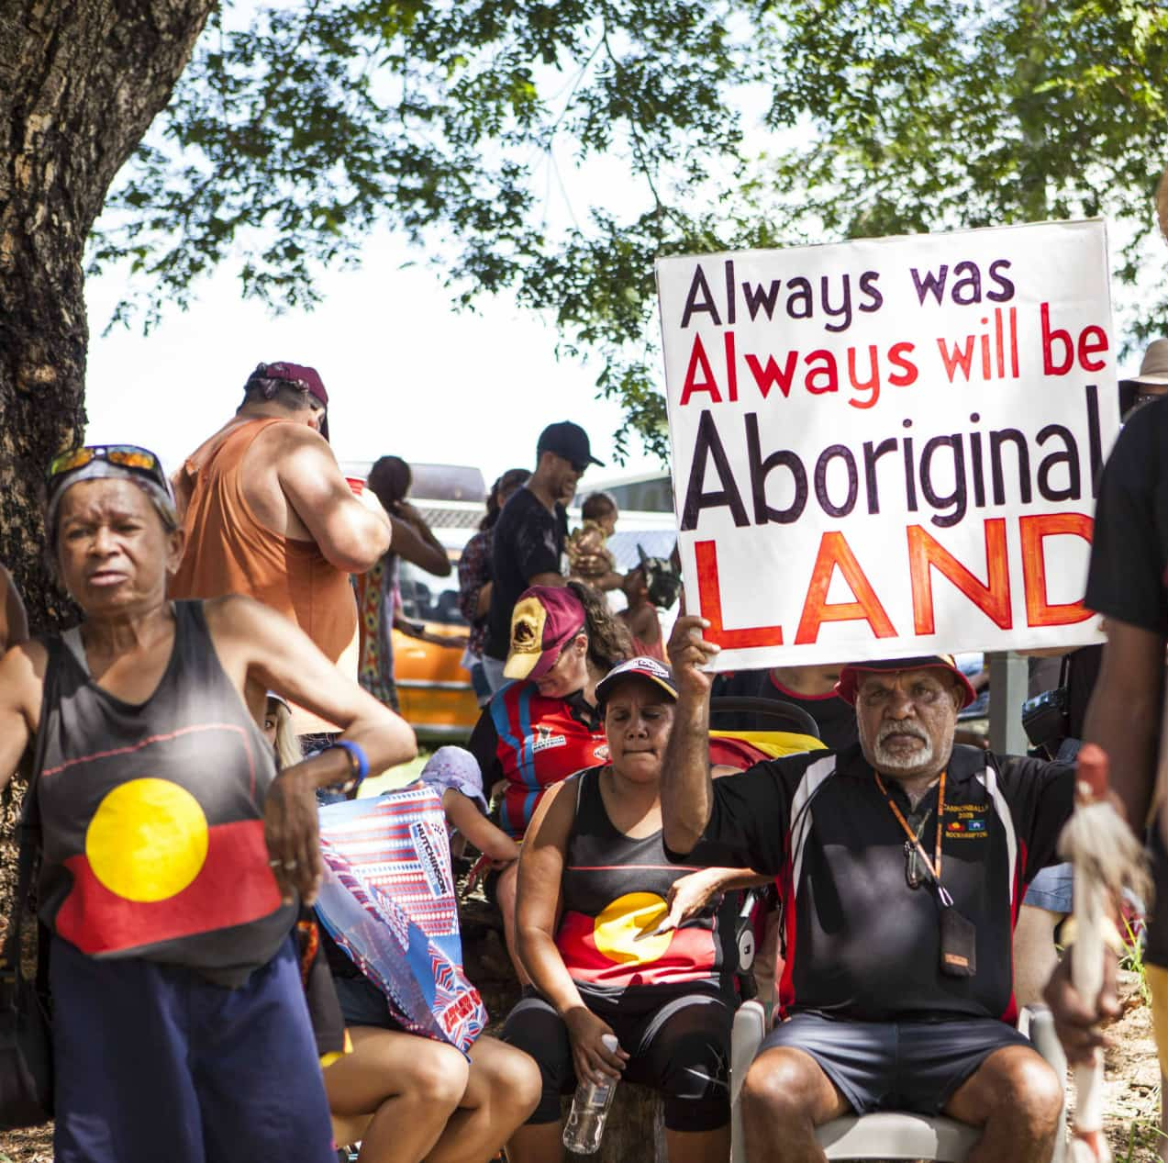
Native Title Act
In 1991, while Australia struggled with economic recession, Paul Keating becomes Labor prime minister. Keating inaugurated financial programs aimed at national recovery. He was reelected prime minister in 1993 as the economy regained strength,
The Native Title Act of 1993 established a process for the granting of Aboriginal land rights. It was legislation passed by the Australian Parliament that recognizes the rights and interests of Aboriginal and Torres Strait Islander people in land and waters according to their traditional laws and customs.
Australia leads intervention force in East Timor in 1999 to counter pro-Indonesia militia violence after territory's independence vote.

Slide 20
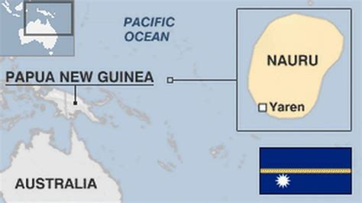
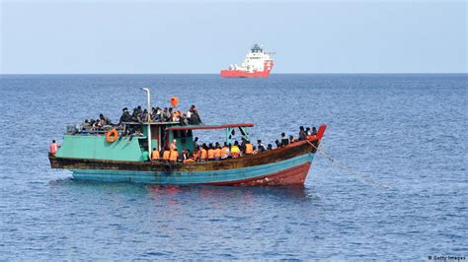
Illegal Immigrants
Today Americans talk about immigrants at the Southern border, but in August 2001 Australia turned away hundreds of boat people over several months, the most prominent group having been rescued from a sinking ferry.
Australia paid Nauru to detain many of them. Nauru, officially the Republic of Nauru and formerly known as Pleasant Island, is an island country and microstate in Micronesia, part of Oceania in the Central Pacific.
Australia has historically been an ideal choice for asylum seekers fleeing numerous strife-ridden countries — from Vietnam during the 1970s to Afghanistan in the 2000s. Because Australia is a signatory to the United Nations' 1951 Convention Relating to the Status of Refugees and its 1967 Protocol, any person who falls within the convention's definition of a refugee is entitled to government protection.

Slide 21
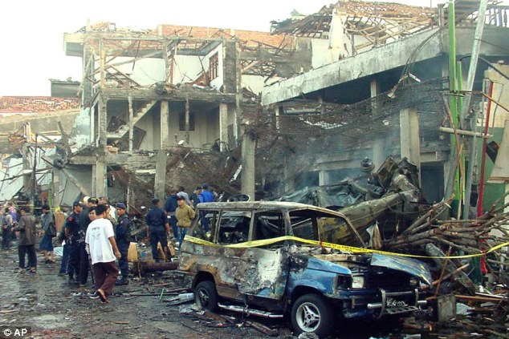
Bali Bombing
Australia mourns as 88 of its citizens killed in a night club bombing in Bali, Indonesia, A series of bombings occurred on 12 October 2002 which some call Australia's September 11. The attacks were claimed by Jemaah Islamiyah, an Islamist group tied to al-Qaeda.
The attracts centered in a tourist district of Kuta on the Indonesian island of Bali. The attacks killed 202 people and a further 209 people were injured. General Da'i Bachtiar, the Indonesian chief of police at the time—said that the bombings was the "worst act of terror in Indonesia's history“.
Over the next few years multiple terrorists were either killed or convicted of the bombing and brought to justice.

Slide 22
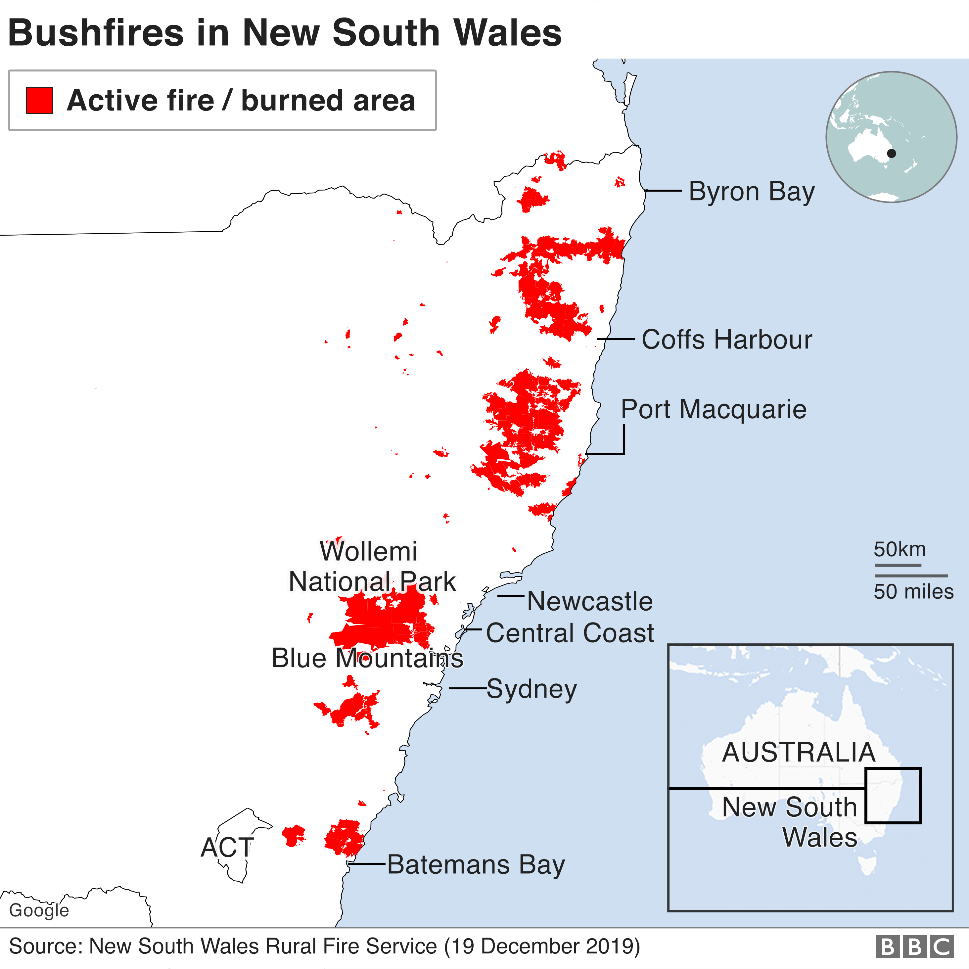
Australia on Fire
Worst bush fires for more than 20 years kill nine people in South Australia. The Eyre Peninsula bushfire also known locally as Black Tuesday and by South Australian Government agencies as the Wangary bushfire, was a bushfire that occurred during January 2005 on the lower part of the Eyre Peninsula, a significant part of South Australia's wheat belt.
The fire resulted in 301 sq mi of land being burned, the loss of nine lives, injury to another 115 people, and huge property damage.

Slide 23
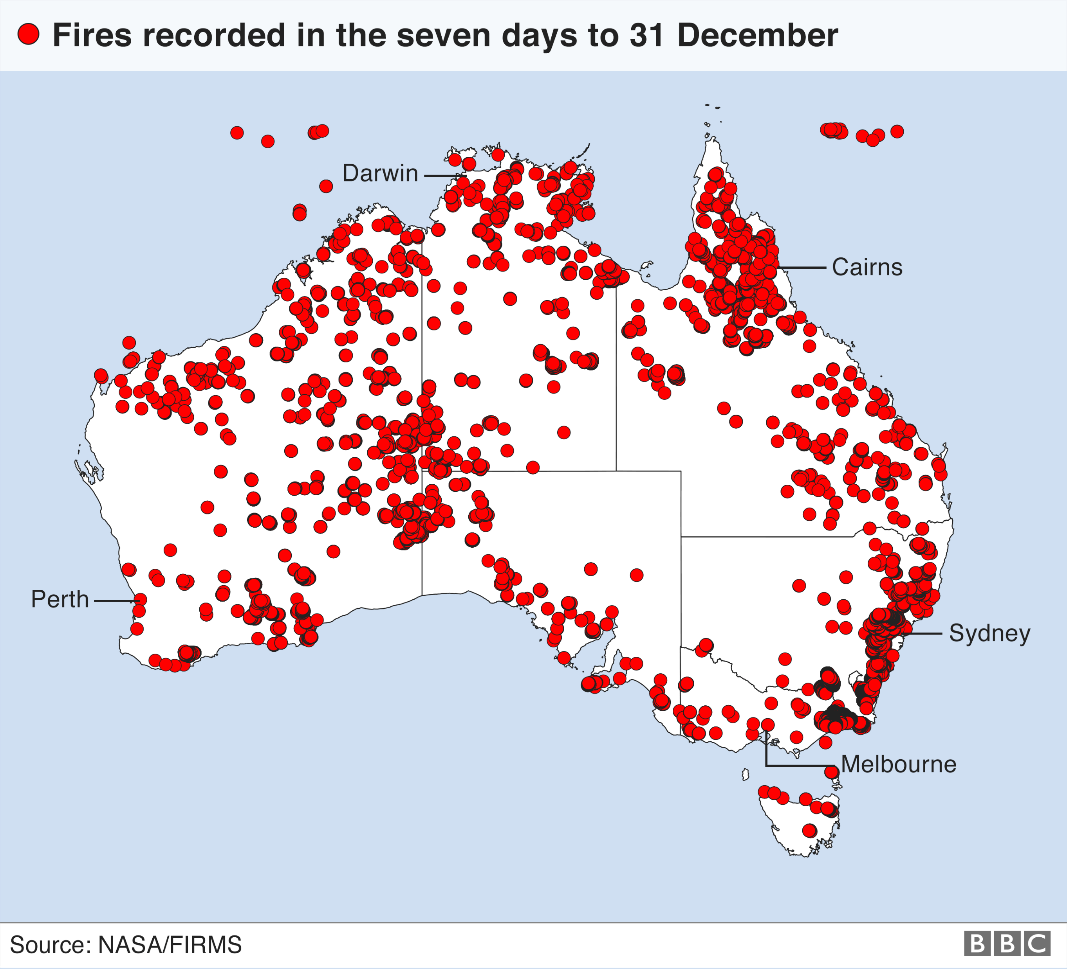
Australia on Fire
The 2019–20 Australian bushfire season, or Black Summer, was one of the most intense and catastrophic fire seasons on record in Australia. It included a period of bushfires in many parts of Australia, which, due to its unusual intensity, size, duration, and uncontrollable dimension, was considered a megafire by media at the time.
Exceptionally dry conditions, a lack of soil moisture, led to an early start to the bushfire season, beginning in June 2019. Hundreds of fires burned into May 2020. The most severe fires peaked from December 2019 to January 2020.
The fires covered over 243,000 square kilometers, resulting in 479 deaths, 9,352 lost structures at a cost of nearly $3.65 billion dollars. Additionally, it was estimated that there were several million animals lost do to the fires.
.

Slide 24
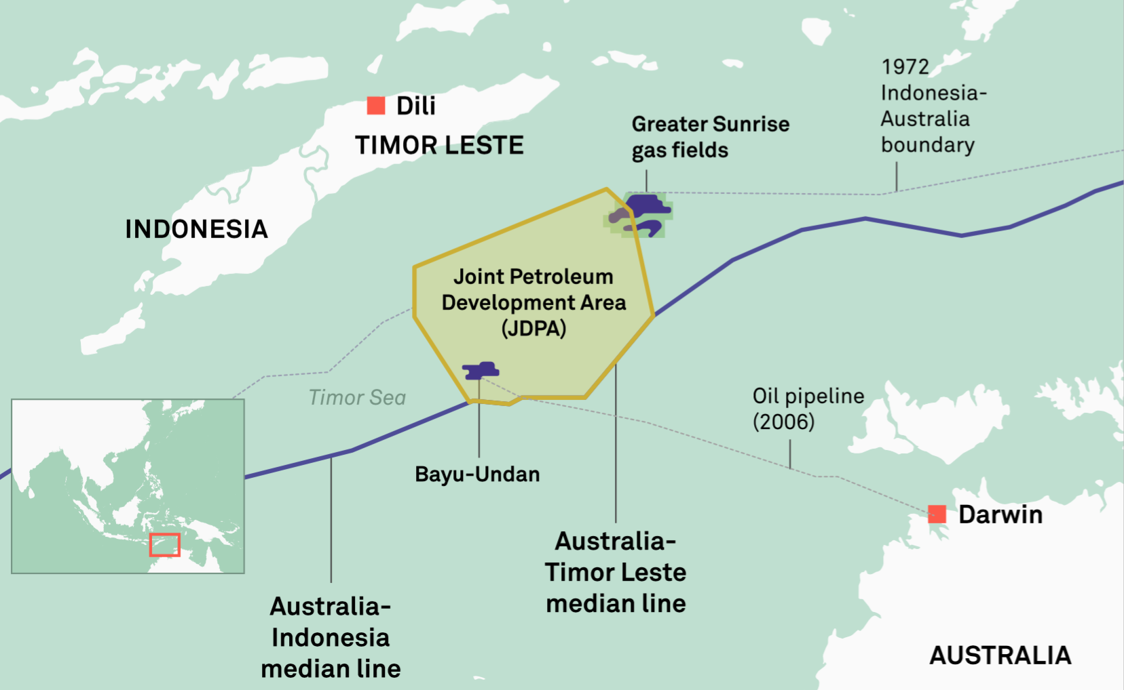
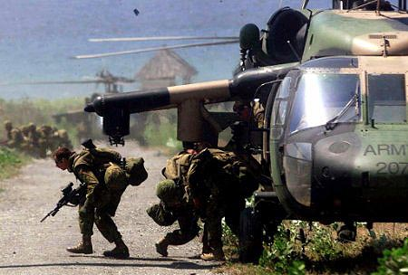
Multibillion Dollar Oil Deal
In January 2006 Australia and East Timor sign a deal to divide billions of dollars in expected revenues from oil and gas deposits in the Timor Sea. Australian Foreign These gas and oil deals will bring over 10 billion dollars to the tiny nation of under 800,000 residents.
Just four months later Australian troops spearhead peacekeeping forces in the Solomon Islands and East Timor after unrest in both countries.

Slide 25
Australian Trivia
The concept of a secret ballot was not a thing until 1856 when Australia became the first country to introduce the secret ballot - or 'Australian ballot' - for elections.
For the sports fans, Australia and England played the first-ever cricket Test match in Melbourne in 1877.
In 1887 Bobby McDonald, a talented young indigenous runner from Cummeragunga Mission in northern Victoria, became the first person to officially begin a running race using a crouch-start.
In the 1850s, James Harrison, a Scottish born resident of Geelong, Vic., designed the first commercially-viable ice-making machine and refrigerator.
Australian Lancelot de Mole was the first person to design a tank in 1911 and submitted his design to the British War Office in 1912.
Tasmanian born and raised Eric Waterworth designed the first stepped-spindle record-changer, allowing six vinyl records to be automatically played in sequence

Slide 26
Australia’s History
I hope you found these facts about Australia’s History interesting and informative.
Hopefully, you all get the opportunity to visit the beautiful and historic country for yourselves.
Thank you for coming!

Slide 27
Acknowledgement
My seminars are the result of many years of travel experience combined with many hours of research over the internet.
I would like to acknowledge the many sources I have accessed.
These include: Wikipedia.com, Britannica.com, and the various Museum, Park and Government websites.

