Slide 1











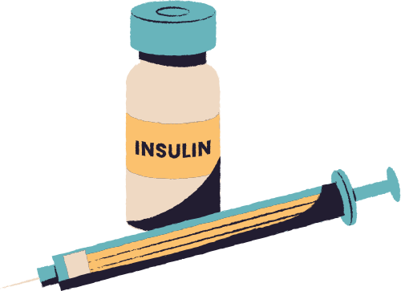
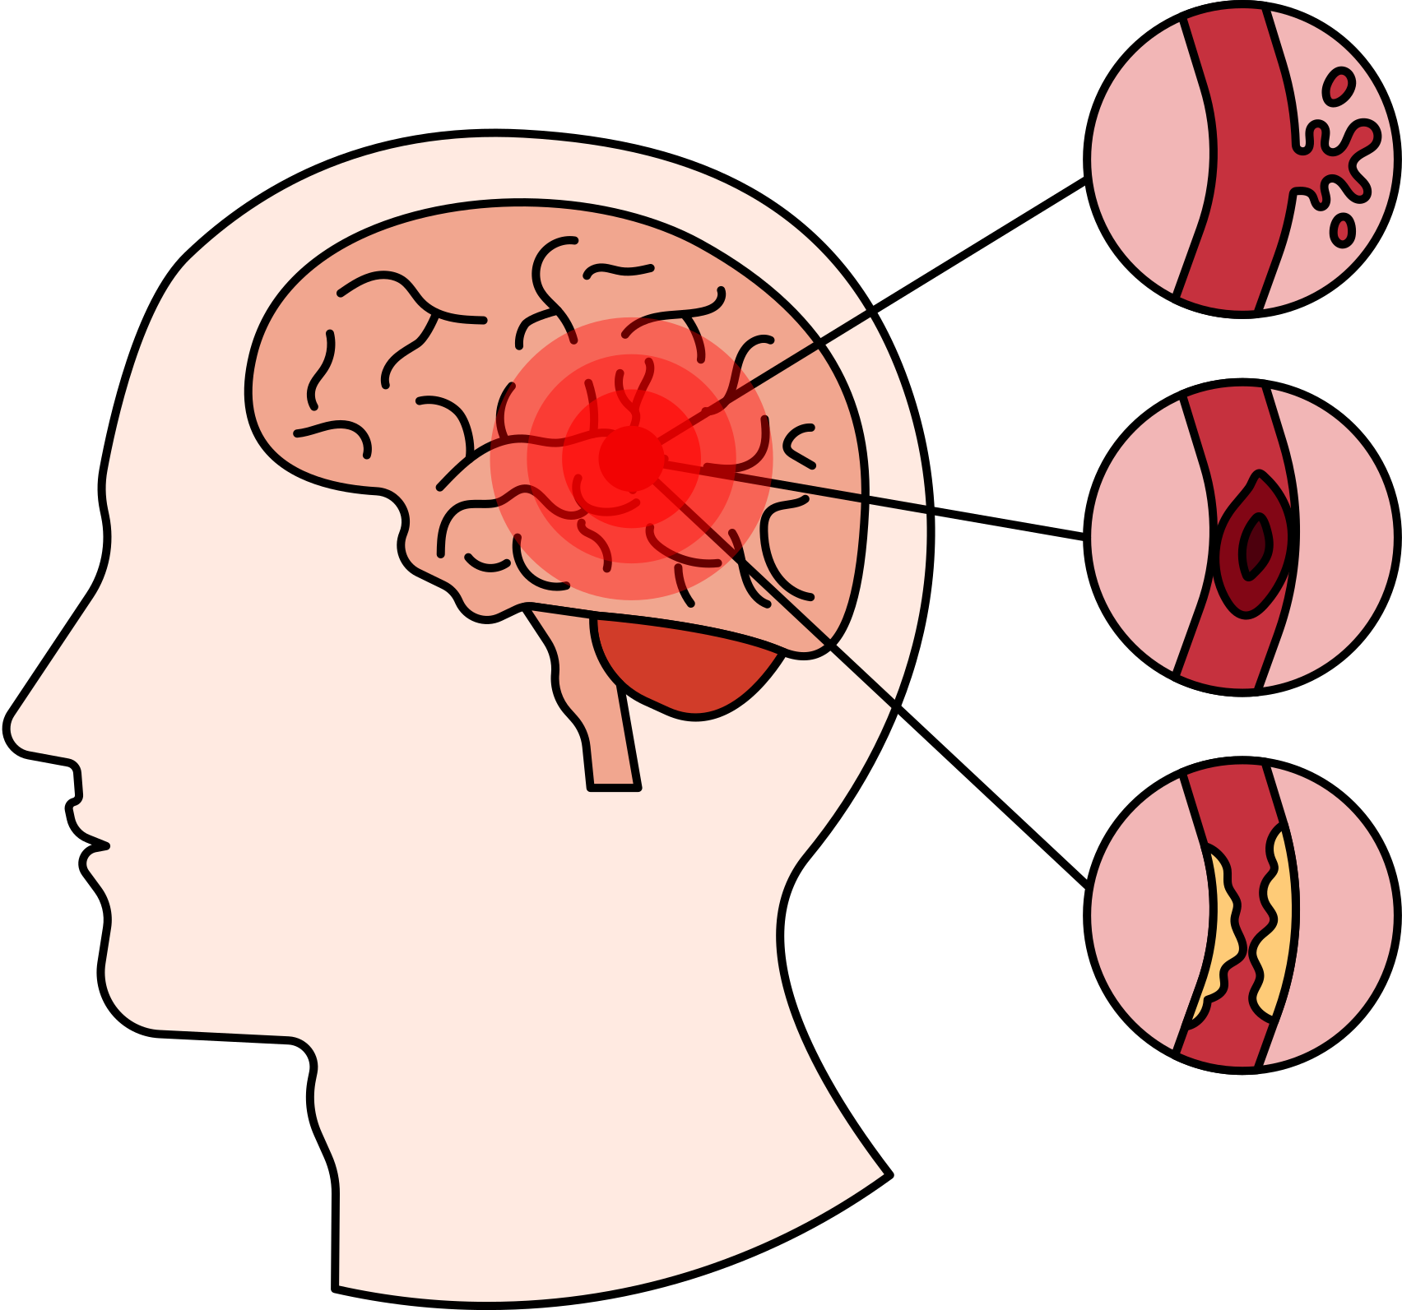


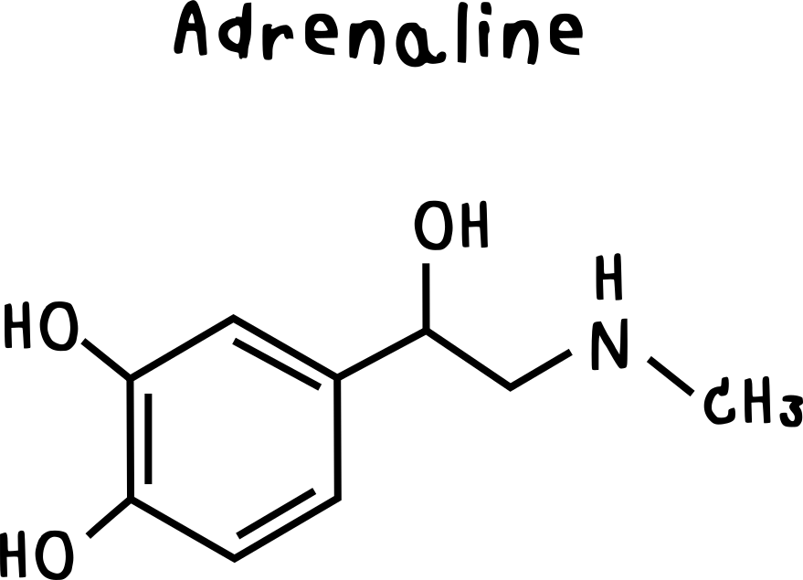

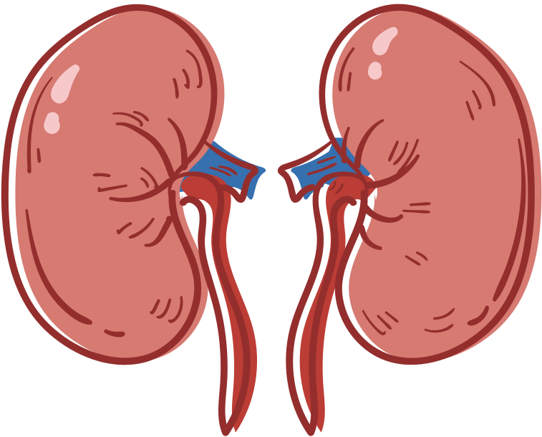

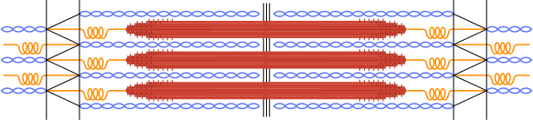




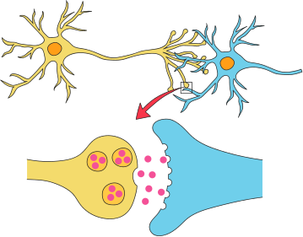
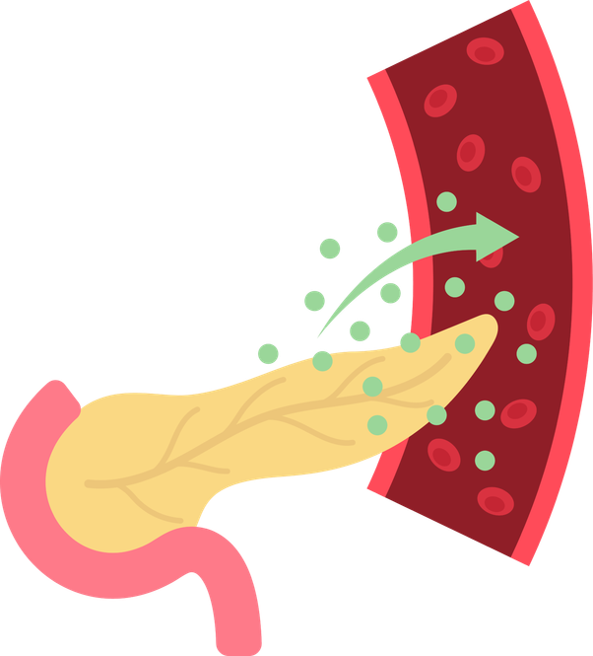

Slide 2

Dobble
Terminales SVT
Dobble
Terminales SVT
Dobble
Terminales SVT
Dobble
Terminales SVT
Dobble
Terminales SVT
Dobble
Terminales SVT

Slide 3

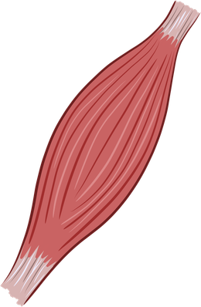

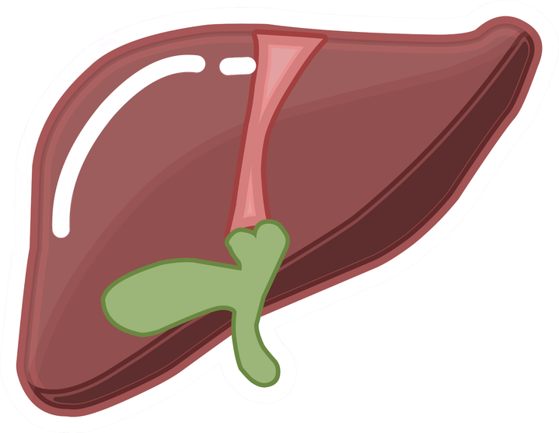

Slide 4
Dobble
Terminales SVT
Dobble
Terminales SVT
Dobble
Terminales SVT
Dobble
Terminales SVT
Dobble
Terminales SVT
Dobble
Terminales SVT

Slide 5



Slide 6
Dobble
Terminales SVT
Dobble
Terminales SVT
Dobble
Terminales SVT
Dobble
Terminales SVT
Dobble
Terminales SVT
Dobble
Terminales SVT

Slide 8
Dobble
Terminales SVT
Dobble
Terminales SVT
Dobble
Terminales SVT
Dobble
Terminales SVT
Dobble
Terminales SVT
Dobble
Terminales SVT

Slide 10
Dobble
Terminales SVT
Dobble
Terminales SVT
Dobble
Terminales SVT
Dobble
Terminales SVT
Dobble
Terminales SVT
Dobble
Terminales SVT

Slide 12
Dobble
Terminales SVT

