Slide 1

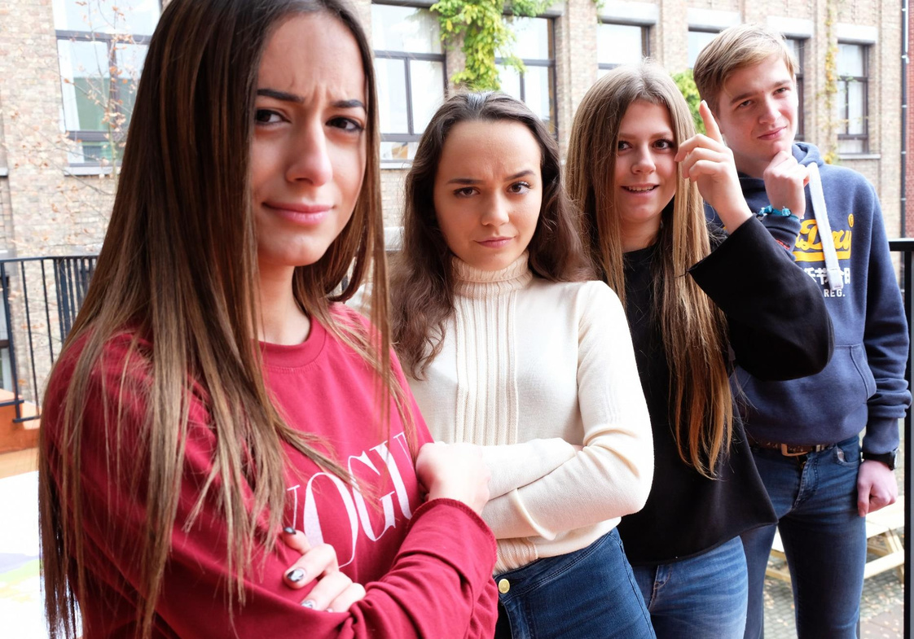




TO BE
FOOLED -
OR NOT?
This module was developed by the European Parliament’s Spokesperson’s Unit and not by the author of the other modules.

Slide 2
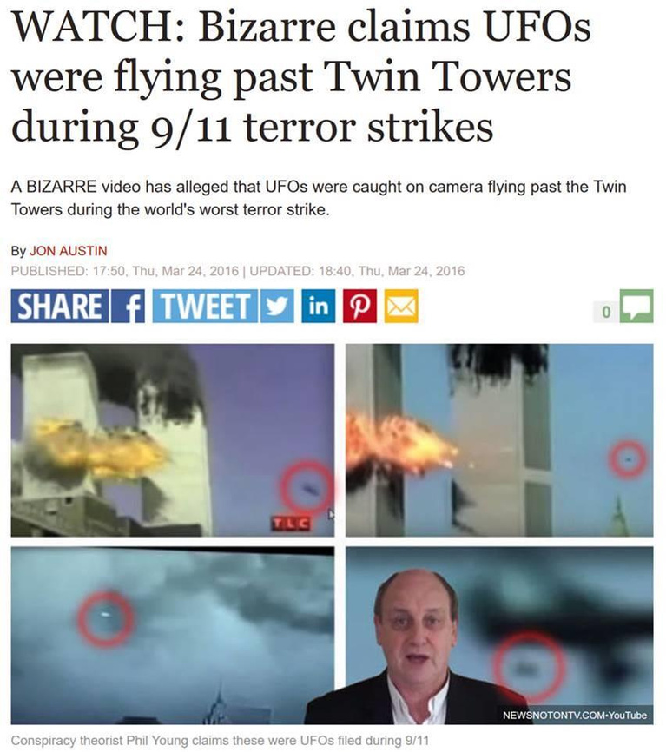
ICE-BREAKER
RELIABLE OR NOT?

Slide 3
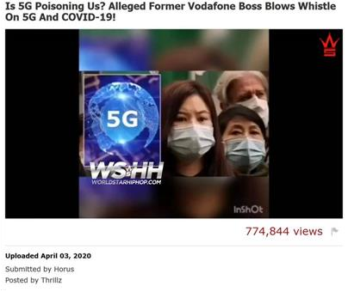
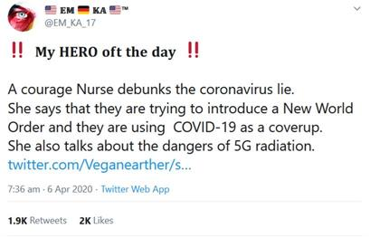
ICE-BREAKER
RELIABLE OR NOT?

Slide 4

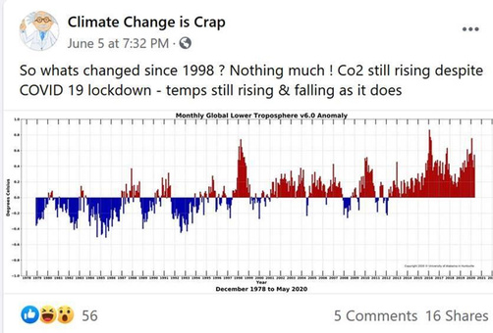
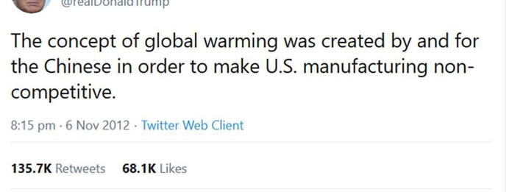
ICE-BREAKER
RELIABLE OR NOT?

Slide 5

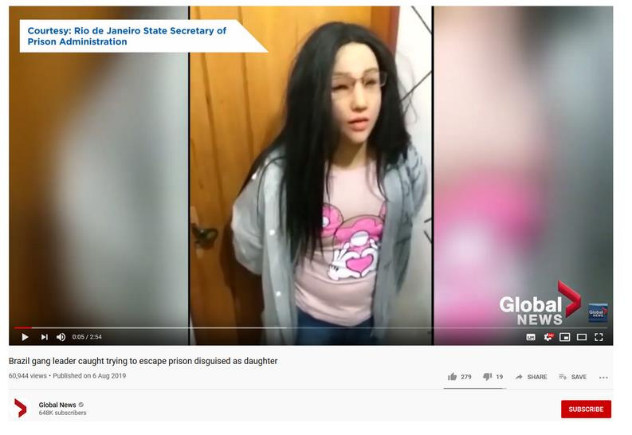
ICE-BREAKER
REAL OR FAKE?

Slide 6

CLASS ACTIVITY
KNOWING
WHAT
HAPPENS
Where do you get the news?
... or what information sources do you know?

Slide 7
CLASS ACTIVITY
THINKING
ABOUT OUR
SOURCES OF
INFORMATION
Have you come across news that seems strange over the past week/month?

Slide 8
CLASS ACTIVITY
a. Simply not true
b. I completely disagree
c. Exaggerated or twisted
d. Too good (or too bad) to be true
e. Contradicts everything I know on the subject
f. Fits my wishes or beliefs a bit too easily
g. Disgusting
h. Joke
i. Other
STRANGE IN WHAT WAY?

Slide 9


CLASS ACTIVITY
OPINION OR FACT?
An opinion is based on a belief or point of view. It is not based on verifiable evidence.
A fact is something that can be checked and backed up with evidence.

Slide 10

CLASS ACTIVITY
WHAT IS DIS-INFORMATION
What? False or misleading information.
How? Made or spread on purpose.
Why? To make money or deceive.

Slide 11
CLASS ACTIVITY
WHAT IS THE PROBLEM WITH DIS-INFORMATION?
1. Fools you into...
only seeing one (twisted) side of the story,
having strong feelings for the wrong reasons,
acting differently,
looking stupid in front of others.
2. Makes it harder to get the right information when you need it.
3. Can have a negative impact on society.

Slide 12
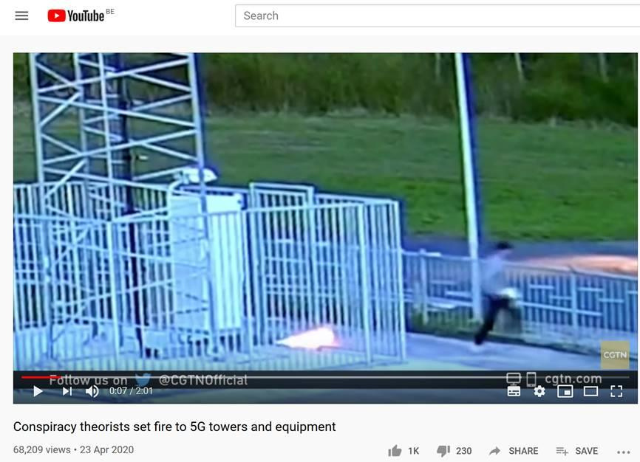
EXAMPLE
DISINFORMATION
CAN DO REAL DAMAGE IN REAL LIFE
Attacks to 5G towers as a result of disinformation about 5G.

Slide 13
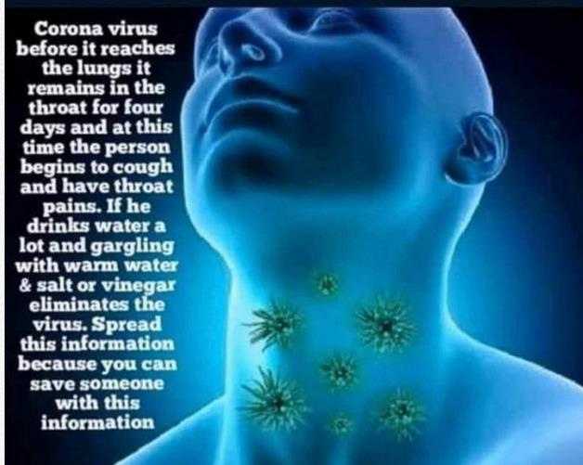
EXAMPLE
DISINFORMATION CAN PUT
PEOPLE’S LIFE IN DANGER
Like this viral picture has done.

Slide 14
FINAL PRESENTATION
WHO CAN BE FOOLED BY DISINFORMATION?
EVERYONE!!!
All age groups, genders, backgrounds, regardless of education levels.
We are easier to fool when:
there are strong feelings involved (love, fear, hope),
the message comes from someone we trust,
the message is in line with our existing beliefs.

Slide 15
FINAL PRESENTATION
WHO SHOULD FIGHT DIS-INFORMATION?
EVERYONE...
Journalists and Influencers,
Politicians,
Media and Social Media Companies,
Educators,
... YOU TOO!
Be alert and verify strange news,
Think before you share news,
Talk to friends who may have been fooled.

Slide 16
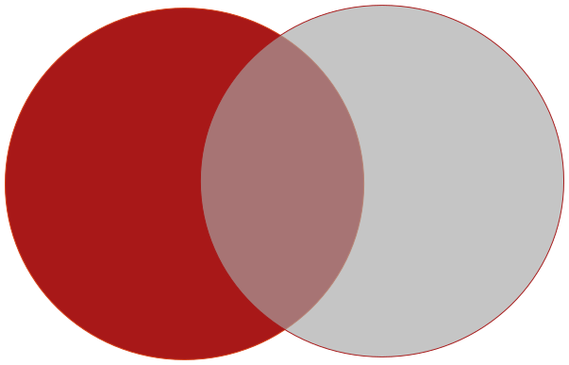
FINAL PRESENTATION
FAKE NEWS, WHAT IS IT ABOUT?
FALSE
INTENT TO HARM
MIS-INFORMATION
DIS-INFORMATION
MAL-INFORMATION
False Connection
Misleading Content
(Some) Leaks
Harassment
Hate Speech
False Content
Imposter Content
Manipulated Content
Fabricated Content

Slide 17
FINAL PRESENTATION
KNOWING WHAT IS TRUE AND FALSE
What ways are there to check whether a news story is true or not?
Some ideas:
Read the whole article – do the content and the headline match?
Search the story on the internet – do other sources corroborate?
Do you know what kind of sources they are?
Verify the date and author.
Check if pictures look strange.

Slide 18
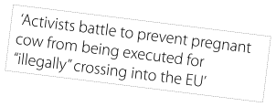
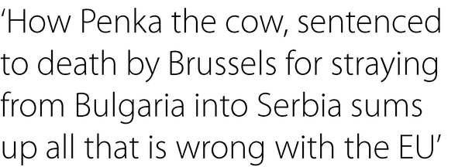
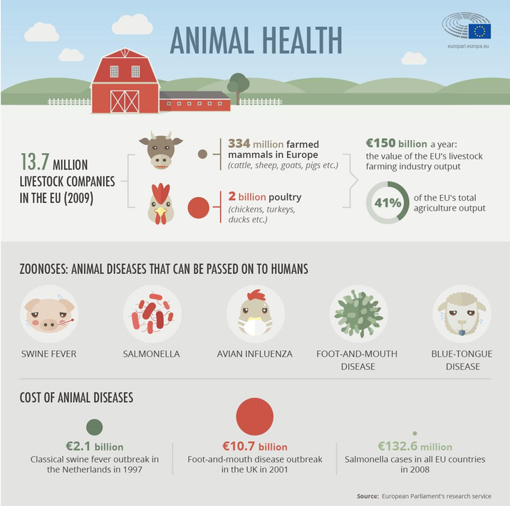
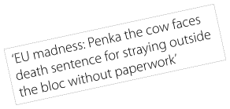
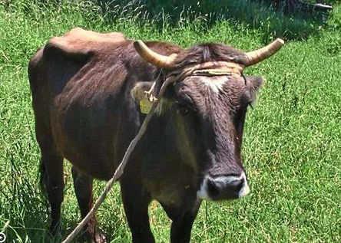
FINAL PRESENTATION
THE SAD BUT
TRUE STORY OF PENKA THE
COW
Often it is not about the facts but how you tell a story.

Slide 19
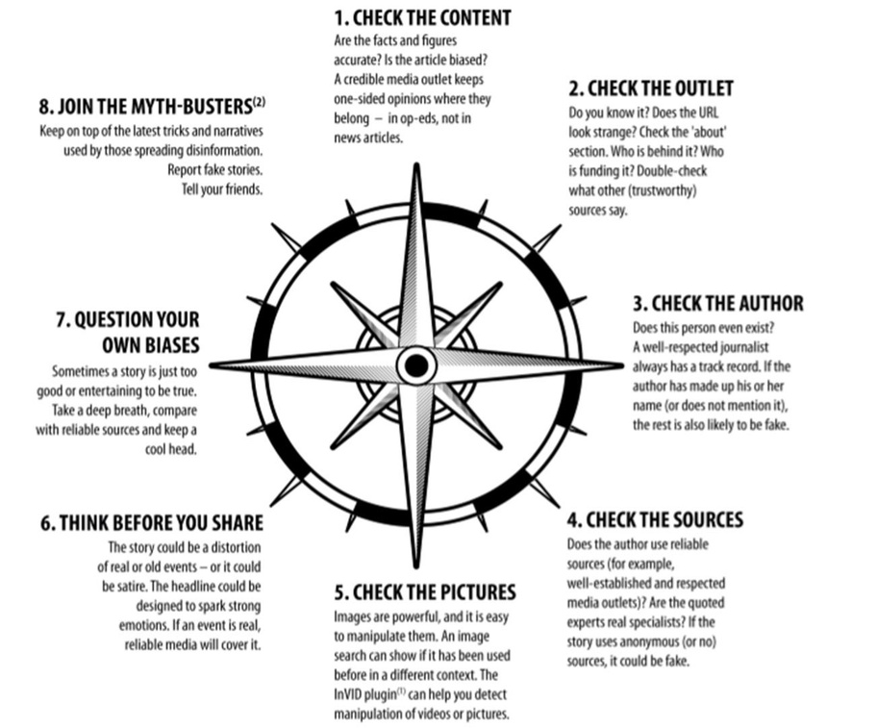
FINAL PRESENTATION
THE
FACT-CHECKING
COMPASS

Slide 20
FINAL PRESENTATION
EU MEASURES AGAINST DIS-
INFORMATION
“EU vs Disinfo” – special team for disinformation abroad.
Improve ways to identify disinformation quickly,
Warn citizens about risks of disinformation,
Put pressure on social media companies so that they also do their part,
Support fact-checkers and journalists inside and outside the EU.
https://euvsdisinfo.eu

Slide 21
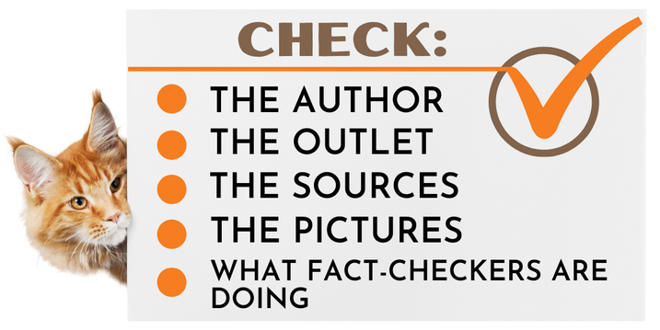
FINAL PRESENTATION
FOLLOW
FACT-CHECKERS
Lists of fact-checking organizations in your country are updated through the Poynter Institute and Facebook.
In Greece, the two official fact-checking organizations are (under the IFCN Code of Principles): Ellinika Hoaxes & Greece Fact Check.
EU’s own anti-disinformation group and “think before you share” campaign.

Slide 22


TO BE
FOOLED -
OR NOT?
CONTACT
Spokesperson’s Unit – European Parliament
europarl-spox@europarl.europa.eu
Portugal
Spain
This module was developed by the European Parliament – Spokesperson’s Unit and not by the author of the other modules © European Parliament, 2020
This presentation was edited on behalf of the Young European Diplomats (YED) Programme, under the supervision of the Young European Ambassadors (YEAs) Initiative of EU NEIGHBOURS EAST. Project funded by the European Union.

