Slide 1






THE EU IN OUR DAILY LIVES

Slide 2

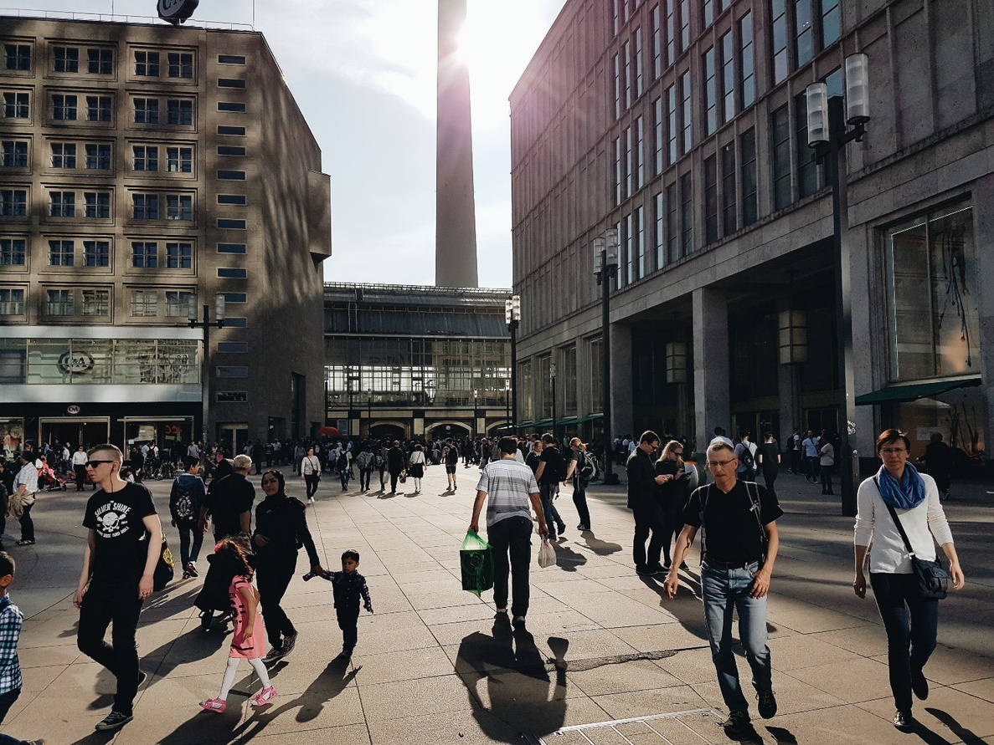
EU MEMBERSHIP HAS CHANGED OUR COUNTRIES AND OUR DAILY LIVES
The internal market, the open borders and the introduction of the euro are some of the most remarkable accomplishments of the European Union.
But EU decisions shape the world we live in much more than we realize and in many areas.
Find out more through some concrete examples.

Slide 3

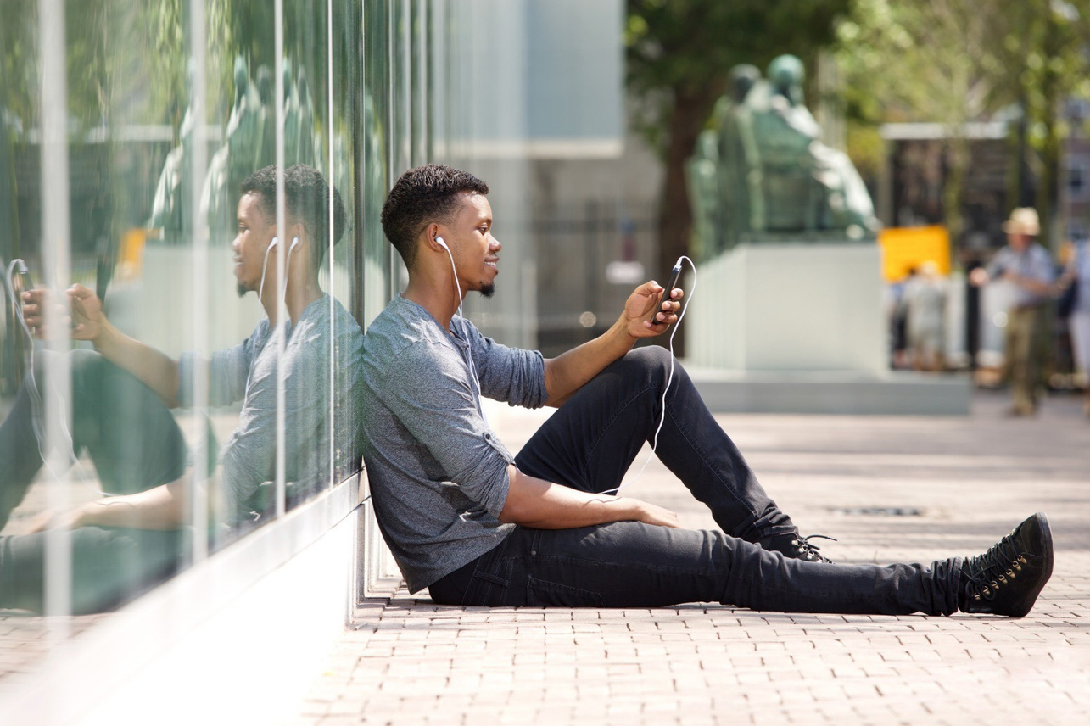
CONSUMER PROTECTION
No roaming charges in the EU
Since 2017, European Economic Area (EEA) residents travelling within the EU countries pay domestic prices for phone calls, text messages and mobile internet.
what-europe-does-for-me.eu/en/portal/2/D14
Photo by Mimagephotos

Slide 4
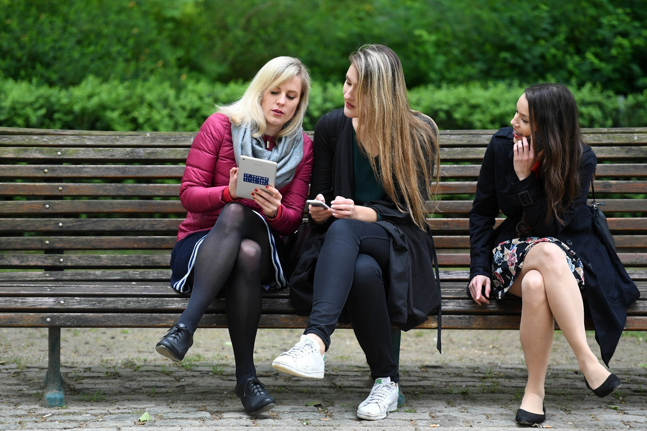
CONSUMER PROTECTION
Two-year warranty on faulty electronic devices
Under EU legislation, manufacturers must provide a legal guarantee period of two years for electronic appliances such as smartphones, printers, laptops, vacuum cleaners, and coffee machines.
what-europe-does-for-me.europarl.europa.eu/en/social/G14
© European Union 2017

Slide 5
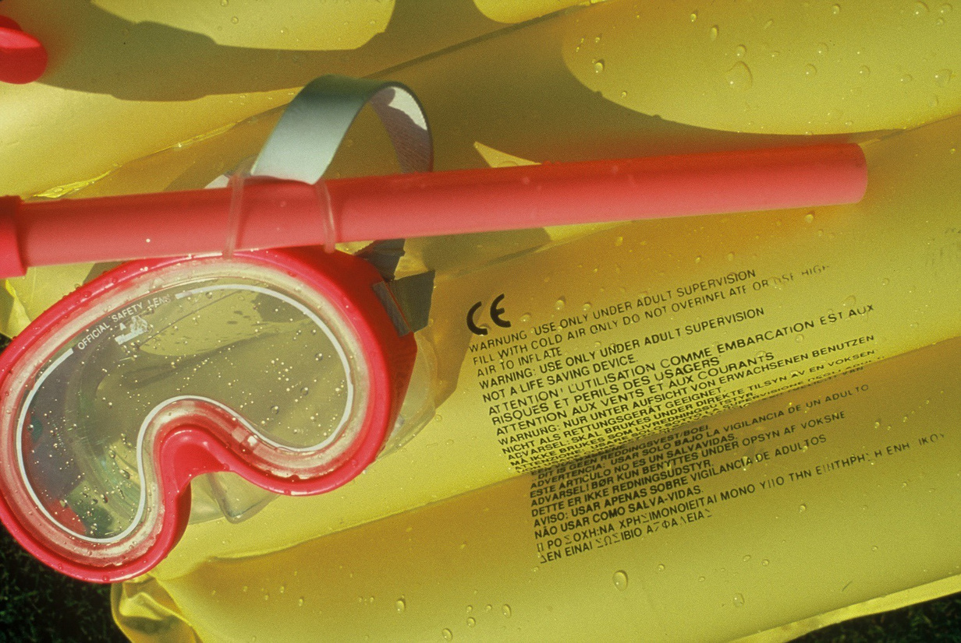
CONSUMER PROTECTION
Product safety standards
Products sold within the EU have to meet the EU’s health, safety, and environmental protection standards. CE marking is a certification mark that indicates conformity with these standards.
ec.europa.eu/growth/single-market/ce-marking_en
© European Communities, 1997

Slide 6
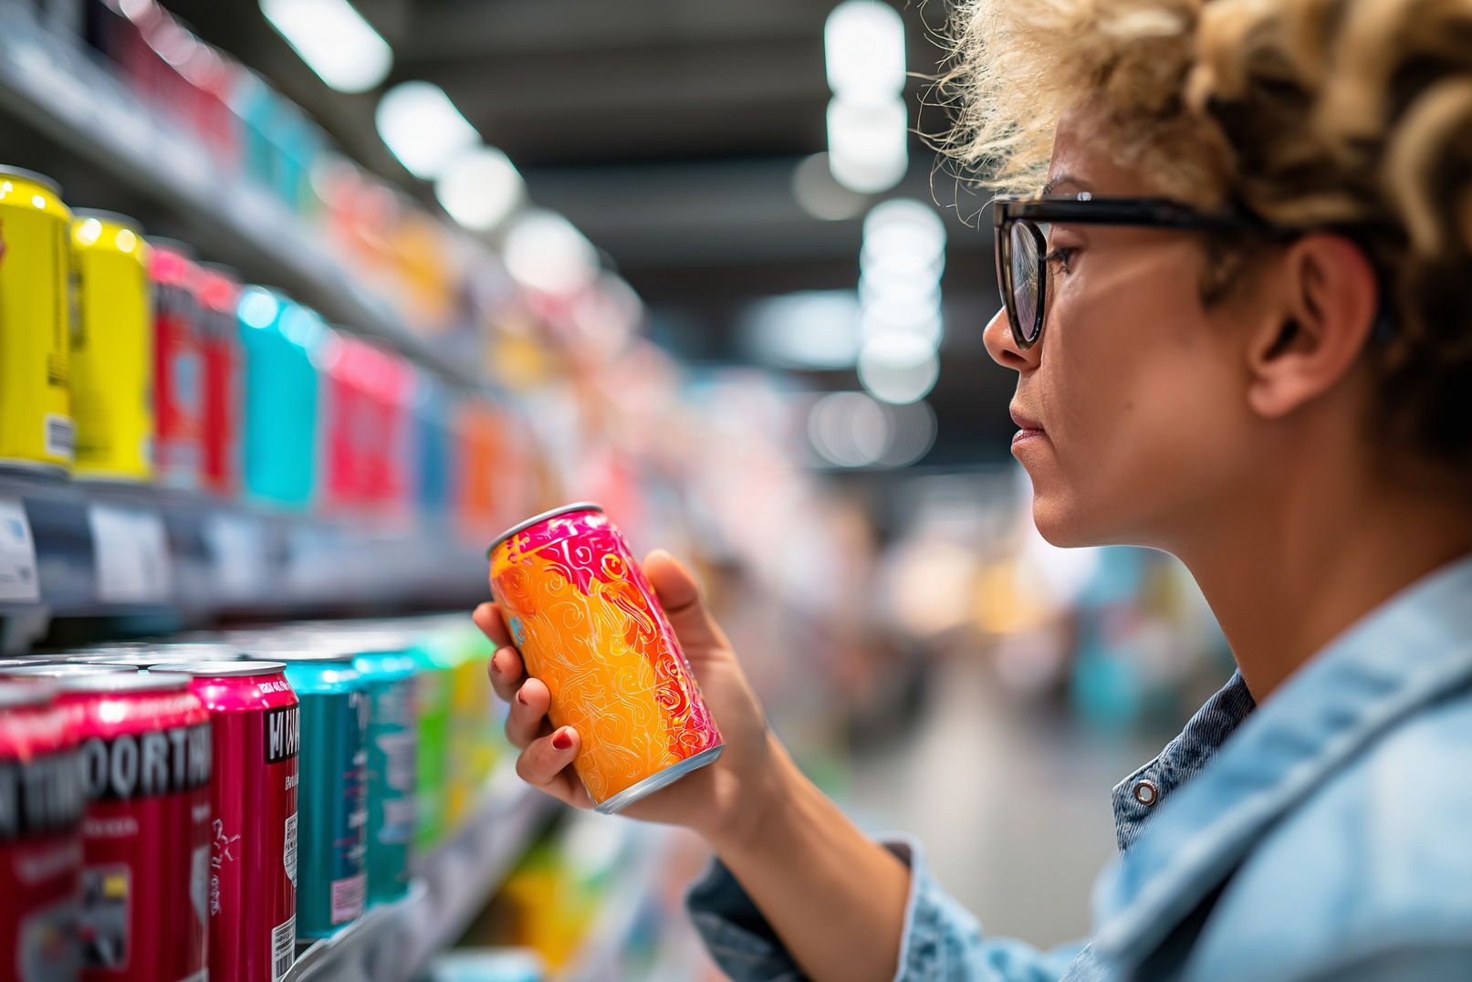
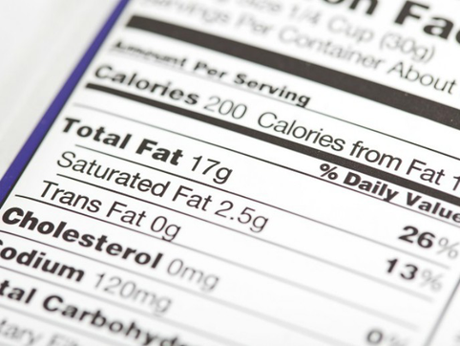
CONSUMER PROTECTION
Information on product labels
The EU wants people to have correct and complete information about what they consume. That is why product labels for food have toinclude certain information, such as ingredients and the name of the manufacturer.
what-europe-does-for-me.europarl.europa.eu/en/social/E23
© European Union 2025 -AdobeStock

Slide 7

WORKING TIME
At least four weeks of paid leave
The EU Working Time Directive, originally introduced in 1993, gives workers the right to ‘paid annual leave of at least four weeks’. Each sector and/or Member State can increase the number of days, but the EU minimum is 20 days.
ec.europa.eu/social/main.jsp?catId=706&langId=en&intPageId=205

Slide 8
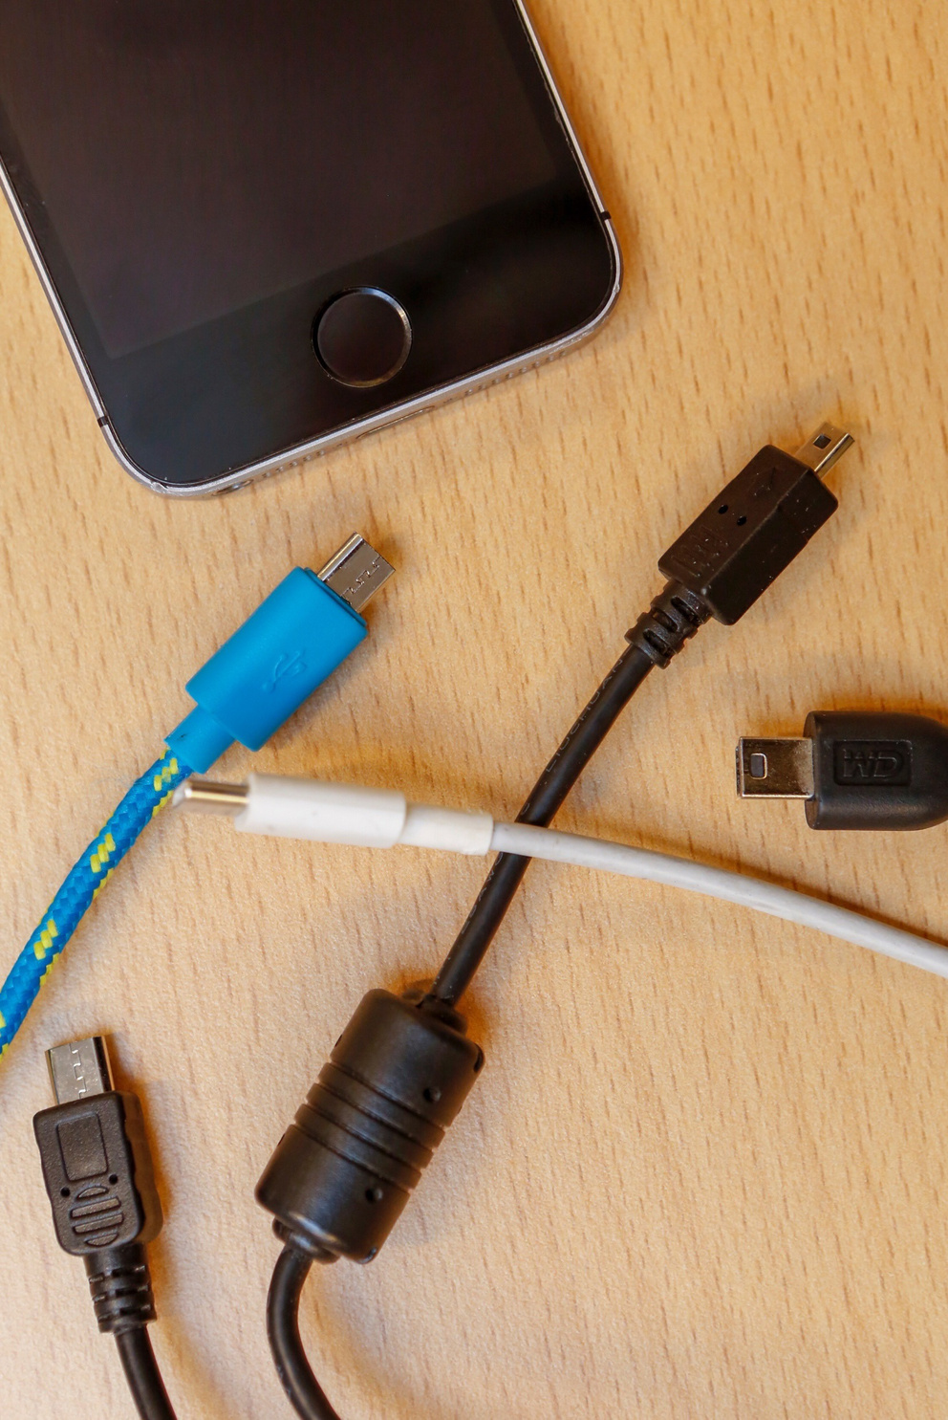
PROTECTION OF THE ENVIRONMENT
Common charger for all mobile devices
All mobile phones, tablets, and cameras sold in the EU must be equipped with a USB Type-C charging port. From spring 2026, the obligation will extend to laptops.
single-market-economy.ec.europa.eu
© European Union 2020 -EP

Slide 9
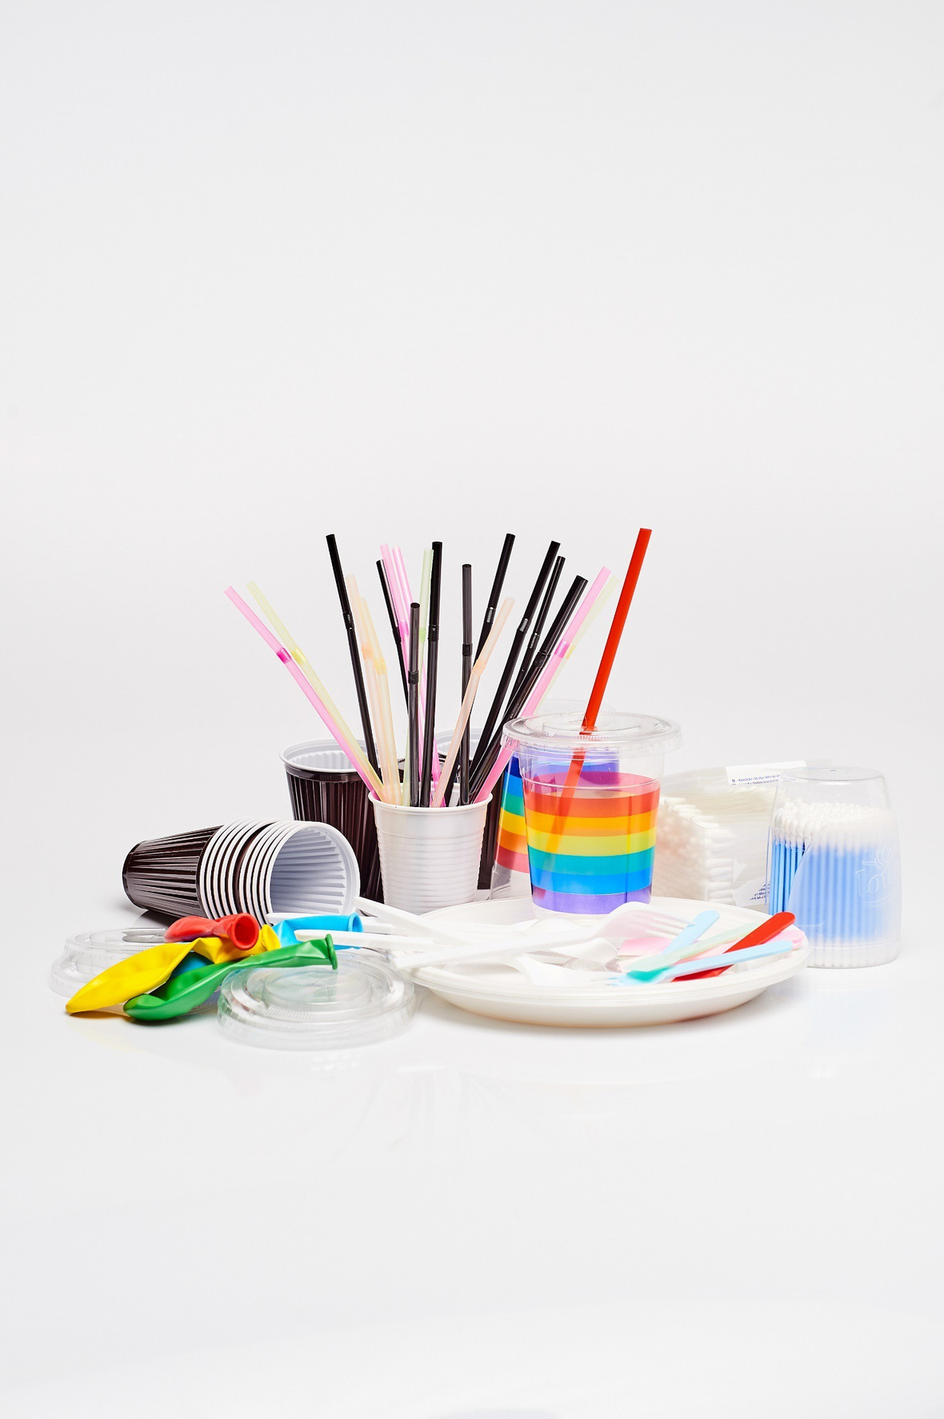
PROTECTION OF THE ENVIRONMENT
A ban on single-use plastics
The EU has approved a new law banning single-use plastic items such as disposable plates, cutlery, straws and cotton bud sticks. The ban has been in effect since 2021.
environment.ec.europa.eu/topics/plastics/single-use-plastics_en
© European Union 2019

Slide 10
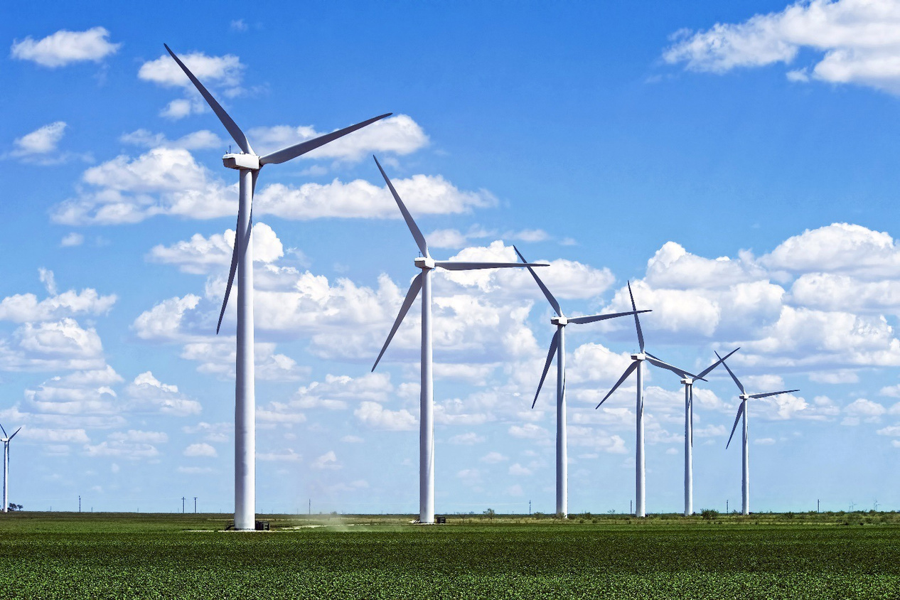
PROTECTION OF THE ENVIRONMENT
A share of at least 42.5% renewable energy by 2030
To facilitate the transition away from fossil fuels towards cleaner energy, the EU raised its target for renewable energy to at least 42.5% of the overall energy mix by 2030, with an aim to reach 45%. This percentage varies for every Member State, depending on the situation in each country.
what-europe-does-for-me.europarl.europa.eu/en/social/B104?search=renewable%20energy
© European Union 2017

Slide 11




THE EU IN OUR DAILY LIVES
You can find more concrete examples of EU legislation on
what-europe-does-for-me.eu
Portugal
Spain
This presentation is part of the educational tool EUROPE@SCHOOL –Active lessons about the European Union. © European Union, 2025
This presentation was edited on behalf of the Young European Diplomats (YED) Programme, under the supervision of the Young European Ambassadors (YEAs) Initiative of EU NEIGHBOURS EAST. Project funded by the European Union.

