Slide 1






A BRIEF
HISTORY
OF THE EU
Portugal
Spain

Slide 2


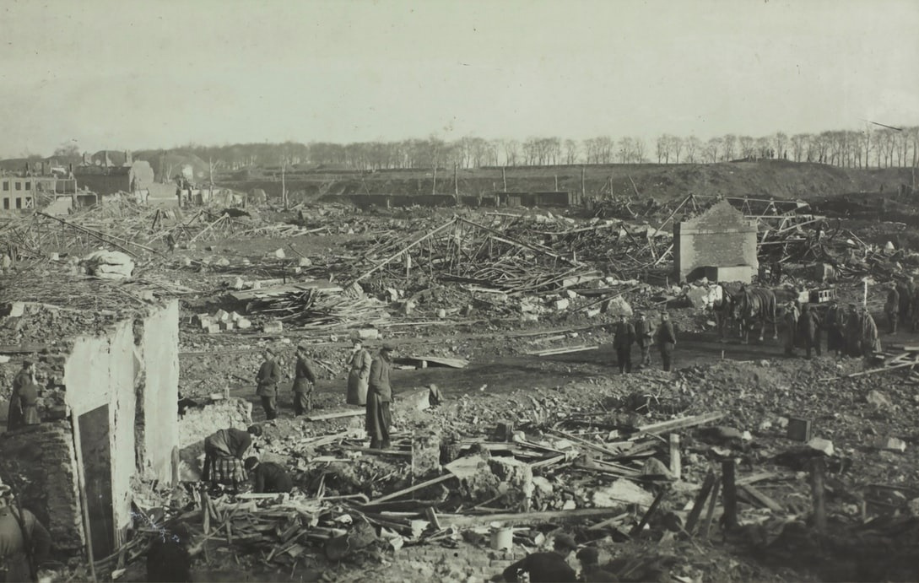
FROM COAL AND STEEL TO A COMMON EURO AND BEYOND
1935
1940
1945
1950
1955
1939-1945
WORLD WAR II
Europe was in ruins after World War II. The war had destroyed cities, roads and much of Europe’s industry. Europe’s economy was in shambles. The war had also been devastating on a human scale:
  55 million people worldwide were killed
  35 million people were injured and,
  190 million people had fled their homes.
The cry for peace was louder than ever before.

Slide 3

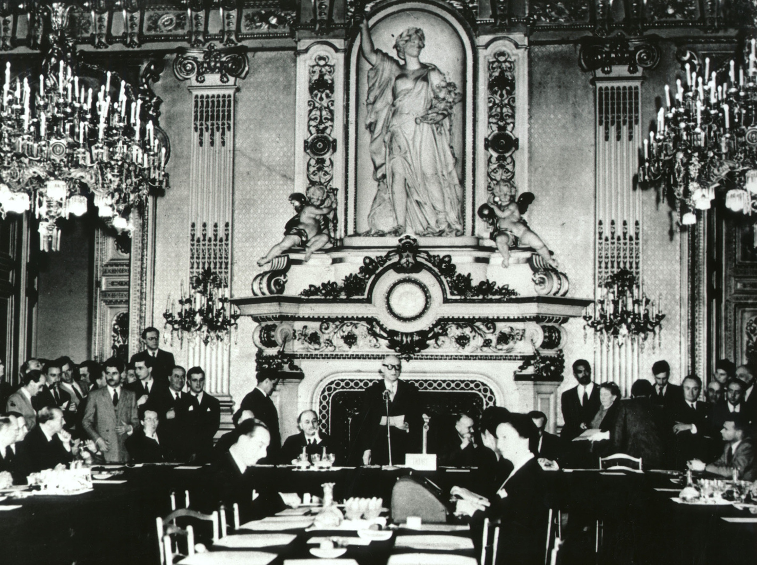
FROM COAL AND STEEL TO A COMMON EURO AND BEYOND
1950
1955
1960
1965
1970
9/5 1950
1950: SCHUMAN DECLARATION
On 9 May 1950, the French Minister of Foreign Affairs, Robert Schuman, held a press conference. He called upon other European countries to pool coal and steel resources. As coal and steel are necessary components for arms production, he hoped this cooperation would render future war impossible. On top of that, coal and steel were also very important in rebuilding the continent after the war.
Schuman declaration © European Communities, 1950

Slide 4
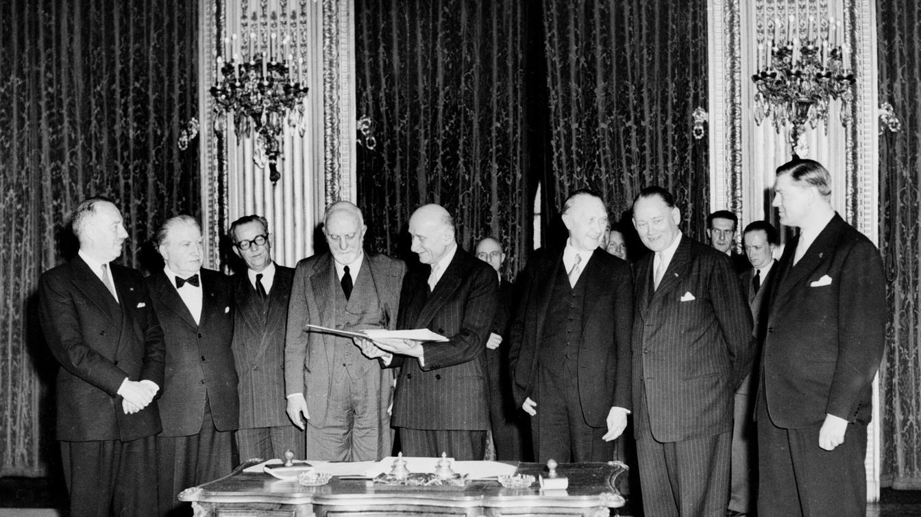
FROM COAL AND STEEL TO A COMMON EURO AND BEYOND
1950
1955
1960
1965
1970
1951
1951: TREATY ESTABLISHING THE EUROPEAN COAL AND STEEL COMMUNITY
France, Germany, Italy, Belgium, the Netherlands and Luxembourg reacted positively to Robert Schuman’s declaration. These six countries signed the Treaty of Paris in 1951. The European Coal and Steel Community (ECSC) entered into force in 1952.
© European Communities, EP

Slide 5
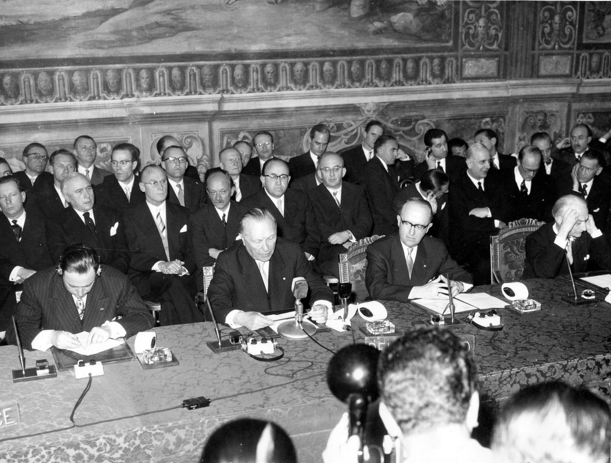
FROM COAL AND STEEL TO A COMMON EURO AND BEYOND
1950
1955
1960
1965
1970
1957
1957 – TREATIES OF ROME: EEC AND EURATOM TREATIES
The first six countries wanted an even stronger economic integration. Therefore, they signed two new treaties in 1957: the EEC treaty and Euratom, also known as the Rome Treaties.
  European Economic Community (EEC): The countries agreed to gradually turn their separate economies into a common market, starting with a customs union. This treaty marked the beginning of the cooperation in agriculture, fisheries, harbourpolicy and transport policy.
  Euratom: This cooperation in nuclear energy aimed at joint research into the possible civilian applications of nuclear energy.
The Rome Treaties entered into force in 1958.
Signing of the Rome Treaties © AP 1957 –Source EC Audiovisual Service

Slide 6
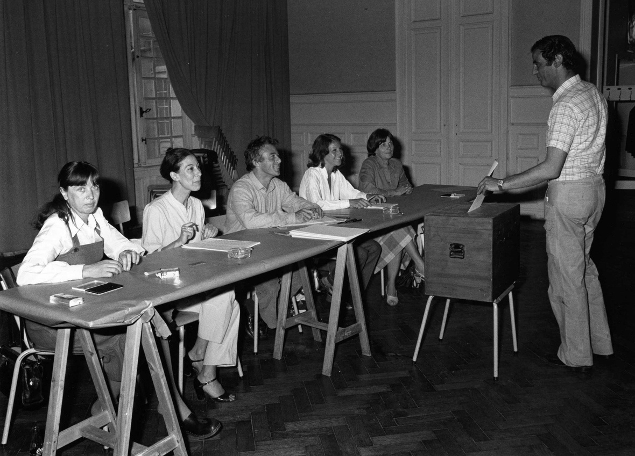
FROM COAL AND STEEL TO A COMMON EURO AND BEYOND
1975
1980
1985
1990
1995
1979
1979: FIRST DIRECT ELECTIONS FOR THE EUROPEAN PARLIAMENT
The citizens of the European Communities directly elected their representatives in the European Parliament for the first time in June 1979. At the time, there were nine countries, electing 410 Members of Parliament from 1979 to 1984.
Polling office in the European elections, Belgium © European Communities, 1957

Slide 7
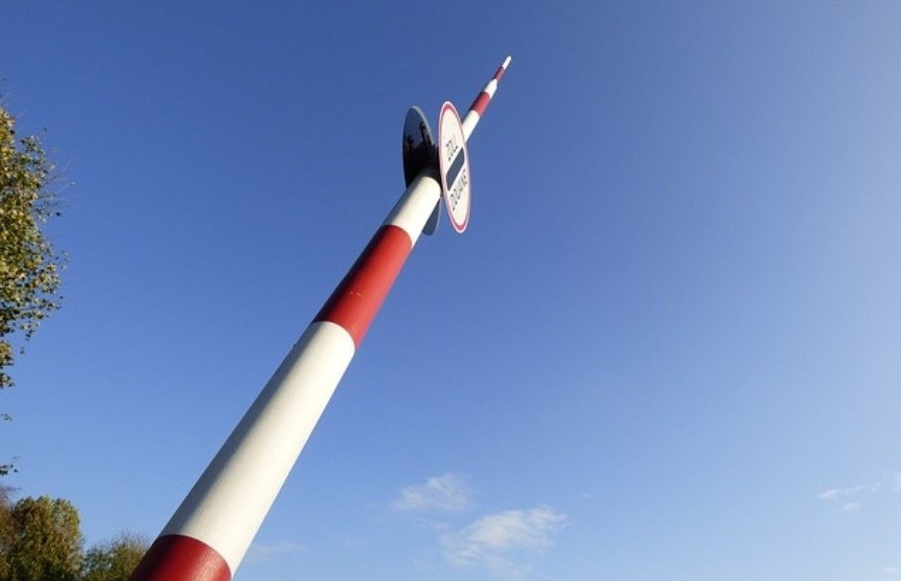
FROM COAL AND STEEL TO A COMMON EURO AND BEYOND
1975
1980
1985
1990
1995
1986: THE SINGLE EUROPEAN ACT
1986
1993
Thirty years after the countries had decided to establish a common market (the Rome Treaties), it was still not in effect. With the Single European Act the Member States decided that all obstacles to trade and free movement had to be removed (it was signed in 1986 and came into force in 1987).
1993: OPEN BORDERS
On 1 January 1993, the internal borders of the Member States of the European Union “disappeared”: The Single Market with free movement of persons, goods, services and capital came into effect.

Slide 8
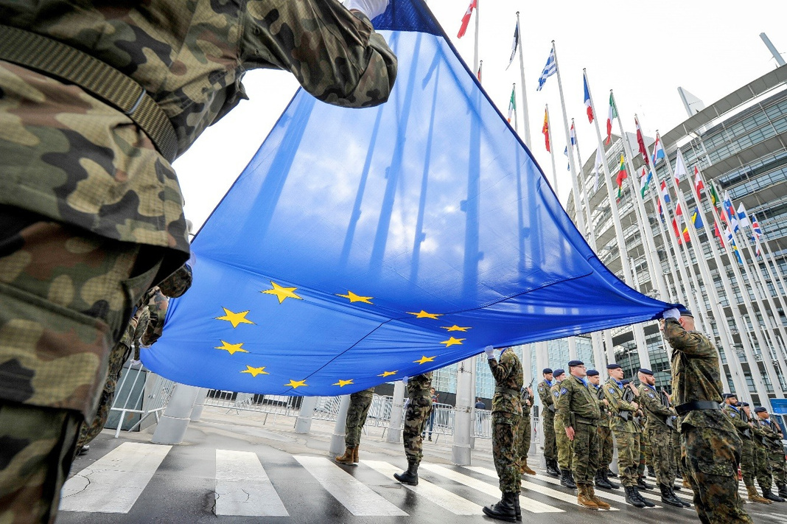
FROM COAL AND STEEL TO A COMMON EURO AND BEYOND
1975
1980
1985
1990
1995
1992: TREATY OF THE EUROPEAN UNION – MAASTRICHT TREATY
1992
The Maastricht Treaty marked the actual beginning of cooperation on a political level, alongside the existing economic integration. A new name was given to the former European Communities: the European Union. The ‘new’ European Union consisted of three main pillars:
  Economic integration: The Member States decided to enhance economic integration and to establish a common European currency: the euro.
  Cooperation on foreign and security policy.
  Cooperation on home/domestic affairs and justice.
This treaty was signed in 1992 and entered into force in 1993.

Slide 9
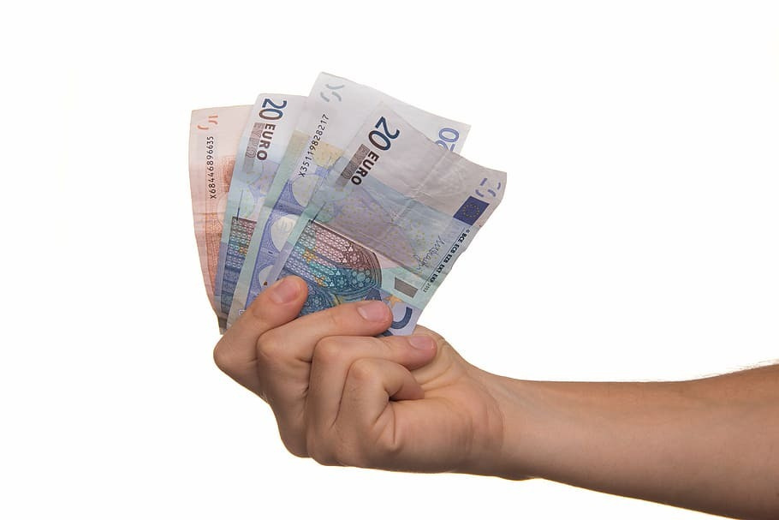
FROM COAL AND STEEL TO A COMMON EURO AND BEYOND
2000
2005
2010
2015
2020
2002
2002: INTRODUCTION OF THE EURO
The euro was introduced into the banking system in 1999. But people only started using euro coins and notes on 1 January 2002.

Slide 10
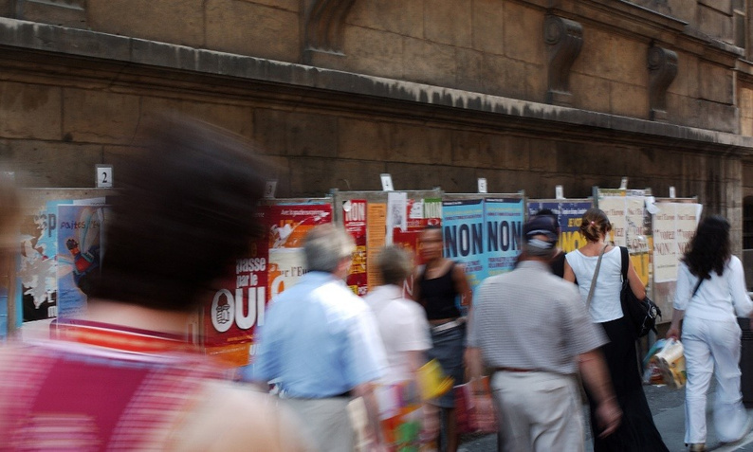
FROM COAL AND STEEL TO A COMMON EURO AND BEYOND
2000
2005
2010
2015
2020
1997
2001
2004 2005
1997: TREATY OF AMSTERDAM
2001: TREATY OF NICE
The population of France and the Netherlands voted against this new “Constitution for Europe”. “Since every new EU Treaty has to be approved by every single Member State, the Constitution couldn't be adopted”.
With the prospect of EU enlargement towards Eastern Europe, the EU needed to be ready for a significant rise in the number of Member States. A reform of the decision-making process was needed: fewer decisions based on unanimity and more on majority voting. The first attempt to change this was with the Amsterdam Treaty (signed in 1997, came into force in 1999). The treaty, however, did not live up to this expectation.
With the accession date of the new countries coming closer, a second attempt to reform the European Union was made in Nice (signed in 2001, came into force in 2003). It also failed to make the EU decision-making easier.
2004-2005: THE EUROPEAN CONSTITUTION
A third attempt was made with the European Constitution in June 2004. Because of the importance of the European Constitution and also the fact that the word “constitution” was used, some countries decided to organize a referendum.
Posters for the referendum about the European constitution in France © European Communities, 2005

Slide 11
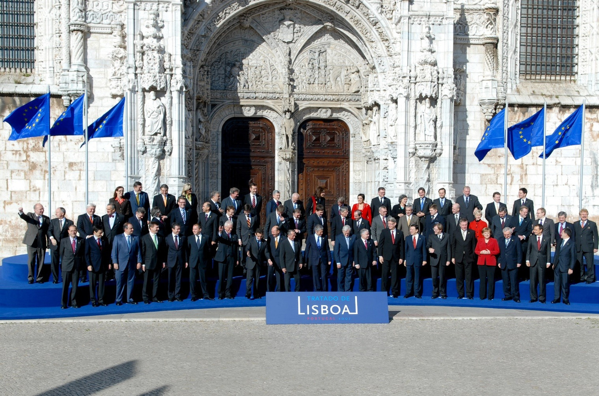
FROM COAL AND STEEL TO A COMMON EURO AND BEYOND
2000
2005
2010
2015
2020
2007
2007: LISBON TREATY
The Lisbon Treaty succeeded in changing the functioning of the EU institutions. Making decisions at the EU level became easier. The new rules entered into force in December 2009 and still determine how the EU functions today.
Heads of state in Lisbon, for the signing of the Treaty. © European Communities 2007

Slide 12
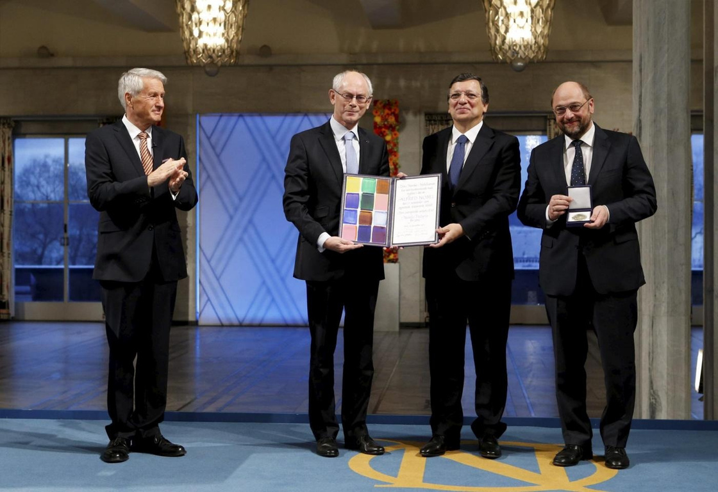
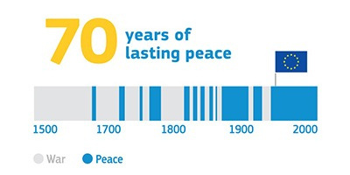
FROM COAL AND STEEL TO A COMMON EURO AND BEYOND
2000
2005
2010
2015
2020
2012
2012: THE EU WINS THE NOBEL PEACE PRIZE
This prize was awarded to recognize European efforts towards peace, reconciliation, democracy and human rights.
© European Union, 2012

Slide 13
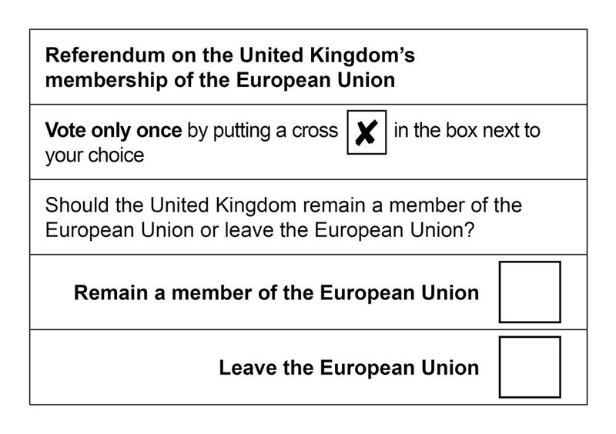
FROM COAL AND STEEL TO A COMMON EURO AND BEYOND
2000
2005
2010
2015
2020
2016
2020
2016: UK REFERENDUM ON LEAVING THE EU
On 23 June 2016, most British citizens and some other UK residents were asked this question: ‘Should the UK remain a member of the European Union or leave the European Union?’ 51.9 % voted to leave, and 48.1 % voted to remain, triggering negotiations on the UK’s exit
from the European Union and making it the first country ever to leave.
2020: THE UK OFFICIALLY WITHDRAWS FROM THE EU
Voting ballot of the Brexitreferendum of 23 June 2016.
The UK officially left the European Union on 31 January 2020, after three years of negotiations.

Slide 14


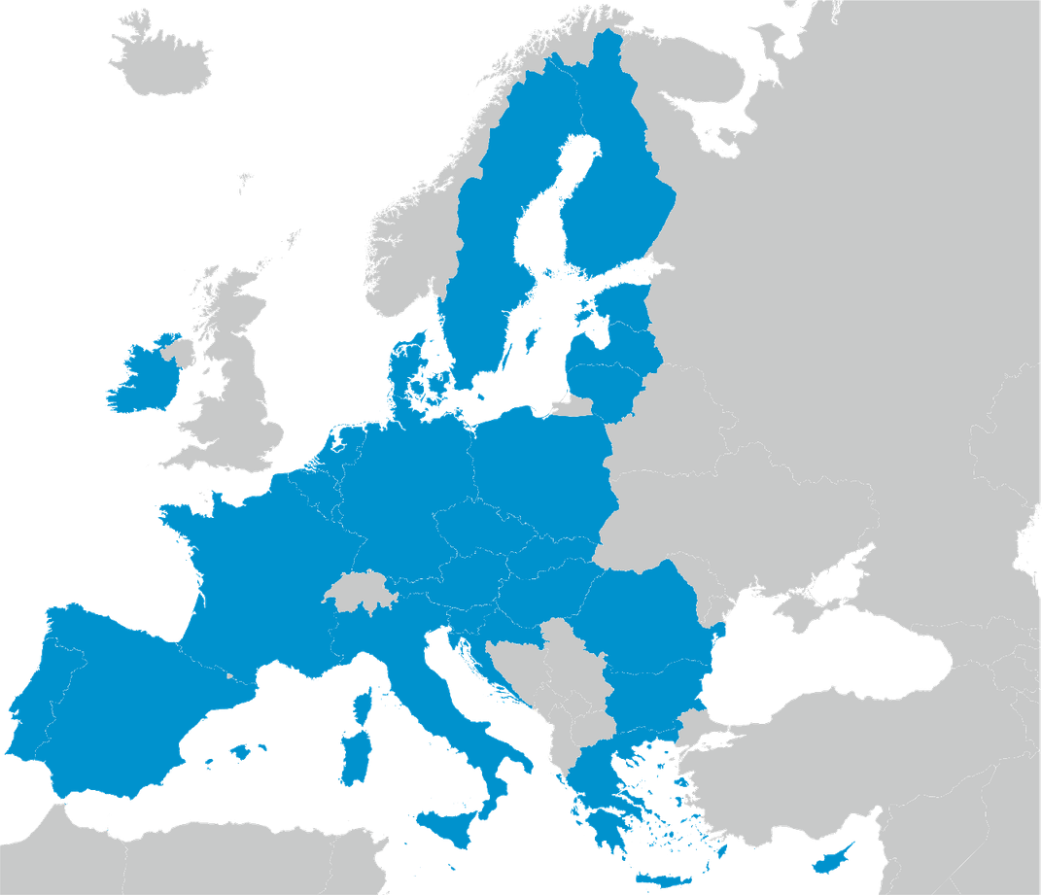
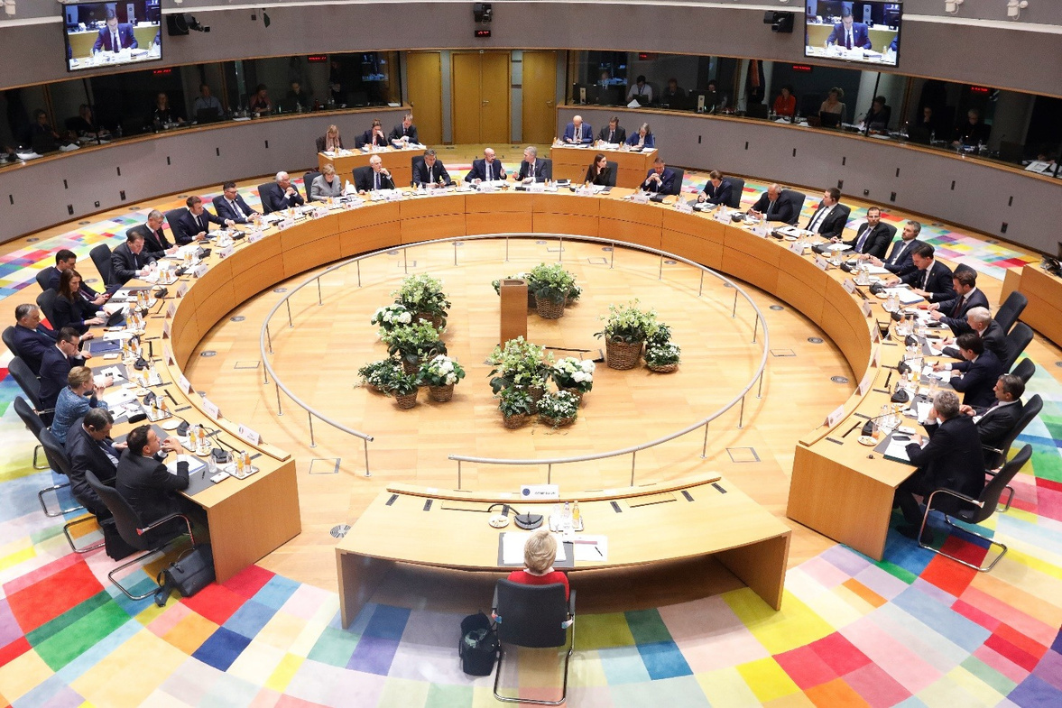
FROM COAL AND STEEL TO A COMMON EURO AND BEYOND
2010
2015
2020
Future?
Meeting of the European Council © European Union, 2020

Slide 15

A BRIEF
HISTORY
OF THE EU
Ireland
Portugal
Spain
This presentation is part of the educational tool EUROPE@SCHOOL –Active lessons about the European Union. © European Union, 2025
This presentation was edited on behalf of the Young European Diplomats (YED) Programme, under the supervision of the Young European Ambassadors (YEAs) Initiative of EU NEIGHBOURS EAST. Project funded by the European Union.

