Slide 1






Part 2!
LESSON A
RE-INTRODUCTION TO YED

Slide 2


National and International Days (for inspiration)
International Days
First Activity!
  International Women’s Day (March 8th)
  International Day of Multilateralism and Diplomacy for Peace (April 24th)
  Labour Day / May Day (May 1st)
  World Press Freedom Day (May 3rd)
  Europe Day (May 9th)
  International Day Against Homophobia (May 17th)
  World Environment Day (June 5th)
  World Youth Skills Day (July 15th)
Brainstorming Ideas for Events and Projects (10 mins.)
  Split into groups of 3 people.
  Each group gets a list of democratic or cultural activities.
  Highlight the ones you would like to run and add any other ideas that would be good.
    You can select some interesting international/national days for inspiration
    Would you like it to be a debate? A lesson/presentation? A cultural event? A campaign?
  After 5 minutes, switch papers with another group (democratic<>cultural activities).
National Days
  Day of the Restoration of the State of Lithuania (February 16th)
  Independence Day in Estonia (February 24th)
  Saint David’s Day (March 1st)
  Liberation Day in Bulgaria (March 3rd)
  National Day of Hungary (March 15th)
  Saint Patrick’s Day (Ireland) (March 17th)
  Celebration of the Greek Revolution (March 25th)
  Saint George’s Day (April 23rd)
  King’s Day in the Netherlands (April 27th)
  Constitution Day in Poland (May 3rd)
  Croatian Statehood Day (May 30th)
  Republic Day of Italy (June 2nd)
Objective?
Find new ideas by brainstorming with others, to find the perfect event/project to run. It helps you collaborate with your classmates, and become reliable partners for your future projects.

Slide 3
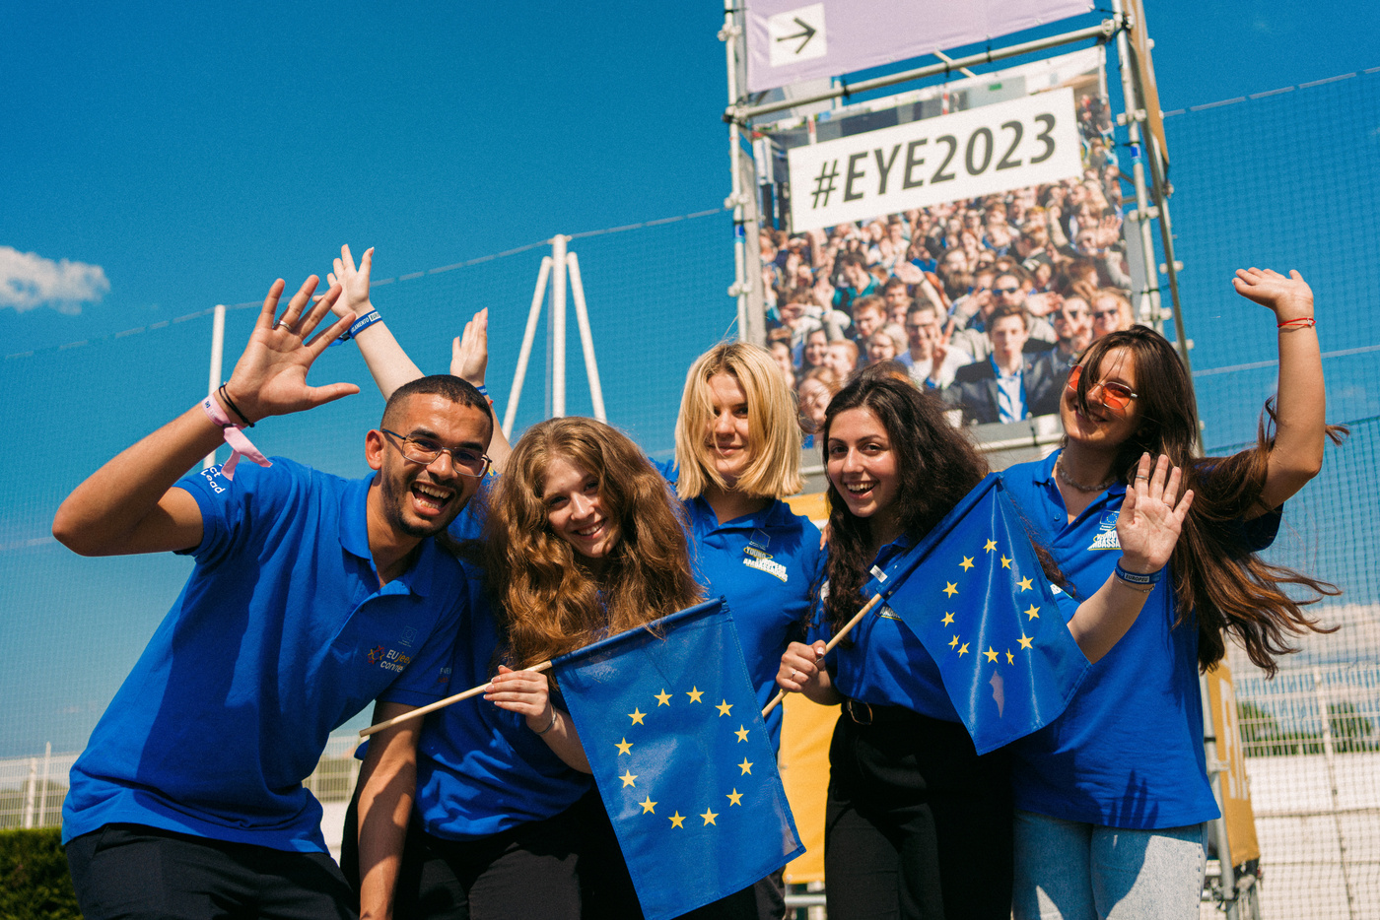
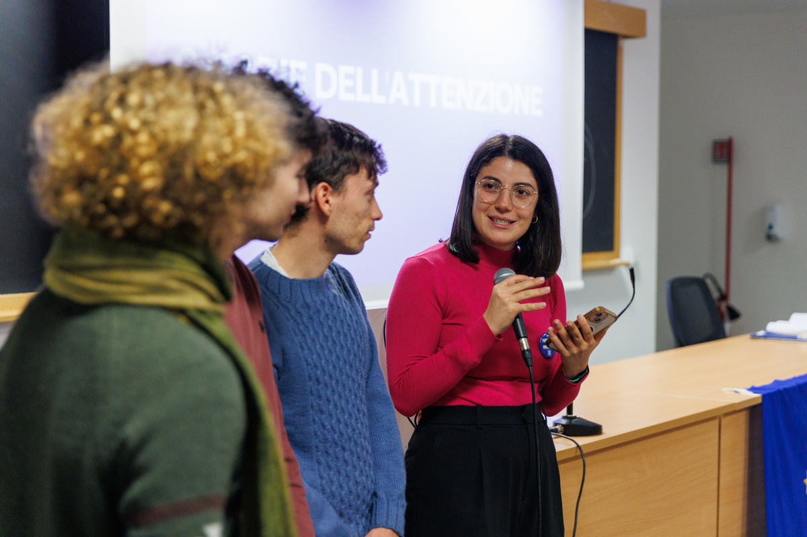
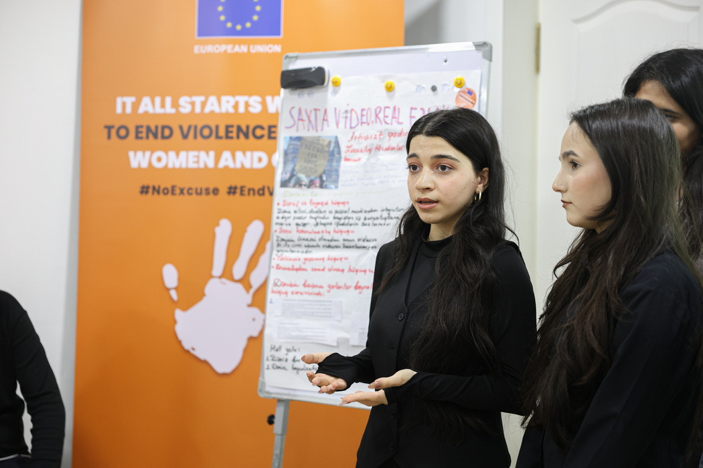







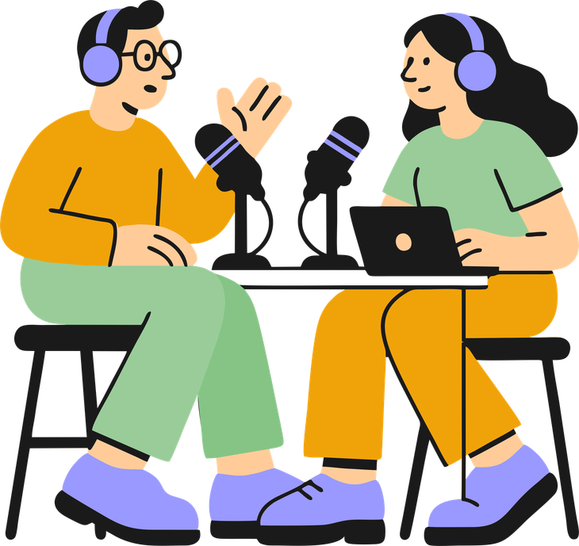




Second Activity!
Decide on Events/Activities (5 mins.)
  You will all vote on which event and activity you would like to work on (2-3 people per event / 3-4 per activity).
  You will also determine a group leader and when in the year they think would be a good idea to run it.
Events
Max. 2 people per custom event
Activities

Slide 4
Planning your Event (Step-by-Step)
Example for Film Screening
  Book the music room/conference hall
    Work out a date when the room/hall is free.
  Choose a film
    Make sure it has subtitles
    Make sure the film is appropriate (for the audience)
    Make sure you have permission to show it
  Advertise
    Design posters
    Put up posters
    Sell tickets (visual, no monetary value)
  On the day
    Check the speakers
    Bring the film
    Put out chairs
    Bag up popcorn
Third (Last) Activity!
Start Planning Your Events (20 mins.)
  Sit in your event teams that you’ve made.
  Understand the different roles each teammate can take, and volunteer for them.
  Using the event planning sheet, think of all the steps you would need to take to make your event a success (break down each step as much as possible).
  Write down each of the small steps and add to each task:
    Any support /permission you might need,
    A deadline by which it should be done,
    Which of you will take responsibility for it

Slide 5
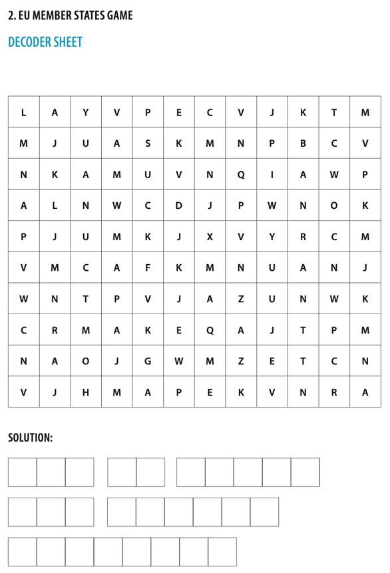
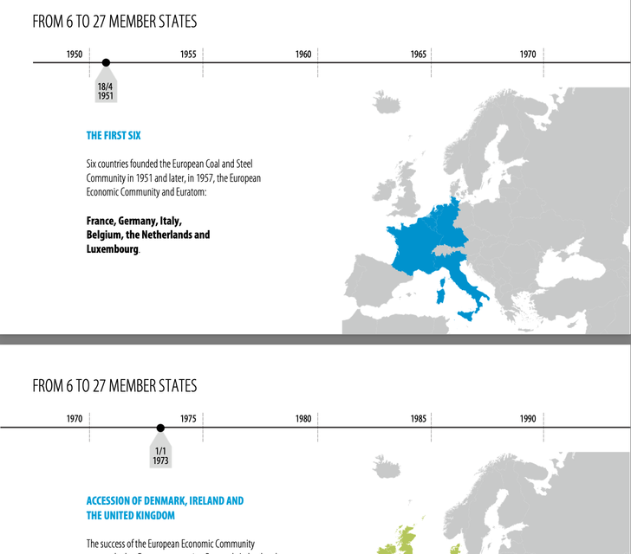
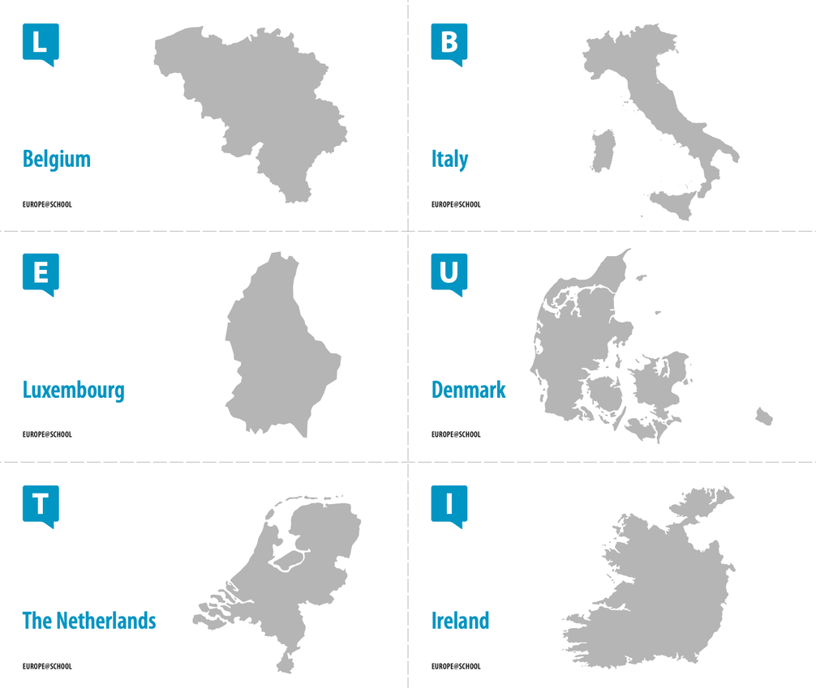
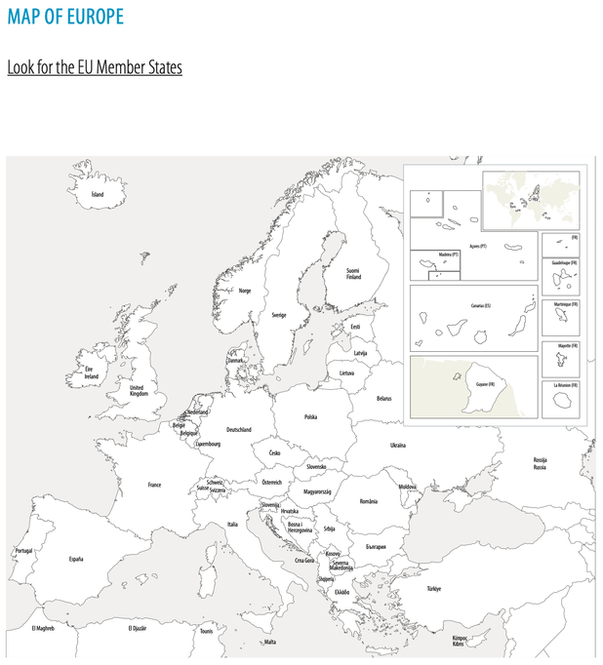
Next Lesson
Session B - EU Quiz & EU Member States Lesson

