Slide 1
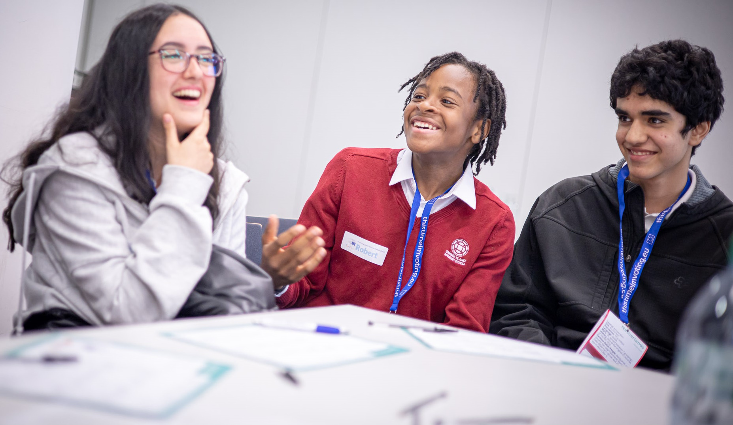




YOUNG EUROPEAN DIPLOMATS
RE-INTRODUCTION - Part 1
Notes:
1

Slide 2
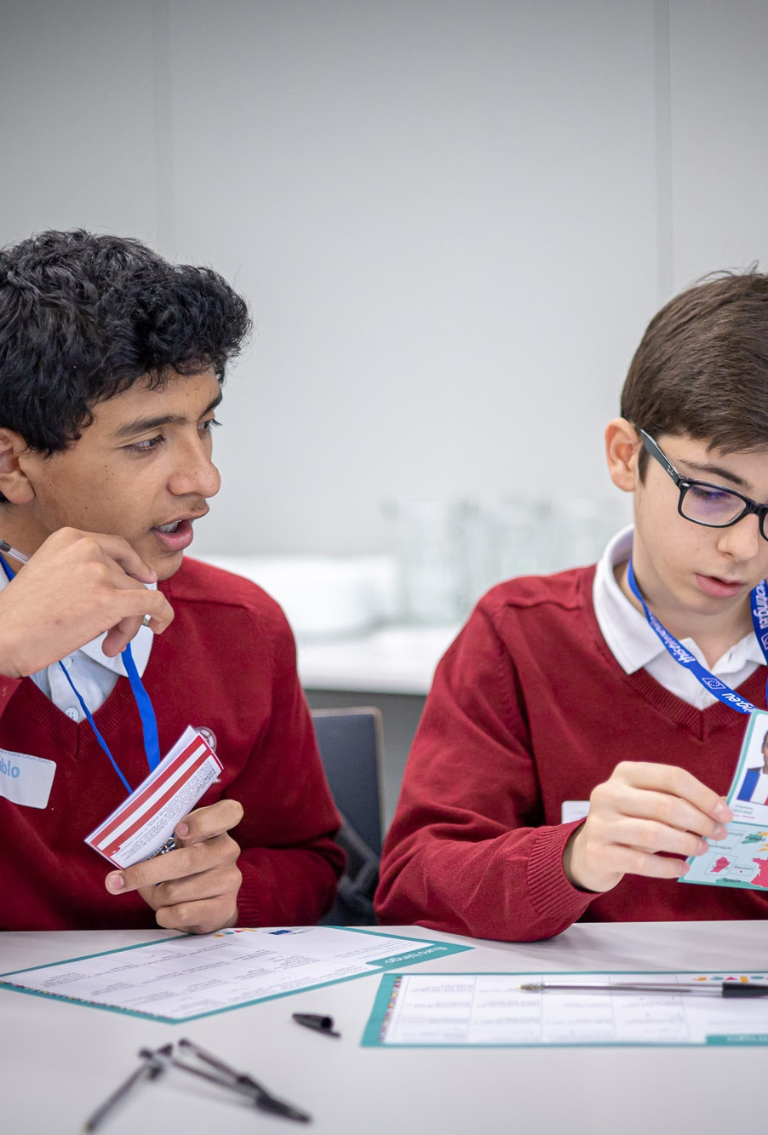


CRITERIA
  Complete all educational lessons from the customized curriculum,
  Create an Info Point and other activities,
  Celebrate Europe Day 2026 (9th May),
  Attend an educational programme offered by the European Parliament,
  Share European culture,
  Promote democratic engagement – via podcasts and article writing,
  Share your experiences through youngeuropeandiplomats.eu and social media – even your own private social media!
Notes:
3

Slide 3
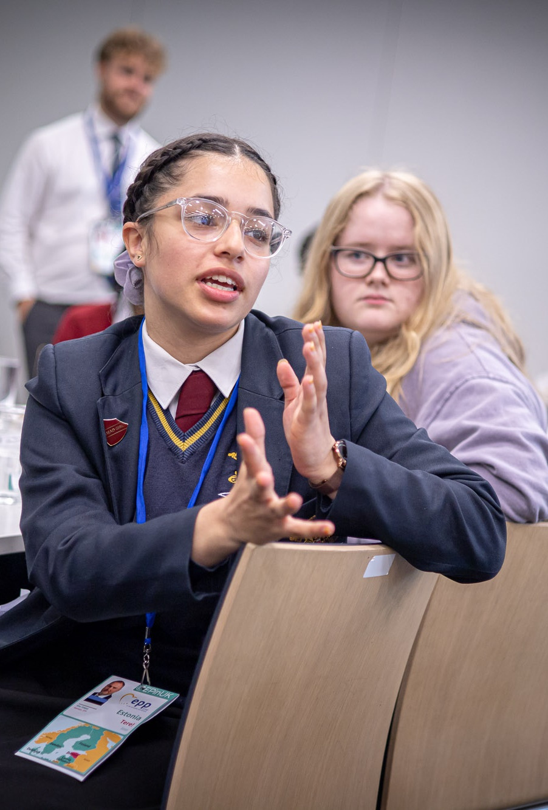

DIPLOMATS
EVERYONE can write their own article, of their own choosing!
Coordinators of YED
YEA Lemonia K.
YEA Dimitri R.K.
Helpers / Partners
Other YEAs
Our School
NGOs / EU Institutions / Schools
Students leading events
Team of Junior Ambassadors
Team of Junior Ambassadors
Team of Junior Ambassadors
Team of Diplomats
Team of Diplomats
Team of Diplomats
Events run by students
Europe Day Event
Podcasts/Journalists
EU InfoPoint
LUX Prize screening
Events Creation
Collaborations / PR
Want to lead a team to create your own event? This is your chance!
Notes:
4

Slide 4
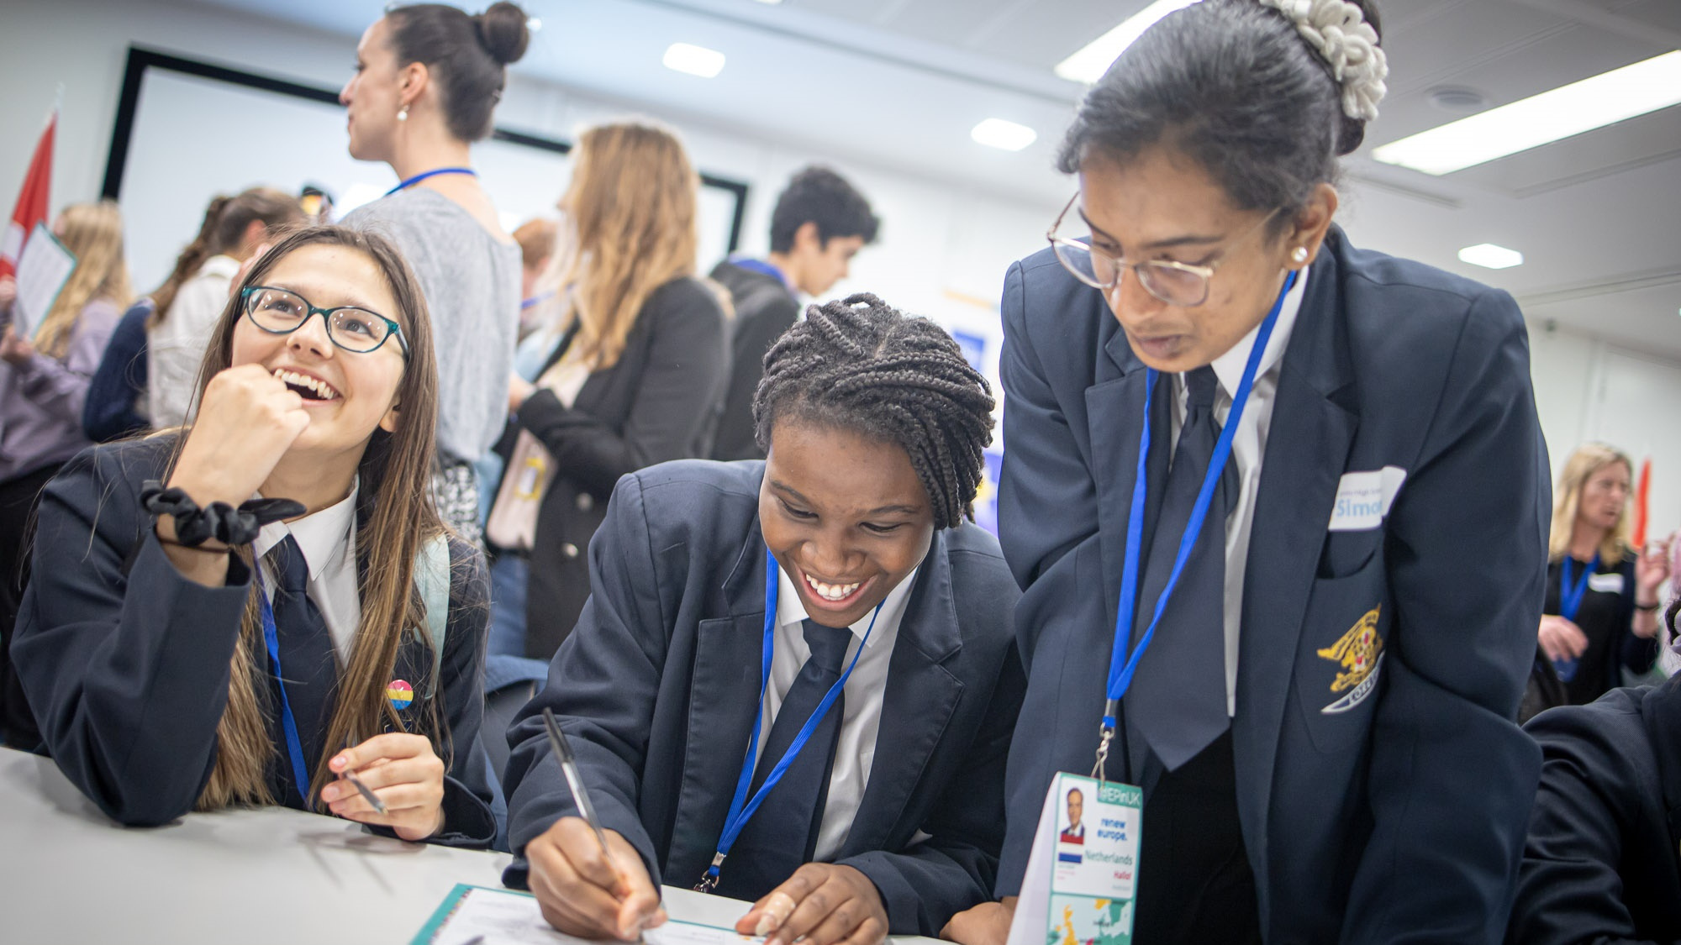














Film Screening
Europe Day 2026
EU Info-Point
Your Own Ideas!
Debate
Events
Activities
Podcasts
Social Media
Journalism
The Brainstormers
Graphic Designers
WHAT ACTIVITIES WOULD YOU LIKE TO RUN?
Notes:
5

Slide 5
SOME MOMENTS YOU COULD MARK
Speech?
Debate?
  European Day of Remembrance for Victims of All Totalitarian and Authoritarian Regimes
  Constitution Day of Slovakia
  Independence Day in Malta
  Multilingualism Day at the European Parliament
  European Day of Languages
  Cyprus Independence Day
  German Unity Day
  European Day against the Death Penalty
  National Day of Spain
  National Day of Austria
  Independence Day in the Czech Republic
  Saint Andrew's Day
  Armistice Day (end of WW1)
  Independence Day in Latvia
  International Day for the Elimination of Violence against Women
  Great Union Day in Romania
  Independence Day in Finland
  Human Rights Day
  Holocaust Remembrance Day
  Data Protection Day
  Day of the Restoration of the State of Lithuania
  Independence Day in Estonia
  Saint David's Day
  Liberation Day in Bulgaria
  International Women's Day
  National Day of Hungary
  National Day of Ireland; Saint Patrick's Day
  Celebration of the Greek Revolution
  Saint George's Day
  King's Day in the Netherlands
  Labour Day; May Day
  World Press Freedom Day; Constitution Day in Poland
  Europe Day
  International Day against Homophobia
  Croatian Statehood Day
  Republic Day of Italy
  Denmark's Constitution Day
  National Day of Sweden
  European Parliament elections
  Portugal Day
  National Day of Luxembourg
  Statehood Day in Slovenia
  National Day of France
  National Day of Belgium
Guest Speaker?
Interviews?
Lesson?
EU Info-Point?
Cultural
Event?
Campaign?
Notes:
7

Slide 6
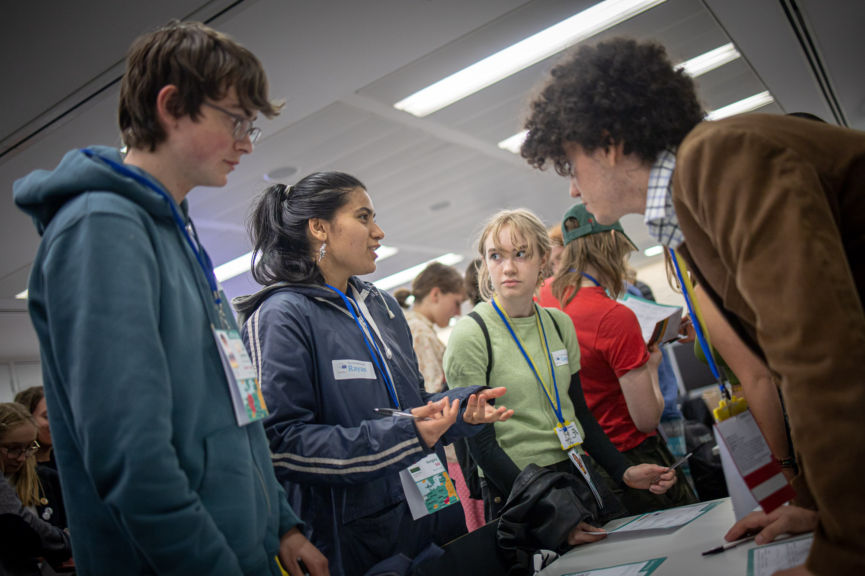
PLANNING YOUR EVENT
Break it down into small steps: the smaller the better, for example:
  Just some of the steps required to ‘Show a French Film’
    Book the school hall/conference hall
      Work out a date when the hall is free
    Choose a film
      Make sure it has subtitles
      Make sure the film is appropriate
      Make sure you have permission to show it
    Advertise
      Design posters
      Put up posters
      Sell tickets (fake tickets, with no monetary value)
    On the day
      Check the speakers
      Bring the film
      Put out chairs
      Bag up popcorn
Notes:
9

Slide 7
Part A
Europe@Schools
Part B
All About: The EU and the EP
Part C
EU Enlargement
Created by YEAs from EUNEIGHBOURS EAST 💚
  Online Quiz about the EU
  The EU Member States
  EU History & Facts
  The EU in our Daily Lives
  EU Values
  European Parliament Role-Play Game
  Media Literacy
  All About: Democracy
  All About: The Environment
  All About: Everyday Life
  All About: Geography
  All About: Rights, Obligations & Benefits
  Shared Culture
  EU Enlargement Workshop
Part D
Erasmus+ Trip
  Visits at National & EU Institutions
  Workshops/Debates
  Discussions with politicians
  Informal Games
EUROPEAN LESSONS
With partners from Lithuania and Georgia 🇱🇹🇬🇪

Slide 8
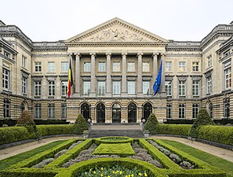
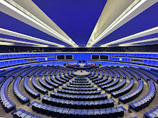
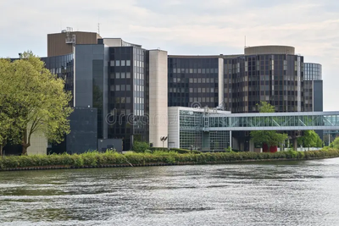
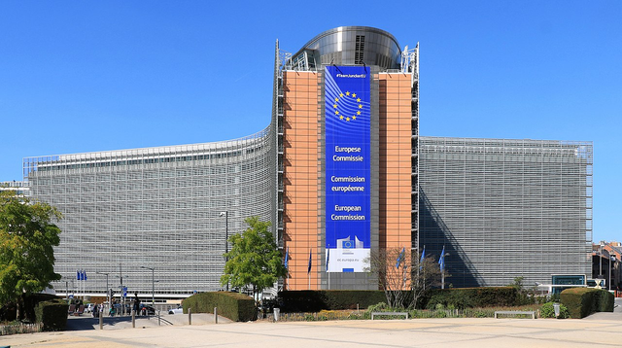
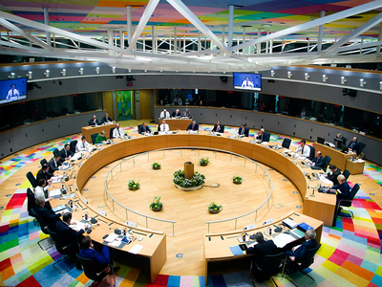
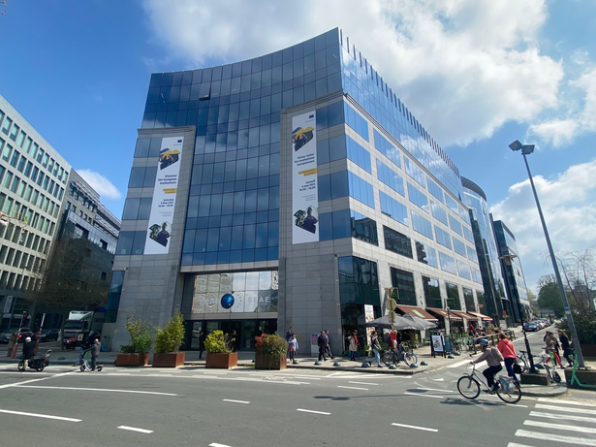

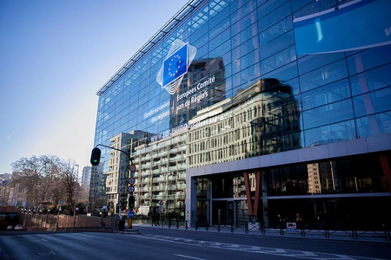
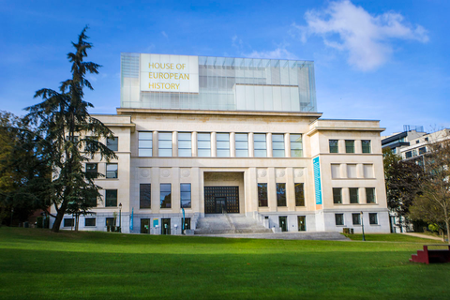
ERASMUS+ PROJECTS
Project A (by YED)
Project B (by Georgian Partner)
Date:
First Week of September 2026
22/06 - 02/07
Country:
Georgia
Date:
Brussels & Strasbourg
Places:
10
Participants:
Belgian Federal Parliament
European Parliament
European Ombudsman
European Commission
European Council / Council of the EU
European External Action Service
European Economic and Social Committee
Committee of Regions
House of European History

