Slide 1
Extraversion and PSB
Examining the link between extraversion and pro-social behaviors

Slide 2
Research Question
Some literature suggests possible relation between Agreeableness and PSB, others say no link with personality traits
Question:
  Can a person’s degree of extraversion predict their pro-social behaviors?
Hypotheses
  Null: There is no statistically-significant correlation between Extraversion and pro-social behaviors
  Alternative: There is a statistically-significant correlation between Extraversion and pro-social behaviors

Slide 3
The Study
15-question survey on: demographics (4), personality (3), self-extension (3), generosity (3), volunteering (2)
Shared via class Blackboard post and USC’s Psychology Club GroupMe (join, they’re awesome!)
14 participants
  72% female
  58% sophomore
  93% Psychology majors

Slide 4
Considerations
Small participant pool (N=14)
Questionable external validity:
  Participants mostly Psych majors (~93%)
  College undergrads (100%)

Slide 5
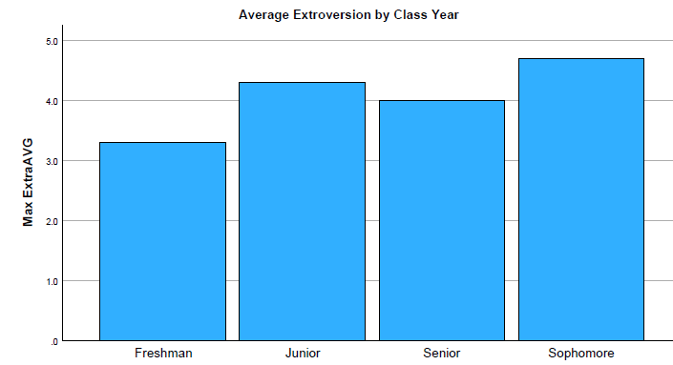
Findings: Extraversion and Class Year
A one-way between-subjects ANOVA was conducted to determine if Extraversion differed among Freshmen (M=2.65, SD=0.575), Sophomores (M=3.18, SD=0.287), Juniors (M=3.65, SD=0.575), and Seniors (M=3.35, SD=0.575). There was no significant effect overall, F(3, 11) = 0.534, p = 0.669.

Slide 6
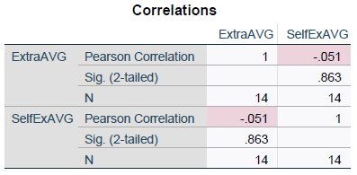
Findings: Extraversion and Self-Extension
A Pearson correlation analysis was conducted to determine whether there was a relationship between Self-Extension(M = 3.19, SD = 0.77) and Extraversion(M = 3.88, SD = 0.77). Results showed there was a weak, negative relationship, r(12) = -0.051, p = 0.863.
As average Self-Extension increases, average Extraversion slightly decreases.

Slide 7
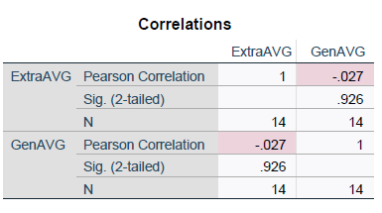
Findings: Extraversion and Generosity
A Pearson correlation analysis was conducted to determine whether there was a relationship between Generosity(M = 3.64, SD = 0.49) and Extraversion(M = 3.19, SD = 0.77). Results showed there was a weak, negative relationship, r(12) = -0.027, p = 0.926.
As Generosity increases, Extraversion slightly decreases.

Slide 8
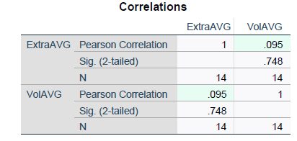
Findings: Extraversion and Volunteering
A Pearson correlation analysis was conducted to determine whether there was a relationship between Volunteering behavior (M = 2.11, SD = 0.59) and Extraversion(M = 3.19, SD = 0.77). Results showed there was a weak, positive relationship, r(12) = 0.095, p = 0.748. As Volunteering score increases, Extraversion slightly increases.

Slide 9
Conclusions
SPSS found no significant correlations
Implications: inconclusive evidence that how outgoing / extroverted a person is can predict to what degree they exhibit pro-social behaviors

