Slide 1
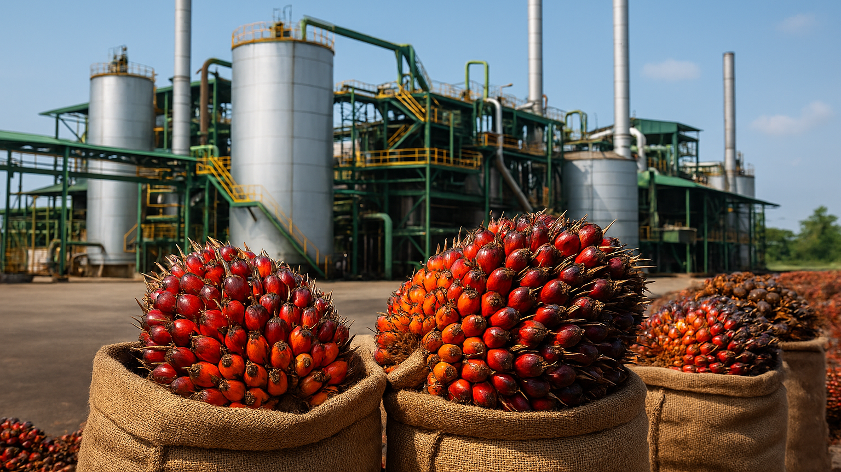

Slide 2
SAJORA EDIBLES INDUSTRIES (M) SDN BHD was established to meet the growing global demand for edible oils and integrated commodity trading solutions. Our foundation is built on more than just transactions; it is built on a legacy of trust, operational excellence, and a proven ability to navigate and thrive in evolving market conditions.
We are steered by leadership with a demonstrable history of building and managing successful, high-revenue commodity enterprises across Southeast Asia. This deep-rooted expertise ensures that every partnership with SAJORA is supported by strategic insight, rigorous execution, and an unwavering commitment to quality and sustainability.

Slide 3
Our Leadership: A Pillar of Proven Success
The strategic vision of SAJORA is guided by combined experience of over 30 years of unparalleled success in commodity business management, international trade and regional business network. It is a testament to building, managing, and expanding enterprises that generate significant revenue and execute complex, high-value international transactions.

Slide 4
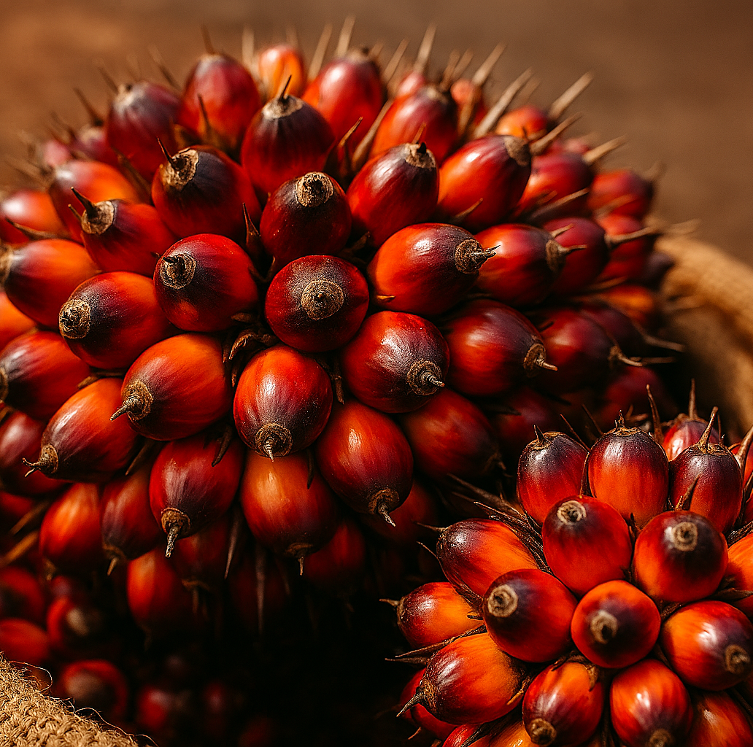
MISSION & VISION
Our Mission: To deliver dependable supply chain solutions through strong commercial relationships, market intelligence, and a focus on sustainable trading practices—particularly within the vital palm oil sector.
Our Vision: To be a trusted trading partner in the palm oil and commodities sector, recognized for operational excellence, sustainability, and long-term partnerships

