Slide 1

Young Leaders’ Scheme
Module G and H – Program Planning
Module I – What did they say?
Scouts.org.uk
#SkillsForLife
Notes:
If you need to change the background please follow these instructions:
1. On your Windows tablet, tap the Design tab.
2. On your Windows phone, open the slide for editing (either by double-tapping it or by tapping it and then tapping Edit). Tap More at the bottom of your screen, tap Home, and then tap Design.
3. Tap Format Background.
4. You will see the background colours divided into Theme Colours and Standard Colours. Theme colours coordinate with the theme you selected previously. You can select a solid colour or colour gradient.

Slide 2

Getting to know you...
Notes:
Icebreaker: 5- 10 mins
Key points:
Participants will be working together during the session so it's a good idea to break the ice and get to know each other first.
Activity option 1 - Speed dating:
Everyone walks around the room, finds someone they don’t know and talk for 1 minute
Ask questions: Who got you into Scouts? When did you join Scouts? What key skill do you bring to your Scout team? what they’d like to learn from workshop,
After two minutes, blow a whistle or shout and they find a new partner
Presenters can come up with other questions if they can think of better ones!
Or alternatively depending on amount or type of participants
Activity option 2 – Group discussion
Participants to discuss above questions (from option 1) within their table groups

Slide 3
Module I – What did they say?

Slide 4
Welcome
By the end of the module, you’ll:
understand why it's important to get feedback and input from young people in the section
list different ways you can gather ideas and feedback within your section
explain how you can bring your section’s ideas to life and make adaptations where necessary
Do more.
Be more.
Young Leaders’ Scheme

Slide 5
Do more. Be more
As an Explorer Scout Young Leader, are you involved in the planning of the programme?
How were you asked?
Do you think you were listened to?
Do you think it's important to ask young people what they think?
What are the positives and negatives of asking young people? Is it appropriate for all sections?
What do you feel are the benefits of young people feeling empowered to plan their programme?
Notes:
Ask Explorer Scout Young Leaders if they were involved in the planning of their programme:
How were they asked?
Do they think they were listened to?
Do they think it's important to ask young people what they think?
What are the positives and negatives of asking young people? Is it appropriate for all sections?
2. Initiate a discussion about why it's important to practice Youth Shaped Scouting. What are the benefits of young people feeling empowered to plan their programme?

Slide 6
Snowball fight!
Notes:
Give each Explorer Scout Young Leader a piece of paper. On it, they should write down one activity they could use to gather feedback from young people.
Once they have written down their ideas, they should screw the paper to make snowballs.
Let the snowball fight commence!
After a few minutes, ask the Explorer Scout Young Leaders to freeze and pick up the snowball closest to them.
Go around the group reading each idea aloud. This should bring up lots of different ideas you could use to gather feedback from young people.
Go over the following points together:
It's important that young people shape their own programme and have input planning and running it.
You can run a forum as to get specific feedback or to gather young people’s ideas for planning.
You can run a simple activity at the end of a session to evaluate the session you have just completed.
The best way to get feedback is to make it fun, interactive and embedded into the programme.
Once you have ideas and feedback from young people it's important that you use them.
Plan them into the programme. Better yet, support the young people to bring their ideas to life themselves. This teaches them valuable life skills.
Top tip: There are lots of ideas for running Youth Shaped sessions with different sections, for ideas on youth shaped programme activities, take a look through our activity finder.

Slide 7
Idea generation
Notes:
Split the group into four teams and set up four bases (or breakout rooms if online)
Place different objects or materials at each base.
Give the Explorer Scout Young Leaders five minutes at each base to come up with an activity that encourages feedback from young people, using the different materials provided.
At the final base, ask each team of Explorer Scout Young Leaders to run one of the activities they have come up with.

Slide 8
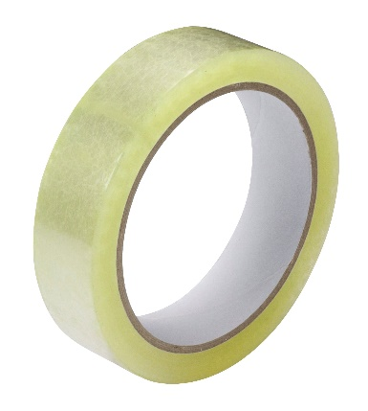



Base 1
Your materials are:
Notes:
Ideas that could come out of this are:
Running a night that teaches them about democracy – each young person can vote in a ballot box for the badge they want to work on in the next term
Ideas box in which young people can submit ideas on what to do

Slide 9

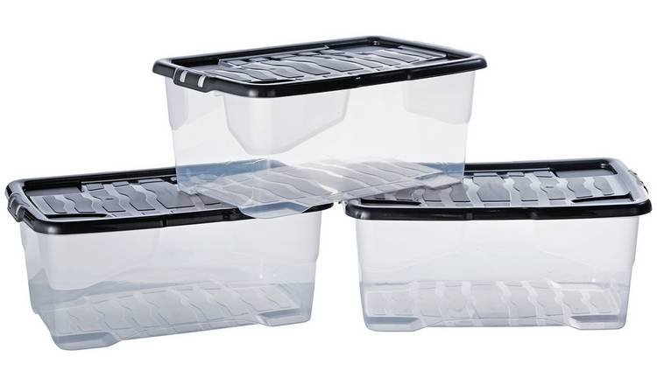
Base 2
Your materials are:
Notes:
Ideas that could come out of this are:
Asking for feedback on how a meeting went using a red coloured ball for not good, orange ball for ok, and green ball for amazing and ask them to put into a respective box
Similarly you could use this coloured ball system for voting on ideas

Slide 10
Base 3
Your materials are:
Notes:
Ideas that could come out of this are:
Snowball fight like you have just done
Give Scouts opportunities to plan their own programmes, such as by getting them to create their dream Scout term or camp
Draw up a new game that you can play as a section

Slide 11

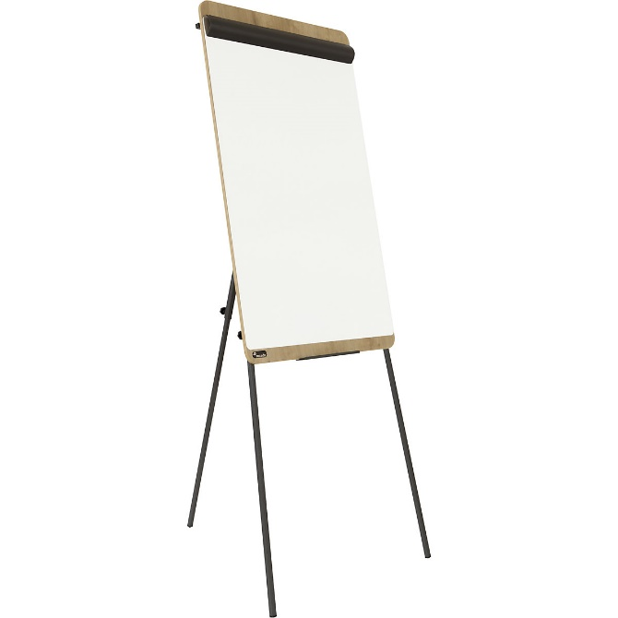

Base 4
Your materials are:
Notes:
Ideas that could come out of this are:
Run a focus group of Patrol Leader, Sixers and Seconders asking for ideas on what they would like to do.
Split the section into groups and ask them to generate ideas for a camp or day out on the flipchart. They can then present them back to the group

Slide 12
Bringing your ideas to life

Slide 13
Objectives this activity links to
4. Understand why it's important to get feedback and input from young people in the section
5. List different ways you can gather ideas and feedback within your section
6. Explain how you can bring your section’s ideas to life and make adaptations where necessary

Slide 14
Do more. Be more
Is it possible to turn these ideas into a reality?
Squirrel Scouts who want to go into space
Beaver Scouts who want to climb Everest
Cub Scouts who want to camp in a rainforest
Scouts who want to go skydiving
If so, how can you make these ideas happen?
If not, can you offer something similar?
Discuss how you might bring these ideas to life
Notes:
Ask the Explorer Scout Young Leaders to get into groups based on the section they support. Give each Explorer Scout Young Leader a scenario from below, or create your own. Suggestions include:
Squirrels who want to go into space
Beaver Scouts who want to climb Everest
Cubs who want to camp in the rainforest
Scouts who want to go skydiving
Ask the Explorer Scout Young Leaders if it’s possible to turn these ideas into a reality. If so, how can you make these ideas happen? If not, can you offer something similar? Discuss how you might bring these ideas to life.
If your Squirrels want to go into space, find out if there is a fun and easy way to inspire them with space themed activities, or a visit to a local space centre. You could look on the Activity Finder for space themed activities for the Squirrels to learn about space travel, and what gravity is, or get them to make their own rockets.
If your Beaver Scouts want to climb Everest, find out how far the distance would be. They may not be able to visit Everest itself, but they could cover the equivalent distance between them on a hike. Learn about the area and the terrain. Discuss what you would need to take with them, and pack a bag with the right kit. Talk about what you would need to know and learn and start that journey. You could find out the highest point in the County and pledge to climb it, though this will depend on the location and the risk assessment.
If your Cub Scouts want to camp in the rainforest, start by learning about the conditions there. What is the weather and terrain like? You could recreate your own rainforest in the meeting place out of recycled materials, go on a kayaking taster session to think about what it might be like to kayak in the Amazon, organise a camp with a rainforest theme and use music to recreate the sounds of the rainforest or learn all about the animals who call the rainforest home.
If your Scouts want to go skydiving, you could encourage them to research places where you can go indoor skydiving. Get them to think about how you could cover costs. Could they fundraise for this?

Slide 15
Final reflections….
Objectives: By the end of this module, you'll be able to:
Understand why it's important to get feedback and input from young people in the section.
List different ways you can gather ideas and feedback within your section.
Explain how you can bring your section’s ideas to life and make adaptations where necessary.
Notes:
Summarise the module by revisiting the objectives. Ask the Explorer Scout Young Leaders whether they feel they have covered all of the objectives satisfactorily. Before they go, carry out a review or an evaluation of the session.

Slide 16
Module G and H – Program Planning

Slide 17
Putting those ideas from mod I into a program

Slide 18
Module G Aims:
Identify the key parts of the 6-25 programme including activity badges, challenge awards, top awards and staged activity badges.
Understand the importance of a high quality balanced programme that works towards the top awards.
Explain how the Moving On awards improve links between sections.
Know some of the unique parts of our programme.
Be able to review the programme using the quality programme checkers.
Notes:
Cover the aims of the webinar.

Slide 19
Module H Aims:
Know where to get programme ideas from.
Use a range of programme planning techniques.
Describe what needs to be considered when planning activities.
Know how to plan an outline programme for a 3 month period.
Understand assessing awards and badges on the basis of personal best.
Notes:
Cover the aims of the webinar.

Slide 20

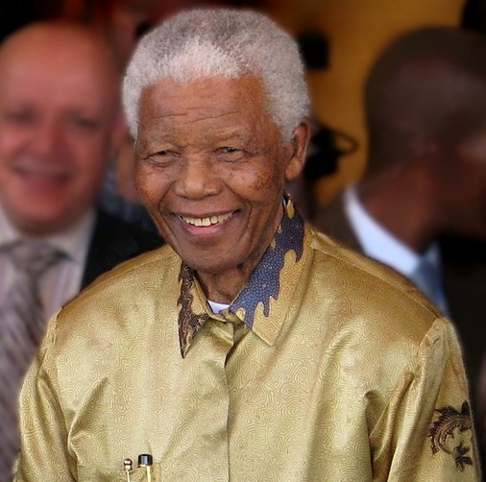


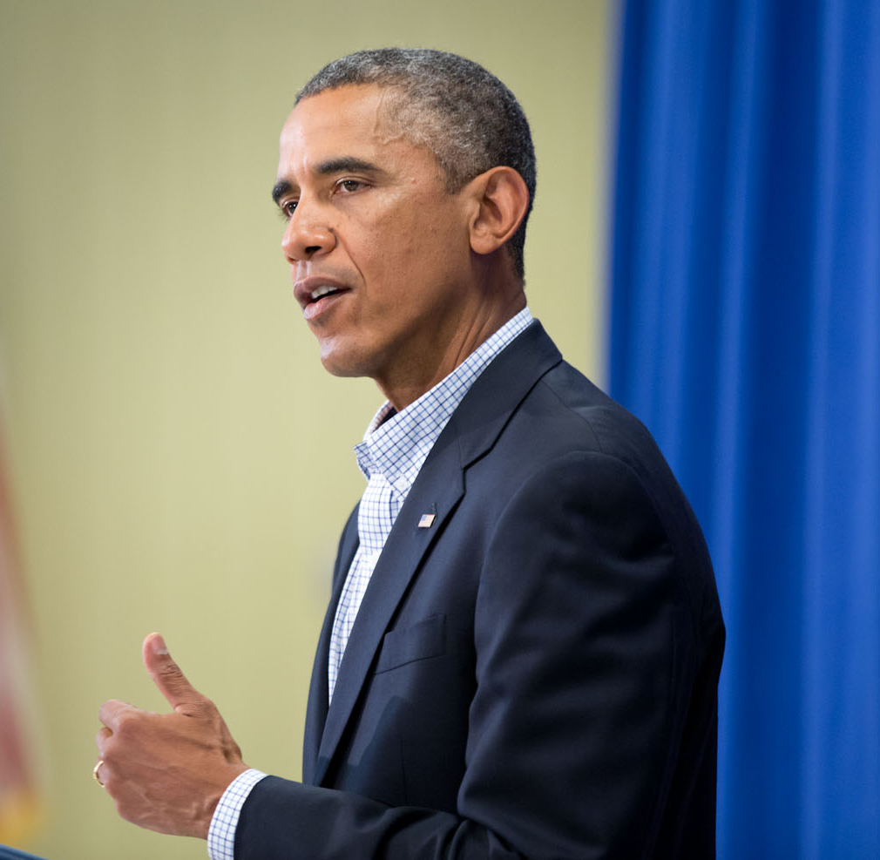
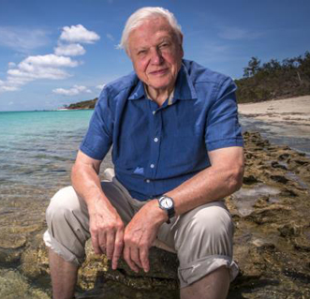
1
2
3
4
5
6
Notes:
What links these 6 people? Who are they and what links them all? (They were all Scouts.)

Slide 21

What makes Scouts unique?
Notes:
Pop answers in the chat – what makes Scouts unique?

Slide 22

Promise and Law
Ceremony
Peer leaders
Salute, sign and handshake
World family
Values and method
Notes:
Spend some time looking at some of the traditions and structures that make our movement unique. Explain that as well as offering unique badges and awards, we have a structure and some traditions that contribute to our identity as Scouts. The Fundamentals of scouting are also covered in Module A.

Slide 23
We follow the Scout Values and do things by the Scout Method.
Our values are Integrity, Respect, Co-operation, Care and Belief.
Notes:
These were covered in Module A but worth a recap. The Method was covered in Module C.
Integrity - We act with integrity; we are honest, trustworthy and loyal
Respect - We have self-respect and respect for others
Care - We support others and take care of the world in which we live
Belief - We explore our faiths, beliefs and attitudes
Cooperation - We make a positive difference; we cooperate with others and make friends

Slide 24
Our members live by a promise and a Scout law.
We have different versions so we include everyone. They reflect the values of Scouts.
Notes:
The Promise and Law are the simple way to remember and think about the fundamentals. It is vital that everyone understands the Promise and its meaning before being invested. There are alternative versions of the promise for different faiths and beliefs or for those with no faith. (Module F)

Slide 25
Ceremonies to open and close the night and when joining and leaving the section.
Opening ceremonies include Riverbanks, the Grand Howl and Flag Break.
Notes:
Ceremonies add structure to our sessions and mark important occasions such as people joining or leaving the section. There are some common parts, such as often being around a flag and get more formal as the Scout progresses.
Common ceremonies include Riverbanks for Beavers, the Grand Howl for Cubs and Flag Break/Down for Scouts.

Slide 26
Sections divided into group led by a young person.
Beavers: Lodge Leaders
Cubs: Sixers & Seconders
Scouts: Patrol Leaders
Notes:
We divide our sections into small groups and get a young person to lead each group to help keep them organised and to help newer members of the section.
Beavers use different names by Lodge is the most popular, Cubs use Sixes and Scouts use Patrols.

Slide 27

Three fingered salute (held to head), sign (held at shoulder height) and left-hand shake
Salute to people and the flag, make Scout Sign when renewing promise.
Notes:
Explain that in Scouting we have a salute, sign and handshake. Three fingers to remind us of the three main purposes of the promise (Duty to self, Duty to others, Duty to a higher purpose.) Explain that the handshake is a sign of loyalty and trust.

Slide 28
Part of a world wide family of Scouts.
50 million across 228 countries/territories. Only 5 countries without Scouts.
Notes:
Every Scout is part of the worldwide family of Scouts (in the Scout Law). This includes Scouts in nearly every country in the world except Andorra, Cuba, Laos, North Korea and Vatican City. (China: it’s complicated!) All have different uniforms, names and promises but all follow the same basic values.

Slide 29
Badges and awards.

Slide 30
Guess the badge
We’re known for our badges in Scouts.
Can you guess what these badges might be for?
Are there any you would want to earn?
Notes:
ESYLs guess the badges on the next page. They don’t have to know for certain but what do they think it might be based on the picture? What might it involve? Which would they want to try?
This can be done together with answers in the chat or could be done in break out rooms to promote a discussion if time allows.

Slide 31















1 | 2 | 3 | 4 | 5
6 | 7 | 8 | 9 | 10
11 | 12 | 13 | 14 | 15
Notes:
Guess the badges.
1 – Sc Circus Skills. 2 – C Local Knowledge. 3 – Ex Hill Walker. 4 – B Animal Friend. 5 – Sc Geocaching.
6 – B Space. 7 – Sc Scientist. 8 – C Backwards Cooking. 9 – Sc Librarian. 10 – Ex Performing Arts.
11 – Sc Model Maker. 12 – Ex Survival Skills. 13 – Sc Dragon Boating. 14 – C DIY. 15 – B Photographer.

Slide 32









Core badges
Membership award
Presented when you take the promise and become a Scout.
Peer Leader stripes
Leads a team in their section. 1 stripe – assistant, 2 stripes – leader, 3 stripes – senior.
Joining In award
Counts the number of years the member has been in Scouts.
Moving on award
Presented when you move on to the next section, shows past experience in Scouts.
Notes:
Cover the core badges that are open to all sections. Mention the Membership badge is common to all Scouts worldwide. For badges with different section looks scroll through them.

Slide 33





Activity badges
Earned for becoming proficient in a specific skill or activity.
Requirements can be found at scouts.org.uk or in Badge Books.
Beavers x22
Cubs x37
Scouts x60
Explorers x27
Notes:
Cover activity badges and that they are for a specific skill. Scouts are not expected to earn all of them, although some Beavers and Cubs do each year. Also explain that we have Activity Plus badges and Instructor badges to show progression and expertise of skills. These go behind the normal badges as shown.
All badges are awarded based on personal best – we have guidelines for the specific amount of effort we imagine YP need to complete it but if they have put an equivalent amount of effort (based on their needs) then they can be awarded it.

Slide 34






Staged Activity badges
Beavers to Explorers can work any level. 15 of them.
Nights, Hikes and Time on the Water count up.
Notes:
Staged Activity badges can be earned by any section under 18. They often cover skills that can be built up over time. Each stage has certain requirements. Explain that the Nights Away, Hikes Away and Time on the Water are special and count up based on time accrued and not on expertise.

Slide 35



Challenge awards
Beavers, Cubs and Scouts work on these over a longer period of time. More of a challenge and requires more effort and skills than an activity badge.
Well balanced, quality programme should achieve these.
6 Beavers, 7 Cubs, 9 Scouts.
Notes:
For these younger sections the Challenge Awards make a big part of their programme as a YP should achieve these if they spend a good amount of their time in the section.
These cover the three main challenge areas of the programme which are Outdoor and Adventure, Skills and World. For balance, Outdoor and Adventure should be about 50%. They also cover the secondary objectives of Teamwork, personal development and leadership.

Slide 36





Top awards
Beavers, Cubs and Scouts work towards the Chief Scouts Bronze, Silver and Gold by earning all their challenge awards.
Explorers can earn their Chief Scout’s Platinum award and Explorers and Network can earn their Chief Scout’s Diamond award and the kings Scout Award. Linked to the DofE.
Notes:
The aim for any YP should be the top awards. For the Beavers, Cubs and Scouts these are the CS Bronze, Silver and Gold awards achieved for earning all of their challenge badges and some other activity badges as well. For Explorers and Network their awards are slightly different but again focus around challenges in different areas.

Slide 37
Moving On 6-25
The Scout programme is progressive.
Skills develop over time. Beavers (taster) to Explorers (experts). Top awards to aim for.
Leading more and having a greater say in their programme.
To keep our Scouts we must have effective transitions.
Joint activities or experience of both sections.
New leaders understand their new young people.
Buddies and welcoming new people.
Moving On awards and talking to those moving up.
Notes:
Cover the basics of the programme and emphasise the importance of having good transitions.

Slide 38
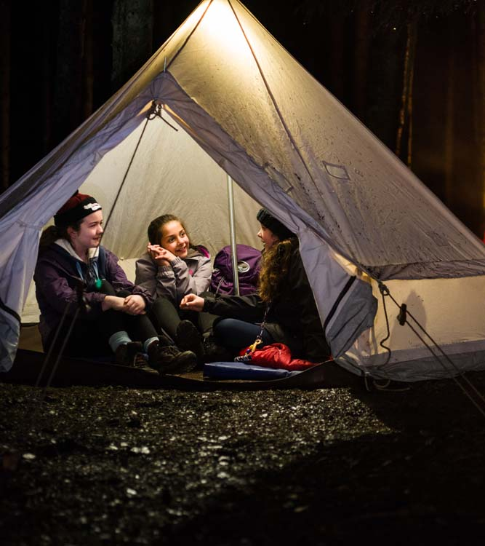
Thinking ahead.

Slide 39
Failing to prepare means prepare to fail.
Planning is important.
Long term plan – covering a young person’s time in the section.
Medium term plan – covering a term, half term or month.
Short term plan – session or camp.
Have an example from my Beaver Scouts.
Notes:
Briefly cover the three different plan types.

Slide 40
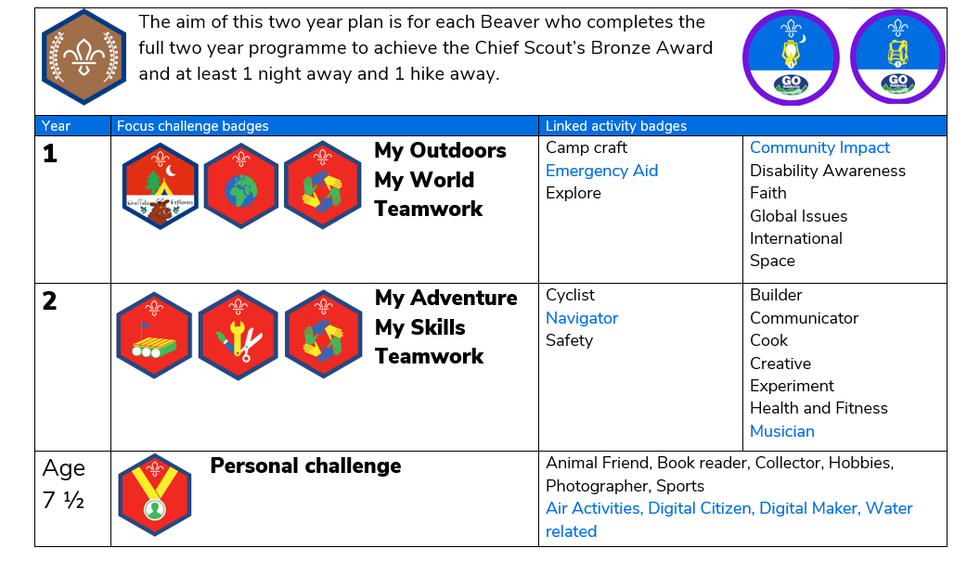
Long term plan.
Notes:
This is an example of a long term plan. Chances are your section leader may have a plan for this without really thinking about it or writing it down. It wrote it down as an aid for my ESYLs so its not vital. My aim is to cover all six challenge badges in 2 years (how long I have Beavers for).

Slide 41
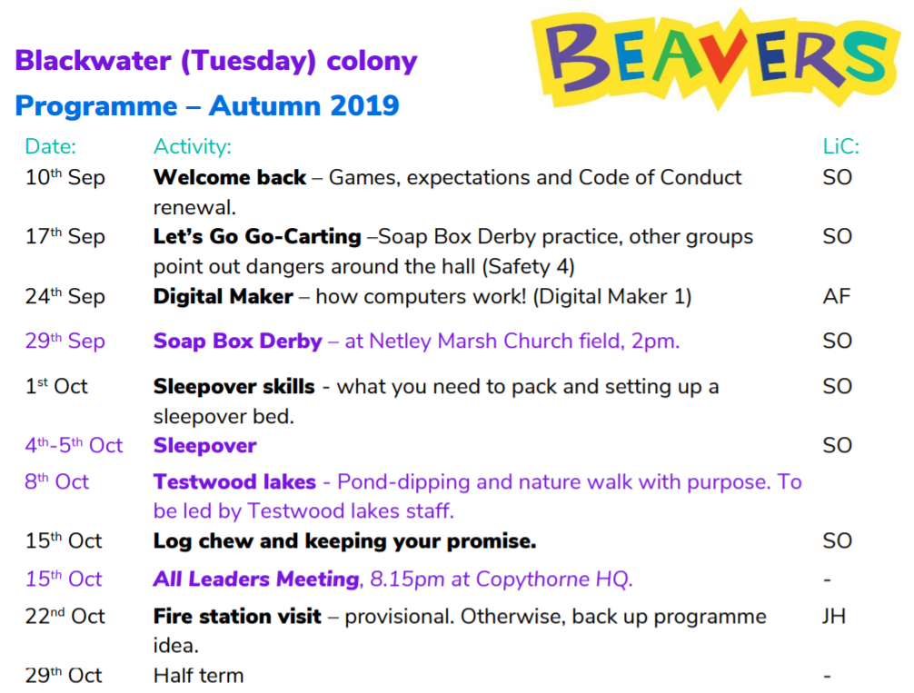
Medium term plan.
Notes:
This is an example of a part of my medium term plan. It lists the date of the meeting, the activity planned for parents reference and our own and who is planning the night (the Leader in Charge or LiC). Purple for me shows meetings not on the normal day or not at the HQ. The italic and purple is for leaders only and isn’t shown on the parents copy.

Slide 42
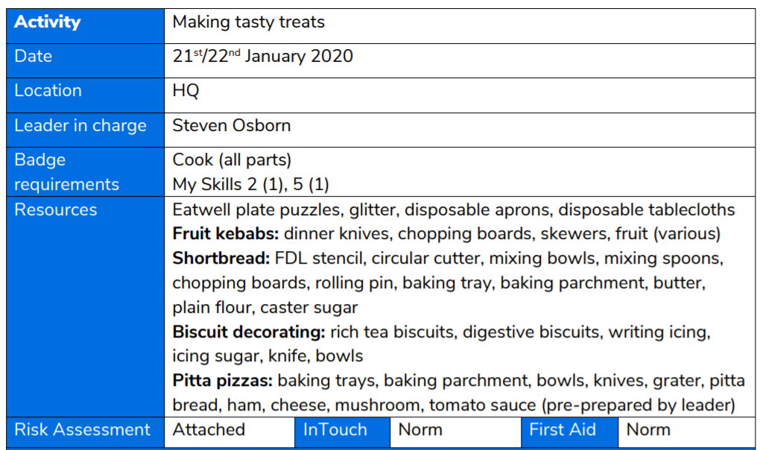
Short term plan.
Notes:
This is an example of a short term session plan. This goes at the top of all my session plans to cover some basic things for me including where it fits into the programme, what I need and some other things I need to think about, like risk assessments and if I need any special first aid or contact.

Slide 43
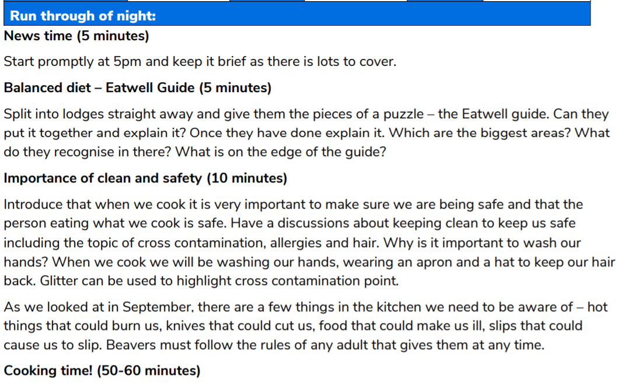
Short term plan.
Notes:
Underneath it is my notes of what is happening. I do my notes more detailed than they need to be as I have a few new and nervous leaders at the moment so having a plan they can pick up and use is helpful to them.

Slide 44
How to build an awesome term.
Fixed dates
UK, County, District or Group events.
Preparation for big events.
Badges or awards covered.
Conditions (weather, light)
Other fun activities I want to try.
Does it all balance – do I have too many similar nights in a row?
Notes:
Cover quickly how I put together a term plan.

Slide 45
Building a term plan.
Fixed dates
UK, County, District or Group events.
Preparation for big events.
Badges or awards covered.
Conditions (weather, light)
Other fun activities I want to try.
Does it all balance – do I have too many similar nights in a row?
Notes:
Use what has just been covered to this half term plan. Fixed dates – Start date and Half term date.
UK, County, District or Group events. – Soap Box Derby
Preparation for big events. – Go-carting beforehand using past experience. Sleepover skills before sleepover.
Badges or awards covered. – Outdoor and World. Sleepover, Fire station, Testwood lakes, sleepover skills all work towards these challenge awards.
Conditions (weather, light) – lots of outdoor activities while it is still light and probably dry.
Other fun activities I want to try. – Testwood lakes and digital maker (based on feedback).
Does it all balance – do I have too many similar nights in a row?

Slide 46


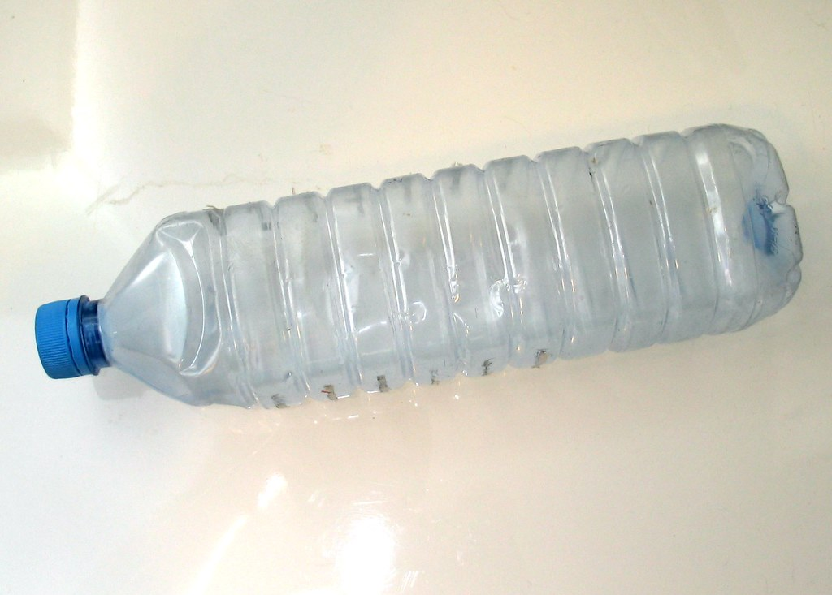
The Random Object Challenge.
Get a pile of random junk. Get someone to pick out an object.
Challenge is to find 5 ideas of activities linked to that object.
Notes:
Mention this idea briefly and then get Mike to challenge Steven by picking something random from his house.

Slide 47
Programme ideas
National days, festivals.
Activity databases at OSM or scouts.org.uk
Magazines, newspapers and books.
Pop culture e.g. Taskmaster evenings or Cluedo night.
Charity resources e,g, Red Cross.
Scout initiatives e.g. A Million Hands.
Group/District/County events
Previous programmes
Other leaders
Ideas from your young people.
Games with your young people.
Notes:
Cover quickly a list of places you can find programme ideas.

Slide 48
Your turn.
In break out rooms, plan a six week half term. It must:
Include at least one badge work skilled activity.
Include at least one event held outside of normal meeting time.
Include at least one themed evening such as linking into a national celebration or event.
You won’t need to worry about:
specific badge requirements
Group/District/County events not planned by you.
Notes:
Send ESYLs into break out rooms by section and with the support of a helper try to plan a simple programme for six weeks to get a feel for it.

Slide 49
Feedback
How did you find that?
Vote on how easy you found it.
Did you find coming up with ideas easy or hard?
Vote on it.
Notes:
Mention this idea briefly and then get Mike to challenge Steven by picking something random from his house.

Slide 50
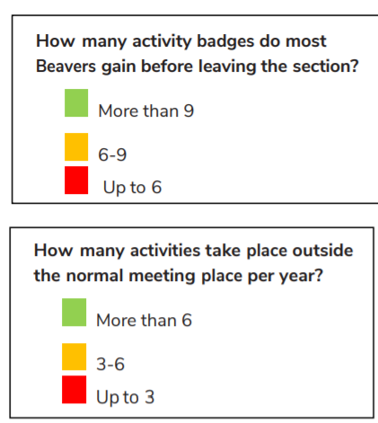
Reviewing a programme
It is important to review your section every now and then to see how it is going.
The review documents can be found on the scout website and are called Quality Programme Checkers.
Ask a series of questions with red, amber, green answers to help identify your priorities and areas for improvement. Not critical but helpful.
Notes:
Briefly explain the Quality Programme Checkers and explain you can email them out if people wish.

Slide 51
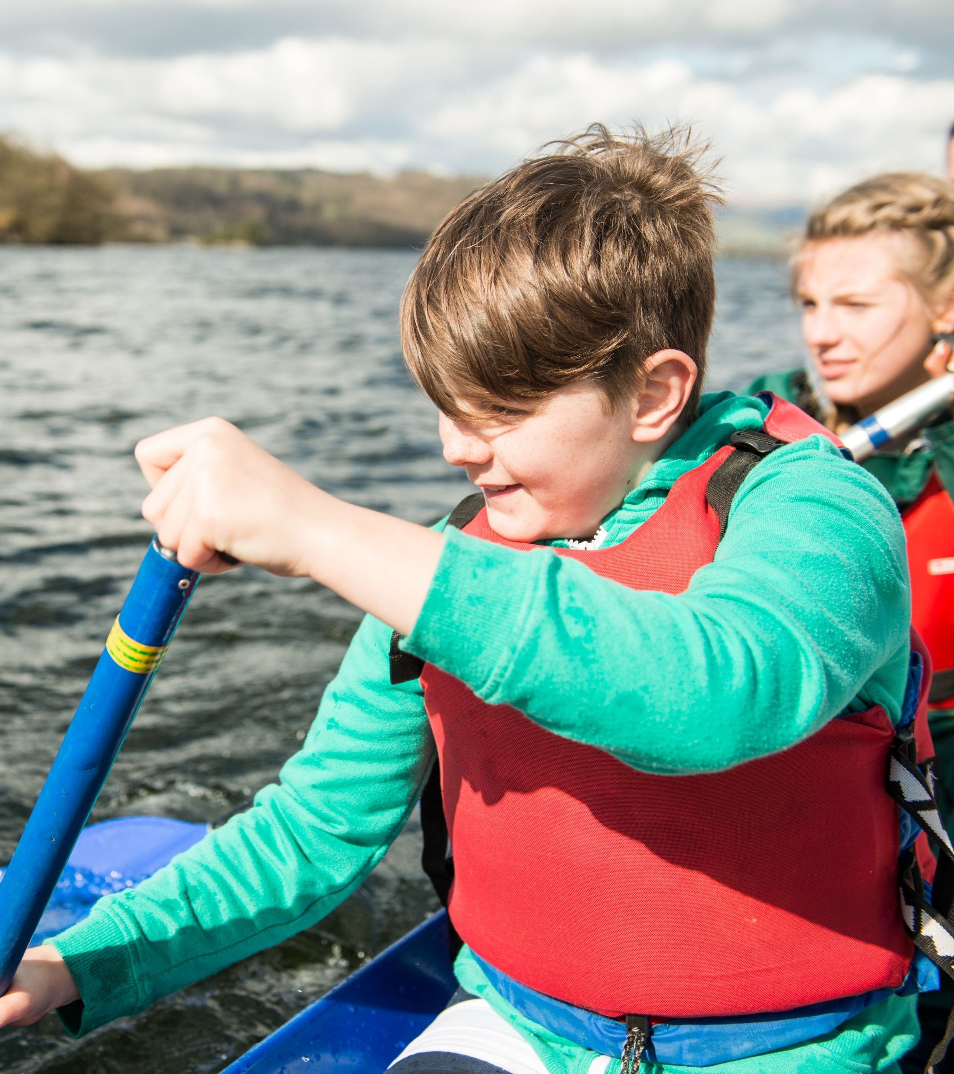
Support and where next?

Slide 52
Resources
Scout website, programme planning tool and badge pages.
OSM activities
Facebook groups e.g. 1st Facebook Scout group.
Internet searches.
Scouting Magazine (Online)
Fellow leaders, young leaders and district leaders.
Notes:
Mention the youth commissioners that are available to help and ask. There are youth shaped activities on the scout website that can be used and these were combined by Steven into cards.
Get Mike to add an option to the quiz asking about do they want the activity cards sent to them and with tick boxes for which sections.

Slide 53

Thank you
Young Leaders’ Scheme
Scouts.org.uk
#SkillsForLife

