Slide 1

Young Leaders’ Scheme
Module F – Making Scouting accessible and inclusive
Scouts.org.uk
#SkillsForLife

Slide 2
Do more. Be more
Welcome
By the end of this module, you'll:
understand that every young person is different
understand that everyone is welcome in Scouting
understand your role in contributing to a positive and inclusive environment
state a range of additional needs that young people in a section may experience
understand how additional needs may affect participation in the Programme
explain how to adapt programmes to meet the needs of all young people within the section
Do more.
Be more.
Young Leaders’ Scheme

Slide 3

Getting to know you...
Notes:
Icebreaker: 5- 10 mins
Key points:
Participants will be working together during the session so it's a good idea to break the ice and get to know each other first.
Activity option 1 - Speed dating:
Everyone walks around the room, finds someone they don’t know and talk for 1 minute
Ask questions: Who got you into Scouts? When did you join Scouts? What key skill do you bring to your Scout team? what they’d like to learn from workshop,
After two minutes, blow a whistle or shout and they find a new partner
Presenters can come up with other questions if they can think of better ones!
Or alternatively depending on amount or type of participants
Activity option 2 – Group discussion
Participants to discuss above questions (from option 1) within their table groups

Slide 4
What is diversity?
Promoting diversity in Scouting means that we welcome members from all and any backgrounds and celebrate what makes every person different.

Slide 5
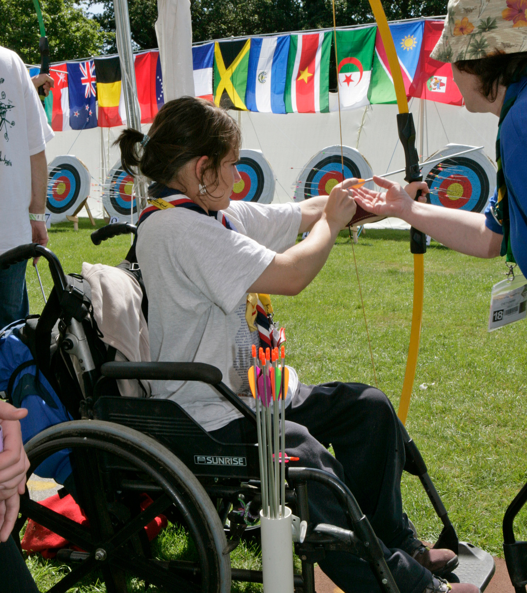
What is inclusion?
The act of ensuring that Scouting is open to all and supporting anyone to overcome any barrier to participating.
We need to ensure that our programme and meeting place is appropriate and that we have considered any additional needs members might have.
Discussion: What do you understand about the terms 'special educational needs' and 'disability'?
Notes:
Ask the Explorer Scout Young Leaders if they have come across additional needs before. They will have done at school.
Explain that everyone is different and that everyone has needs in some way. This is what makes the world interesting.
What do the Explorer Scout Young Leaders understand by the terms ‘special educational needs’ and ‘disability’?

Slide 6
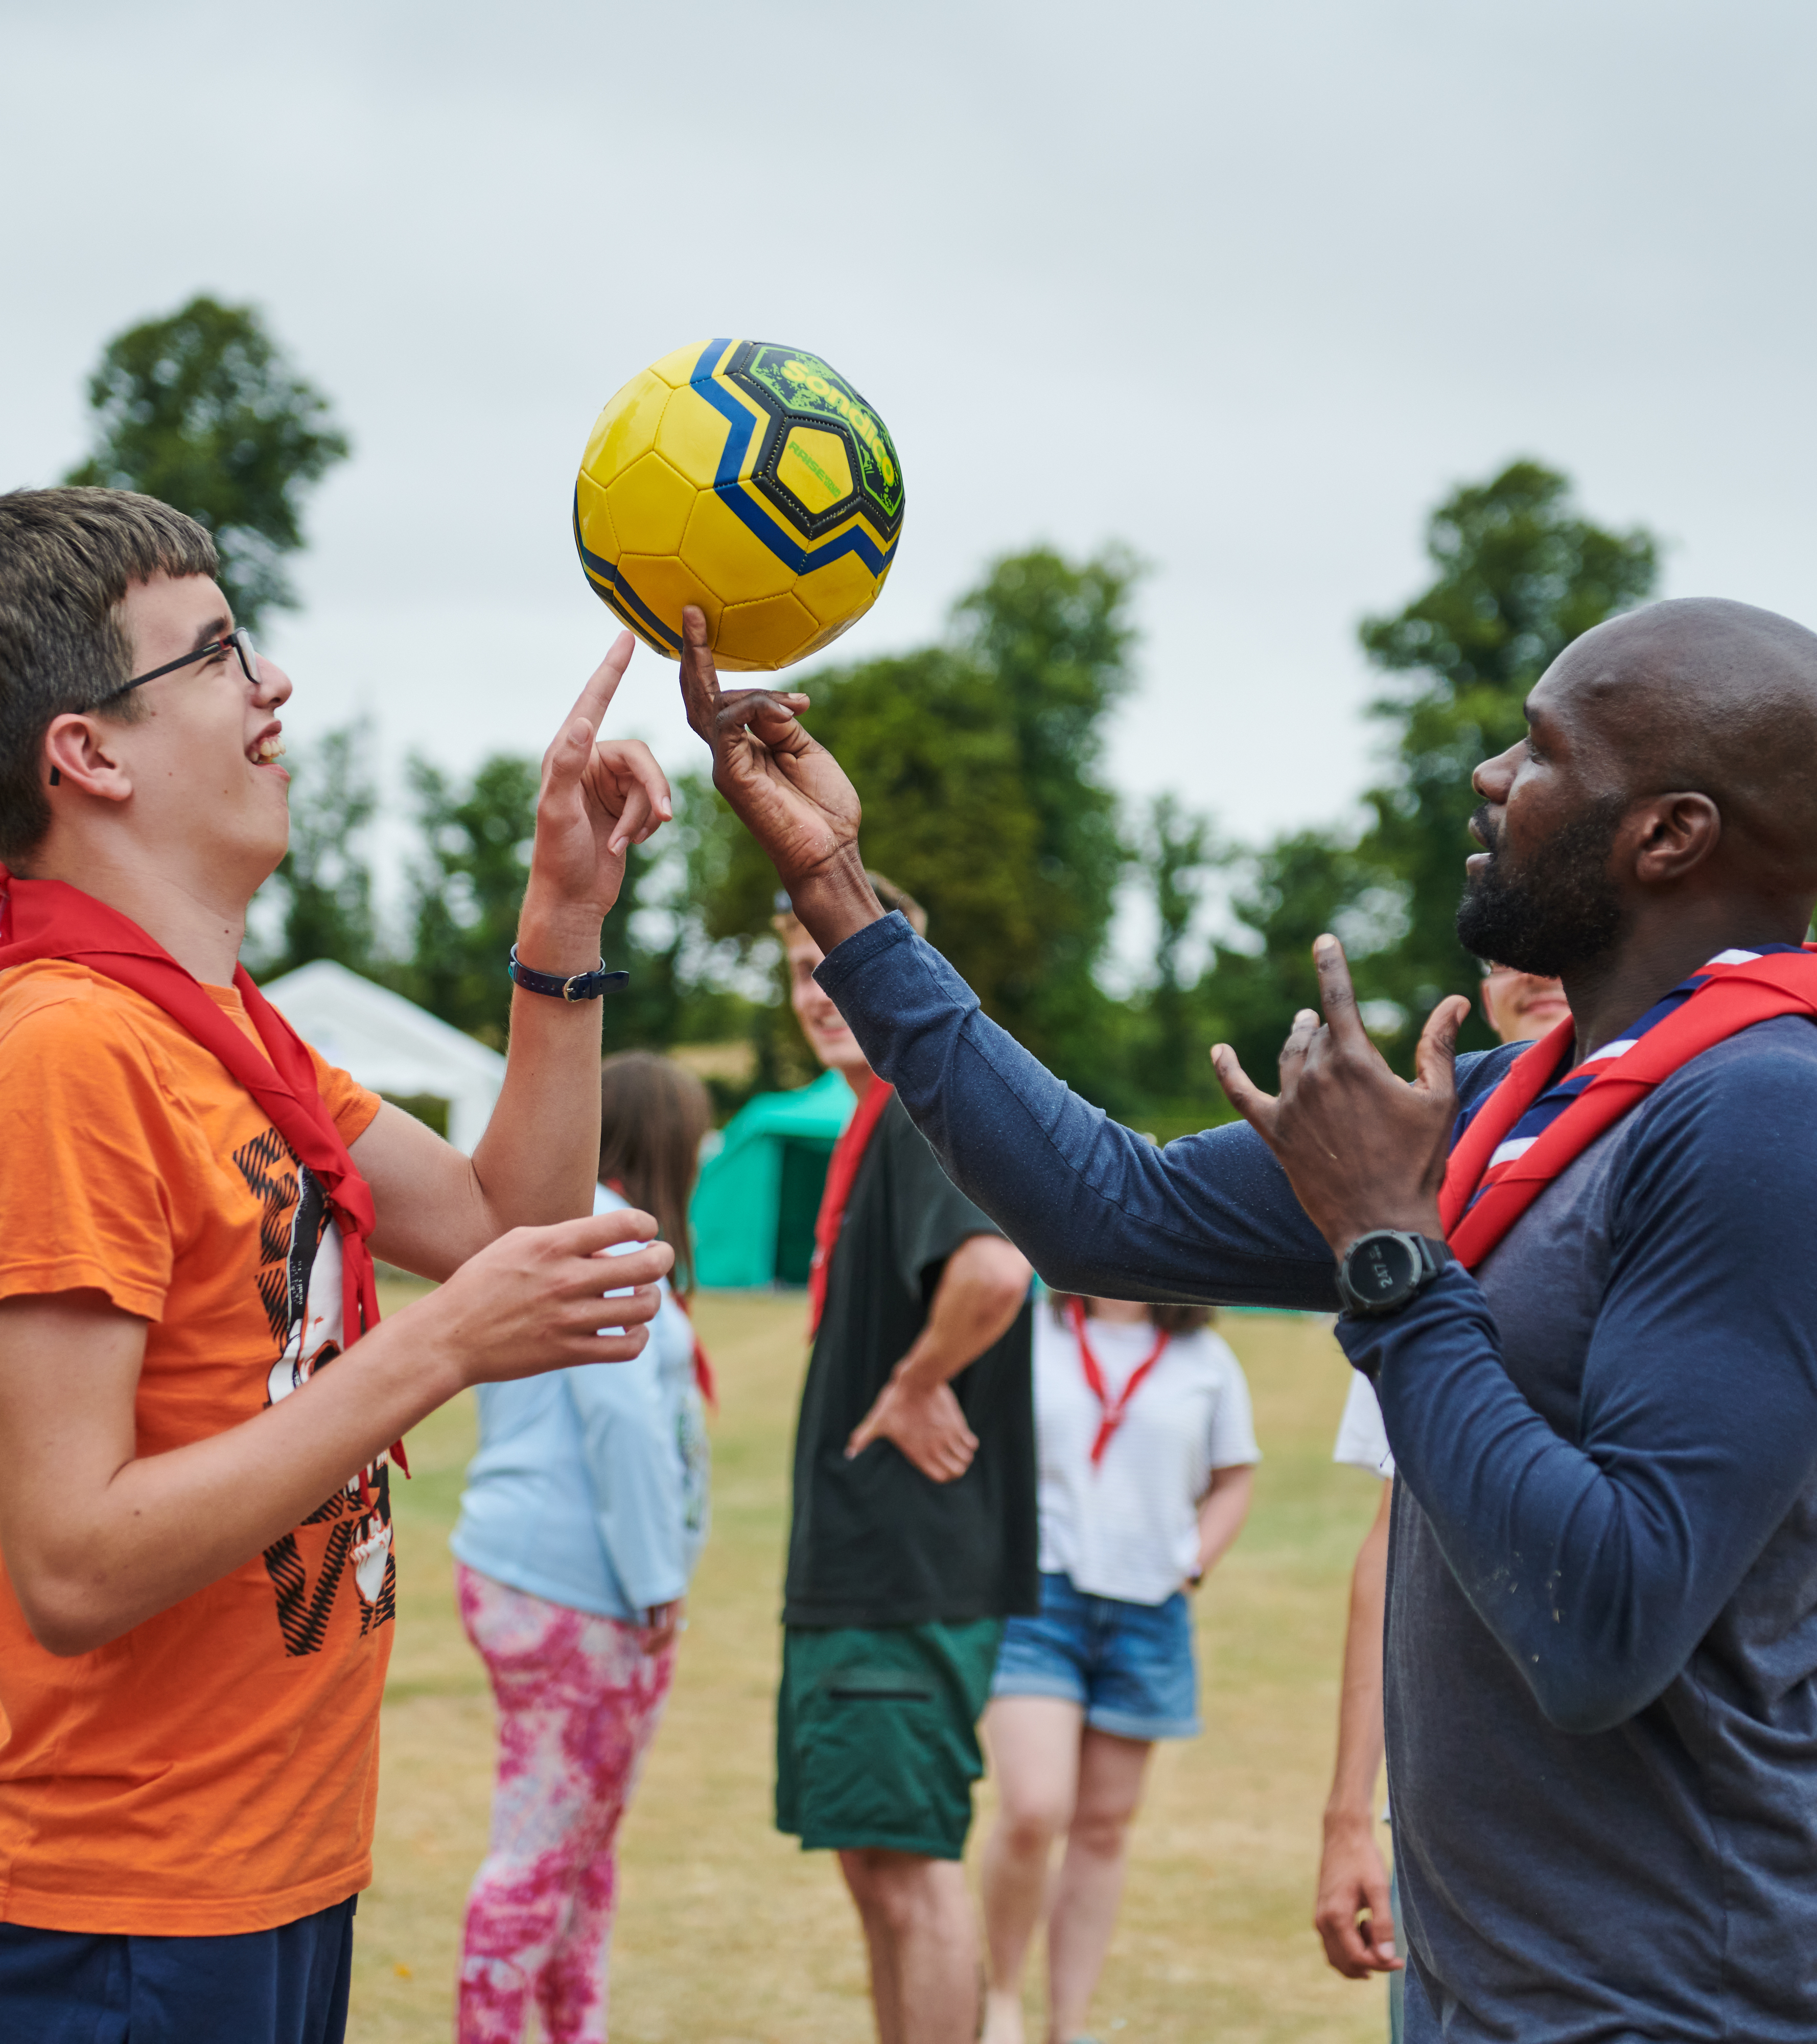
Additional needs and disabilities
Additional needs and disabilities may be visible or invisible, and the needs of each young person will be unique.
Some may occur for a limited period of time. E.g. a broken arm.
Many additional needs are permanent conditions. These include conditions such as ASD (Autism Spectrum Disorder), dyslexia or physical disabilities.
Some additional needs can fluctuate and may be affected by a range of different factors, such as stress.
Notes:
Additional needs and disabilities should not prevent a young person from being able to participate in Scouting. By making reasonable adjustments (doing things differently or providing additional support), most young people can access Scouting and develop to their full potential.
In Scouting, adults need to be aware of any allergies, medical needs, and faith-based or cultural needs a young person may have. You may need to cater for vegetarian, Halal and Kosher diets, for example. Or, you may need to cater to a young person who is coeliac or has a nut allergy. It's important to ensure that everyone’s needs are incorporated into section meetings and camps.

Slide 7
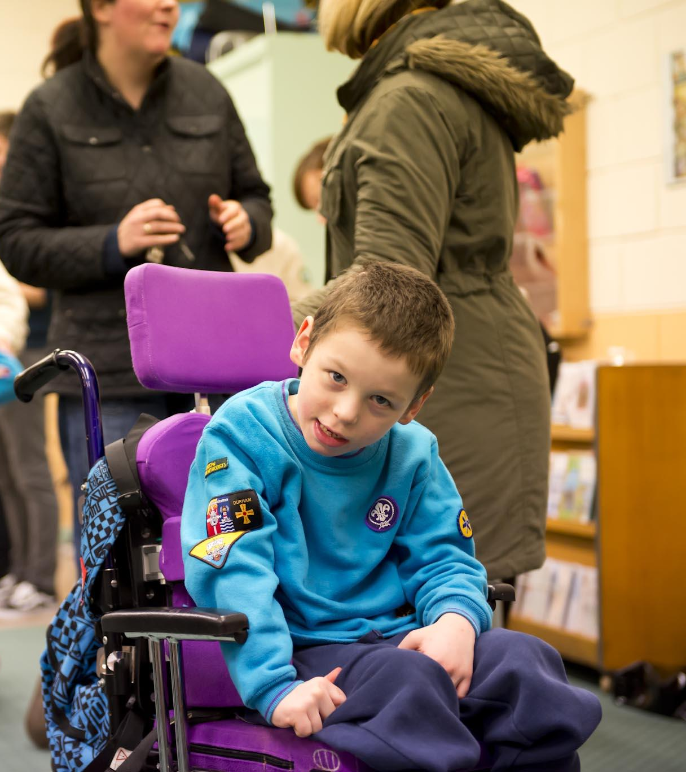


Additional needs.
Notes:
We’re now going to look at different additional needs. While knowing someone has this need can help us understand what we can do to help, labelling people is not helpful. Everyone is going to be different so use this knowledge as a starting point and then work out what makes each Scout tick.

Slide 8


Scouting for all
What additional needs might we need to think about when planning Scouts?
We’ll use Menti for this so grab your phones or open a new tab.
We’ll compare lists and see what you’ve got.

Slide 9

Scouting for all - disclaimers
I am massively simplifying this.
This will look different between young people.
I am outlining what it might involve as a young person or adult with this might need this adaptation or consideration.
Ask the young person, ask their parent or research more to find out more.
Focus on what they can do rather than what they can’t.
Notes:
Go through the health warnings before we get into the full list.

Slide 10
Scouting for all – additional needs
Cognition and Learning
Learning difficulties
Dyslexia
Dyscalculia
Dyspraxia
Down Syndrome
Notes:
This list is organised into the different groupings of additional needs that are used by local authorities, schools etc and all of these have guidance on how to include on the Scout website.

Slide 11
Scouting for all – additional needs
Communication and Interaction
Autism
Asperger’s Syndrome
ASD / ASC
Pathological Demand Avoidance
Speech, Language and Communication needs
Stammer
Tourette Syndrome
Need a Visual support
Notes:
This list is organised into the different groupings of additional needs that are used by local authorities, schools etc and all of these have guidance on how to include on the Scout website.

Slide 12
Scouting for all – additional needs
Sensory and Physical needs
Allergies / Coeliac
Asthma
Cerebal Palsy
Diabetes
Epilepsy
Hearing Loss
Incontinence
Juvenile arthritis
Migraine
Mobility Impairment
Broken limbs
Spina bifida and Hydrocephalus
Muscular dystrophy
Sensory processing differences and disorder
Stoma
Visual Impairment
Notes:
This list is organised into the different groupings of additional needs that are used by local authorities, schools etc and all of these have guidance on how to include on the Scout website.

Slide 13
Scouting for all – additional needs
Social, Emotional and Mental Health
Anxiety and Panic disorders
Depressive disorders
Eating disorders
Hyperactivity: ADHD / ADD
Looked after Children (LAC)
Oppositional Defiant Disorder
Obsessive Compulsive Disorder (OCD)
Phobias
Post Traumatic Stress Disorder (PTSD)
Notes:
This list is organised into the different groupings of additional needs that are used by local authorities, schools etc and all of these have guidance on how to include on the Scout website.

Slide 14
Scouting for all
Individual characteristics
Literacy skills
English as an Additional Language (EAL)
LGBT+
Gender
Faiths and beliefs
Social and economic background
Vegetarian and Vegan
Notes:
Compare the list they came up with, with this list from the Scouting for all section on the scout website.
We need to think about communication styles when helping someone with poor literacy or who knows English as an Additional Language. It may not affect their understanding but be careful of idioms that don’t make sense when directly translated.
As well as building an emotionally supportive environment for members of the LGBT+ community we may also need to think about practical arrangements like toilets if someone is transgender. Explain the acronym and that others put additional letters after it sometimes so we often add the + to show how inclusive this community is.
Gender mainly comes down to accommodation on residentials, making sure that girls and boys have either separate sleeping accommodation or a place to change depending on age.
People might follow specific diets or have requirements on praying depending on their religion and if they are not religious then holding events in a church may not be appropriate.
We should always be offering a range of activities that do not cost anything so that those from poorer social and economic backgrounds aren’t excluded. Scouts should be a leveller and has been right from the 1907 camp.
Vegetarian and Vegan goes beyond just a different diet – if someone is an ethical vegan for example they are choosing to follow that diet for the environmental and ethical benefits and this should be respected in a similar way to a religious linked diet (recent high court rulings).

Slide 15
Making adjustments
Know your Scouts and their needs.
Plan ahead to include them.
Activities that may not be accessible can be adapted or changed to include everyone.
Time to try this yourself in breakout rooms.
Notes:
Use appendix I for the break out room sessions

Slide 16
Thinking on your feet
Sometimes we have to adapt a game quickly to different needs.
Imagine we’re playing a game of north, south, east and west.
A young person on crutches has now arrived. What could we do to include them?.
A young person who wears hearing aids comes in but has forgotten them. How can we include them?
Notes:
Put ideas in the chat. If there isn’t time then talk through this briefly to explain the importance and to reassure that every amount of planning can still not prepare us sometimes.

Slide 17
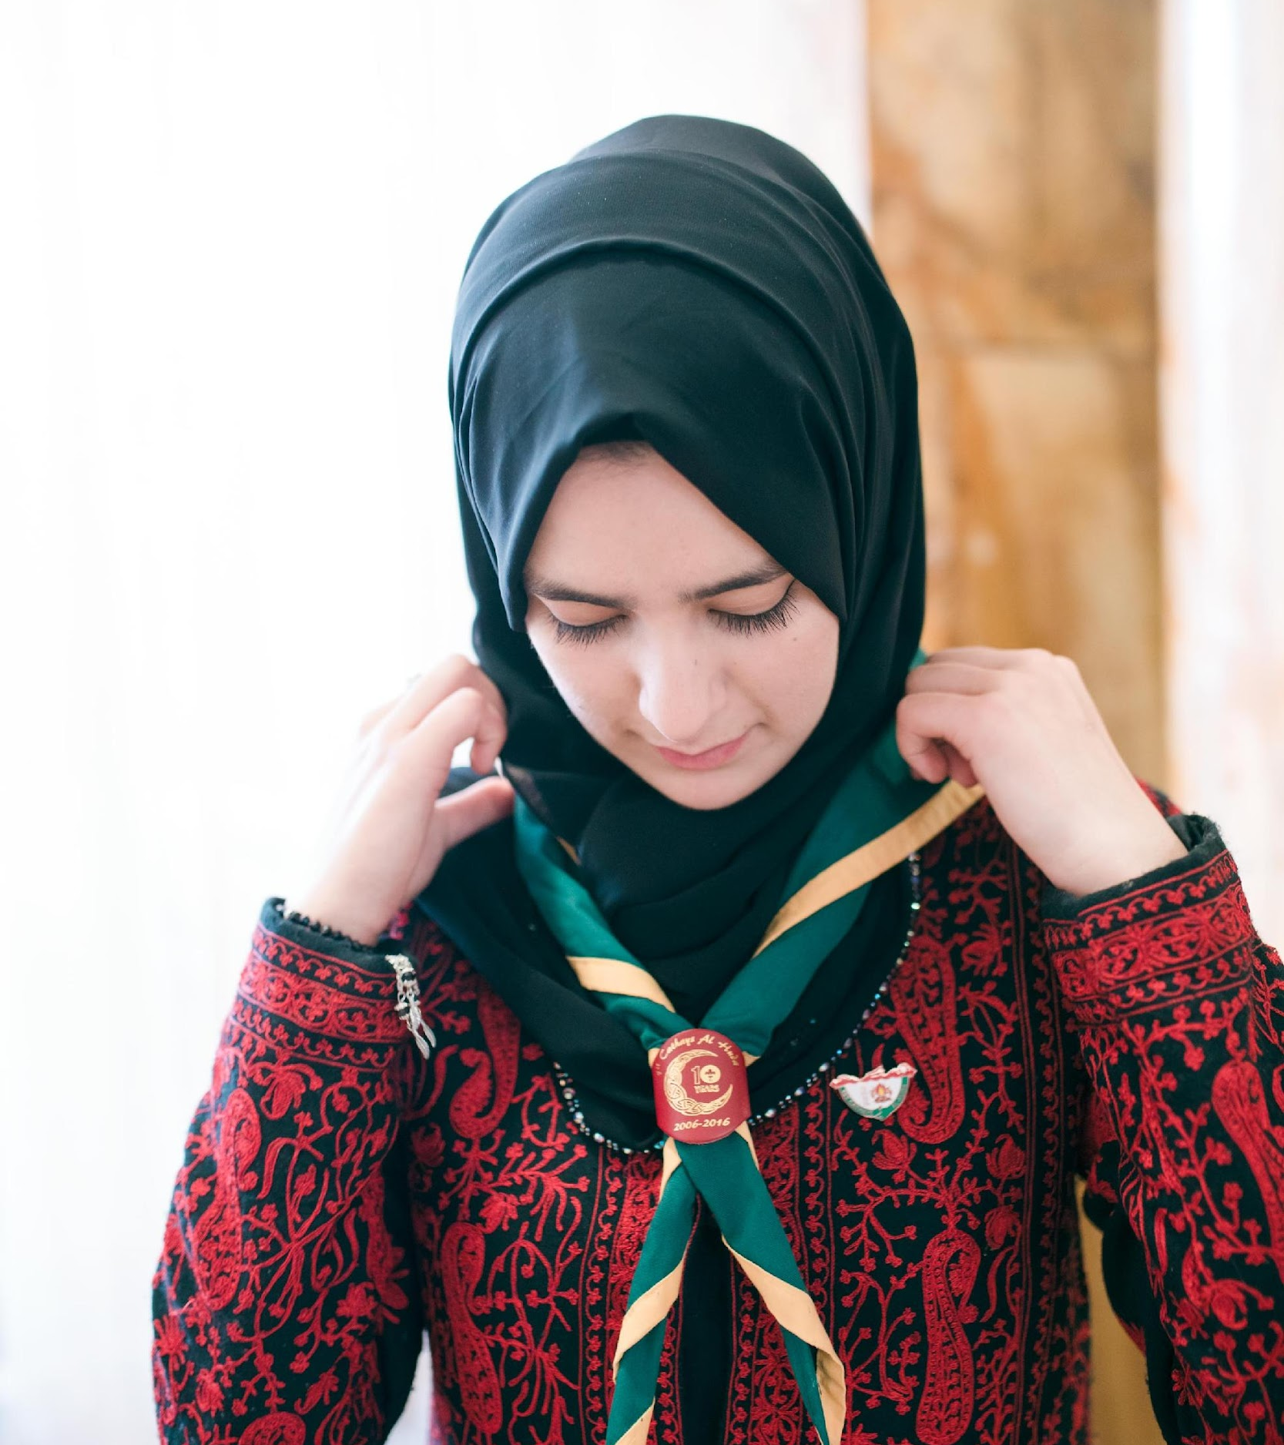
Support and where next?

Slide 18
More support
These are broad topics – we can’t cover every part of them.
Behaviour advice:
Other leaders in your section.
Assistant Explorer Scout Leader (Young Leader)
Bullying advice:
NSPCC and Childline
Bullying UK
National Bullying helpline
Notes:
Cover the areas where ESYLs can gain extra support.

Slide 19
More support
Society websites can provide more information about additional needs e.g. RNIB for blind, Mind for mental health problems.
Scout website has a lot of resources, information and links.
scouts.org.uk/volunteers/inclusion-and-diversity/
Scouts website >> Info for volunteers >> Inclusion and Diversity
LGBT+ support including from FLAGS Scout Active Support Unit.
Notes:
Cover the areas where ESYLs can gain extra support.

Slide 20
More support
Resources to raise awareness of additional needs in your section:
A Million Hands – Community Impact projects; disability, refugees, kindness, mental health
Disability Awareness Beaver and Cub activity badges
Alternative promises, Makaton promise.
People you can ask:
Other leaders in your group or district
ACC Inclusion and Diversity, Lynn Tatavossian
Notes:
Cover the areas where ESYLs can gain extra support. Lynn Tatavossian is Hampshire Scouts’ ACC Inclusion and given her involvement in the YL programme is very open to talk to anyone about inclusion matters.

Slide 21
A safe space
Notes:
Task: approx. 15 minutes
Have a discussion with the Explorer Scout Young Leaders about what we mean by creating a positive and inclusive environment. Re-emphasise the fact that Scouting is open to all.
Ask Explorer Scout Young Leaders to draw a rough picture of where their section meets. What might a positive and inclusive environment might look like?
How would young people say their current meeting place makes them feel? Do they think their meeting place is currently a positive and inclusive environment? Are there any changes they could make?

Slide 22
Distraction: sensory overload
Notes:
Task: approx. 10 minutes
Ask an Explorer Scout Young Leaders to volunteer for this activity. Please note: the volunteer will be made to feel disorientated, so it's important to take this into account when choosing someone.
Blindfold the Explorer Scout Young Leaders and sit them on a chair in the middle of a circle.
Next, put on some music. Ideally, you should choose a frantic sample of music (with a fast tempo or multiple instruments, for example) or play some sound effects of a busy road. Place the source of the music at one side of the room.
At the other side of the room, play a different type of music or sound effect. If you don’t have access to music, you could ask some of the Explorer Scout Young Leaders to mimic the noises of a busy road or to sing a song.
Ask the other Explorer Scout Young Leaders to walk close to the blindfolded person, without touching them.
Then, ask the blindfolded Explorer Scout Young Leaders a series of simple maths questions with two steps. Could the Explorer Scout Young Leaders solve them? How did they feel? Did the distractions become frustrating and stop them from concentrating?
Explain that feeling distracted and overwhelmed can be a common experience for some young people. At some point in their lives, they may have felt like that themselves, as it's a very common experience. Everyone experiences things differently. We should always take that into consideration when supporting and leading sessions for others.

Slide 23
On the outside
Notes:
Task: approx. 10 minutes
Give each member of the group a piece of paper with different colour on it eg yellow, blue, red, and green. There should be two or more pieces of paper representing each colour, except the green.
Once everyone has received a piece of paper, Explorer Scout Young Leaders should keep the colour to themselves. They should not share details with each other.
Ask Explorer Scout Young Leaders to set out and find the other person/people who have been given the same colour paper as them, using actions only. For example, they might point to the relevant colour if it's represented in the room, or they might do an action to represent a colour (such as mimicking waves to represent the colour blue). Once they have found other people with the same colour, they should stand together as a group. Once everyone (except the green person) have found their groups, stop the activity.
Ask the green person how they feel. Do they feel sad? Isolated? What did people say when they approached their group? Did they turn them away? How did this make them feel?
How did the other members of the group feel when they found a colour match? Did they feel relieved?
The activity highlights the experience of someone who might feel they are somehow different to others. People are naturally drawn to others who ‘are like them’, but this does not lead to diversity, creativity or innovation. This also mirrors how a new young person might feel when joining an established section.
Note: before you hand out the coloured cards, give some thought to the person who will play ‘the green’ character. The activity will inevitably lead to this person feeling temporarily isolated and ‘left out’. This can be a frustrating and unsettling experience. It's therefore important to choose an Explorer Scout Young Leaders who you know will respond well to this. Activities about special educational needs and additional needs There are lots of different types of Special Educational Needs (SEN) that Explorer Scout Young Leaders may come across in their role. It's really important not to label people. Instead, they should get to know individuals, as discussed in the previous activity. Different needs can present differently in different people, so it's important not to generalise or stereotype. That said, there are often some commonalities within different Special Educational Needs. Understanding these commonalties will help them to best support young people to have a fun and rewarding time in scouting. Below are some games and activities that can be used to support Explorer Scout Young Leaders to develop an understanding of both additional needs and Special Educational Needs.

Slide 24
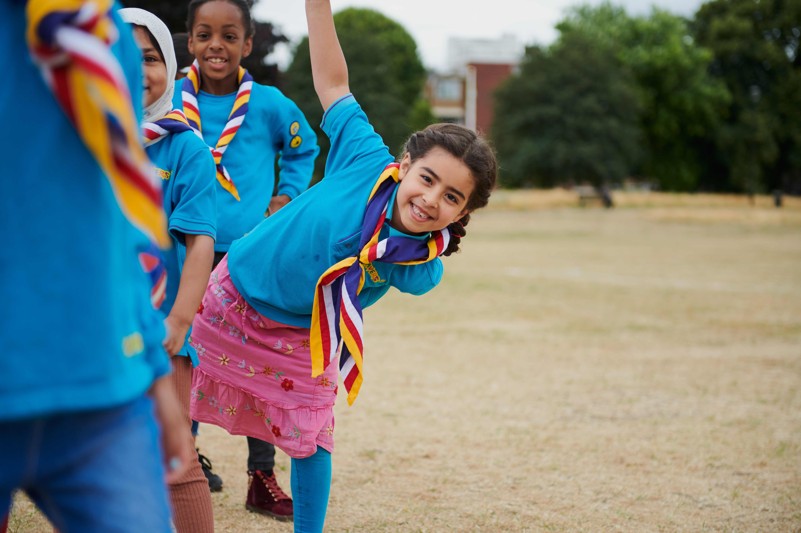
Making reasonable adjustments
Get to know your young people
Plan ahead
Activities that may not be accessible can be adapted or changed to include everyone
Scouting for all
Task: In small groups read your scenario.
What adjustments have been made to make sure the scenario is inclusive?
Is there anything else that could be done?
Notes:
Explain to the Explorer Scout Young Leaders that they will get to know their young people and should plan ahead with the rest of the leadership team for sessions. By doing this they can consider any additional needs before the meeting and ensure that the sessions are as inclusive as possible.

Slide 25
Thinking on your feet
Notes:
Task: approx 20 mins
Sometimes Explorer Scout Young Leaders may find themselves in a situation where they have to adapt a game or activity they are running on the spot. An example of this might be if they are running an opening game and a young person turns up with a broken leg. This requires them to be able to adapt at speed, and to think creatively, so everyone can join in.
To begin, ask a couple of Explorer Scout Young Leaders to volunteer to run a game with the rest of the Unit. They can play any game they like. Something simple like ‘North, South, East, West’ or ‘Duck, Duck, Goose’ would work well.
Once they have been playing for a couple of minutes, give them a scenario to adapt to. You could pretend that a young person on crutches has arrived and wants to join in. How can they adapt to be inclusive?
Next, imagine that there is also a person who is deaf within the group. How can they make sure that the game is suitably adapted this time?
Keep going, asking Explorer Scout Young Leaders to further adapt their approach to suit someone with a different need, such as a visual impairment, or a difficulty following instructions, for example. Each time, ask the Explorer Scout Young Leaders to contribute their ideas as a group. How can they adapt the activity to make sure everyone can join in?

Slide 26
Now we are going outside…

Slide 27
Activity 1 – Walk across the Field, one person blind folded and one person navigating them.
Activity 2 – Put up the 2/3 Man tents (Again) HOWEVER, One person is Blind, One person is deaf, one person can only use ONE arm.

Slide 28
Module F
Key takeaways
Every young person is different
Everyone is welcome in Scouting
You will play a key part in creating a positive and inclusive environment
Plan ahead to adapt programmes to meet the needs of all young people within the section

Slide 29
Final reflections….
Notes:
Task:
Ask each Explorer Scout Young Leader to reflect and answer the following questions on their own before sharing as a group:
What is one thing I am going to take away from today's session which I can implement into my section?
What is one way I like to learn that might help young people?
Is there anything you want to learn more about following today's session?

Slide 30
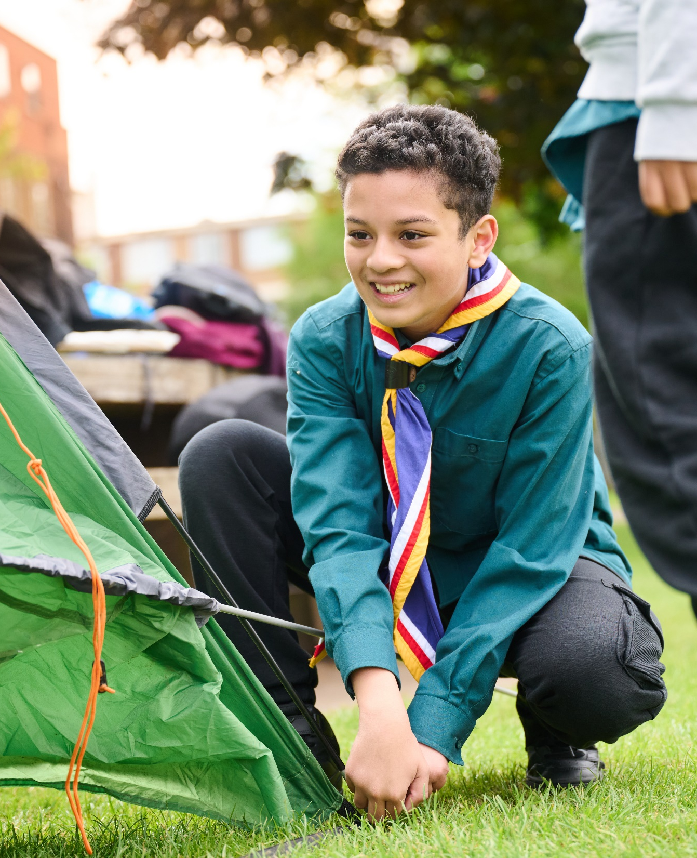
The Young Leader Scheme
Who to contact
If you have any questions, please contact the following people who will be able to help you.

Slide 31

Thank you
Young Leaders’ Scheme
Scouts.org.uk
#SkillsForLife

