Slide 1

Young Leaders’ Scheme
Module B – Leading Together - Teamwork
Scouts.org.uk
#SkillsForLife
Notes:
If you need to change the background please follow these intructions:
1. On your Windows tablet, tap the Design tab.
2. On your Windows phone, open the slide for editing (either by double-tapping it or by tapping it and then tapping Edit). Tap More at the bottom of your screen, tap Home, and then tap Design.
3. Tap Format Background.
4. You will see the background colours divided into Theme Colours and Standard Colours. Theme colours coordinate with the theme you selected previously. You can select a solid colour or colour gradient.

Slide 2

Getting to know you...
Notes:
Icebreaker: 5- 10 mins
Key points:
Participants will be working together during the session so it's a good idea to break the ice and get to know each other first.
Activity option 1 - Speed dating:
Everyone walks around the room, finds someone they don’t know and talk for 1 minute
Ask questions: Who got you into Scouts? When did you join Scouts? What key skill do you bring to your Scout team? what they’d like to learn from workshop,
After two minutes, blow a whistle or shout and they find a new partner
Presenters can come up with other questions if they can think of better ones!
Or alternatively depending on amount or type of participants
Activity option 2 – Group discussion
Participants to discuss above questions (from option 1) within their table groups

Slide 3
Do more. Be more
  Welcome
In this session, we are going to look at:
Have confidence to take on a leadership role in your section.
Be able to run activities appropriate for your role.
Recognise different leadership styles
Understand when each style should be used effectively.
Recognise the impact of different leadership styles.
Understand the need for evaluation when running activities.
Do more.
Be more.
Young Leaders’ Scheme

Slide 4
Leadership

Slide 5

Do more. Be more
  What is leadership?
  The word leadership can mean different things in different contexts.
  Task: Look at the word cloud below, pick a word connected to leadership. You have 2 minutes to consider why this word is linked to good leadership. Get ready to share with the group.
Notes:
Task: Look at the word cloud below, pick a word connected to leadership. You have 2 minutes to consider why this word is linked to good leadership. Get ready to share with the group.

Slide 7
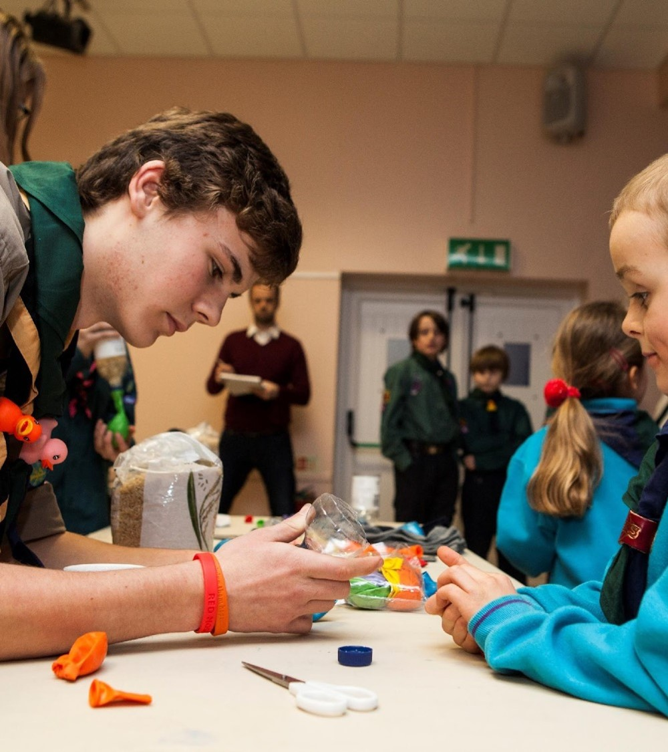
Where can we find leaders?
Teachers
Politicians
Business managers
Religious figures
Family/friends
Activists
Sports managers/coaches
Judges
Scout leaders
Youth Parliament members
Notes:
Task: Ask ‘Where have you encountered leaders?’
Examples show on the slide

Slide 8
Do more. Be more
  Leaders
  You will have come across lots of leaders in your life (e.g. Teachers, Coaches etc.). You will have an idea of what you think makes a good leader.
  In pairs try to answer the following questions:
  Can you think of 2 good leaders?
  What do they do?
  Why are they a good leader?
  What similarities does their leadership have with being a young leader?

Slide 9
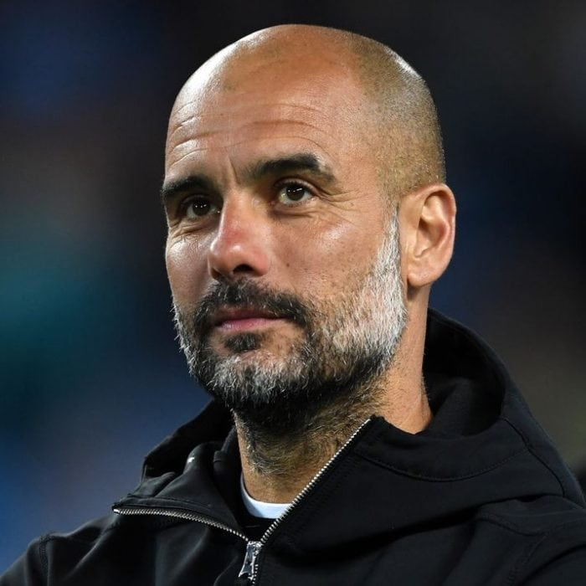
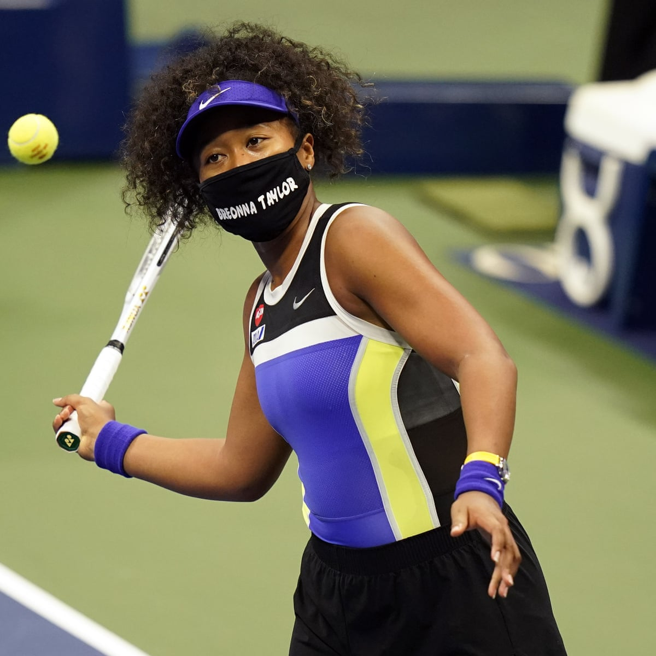
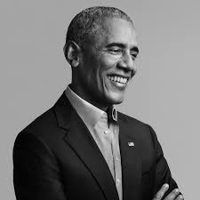
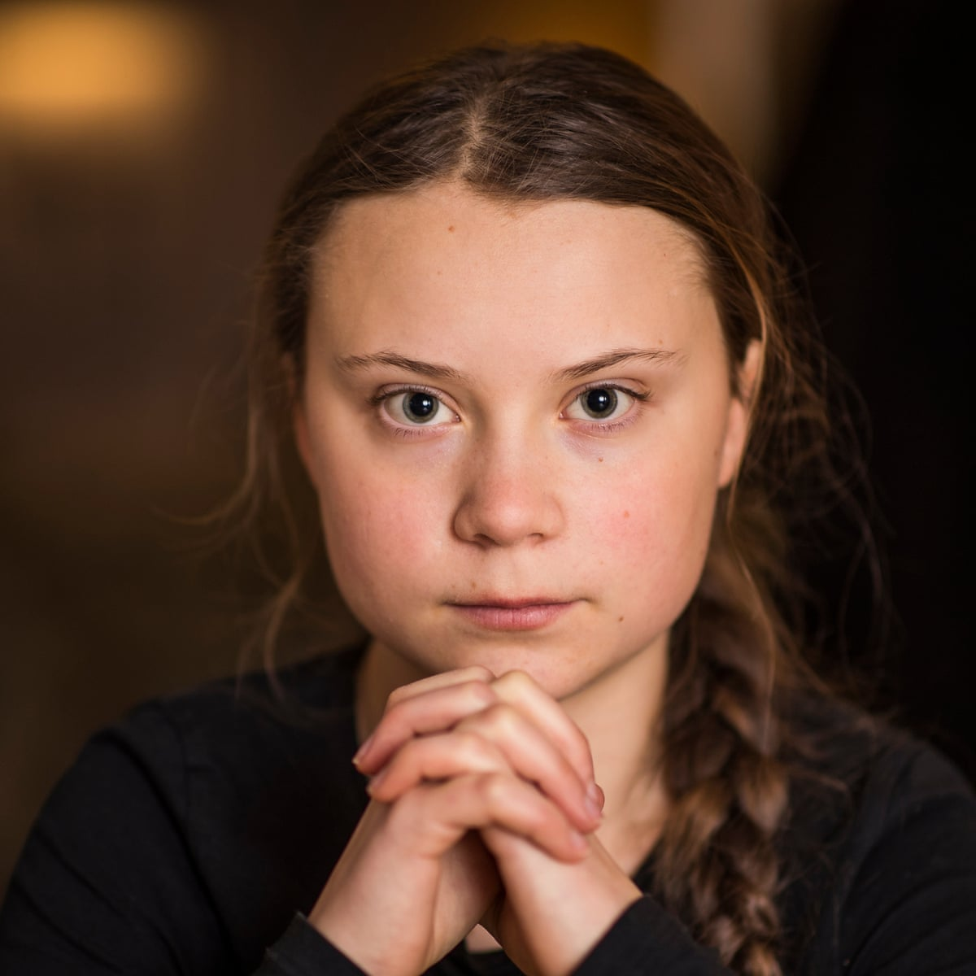
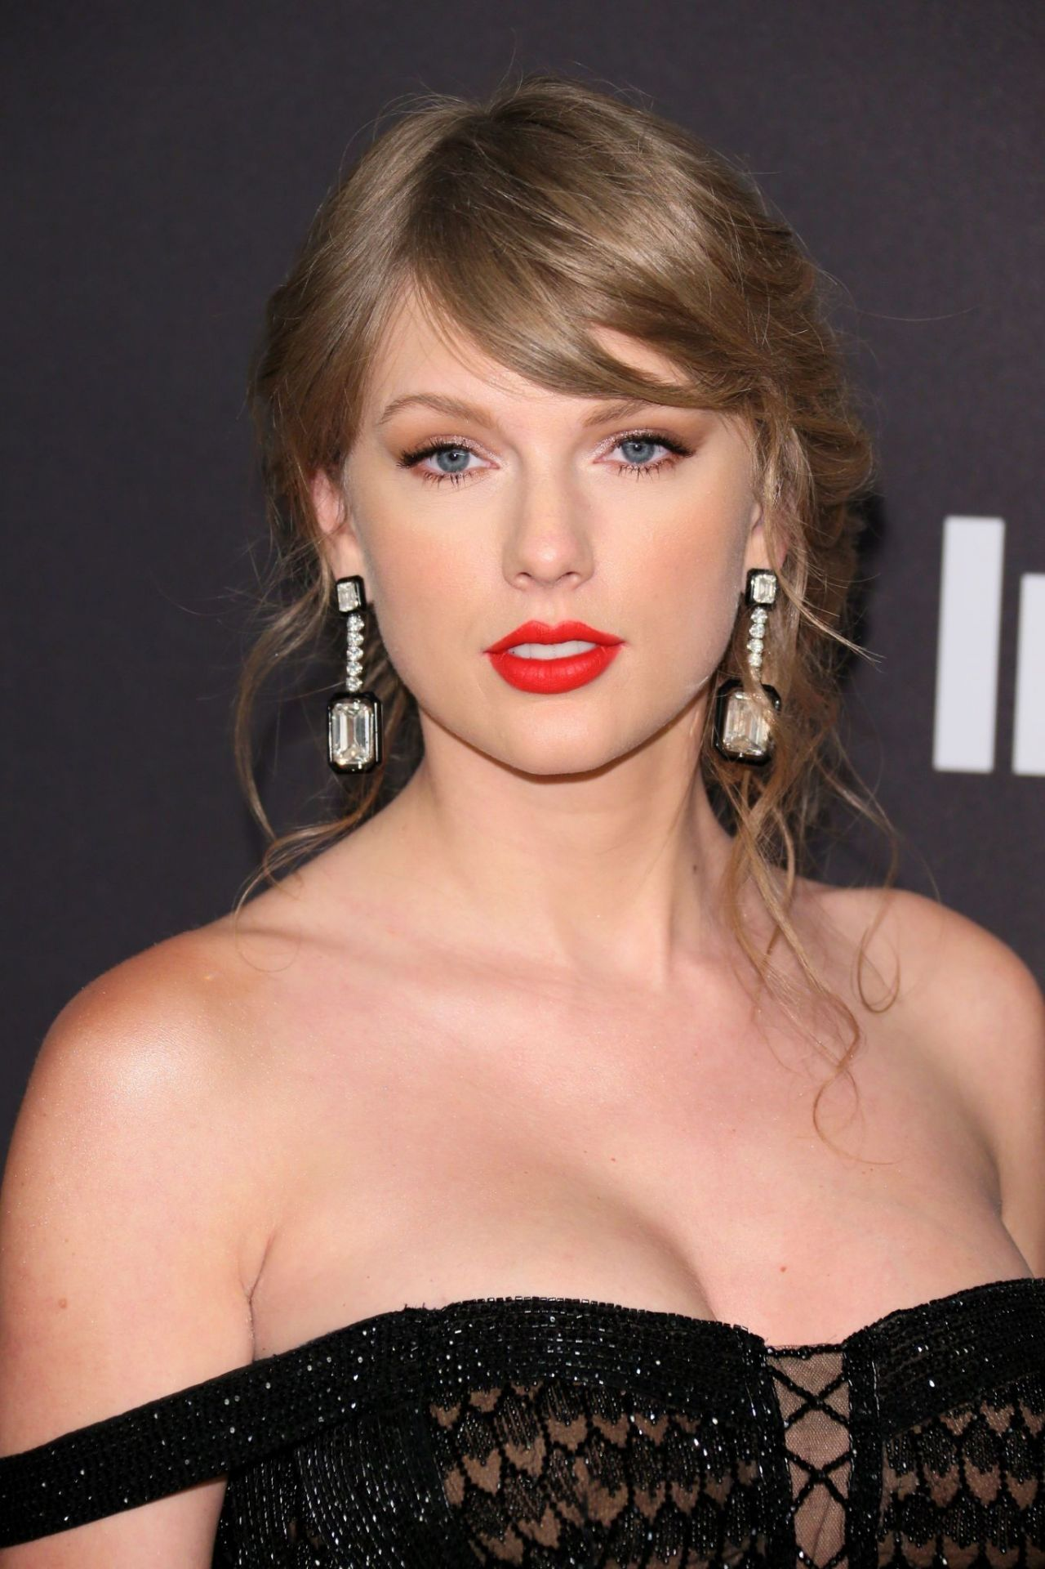
  Try to answer the following for each leader:
  Who are they?
  What do they do?
  Do you think they are a good leader? Why?
  What similarities does their leadership have with being a young leader?
Notes:
Leaders from left to right:
Pep Guardiola - Manager of Manchester City FC and formerly FC Barcelona
Naomi Osaka - Tennis player, won multiple grand slams and activist
Barak Obama – Former US president
Greta Thunberg - Environmental activist
Taylor Swift - Musician/artists, first musician to become a billionaire purely off her music/performances

Slide 10
Effective Leaders
In pairs decide which column each leadership character trait belongs in.
Effective leaders | Ineffective leaders
Generate ideas | Impose
Notes:
Character traits to use:
Generate ideas
Impose
Encourage others
Help others learn
Try to do everything themselves
Don’t listen to others
Not leaving room for flexibility
Give positive feedback
Listen
Don't learn from past experiences
Team player
Asks for help when needed
Bends rules
Learns from mistakes
Takes their time
Rushes people
Unrealistic expectations of others

Slide 11
Leadership styles

Slide 12
Leadership styles
Informal/supportive (Selling)
  Young people may not be aware you’re playing a leadership role.
  There to help and support young people.
Formal/directive (Telling)
  Giving firm and clear instructions.
  One sided where knowledge needs to be shared.
Democratic/team-based (Sharing)
  Leading a discussion
  Including everyone in the final decision.
Notes:
Lots of different models of leader skills but we’re going to look at 5 styles in red. Some prefer a different model focusing on four main styles in blue and these are looked at in the adult training scheme.

Slide 13
Leadership styles
Passive (Delegating)
  Letting young people take the lead and make the decisions.
  Used when there is no risk to safety.
Organiser
  Responsibility for organising things.
  Guiding team to an outcome based on what is provided to use.
Notes:
Lots of different models of leader skills but we’re going to look at 5 styles in red. Some prefer a different model focusing on four main styles in blue and these are looked at in the adult training scheme.

Slide 14
Activity
Look through the sample programmes for the sections.
Use the leadership styles just discussed to decide in your groups which style is best for each activity.
Notes:
Explain the task and send off to break out rooms. Sample programme to be shared by the facilitator in each focus group by sharing their screen.

Slide 15
Activity
Listen to this narrative of a Beaver Scout meeting.
When I pause, vote on which style was just being used.
Notes:
Read out appendix E from the Young Leader training scheme and pause after each change in style.

Slide 16
Planning can help
Planning ahead is really important and feeds in to nearly all the modules.
One way of planning is a systematic planning method is called DOOR.
  Decide
  Organise
  Operate
  Review
This can be applied from running a session to making a change or helping a Scout.
Notes:
Lots of different models of leader skills but we’re going to look at 5 styles in red. Some prefer a different model focusing on four main styles in blue and these are looked at in the adult training scheme.

Slide 17
Time to think
Think about the styles. Which do you tend to use?
Which do you want to try and use more?
Are there any you don’t use?
Notes:
This is a personal reflection. They can write it down if they like but it is important to know where our defaults lie.

Slide 18
Do more. Be more
  Why do we work in teams?
  Effective teams working together achieve more than individuals can working alone. Scouts work in teams for lots of reasons, including:
  Collaborative problem-solving in teams leads to faster, better outcomes
  No one person can do everything well
  You learn from your team-mates
  Teams are more flexible and can adapt to change
  Teams can address more complex problems than individuals
  Teams are more than the sum of their parts

Slide 19
What’s Next?

Slide 20
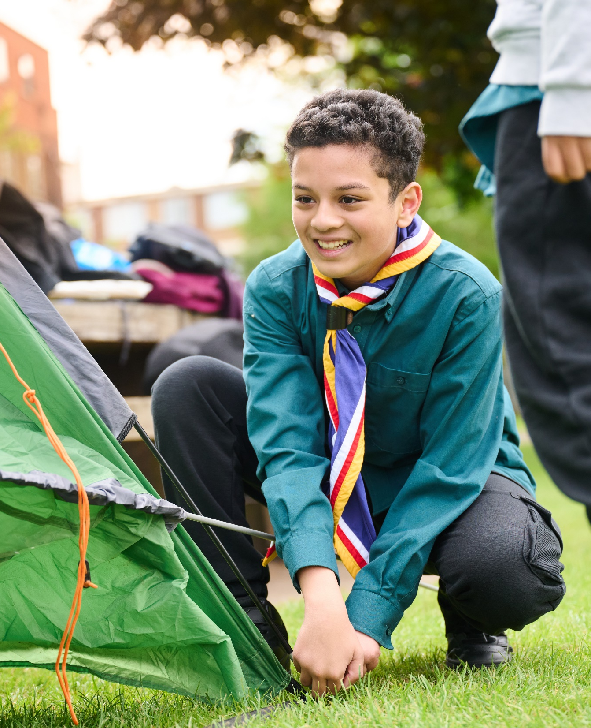
The Young Leader Scheme
Who to contact
If you have any questions, please contact the following people who will be able to help you.

Slide 21
Thank you
Young Leaders’ Scheme
Scouts.org.uk
#SkillsForLife

