Slide 1

Young Leaders’ Scheme
Scouts.org.uk
#SkillsForLife

Slide 2
Explorer Scout Young Leader Training
Module A – Preparing for Take-off

Slide 3
Aims:
Understand your role as an Explorer Scout Young Leader.
Explain how Scouts is organised.
Summarise the purpose, method and values of Scouts (Fundamentals)
Explain how the Child Protection Policy applies to you.
Know how to access Policy Organisation and Rules (POR) and understand how it affects you.
Explain why it is important to run activities safely and why we need to risk assess activities.
Understand how the Young Leader’s scheme works.
Notes:
Cover the aims of the session. Emphasise this is the only compulsory module because it contains lots of important information.

Slide 4

Getting to know you...
Notes:
Icebreaker: 5- 10 mins
Key points:
Participants will be working together during the session so it's a good idea to break the ice and get to know each other first.
Activity option 1 - Speed dating:
Everyone walks around the room, finds someone they don’t know and talk for 1 minute
Ask questions: Who got you into Scouts? When did you join Scouts? What key skill do you bring to your Scout team? what they’d like to learn from workshop,
After two minutes, blow a whistle or shout and they find a new partner
Presenters can come up with other questions if they can think of better ones!
Or alternatively depending on amount or type of participants
Activity option 2 – Group discussion
Participants to discuss above questions (from option 1) within their table groups

Slide 5
What is a Young Leader?
Notes:
Pair discussion (or breakout rooms if online) (3 mins)
Participants to come up with 5 words (or phrases) they associate with Young Leaders or what they think being a Young Leader will be like

Slide 6
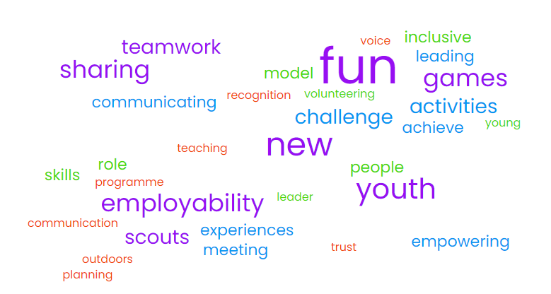
Module A - YLS
Do your words match?
Notes:
Other examples to consider:
Teamwork
planning
communication
Leader
Teaching
Communicating
Empowering
Trust
Sharing
Outdoors
Scouts
Experiences
Meeting
Programme
New experience
People
Youth
Young
Achieve
Activities
Games
Voice
Inclusive
Fun
Volunteering
Role Model
Recognition

Slide 7
Module A - YLS
Young Leaders…
Are Explorer Scouts who help lead Younger People (Scouts, Cubs, Beavers, and Squirrels)
Have the support of their own Leaders, as well as of the Leaders in the section they’re helping
Work towards the Young Leader Award by completing training (‘Modules’) and challenges (‘Missions’) while volunteering
Notes:
Now discuss in more detail what a Young Leader is.
Remember you might have some participants who have not gone through the sections.

Slide 8
Being a young leader (activity)
Please discuss these things
1. What are the responsibilities of a young leader?
2. What skills might you gain?
3. Any worries you might have?
Notes:
Split into breakout rooms to discuss what responsibilities they think a YL has, what skills they need and if they have any worries.

Slide 9
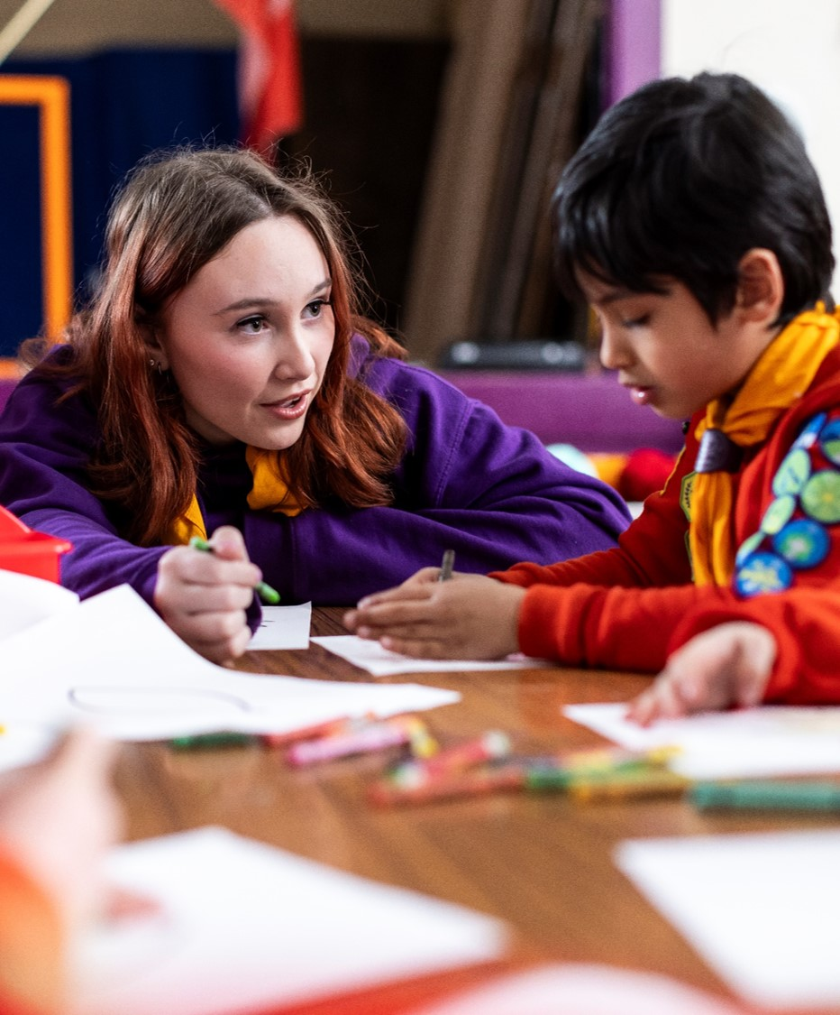
What responsibilities do Explorer Scout Young Leaders have?
Notes:
Discussion task: 5 mins
Get Young Leaders to discuss the following questions in pairs/small groups:
What things might you be asked to do as a Young Leader?
What are you looking forward to doing as a Young Leader?
How will the Young Leader role change your dynamic with young people and adult volunteers in the section?

Slide 10
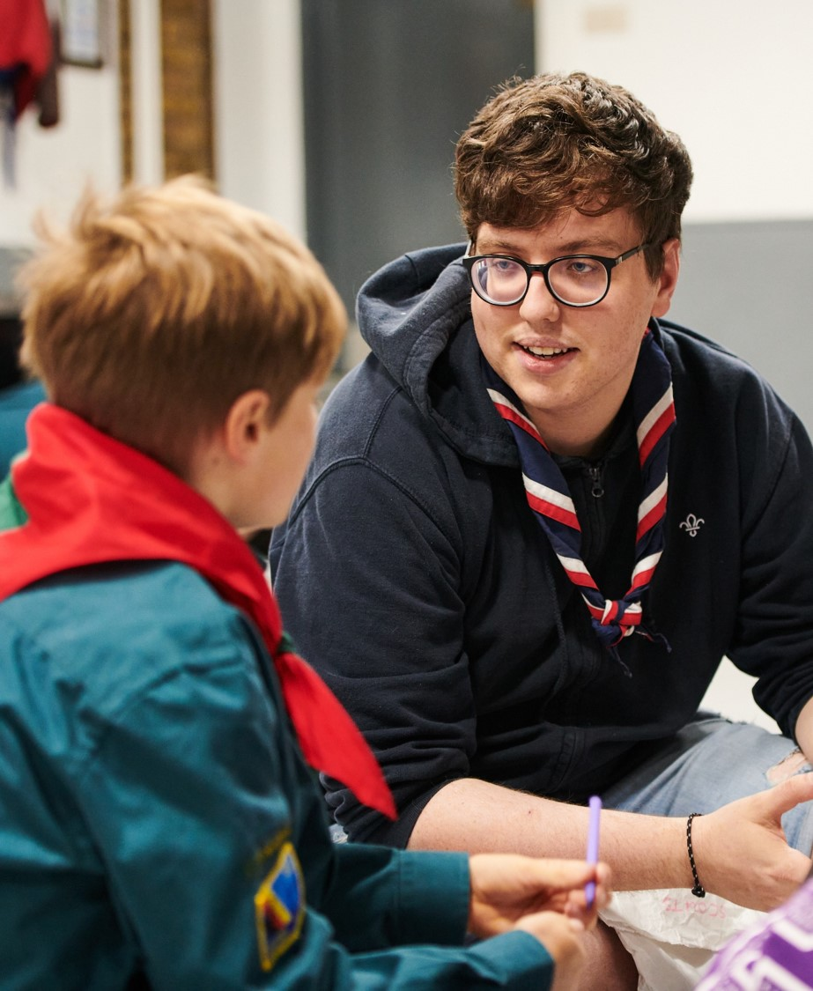
What skills can help me as a Young Leader?
Notes:
Task: 5 mins
As a group create a list of all the skills/talents you think will help you as a Young Leader!
Hints:
What do you enjoy doing?
What could you teach others?
What did you learn in Scouts that you could pass on?
Do we want everyone to have the same skills and talents? If not, why not?

Slide 11
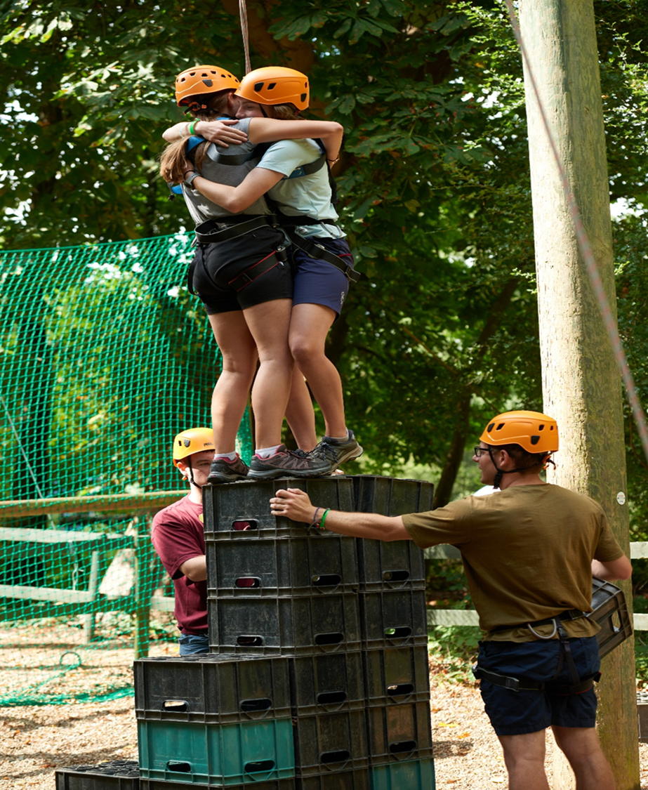
Who can you turn to for support?
Notes:
Think about who forms your support network? (5-10 mins)
When you are a young leader there might be times where you have questions and you need to know who you can turn to: Who you gonna call?
Activity: Using a ball of string/wool. Throw the ball of string to someone else in the room/circle and say one person you might be able to turn to for support. They then throw to someone else etc. This will create a web for people with lots of examples.
Potential examples: Section leaders, Group Scout Leader, Other young leaders, Young people, Training manager, Explorer Scout leader, teachers, friends, family etc.

Slide 12





How the Scouts is organised:
Scout District
Scout Group
Scout Group
Scout Group
Notes:
Briefly cover the organisation of Scouts.
You as Yls will be working in either a Beaver colony, Cub pack or a Scout troop. Each are led by a leader and a leader team.
These are run by a Scout Group led by a Group Scout Leader.
These groups are overseen by a Scout District. The district is in charge of lots of other groups in a local area and also run Explorer Units and a Scout Network. They’re run by a District Commissioner and a wider team.
Each district is overseen by a County (in England, Area, Regions or Baliwick in other areas). For us, this is Hampshire Scouts and they’re run by a County Commissioner called Martin Mackey.

Slide 13
What is it all for?
Our Fundamentals – purpose.
Scouting exists to actively engage and support young people in their personal development, empowering them to make a positive contribution to society.
Notes:
The fundamentals of Scouts are what sets us apart and describes us.
The purpose is what we do in a sentence.

Slide 14
What is it all for?
Our Fundamentals - method.
Scouting takes place when young people, in partnership with adults, work together based on the values of Scouting and:
  Enjoy what they are doing and have fun;
  Take part in activities indoors and outdoors;
  Learn by doing;
  Share in spiritual reflection;
  Take responsibility and make choices;
  Undertake new and challenging activities; and
  Make and live by their Promise.
Notes:
The fundamentals of Scouts are what sets us apart and describes us.
The method is how we do it.

Slide 15
What is it all for?
Our Fundamentals - values.
Integrity: we act with integrity, we are honest, trustworthy and loyal.
Respect: we have self-respect and respect for others.
Care: we support others and take care of the world in which we live.
Belief: we explore our faiths, beliefs and attitudes.
Co-operation: we make a positive difference, co-operate with others and make friends.
Notes:
The fundamentals of Scouts are what sets us apart and describes us.
The values is how we do things.
Ask for Yls to pop in the chat their ideas for an activity that fits in with an activity and their reasons for it.

Slide 16
Safeguarding
Notes:
Important to remind Young Leaders that this part is really important, but also that they have nothing to worry about and to ask any questions they have.
Try to give them an opportunity to ask quietly if they do not want to answer in front of the group.

Slide 17
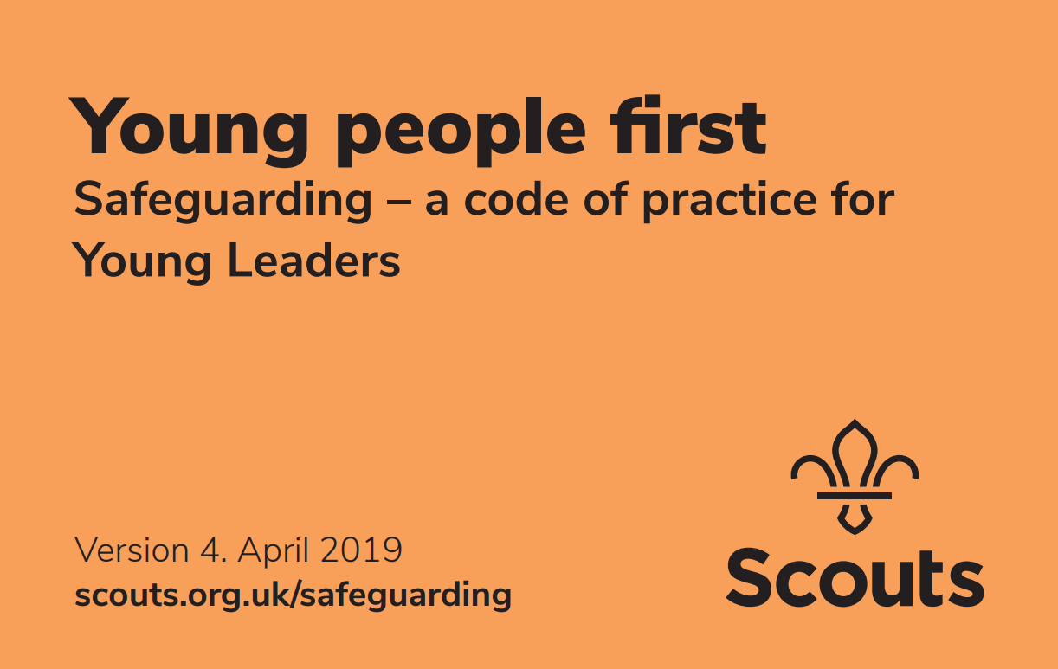
Safeguarding and The Orange Card
Safeguarding is…
Ensuring that we always put the wellbeing of Young People first
Something that all Adult Leaders and Young Leaders are responsible for putting into practice
Covered by the Yellow Card for Adult Leaders, and the Orange Card for Young Leaders
Always following the rules established for
ensuring the safety and security of Young
People, and rules for reporting incidents

Slide 18
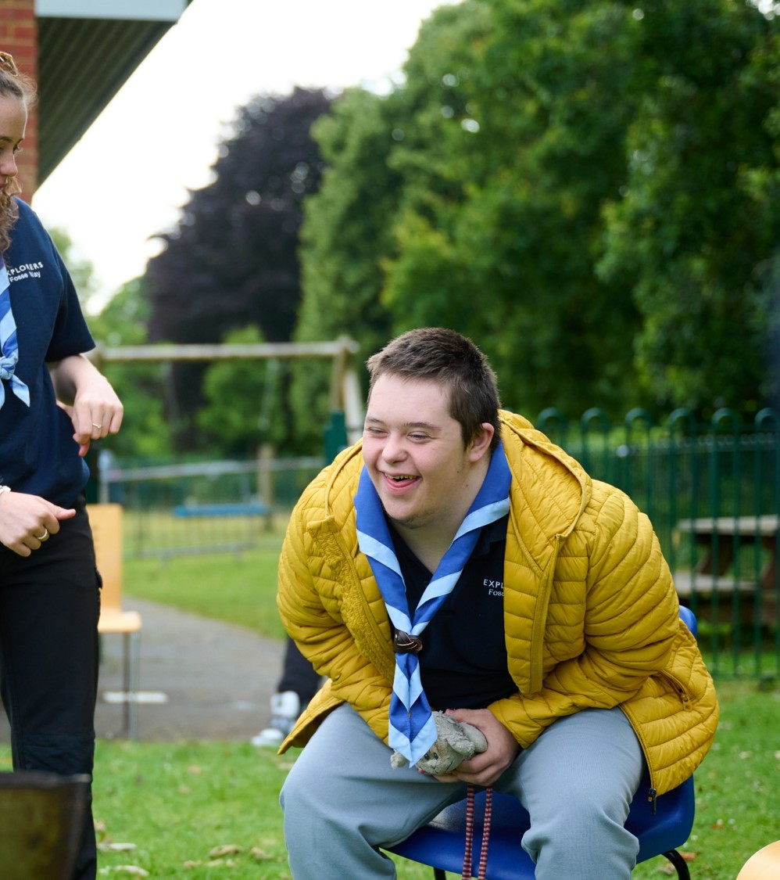
Safeguarding and The Orange Card
Safeguarding includes…
Implementing our Anti-Bullying Policy, to ensure a caring and supportive atmosphere, where bullying in any form is unacceptable
Taking action to deal with bullying when it happens, and allowing Young People to talk about their concerns
Encouraging and inspiring others to feel comfortable and caring enough to point out attitudes or behaviour they don’t like

Slide 19
      1.
      Having favorites is never OK.
True
False
Notes:
True. We don’t want to have favourites.

Slide 20
      2.
      When working as a young leader, it is OK to run a game when an adult leader is not present.
True
False
Notes:
False. You should never be left alone with the young people as our adult volunteers are there to make sure you and the young people stay safe.

Slide 21
      3.
      Young Leaders may share sleeping accommodation with adults when space is limited.
True
False
Notes:
False. Legally, you are all still children and our safeguarding policy is clear that under 18s can’t sleep with over 18s. When space is limited Yls can sleep with young people but this isn’t ideal and we would always aim for and plan for separate accommodation for adults, Yls and YP.

Slide 22
      4.
      Young Leaders can't have a relationship with members of their section.
True
False
Notes:
False - We’re being a bit sneaky with this one. Young Leaders can’t have a romantic relationship with any members of their section because its favouritism again. A professional relationship is fine though.

Slide 23
      5.
      Young leaders should not have any physical contact with members of their section.
True
False
Notes:
False. Again, a bit sneaky. Physical contact is quite personal and can make young people feel uncomfortable. But it may be needed at times. E.g. one of my Beavers is walking near a fire and I need to move them away for their safety.

Slide 24
      6.
      It is acceptable to “take the mickey” out of a young person.
True
False
Notes:
False. It’s not acceptable. What is mickey taking to one is bullying to others and we have no tolerance for it.

Slide 25
      7.
      Young people always report incidents of abuse.
True
False
Notes:
False. Many may not know how to put it into words or may worry what others will do if they find out.

Slide 26
      8.
      Young people are likely to exaggerate incidents of abuse.
True
False
Notes:
False. We should never presume that a young person is exaggerating stories such as this.

Slide 27
      9.
      It is better to wait and see what happens before reporting behaviours or attitudes you do not like.
True
False
Notes:
False. We should always report anything we notice that is suspicious as soon as possible. It will be reported up to those with more training to deal with this and those who are paid to deal with it. It means we can get support in when its needed before it gets worse.

Slide 28
      10.
      It is OK to be friends with young person in your section on Social Media.
True
False
Notes:
False. Think again the favourites rule and being alone with young people. It is for the same reason that you and your leaders shouldn’t be talking 1:1 in online chats (group chats or emails with parents copied in is fine).

Slide 29
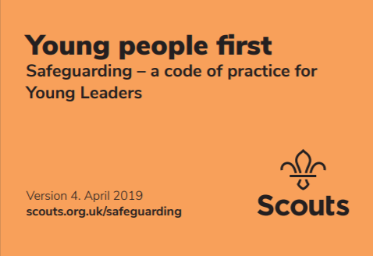
Young people first:
Orange card – your responsibilities under the Scouts’ Child Protection policy.
List of Dos and Don’ts
What to do if a young person discloses to you.
Remember you are a role model.
https://cms.scouts.org.uk/media/11948/orange-card-april-2019.pdf
Notes:
Your responsibilities are laid out in the Orange Card, called Young People First. Adult leaders have an equivalent one called the yellow card. We recommend you keep this on you at all times when Scouting face to face.
It contains a list of dos and donts and what to do if a young person discloses to you. You are a role model at all times so it is very important you follow these to keep yourself safe from allegations as well as the young people safe.

Slide 30
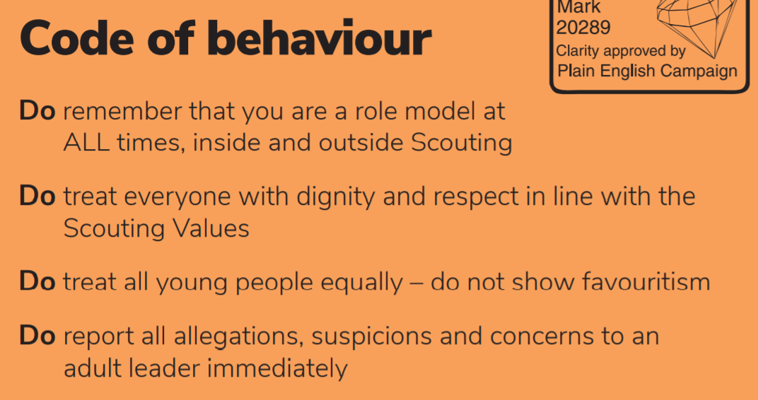

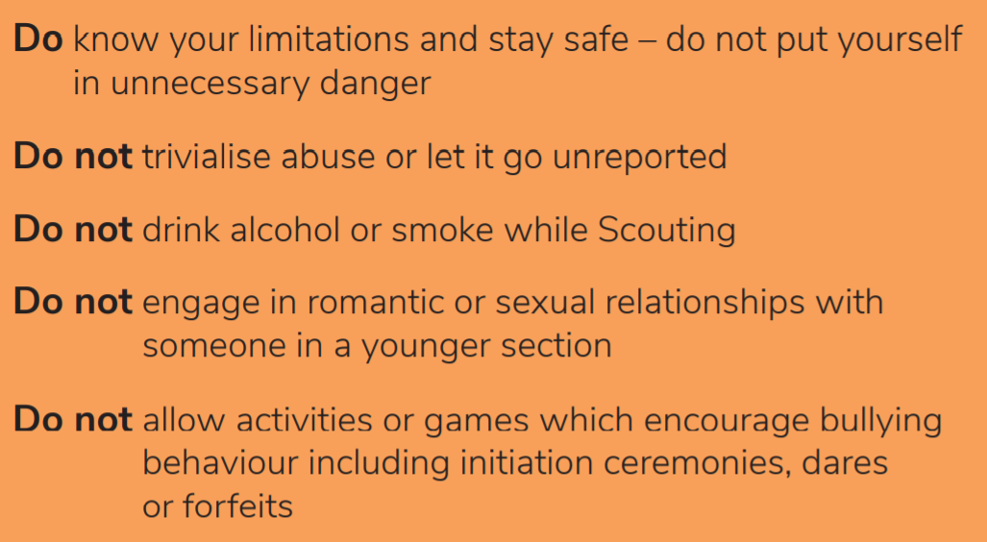
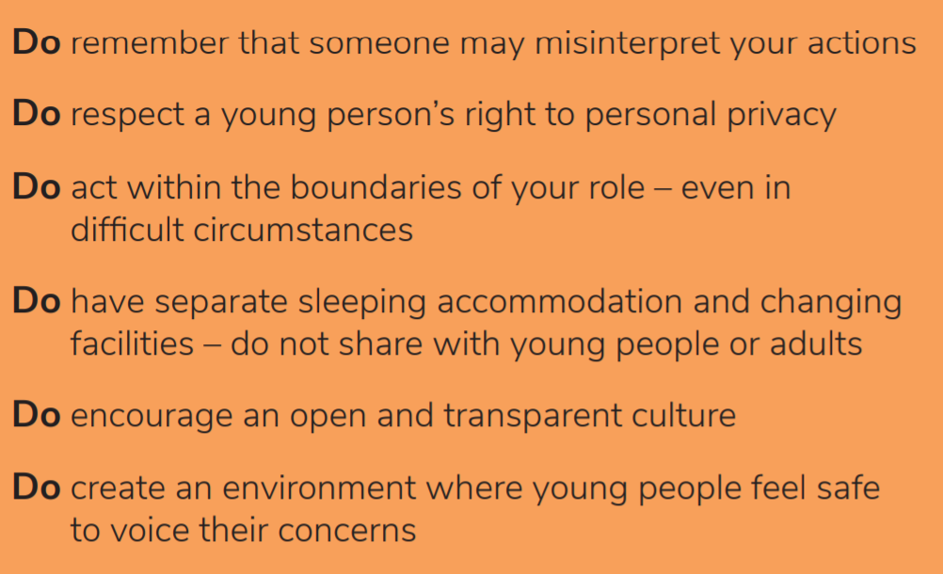
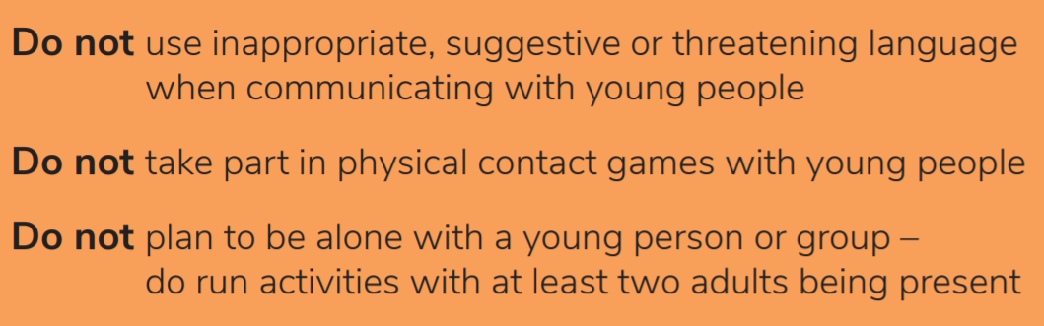
Notes:
Cover the Dos and Donts of the orange card.

Slide 31
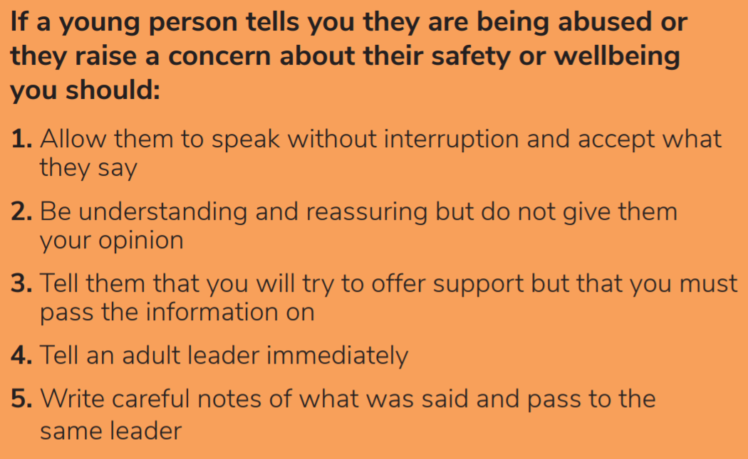
Disclosures
Notes:
Cover what to do if a young person discloses.

Slide 32
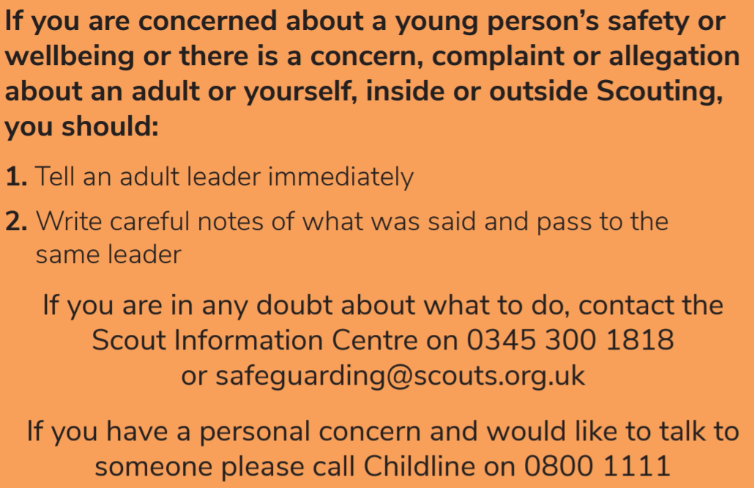
Disclosures
Notes:
Cover what to do if a young person discloses.

Slide 33
Ratios
 | Usual meeting place | Outside the meeting place | Nights away
Squirrels | 1:6 + 1 leader in charge (minimum of 3 adults) | 1:4 + 1 leader in charge (minimum of 3 adults) | 1:4 + 1 leader in charge (minimum of 3 adults)
Beavers | 2 adults | 1:6 + 1 leader in charge (minimum of 2 adults) | 1:6 + 1 leader in charge (minimum of 2 adults)
Cubs | 2 adults | 1:8 + 1 leader in charge (minimum of 2 adults) | 1:8 + 1 leader in charge (minimum of 2 adults)
Scouts | 2 adults | 1:12 (minimum of 2 adults) | 1:12 (minimum of 2 adults)
Notes:
End this activity by reminding ESYLs that the leader in charge is responsible for the group, including ratios are being met, but their role requires them to follow the Orange Card and take care to ensure they’re doing their best to ensure the meeting is as safe and fun as possible.

Slide 34
Scenarios:
1 A Beaver Scout only seems to have a few friends
2 A Cub Scout seems to have depression, or mood swings which are out of character.
3 Leaders are making negative comments all the time or shouting a lot to get young people to do things.
What would you do?
How would you handle it?
What parts sound unusual to you?
Notes:
We’re now going to put you into breakout rooms again. The number next to the scenario is the room you’re in. What would you do, how would you handle it and which parts are potentially a problem.

Slide 35

POR, Health and Safety.

Slide 36

The Rules:
Scouts’ Safety Policy
  Exciting but not dangerous.
  Identify risks and minimise them as much as possible.
  Clear instructions and training.
  Don’t be afraid to stop or change an activity if it becomes too risky.
Policy, Organisation and Rules (POR)
  Rules on specific activities.
  scouts.org.uk/por
Notes:
What do the rules say about keeping safe?
The Scouts Safety policy covers a lot of the fundamentals of this but essentially we want activities to be exciting but not dangerous. We need to identify the risks and minimise them as much as possible. We should be able to manage risks through clear instructions and training. Don’t be afraid to stop or change activity if it becomes too risky.
There are rules on specific activities in the scouts rule book called POR.
Knowing the rules are important – insurance covers us when we follow the rules.

Slide 37
The Rules
Policy, Organisation and Rules (POR)…
Provides support and guidance to help us all run Scouting
Applies to every single person in Scouting
Includes rules on specific activities
You can find it at scouts.org.uk/por

Slide 38
The Rules
Over to you...
In small group we will give you a scenario which could happen at a section meeting. We want you to decide as a group what you would do next. We have provided some questions to think about
Is everyone safe?
Do you need to deal with the situation immediately, or is it not time sensitive?
Can you deal with the situation on your own? If not, who will you ask to help?
What will you do next?
Notes:
Task: 15 mins
Give a scenario to each small group. Feel free to provide some hints if they are unsure. Ask the groups to pick someone who can explain their scenario and next steps to the whole group at the end.
Try picking a scenario the Young Leaders might not have come across before. Consider what they gave as their skills in an earlier task.
Scenario A: A Beaver Scout has started being aggressive towards others
Scenario B: An older sibling who you don't know has come to collect one of the Cubs at the end of a section meeting
Scenario C: A Scout tells you that they are being excluded by some other young people and they are calling them by a nickname they do not like.
Scenario D: A Squirrel tries to give you a hug
Scenario E: You notice that a Cub is standing at the edge of the hall and not joining in with all activities
Scenario F: You notice that a group of Scouts were not listening to the instructions another leader was giving about lighting fires
Scenario G: A couple of Cubs are messing around and an Assistant Section Leader tries to make them do press-ups as a punishment.
Scenario H: A Scout finds you on social media and comments on your posts.

Slide 39
Raising concerns
It is always best to raise any concerns you have with an adult volunteer you trust. Try to remember the following:
Report any concerns immediately
You might have noticed something that others have not
Don't promise confidentiality to a young person
Stay calm
Reassure any young people involved
Write down what you can remember as soon as possible
Notes:
Once the Young Leaders have explained their scenarios and what they would do go through these key reminders. Make sure you take time with this section and answer any questions the Young Leaders may have.

Slide 40
Risk Assessment

Slide 41
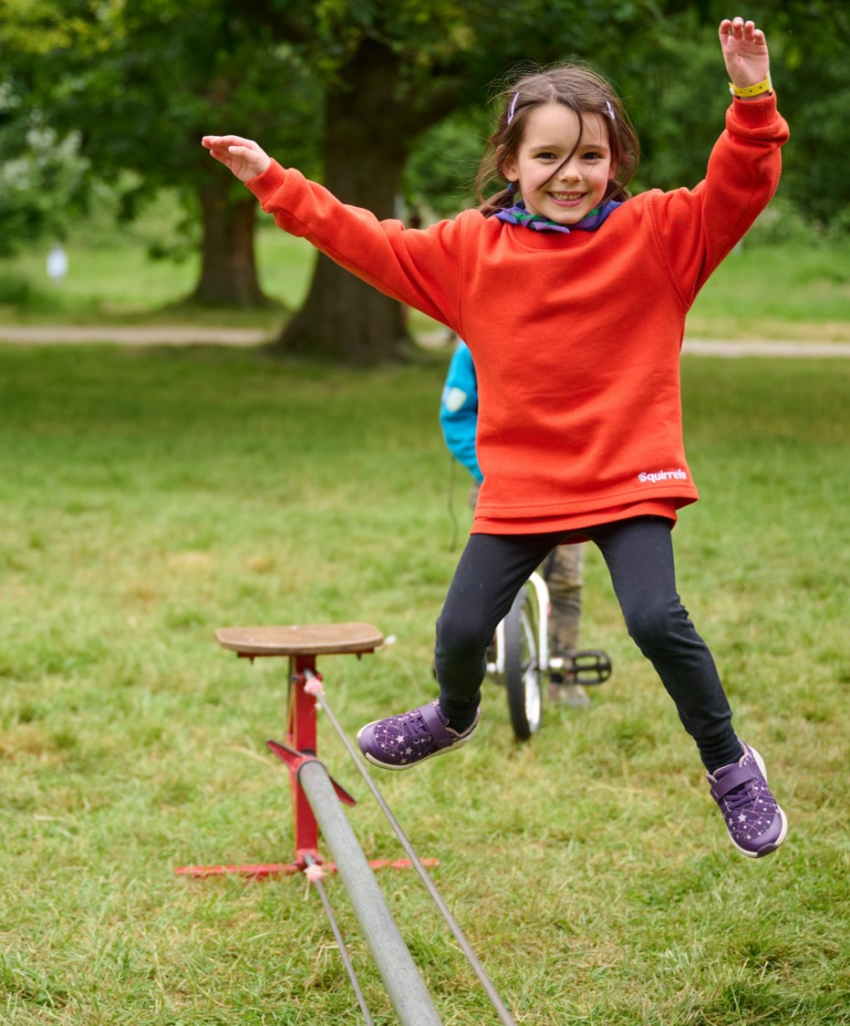
Risk assessments
What is a risk?
This is a word we use a lot, but what does it actually mean...?
You have 3 minutes to write a short description of what you think RISK means. However, you only have 280 characters (the length of a tweet) to explain it.
Notes:
Bonus: What risks can you identify in this image?

Slide 42
Risk assessments
What is a risk?
Risk = An action that can cause harm to you and/or other people.
When do we need a risk assessment?
All venues
All activities
All adventurous activities
All games

Slide 43
Risk Assessments
What is a risk assessment?
It’s the process of…
Thinking about what could go wrong
Considering who could be impacted
Trying to reduce the risk
Recording what you just did
Reviewing it, and making any necessary changes for next time

Slide 44
Risk Assessments
Look for a hazard/risk
Add the next four steps...
Record
Review
Who might be harmed/at risk?
Evaluate and control risks
Notes:
Task:
Get the Young Leaders to add the statements to the correct part of the cycle!

Slide 45
Risk Assessments
Look for a hazard/risk
2. Who might be harmed/at risk?
5. Review and repeat
3. Evaluate and control risks
4. Record
Notes:
Answers

Slide 46
Look for hazards
Who might be harmed?
Evaluate and control risks
Record
Review
Risk assessment:
Notes:
Cover each step:
Step 1 - A hazard is anything that could cause harm. It could be weather, equipment, the way you are doing it or something else. Look for the hazards which are really obvious, not every single little thing.
Step 2 - Who is involved in the activity and how could they get hurt - Young People, adults, visitors? Participants with additional needs? What could happen to cause them harm? A risk is the chance - high or low - that someone will be harmed by the hazard.
Step 3 - Controls are ways of removing or reducing risk. Ask: Can I get rid of the hazard altogether? (E.g. not crossing a road but using a bridge or underpass). Can we reduce the risk? (E.g.Use a zebra crossing rather than any busy point on the road). What sort of instructions are needed? (Written sheet, simple rules) Any tips from others who have done the activity? Do they have to wear any protective clothing e.g. gloves, climbing harness, walking boots?
Step 4 - Record and communicate it effectively and appropriately. Telling others about what we have found and done. Best practice is to write it down but if you have to share it verbally then write down bullet points of things to remember.
Step 5 – Review as a minimum every 12 months but review if something changes, such as starts raining, or after you complete an activity for next time.

Slide 47
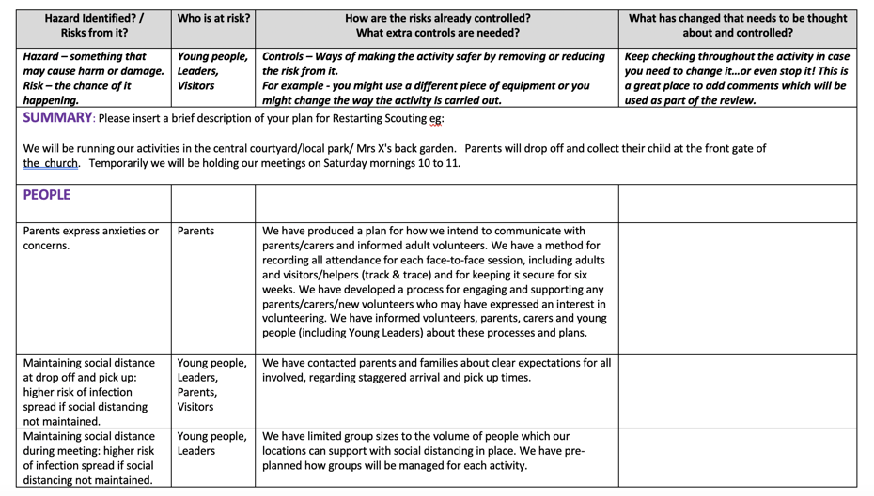
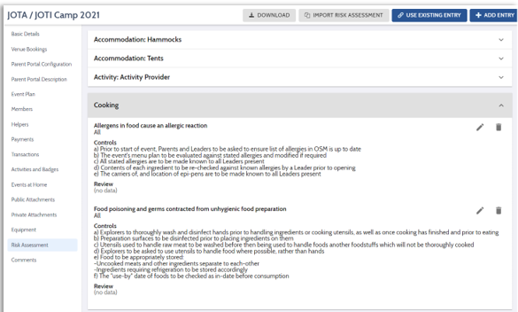
Risk Assessments
In Scouts, all activities should have a written or digital Risk Assessment.

Slide 48
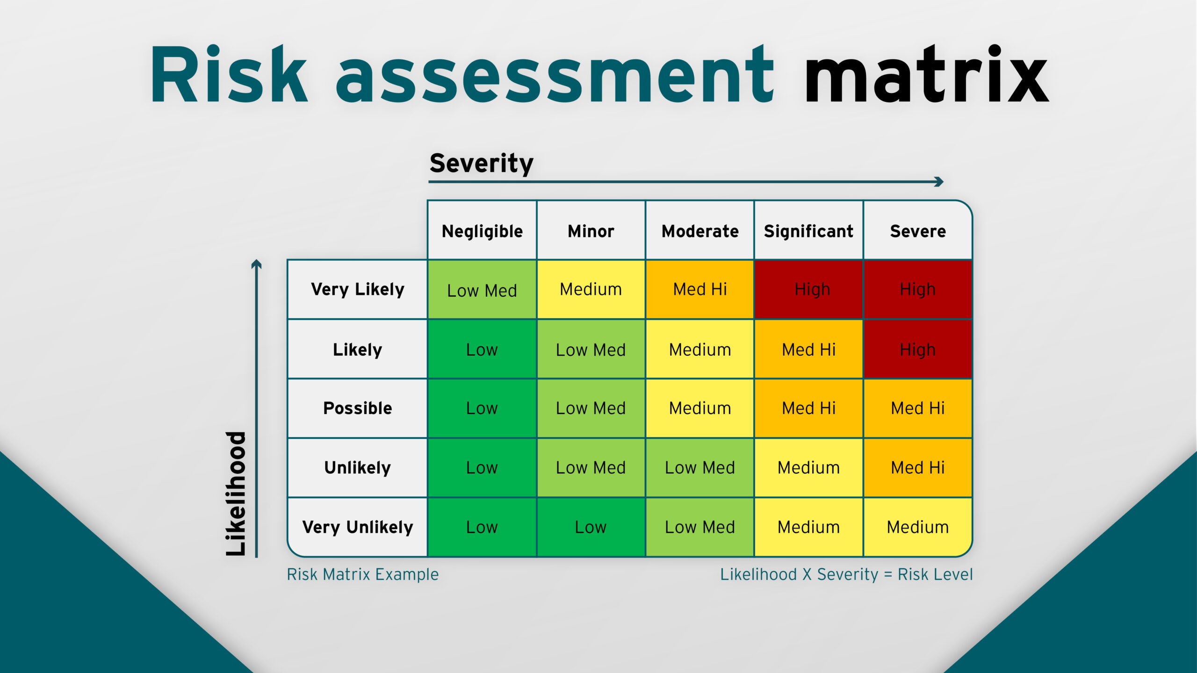
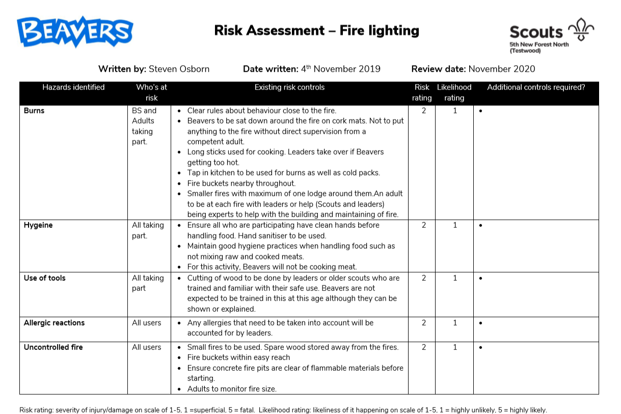
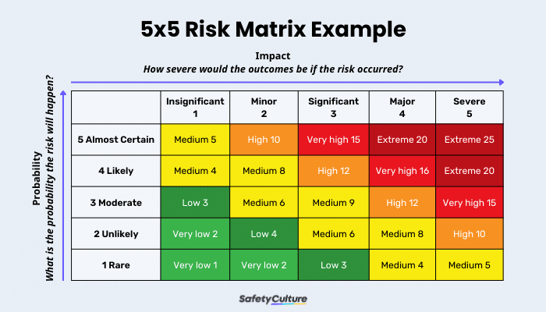
Notes:
Here’s an example of a risk assessment I completed for fire lighting. Briefly outline it and how it fits in to the steps outlined. Mention the numbered risk ratings which aren’t strictly required but you’ll often see people use it to help identify if more can be done.

Slide 49
The Young Leaders Scheme.

Slide 50

The Young Leader Scheme
Module A = Completed!
You've earned your Young Leaders badge and woggle.

Slide 51
The Young Leader Scheme
What's next?
Congratulations on completing module A!
Next up:
There are 10 modules to help you get the most out of being a young leader
You will also complete 4 missions...

Slide 52
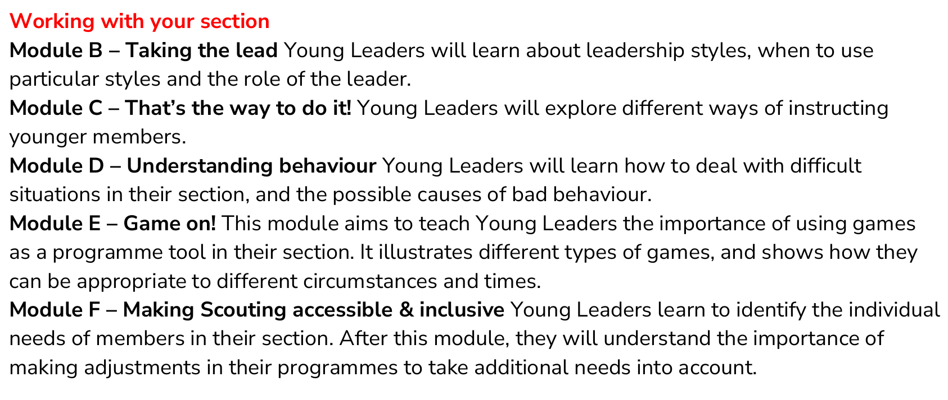
Young Leader Training Modules
Getting Started:
Module A – Completed Tonight!
These are in the booklet

Slide 53
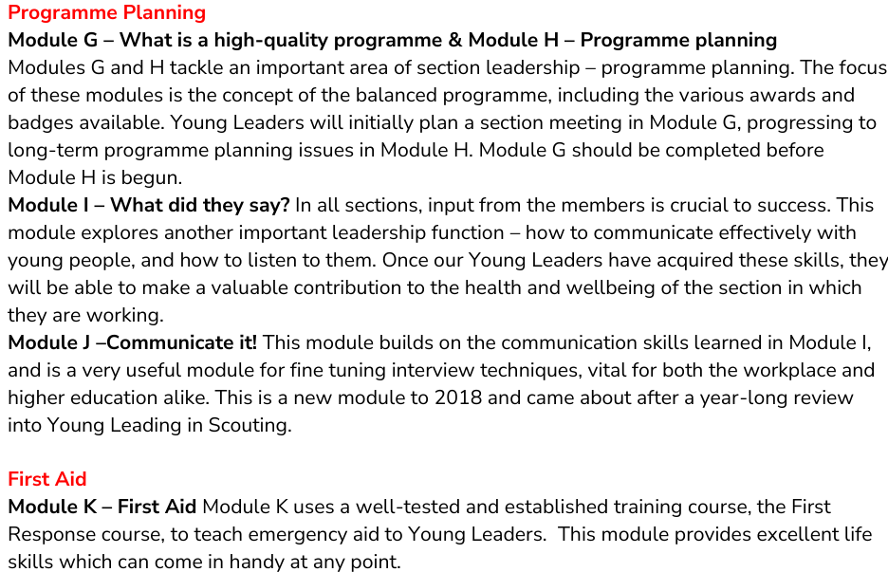

Slide 54
The Young Leader Scheme
What are your missions?
Mission 1:
Plan and run a minimum of 3 games, a mix of indoors and outdoors – Page 28
Mission 2:
Plan and run an activity (not a game)
Mission 3:
Take the section's ideas to a programme planning meeting
Mission 4:
Take responsibility for organising and running part of the programme

Slide 55



The Young Leader Scheme
You will earn a Mission leaf badge when you complete each mission
When you complete all your modules and missions, you will be able to wear the prestigious Young Leader Belt
If you earn the Young Leader Belt, and then become an adult volunteer you’re entitled to wear the Young Leader Adult Recognition Badge for life

Slide 56
Mission 1 - Game
Plan and run a minimum of three games with the section you are volunteering with. At least one game should take place indoors and one outdoors.
The games should be varied, using at least two different types of leadership style (Modules B and C) and three different types of games. (Module E)
To complete this mission, you could:
run a game at the beginning or end of a section night,
run a wide game on a camp,
run a game that ties into a badge the section is working towards,
run a game that reinforces something the section has learned,
any other ideas, subject to agreement with Young Leader’s leader and Section Leader.
Notes:
Cover what is needed to complete the module and what people have done to complete it in the past.

Slide 57
Mission 1 - Game
I was talking to one of my friend who is a Young Leader with another group and they told me about a game called Ladders. They taught it to us at Explorers and then I ran it for the Cubs. It was a blast!
One of my Beavers came one night raving about non-stop cricket, a game they had played at school, but they were a bit unsure of the rules. I went home, looked it up and ran the new game the next week while the other leaders set up the activities.
I ran a game of Bench ball for the Scouts that I volunteer with. I remembered playing it as a Scout myself so wanted to teach it to them. They loved it and now always ask to play it.
Notes:
What have YLs done in the past?

Slide 58
Mission 2 - Activity
Plan and run an activity (not a game) with the section you are volunteering with.
The activities should include planning and organisation, delivery and gathering any equipment or materials needed.
To complete this mission, you could:
choose an activity badge to run as part of the programme, providing everything needed for the section.
run a segment of the camp programme, such as a pioneering activity or obstacle course. ESYLs could also plan the route for a hike, initiate some team challenges, or organise and lead a campfire.
record how your section’s activities count towards different badges and awards.
run an activity for the section, relating to one of your own hobbies or interests.
any other ideas, subject to agreement with Young Leader’s leader and Section Leader.
Notes:
Cover what is needed to complete the module and what people have done to complete it in the past.

Slide 59
Mission 2 - Activity
The Scouts decided that they wanted to go on a hike, but said that they were bored of just walking. As a leadership team, we paired off and chose a base to run. I took the lead on our First Aid base. Skip was under a car with (fake) blood and the Scouts used their skills!
For our end of term treat, we had a fire and cooked s’mores with the Beavers. I planned the activity, bought the marshmallows and biscuits and showed everyone what they were doing. No-one got burned and everyone managed to make s’mores.
The Cubs decided that they wanted to do the Scientist badge as they wanted to blow some things up! I couldn’t get my hands on any explosives so we borrowed some bicycle pumps and launched water rockets.
Notes:
What have YLs done in the past?

Slide 60
Mission 3 – Programme planning
Take the section’s ideas to a programme planning meeting.
They should ask the young people in the section for their ideas on what they want to do, capture the ideas and suggestions, see how these could be incorporated into their programme and attend & contribute to a meeting (programme planning, leaders, district).
To complete this mission, you could:
attend a section planning meeting,
plan and run a meeting (YouShape resources are helpful for this),
decide who should attend a meeting and invite them along,
organise and run a forum for the young people in your section, gathering their ideas and suggestions, and feeding these back to the section leader,
organise for someone to take notes, minutes or points of action,
plan and run a forum, ensuring the young people know how they can share their ideas,
any other ideas, subject to agreement with the ESLYL and SL.
Notes:
Cover what is needed to complete the module and what people have done to complete it in the past.

Slide 61
Mission 3 – Programme planning
I worked with the Patrol leaders at Scouts as they asked their patrols what we should do on Summer Camp. I kept in regular contact with the Patrol leaders and used their ideas to plan a structure for the camp. Each of the leaders planned a different day based on what the PLs asked for.
I planned and ran a log chew at Beavers. I set each lodge a question and asked the other leaders to help them making notes. We took the notes from the Beavers and used them to build the programme for next term.
I was really pleased when I was asked to represent my Pack at the District Cub leader’s meeting. To prepare for this, I ran a game of Snowballs! All of the Cubs wrote down what they want to do and threw them around the room! I picked some of the most exciting ideas and lead the discussion on how we can visit the moon.
Notes:
What have YLs done in the past?

Slide 62
Mission 4 – Delivery
Take responsibility for organising and running part of the section programme.
This mission should include planning and organising a selection of activities on a theme, delivery of those activities and evaluation and review of the activities with the section.
To complete this mission you could:
Plan and run a linking event with a younger or older section. Together with other leaders, organise a joint event. Plan the event and ensure it is appropriate for both age groups, letting the other leaders know how they can help the event run smoothly.
Plan and run a challenge award. You should choose a challenge award that few young people in the section already hold.
Plan and help to run a camp. With the help of a leader with a night’s away permit.
Help the young people in the section to explore a particular topic, or to develop some specific skills over a number of sessions.
You may work on any other ideas, subject to agreement with the section leader
Notes:
Cover what is needed to complete the module and what people have done to complete it in the past.

Slide 63
Mission 4 – Delivery
At the programme planning meeting, I asked if I could lead a whole badge. As it was the summer, Akela suggested I lead the Adventure Challenge badge. I thought there would be loads of work but I got it done in half term still with an evening for a water fight!
I planned a linking evening for the Cubs to come up to my Scout Troop. I invited the Cub Pack and set the Patrol Leaders the task of running a game that I had given them. This went towards their Team Leader Challenge badge and meant that the Cubs felt welcome.
As part of my Jamboree experience, I was able to lead some ‘Join In Jamboree’ activities. When I told my Beaver Leaders this, I asked if I could run the whole of the international activity badge over a few evenings. All 24 Beavers joined in, had fun and got the badge!
Notes:
What have YLs done in the past?

Slide 64
Thank you
Young Leaders’ Scheme
Scouts.org.uk
#SkillsForLife

