Slide 1

Young Leaders’ Scheme
Module E – Game on!
Scouts.org.uk
#SkillsForLife
Notes:
If you need to change the background please follow these instructions:
1. On your Windows tablet, tap the Design tab.
2. On your Windows phone, open the slide for editing (either by double-tapping it or by tapping it and then tapping Edit). Tap More at the bottom of your screen, tap Home, and then tap Design.
3. Tap Format Background.
4. You will see the background colours divided into Theme Colours and Standard Colours. Theme colours coordinate with the theme you selected previously. You can select a solid colour or colour gradient.

Slide 2
Do more. Be more
Welcome
In this session, we are going to look at:
the importance of games in the section meeting
the need for different types of games and when to play them
being able to explain and run different types of games
being able to select games that suit the section’s programme
Do more.
Be more.
Young Leaders’ Scheme

Slide 3

Getting to know you...
Notes:
Icebreaker: 5- 10 mins
Key points:
Participants will be working together during the session so it's a good idea to break the ice and get to know each other first.
Activity option 1 - Speed dating:
Everyone walks around the room, finds someone they don’t know and talk for 1 minute
Ask questions: Who got you into Scouts? When did you join Scouts? What key skill do you bring to your Scout team? what they’d like to learn from workshop,
After two minutes, blow a whistle or shout and they find a new partner
Presenters can come up with other questions if they can think of better ones!
Or alternatively depending on amount or type of participants
Activity option 2 – Group discussion
Participants to discuss above questions (from option 1) within their table groups

Slide 4
Game types
Learn by doing.
Active and loud / calm and quiet
Equipment / equipment free
Team / individual
Indoor / outdoor
Competitive / non-competitive
Elimination
Notes:
Different types of games suit difference audience sizes, different purposes, equipment available and settings.

Slide 5

What games can you create with this equipment?
My Scouting backpack
Notes:
understand the importance of games in the section meeting 2. understand the need for different types of games and when to play them 3. be able to explain and run different types of games 4. be able to select games that suit the section’s programme
Set up a number of activity tables. Leave one table empty, and place different materials on the rest. For example, you could place a pen and flipchart on one table, a ball on another, and a box of creative art materials on another.
Split the ESYLs into small groups and explain that they will have five minutes at each table. During this time, they should come up with as many games as possible using the materials provided.
Rotate the teams so they get a chance to visit every table.
At the end, get the groups to run one of the games they came up with.

Slide 6

What games can you create with this equipment?
A-Z
Notes:
In small groups, ask ESYLs to think of a different game for each letter of the alphabet.
After completing this, explain that there are many different categories of games, including:
team-based or individual games
indoor or outdoor games
competitive or non-competitive games
team-building games
skill-based games
observational games
elimination games
energetic or restful games
games to start or end a meeting
relay races
3. Look at different categories together. Write them down and stick them on the wall for everyone to see. Now, ask the ESYLs to match each game idea to a category on the wall.
4. As a group discuss where else ESYLs can get ideas for games. Ensure the discussion includes other ESYLs and the activity finder (www.scouts.org.uk/activities) which has 1000s of activities and over 200 games.

Slide 7
Games A-Z
Have a go in your groups at coming up with a list of games, one for every letter of the alphabet.
Active and loud / calm and quiet
Equipment / equipment free
Team / individual
Indoor / outdoor
Competitive / non-competitive
Elimination
Notes:
In break out rooms, get the Yls to try and make a list of games they can play that cover every letter of the alphabet. Whiteboard function can work well for this or a helper can share a word document and type their ideas up as they say them.

Slide 8

How can they prepare for a games session, to make sure it runs successfully?
Being prepared
Notes:
Have an open discussion with the ESYLs about preparation. How can they prepare for a games session to make sure it runs successfully? Their suggestions should include: • having the correct equipment • explaining the rules clearly and simply • maintaining discipline and sporting behaviour during the game • timekeeping • safety (equipment and environment) • supervision
End this activity by reminding ESYLs that the leader in charge is responsible for the group, including ratios are being met, but their role requires them to follow the Orange Card and take care to ensure they’re doing their best to ensure the meeting is as safe and fun as possible.

Slide 9
Being prepared
Having the correct equipment
Explaining the rules clearly and simply
Maintaining discipline and sporting behaviour during the game
Timekeeping
Safety (equipment and environment)
Supervision
Notes:
Have an open discussion with the ESYLs about preparation. How can they prepare for a games session to make sure it runs successfully? Their suggestions should include: • having the correct equipment • explaining the rules clearly and simply • maintaining discipline and sporting behaviour during the game • timekeeping • safety (equipment and environment) • supervision
End this activity by reminding ESYLs that the leader in charge is responsible for the group, including ratios are being met, but their role requires them to follow the Orange Card and take care to ensure they’re doing their best to ensure the meeting is as safe and fun as possible.

Slide 10
Ratios
 | Usual meeting place | Outside the meeting place | Nights away
Squirrels | 1:6 + 1 leader in charge (minimum of 3 adults) | 1:4 + 1 leader in charge (minimum of 3 adults) | 1:4 + 1 leader in charge (minimum of 3 adults)
Beavers | 2 adults | 1:6 + 1 leader in charge (minimum of 2 adults) | 1:6 + 1 leader in charge (minimum of 2 adults)
Cubs | 2 adults | 1:8 + 1 leader in charge (minimum of 2 adults) | 1:8 + 1 leader in charge (minimum of 2 adults)
Scouts | 2 adults | 1:12 (minimum of 2 adults) | 1:12 (minimum of 2 adults)
Notes:
End this activity by reminding ESYLs that the leader in charge is responsible for the group, including ratios are being met, but their role requires them to follow the Orange Card and take care to ensure they’re doing their best to ensure the meeting is as safe and fun as possible.

Slide 11



















Learning through Games
Notes:
In pairs, give the ESYLs a badge that matches the section they support.
Ask them to think of a suitable game that either fulfils the requirement of the badge, or provides a nice introduction to the topic.
Once they have come up with a suggestion, each pair should explain the rules of their game to a second pair. The second pair should suggest one thing that is positive about the game and one improvement that could make the game even better.

Slide 12
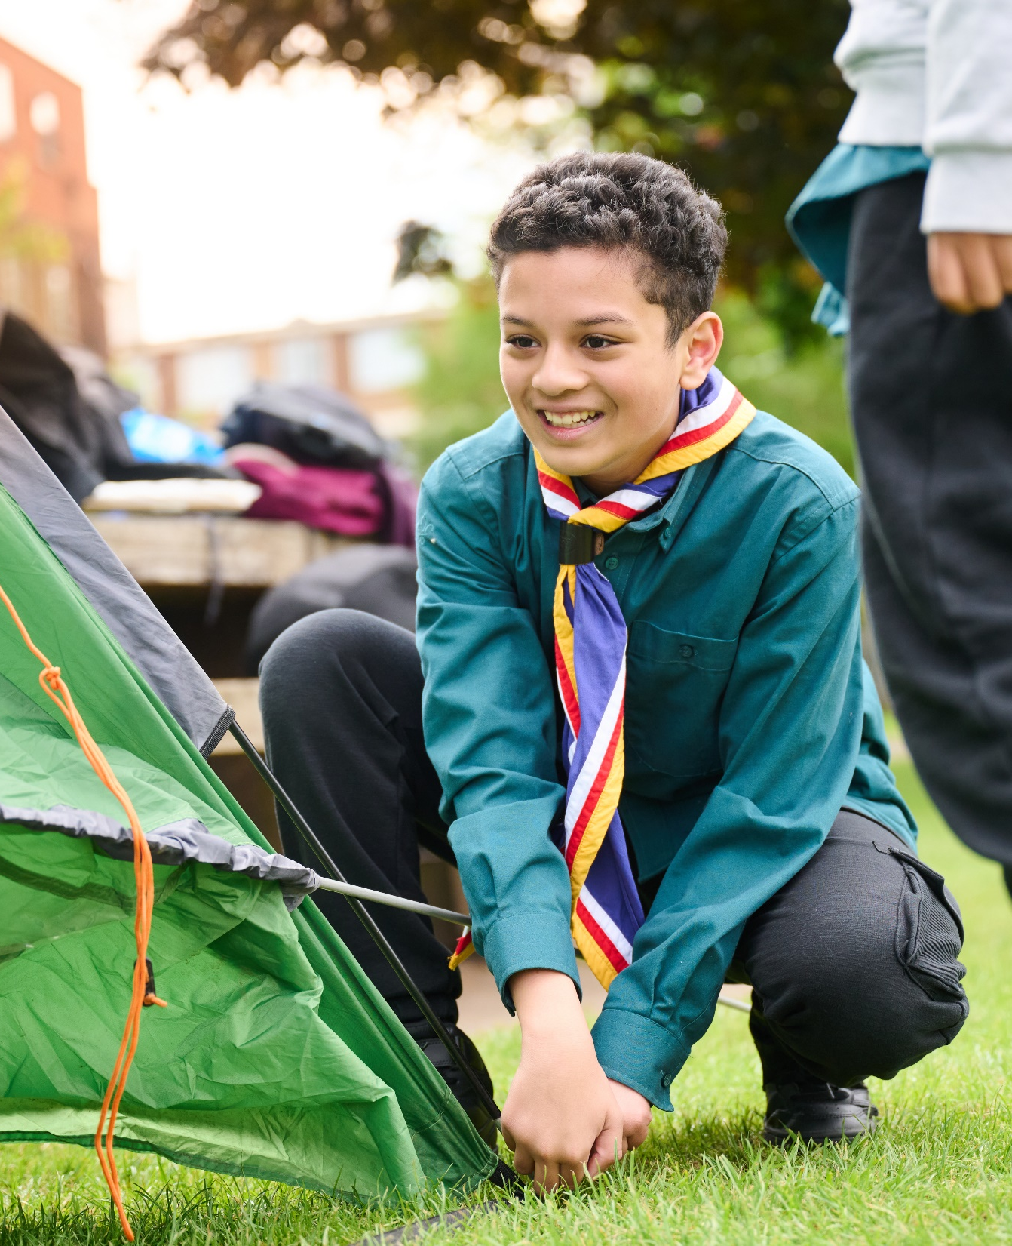
The Young Leader Scheme
Who to contact
If you have any questions, please contact the following people who will be able to help you.

Slide 13

Thank you
Young Leaders’ Scheme
Scouts.org.uk
#SkillsForLife

