Slide 1

Young Leaders’ Scheme
Module C – That’s the way to do it
Scouts.org.uk
#SkillsForLife
Notes:
If you need to change the background please follow these instructions:
1. On your Windows tablet, tap the Design tab.
2. On your Windows phone, open the slide for editing (either by double-tapping it or by tapping it and then tapping Edit). Tap More at the bottom of your screen, tap Home, and then tap Design.
3. Tap Format Background.
4. You will see the background colours divided into Theme Colours and Standard Colours. Theme colours coordinate with the theme you selected previously. You can select a solid colour or colour gradient.

Slide 2
Do more. Be more
Welcome
By the end of this session you will:
Understand and be able to talk about how young people learn effectively
Demonstrate an ability to pass on skills to younger people
Understand and talk about different learning styles
Have confidence in using different training techniques
Do more.
Be more.
Young Leaders’ Scheme

Slide 3
Module C Aims:
Understand and be able to talk about how young people learn effectively including different learning styles.
Know how to pass on skills including different training technique

Slide 4
Ways to teach skills…

Slide 5
Learning Styles
Young people learn in different ways, some need: need:
Words or verbal instructions (auditory)
Pictures they can copy (visual)
A person or video to show them what to do between the pictures (combined)
Practical examples & ‘doing’ (kinaesthetic)

Slide 6
Teaching styles/Learning Techniques
Different learning styles also suit different situations
Which you use depends on:
The activity
The size of your group & they are reacting to you
What equipment you have or are using
They each have advantages and disadvantages

Slide 7
Try to draw this picture. Listen carefully.
Notes:
Read the instructions below. This helps to understand the weaknesses of verbal methods. Some need more time, some are in a hurry to carry on. You need to understand the technical language in the instructions.
Draw a short horizontal line in the middle of your page. From the left end of this line draw a near vertical line of similar length upwards slanting slightly to the left. At the top of this new vertical line draw a filled in circle. Return to your first horizontal line. Above this, draw a parallel horizontal line slightly shorter than the first that joins up to the vertical line. From near where this new line meets the vertical line, draw three quarters of a circle around to the left. Return to the first line and from the right edge draw a diagonal line down and to the right. End this line with a perpendicular diagonal line to the right.

Slide 8
Draw a short horizontal line in the middle of your page. From the left end of this line draw a near vertical line of similar length upwards slanting slightly to the left. At the top of this new vertical line draw a filled in circle. Return to your first horizontal line. Above this, draw a parallel horizontal line slightly shorter than the first that joins up to the vertical line. From near where this new line meets the vertical line, draw three quarters of a circle around to the left. Return to the first line and from the right edge draw a diagonal line down and to the right.

Slide 9
Draw a short horizontal line in the middle of your page.
From the left end of this line draw a near vertical line of similar length upwards slanting slightly to the left.
At the top of this new vertical line draw a filled in circle.
Return to your first horizontal line.
Above this, draw a parallel horizontal line slightly shorter than the first that joins up to the vertical line.
From near where this new line meets the vertical line, draw three quarters of a circle around to the left.
Return to the first line and from the right edge draw a diagonal line down and to the right.

Slide 10


Slide 11
Teaching styles
Talking
Pros
Useful for rules of a game.
Effective when instructions are short and easy to understand.
Gets a message across to a lot of people at once.
Cons
Gets boring if too long.
Can be confusing if jargon or technical language is used.
Pace is a problem – too slow for some and too fast for others.
Notes:
Using what we’ve learned what pros and cons are there to talking like that?

Slide 12
Teaching styles
Try thinking of the advantages and disadvantages for each of these:
Diagram or picture
Demonstration
PowerPoint presentation
Written
Group instruction
Notes:
Explain the task and send off to break out rooms.

Slide 13
Teaching styles
Diagram or picture
Pros
Useful when everyone needs to make the same thing.
Everyone gets the same message.
Helps young people know if they’re doing it right (looks like the picture) or not.
Cons
Getting enough copies for everyone can be a challenge.
Often skip steps or may be unclear how to get from one picture to another.
Can be unhelpful on their own.
Notes:
Get the Yls to think about the pros and cons of each method. Their opinions can be gathered through the use of the chat or breakout rooms.

Slide 14
Teaching styles
Demonstration
Pros
Effective and has impact.
When combined with the young people trying it themselves, is often effective.
Works well in small groups.
Can be very hands on.
Cons
Harder in bigger groups, both to see or have 1:1 problem solving with a leader.
Not useful if the leaders shows the young people without a chance for them to try it themselves.
Notes:
Get the Yls to think about the pros and cons of each method. Their opinions can be gathered through the use of the chat or breakout rooms.

Slide 15
Teaching styles
Presentation using PowerPoint
Pros
Useful for large groups.
Can get lots of information across or show pictures/video clearly to lots of people.
Effective if they have a clear and simple message.
Helpful for distance learning.
Cons
Can be lengthy or boring if not careful.
Not always equipped for them.
Death by PowerPoint if not careful!
Notes:
Get the Yls to think about the pros and cons of each method. Their opinions can be gathered through the use of the chat or breakout rooms.

Slide 16
Teaching styles
Written material
Pros
Independence when learning new skills.
Can provide detailed instructions that can be read at any time.
Useful for Scouts +
Cons
Think about number of copies needed.
Less suitable for Beavers and Cubs – reading skill not fluent enough.
Difficult to visualise if text on its own.
Notes:
Get the Yls to think about the pros and cons of each method. Their opinions can be gathered through the use of the chat or breakout rooms.

Slide 17
Teaching styles
Group instruction
Pros
Easier to demonstrate and answer questions.
Quicker access to a leader or an experienced/trained peer leader.
Can rotate the activities through the groups.
Cons
All leaders would need to know what is happening or their role in the evening.
Difficult to see the bigger picture.
Notes:
Get the Yls to think about the pros and cons of each method. Their opinions can be gathered through the use of the chat or breakout rooms.

Slide 18
Task 1: The observer, the runner, the builder
Notes:
Task: The observer, the runner, the builder
(suitable for groups of at least three, approx. 20 minutes)
Split the group into teams of three. In each team, you’ll be assigning different roles. One person in the team should play the role of the ‘observer’. They will be given an object such as a drawing, or a model built from Lego. Another person should play the role of the ‘builder’ or ‘artist’. They have to recreate what the observer is looking at, and shouldn’t be able to see the object at all. The third and final person should play the role of the ‘runner’, who can alternate between the two.
The observer can only give verbal descriptions of their object to the runner. They should not be able to see the object.
The runner must repeat the description to the builder or artist. Again, the runner should not be able to see what they begin to build or draw. The builder cannot ask questions for clarification.
When the runner has finished relaying information and the builder has finished recreating the object, the observer should reveal the object they were describing. The builder or artist should then reveal their recreation.
Regroup to discuss the results of the game. What was difficult about the task? Was it challenging to give a verbal description of a physical object or drawing? What about passing that description on to another person? How about recreating something with only verbal instructions to go on?

Slide 19
Task 2: - OPTIONAL I do, we do, you do
Notes:
Task: I do, we do, you do
(suitable for groups of all sizes, approx. 25 minutes)
Give each Explorer Scout Young Leader a strawberry lace, and show them how to tie a knot with it.
Next, ask the Explorer Scout Young Leaders to fasten their own knots, instead of just observing you. They should all do this at the same time, creating the knot together. Finally, they should attempt to fasten the knot on their own.
This activity teaches the method of ‘I do, we do, and you do’. Once you have tried all methods, regroup and discuss the points below.
All methods described have both advantages and disadvantages
talking something through gets a message across to lots of people at once, but often misses out on detail
using a diagram or paper copy ensures that everyone gets the same message
demonstrating a skill or technique has visual impact, but you can only use this technique in small groups
demonstrating with material has additional visual impact
in terms of learning, demonstrating something by doing has more effect than merely seeing or listening to something
in general, younger members respond better to doing something simple with coloured bits and pieces
as members get older, written and printed material can be useful
talking to groups has its limitations with any age group, but can be essential in describing the rules of games (as long as they are simple)
small groups lend themselves to demonstrations and tend to respond well to a hands-on approach to learning
larger groups require visual aids that everyone can see, such as slides, Over Head Projectors or PowerPoint presentations, along with a simple and effective verbal message
leadership is easier to do effectively in a small group, especially if everyone is involved in doing things themselves and taking an active role
the larger the group, the more difficult teaching becomes, as boredom and disinterest become issues
using directed questions could be useful, but remember not to pick on any one member all the time
if boredom and disinterest are becoming a problem, maybe you need to rethink the method you're using to get your message across (How can you bounce back? Is there a different way you could approach things?)
Scout Young Leaders using the different colours of the different sweets. Explorer Scout Young Leaders
Top tip: teaching sign language instead of knots can be another good way to cover this method. Alternatively, you could use Smarties instead of strawberry laces, by demonstrating a pattern to the Explorer Scout Young Leaders could attempt to create the pattern at the same time as you, and then attempt to do it themselves from memory. The message remains the same.

Slide 20
Make us a cuppa!

Slide 21
Activity: Make us a cuppa! Duration: 15 minutes
Objectives the activity links to:
understand and be able to talk about how young people learn effectively
demonstrate an ability to pass on skills to younger people
understand and talk about different learning styles
have confidence in using different training techniques
Description:
In groups or pairs, one of the ESYLs should write down their own instructions for making a cup of tea, exactly as they like to drink it. They should then pass the instructions on to their partner, who should attempt to make the cup of tea, following the exact instructions given.
Once they have made the cup of tea just so, they should add their own further instructions to the existing ones given, and pass all this information on to the next ESYL. The process is like the game Broken Telephone.
The next ESYL in line should then follow these two sets of instructions simultaneously. What do they notice about the process? What is difficult about it? Do any of the instructions contradict one another?
The activity should highlight the importance of being clear with instructions. It should also demonstrate that different people interpret things in different ways and encourage ESYLs to think about how practice and preparation can affect the outcome of an activity.

Slide 22
Module C
Active learning strategies
There are several benefits to employing active learning strategies in your session that aid the development of young people in a variety of age groups:
Create lifelong learners
Provide students with greater control over their learning
Encourage students to stay focused on their learning
Improve a student’s enthusiasm for their studies
Make a topic more intellectually exciting
Allow students to participate at a higher level of academic discussion
Provide unparalleled support and a more rounded education
Prepare students of any age for future employment
Improve collaboration

Slide 23
Final reflections….
Notes:
Task:
Ask each Explorer Scout Young Leader to reflect and answer the following questions on their own before sharing as a group:
What is one thing I am going to take away from today's session which I can implement into my section?
What is one way I like to learn that might help young people?
Is there anything you want to learn more about following today's session?

Slide 24
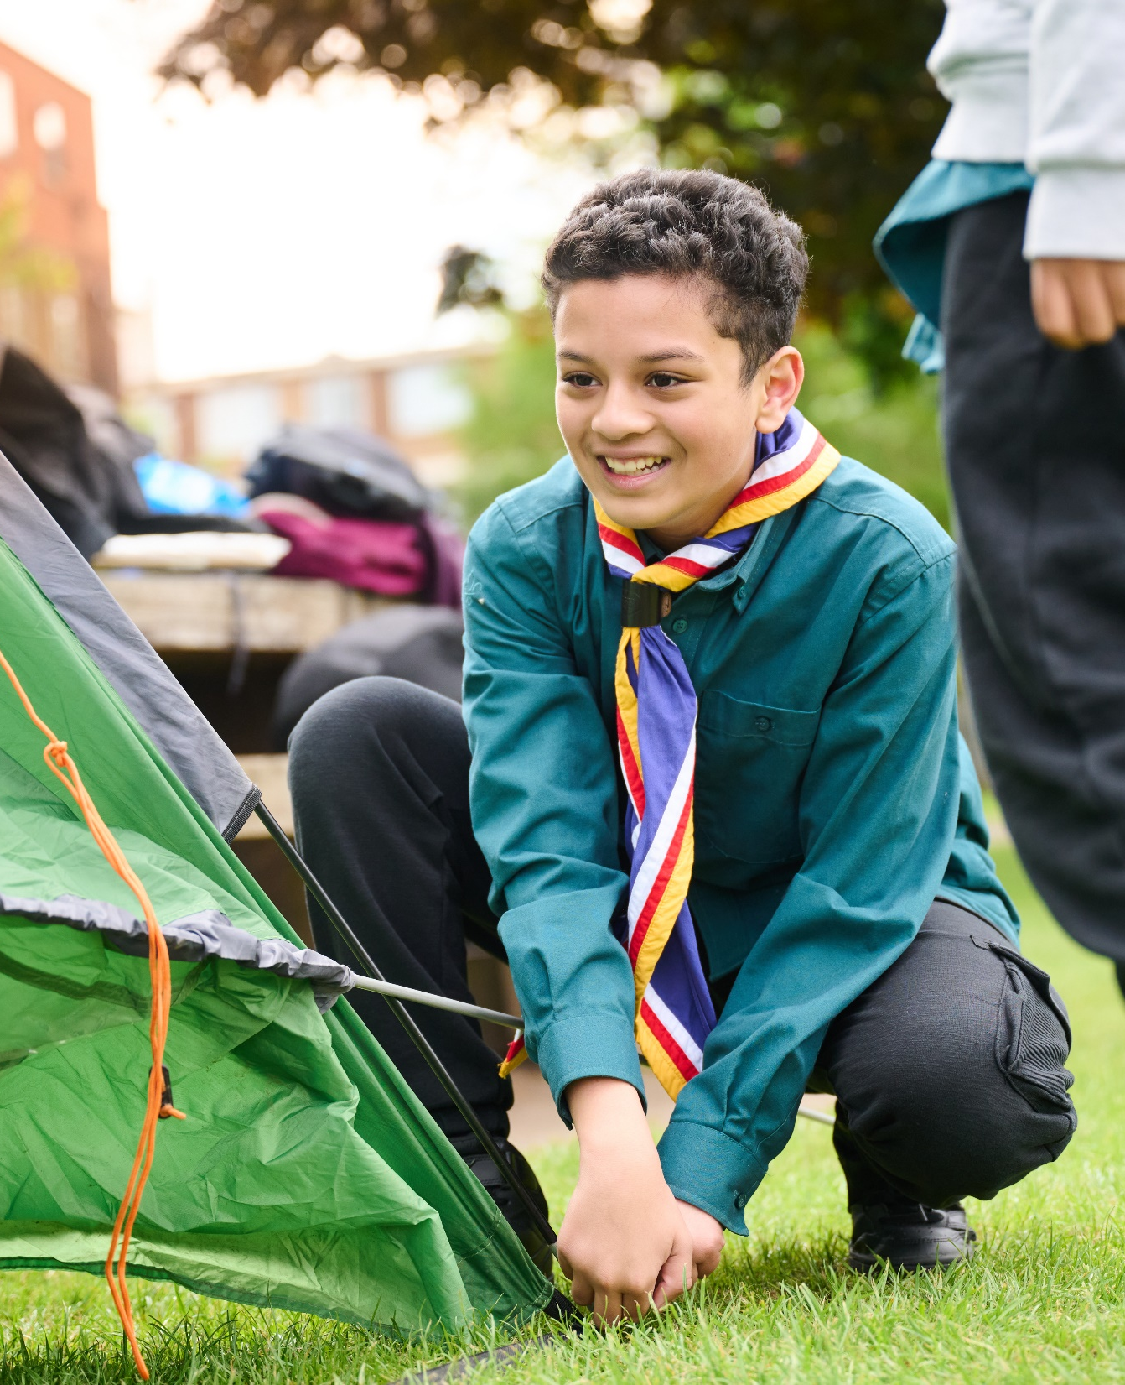
The Young Leader Scheme
Who to contact
If you have any questions, please contact the following people who will be able to help you.

Slide 25

Thank you
Young Leaders’ Scheme
Scouts.org.uk
#SkillsForLife

