Slide 1

Young Leaders’ Scheme
Module J – Communicate it!
Scouts.org.uk
#SkillsForLife
Notes:
If you need to change the background please follow these instructions:
1. On your Windows tablet, tap the Design tab.
2. On your Windows phone, open the slide for editing (either by double-tapping it or by tapping it and then tapping Edit). Tap More at the bottom of your screen, tap Home, and then tap Design.
3. Tap Format Background.
4. You will see the background colours divided into Theme Colours and Standard Colours. Theme colours coordinate with the theme you selected previously. You can select a solid colour or colour gradient.

Slide 2
Do more. Be more
Welcome
By the end of this module, you'll:
understand how important effective communication is between leaders and young people in the section
adapt your communication style to suit the activity or situation
explain how tone and body language can affect how you communicate with others
be able to communicate how what you're learning and the experiences and skills you're gaining through completing the Scheme can be used in other Scouting and non-Scouting activities.
Do more.
Be more.
Young Leaders’ Scheme

Slide 3

Getting to know you...
Notes:
Icebreaker: 5- 10 mins
Key points:
Participants will be working together during the session so it's a good idea to break the ice and get to know each other first.
Activity option 1 - Speed dating:
Everyone walks around the room, finds someone they don’t know and talk for 1 minute
Ask questions: Who got you into Scouts? When did you join Scouts? What key skill do you bring to your Scout team? what they’d like to learn from workshop,
After two minutes, blow a whistle or shout and they find a new partner
Presenters can come up with other questions if they can think of better ones!
Or alternatively depending on amount or type of participants
Activity option 2 – Group discussion
Participants to discuss above questions (from option 1) within their table groups

Slide 4
Why is communication key?
We are going to take part in a range of activities to highlight the importance of communication.
Try to reflect throughout so that you can get the most out of this module.

Slide 5
Instructor and seeker
Notes:
Task: approx. 20minutes
1. Choose one person to play the role of the seeker, who is blindfolded, and one to play the role of the instructor. Have the rest of the group line up at the end of the room.
2. The instructor should stand in the middle of the room facing them. The instructor is not allowed to turn around.
3. The seeker stands with their back to the instructor and the rest of the group in the top half of the room.
4. Place a treasure object somewhere in the seeker’s area of the room. Everyone other than the instructor and seeker should see where it's located.
5. The rules of the game are: - the instructor can speak but cannot use gestures or see where the treasure is hidden - the rest of the group can see where the treasure is hidden but cannot speak - the seeker can neither see the treasure nor speak
6. The aim of the game is to get the seeker to find the treasure. The group should use gestures so the instructor can tell the seeker where to go (i.e. left, right, back or forward).
7. Follow the seeker to make sure they stay safe throughout the game.
8. After the game, ask the Explorer Scout Young Leaders to feedback on what was difficult about the task for each of the roles. How did body language/gestures affect the game? Why are clear instructions important?
.

Slide 6
Storytelling
Notes:
Task: approx. 20 minutes
Pick out a number of ‘trigger words’ from a short story and write them up on a piece of flipchart paper. For example, if you were reading ‘Goldilocks and the Three Bears’, you could maybe write ‘bear’, ‘porridge’, ‘forest’ and ‘cold’. You'll need to choose a different story for this activity. Choose something Explorer Scout Young Leaders are not likely to know already.
Tell the group that you'll be reading out a story. Every time the group hears one of these trigger words, they will need to perform a certain action. With the example above, every time they hear ‘bear’, they might have to stand up and sit down again. Afterwards, you'll be asking them questions about the story.
As you read the story, Explorer Scout Young Leaders will have to keep carrying out the action for each trigger word. Keep a relatively fast pace and see how focused the Explorer Scout Young Leaders are. How many of the words do they respond to?
At the end of the story, ask Explorer Scout Young Leaders a series of questions. How many did they get right? Was it hard to listen? If they struggled to concentrate, what distracted them? This exercise demonstrates how you need to stop what you’re doing and give the other person full attention in order to listen properly.

Slide 7
The magic of questioning
Notes:
Task: approx. 10 minutes
Explain that open and closed questions can help to steer a conversation and can be very useful when working with young people to check for learning or understanding.
Give an example of a closed question. Closed questions are questions that elicit a ‘yes’ or ‘no’ answer in the response (eg ‘did you have a good day?’, ‘do you understand?’).
Then, ask the Explorer Scout Young Leaders if they can turn a closed question into an open question. How can they encourage young people to give longer answers? For example, rather than asking ‘did you have a good day? ‘they could ask ‘what did you do today?’. Instead of asking ‘do you understand?’ they could ask ‘can you explain the task to me?’ What are the pros and cons of both question types?

Slide 8
Adapting your style
Notes:
Task: approx. 15 minutes
Ask the Explorer Scout Young Leaders about whom they might have to communicate with in their roles. Ask them to think about how they want to come across to these different people. How could they use their body language and tone to help them come across well?
Ask them to imagine that a Cub Scout is having a nosebleed. They are the first to notice. What should they do and who do they need to communicate with? For example, they may need to speak to the Cub Scout themselves, while also alerting the section leader and keeping all of the other Cubs calm.
In this scenario, ask them about how their tone might change. Will they adapt it to suit each audience?
To develop this activity, you could encourage one of the Explorer Scout Young Leaders to take on the role of the Cub Scout and another to take on the role of the section leader. Invite the others to react in different ways.
Although this activity can get dramatic, it highlights the impact that your communication style has on others. Acting calm in a potentially stressful situation can help others to feel calm, which is very important when working with younger sections.

Slide 9
Shout about your skills
Notes:
Task: approx. 20 minutes
Explain that Explorer Scout Young Leaders will be looking at how they communicate what they are learning through the Scheme and how they talk about the Scheme with other people from inside and outside Scouting. Get some paper. On each piece, write down the name of a different ‘audience’ Explorer Scout Young Leaders might come into contact with. You could include: - a friend at school - a teacher - a parent - someone interviewing an Explorer Scout Young Leader for a job, apprenticeship or higher education opportunity (adapting as appropriate)
Place the pieces of paper up on the wall where everyone can see them.
Split Explorer Scout Young Leaders into pairs and ask them to think about how they would explain the Scheme to each different audience. Which information is most important to highlight and why?
Gather some Post-it notes. Ask them to write down the three things they think are most important for each audience to know, and to stick them on the relevant wall. Does every pair come up with the same ideas?

Slide 10
Final reflections….
Notes:
Task:
Ask each Explorer Scout Young Leader to reflect and answer the following questions on their own before sharing as a group:
What is one thing I am going to take away from today's session which I can implement into my section?
What is one way I like to learn that might help young people?
Is there anything you want to learn more about following today's session?

Slide 11
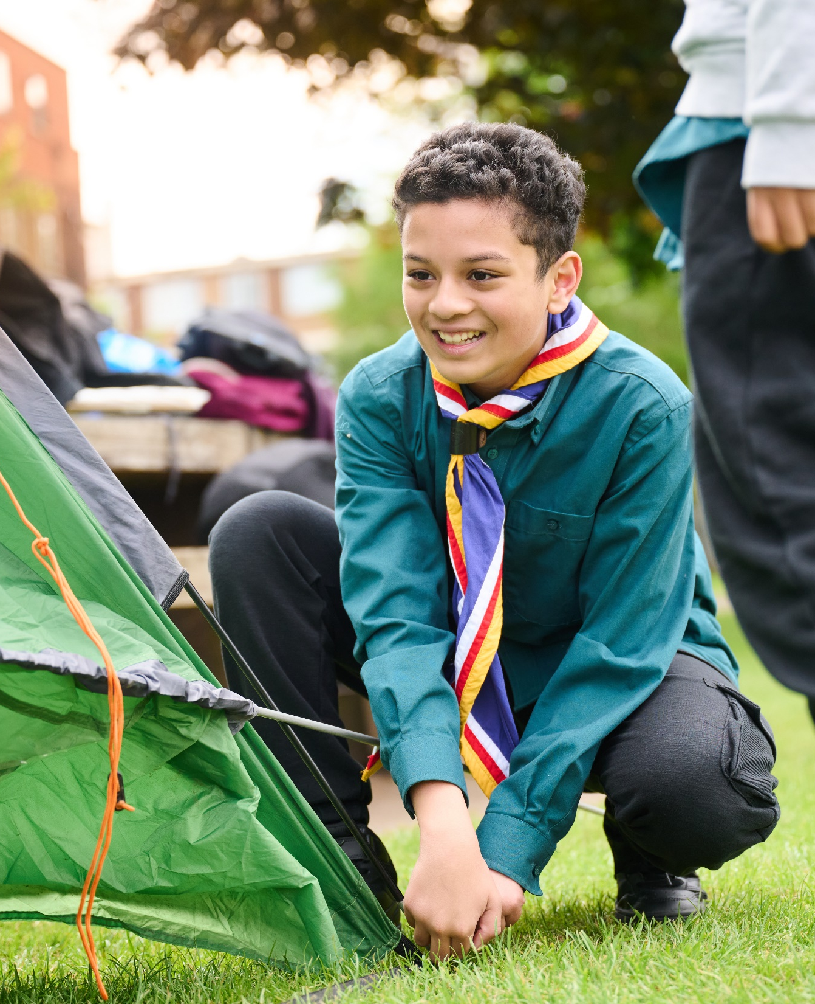
The Young Leader Scheme
Who to contact
If you have any questions, please contact the following people who will be able to help you.
Enter details of County/District contacts here

Slide 12

Thank you
Young Leaders’ Scheme
Scouts.org.uk
#SkillsForLife

