Slide 1
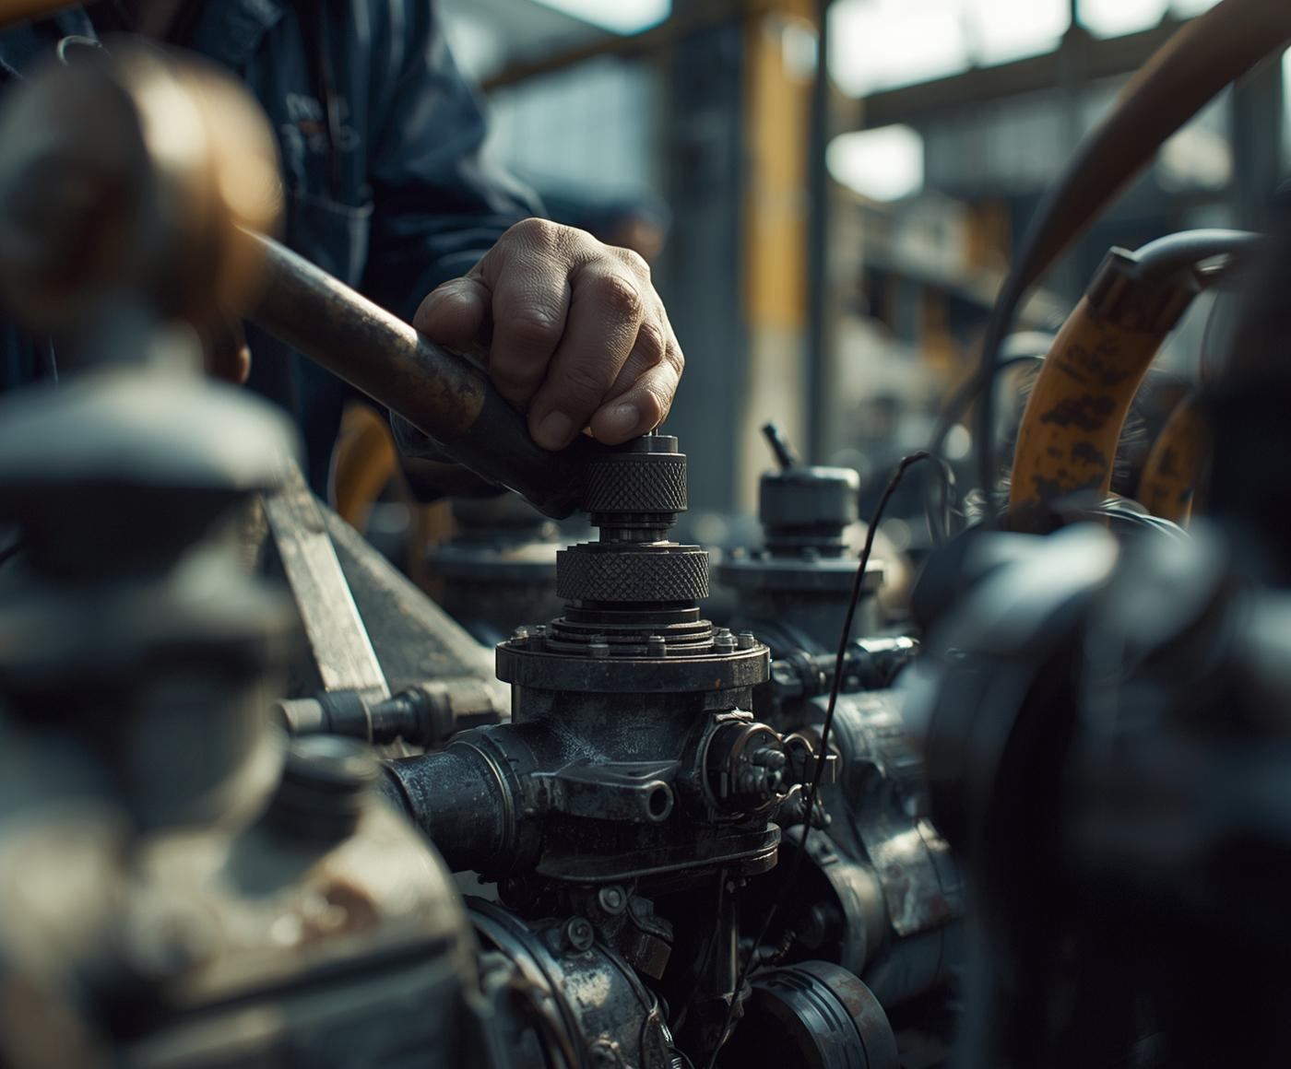
My Journey
Farhan Zafar
MECHANICAL MAINTAINER

Slide 2
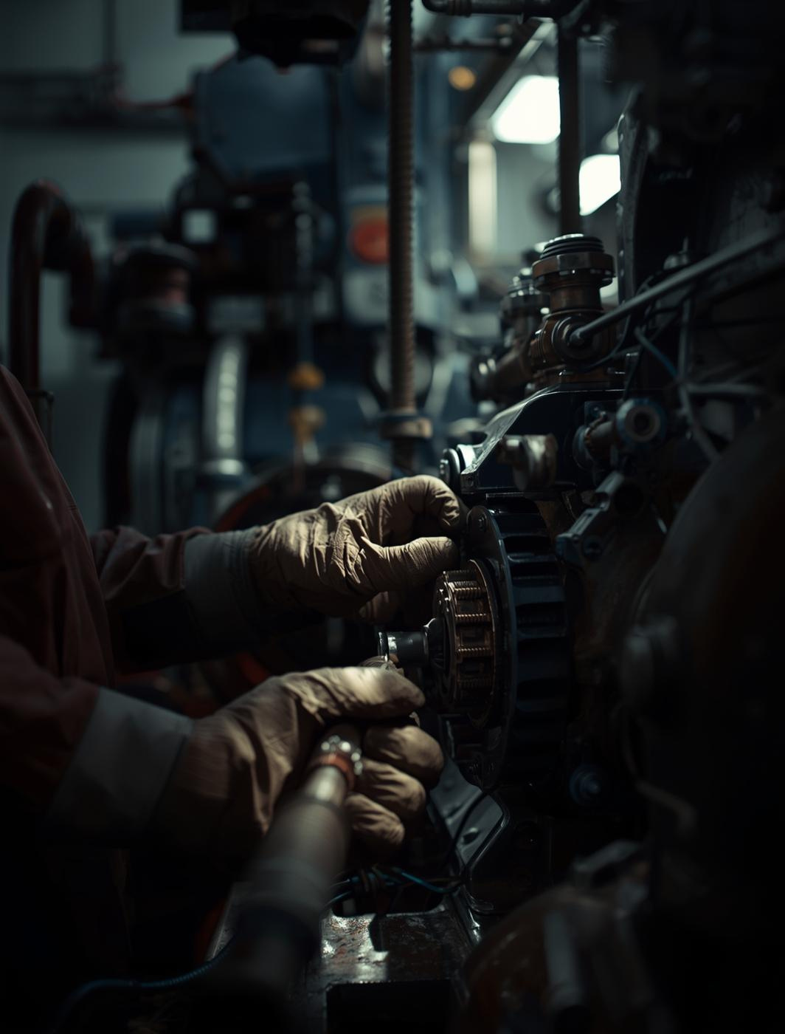
From Uncertainty to Expertise
Transforming Inexperience into Confidence in Mechanical Maintenance
I did not start as an expert. I started confused, nervous, and unsure. The journey from uncertainty to expertise was filled with challenges and valuable lessons. Navigating my early days on the job taught me the importance of learning through experience, embracing mistakes, and seeking support from colleagues.

Slide 3
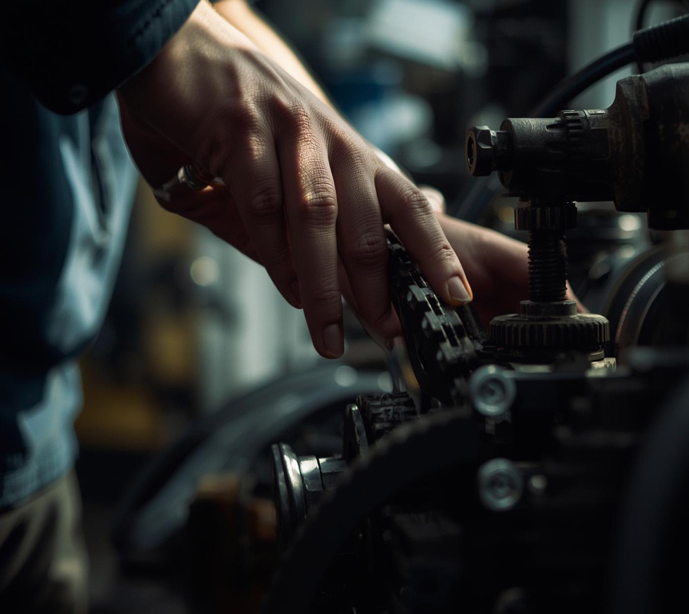
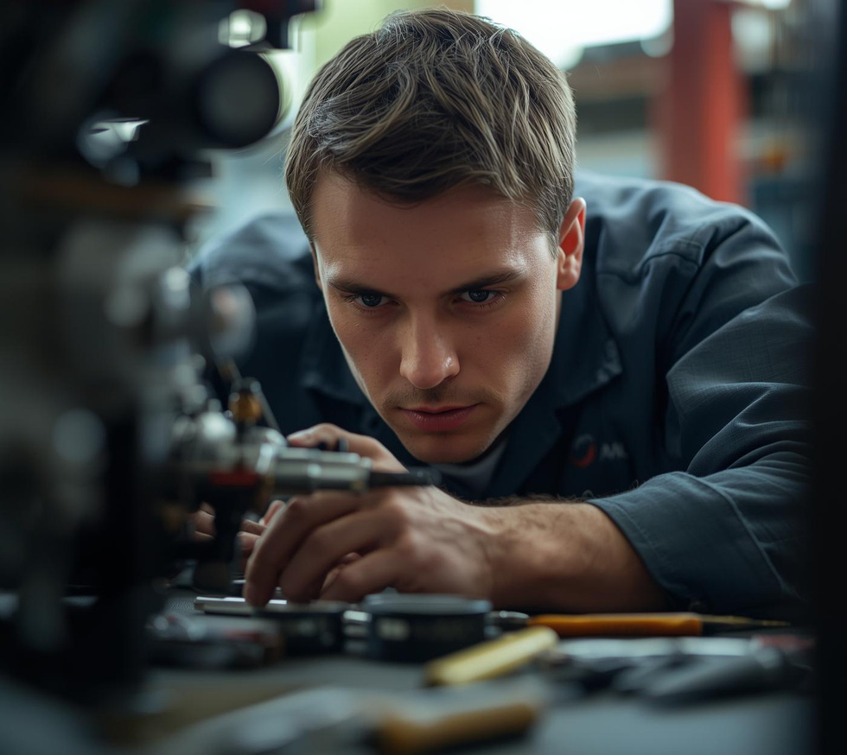
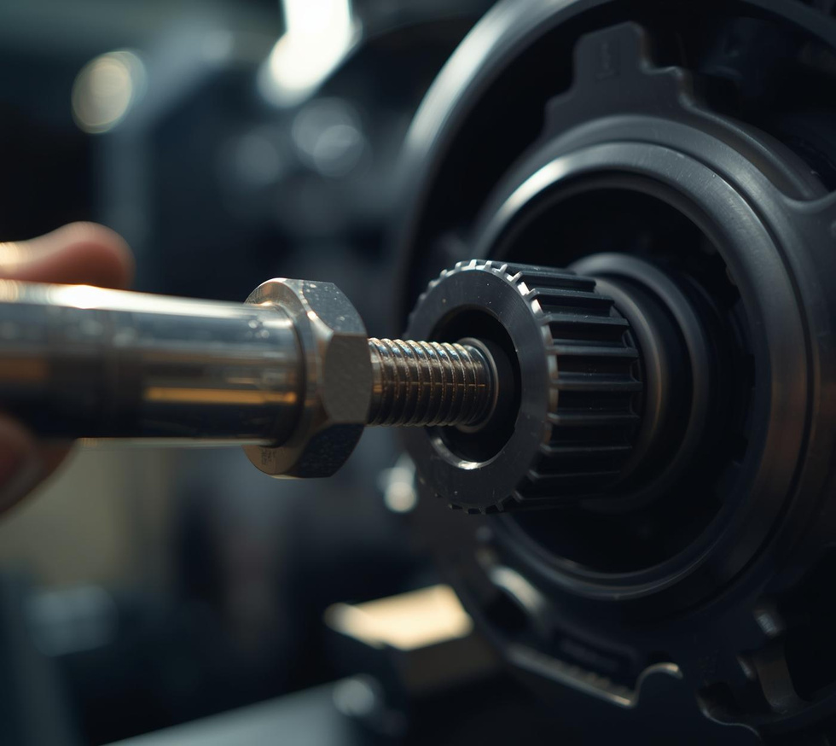
Early Misconceptions
Speed vs. Quality
Strong Hands
Understanding Torque
Rushing leads to costly mistakes in maintenance.
Strength is less vital than a calm mindset.
Proper torque is essential for safe operations.

Slide 4

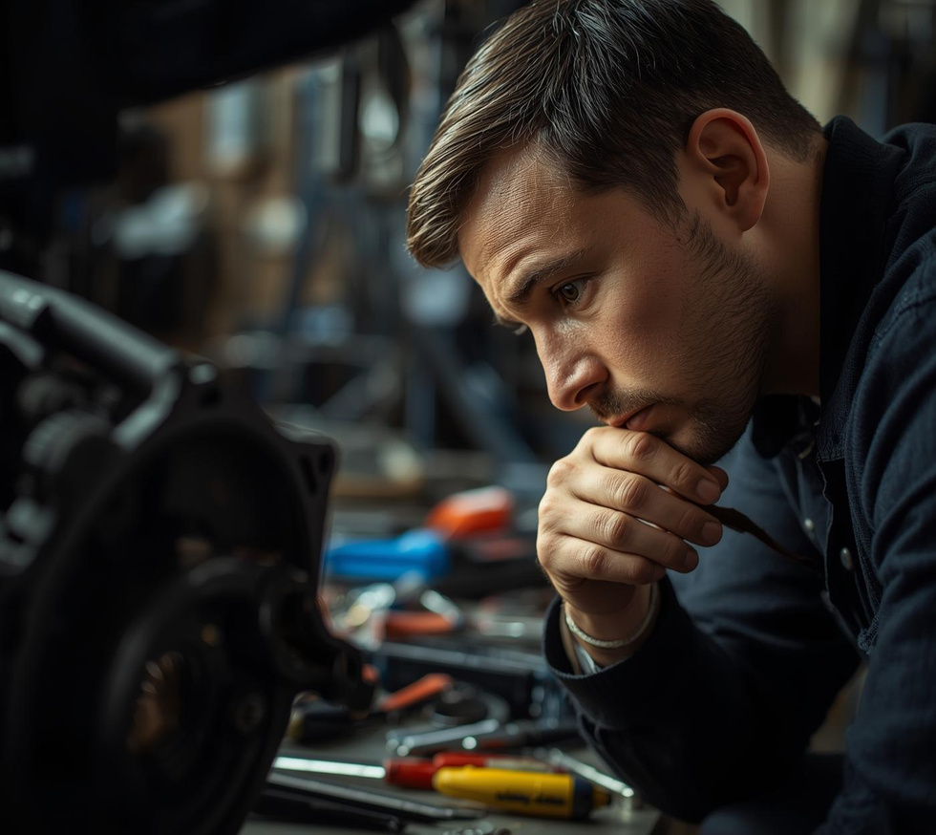
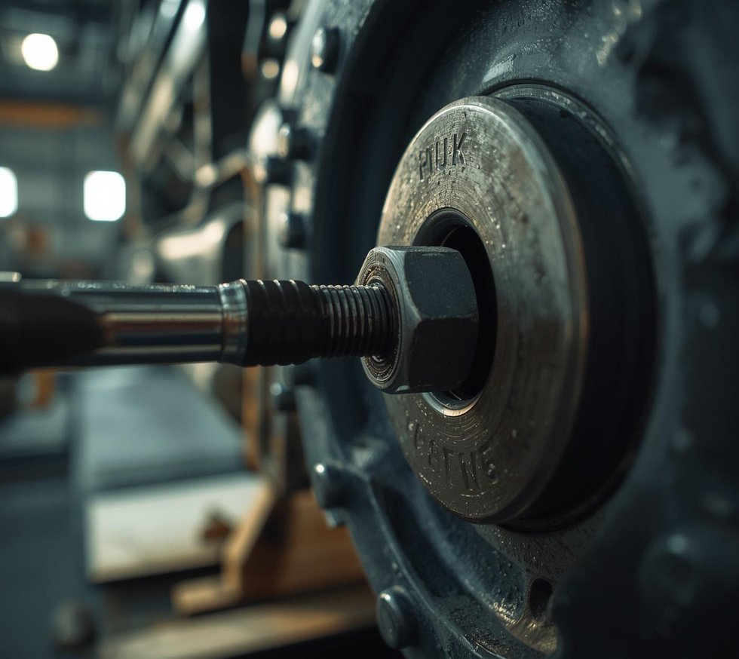
Initial Mistakes
Ignoring Noises
The Hard Way
Misunderstanding Torque
Small sounds can indicate bigger problems.
Learning lessons often comes from mistakes.
Proper torque prevents damage and failures.

Slide 5
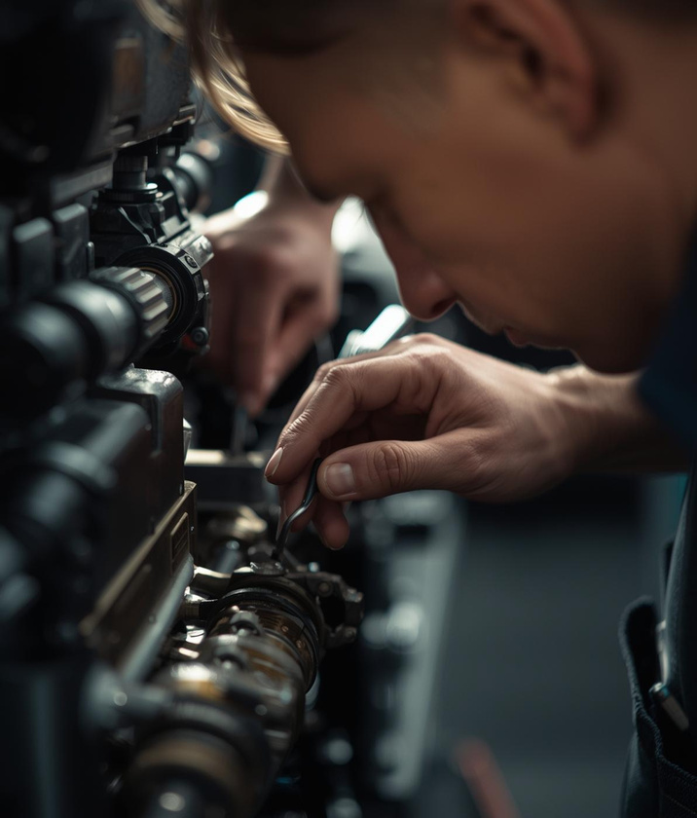
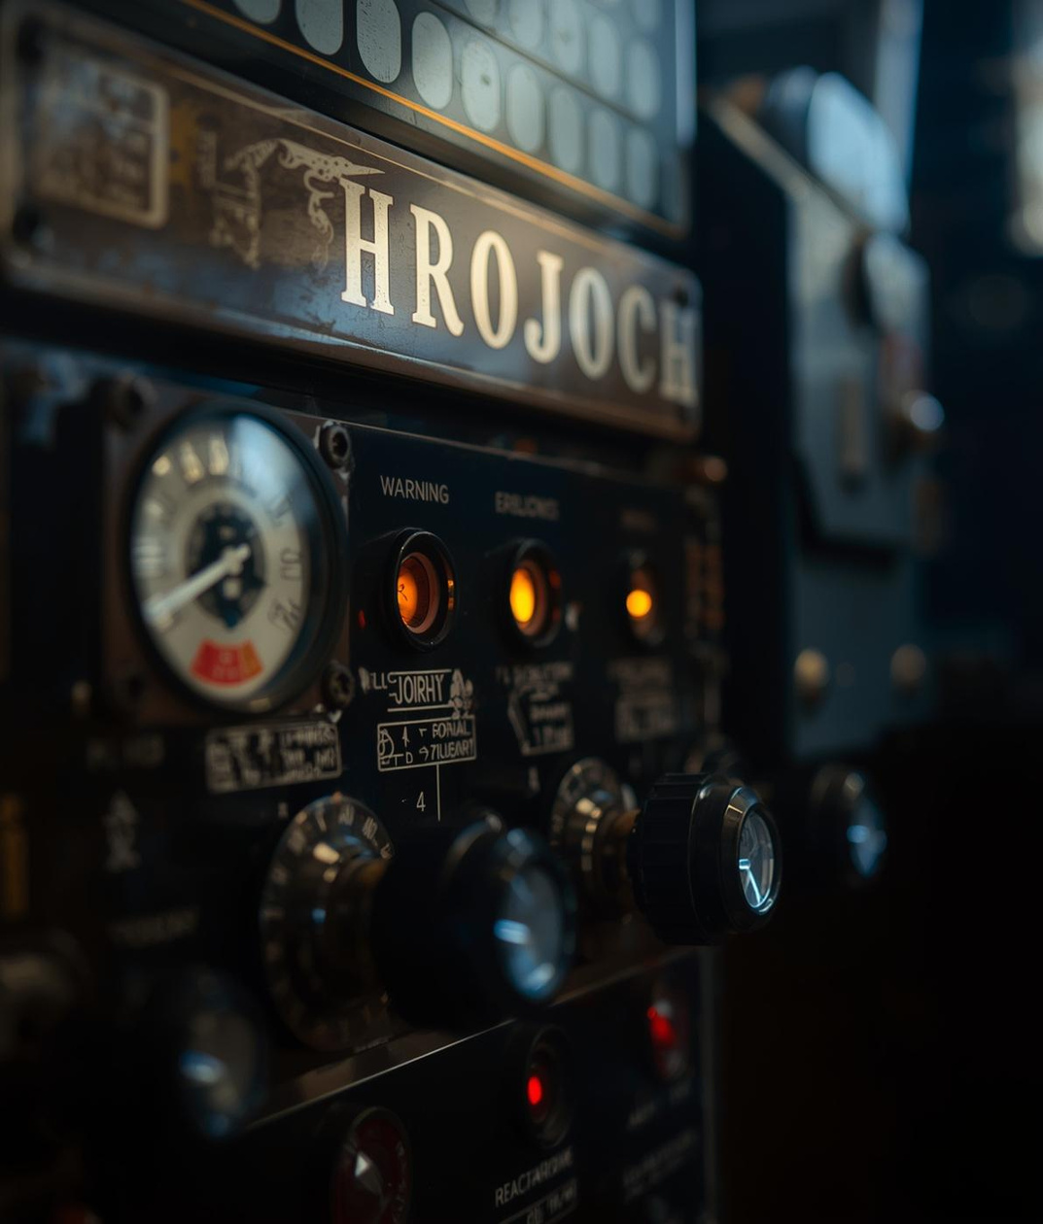
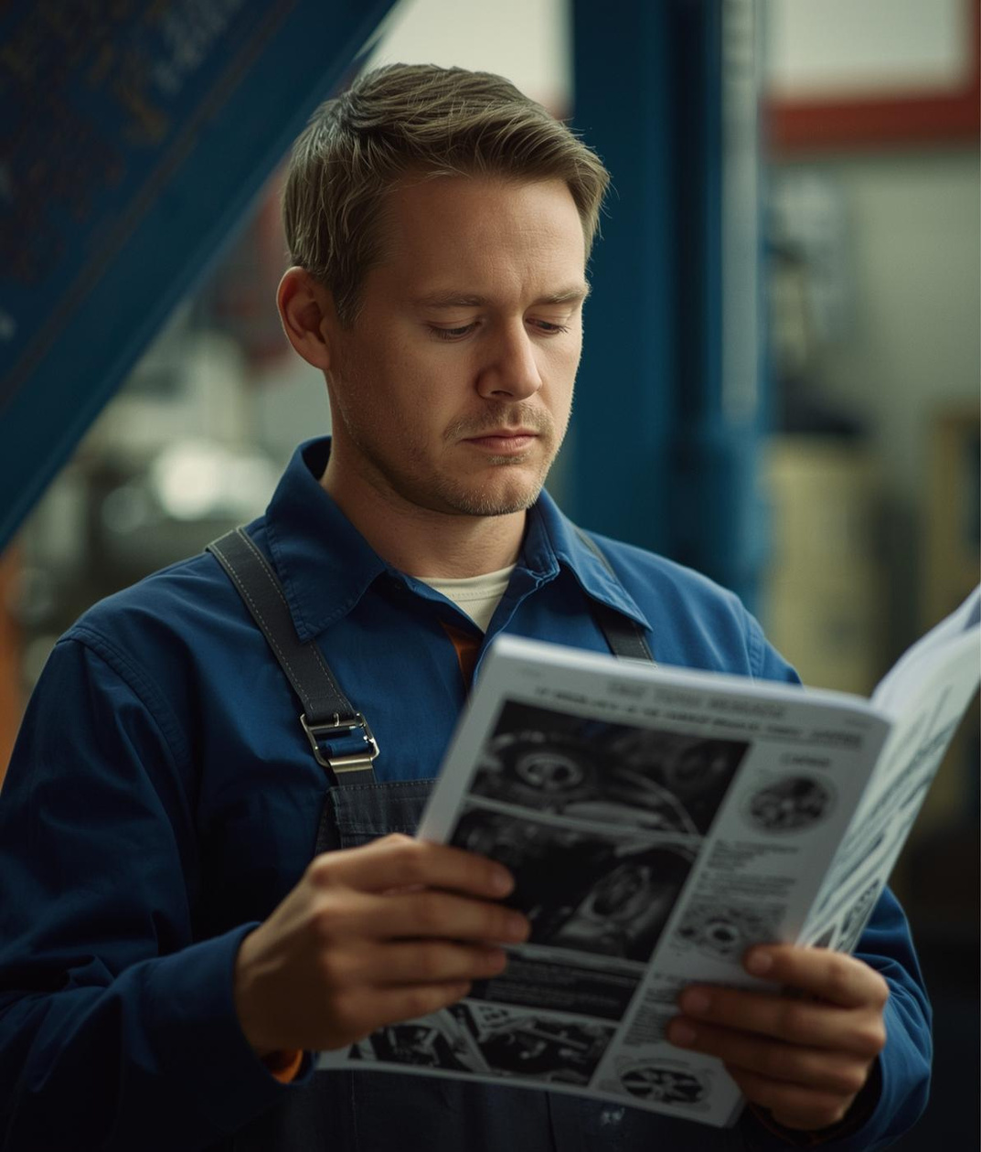
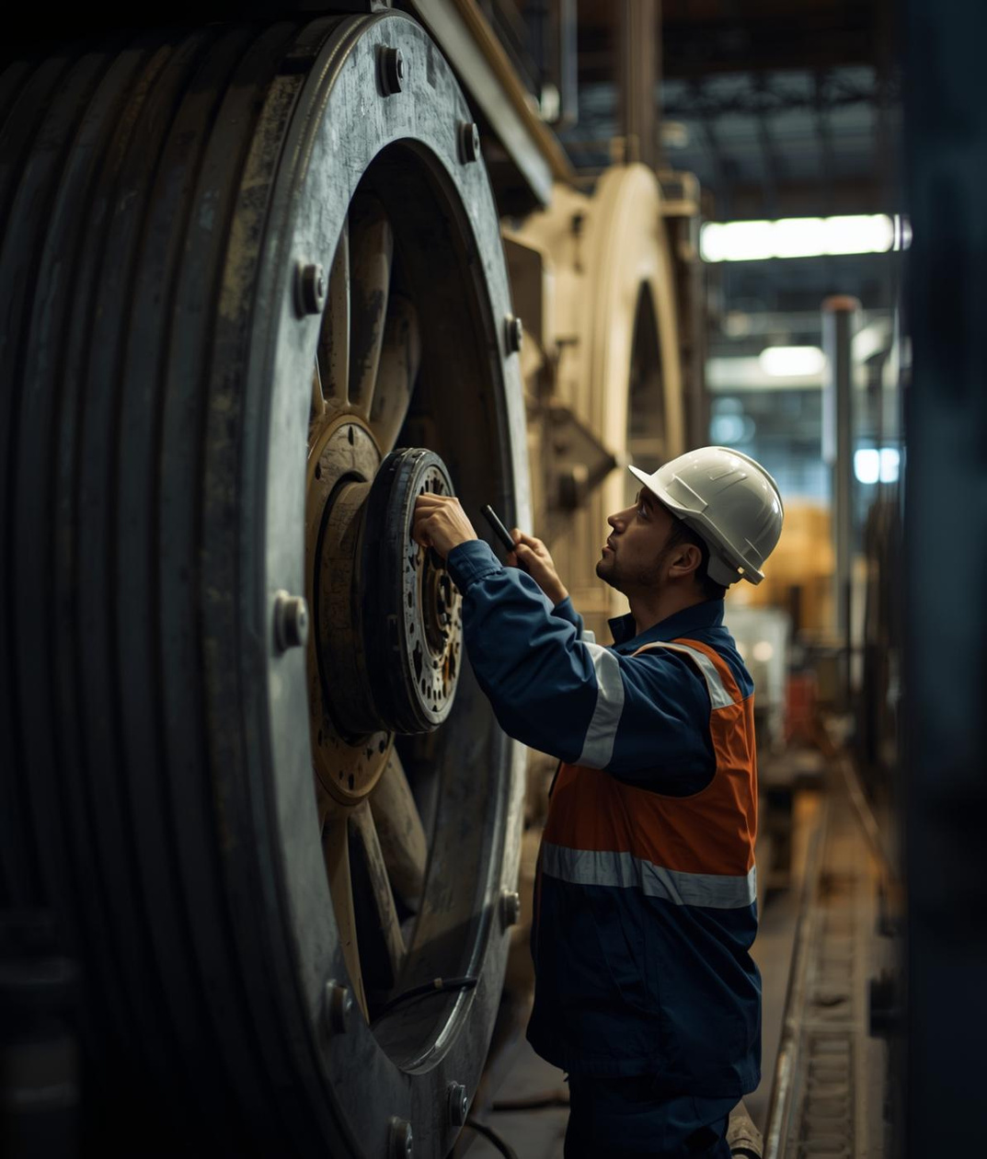
Lessons Learned in Maintenance
Thoughtful Work
Small Details
Learn from Mistakes
Proactive Maintenance
Careful attention leads to better outcomes
Overlooked elements can cause major issues
Mistakes are valuable lessons for growth
Anticipating problems prevents future breakdowns

Slide 6

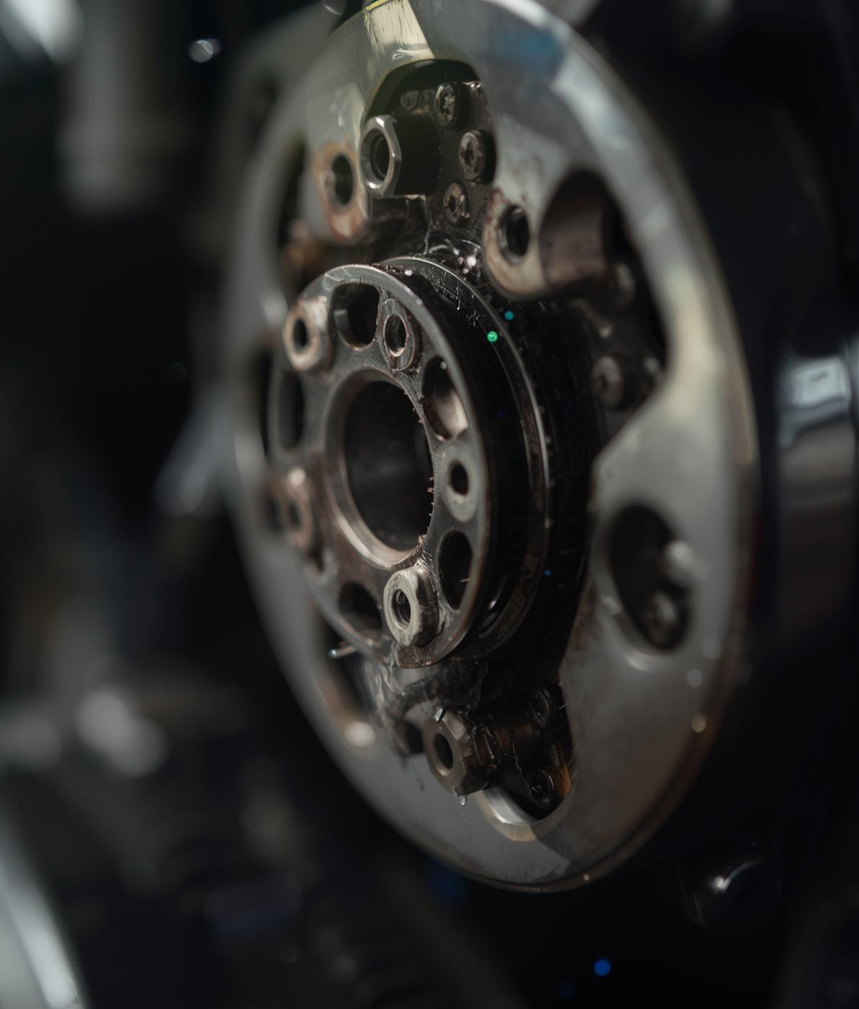


Failures from Overlooked Issues
Neglected Maintenance
Small Warning Signs
Improper Torque
Last-Minute Fixes
Incorrect tightening procedures resulted in failures.
Rushed repairs often lead to repeated issues.
Skipped inspections led to major breakdowns.
Ignoring minor noises caused critical failures.

Slide 7
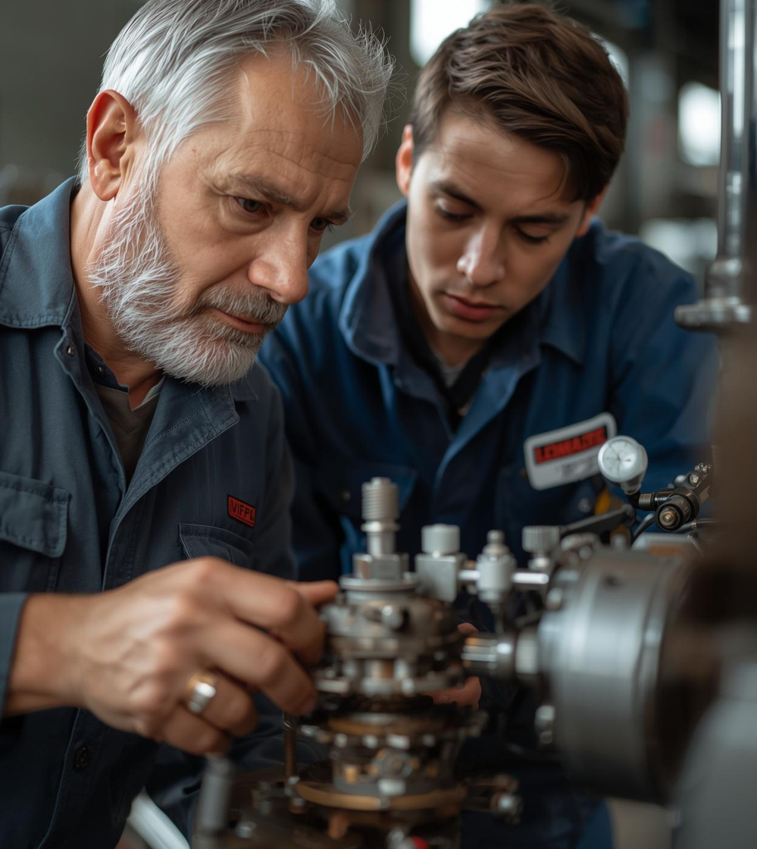

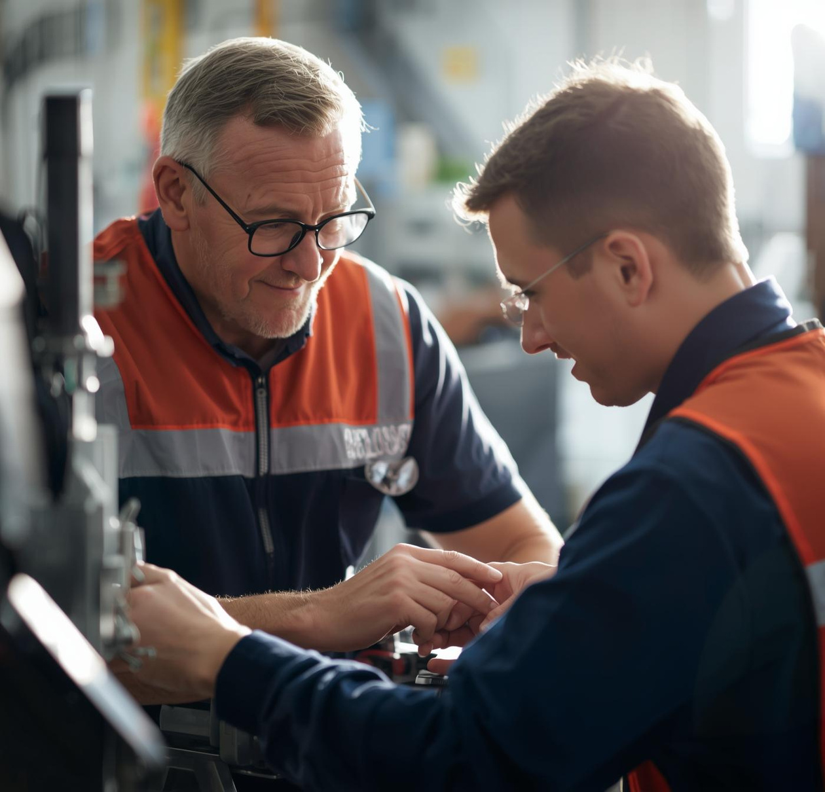
Mentorship in Action
Inspiring growth through patient and guiding approaches
The images illustrate the essential role of mentorship in shaping a mechanical maintainer's growth, showcasing moments of guidance, support, and collaborative learning in the workplace.

Slide 8
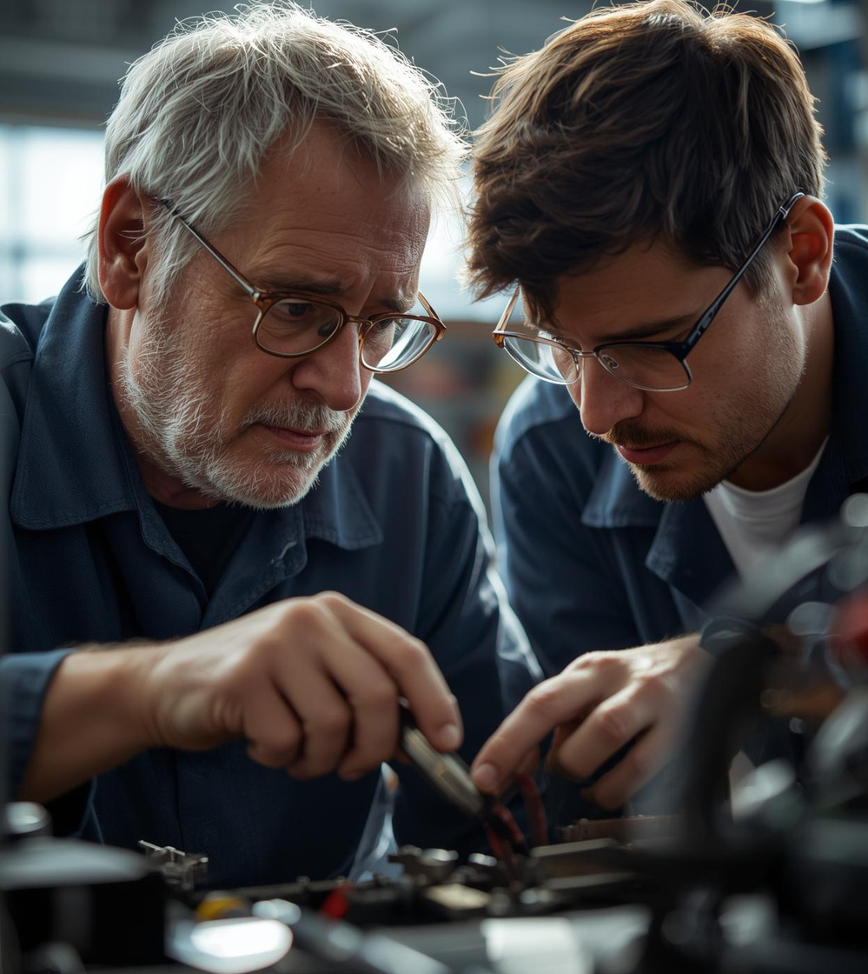
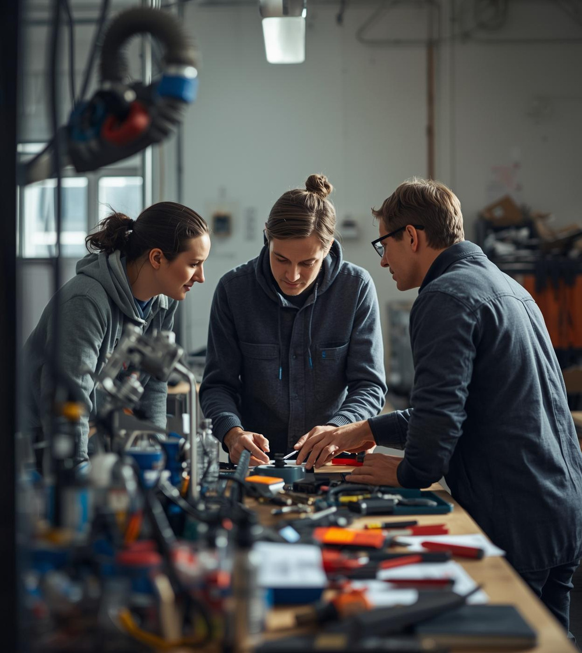

Positive Mentorship Matters
Emphasizing guidance and support from experienced colleagues
These images capture moments of mentorship, highlighting the supportive environment, where experienced technicians share knowledge and foster growth without insult, ensuring a positive learning atmosphere.

Slide 9
Knowledge is not a power until it is applied
– IT IS APPLIED

Slide 10
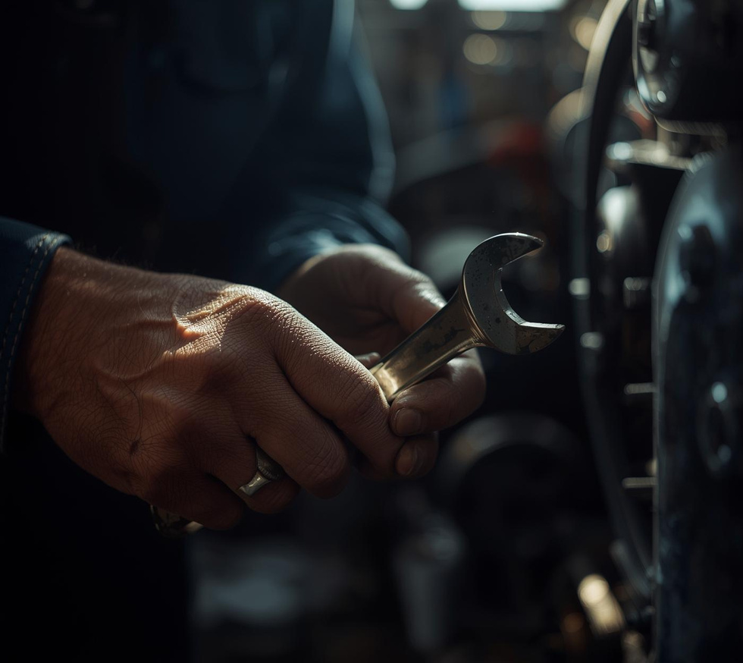
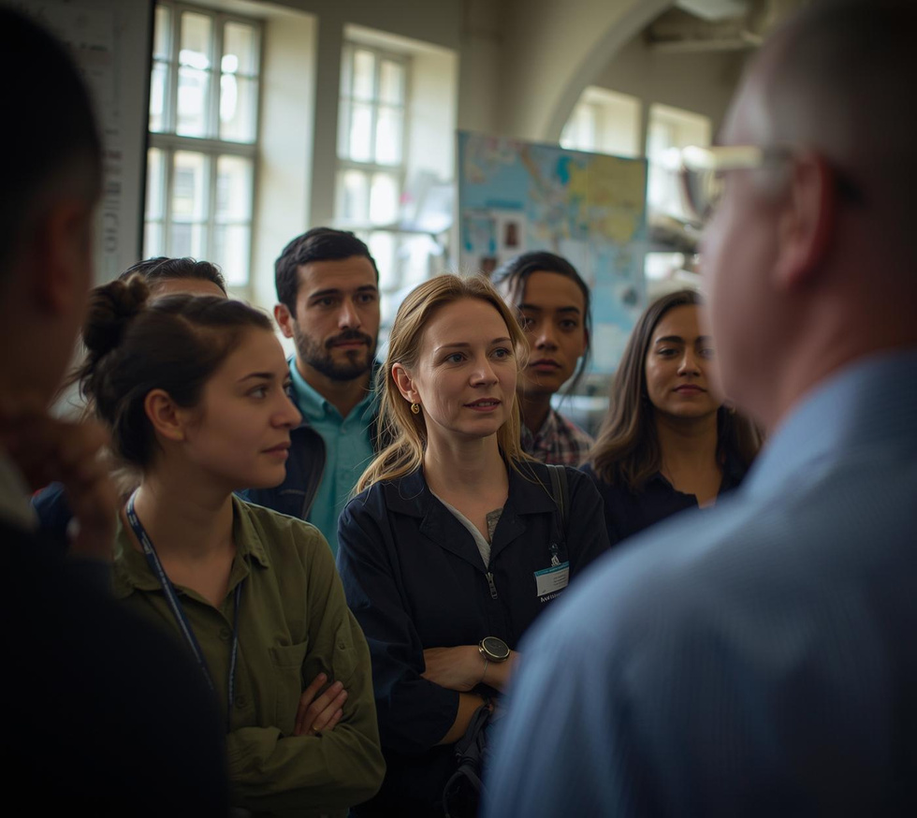
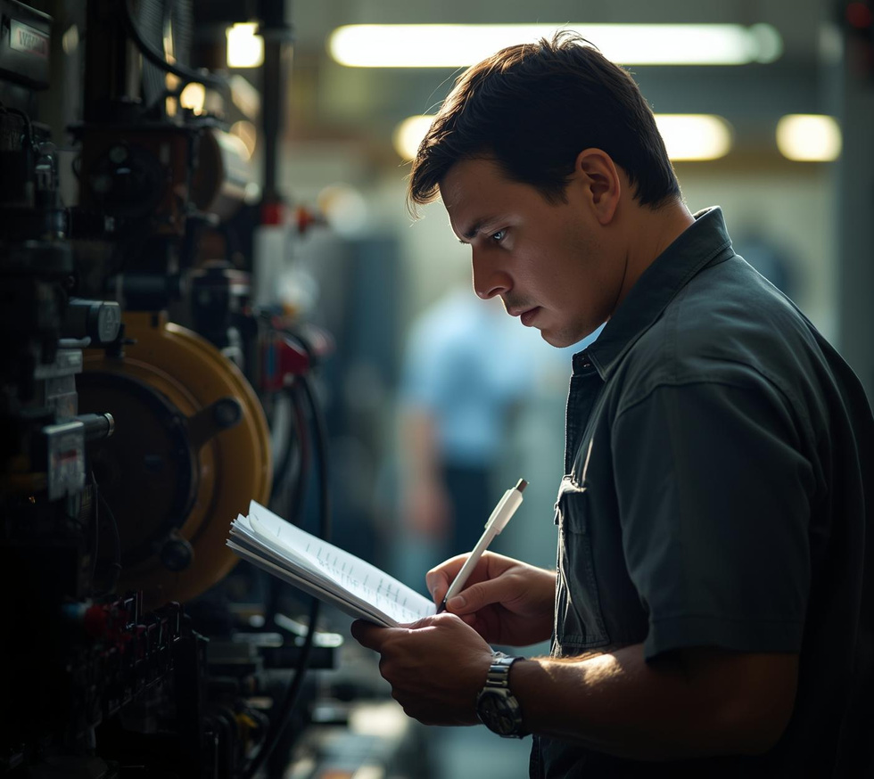
Channel’s Mission
Practical Lessons
Target Audience
Value Proposition
Just real work insights for technicians.
New technicians eager to learn effectively.
Avoid mistakes through practical, clear guidance.

Slide 11
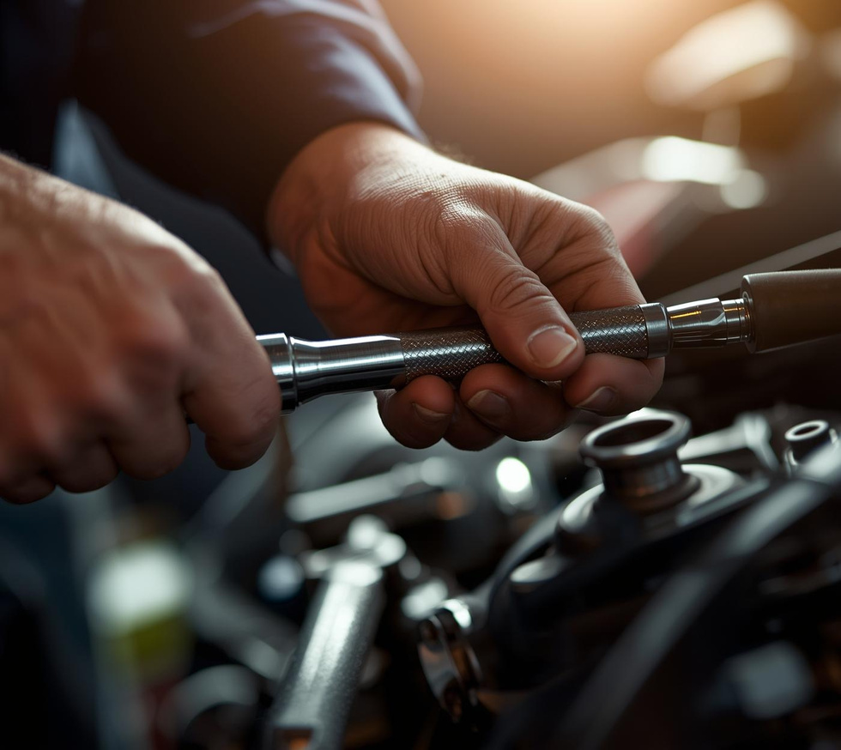
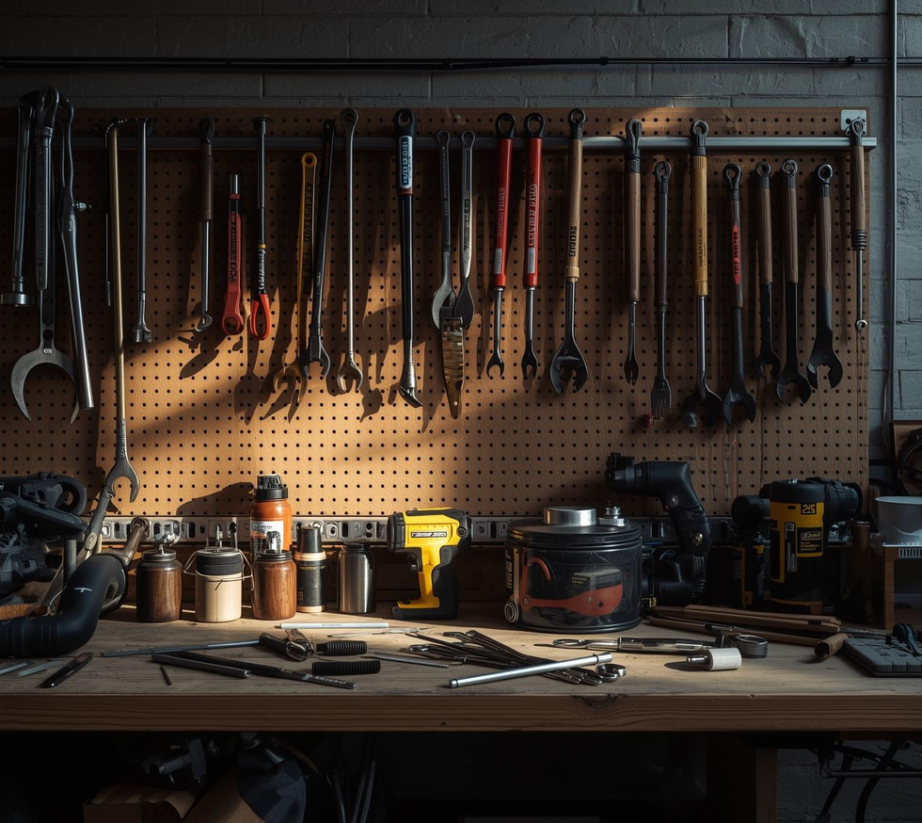
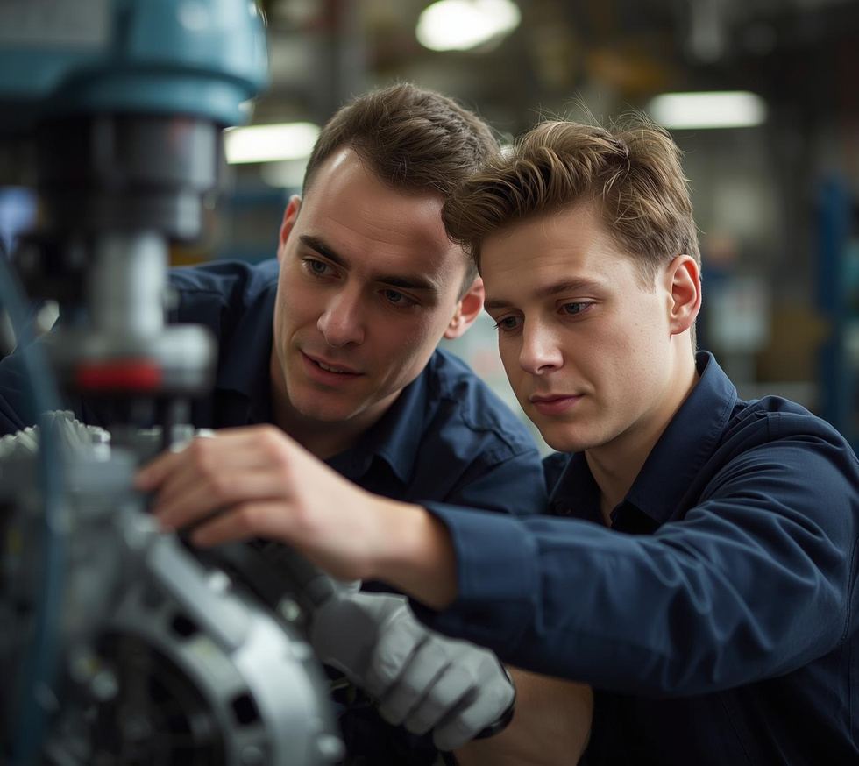
Practical Lessons
Simple Techniques
Consistent Practice
Seek Mentorship
Mastering basics can elevate your skills.
Regular maintenance habits lead to expertise.
Learning from others speeds up growth.

Slide 12
Thank You
YOUTUBE CHANNEL
www.youtube.com/@learngrow85
Contact Information for Further Inquiries and Support
EMAIL
learn4grow85@gmail.com
PHONE
+923141067776

