Slide 1
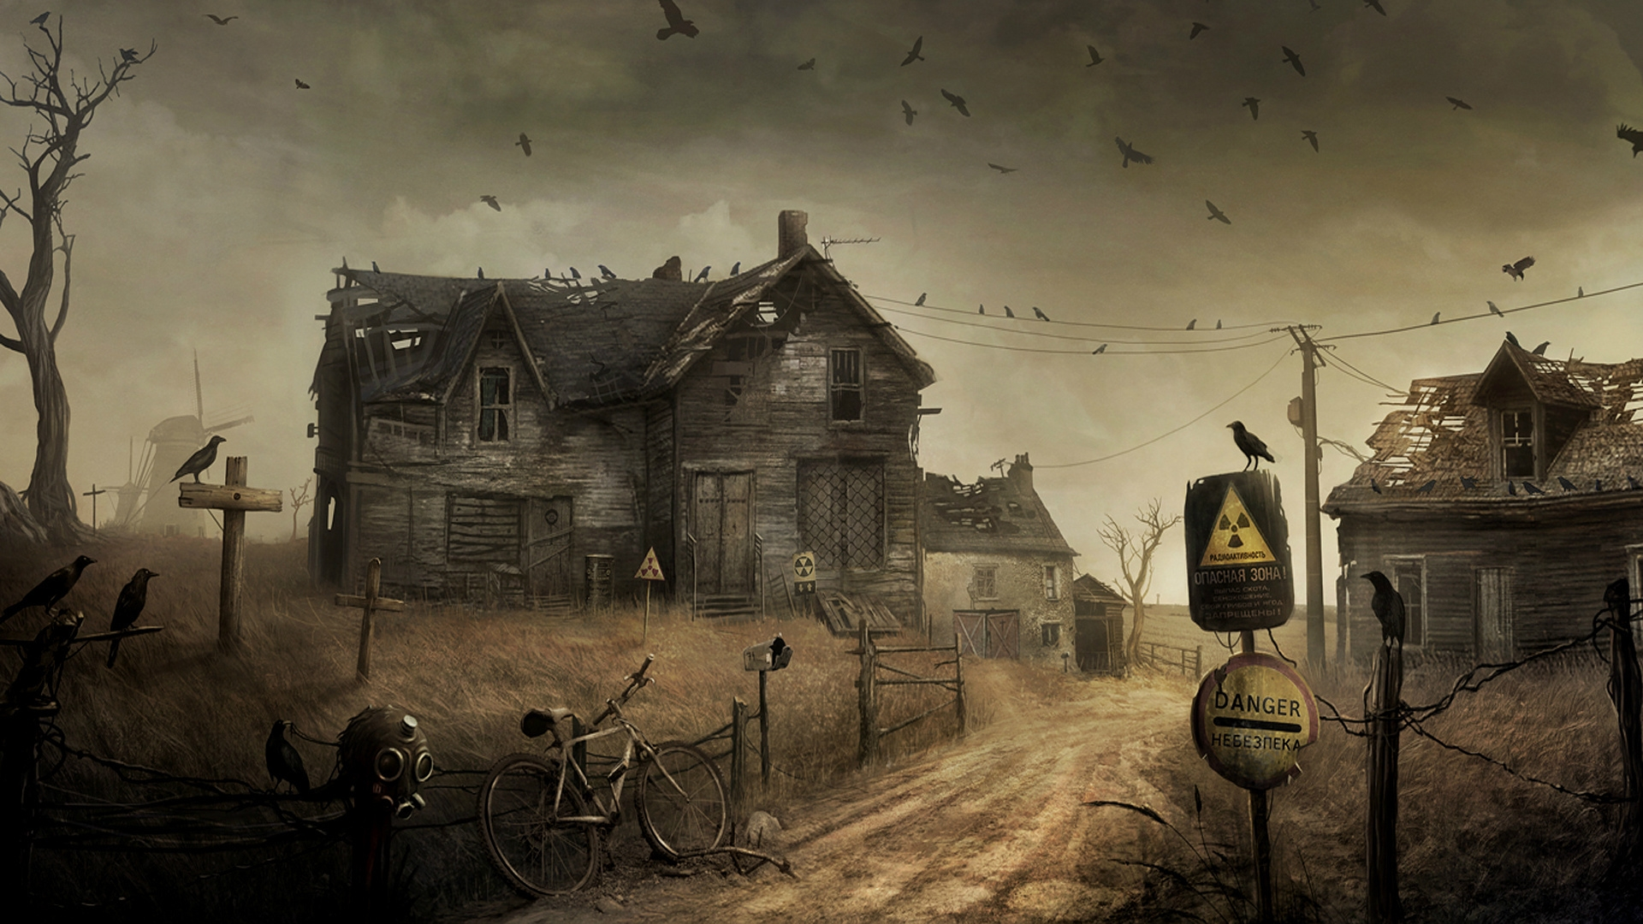
TALES FROM THE GRINDHOUSE
Urban Legends and Supernatural Tales to Chill your Soul.

Slide 2
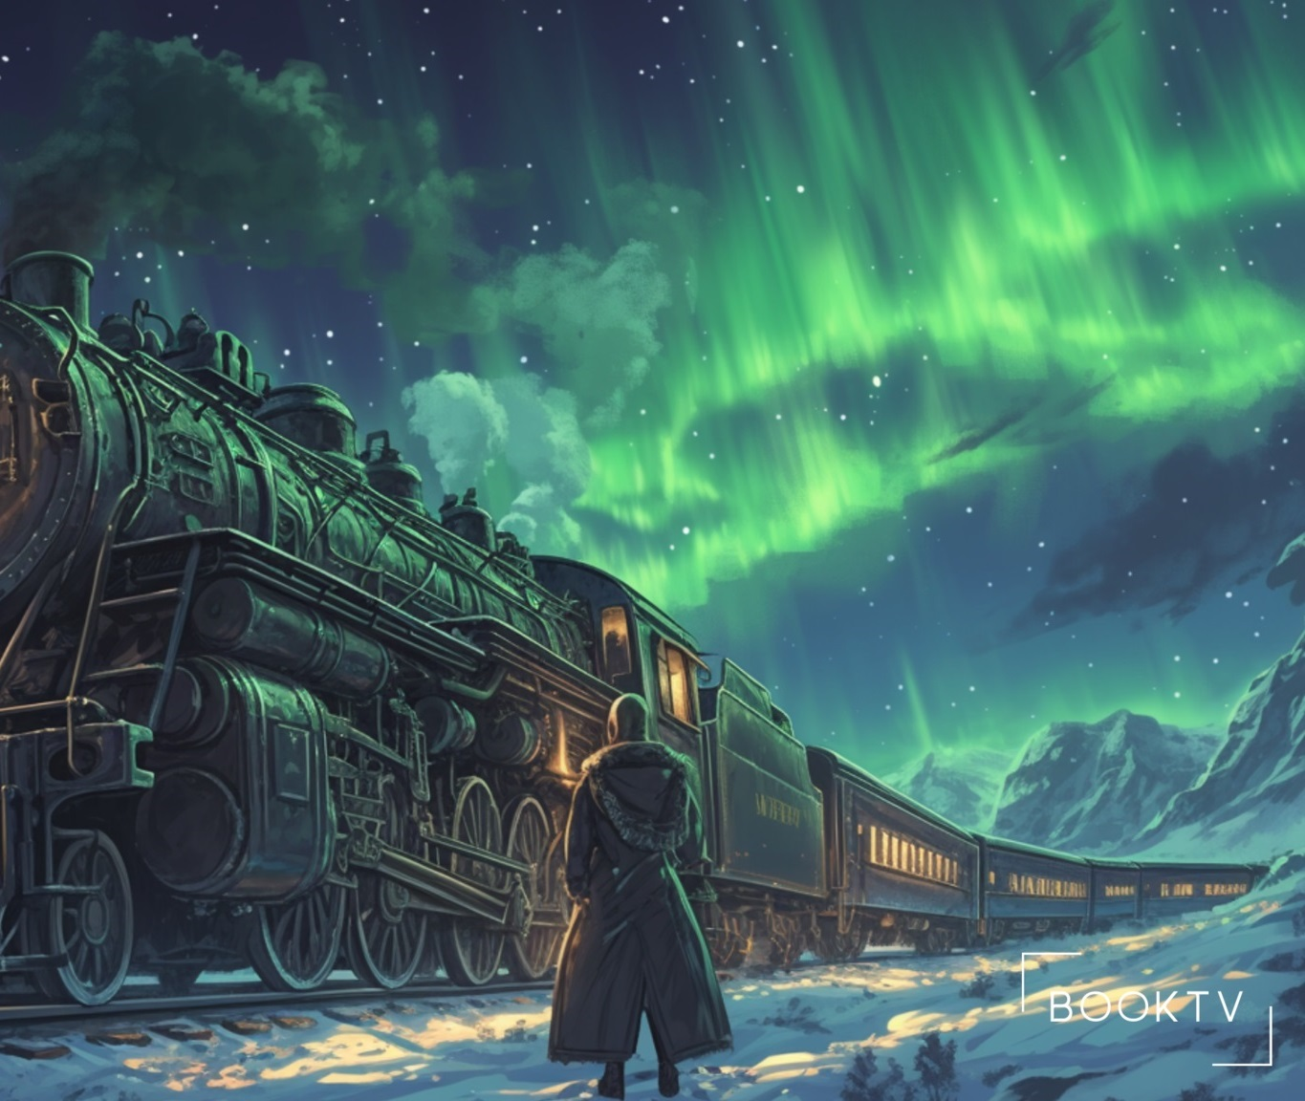
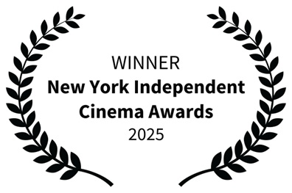
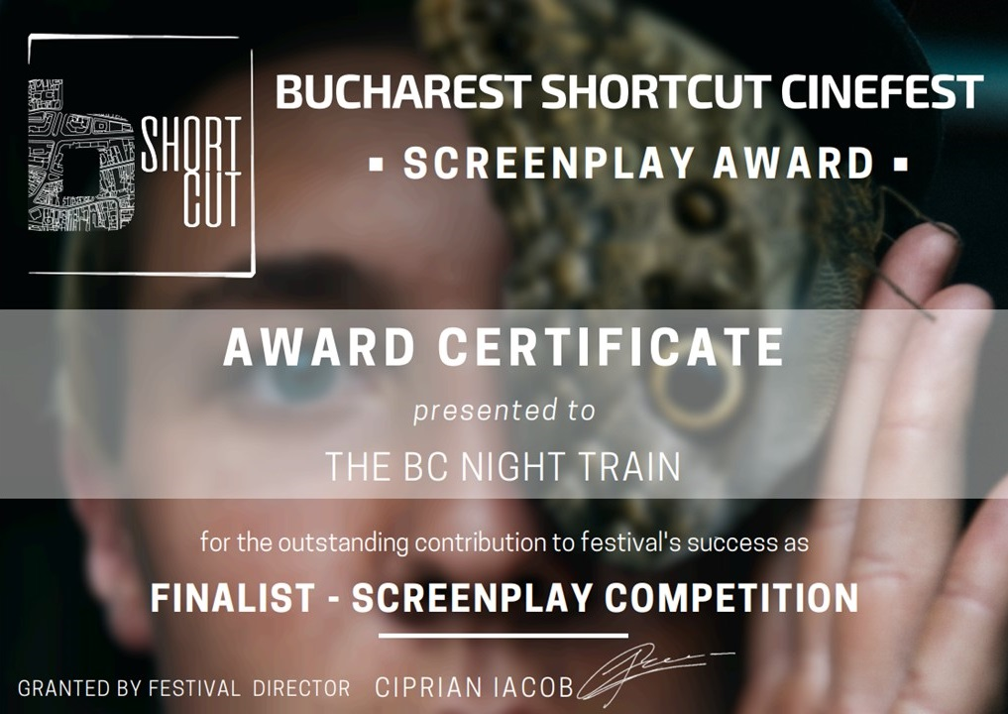
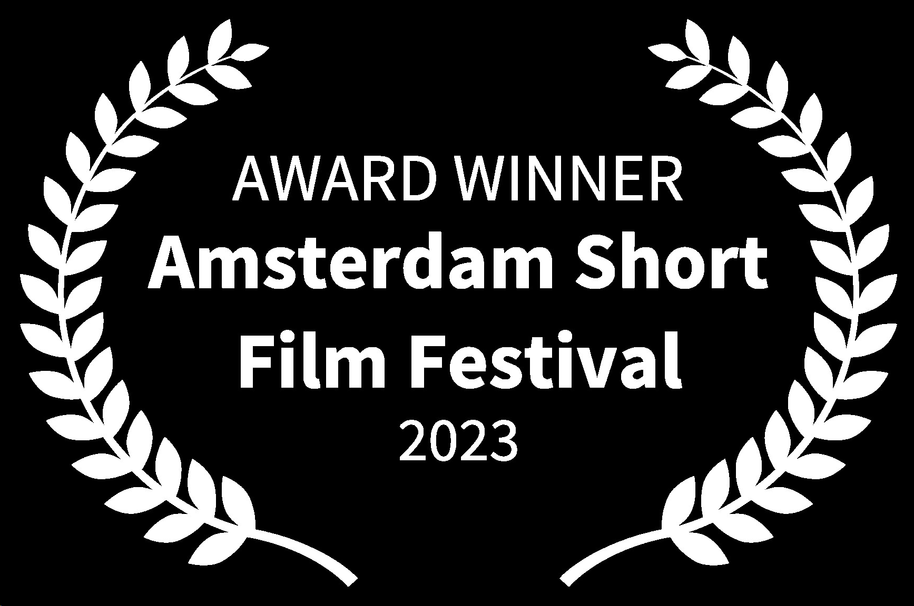
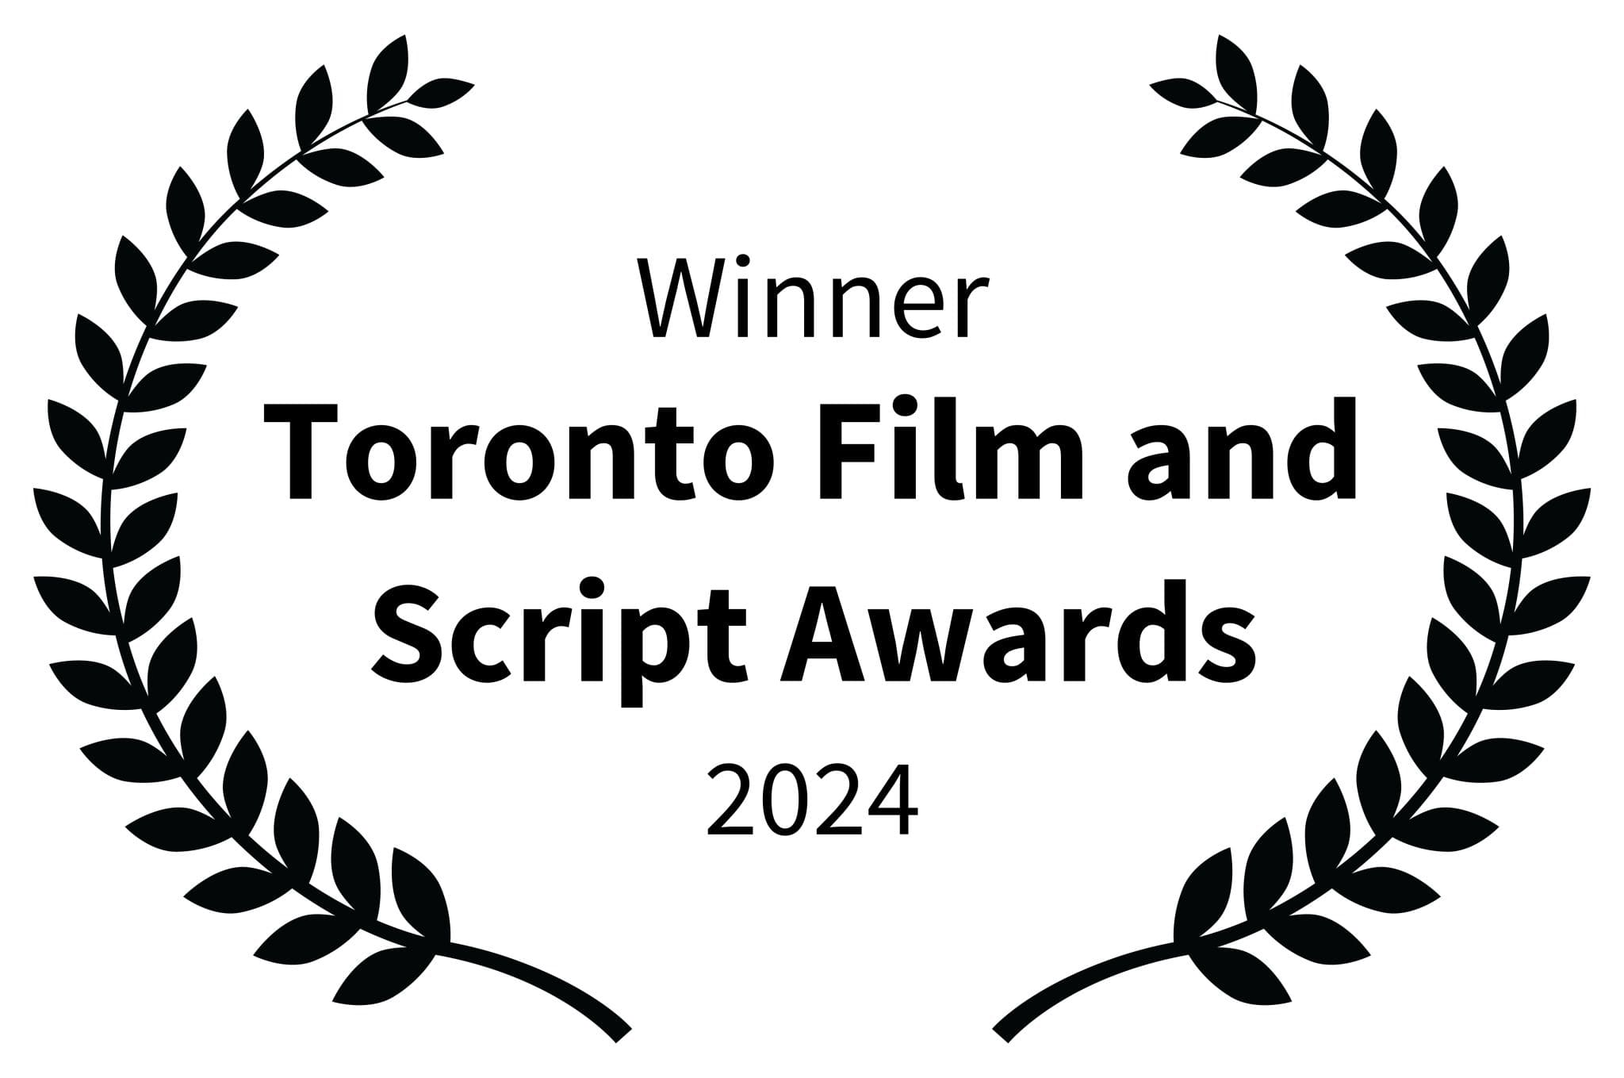
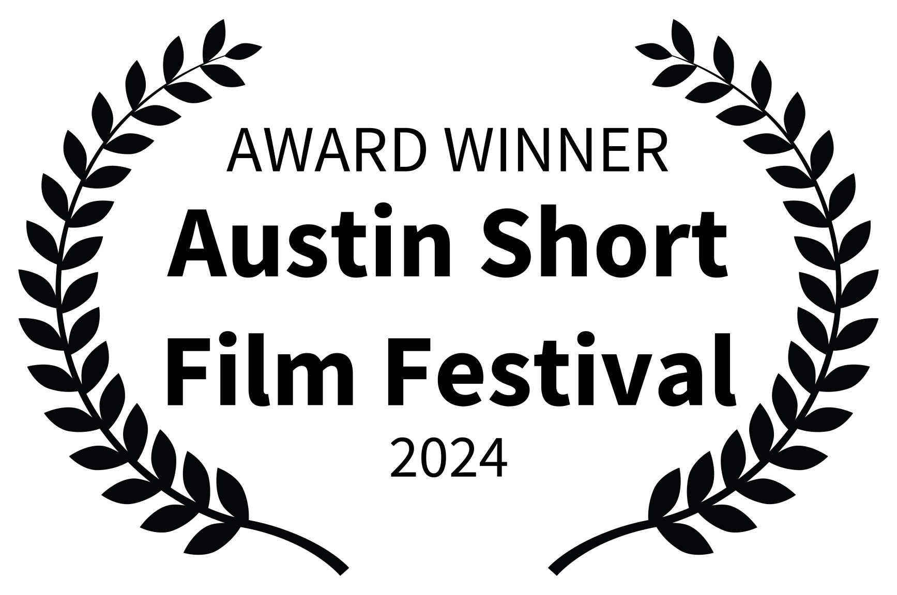
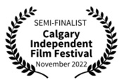
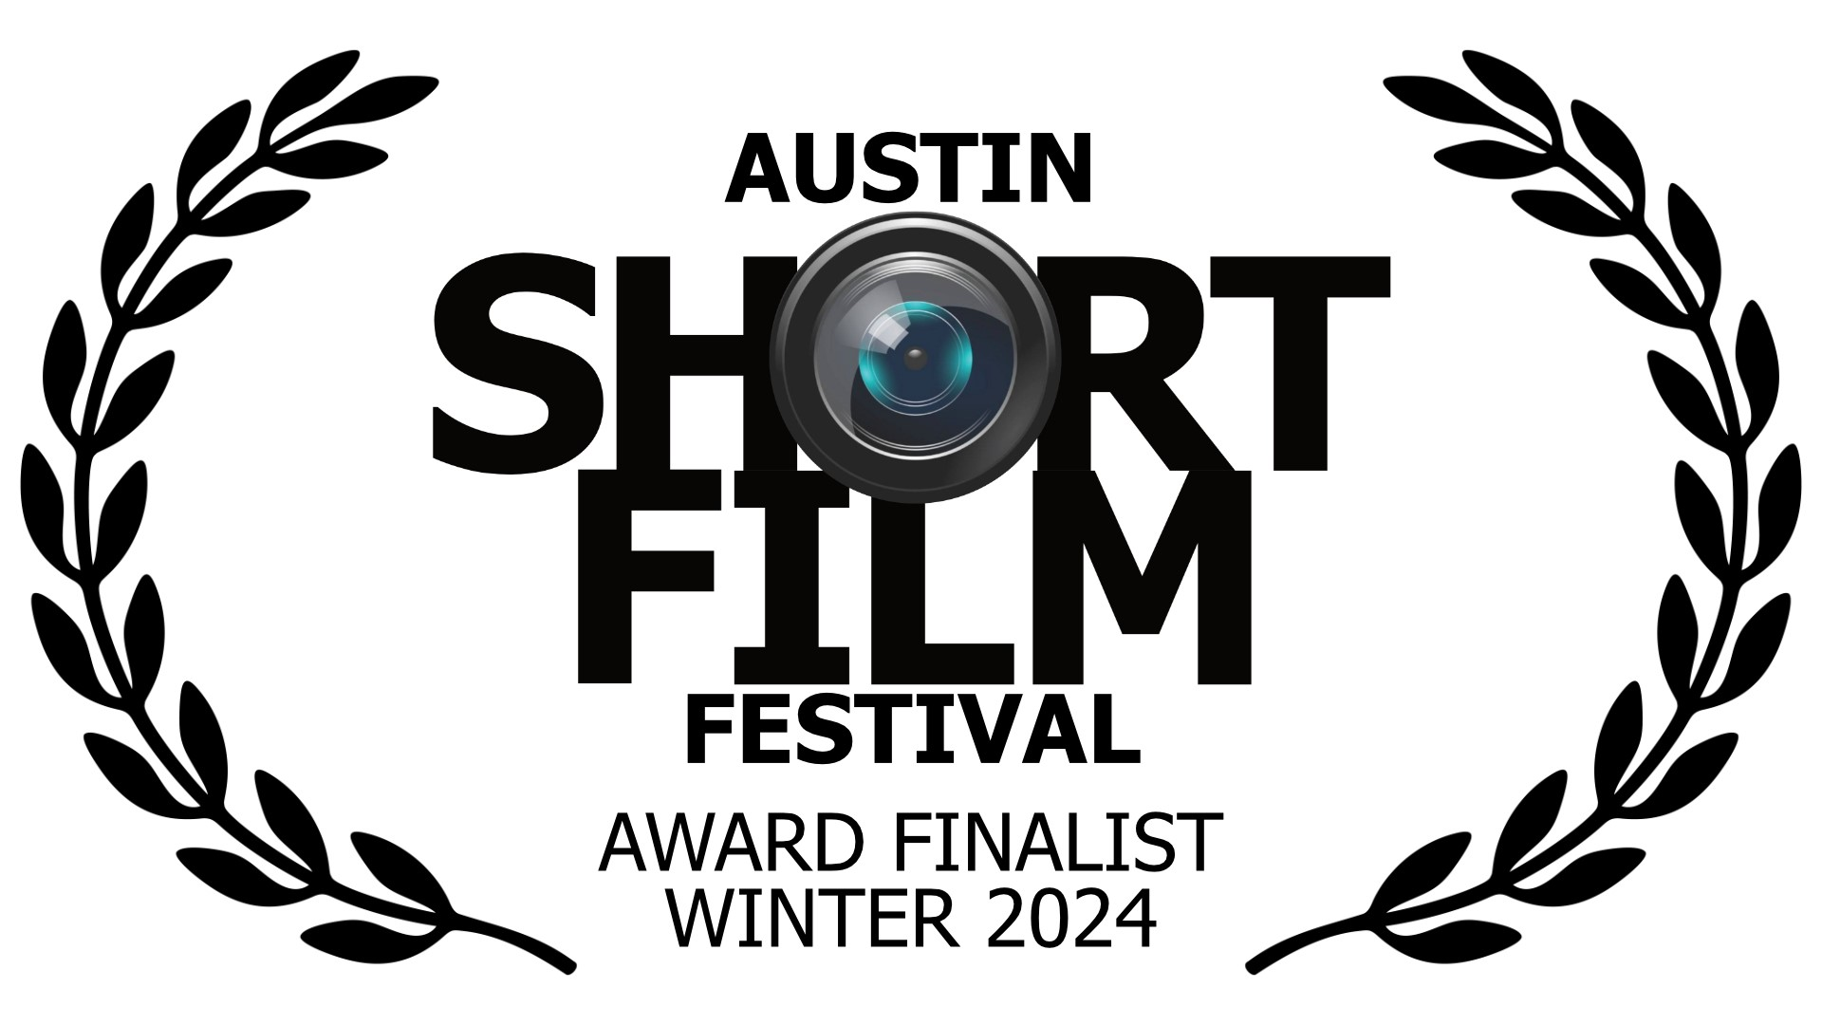
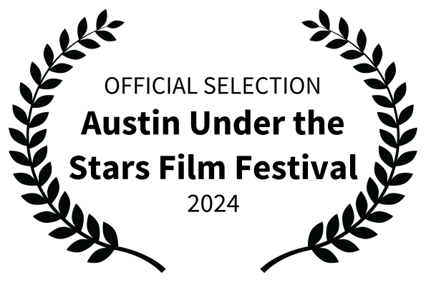
Series Overview
Format:
Streaming Series, Two Seasons: Six Episodes, 51-59 Mins
Genre:
Thriller / Supernatural / Historical
Comparable:
American Horror Story meets The Twilight Zone
Synopsis:
Six episodes emanating from two Grindhouse supernatural novels.
Season one: Set in Canada, the Grindhouse Canada triple bill spans the Canadian landscape from coast to coast and features a native Canadian spirit known as the Reclaimer who rights the wrongdoings of man.
Season two: The stories take place across the Caribbean region. The themes of these three stories revolve around people who attempt to cheat death only to find out that death always wins.
Based on the novels Grindhouse Canada and Grindhouse Caribbean by best-selling author Sean O’Neil.
A Canadian Elbows Up Project,
Tales from the Grindhouse
Series Overview

Slide 3
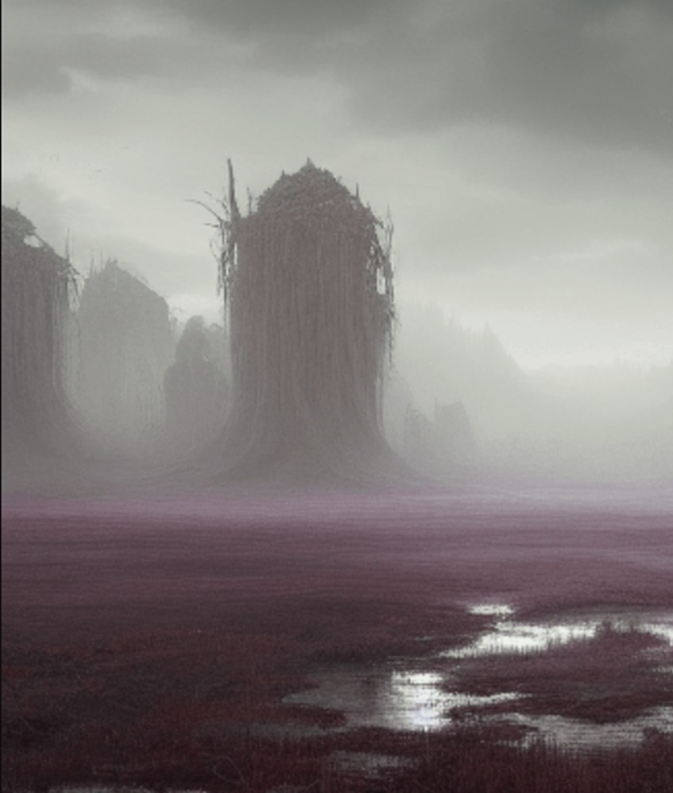
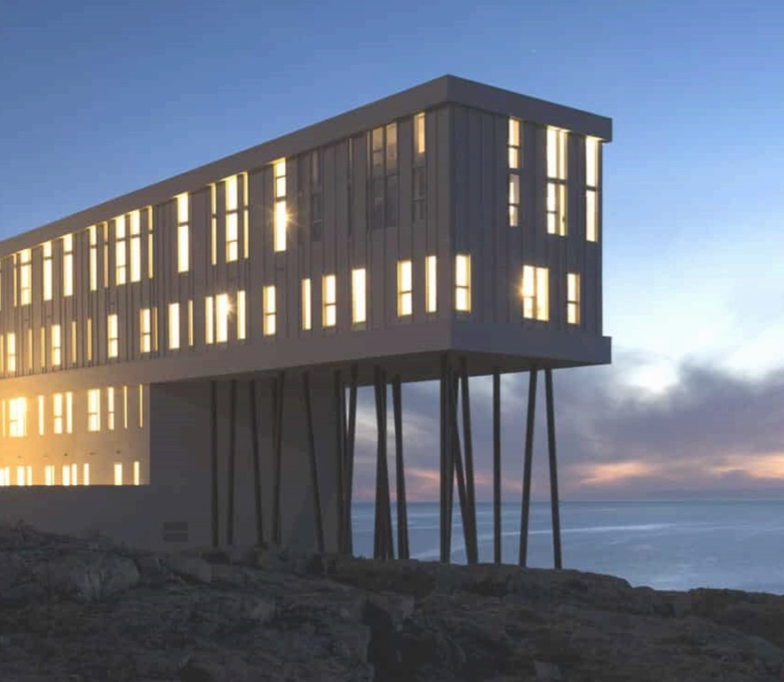
Season 1: Grindhouse Canada
The BC Night Train
The Manitoba Mining Mist
The Fogo Island Blind Spot
Supernatural tales from across the Great White North

Slide 4
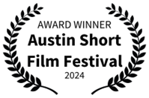
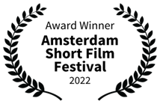
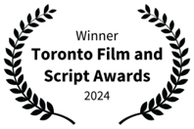
E1: The BC Night Train (PILOT)
JAMES, a young professor from the University of Hong Kong, is in Vancouver to audit a course at the University of British Columbia (UBC). The course, Canadian Urban Legends, has quickly gained interest in Canada as well as at foreign universities with good ex-pat populations.
During the course, JAMES is drawn to a horrific event that took place in BC during the building of the railroad where over a hundred Chinese immigrants were killed in a train bombing. The event raised a native spirit, the Reclaimer.
JAMES, through a series of dreams, finds a connection to the event and his great-grandfather. When the school is offered a ghost ride along the original tracks where the event occurred, JAMES and the UBC professor, BILL, find out just how real the story is.

Slide 5
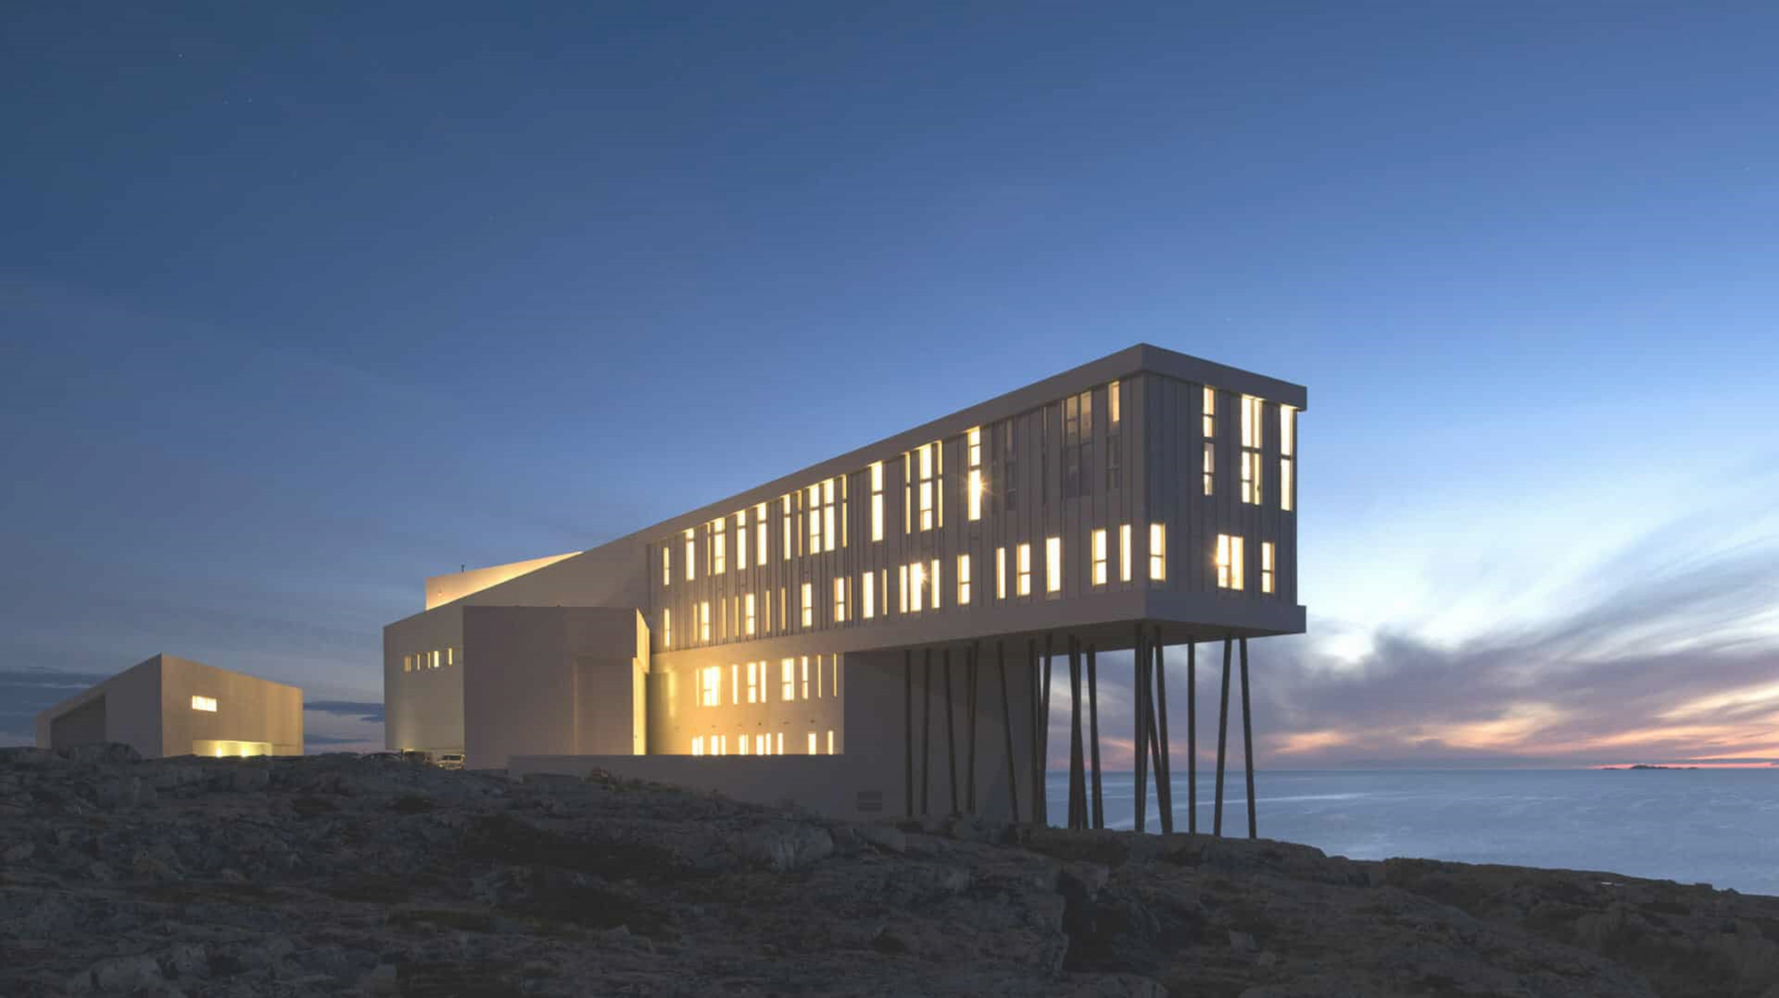
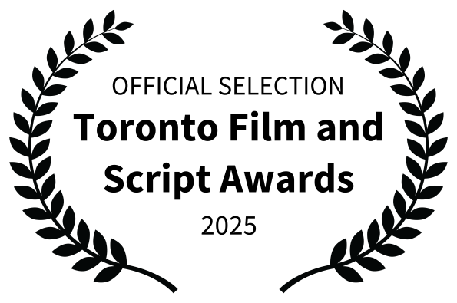
E2: The Fogo Island Blind Spot
It’s the mid-1800s, during the height of the Irish famine, when a ship carrying starving men, women, and children in search of a better life in Canada is hit by a mysterious storm. The ship is forced to take to port in Fogo Island, Newfoundland.
The inhabitants don’t take kindly to having the Irish on their island. When the Irish take shelter from the storm in a local Anglican church, the locals, led by GERRY SMITH, a vile little man, burn the church down, killing over 80 people. The event causes a native spirit known as the Reclaimer to rise.
Jumping ahead to the present day, MIKE MURPHY, a young university student, finds himself taking a new offering at McGill University in Montreal. The course, Canadian Urban Legends, quickly has him enthralled. One story, in particular, draws him in: The Fogo Island Blind Spot. When his project group decides to visit Fogo Island during the Canadian Thanksgiving, he and his roommate, JERRY, find a terrifying connection to the event and the legend.

Slide 6
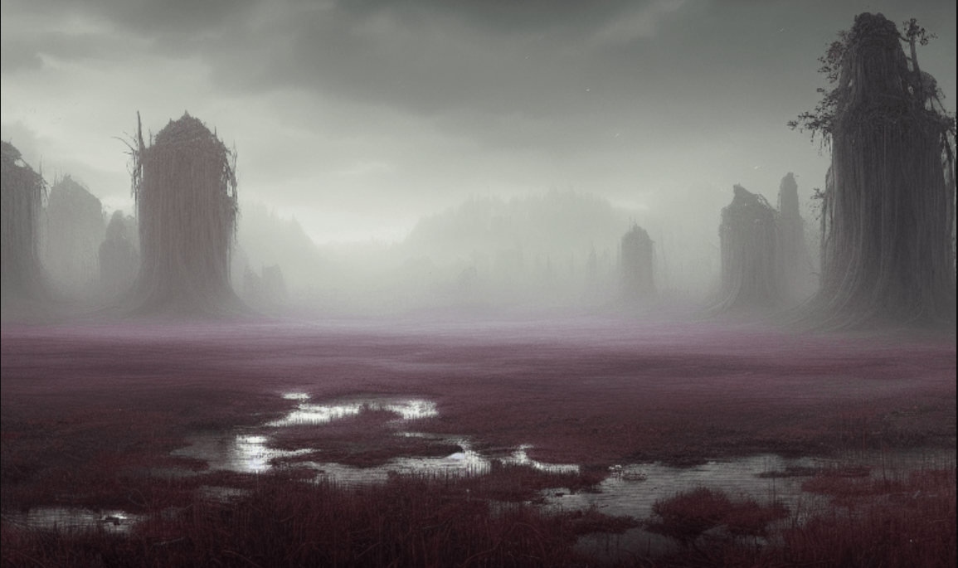
E3: The Manitoba Mining Mist
MIKE EDWARDS, the mayor of Randall, Manitoba, was looking to make a little quick money at the tail end of WWII. It seemed easy, sign off on some mining rights, turn a blind eye to the fact that the mine would make its way into a Native burial ground, and collect some cash.
When the mine, dug by a company known for its questionable methods, caves in, the Reclaimer escapes from the mine in the form of a mist. The mist seeks out those who have done wrong and causes them to violently take their own lives. Just as the town loses hope, CHIEF PROUDFOOT and a group of Native elders manage to return the mist to the cave-in site and trap it inside.
Jump to the present day, where PETE SAMPSON, a football player at the University of Saskatchewan, is looking for some easy credits to maintain his grade point average. He and several other players register for a new course called Canadian Urban Legends. The four of them find a connection to the Manitoba Mining Mist legend and following a football game in Winnipeg, they decide to visit Randall, Manitoba, and look for the mine. Once there, under the influence of a young Native spiritualist, PETE and his friends open the mine and release mist. The horrors of the past quickly return, and PETE finds himself tied into a history he never knew.

Slide 7
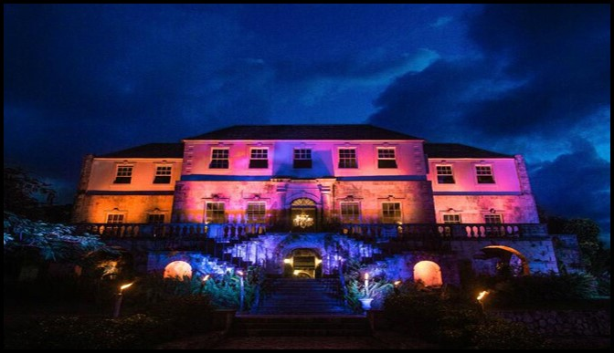
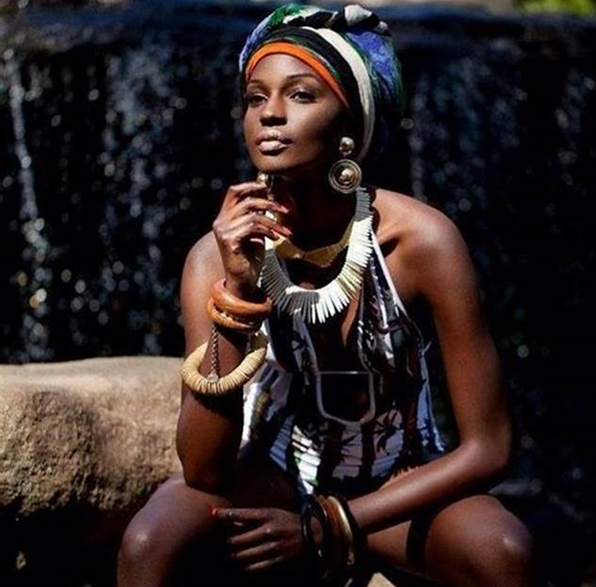
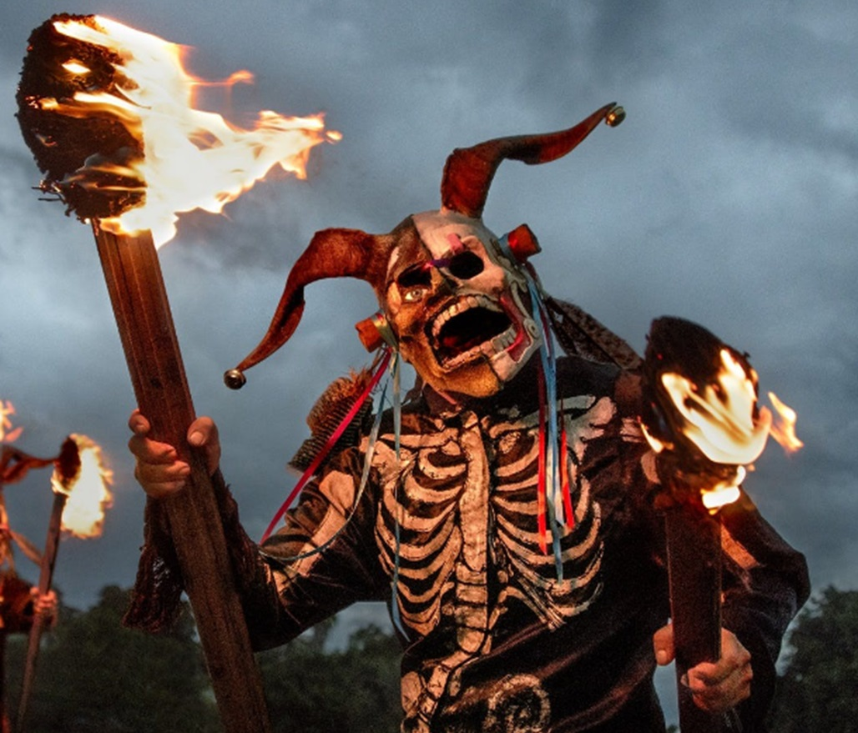
Season 2: Grindhouse Caribbean
The White Witch of Rose Hall
The Voodoo Princess of Haiti
Dia de la Morte
Supernatural tales from across the Caribbean landscape

Slide 8
E4: The White Witch of Rose Hall
ADIO is a well-known gangster in Kingston, Jamaica. Knowing that his position put him at risk, he and his right-hand man, MOBI, enter a contract with the witch great-granddaughter of the WHITE WITCH OF ROSE HALL. The contract is to resurrect either one of them if they were to be killed.
When ADIO mistakenly kills a New York main man, they are forced to call in the contract to resurrect him. The WHITE WITCH manages to bring the man back to life, but,in the process, ADIO and MOBI discover the true price of the contract.
They attempt to sneak out on the deal only to find out the true nature and power of the WHITE WITCH.

Slide 9
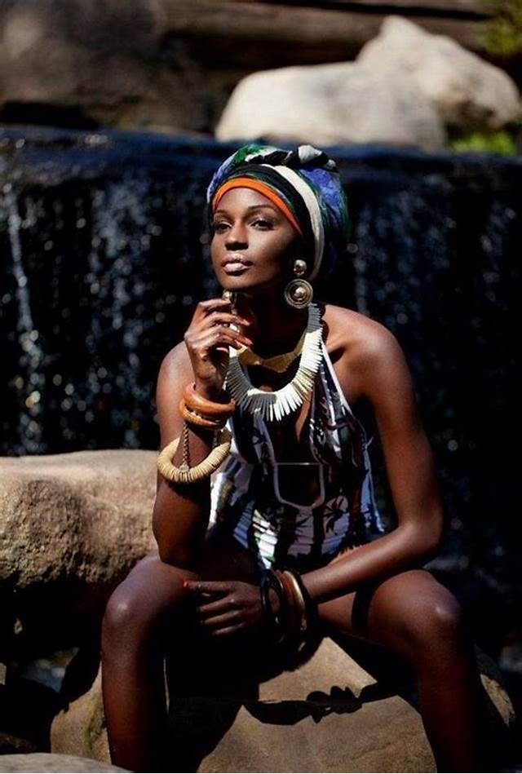
E5: The Voodoo Princess of Haiti
EDWARD WICKS is a very wealthy man. However, he is old and recognizes that his days are numbered. While on an African safari, he witnesses a voodoo priest resurrect a dead lion. From that point, he decides to move his business and himself to Haiti. Once there, he hunts for a Voodoo princess who can assure bringing him back from the dead when his time comes. When PRINCESS SHANTI resurrects a goat in front of him, he knows he has found his savior.
EDWARD enters into a contract with PRINCESS SHANTI and sets her up with a house on his estate. As EDWARD’S health begins to decline, PRINCESS SHANTI brings him an offer. Not only will she bring him back, but she can bring him back younger. The price, she tells him, is another human life. In a moment of weakness and desperation, he accepts.
Eventually, his day does come, and as agreed, PRINCESS SHANTI brings him back to life. He soon finds himself getting younger and younger. Worse, PRINCESS SHANTI is nowhere to be found. He finds himself alone, facing a fate he wants nothing to do with.

Slide 10
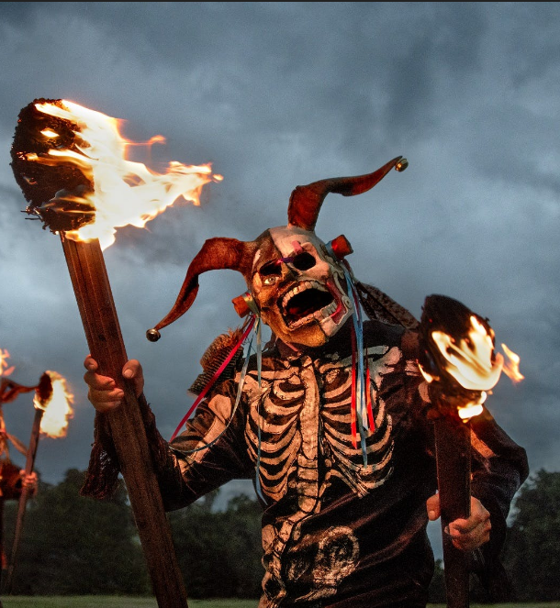
E6: DIA DEL LA MORTE
WILLY DIAZ is as tough as they come. Born and raised on the hard streets of a poor neighborhood just outside Mexico City, it isn’t long before he finds himself working for the Cartel. He is eventually given a gift following years of loyal service. He is made block captain on a lucrative stretch of 5th Avenue in Playa Del Carmen. Once there, he marries, has a daughter, and settles into a better life. One night, on the Day of the Dead, he is attacked and hung by a rival gang. His daughter wakes, and with the help of the Alux, they resurrect WILLY.
The next day, WILLY has no idea what happened, and worse, people around town are calling him The Resurrected. The story reaches the heads of the Cartel, and he is invited to a meeting where he is asked by a Cartel leader to provide him with the ability to survive death. Under pressure to serve the cartel, he also finds out his daughter made a trade to save WILLY that night, a trade that may have terrible consequences. WILLY, with the help of a local Mayan priest, makes a deal with a Mayan spirit, a trade of two cartel heads to let his daughter out of her deal. The spirit takes the men while WILLY and his family escape to Tulum.
A year later, on El Dia de los Muertos, WILLY finds out that deals with spirits are not always what they seem to be.

Slide 11
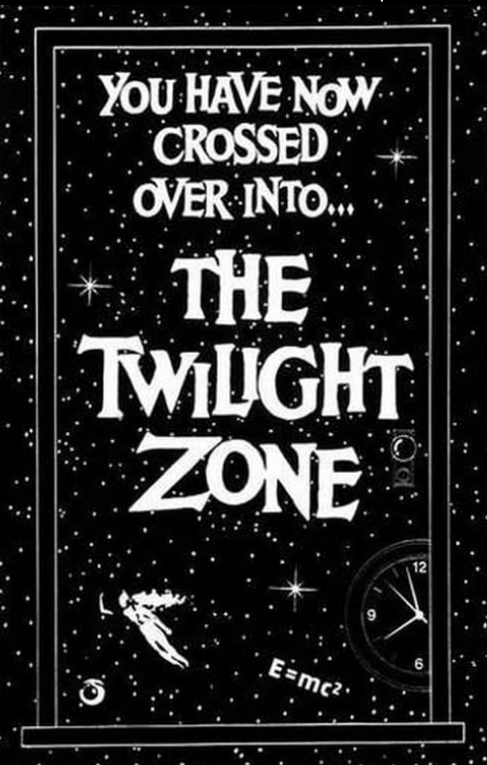
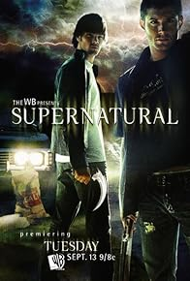
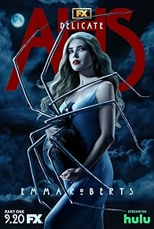
Film Comparables
The Twilight Zone, 1959 - 1964– Produced Cayuga, Distributed by CBS
Connection: The Twilight Zone was the innovator in creating a series of spooky tales that crossed the boundaries of Fantasy, Science Fiction, Thriller and horror.
Supernatural, 2005 - 2020 – Produced by Kripke, Distributed by The WB TV Network
Connection: Supernatural picked up The Twilight Zone theme and modernized it. They added the concept hunting demons and being hunted by demons.
American Horror Story, 2010 - 2022 – Produced by FX , Distributed by Walt Disney
Connection: American Horror Story brought more of a miniseries concept to the Genre and added a little more darkness.
Creepshow, 2008 – Produced by United Films, Distributed by Warner Bros
Budget: $8M USD Gross: $21M USD
Connection: The Stephen King and George Romero tongue in cheek comic book-oriented classic was one of the influences for my Grindhouse book series.

Slide 12
Why Invest in The Tales from the Grindhouse
Horror Consistently Ranks as the Top in ROI amongst Film Genre
2023 showed a 173% ROI according to the Kaggle The Movie Dataset.
A popular place to invest given the growth of horror streaming platforms.
The Series is Highly Compelling
Multi award winning scripts based on two published novels by a best-selling author.
A series of slow burn classics built on urban legends and native spirits.
Reminiscent of old-school classics such as The Twilight Zone and The Outer Limits.
Cost Efficient Production Plan and Positive ROI Forecast
Leverages the efficiencies of the Canadian film industry and the Canadian Dollar.
Leverages the Canadian tax credit and grant infrastructure, the Canadian trilogy is grant friendly.
Canadian Centric Stories. People and Locations in the Canadian Trilogy
The actors, crews and locations will be primarily Canadian.
Highlighting Canada incredible landscape and the skills of our people.
The series to include Native Canadian content, actors and resources.

Slide 13
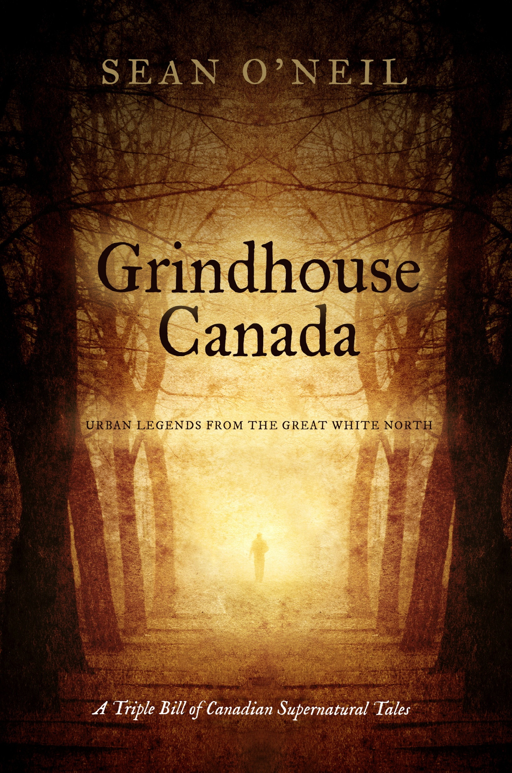
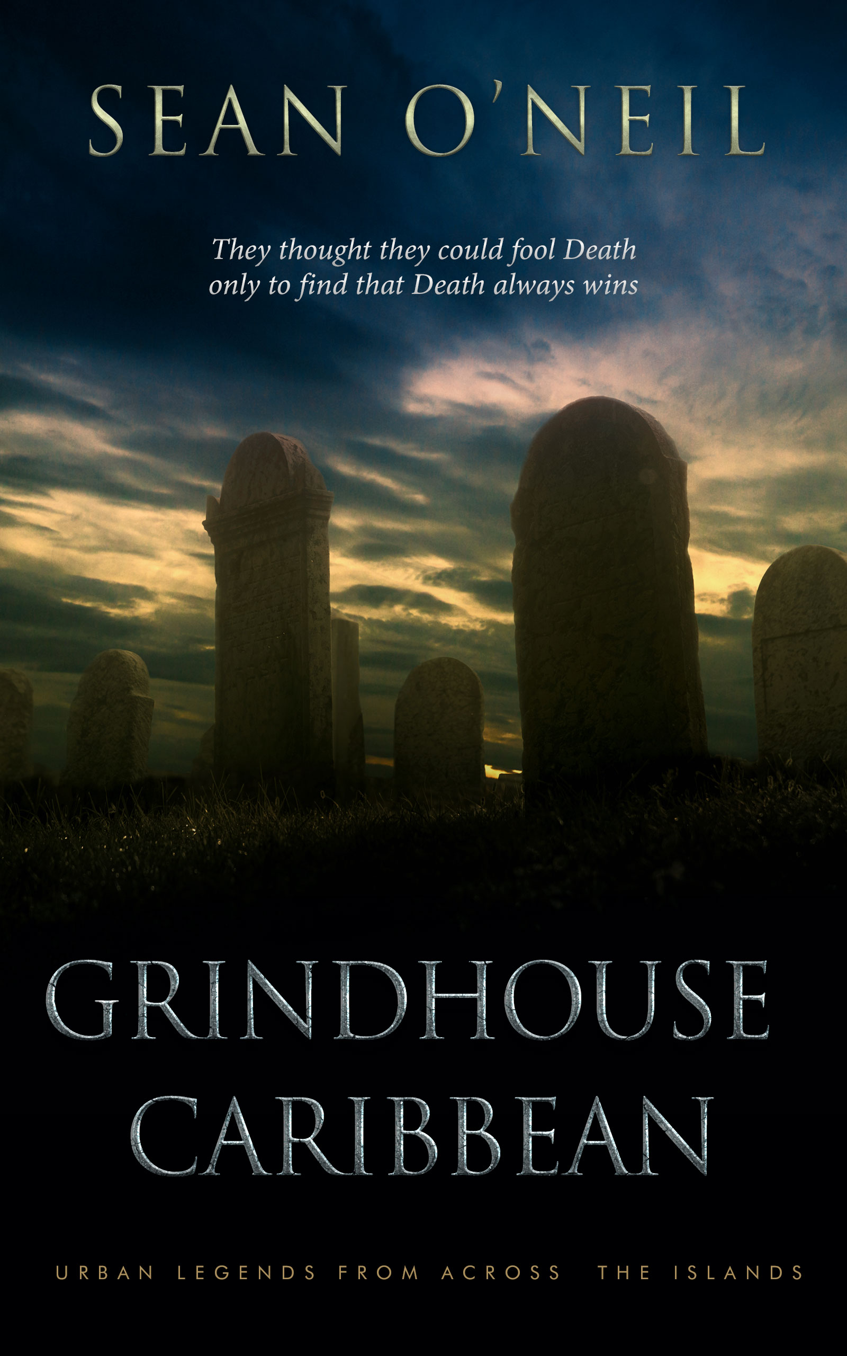
The series is based on two novels from best-selling author Sean O’Neil

Slide 14
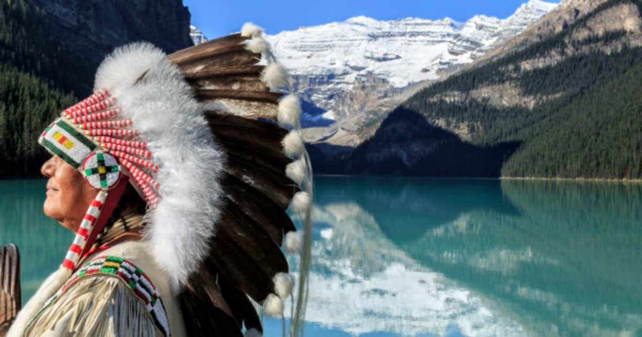
Honoring our First Nations people
The story pays homage to the history and talents of Canada’s First Nation people.
Highlights the incredible link between the First Nations people to both nature and the spiritual world.
The film project will provide multiple opportunities for First Nation actors, crew and supporting businesses.

Slide 15
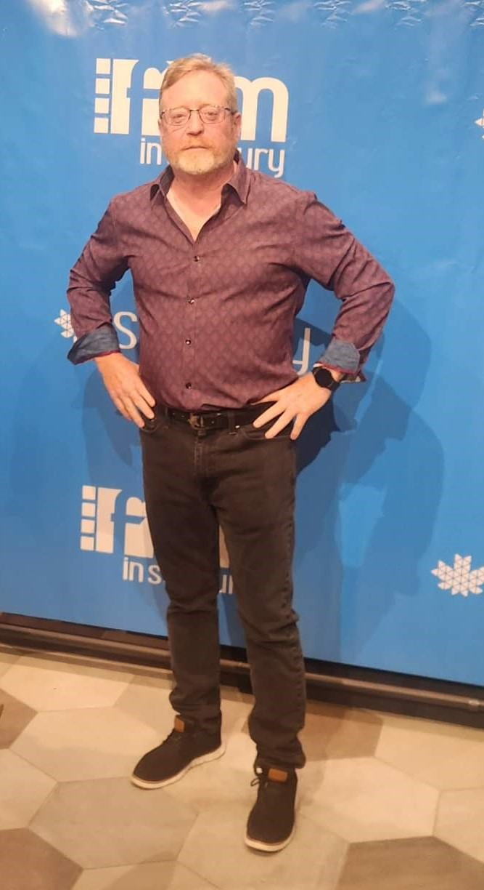
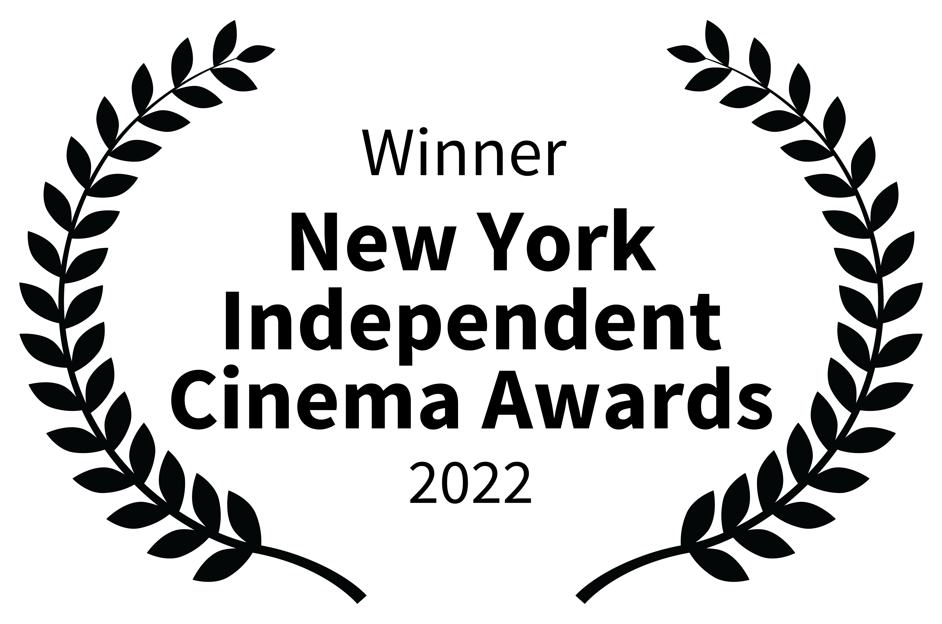
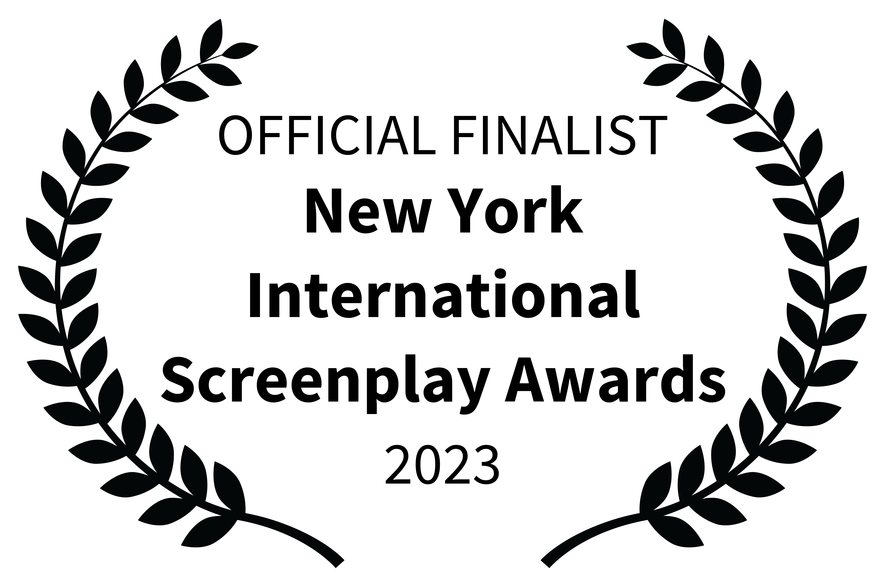
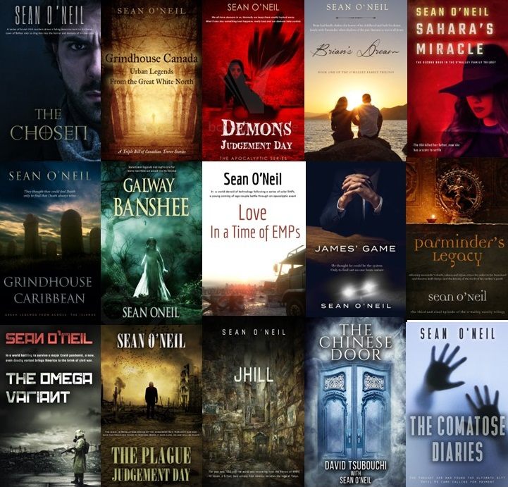
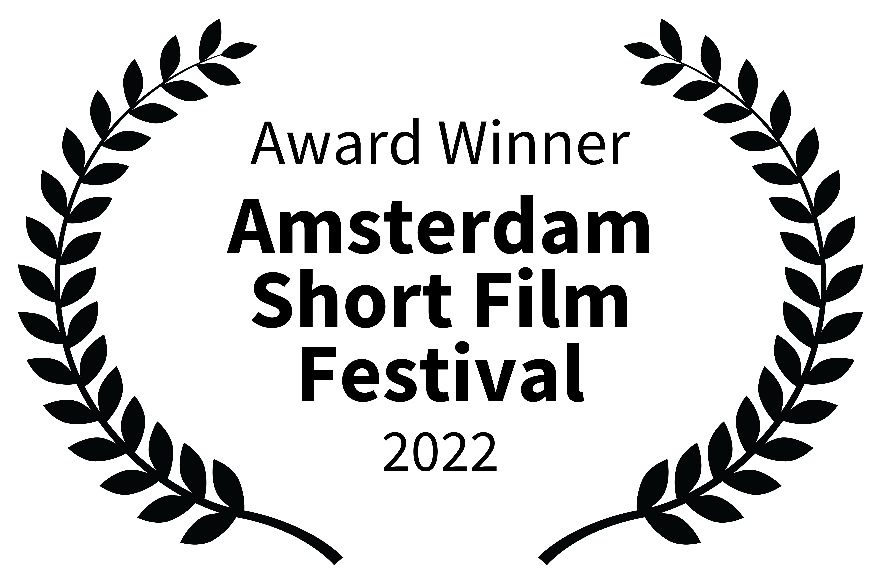
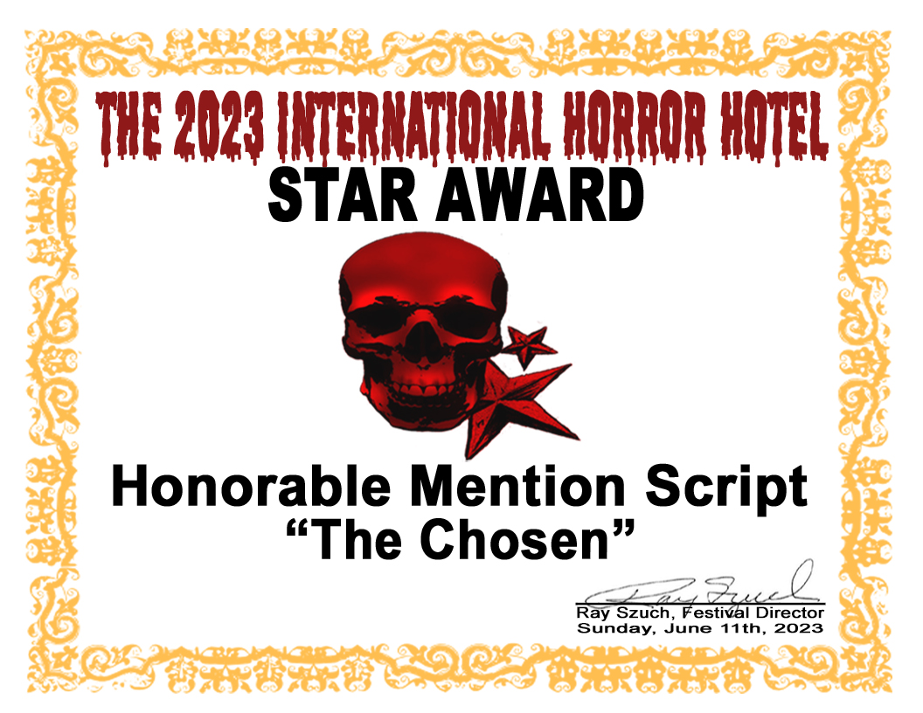
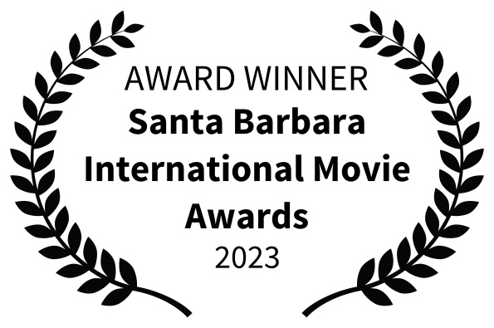
About the Creator
Sean is a Toronto based, best-selling author and award-winning screenwriter. He has published fifteen books to date and is known for his quick-paced thriller style. On the film front, he has penned seven film scripts and has three active film projects.
Recent Screenwriting Awards and Recognition

