Slide 1

Traya Hospitality
Make Your Moment Perfect

Slide 2
AB UT US
Traya Hospitality is a Finest hospitality company founded on the principles of excellence, authenticity, and heartfelt service.
With over five years of hands-on experience in the hospitality industry, we bring a deep understanding of what it takes to deliver not just events, but unforgettable experiences.
At Traya, we specialize in weddings, luxury celebrations, and bespoke corporate events, offering end-to-end services that blend creativity with precision. From curated guest experiences and RSVP coordination to on-site logistics and concierge-level attention, our team ensures that every moment
is executed with seamless perfection.
What sets Traya apart is our people-first approach. Whether it's guests, clients, or creative collaborators, we believe that human connection is at the heart of every successful event. We listen intently, plan thoughtfully, and deliver passionately-so that every experience feels personal, elevated, and deeply memorable.
With Traya Hospitality, you're not just planning an event-you're crafting a story that will be cherished for years to come.

Slide 3
The Literal Purpose
Behind Work
Vision
Develop into a healthier, more sustainable world-class hospitality company.
Mission
Create a "Basket of Joy" for guests.
Create a joyful and progressive environment for employees.
Create a constant trust.
Core Value
Professionalism, Care & Compassion, Guest-Centricity & Service Excellence, Agility, Respect, Integrity & Ethics.

Slide 4


UR SERVICES

Slide 5
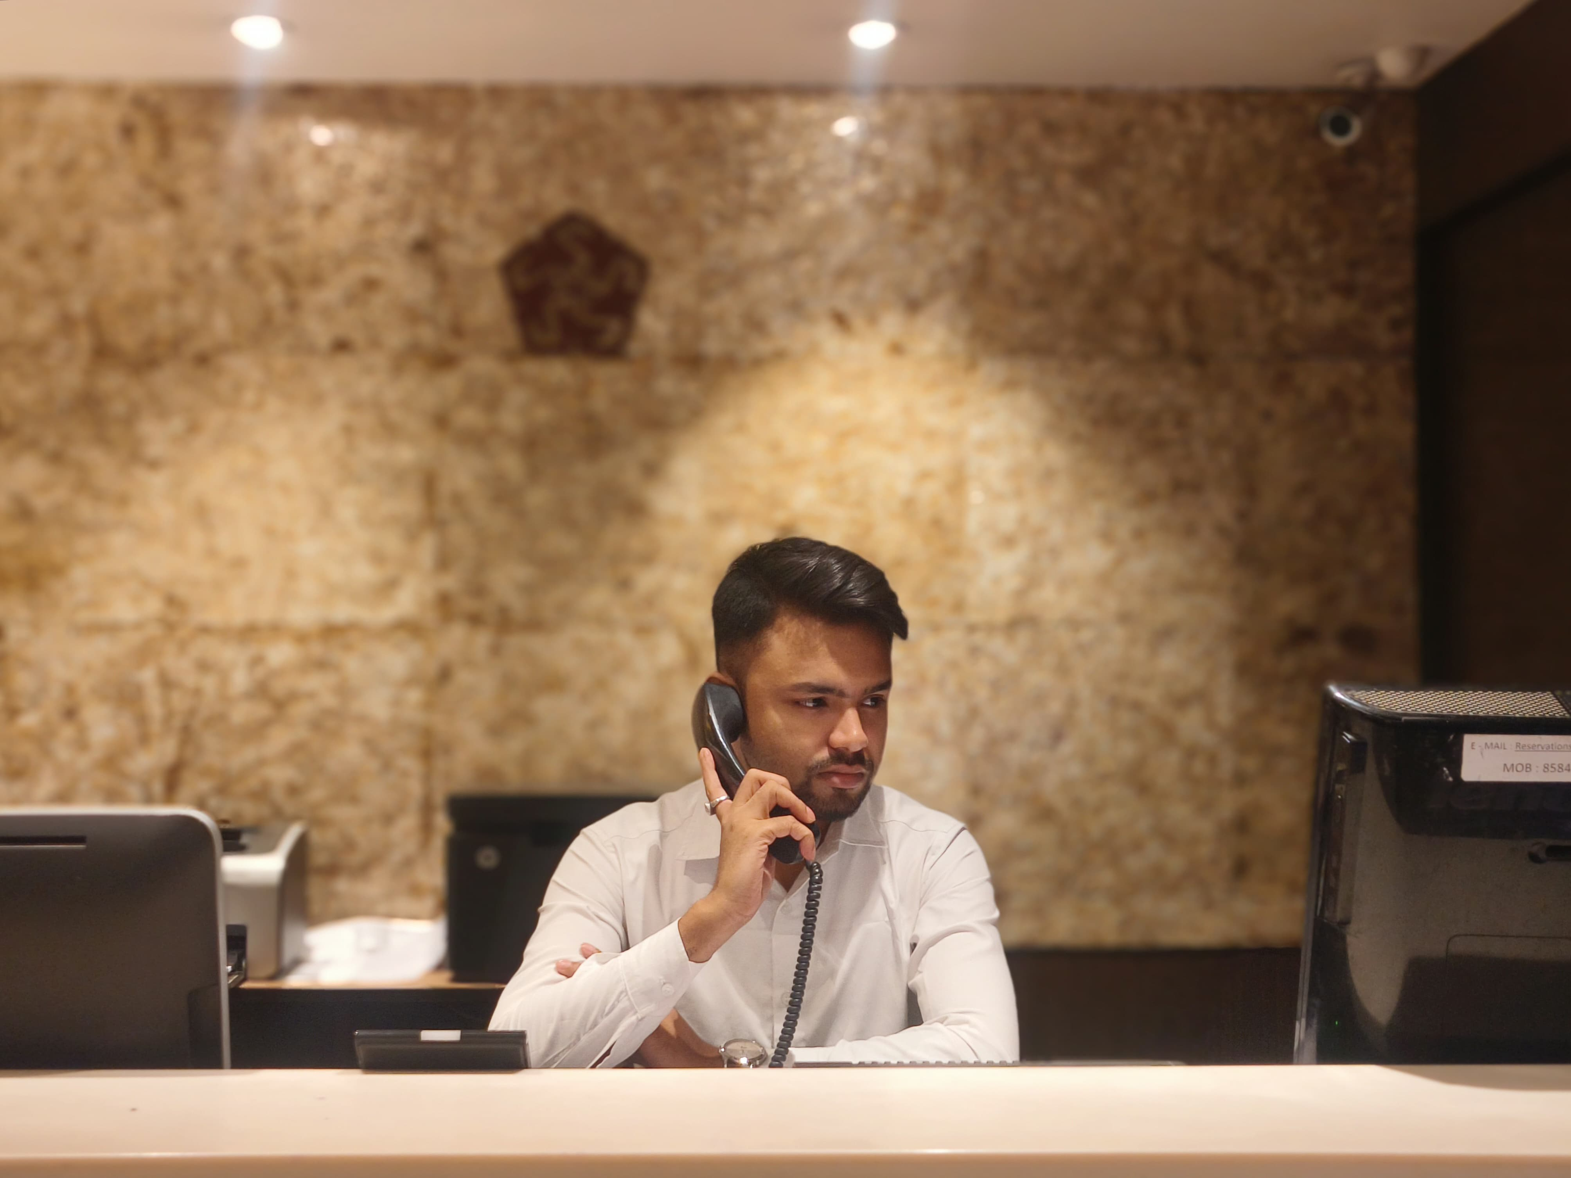
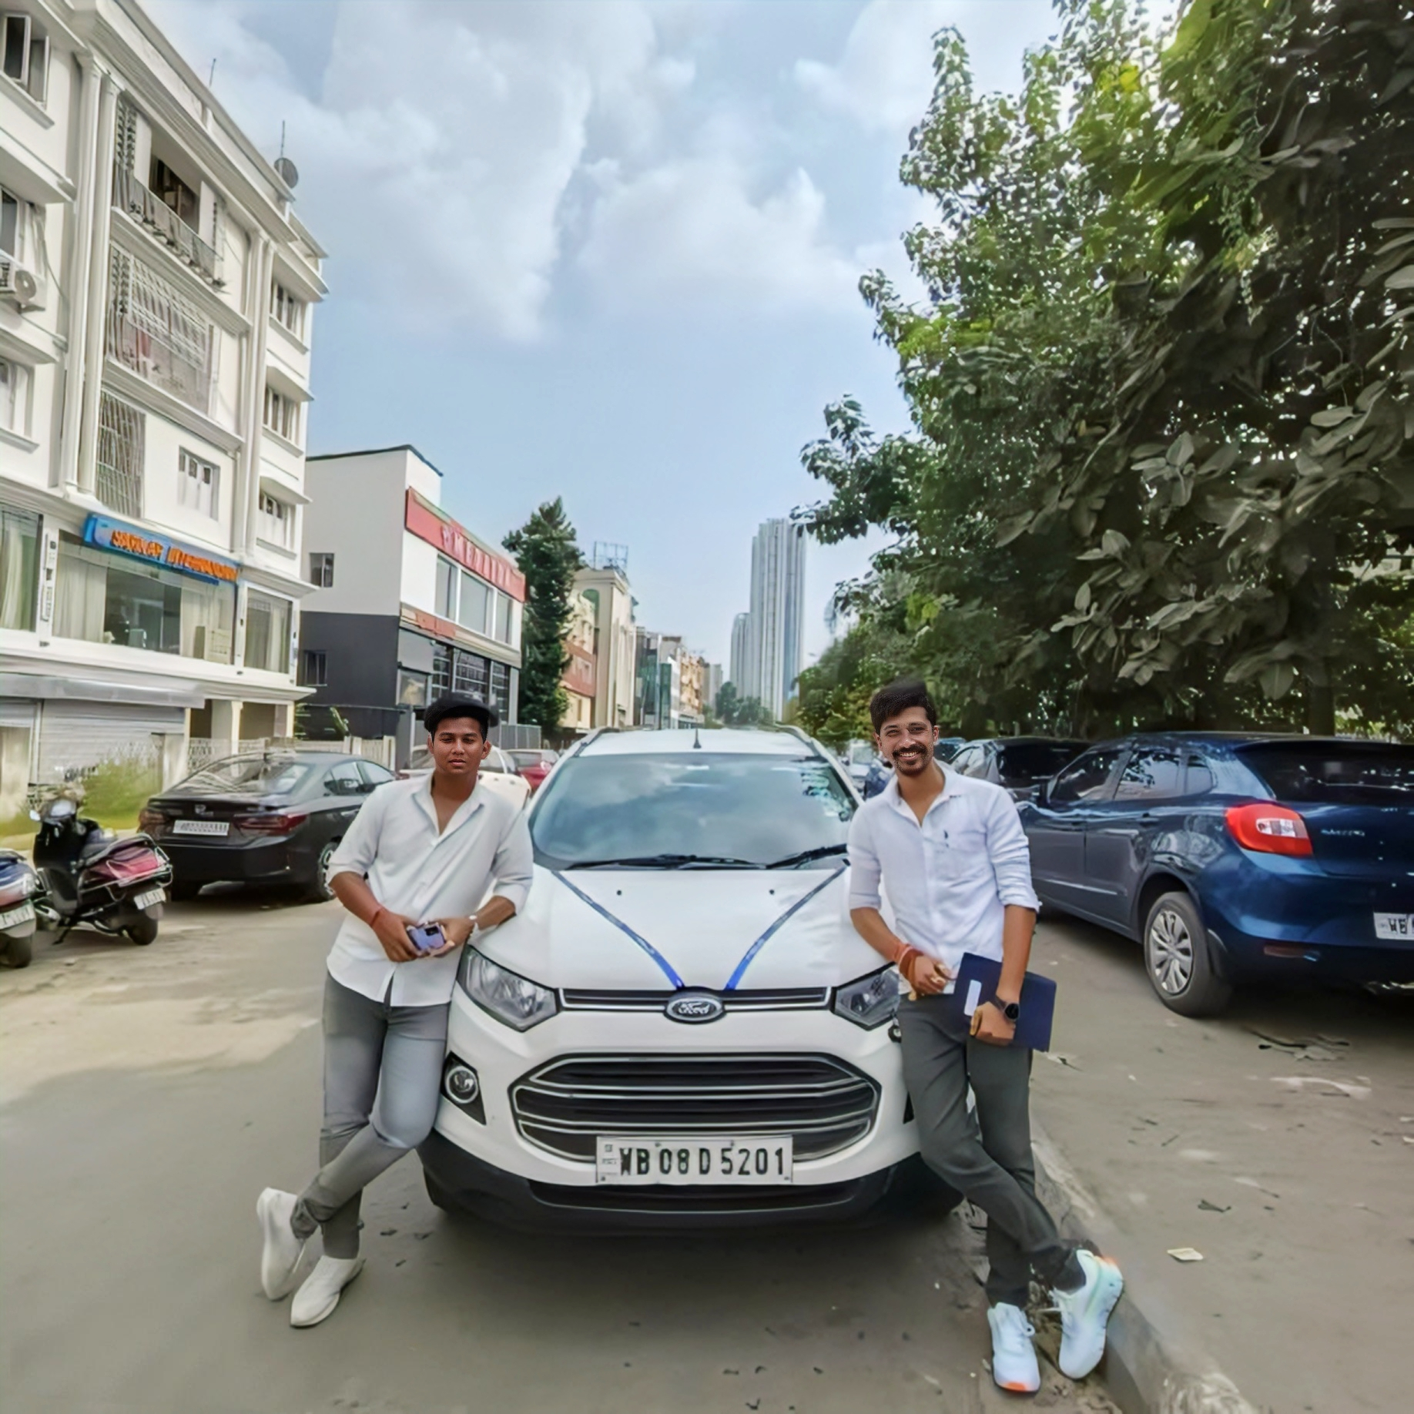
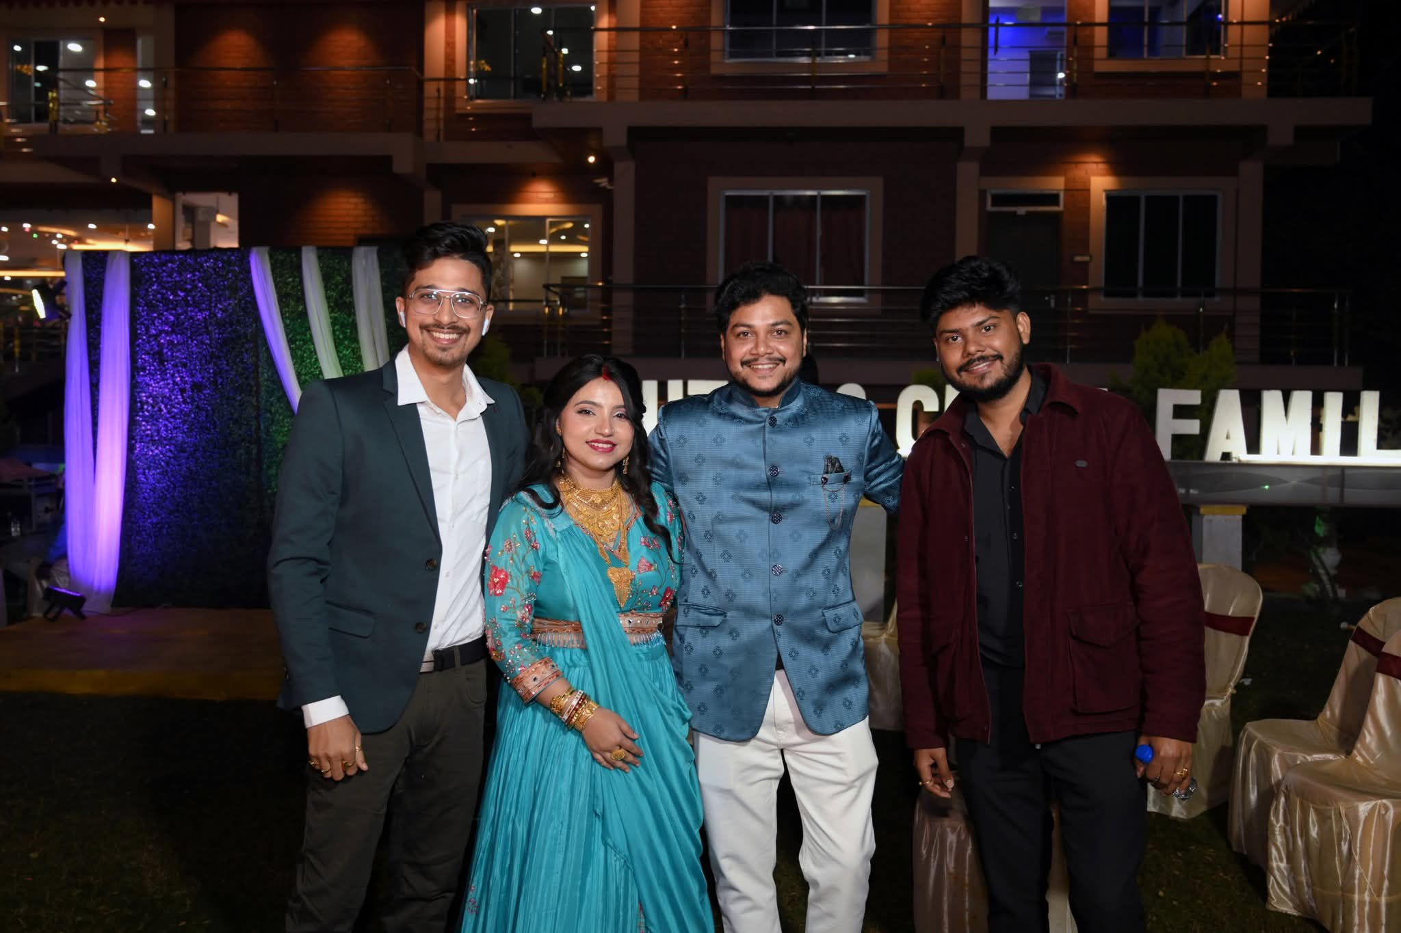
RSVP Calling
The planners behind the precision! From guest lists to travel details, this team ensures every plan and preference is flawlessly managed. Their behind-the-scenes coordination guarantees each guest arrives informed, expected, and warmly welcomed.
Logistics
The invisible force turning vision into reality with flawless precision. From venue layouts and vendor coordination to guest transfers and transport tracking, they handle every detail seamlessly. With accurate movement management and real-time monitoring, they ensure zero delays and total comfort. Post-event, a detailed Excel report offers full transparency and easy reference.
Guest Assistance
The smiling faces behind every smooth experience! From guiding guests to resolving queries, this team ensures everyone feels welcomed and cared for. With warmth and attention to detail, they turn hospitality into a personal, memorable touch.

Slide 6

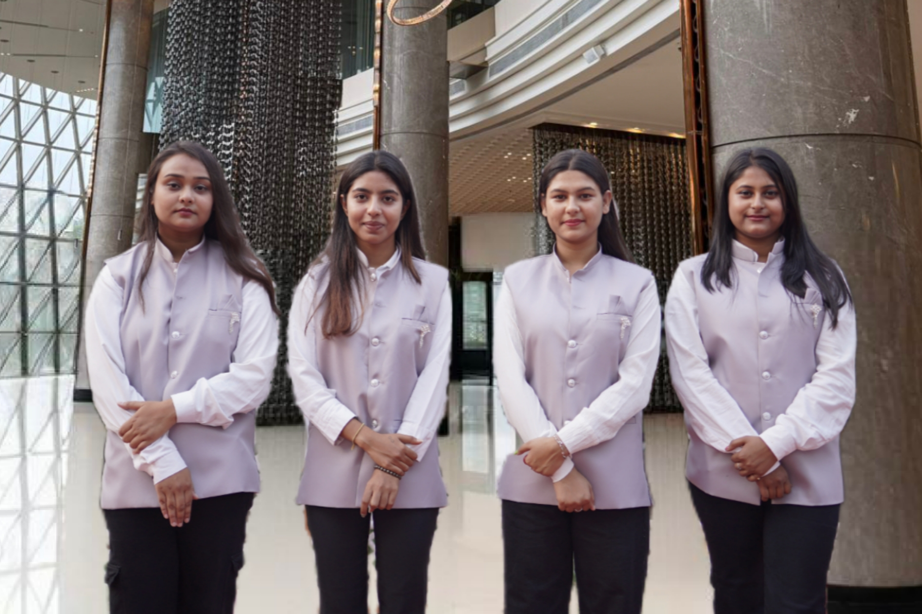
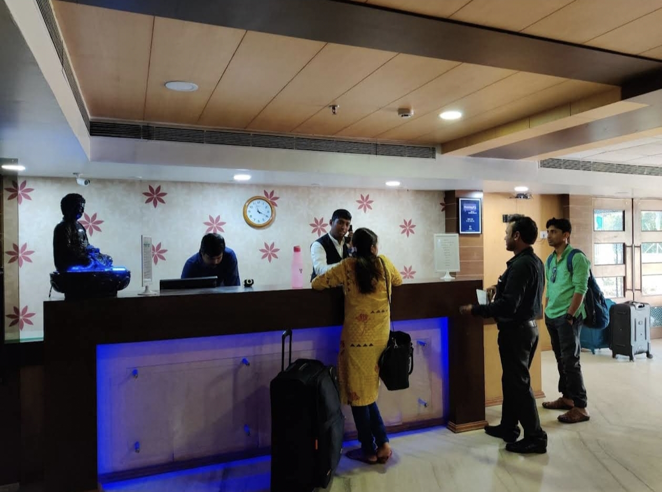
Arrivals & Pickups
The first touchpoint of every guest's journey! From tracking flights to smooth pickups, this team ensures timely, stress-free arrivals. With sharp coordination and a warm welcome, every guest feels special from the moment they arrive.
Concierge Services
The ultimate problem-solvers and go-to guides! From handling special requests to last-minute travel and luggage needs, this team ensures every guest's experience is smooth and personalized. With calm efficiency and a smile, they turn chaos into comfort..
Check-Ins
The first and last impression of the celebration! From warm welcomes to smooth departures, this team ensures every guest's journey is seamless. From room allocations to key handovers, they handle every detail with professionalism and grace....

Slide 7
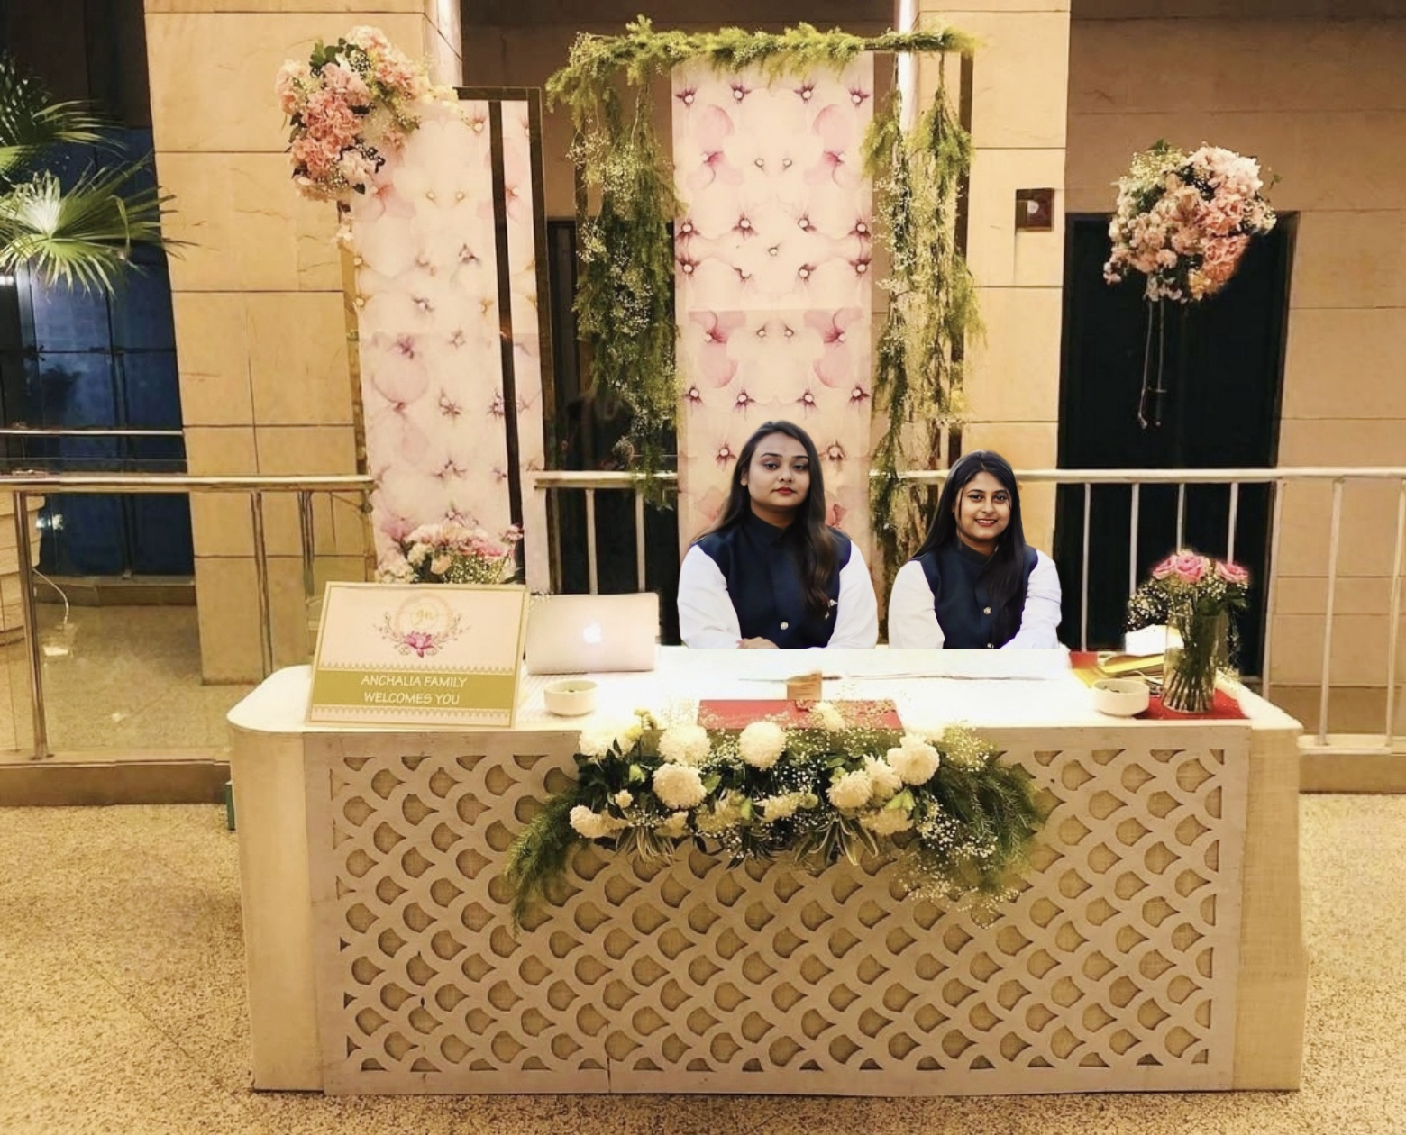
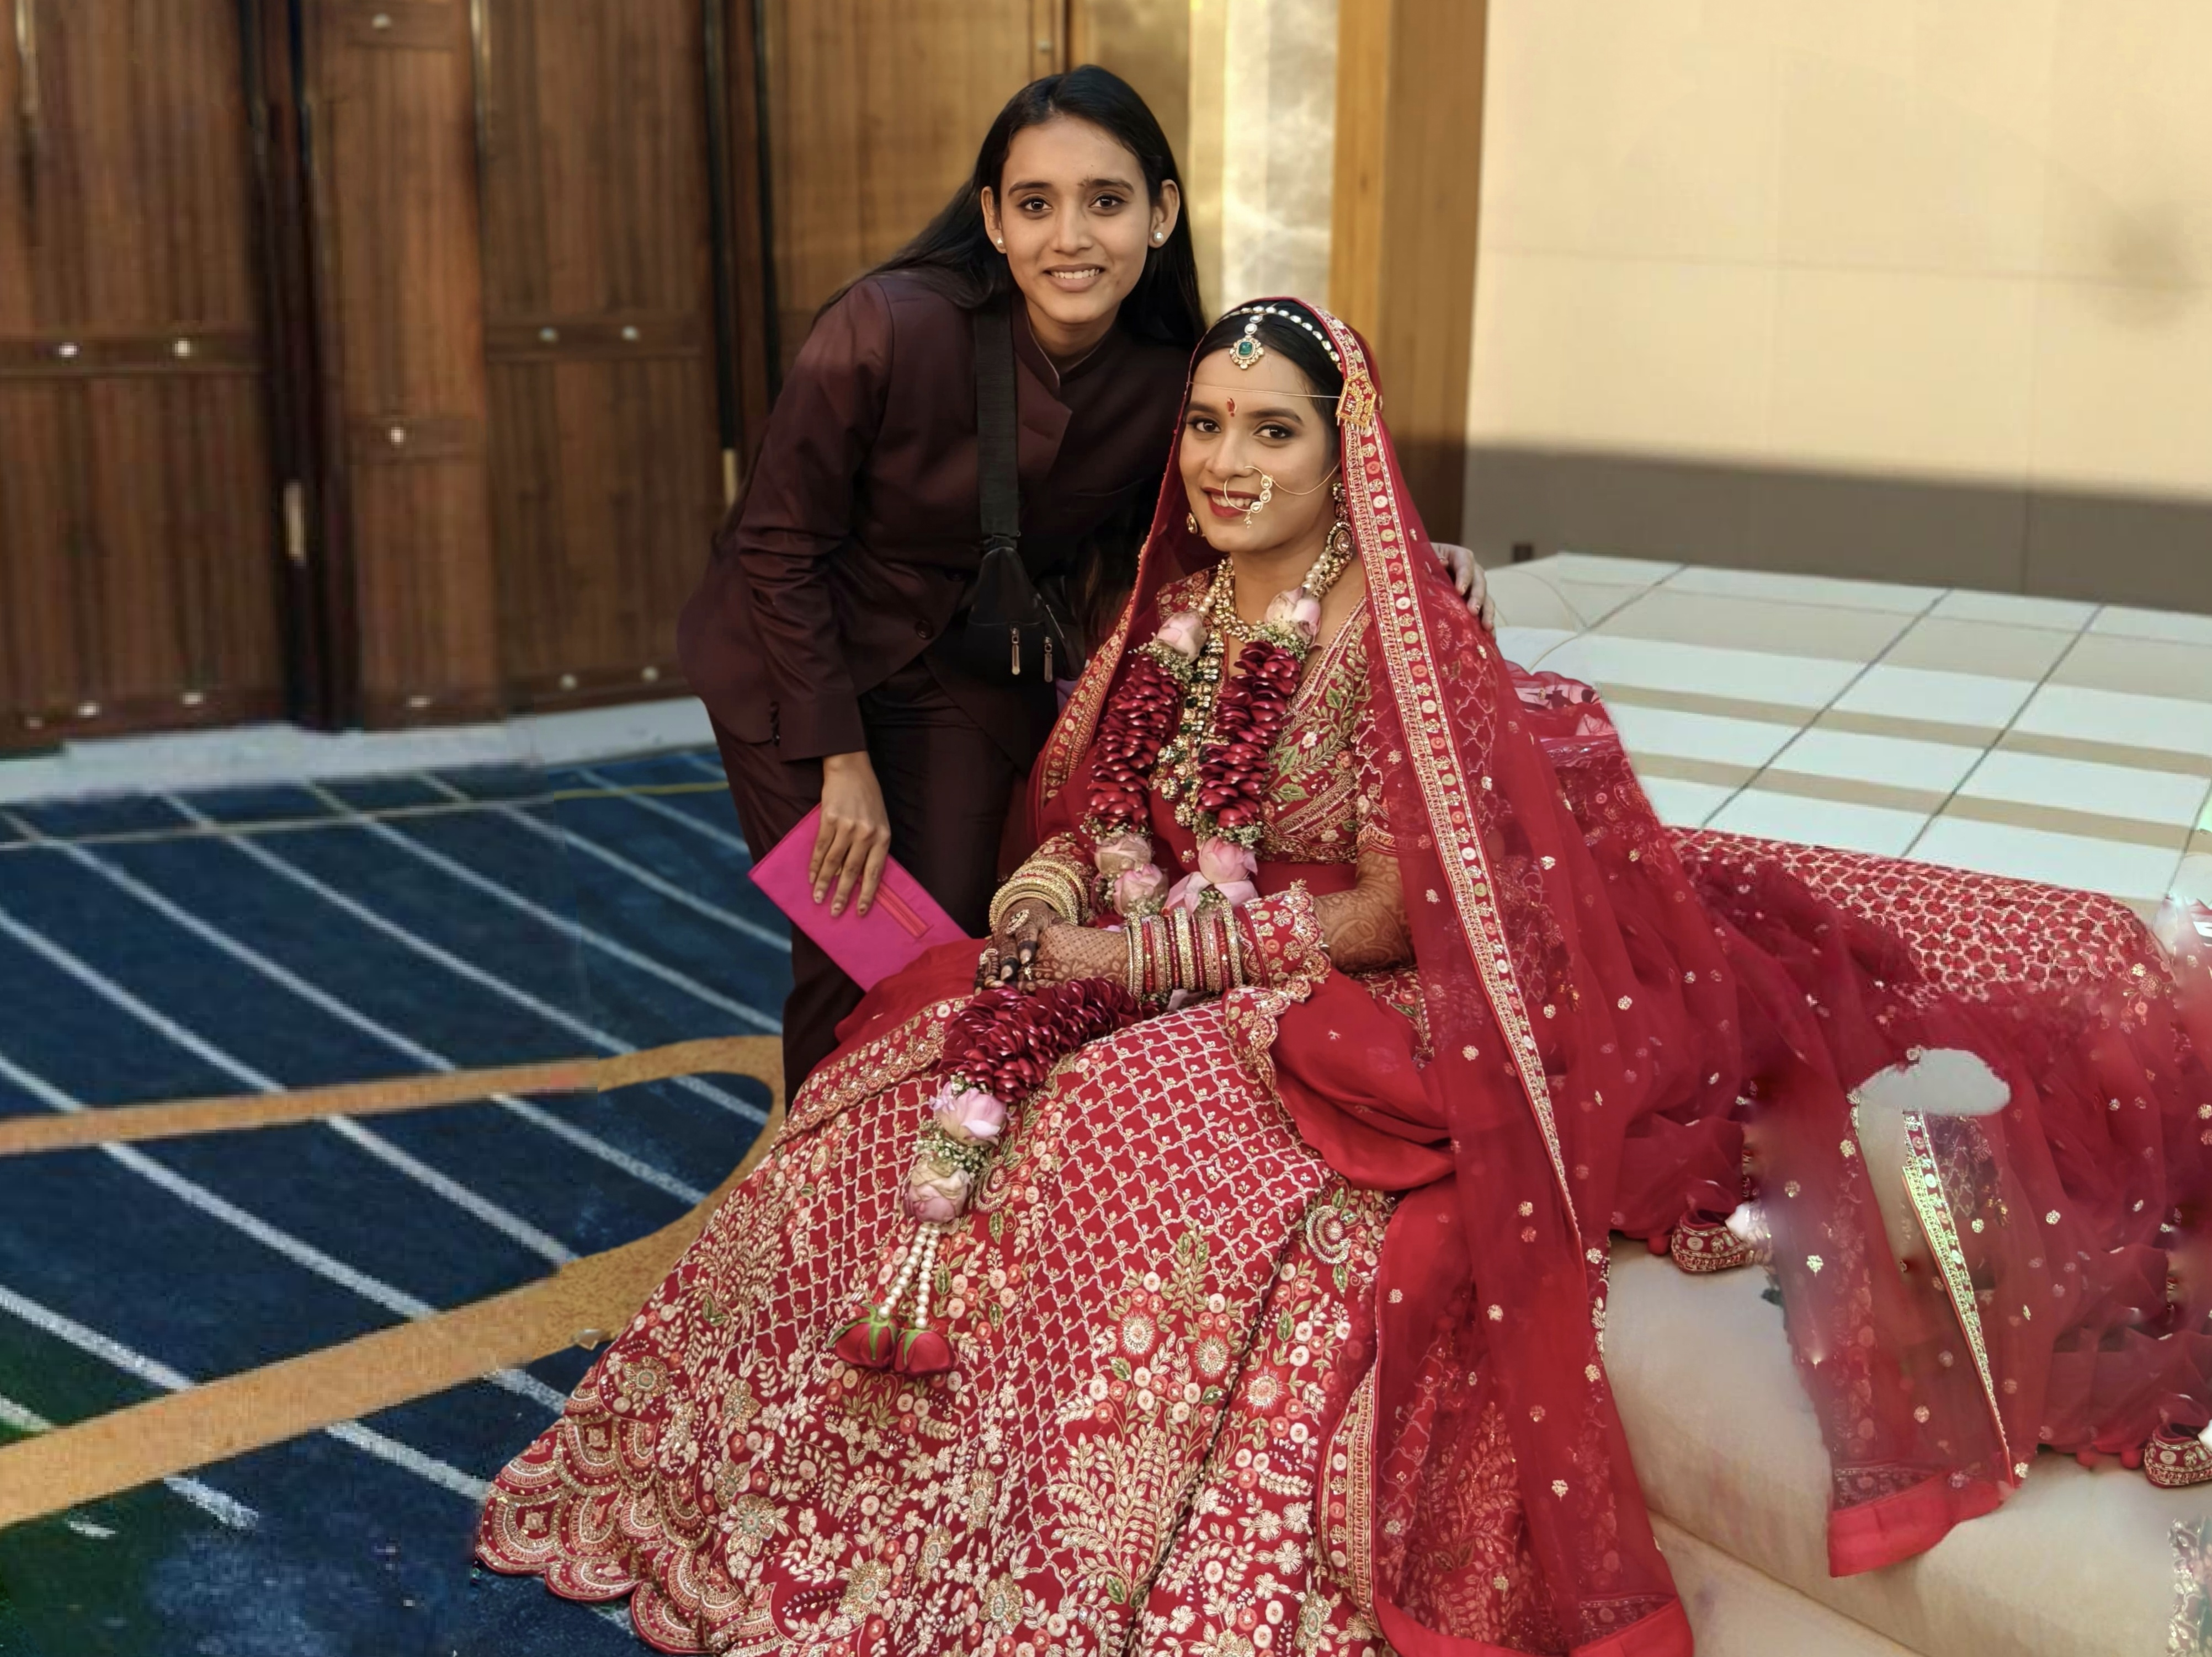
Hamper Placement
The team that turns every room into a warm welcome! With care and creativity, they deliver beautifully curated hampers, perfectly timed and presented. Their behind-the-scenes magic adds a personal, pampered touch to every guest's arrival.
Helpdesk & Room Calling
The calm voice behind every guest query! From directions to room service, this team is always just a call away. With prompt, courteous support, they turn every concern into comfort—anytime, every time.
Shadow
Personal guardians of guest and VIP comfort, this team ensures a smooth, stress-free experience. From schedules to last-minute needs, they handle it all with quiet grace, making every guest feel like royalty.

Slide 8
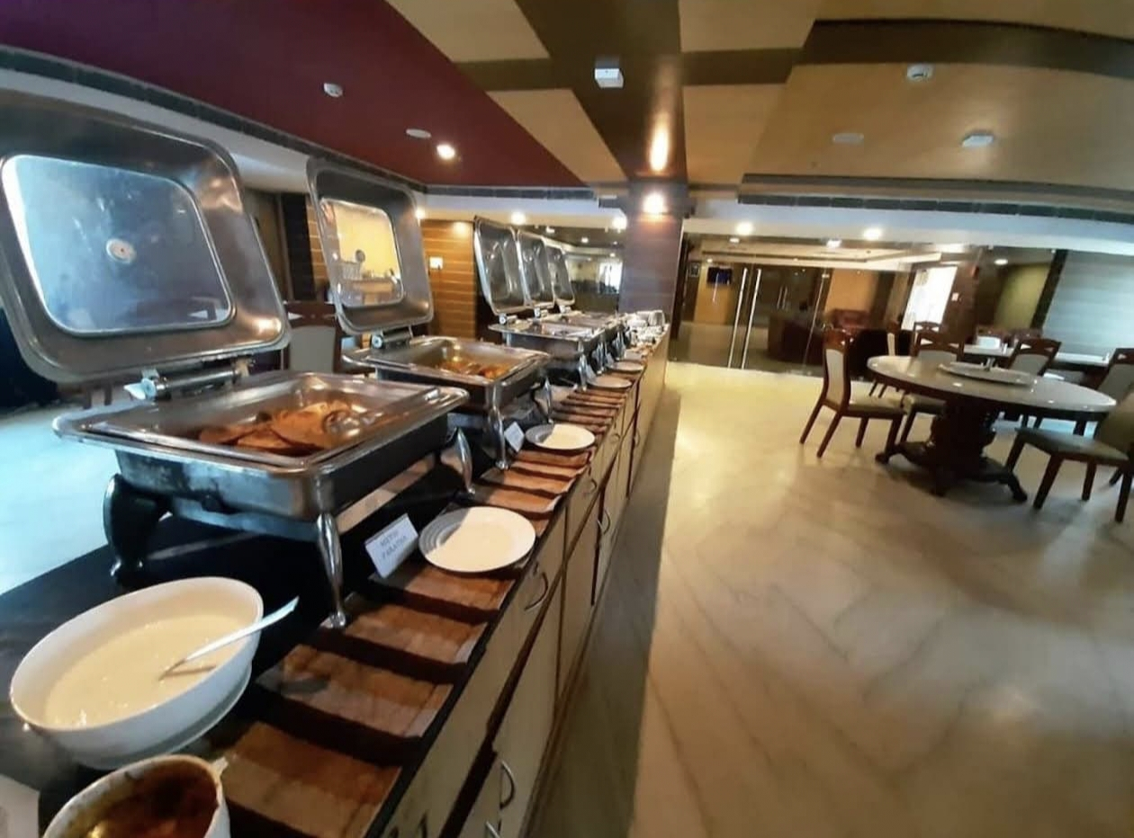
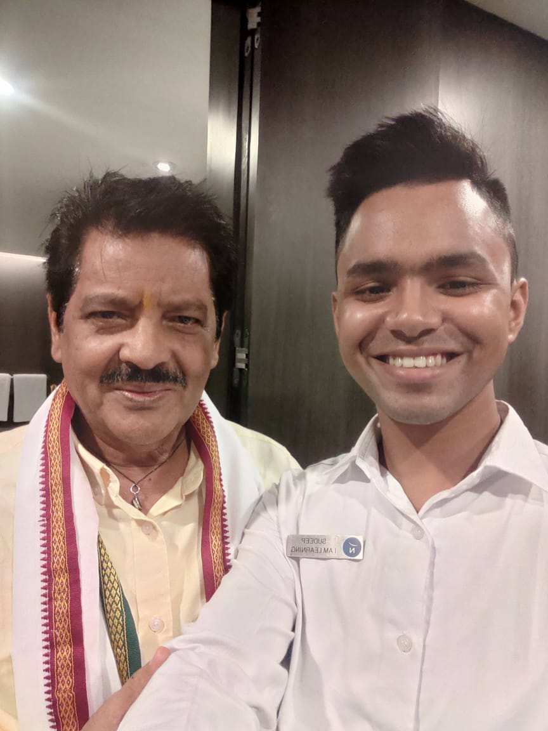
Store Management
The backbone of every seamless setup! From inventory to timely deliveries, this team ensures every item—from décor to guest amenities—lands exactly where it should. With sharp planning and dedication, no detail is ever out of place.
Food & Beverage
The masters behind every memorable bite and sip! From grand buffets to midnight snacks, this team delivers flawless service with flavor and finesse. Their passion and precision turn dining into a true celebration experience.
Artist Management
The silent force behind every show-stopping performance! From artist logistics to stage cues, this team ensures flawless execution with sharp planning and round-the-clock support—so every moment shines just right.

Slide 9
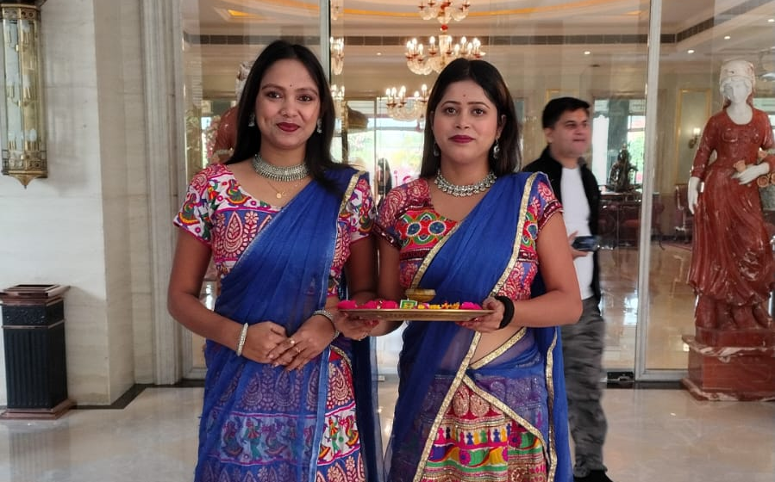
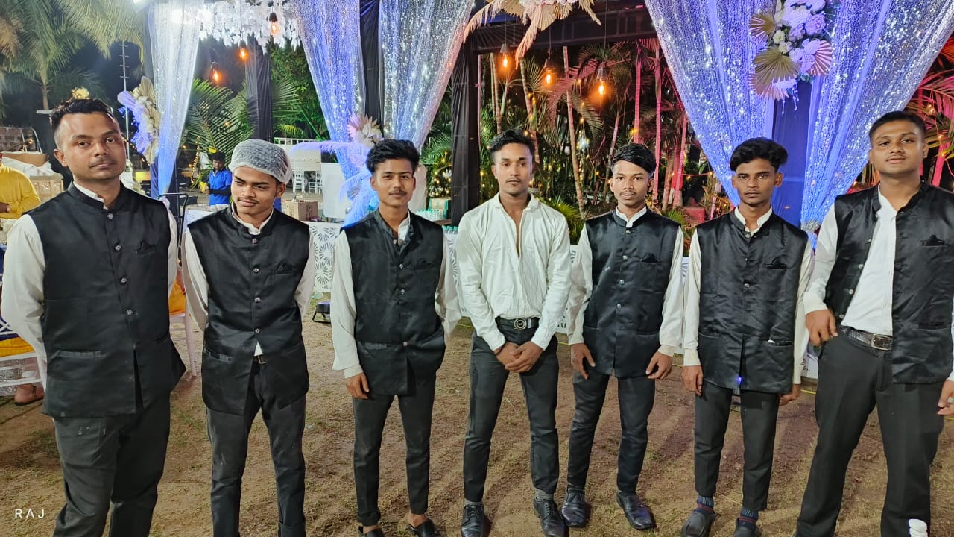
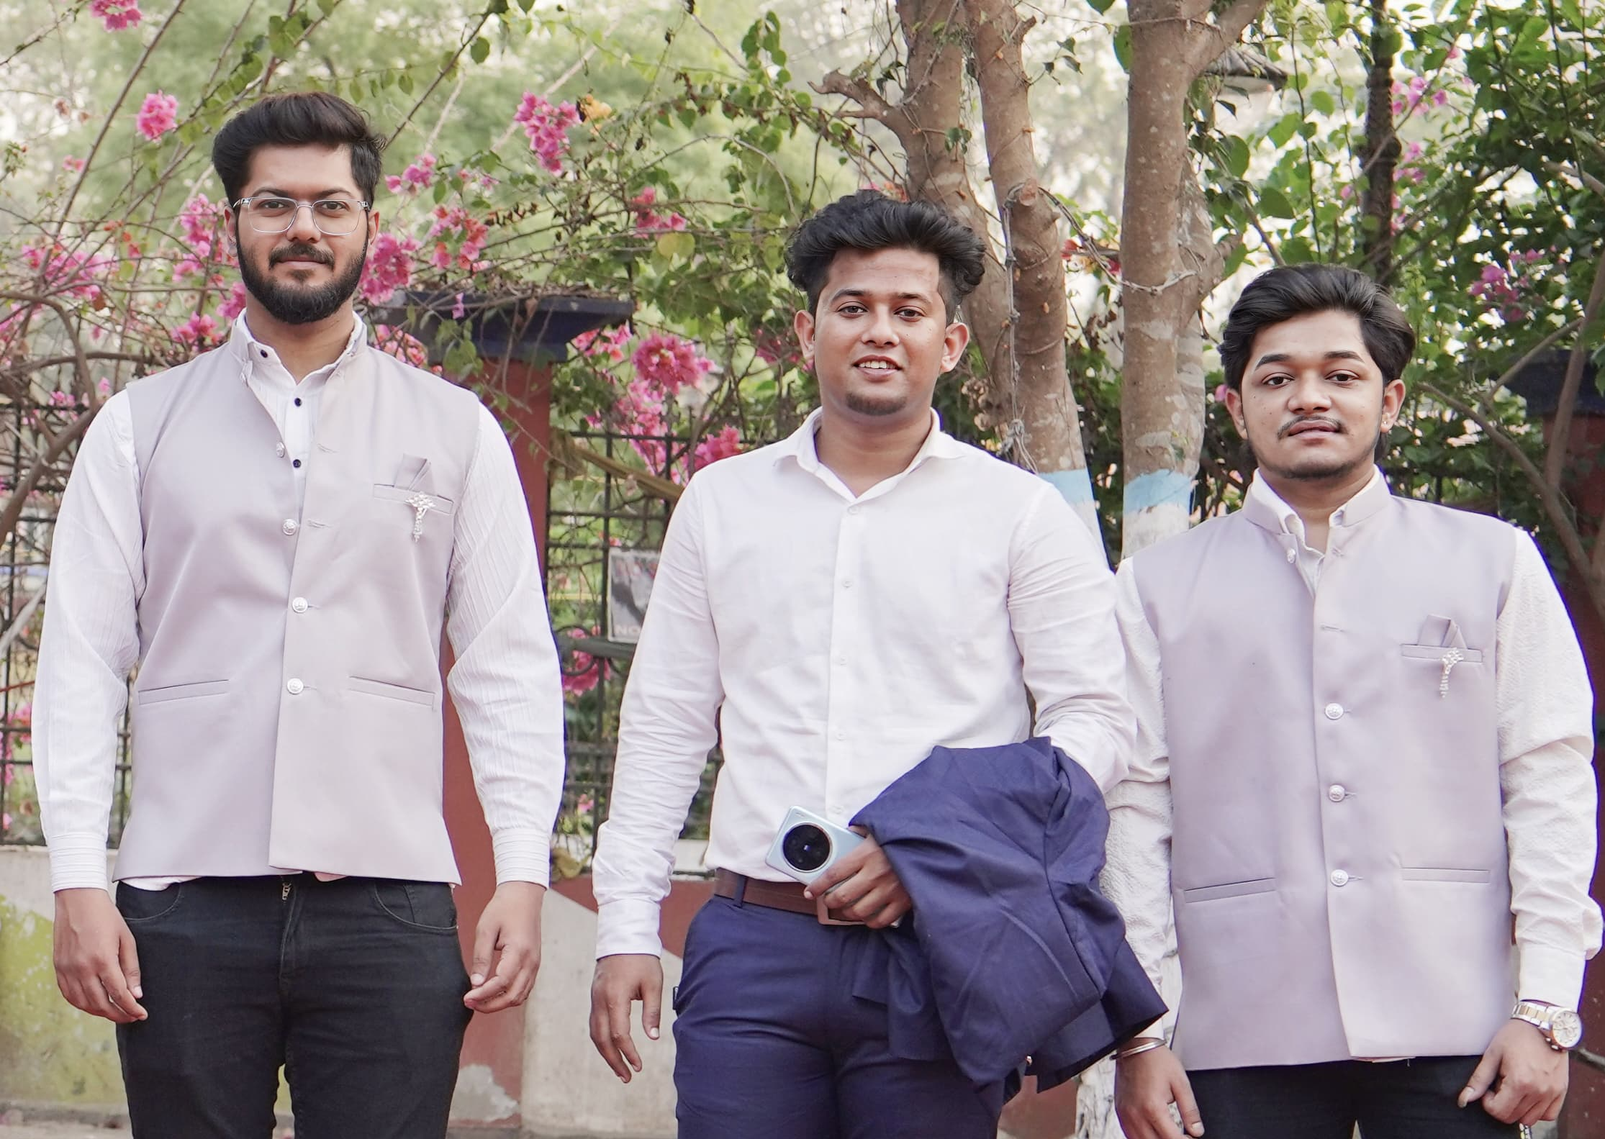
Greeting Team
The graceful hosts of first impressions! With warm smiles and attentive care, they welcome every guest with charm and ease—setting the perfect tone for a memorable celebration.
VIP Suite Service Steward
The elite team behind flawless VIP service ! Trained to perfection, they deliver every dish and drink with grace, discretion, and precision—ensuring all guests feel truly valued every moment
Runners & Porters
The silent movers behind the scenes! From luggage to supply runs, this dedicated team keeps everything flowing smoothly. With strength, speed, and precision, they ensure every detail is in place—making the celebration seamless and stress-free.

Slide 10
T
What Makes
raya Hospitality
he Right Choice
More Comfort, Less Cost
Expect top-notch service that’s truly worth the cost.
Strong Work Ethic
You matter most to us, and we work hard to make sure you feel in every interaction.
Seamless Team Coordination
Our team built through in-person interviews with individuals who truely love what they do.
Commitment to Excellence
Efficiency is our trademark, our clients feedback reflects it..

Slide 11






Contact Us :-
+91 7365825866
+91 8695901050
+91 8240369140
2nd Floor_FL - A, (Old 57) New 73 PC.Panchanontola Mandir, Ghosh Road, LP - 64/11/3, Kol - 48, Block E, Lake Town, South Dumdum.
facebook.com/Traya.hospitality
instagram.com/traya.hospitality
contact@trayahospitality.com
+91 7365825866

Slide 12
Traya Hospitality
Thank You
Make Your Moment Perfect

