Slide 1
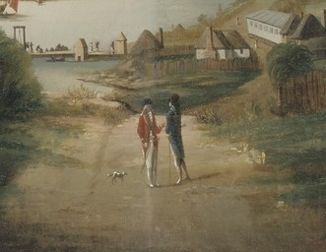
Class in a Convict Society
Gary L. Sturgess
Colloquium on the Convict System & Early Colonial Society
Sydney, 14-15 March 2025

Slide 2
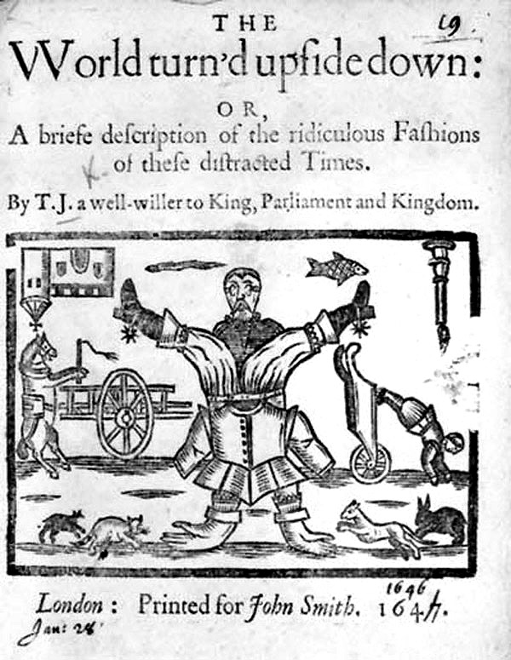
A World Turned Upside Down
If buttercups buzz'd after the bee,
If boats were on land, churches on sea,
If ponies rode men and if grass ate the cows,
And cats should be chased into holes by the mouse,
If the mamas sold their babies
To the gypsies for half a crown;
If summer were spring and the other way round,
Then all the world would be upside down.

Slide 3
A World Turned Upside Down
A smuggler as Commissioner of the Customs?
A swindler as Keeper of the Seals?
A pickpocket as Keeper of the Privy Purse?

Slide 4
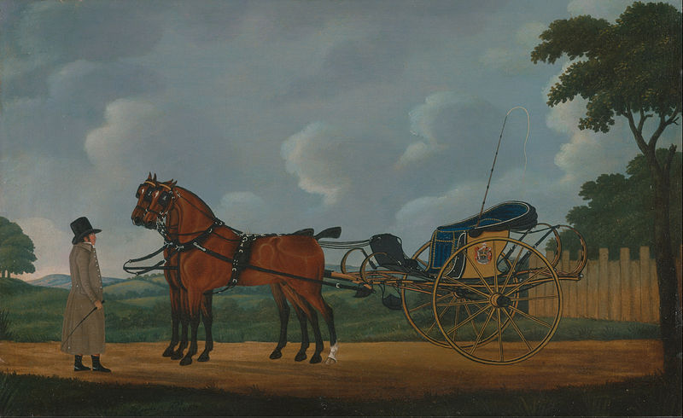
A World Turned Upside Down
The notorious Robert Sidaway – was baker for the colony, pardoned & had accumulated £500 in capital
George Barrington, the gentleman pickpocket - was High Constable at Parramatta
John Stogdale, sent out for stealing watches and jewellery – was driving around town in a curricle and pair, followed by liveried servant.

Slide 5
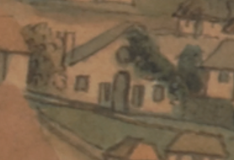
A. Equality before the Law
Men and women still serving their time were:
Giving evidence in court
Launching criminal prosecutions
Launching civil actions (Kable v Sinclair)
Cross-examining the Governor (R v Cullyhorn)
Arresting marines for breaking the law (Nightwatch)
David Collins’ house, where the magistrates sat

Slide 6
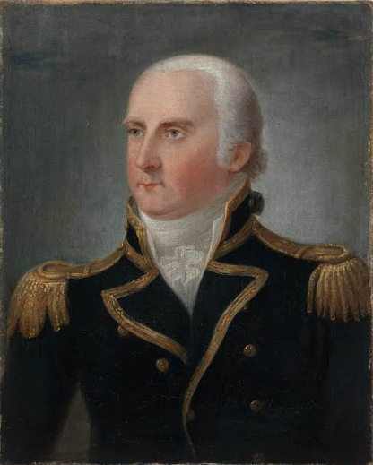
A. Equality before the Law
December 1792 – Philip Gidley King discovered that a convict had been viciously beaten by way of summary punishment. He immediately issued an order, warning that the laws of England gave the same protection to convicts as they did to the rest of His Majesty’s subjects.
He wrote in his journal that he hoped this would convince unthinking people ‘that those Objects who are sent here to Expiate a Crime, are Still entitled to the rights of humanity; Such I believe to be His Majestys most Gracious Intentions, and that of the Legislature. . .’

Slide 7
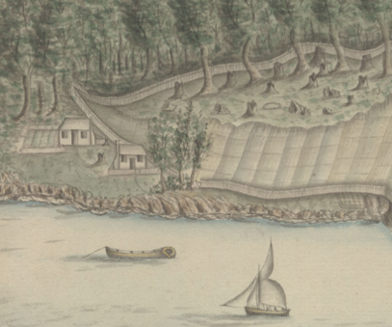
B. Creating a Sustainable Economy
Highly valued convicts - principally artisans and overseers - were granted privileges – greater freedom of movement, government-built housing, additional provisions, freedom to trade in their own time, the Governor’s leave, an early pardon.
William Bryant’s house

Slide 8
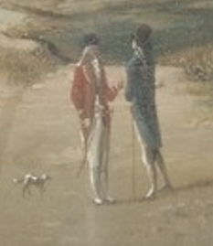
Class Distinctions in First Fleet Society
The distinction was not bond vs free:
Convicts could be disrespectful to private marines when the latter were not on duty
Convicts acting in a public capacity (overseers of gangs, &c) could speak back and get nothing more than an admonition.
It was a matter of social standing:
Insolence to one of the 42 gentlemen & 1 gentlewoman would be punished
Convicts would have been required to doff their hats in the street.

Slide 9
Case Study: Herbert Keeling
- Dogherty v Keeling -

Slide 10
Case Study: Herbert Keeling
Son of a gentleman of St James’s - ‘tenderly brought up’.
‘A man of education and considerable abilities’.
Went to sea as a midshipman at the end of the American War.

Slide 11
Case Study: Herbert Keeling
1783 – Stole a sword from a home in the Strand & sentenced to 7 years in America.
1783 & 1784 – Escapee/mutineer from the Swift.
February 1788 – Assistant to the Surveyor-General
April 1788 – Overseer at the storehouse
August 1788 – Overseer of the convict camps & confidant of Major Ross
August 1789 – Overseer of the Nightwatch

Slide 12
Case Study: Herbert Keeling
October 1791 – 50 lashes for disobedience to Ross’s orders
January 1800 – Absolute pardon
January 1803 – Charged with assault & battery
April 1806 – Tried over the forgery of two promissory notes and hanged.

Slide 13
The Middle Class in First Fleet Society
Genteel convicts (the surgeon, John Irving);
Upper middle class (e.g. former midshipmen like Herbert Keeling and Francis Fowkes);
Men and women who had worked or spent their childhoods in the great houses of the aristocracy or the gentry (Elizabeth Needham);
Respectable tradesmen and women (James Bloodsworth, John Baughan);
Wealthy and well-educated professional criminals (the McCoulls)

Slide 14
The Middle Class in First Fleet Society
How did genteel or respectable middle-class men and women translate their former social standing to a convict society?
How did men and women lift their social standing in a convict society?

Slide 15
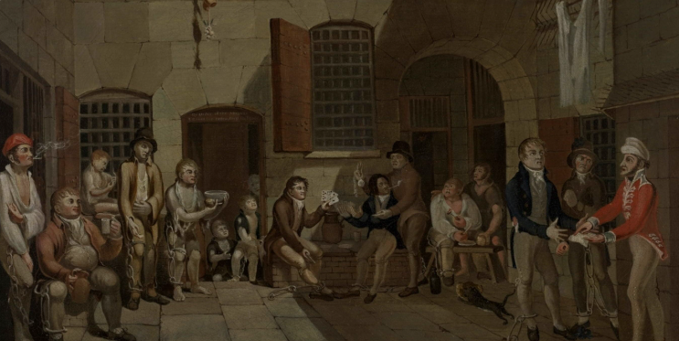
1. Communicating Social Standing & Respectability in a New Society
Stay on the Master’s Side in prison, or in a debtor’s ward on the Common Side
Travel from prison to ship in a carriage
Have someone prominent (preferably one of the aristocracy) send money on board for you
Stay in a private berth on board the ship, or at worst, a separate mess
Spend money on the other convicts
Get oneself invited into the captain’s cabin (rare)
Wear respectable clothing

Slide 16
Case Study: John Henry Palmer
‘A genteel man’ ‘a Man of Languages, of Letters, accounts, of Science’.
Operated a labour exchange.
Represented by counsel at the Old Bailey.
Stayed in a debtors’ ward on the Masters Side & then the Common Side.
Lady Pryce petitioned on his behalf.
He corresponded with the Duke of Buckingham from the hulk, seeking permission ‘that I shall go thither in a different character and detach’d from the other Convicts. . . the tortures of a Damiens are in my mind infinitely preferable to a wretched association with a Set of the most abandoned Men!’
He sailed on the Alexander in a mess with William Parr, a merchant’s clerk, and several mariners.
Died shortly before the fleet arrived.

Slide 17
1. Communicating Social Standing & Respectability in a New Society
Don’t go ashore in Sydney Cove at the same time as the other convicts
Be given liberty shortly after going ashore
Bring letters of recommendation
Don’t work at the same jobs as other convicts
Don’t associate with the great mass of other convicts

Slide 18
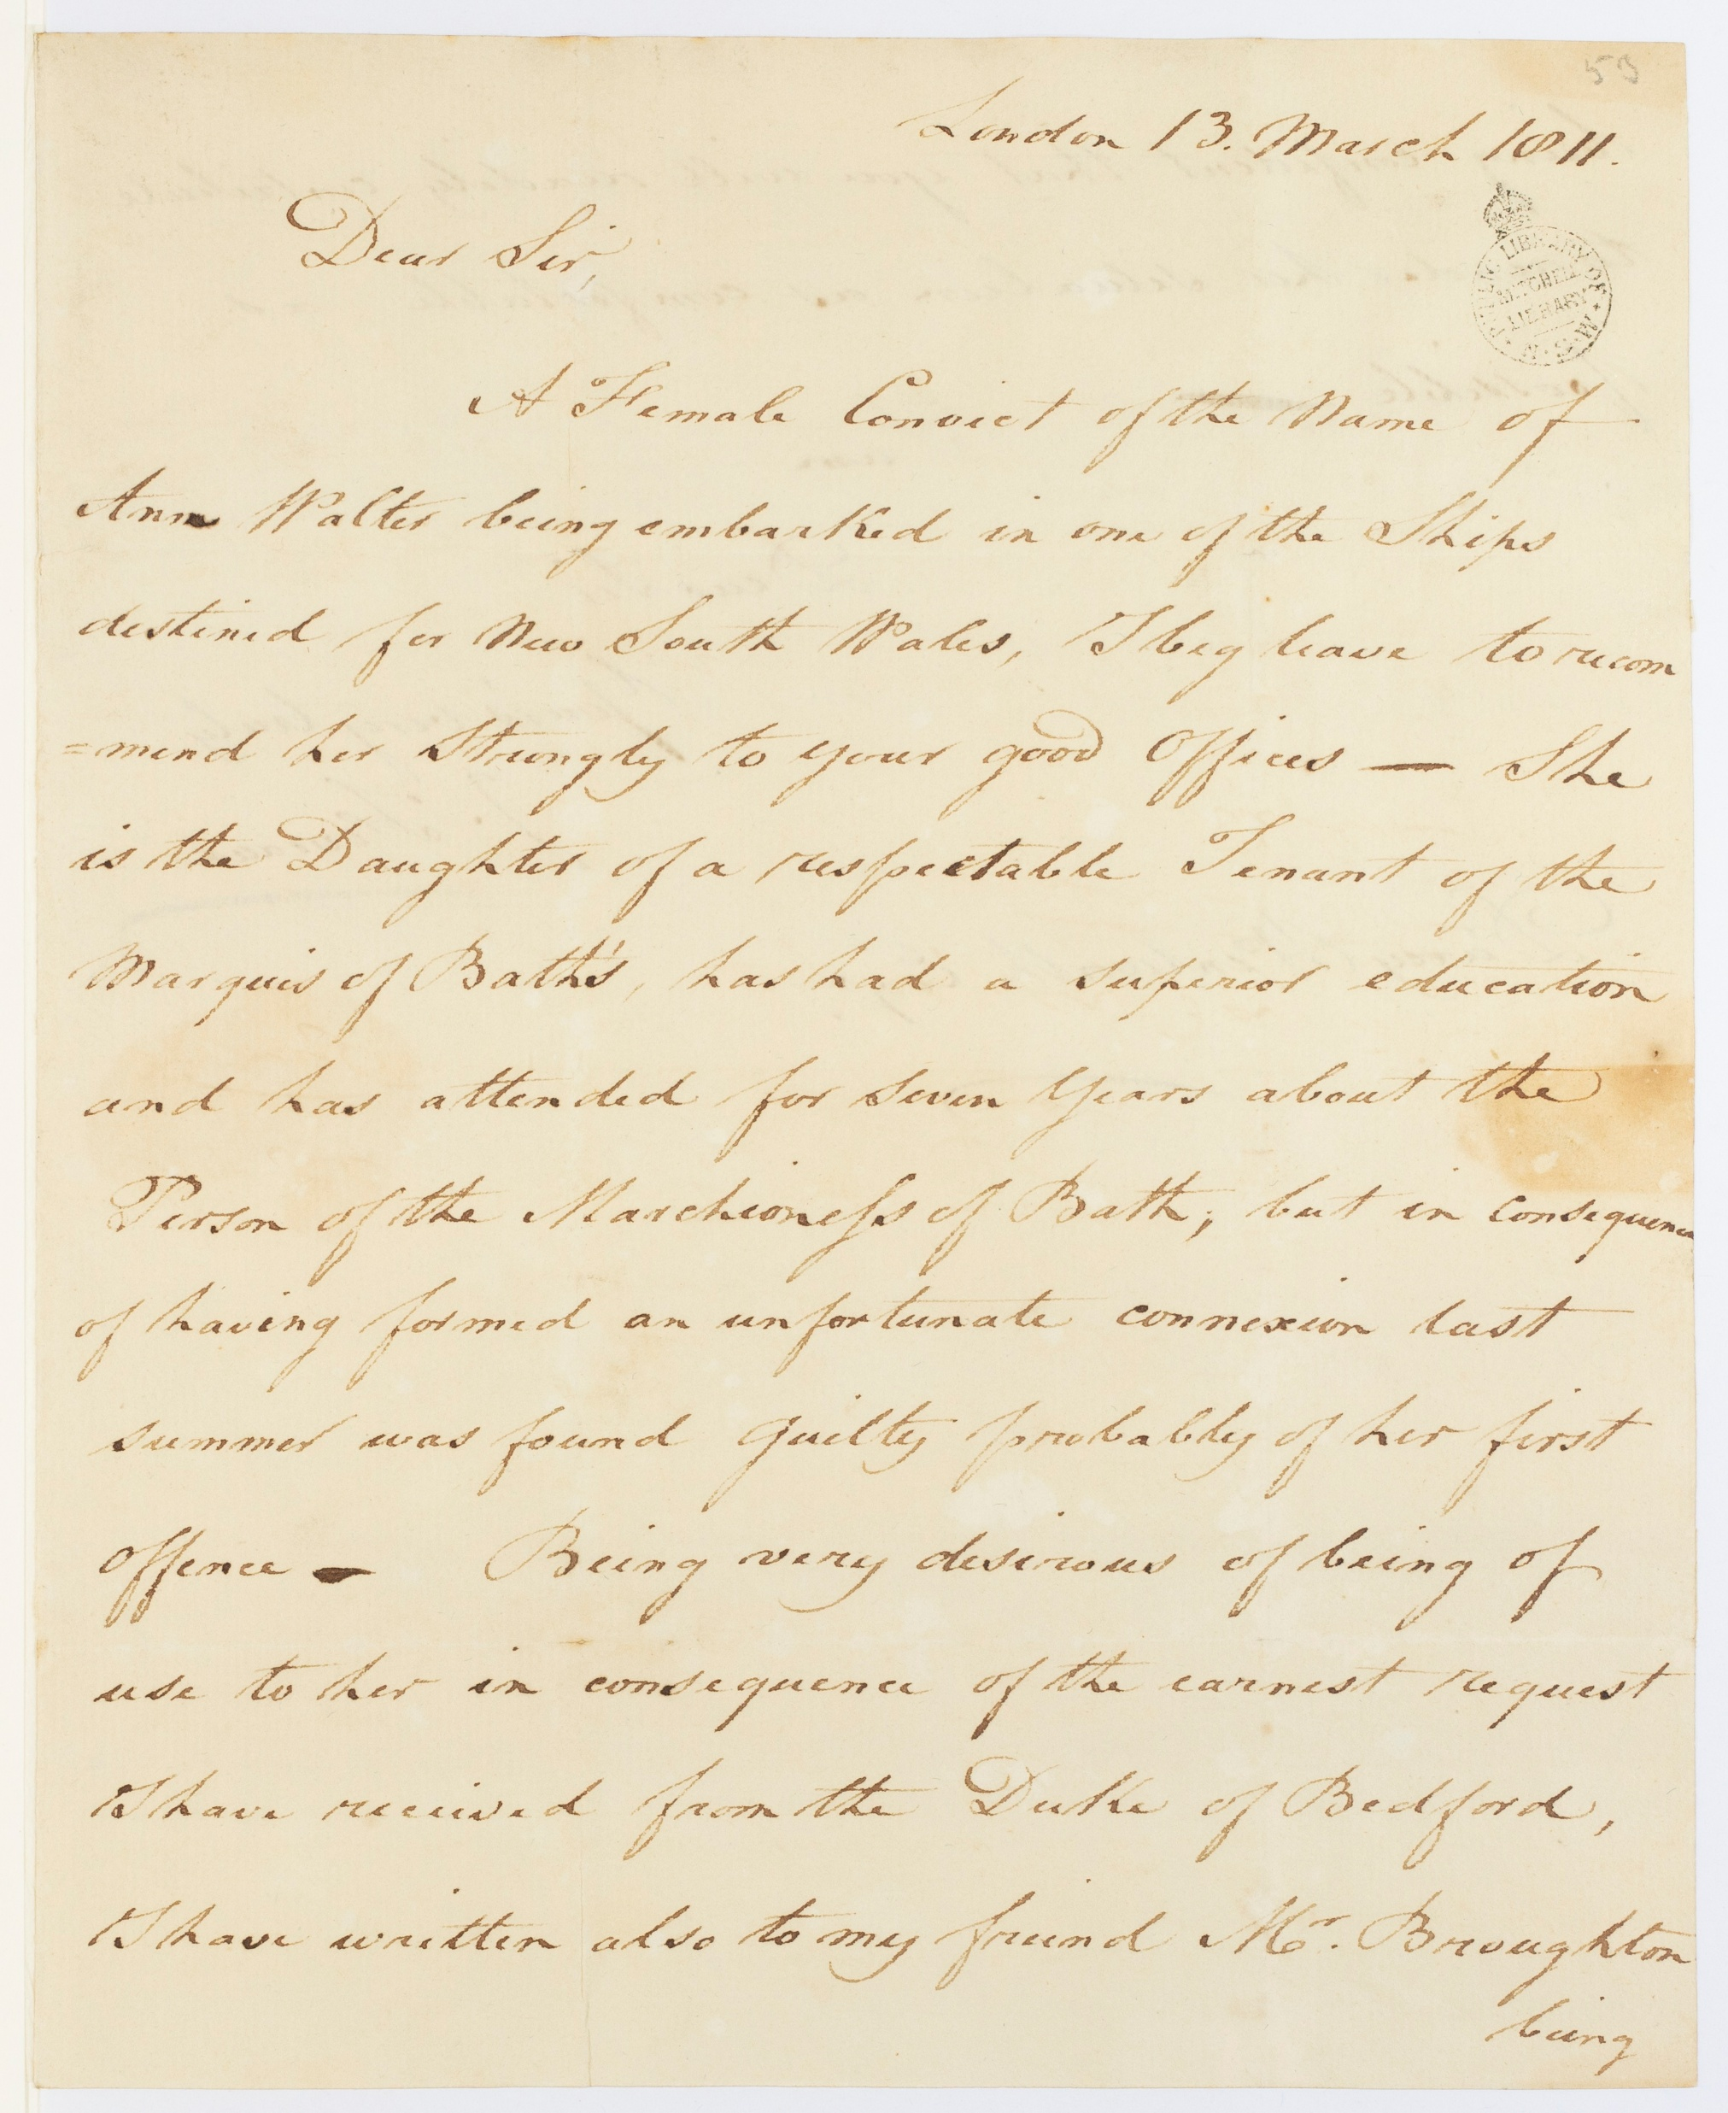
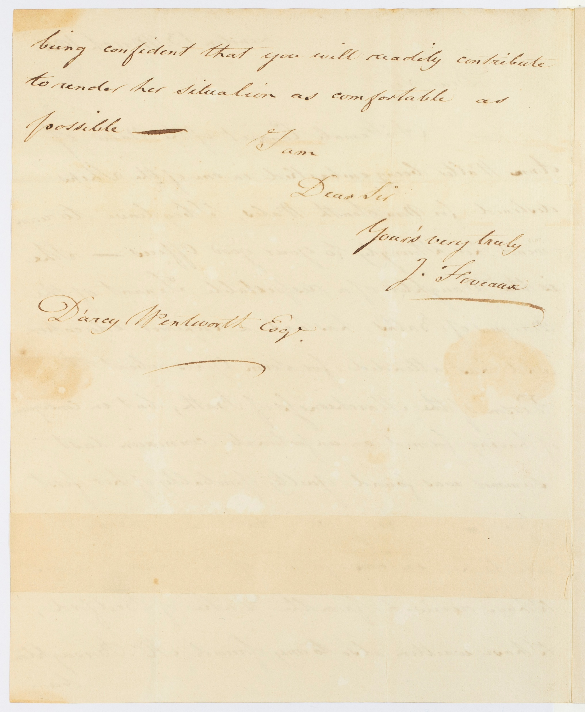
1. Communicating Respectability in a New Society

Slide 19
The Ann Walter Reference
March 1811
Joseph Foveaux (in London) to D’Arcy Wentworth (in NSW)
She is ‘the Daughter of a respectable tenant of the Marquis of Bath’
‘has had a superior education’
‘attended for seven years on the person of the Marchioness of Bath. . .’
‘. . .confident that you will readily contribute to render her situation as comfortable as possible’.

Slide 20
2a. Building a Reputation – The Men
Artisans
Medical (John Irving)
Manufacturing (Samuel Wheeler, brickmaker)
Construction (James Bloodsworth, bricklayer)
Trade (Francis Cox, locksmith)
Gardening/farming (Thomas Eccles, Governor’s gardener)
Clerical (Francis Fowkes, Governor’s clerk)
Financial (Shadrach Shaw, 1792, adviser to the Rum Corps)

Slide 21
2a. Building a Reputation – The Men
Overseers
Gang Overseers (William Bryant, fishing gang)
Camp Overseers (Herbert Keeling, camp overseer)
Public Service
Members of the ‘Nightwatch’

Slide 22
Case Study – Robert (‘Bob’) Sidaway
Son of a pastry cook and a publican (‘The Barking Dog’)
A criminal career lasting more than a decade
Ralph Clark: ‘a darring Valinous fellow’
Bowes Smyth: ‘a very bad kind of man’
By March 1789 – the public baker, paid a fee for each loaf
By December 1789 – selling bread privately
March 1791 – selling flour privately

Slide 23
Case Study – Robert (‘Bob’) Sidaway
June 1792 - A London paper:
‘The baker for the colony at Botany Bay is the notorious Robert Sidaway, who was several times tried for house-breaking, highway robberies, &c. when in this country. He has now one of the best situations in the new settlement, being allowed a toll out of every quantity of flour he makes into bread for the officers and convicts.’
October 1792 – He had an investment of several hundred pounds on the first venture of the Rum Corps, to buy flour
November 1792 – Conditional pardon by Phillip.

Slide 24
Case Study – Robert (‘Bob’) Sidaway
13 October 1809 – Sidaway died after a long and painful illness, at his Sydney home, aged 52:
He was one of the first inhabitants of this Colony; during his very long residence in which he ever supported the reputation of a true philanthropist, and in all other respects a valuable member of society, in which he was universally respected’. (Sydney Gazette, 15 October 1809)

Slide 25
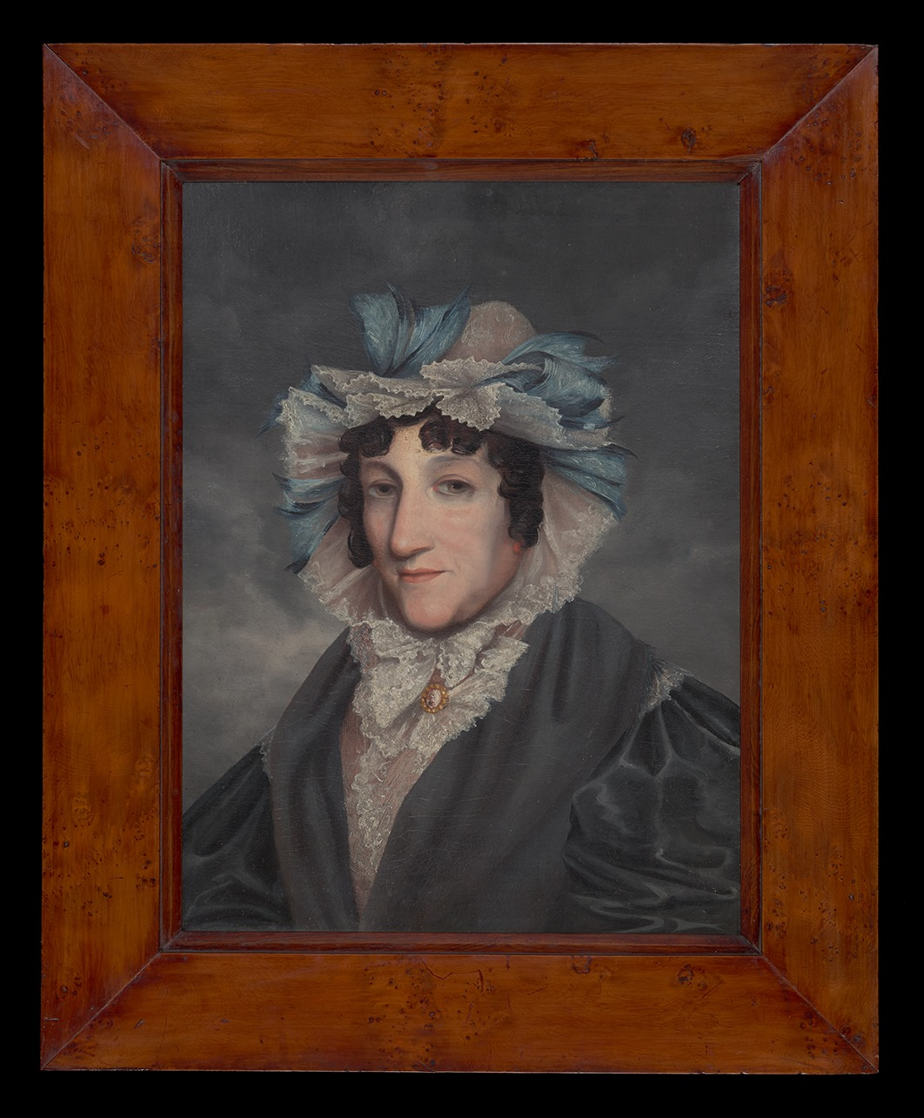
2b. Building a Reputation – The Women
In the early years, their social status was uncertain – ‘housekeepers’, ‘cooks’ and ‘nurses’
Over time, those who remained in NSW acquired respectability
Esther Abrahams/Johnston
Elizabeth Burleigh/Arndell

Slide 26
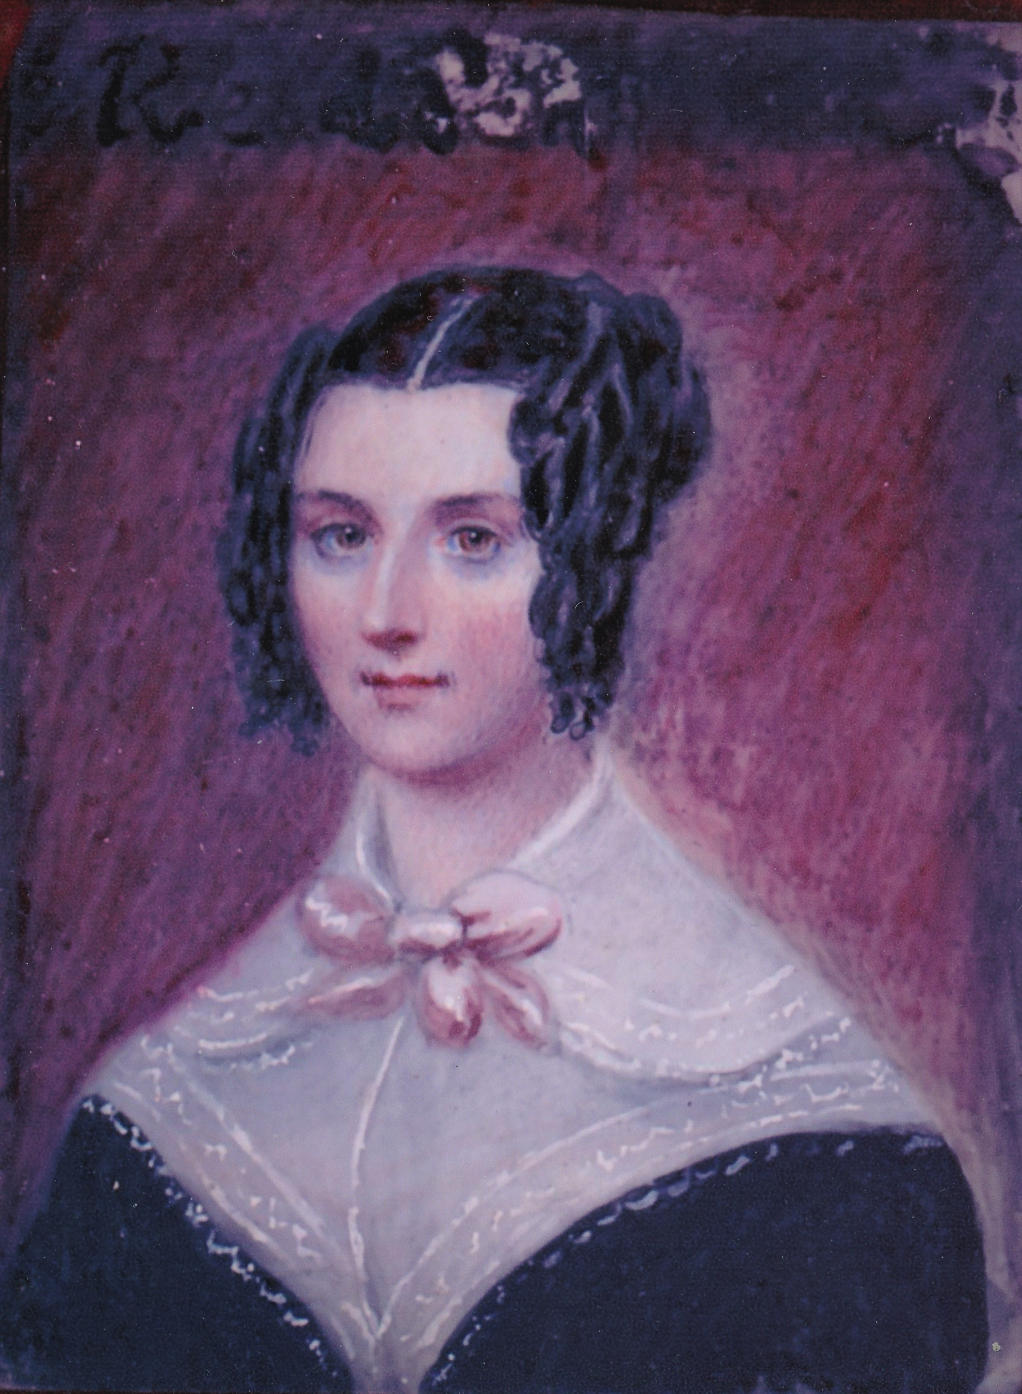
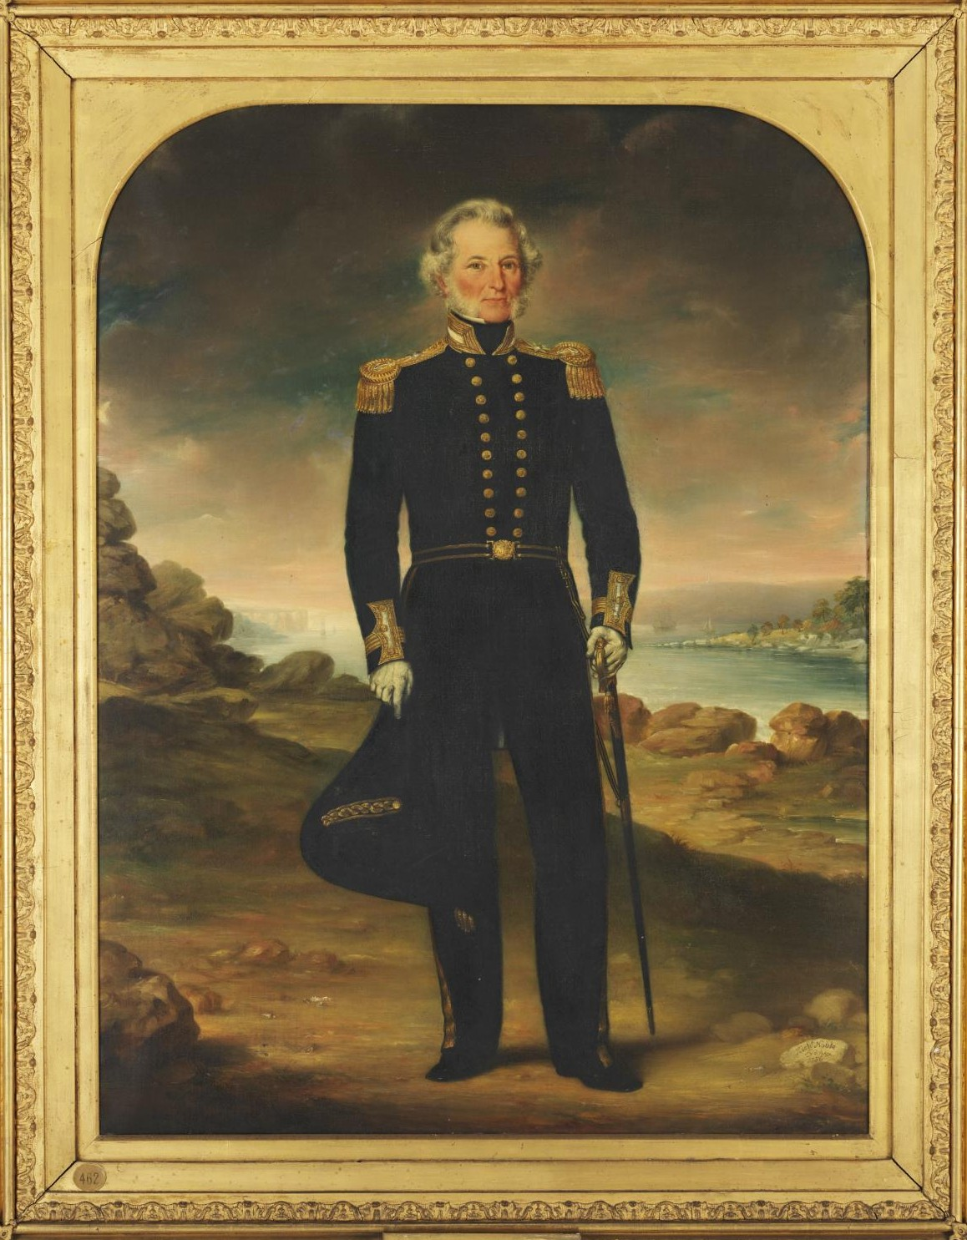
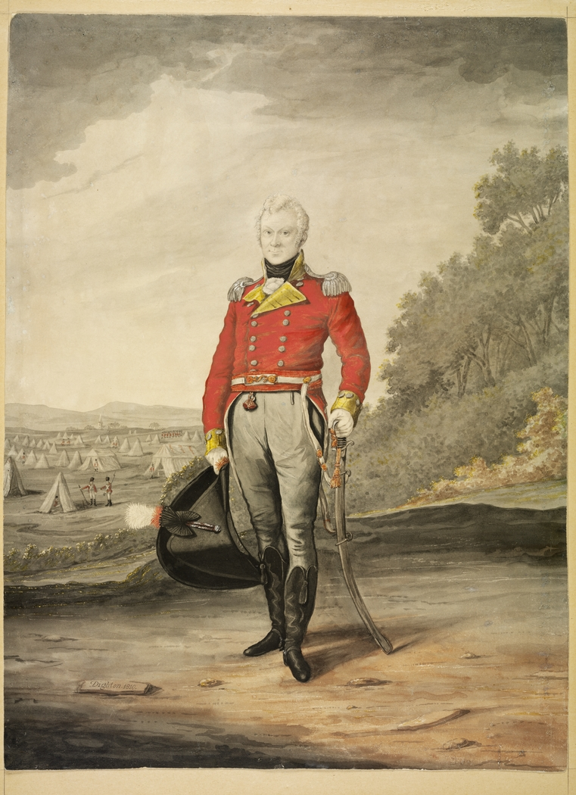
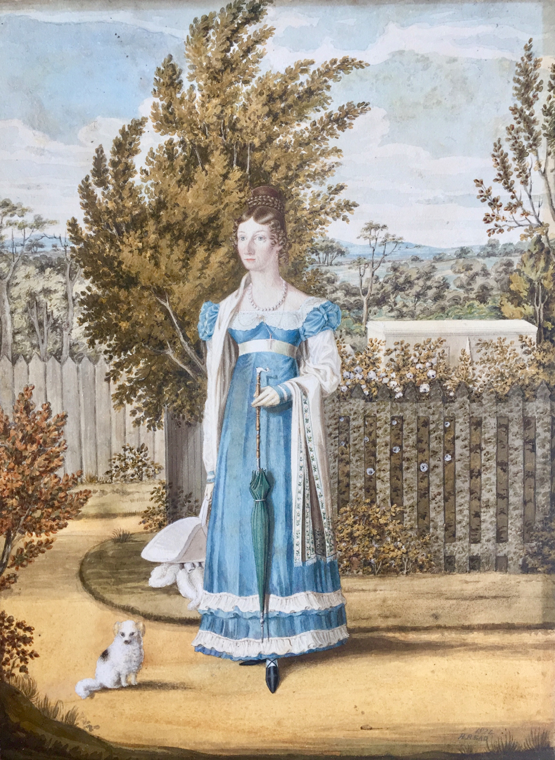
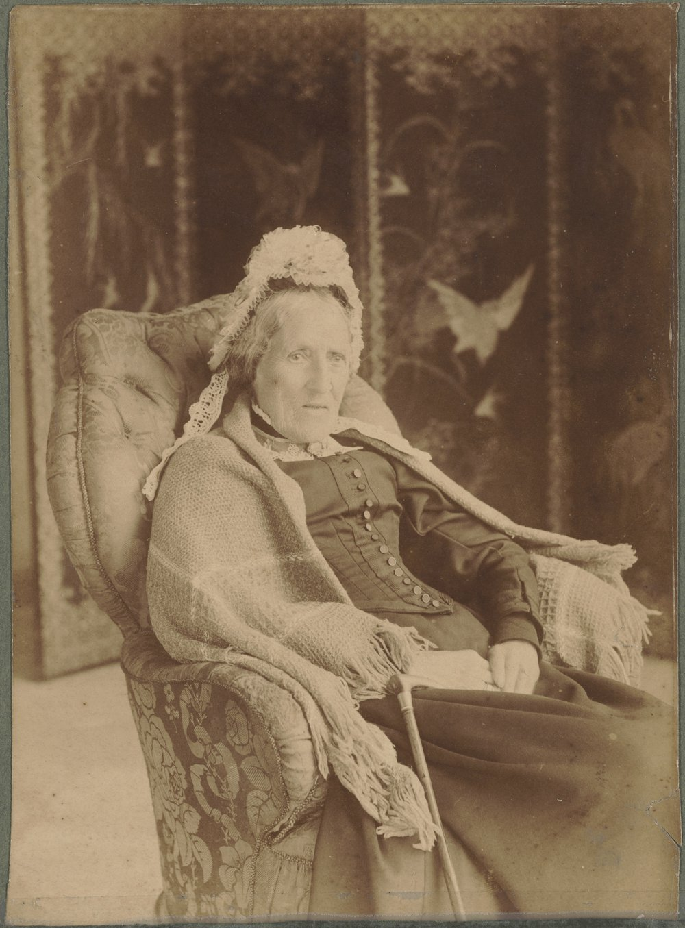
Convict ‘Housekeepers’ – Esther Abrahams/Johnston

Slide 27
Convict ‘Housekeepers’ – Esther Abrahams/Johnston

Slide 28
Convict ‘Housekeepers’ – Esther Abrahams/Johnston
When George Johnston suggested to his commanding officer, Major Francis Grose, that he might buy a commission for his eldest son George, Grose ‘was particularly averse to it on Account of his Mother’.
In writing about this in 1804, Johnston added that ‘I can only say that his Mother’s Conduct has been such in this Country, that not the smallest stigma can attach to it’.

Slide 29
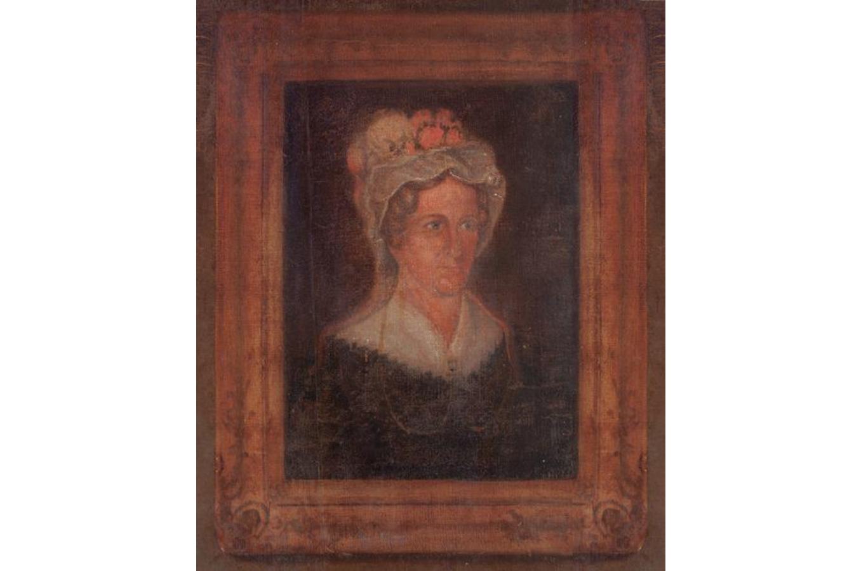
2b. Building a Reputation – The Women
The women who remained behind and married someone else also enjoyed an uplift in social status.
Rachel Moore

Slide 30
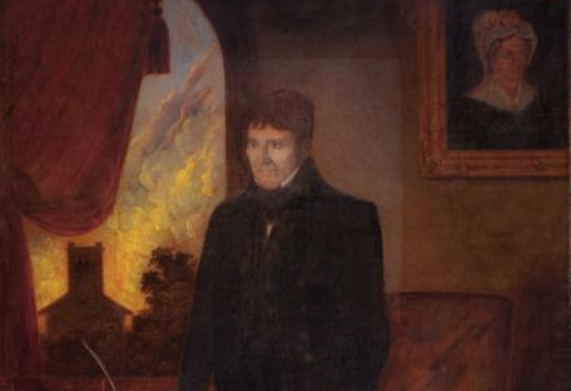
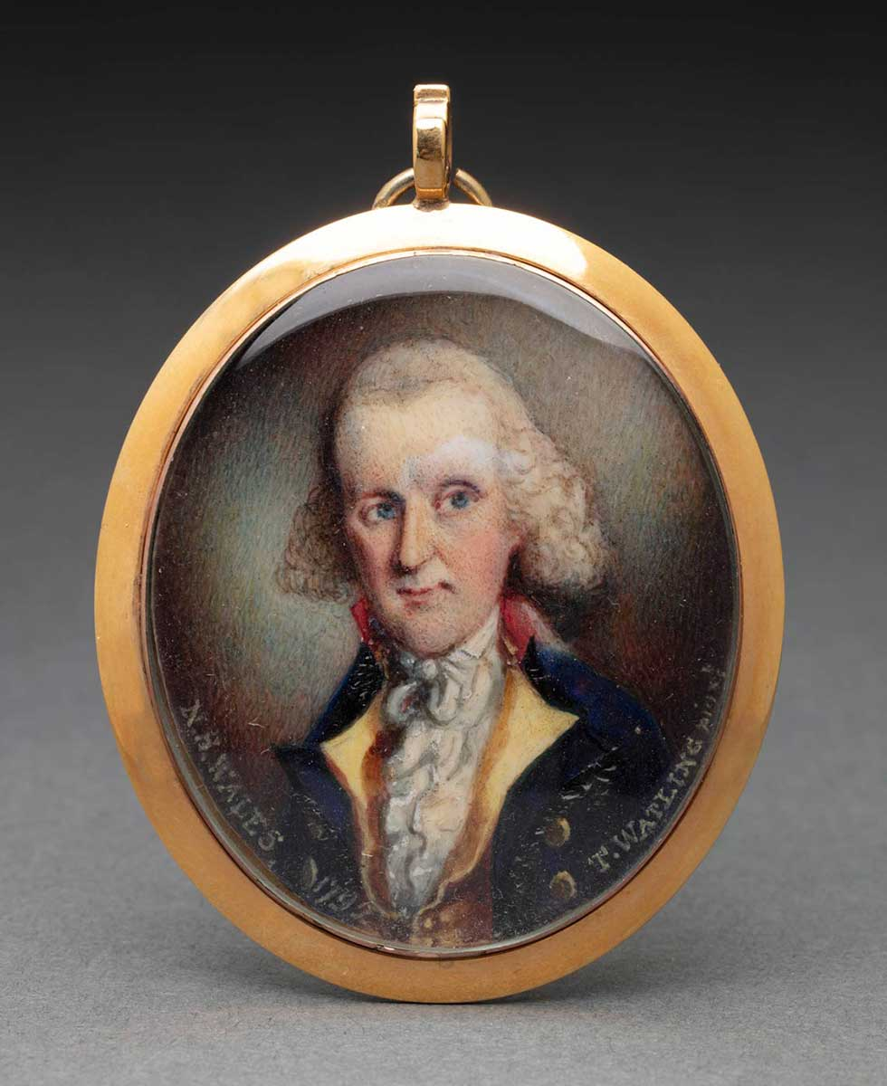
Convict ‘Housekeepers’ – Rachel Turner/Moore

Slide 31
2b. The Next Generation – The Boys
Almost all of these women gave their children a substantial uplift in social status
Of the 14 boys for whom we have details:
Five joined the Royal Navy: one became a Captain, another a Commander and three Lieutenants (two of whom died young and did not have an opportunity of promotion)
Others ended up as – a Major in the East India Company’s service, a Captain in the Royal Engineers, a Captain in the Royal Marines, and a Lieutenant in the Royal Marine Artillery (the last killed in battle as a young man).
William Balmain’s son became a surgeon and returned to NSW.

Slide 32
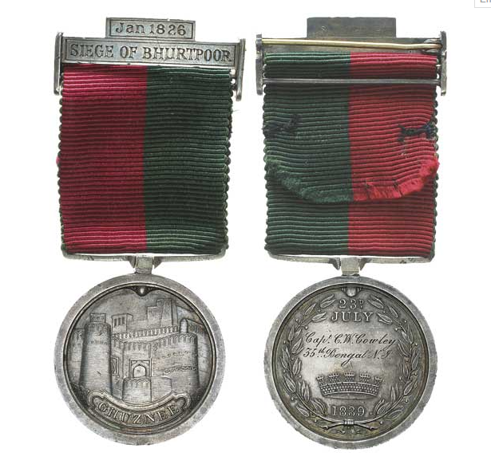
2b. The Next Generation – The Boys
Medal given to Captain Constantine Cowley for his part in the Siege of Bhurtpore

Slide 33
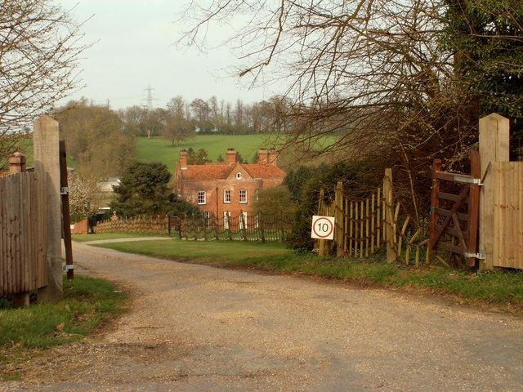
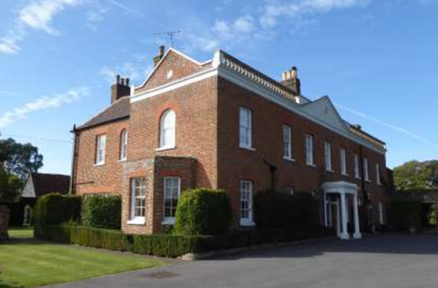
2b. The Next Generation – The Girls
Constantia Cowley
Jane Henderson

Slide 34
Class in a Convict Society
I look forward to discussion and challenge.

